Slide 1
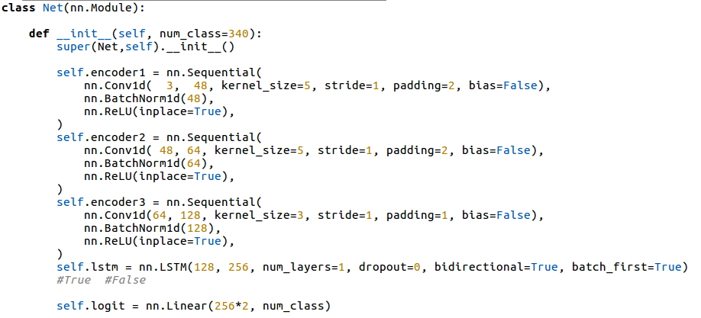
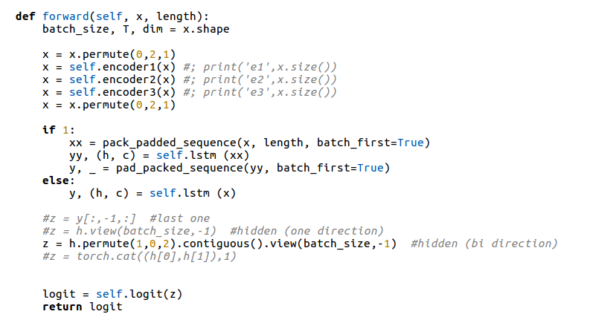
implementation of stroke-based rnn sketch recognition using bidirection LSTM
packing for variable length sequence

Slide 2
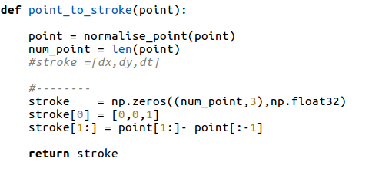
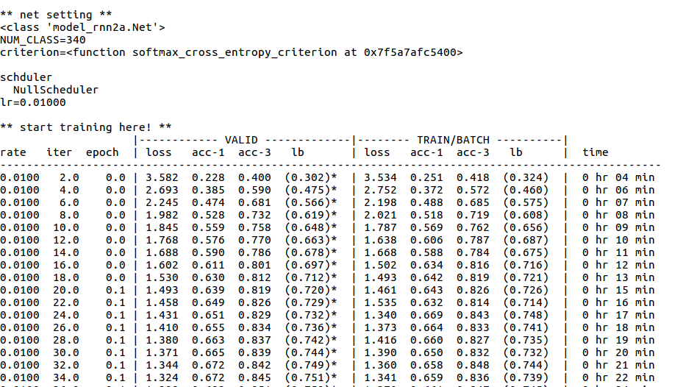
stroke encoding: we only encode x = [ dx,dy, is_stroke_start ].
you can experiment with your encoding for follow quickDraw paper
example results:

