Slide 1
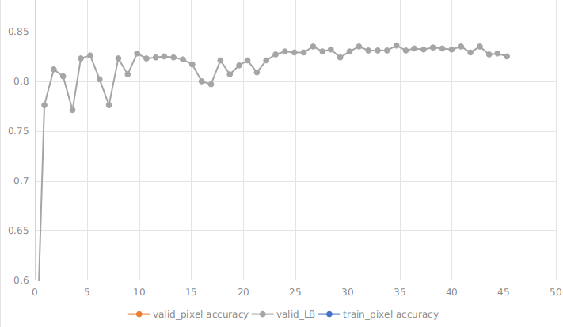
implementation
- Unet with resnet32 encoder, taken from @Jakub Czakon (neptune.ml)
https://www.kaggle.com/c/tgs-salt-identification-challenge/discussion/61949
- remove center maxpool and upsample
- added BN layer to decoder (using synchronised BN across mupltiple GPU)
- robust 2d focus loss per pixel
- input: 101 is upsized to 202 and pad with 27, giving input_size = 202+27+27=256
** SUBMISSION RESULTS **
single model : public LB = 8.090 single model + null and flip test-time augmentation : public LB = 8.190
SGD 0.01
SGD 0.005
SGD 0.001
#Note: initialisation is previously trained resnet34 which is reused to speedup experiments ...

Slide 2
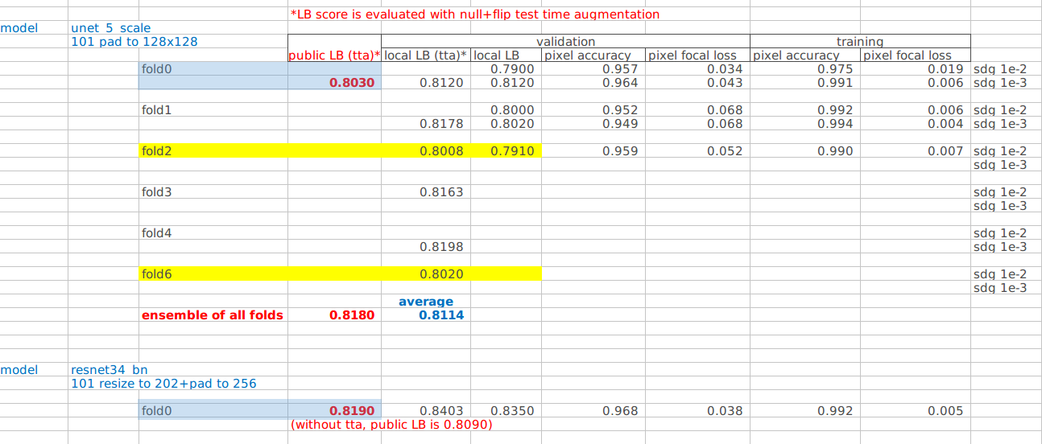
- comparsion:

