Slide 1
Chapter 2: Intro to Relational Model

Slide 2
Outline
Relational Model
Structure of Relational Databases
Keys
Database Schema
Schema Diagrams
Relational Query Languages
The Relational Algebra
Notes:
1

Slide 3
关系模型
关系模型是一种数据模型，是关系数据库的理论基础
数据模型的三要素
数据结构
数据操作
数据完整性
关系模型的三要素
单一数据结构 —— 关系
数据操作 —— 关系操作
数据完整性 —— 关系完整性
什么是关系？

Slide 4
关系的定义: 域
相同类型值的集合
例子
D₁: { 1, 2, 3 }.
D₂: { Female, Male }
D₃: { “Jones”, “Smith”, “Jackson” }
反例： { 1, ‘Jones’} 不是域
域的基数：域中值的个数
域D₁的基数为3

Slide 5
笛卡儿积
笛卡儿积D₁×D₂×…×D_{n}, D₁, D₂,…, D_{n} 是域（可有重复）
所有这样的有序组合构成了该笛卡儿积：第一个元素来自D₁ ，第二个元素来自D₂ ，… 第n个元素来自D_{n}
D₁×D₂×…×D_{n} = { (d₁, d₂, …, d_{n}) |d₁∈D₁, d₂∈D₂ , … d_{n}∈D_{n} }
每个组合(d₁ , d₂ , … , d_{n}) 称为元组 ，其中的各个值d_{i}（来自域D_{i}）称为分量。有n个分量的元组又称为n-元组。
笛卡儿积中元组的个数, 称为笛卡儿积的基数

Slide 6
笛卡儿积
给定域
D₁: { 1, 2, 3 }.
D₂: { Female, Male }
D₃: { “Jones”, “Smith”, “Kate” }
问题：对于笛卡儿积D₁×D₂×D₃ ,
(1, ‘Jones’) 是它的一个元组么?
(1, ‘Jones’, Male) 是它的一个元组么?
(1, Male, ‘Jones’) 是它的一个元组么?
D₁ ×D₂×D₃ 有多少个元组?
结论：笛卡儿积D₁×D₂×…×D_{n}的基数= 域D₁的基数×域D₂的基数×……×域D_{n}的基数

Slide 7
笛卡儿积
1
2
3
?
Female
Male
D₁
D₂
D₁×D₂

Slide 8
笛卡儿积
1 | Female
1 | Male
1
2
3
Female
Male
D₁
D₂
D₁×D₂

Slide 9
笛卡儿积
1 | Female
1 | Male
2 | Female
2 | Male
1
2
3
Female
Male
D₁
D₂
D₁×D₂

Slide 10
笛卡儿积
1 | Female
1 | Male
2 | Female
2 | Male
3 | Female
3 | Male
1
2
3
Female
Male
D₁
D₂
D₁×D₂

Slide 11
笛卡儿积
1 | Female
1 | Male
2 | Female
2 | Male
3 | Female
3 | Male
1
2
3
Jones
Smith
Kate
?
Female
Male
D₁
D₂
D₁×D₂
D₃
D₁×D₂×D₃

Slide 12
笛卡儿积
1 | Female | Jones
1 | Female | Smith
1 | Female | Kate
1 | Male | Jones
1 | Male | Smith
1 | Male | Kate
2 | Female | Jones
2 | Female | Smith
2 | Female | Kate
2 | Male | Jones
2 | Male | Smith
2 | Male | Kate
3 | Female | Jones
3 | Female | Smith
3 | Female | Kate
3 | Male | Jones
3 | Male | Smith
3 | Male | Kate
1 | Female
1 | Male
2 | Female
2 | Male
3 | Female
3 | Male
1
2
3
Jones
Smith
Kate
Female
Male
D₁
D₂
D₁×D₂
D₃
D₁×D₂×D₃

Slide 13
笛卡儿积
1 | Female | Jones
1 | Female | Smith
1 | Female | Kate
1 | Male | Jones
1 | Male | Smith
1 | Male | Kate
2 | Female | Jones
2 | Female | Smith
2 | Female | Kate
2 | Male | Jones
2 | Male | Smith
2 | Male | Kate
3 | Female | Jones
3 | Female | Smith
3 | Female | Kate
3 | Male | Jones
3 | Male | Smith
3 | Male | Kate
笛卡儿积的元组代表了“所有可能的组合”。
然而在这些 “所有可能的组合”中，仅有一些元组是“有意义的，事实成立的组合”，它们反映了现实世界中的物体和属性。
这些元组构成了笛卡儿积的一个子集，赋予其名字，就是关系。
D₁×D₂×D₃

Slide 14
关系的定义
1 | Female | Jones
1 | Female | Smith
1 | Female | Kate
1 | Male | Jones
1 | Male | Smith
1 | Male | Kate
2 | Female | Jones
2 | Female | Smith
2 | Female | Kate
2 | Male | Jones
2 | Male | Smith
2 | Male | Kate
3 | Female | Jones
3 | Female | Smith
3 | Female | Kate
3 | Male | Jones
3 | Male | Smith
3 | Male | Kate
数学上的关系
定义在D₁ , D₂, …, D_{n}上的关系R是笛卡儿积D₁×D₂×…×D_{n}的一个命名子集（由有意义的元组构成）
R即是关系名。
student
1 | Male | Jones
2 | Male | Smith
3 | Female | Kate
D₁×D₂×D₃

Slide 15
关系的定义
为了区分关系中的列，列又称为属性，并取唯一的名字
假设属性名是A₁, A₂, ……, A_{n} ，那么关系R可以简记为：
R (A₁ , A₂, …, A_{n} )
student
student-no | sex | name
1 | Male | Jones
2 | Male | Smith
3 | Female | Kate
student (student-no, sex, name)

Slide 16
关系的组成
关系是一个命名的二维表
关系的一列是属性，属性必定有名字（属性名）
关系的一行是元组
分量是行和列的交叉，或者说，分量是某个元组的某个属性（值）
关系名
属性
student
分量
student-no | sex | name
1 | Male | Jones
2 | Male | Smith
3 | Female | Kate
元组

Slide 17
关系的组成
关系的度: 属性的数目
关系的基数: 元组的数目
属性的域: 属性可能取值的集合
关系名
属性
student
分量
student-no | sex | name
1 | Male | Jones
2 | Male | Smith
3 | Female | Kate
元组

Slide 18
关系的性质（必须满足的条件）
关系的性质
列是同质的。列中的分量类型必须相同，因为它们来自同一个域。
不同的列可来自同个域，但属性名不能相同
关系里的任意两行不能相同，因为关系是一个元组集合
数学上严格禁止，但是在实际数据库里面可以容忍重复
关系的行或列是无序的。即改变行或列的次序（例如交换两行或者两列），关系不会变
属性值(分量)必须是原子的(不可分)。满足该条件的关系称作第一范式
例如，多值属性，复合属性都是非原子的

Slide 19
以下二维表是关系么?
R1
R2
A | B | C
1 | “abc” | “c”
2 | “de” | “a”
3 | “f” | 2
A | B | A
1 | “abc” | “c”
2 | “de” | “a”
3 | “f” | “b”
R3
R4
A | B | C
1 | “abc” | “c”
2 | “de” | “a”
1 | “abc” | “c”
A | B | C
1, 3 | “abc” | “c”
2 | “de” | “a”
3 | “f” | “b”

Slide 20
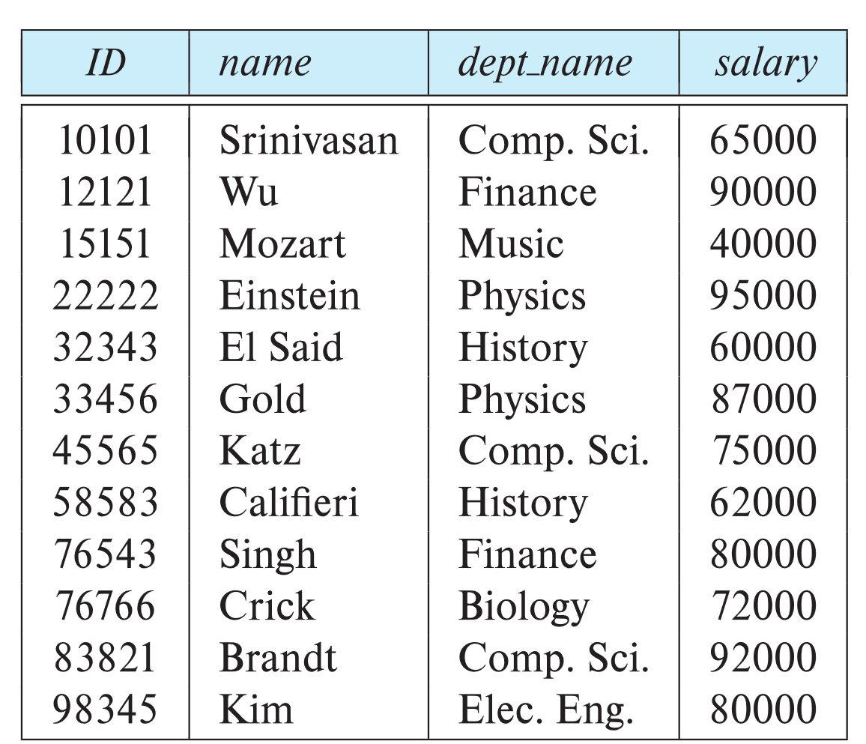
Example of a Instructor Relation
attributes
(or columns)
tuples
(or rows)

Slide 21
Data Mining： Data Sets
Record
Relational records
Data matrix, e.g., numerical matrix, crosstabs
Document data: text documents: term-frequency vector
Transaction data
Spatial, image and multimedia:
Spatial data: maps
Image data:
Video data:

Slide 22
Relation Schema and Instance
A₁, A₂, …, A_{n} are attributes
R = (A₁, A₂, …, A_{n} ) is a relation schema
Example:
instructor = (ID, name, dept_name, salary)
A relation instance r defined over schema R is denoted by r (R).
The current values a relation are specified by a table
An element t of relation r is called a tuple and is represented by a row in a table
Notes:
1

Slide 23
Attributes
The set of allowed values for each attribute is called the domain of the attribute
Attribute values are (normally) required to be atomic; that is, indivisible
The special value null is a member of every domain. Indicated that the value is “unknown”
The null value causes complications in the definition of many operations

Slide 24
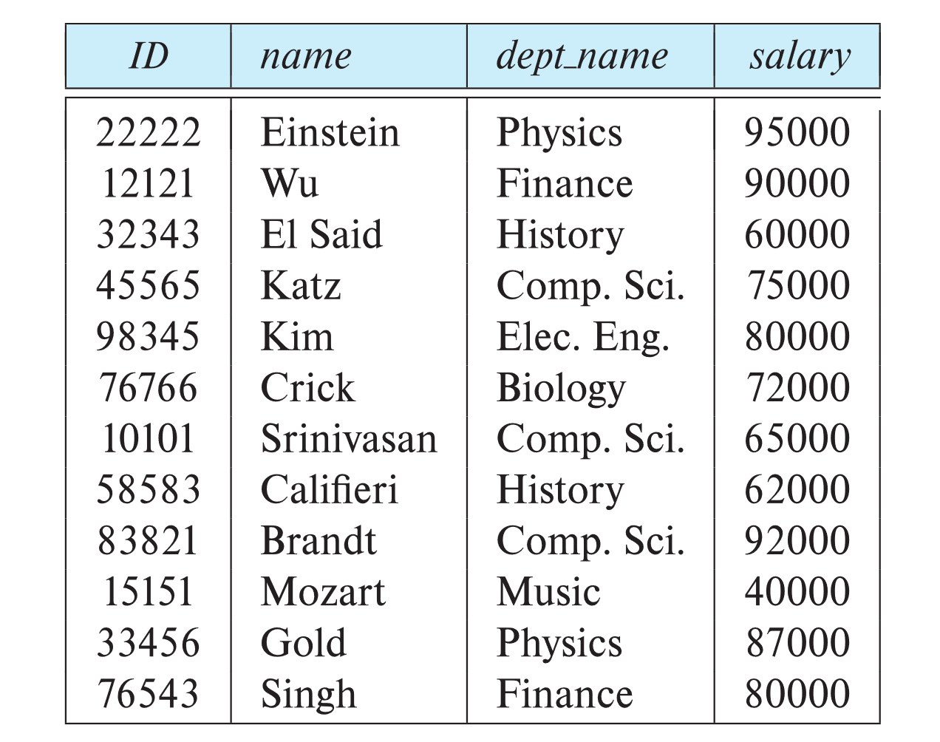
Relations are Unordered
Order of tuples is irrelevant (tuples may be stored in an arbitrary order)
Example: instructor relation with unordered tuples

Slide 25
Keys
Let K ⊆ R
K is a superkey of R if values for K are sufficient to identify a unique tuple of each possible relation r(R)
Example: {ID} and {ID,name} are both superkeys of instructor.
Superkey K is a candidate key if K is minimal Example: {ID} is a candidate key for Instructor
One of the candidate keys is selected to be the primary key.
Foreign key constraint: Value in one relation must appear in another
Referencing relation
Referenced relation
Example: dept_name in instructor is a foreign key from instructor referencing department

Slide 26
关系的码
外部码
关系R₁中的单个属性或属性集合，对应关系R₂的主码
R₁称为参照关系， R₂称为被参照关系
例如，“student”关系中的dept-no就是一个外部码，对应“deparment”关系的主码
department
student
dept-no | dept-name
D1 | 计算机科学
D2 | 经济管理
dept-no | student-no | name | sex
D1 | S1 | 张三 | 男
D1 | S2 | 李四 | 男
D2 | S3 | 王五 | 女

Slide 27
关系的码
思考
将student的dept-no属性更名为dept，它还是一个外部码吗？
换句话说，如何正确理解 “外部码参照(引用)主码” ？—— 值的参照，而不是名字的参照。
重要结论：外部码和对应主码的属性名不一定要相同。
department
student
dept-no | dept-name
D1 | 计算机科学
D2 | 经济管理
dept | student-no | name | sex
D1 | S1 | 张三 | 男
D1 | S2 | 李四 | 男
D2 | S3 | 王五 | 女

Slide 28
Database Schema
Database schema -- is the logical structure of the database.
Database instance -- is a snapshot of the data in the database at a given instant in time.
Example:
schema: instructor (ID, name, dept_name, salary)
Instance:

Slide 29
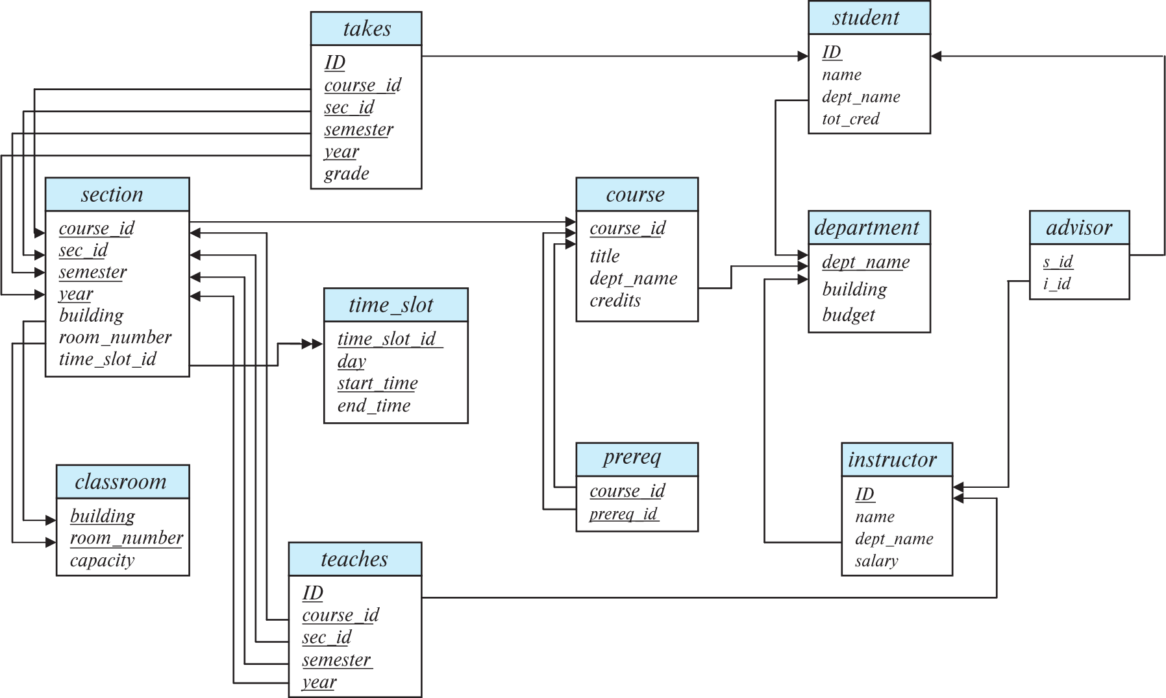
Schema Diagram for University Database

Slide 30
Outline
Relational Model
Structure of Relational Databases
Keys
Database Schema
Schema Diagrams
Relational Query Languages
The Relational Algebra
Notes:
1

Slide 31
Relational Query Languages
Procedural versus non-procedural, or declarative
“Pure” languages:
Relational algebra
Tuple relational calculus
Domain relational calculus
The above 3 pure languages are equivalent in computing power
We will concentrate in this chapter on relational algebra
Consists of 6 basic operations

Slide 32
Relational Algebra
A procedural language consisting of a set of operations that take one or two relations as input and produce a new relation as their result.
Six basic operators
select: σ
project: ∏
union: ∪
set difference: –
Cartesian product: x
rename: ρ

Slide 33
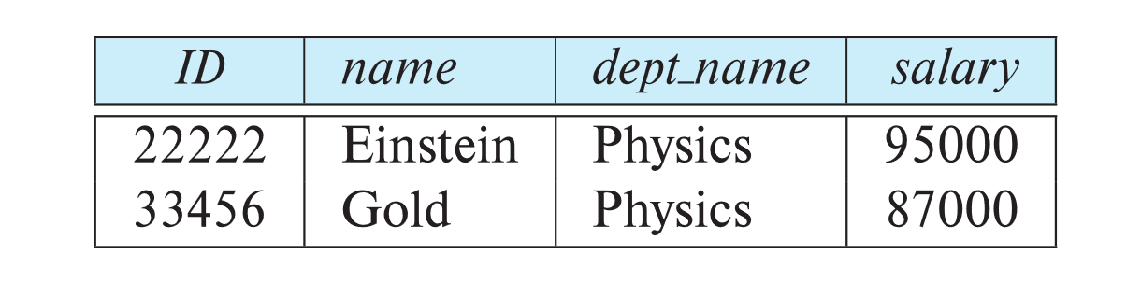
Select Operation
The select operation selects tuples that satisfy a given predicate. （σ : sigma）
Notation: σ _{p} (r)
p is called the selection predicate
Example: select those tuples of the instructor relation where the instructor is in the “Physics” department.
Query σ _{dept_name=“Physics”} (instructor)
Result

Slide 34
Select Operation (Cont.)
We allow comparisons using
=, ≠, >, ≥. <. ≤
in the selection predicate.
We can combine several predicates into a larger predicate by using the connectives:
∧ (and), ∨ (or), ¬ (not)
Example: Find the instructors in Physics with a salary greater $90,000, we write: σ _{dept_name=“Physics”} ∧ _{salary >} _{90,000} (instructor)
The select predicate may include comparisons between two attributes.
Example, find all departments whose name is the same as their building name:
σ _{dept_name=building} (department)

Slide 35
选择运算(σ) – 例子
关系 r
A
B
C
D
α
α
β
β
α
β
β
β
1
5
12
23
7
7
3
10
σ_{A=B ∧ D > 5} (r)
A
B
C
D
α
β
α
β
1
23
7
10

Slide 36
思考
下列选择运算的结果是什么？
σ ₁₌₁ (student)
student
?
student-no | name | sex
1 | Jones | Male
2 | Smith | Male
3 | Kate | Female
student-no | name | sex
1 | Jones | Male
2 | Smith | Male
3 | Kate | Female

Slide 37
思考
下列选择运算的结果是什么？
σ ₁₌₂ (student)
student
ø
×
student-no | name | sex
1 | Jones | Male
2 | Smith | Male
3 | Kate | Female

Slide 38
思考
下列选择运算的结果是什么？
σ ₁₌₂ (student)
student
√
student-no | name | sex
1 | Jones | Male
2 | Smith | Male
3 | Kate | Female
?
student-no | name | sex

Slide 39
Project Operation
A unary operation that returns its argument relation, with certain attributes left out. (∏: pi)
Notation:
∏ _{A1,A2,A3 ….Ak} (r)
where A₁, A₂, …, A_{k} are attribute names and r is a relation name.
The result is defined as the relation of k columns obtained by erasing the columns that are not listed
Duplicate rows removed from result, since relations are sets

Slide 40
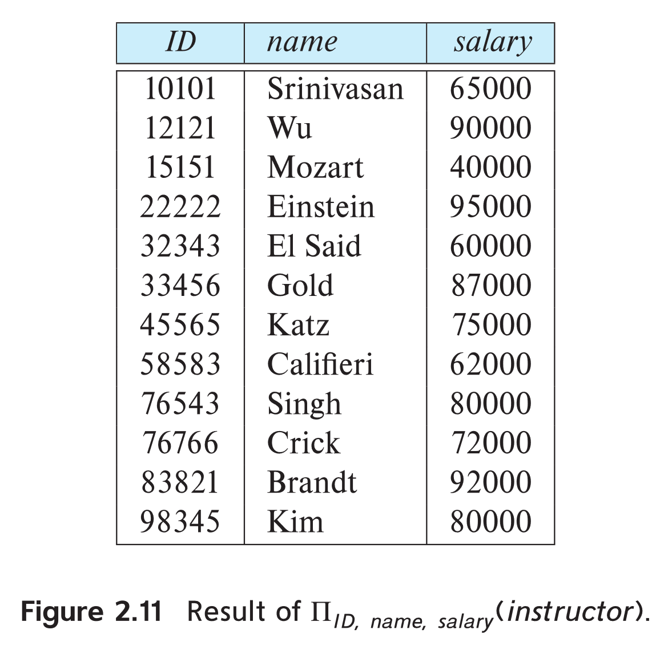
Project Operation Example
Example: eliminate the dept_name attribute of instructor
Query: ∏_{ID, name, salary} (instructor)
Result:

Slide 41
Composition of Relational Operations
The result of a relational-algebra operation is relation and therefore of relational-algebra operations can be composed together into a relational-algebra expression.
Consider the query -- Find the names of all instructors in the Physics department.
∏_{name}(σ _{dept_name} _{=“Physics”} (instructor))
Instead of giving the name of a relation as the argument of the projection operation, we give an expression that evaluates to a relation.

Slide 42
Union Operation
The union operation allows us to combine two relations
Notation: r ∪ s
For r ∪ s to be valid.
1. r, s must have the same arity (same number of attributes)
2. The attribute domains must be compatible (example: 2nd
column of r deals with the same type of values as does the
2nd column of s)
Example: to find all courses taught in the Fall 2017 semester, or in the Spring 2018 semester, or in both ∏_{course_id} (σ _{semester=“Fall” Λ year=2017} (section)) ∪ ∏_{course_id} (σ _{semester=“Spring” Λ year=2018} (section))

Slide 43
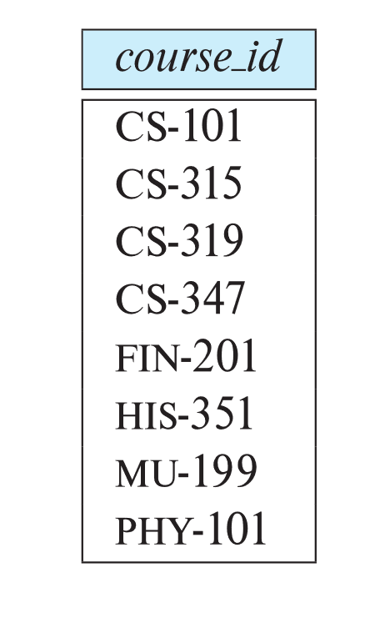
Union Operation (Cont.)
Result of: ∏_{course_id} (σ _{semester=“Fall” Λ year=2017} (section)) ∪ ∏_{course_id} (σ _{semester=“Spring” Λ year=2018} (section))

Slide 44
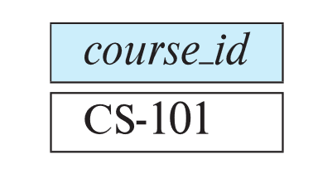
Set-Intersection Operation
The set-intersection operation allows us to find tuples that are in both the input relations.
Notation: r ∩ s
Assume:
r, s have the same arity
attributes of r and s are compatible
Example: Find the set of all courses taught in both the Fall 2017 and the Spring 2018 semesters.
∏_{course_id} (σ _{semester=“Fall” Λ year=2017} (section)) ∩ ∏_{course_id} (σ _{semester=“Spring” Λ year=2018} (section))
Result

Slide 45
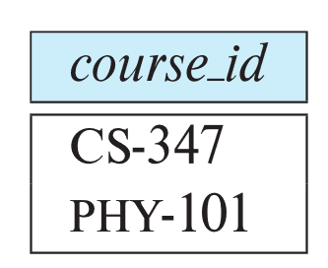
Set Difference Operation
The set-difference operation allows us to find tuples that are in one relation but are not in another.
Notation r – s
Set differences must be taken between compatible relations.
r and s must have the same arity
attribute domains of r and s must be compatible
Example: to find all courses taught in the Fall 2017 semester, but not in the Spring 2018 semester ∏_{course_id} (σ _{semester=“Fall” Λ year=2017} (section)) − ∏_{course_id} (σ _{semester=“Spring” Λ year=2018} (section))

Slide 46
并,交,差运算 – 例子
关系 r, s:
r
s
A
B
A
B
α
α
β
1
2
1
α
β
2
3
r ∪ s:
A
B
A
B
r ∩ s:
A B
r – s:
A
B
α
α
α
β
β
1
2
2
1
3
α
α
β
β
1
2
1
3
α 2
α
β
1
1

Slide 47
Cartesian-Product Operation
The Cartesian-product operation (denoted by X) allows us to combine information from any two relations.
Example: the Cartesian product of the relations instructor and teaches is written as:
instructor X teaches
We construct a tuple of the result out of each possible pair of tuples: one from the instructor relation and one from the teaches relation (see next slide)
Since the instructor ID appears in both relations we distinguish between these attribute by attaching to the attribute the name of the relation from which the attribute originally came.
instructor.ID
teaches.ID

Slide 48
笛卡儿积运算(x) – 例子
关系 r, s:
r x s:
r
s
A
B
C
D
E
A
B
C
D
E
α
α
α
α
β
β
β
β
1
1
1
1
2
2
2
2
α
β
β
γ
α
β
β
γ
10
10
20
10
10
10
20
10
a
a
b
b
a
a
b
b
α
β
1
2
α
β
β
γ
10
10
20
10
a
a
b
b

Slide 49
笛卡儿积运算(x)
笛卡儿积运算的例2
R
S
R×S
A | B | C
1 | 2 | 3
B | C | D
4 | 5 | 6
A | R.B | R.C | S.B | S.C | D
1 | 2 | 3 | 4 | 5 | 6

Slide 50
Join Operation
The Cartesian-Product
instructor X teaches
associates every tuple of instructor with every tuple of teaches.
Most of the resulting rows have information about instructors who did NOT teach a particular course.
To get only those tuples of “instructor X teaches “ that pertain to instructors and the courses that they taught, we write:
σ _{instructor.id = teaches.id} (instructor x teaches ))
We get only those tuples of “instructor X teaches” that pertain to instructors and the courses that they taught.
The result of this expression, shown in the next slide

Slide 51
运算的复合: 关系代数表达式
一个关系运算+输入关系，本身就是一个简单的关系代数表达式
例如，r x s，σ₁₌₁(r)
可以用多个运算的复合来构建复杂的关系代数表达式
例如， σ_{A=C}(r x s)
r
s
r x s
A
B
C
D
E
A
B
C
D
E
α
α
α
α
β
β
β
β
1
1
1
1
2
2
2
2
α
β
β
γ
α
β
β
γ
10
10
20
10
10
10
20
10
a
a
b
b
a
a
b
b
α
β
1
2
α
β
β
γ
10
10
20
10
a
a
b
b

Slide 52
运算的复合: 关系代数表达式
A
B
C
D
E
σ_{A=C}(r x s)
α
α
α
α
β
β
β
β
1
1
1
1
2
2
2
2
α
β
β
γ
α
β
β
γ
10
10
20
10
10
10
20
10
a
a
b
b
a
a
b
b
A
B
C
D
E
α
β
β
1
2
2
α
β
β
10
20
20
a
a
b

Slide 53
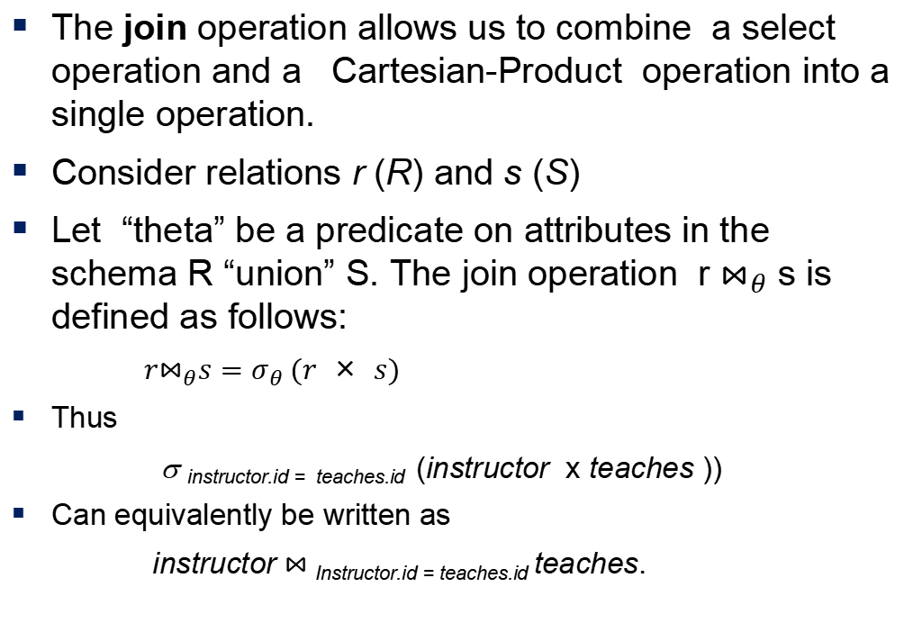
Join Operation (Cont.)
The join operation allows us to combine a select operation and a Cartesian-Product operation into a single operation.
Consider relations r (R) and s (S)
Let “theta” be a predicate on attributes in the schema R “union” S. The join operation r $⋈_{θ}$ s is defined as follows:
$r⋈_{θ}s=σ_{θ} (r × s)$
Thus
σ _{instructor.id = teaches.id} (instructor x teaches ))
Can equivalently be written as
instructor $⋈_{ }$_{Instructor.id = teaches.id} teaches.

Slide 54
The Rename Operation
The results of relational-algebra expressions do not have a name that we can use to refer to them. The rename operator, ρ , is provided for that purpose
The expression:
ρ_{x} (E)
returns the result of expression E under the name x
Another form of the rename operation:
ρ_{x(A1,A2, .. An)} (E)

Slide 55
重命名运算(ρ)
student
σ _{sex=“Male”} (student)
?
student-no | name | sex
1 | Jones | Male
2 | Smith | Male
3 | Kate | Female
student-no | name | sex
1 | Jones | Male
2 | Smith | Male
ρ _{boy} ( σ _{sex=“male”} (student) )
boy
student-no | name | sex
1 | Jones | Male
2 | Smith | Male

Slide 56
重命名运算(ρ)
格式2:
ρ _{x (A1, A2, …, An)} (E)
下标表示将E的结果关系命名为x，同时属性依次命名为A₁, A₂, …, A_{n}

Slide 57
重命名运算(ρ)
R
S
R×S
A | B | C
1 | 3 | 3
B | C | D
4 | 5 | 6
A | R.B | R.C | S.B | S.C | D
1 | 2 | 3 | 4 | 5 | 6
ρ _{V(RA, RB, RC, SB, SC, SD)} ( R×S )
V
RA | RB | RC | SB | SC | RD
1 | 2 | 3 | 4 | 5 | 6

Slide 58
The Assignment Operation
It is convenient at times to write a relational-algebra expression by assigning parts of it to temporary relation variables.
The assignment operation is denoted by ← and works like assignment in a programming language.
Example: Find all instructor in the “Physics” and Music department. Physics ← σ _{dept_name=“Physics”} (instructor)
Music ← σ _{dept_name=“Music”} (instructor)
Physics ∪ Music
With the assignment operation, a query can be written as a sequential program consisting of a series of assignments followed by an expression whose value is displayed as the result of the query.
Notes:
用途
对复杂的关系代数表达式，可以用如下方法简化
将其中的一些子式分解出来，并赋值给“中间关系”
再利用中间关系代替这些子式重写原表达式

Slide 59
Equivalent Queries
There is more than one way to write a query in relational algebra.
Example: Find information about courses taught by instructors in the Physics department with salary greater than 90,000
Query 1
σ _{dept_name=“Physics”} ∧ _{salary > 90,000} (instructor)
Query 2
σ _{dept_name=“Physics”} (σ _{salary > 90.000} (instructor))
The two queries are not identical; they are, however, equivalent -- they give the same result on any database.

Slide 60
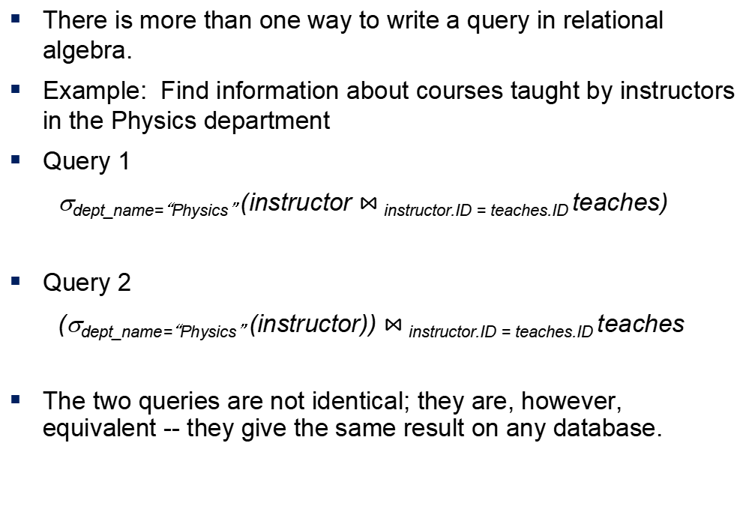
Equivalent Queries
There is more than one way to write a query in relational algebra.
Example: Find information about courses taught by instructors in the Physics department
Query 1
σ_{dept_name=“Physics”} (instructor $⋈_{ }$_{instructor.ID = teaches.ID} teaches)
Query 2
(σ_{dept_name=“Physics”} (instructor)) $⋈_{ }$_{instructor.ID = teaches.ID} teaches
The two queries are not identical; they are, however, equivalent -- they give the same result on any database.

Slide 61
End of Chapter 2

