Slide 1
AI-aided music composition system (人工智慧輔助音樂創作系統)
資工三 104590024 蔡一玄

Slide 2
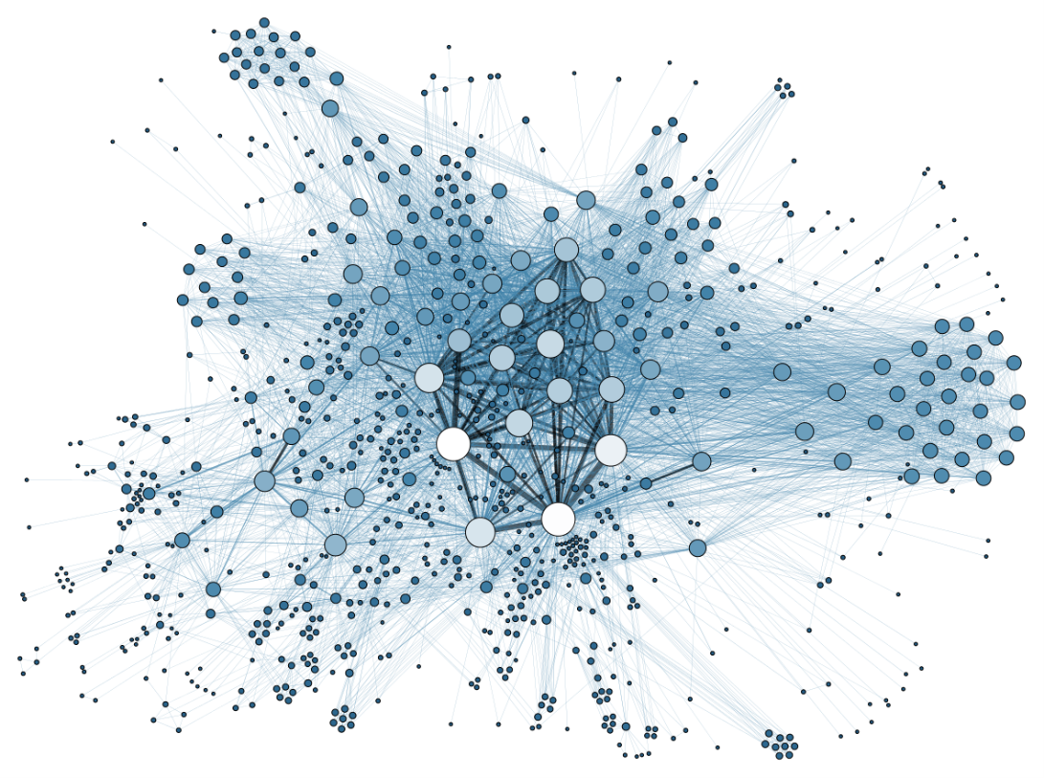
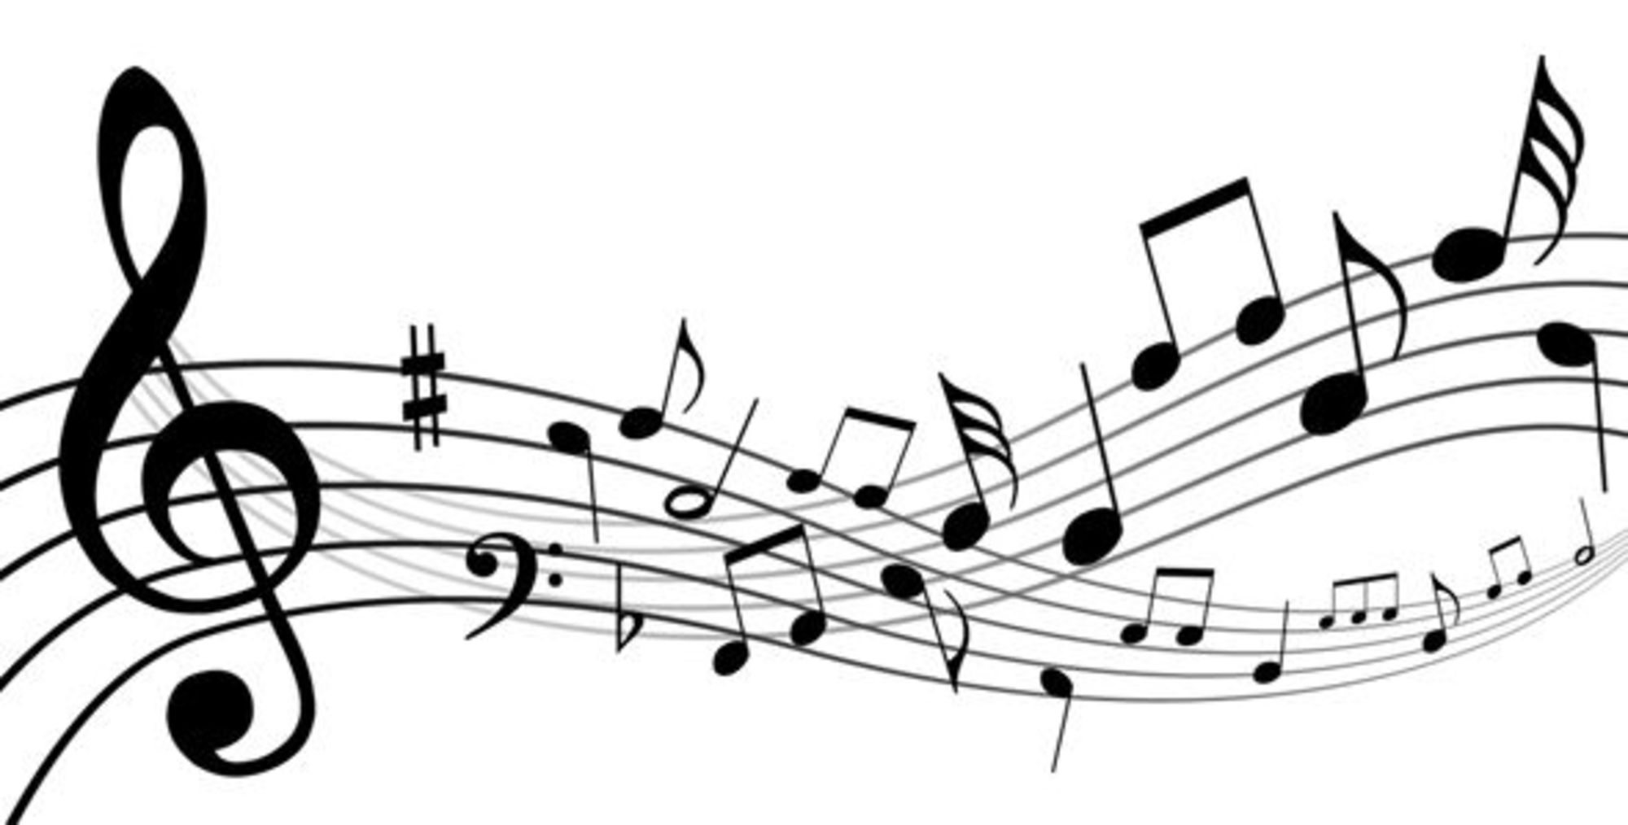
Motivation and Purpose
Getting started exploring machine learning
Knowing the limitation of computer’s creativity
Challenging myself (Stay away from comfort zone)

Slide 3
System functions
Goals
Generate music which is similar to a specific composer
Learn the fundamental concept of some deep learning methods
Capable of inputting multi-part music
Have a simple music structure
In each part, both note and chord are allowed

Slide 4
Application Field
Data preprocessing, cleaning, transformation
Neural Network => RNN, LSTM, RBM
*Probabilistic Graphical Models => Markov Chain, Gibbs Sampling, MCMC
Basic Music Theorem => Rhythm, Pitch, Chord, Music form

Slide 5
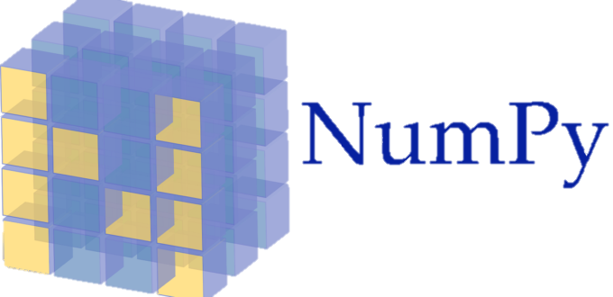

Tool Introduction
A Python-based toolkit for computer-aided musicology. (Music21)
A high-level neural networks API, written in Python.
A fundamental package for scientific computing with Python

Slide 6
Choices of music and dataset
Music category:
Classical/Art: Baroque, Classical period, Romantic, Contemporary
Popular: Jazz, Rock, Country, Hip hop
Dataset:
File type: .mid, .xml, .mxl
Current resources: Bach chorales dataset, Mozart piano sonata dataset, Chopin mazurka dataset, etc.

Slide 7
Why choose Baroque or classical period music?
The variation of rhythm and expression does not change too much
Music form and structure is simple
My favorite music type

Slide 8
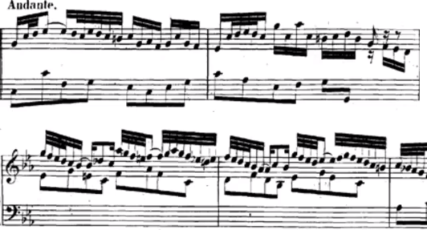

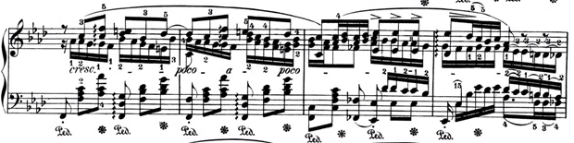
Examples:

Slide 9
System Structure and Procedure
Midi Files
Note Matrix
Probability Matrix
LSTM Neural Network Model
Output
Midi
Transform to
Feed to
Generate
Sampling

Slide 10


Details – Data Preprocessing and Transformation
Quantize all notes to 16th note
$\left[\begin{aligned}83 \\ 67 \\ 52 \\ 35\end{aligned}\right.\left.\begin{aligned}79 \\ 129 \\ 50 \\ 131\end{aligned}\right.\left.\begin{aligned}81 \\ 62 \\ 47 \\ 40\end{aligned}\begin{aligned} 128 \\ 129 \\ 52 \\ 38\end{aligned}\begin{aligned}73 \\ 65 \\ 130 \\ 131\end{aligned}\begin{aligned}128… \\ 70… \\ 130… \\ 39…\end{aligned}\right] \left[\begin{aligned}0 \\ 3 \\ 5 \\ 23\end{aligned}\right.\left.\begin{aligned}1 \\ 8 \\ 12 \\ 11\end{aligned}\right.\left.\begin{aligned}2 \\ 15 \\ 10 \\ 9\end{aligned}\begin{aligned}… \\ … \\ … \\ …\end{aligned}\right]$
Encode
Number of parts
{0:83, 1:79, 2:81
3:67, 4:73, 5:52}
t0 t1 t2 ．．．
Transpose
Time
$$\left[\begin{aligned}0 \\ 1 \\ 2 \\ . \\ .\end{aligned}\right.\left. \begin{aligned}3 \\ 8 \\ 15 \\ . \\ .\end{aligned}\right.\left.\begin{aligned}5 \\ 12 \\ 10 \\ . \\ .\end{aligned}\begin{aligned} 23 \\ 11 \\ 9 \\ . \\ .\end{aligned}\right]$$
[ 1 0 0 1 0 1 0 0 0 0 0 0 0 0 0 0 0 0 0 0 0 0 0 1 …]
Transform
to
One-Hot
Representation

Slide 11
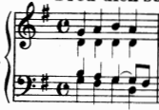
Details – Input and Target Data Structure
[[[ 1 0 0 0 0 0 0 0 0 0 0 0 0 0 0 0 0 0 0 0 0 0 0 0 …]
[ 0 0 0 1 0 0 0 0 0 0 0 0 0 0 0 0 0 0 0 0 0 0 0 0 …]
[ 0 0 0 0 0 1 0 0 0 0 0 0 0 0 0 0 0 0 0 0 0 0 0 0 …]
[ 0 0 0 0 0 0 0 0 0 0 0 0 0 0 0 0 0 0 0 0 0 0 0 1 …] ]
.
.
. ]
[[ 1 0 0 1 0 1 0 0 0 0 0 0 0 0 0 0 0 0 0 0 0 0 0 1 …]
[ 0 1 0 0 0 0 0 0 1 0 0 1 1 0 0 0 0 0 0 0 0 0 0 0 …]
[ 0 0 1 0 0 0 0 0 0 1 1 0 0 0 0 1 0 0 0 0 0 0 0 0 …]
.
.
. ]
Input data(X) =
Target data(Y) =

Slide 12
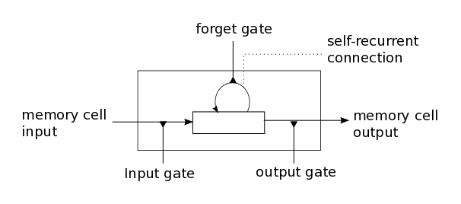
Details – Model Decision and Architecture
Choices : RNN, LSTM, GRU, RBM, CNN
First try : LSTM
1. Suitable for sequence or time-series data (Ex: speech recognition, translation)
2. Capable of learning long-term dependencies
(RNN has the problem: Vanishing/Exploding Gradients)
←LSTM Architecture

Slide 13
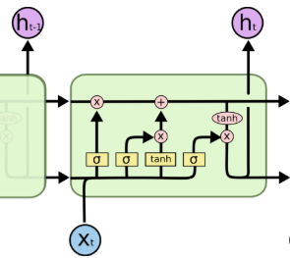
LSTM - Outline
Notation | Description
f , i , t | Forget gate, input gate, output gate
W_{f} , W_{i} , W_{o} , W_{c} U_{f} , U_{i} , U_{o} , U_{c}, V_{o} | Weight Matrices
f_{t} , i_{t} , o_{t} | Gates’ state at time t
b_{f} , b_{i} , b_{o} | Bias vectors
h_{t} | Hidden state at time t
x_{t} | Input value at time t
C_{t} | Cell state at time t
σ | Sigmoid function
Forget Gate
Output Gate
Input Gate

Slide 14

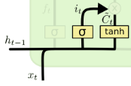

LSTM – Outline (Cont.)
h_{t-1}
h_{t}

Slide 15
Train Model
One bar notes
LSTM
Dropout
Dropout
LSTM
[[t0 ~ t16], …]
t0 = [ 1 0 0 1 0 1 0 0 0 0 0 0 0 0 0 0 0 0 0 0 0 0 0 1 …]
Output
Layer
Activation function
(Softmax)
Chord
Do
Re
Mi
…
Fa La

Slide 16
Difficulty
No experience in machine learning
Music is an uncommon topic in machine learning => Few of articles or examples
Machine learning is difficult to apply to art field
The quality of generated music

Slide 17
Future Plan and Expectation
Find some methods to generate totally new music
Improve the music quality
Try other neural network structure

