Slide 1
Natural Language Processing with Disaster Tweets
Jin Niu
COSC 586 Text Mining & Analysis

Slide 2
Introduction
My project is predicting whether a given tweet is about a real disaster or not.
It is based on the paper A Sentiment-Aware Contextual Model for Real-Time Disaster Prediction Using Twitter Data and Comparing Performance of Classifiers Applied to Disaster Detection in Twitter Tweets – Preliminary Considerations. They offer a new model SentiBERT-BiLSTM-CNN and methods of data preprocessing.
My project is to improve the model by using the methods of data preprocessing.

Slide 3
Introduction
By analyzing the features of the dataset, I choose 5 features to preprocess the dataset.
Then I build the model and combine it with processors about the 5 features.
At last, I choose the best processor and fine tune the model to analyze the result.

Slide 4
Dataset
The dataset is separated into train dataset and test dataset.
Train dataset have columns of id, text, location, keyword and target. Location and keyword columns can be empty.
Since it’s a competition on Kaggle, so test dataset does not have target and score of competition is accuracy on test dataset. But the full dataset is leaked, so I will use the test dataset with target to evaluate my model.

Slide 5

Dataset
There are more “non disaster tweets” than “disaster tweets” in both data sets while the ratio is almost same.
They also have similar percentage of keyword and location. Since keyword and location are select from the text, so I just use the text column to train the model.

Slide 6
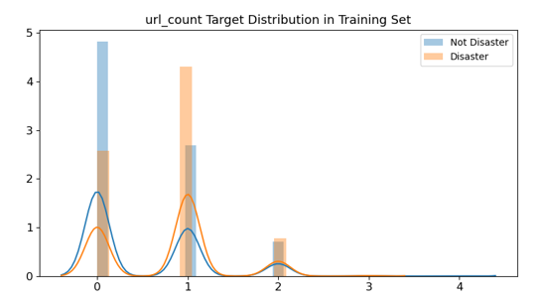
Dataset
Feature: URL
URL may have meaningless characters, so remove url may improve the model.

Slide 7
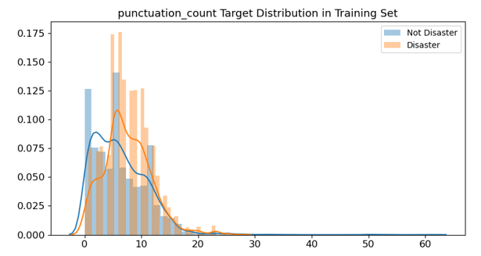
Dataset
Feature: punctuation

Slide 8
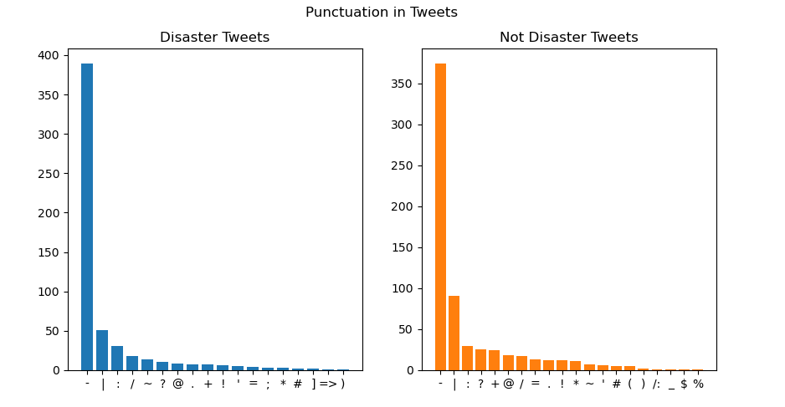
Dataset
Feature: punctuation
Top 3 punctuations are same, so remove punctuations may improve the model

Slide 9
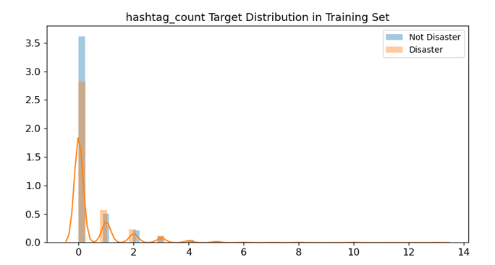
Dataset
Feature: hashtag #

Slide 10
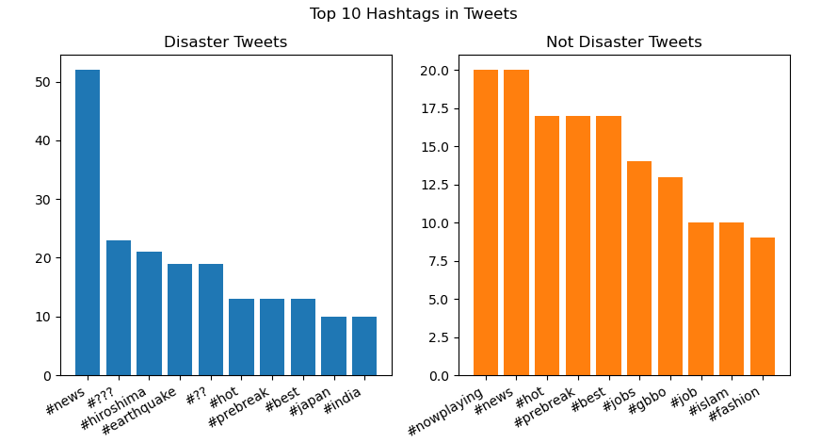
Dataset
Feature: hashtag #
The number of hashtags is too small so I do not choose this feature.
Notes:
The number of hashtags is too small so I do not choose this feature.

Slide 11
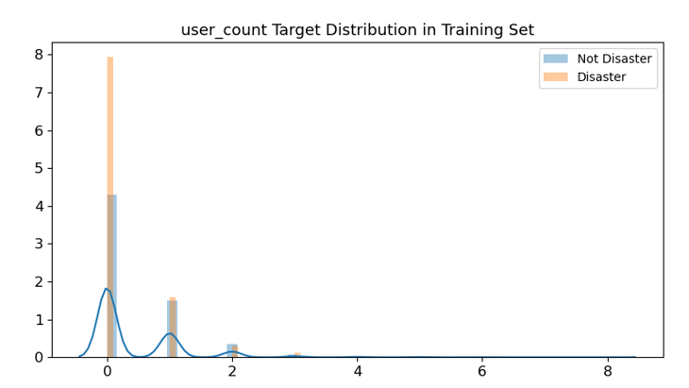
Dataset
Feature: User @
The user name is generally considered irrelevant to the content, so remove user may improve the model.

Slide 12
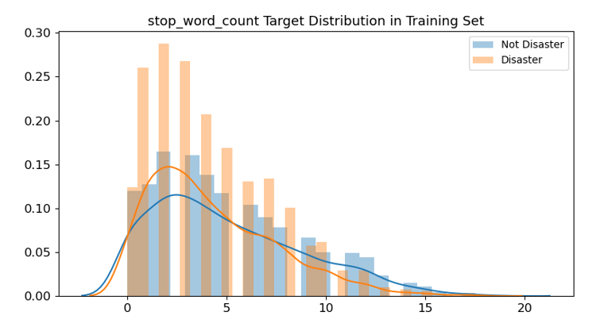
Dataset
Feature: stopword

Slide 13
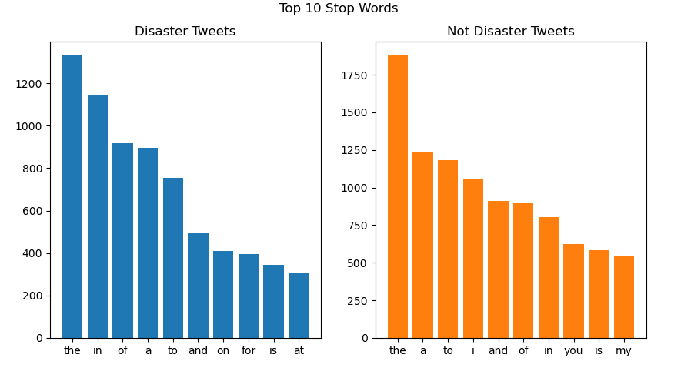
Dataset
Feature: stopword
In disaster tweets, preposition are more while non disaster have more pronoun. Preposition may be used to describe the disaster, so remove stopwords may not improve the model.

Slide 14
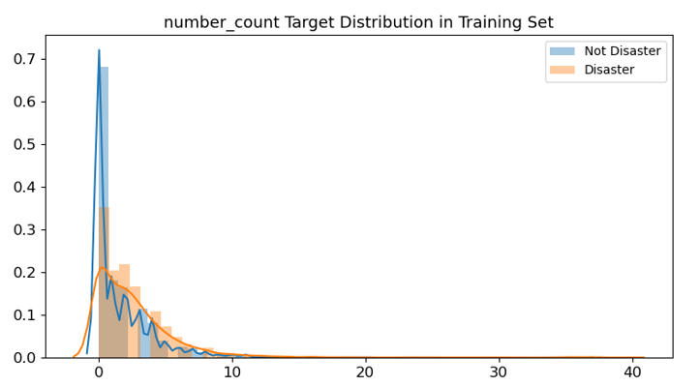
Dataset
Feature: number

Slide 15
Dataset
5 features: url, punctuation, user, stopwords, number.

Slide 16
Model
4 Model:
Bert(Baseline)
SentiBert(a BERT variant)
Bert-BiLSTM-CNN
SentiBert-BiLSTM-CNN

Slide 17
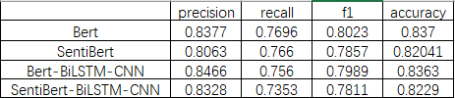
Experiment and Result
First, I use 4 models without any data preprocessing.

Slide 18
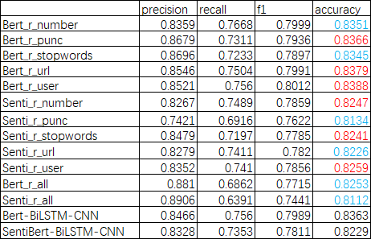
Experiment and Result
Then I remove one feature separately and remove all features on data preprocessing for 2 combined model.
Bert is better than SentiBert and they have opposite rule. So in following experiment, I will only use Bert-BiLSTM-CNN model.

Slide 19
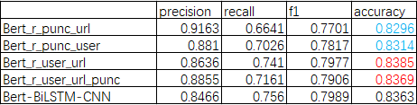
Experiment and Result
For 3 features improving the model: remove url, user and punctuations, I combine them and then make the experiment.

Slide 20

Experiment and Result
For preprocessors with top 2 accuracy remove user and remove both user and url, I fine tune the model and then make the experiment.
The accuracy is 10th highest score on Kaggle except using the leak dataset as submission.

Slide 21
Analysis
SentiBert does not performs better than Bert as the paper mentioned.
About the training time for each epoch, Bert is twice as long as SentiBert. So Bert may find more details about the text.

Slide 22
Analysis
Reason of 3 features improving the model: remove url, user and punctuations, and the best is remove url and user
User name is irrelevant to the content, URL may have meaningless characters.
Though top 3 punctuations are same, other punctuations may show details like mood.

Slide 23

Analysis
The model is not as good as the paper’s.
Maybe because of the fine tuning on the model, and the paper of Senti-BiLSTM-CNN seems use different dataset though the paper said it is also from the same Kaggle competition.
The paper have 10,876 samples in the dataset, including 4692 disaster and 6184 non disaster, while mine is 4673 and 6203. And I can’t find the examples from the paper in my dataset.

Slide 24
Error Analysis(152FP & 352FN)
Non disaster tweet with disaster prediction. (False positive)
beware world， sierra leone and guap are music names of a rapper. It seems like Sierra Leone, a country is ablaze.
beware world ablaze sierra leone &amp; guap.

Slide 25
Error Analysis
FP
It is ablaze, but not serious enough to be a disaster.
@CTVToronto the bins in front of the field by my house wer set ablaze the other day flames went rite up the hydro pole wonder if it was him

Slide 26
Error Analysis
FP
It is relevant to disaster, but not disaster
For Legal and Medical Referral Service @1800_Injured Call us at: 1-800-465-87332 #accident #slipandfall #dogbite

Slide 27
Error Analysis
FP
No zombie in the world : )
OMg zombie apocalypse among my students... -___-

Slide 28
Error Analysis
Disaster tweet with non disaster prediction. (False negtive)
It have many topics.
@rewind_music found out about you guys today(regarding the accident on the airplane lol) &amp; became a fan! Sending love &amp; support from Cali~?

Slide 29
Error Analysis
FN
The ‘love’ mislead the model, and the more important messages are not text.
To love you love you love you ... Massive Attack - Angel (HD) https://t.co/9TW34Gffox vÌ_a @YouTube

Slide 30
Error Analysis
FN
‘bleeding’ here seems serious enough to be a disaster
@Battlehork I wish I could watch but the gif the LU account posted of Mundo bleeding... Jesus! D:

Slide 31
Error Analysis
Problems? with the dataset:
Marked as a disaster and predict as non disaster(FN)
2 held with heroin in ambulance http://t.co/d9sOwi1G21 http://t.co/OPxmdPIwAu
New Nanotech Device Will Be Able To Target And Destroy Blood Clots http://t.co/MnmyJXQ9go #science
Why should a helicopter ambulance ride to transfer to a hospital 21 miles away cost $29800? http://t.co/7ZqIreY7Te http://t.co/9Qp3PqPwZv

Slide 32
Error Analysis
Features of FP:
Some words to describe a disaster become proper noun.
Disasters in game or movie is not a disaster : )
Features of FN:
When too many topics in one tweet.
Pray for people in disaster.

Slide 33
Error Analysis
Common features:
Boundary of whether an event is a disaster.
Subevent of a disaster can be subevent of non disaster event.
In tweet, there may be more information in links(urls), include videos and pictures.

Slide 34
Conclusion
In my project, from the dataset I choose appropriate features as preprocessor to improve the combined Bert model.
With the result of experiment, I try to analyze the reason of improving and reason of why mistakes occur.
From the limitations on my work, there are more ways to improve in the future. More dataset can make the boundary of disaster more clear. Fine tuning of Bert model is also important.

Slide 35
Thank you!

