Slide 1
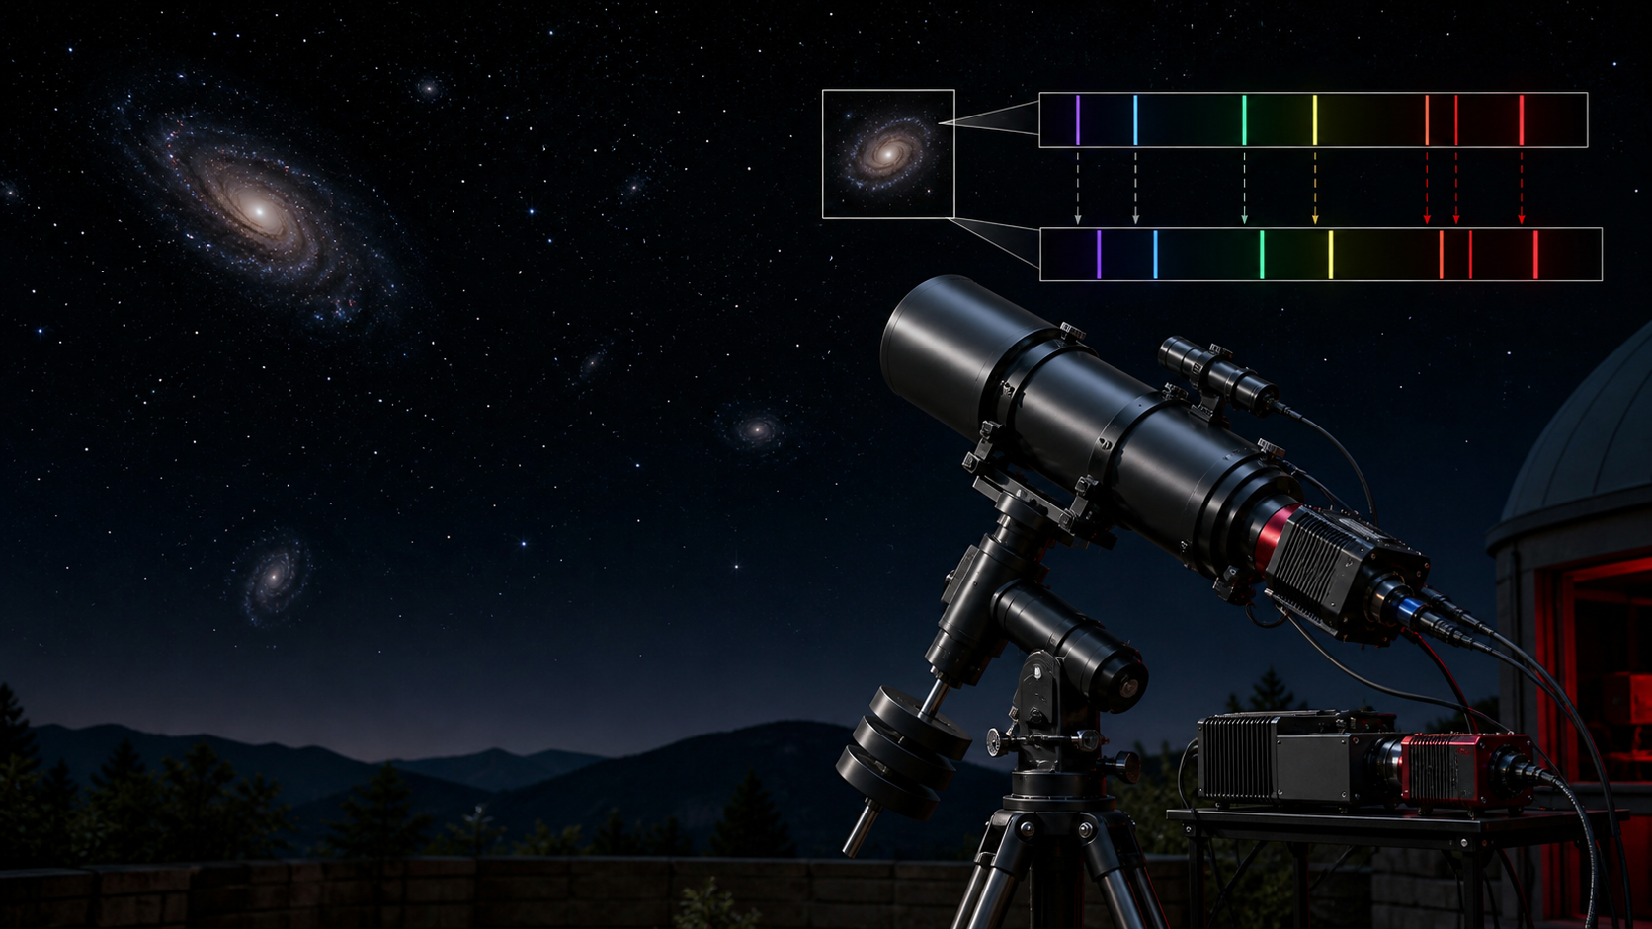
Testing Hubble's Law:
Measuring Cosmic Expansion: Galaxy Redshifts with a High-Resolution Spectroscope
Science fair project plan, September 2026 to March 2027
Shlok
Keya Attre
Anushka Prasad
Team goal: measure galaxy redshifts and compare them with distance
Notes:
Generated educational visual created with the built-in image generation tool. Hubble's Law workflow uses standard redshift calculations and public spectra as a backup option.

Slide 2
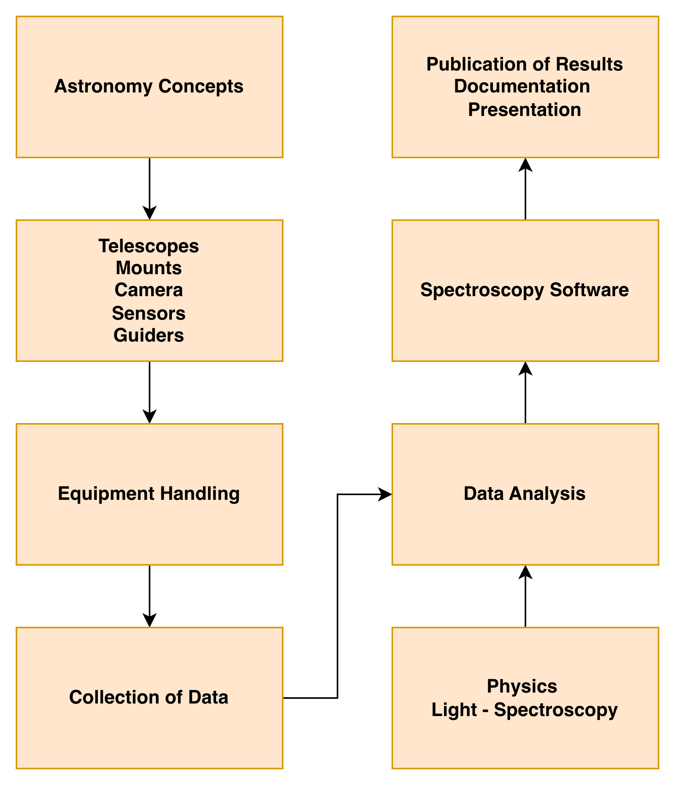
Project agenda
The team connects spectra, redshift and galaxy distance
Learn how spectra encode wavelength information
Calibrate the spectroscope with known lines
Measure redshift from galaxy spectra
Convert redshift into recession velocity
Plot velocity against distance and interpret the trend
Hubble's Law spectroscopy
undefined

Slide 3
Research question
The project tests one measurable piece of cosmic expansion
Can high-resolution amateur spectroscopy measure galaxy redshifts well enough to support Hubble's Law?
Hypothesis: more distant galaxies will show larger recession velocities
Measured result: observed wavelength shift of known spectral lines
Main graph: recession velocity against published galaxy distance
Hubble's Law spectroscopy
undefined

Slide 4
Spectroscopy method
The students measure how far known spectral lines shift toward longer wavelengths
What students collect
Calibration spectra or known stellar lines
Galaxy spectra with visible emission or absorption features
Exposure time, target altitude and observing notes
Published galaxy distance for each target
Hubble's Law spectroscopy
undefined

Slide 5
Redshift calculation
A shifted line gives redshift, and redshift gives velocity for nearby galaxies
z = (observed wavelength - rest wavelength) / rest wavelength
velocity approx. z x 300,000 km/s
Example | Value
Rest H-alpha line | 656.3 nm
Measured H-alpha line | 660.0 nm
Redshift | 0.0056
Approx. velocity | 1,680 km/s
Hubble's Law spectroscopy
undefined
Notes:
The velocity approximation works best for low redshift galaxies. Students should explain this limitation.

Slide 6
Expected Hubble's Law graph
A positive trend supports the relationship between distance and recession velocity
Each point represents one galaxy
Large scatter can come from measurement noise and local motion
The slope estimates the Hubble constant
Hubble's Law spectroscopy
undefined
Notes:
Chart uses illustrative values to show the expected graph form. Students should replace it with measured or curated public data.

Slide 7
Project calendar
The first goal is reliable wavelength calibration before galaxy data
Month | Student learning | Project milestone
Sep | Spectra, redshift, wavelength and Hubble's Law | Roles assigned and formula practice complete
Oct | Spectroscope setup and calibration | Calibrated stellar spectrum with labeled lines
Nov | Galaxy target choice and long exposures | First galaxy spectrum attempt
Dec | Line fitting and comparison with published redshifts | Quality review and target list revision
Jan | Final galaxy set or hybrid public dataset | Velocity-distance table ready
Feb | Graphs, uncertainty and judge questions | Board draft and oral practice
Mar | Final polish | Fair presentation ready
Hubble's Law spectroscopy
undefined

Slide 8
Target strategy
Emission-line targets give the team the best chance of clear measurements
Target type | Why it helps | Examples
Bright emission-line galaxies | Sharper lines can be easier to locate | M82, M77, NGC 4151
Nearby bright galaxies | Easier to acquire but smaller redshifts | M81, M87
Quasars | Large redshifts but faint targets | Use only after pilot tests
Public survey spectra | Reliable backup and larger sample | SDSS spectra
Pilot test with one bright galaxy before committing to the final sample
Use public spectra if weather or signal strength limits student observations
Hubble's Law spectroscopy
undefined
Notes:
The target examples are starting candidates. Final choices should use visibility, altitude, Moon phase and spectroscope sensitivity.

Slide 9
Risks and backup plan
Galaxy spectroscopy has high reward and real technical risk
Risk | Mitigation
Galaxy spectra too faint | Use longer exposures or a lower-resolution mode if available
Line identification uncertain | Start with calibration stars and known line lists
Small redshift on nearby galaxies | Choose targets with stronger published redshifts
Distance estimates vary | Use one distance source consistently
Clouds or poor seeing | Use SDSS public spectra as a labeled backup dataset
A hybrid project can still be strong: student spectra plus public spectra
Judges value a clear limit as much as a perfect result
Hubble's Law spectroscopy
undefined

Slide 10
Science fair deliverables
The final board should make the measurement chain visible
Research question, hypothesis and variables
Equipment diagram or setup photo
A calibrated spectrum with labeled spectral lines
Table of galaxies, redshifts, velocities and distances
Velocity-distance graph with trendline
Conclusion with uncertainty and limits
Hubble's Law spectroscopy
undefined

Slide 11
Starter resources
Use these references for calibration, public data and interpretation
Resource | Use
AAVSO spectroscopy guide | Beginner workflow for astronomical spectroscopy
Sloan Digital Sky Survey | Public galaxy spectra for backup or comparison
NASA/IPAC Extragalactic Database | Published galaxy properties and distances
Astro spectroscopy software | Wavelength calibration and line measurements
Notes for mentors: keep a record of calibration accuracy, line choices and each distance source.
Hubble's Law spectroscopy
undefined
Notes:
Sources to consult during the project: AAVSO spectroscopy materials, Sloan Digital Sky Survey spectra, and NASA/IPAC Extragalactic Database.

Slide 12
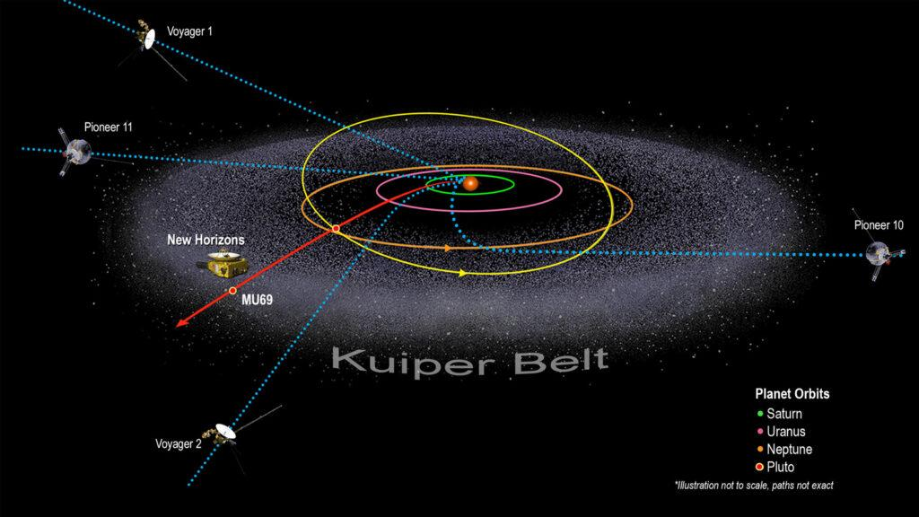

Slide 13
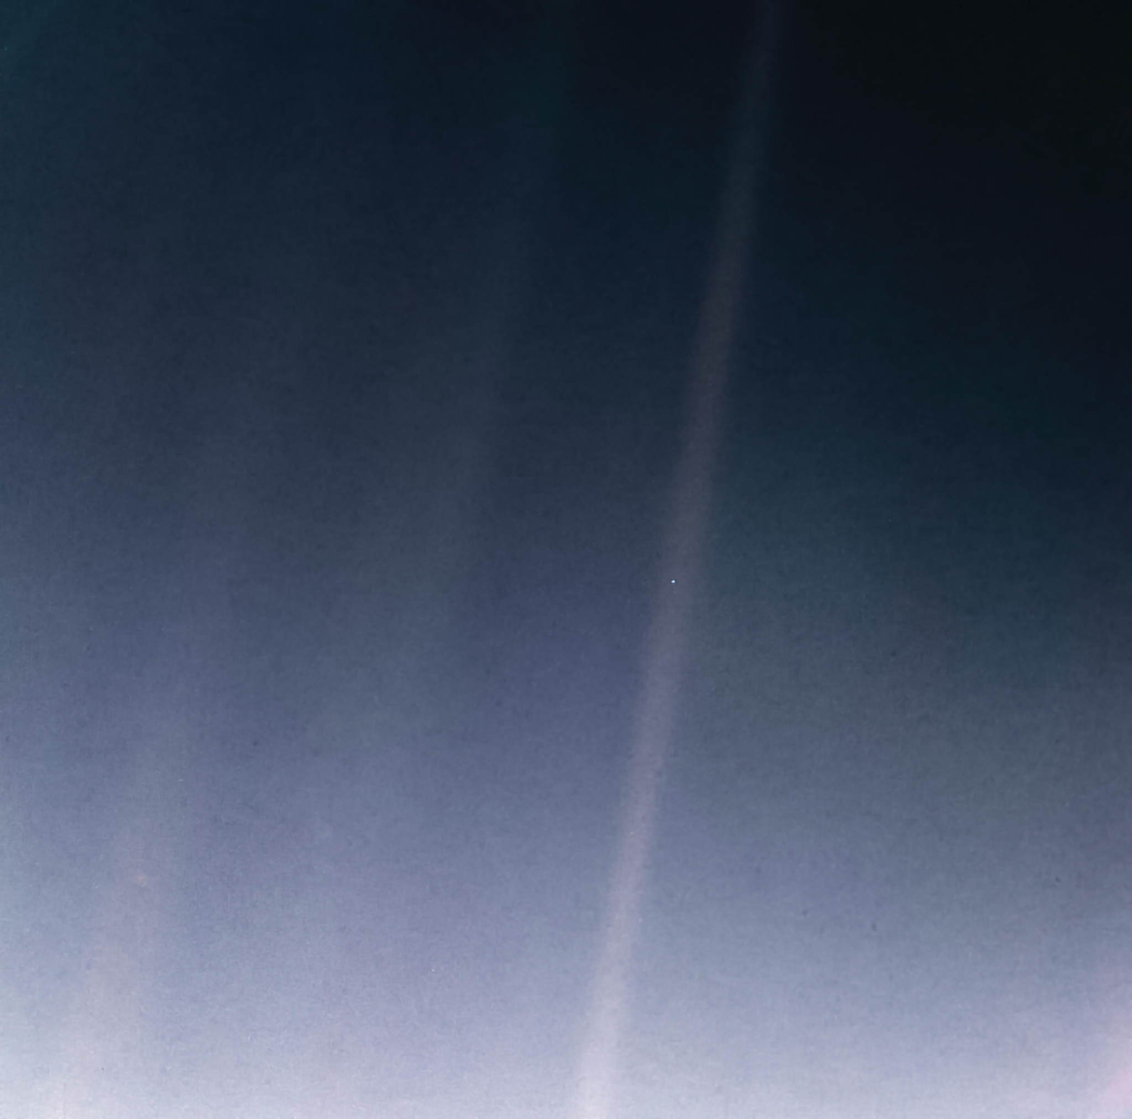
The Pale Blue dot
“Look again at that dot. That's here. That's home. That's us. On it everyone you love, everyone you know, everyone you ever heard of, every human being who ever was, lived out their lives. The aggregate of our joy and suffering, thousands of confident religions, ideologies, and economic doctrines, every hunter and forager, every hero and coward, every creator and destroyer of civilization, every king and peasant, every young couple in love, every mother and father, hopeful child, inventor and explorer, every teacher of morals, every corrupt politician, every "superstar," every "supreme leader," every saint and sinner in the history of our species lived there-on a mote of dust suspended in a sunbeam.

Slide 14
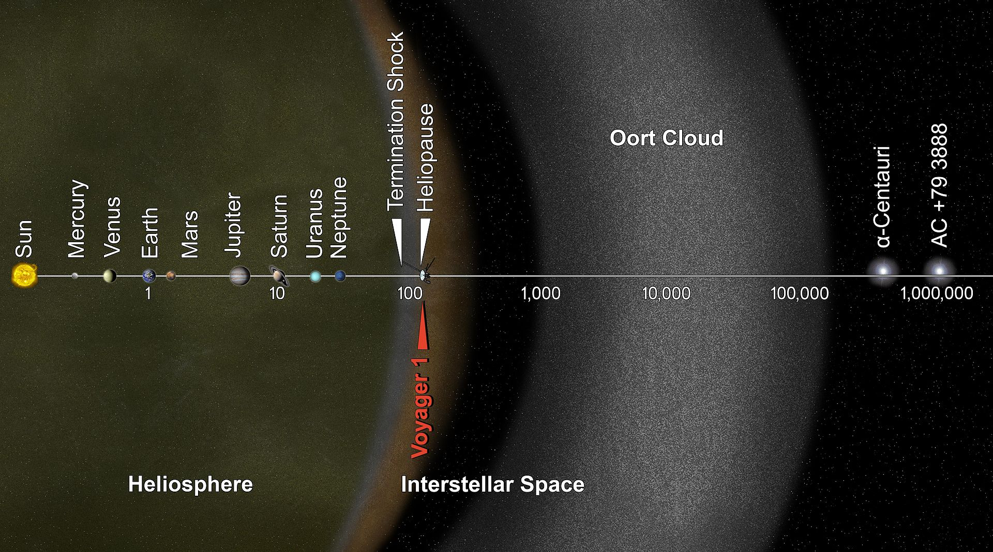

Slide 15
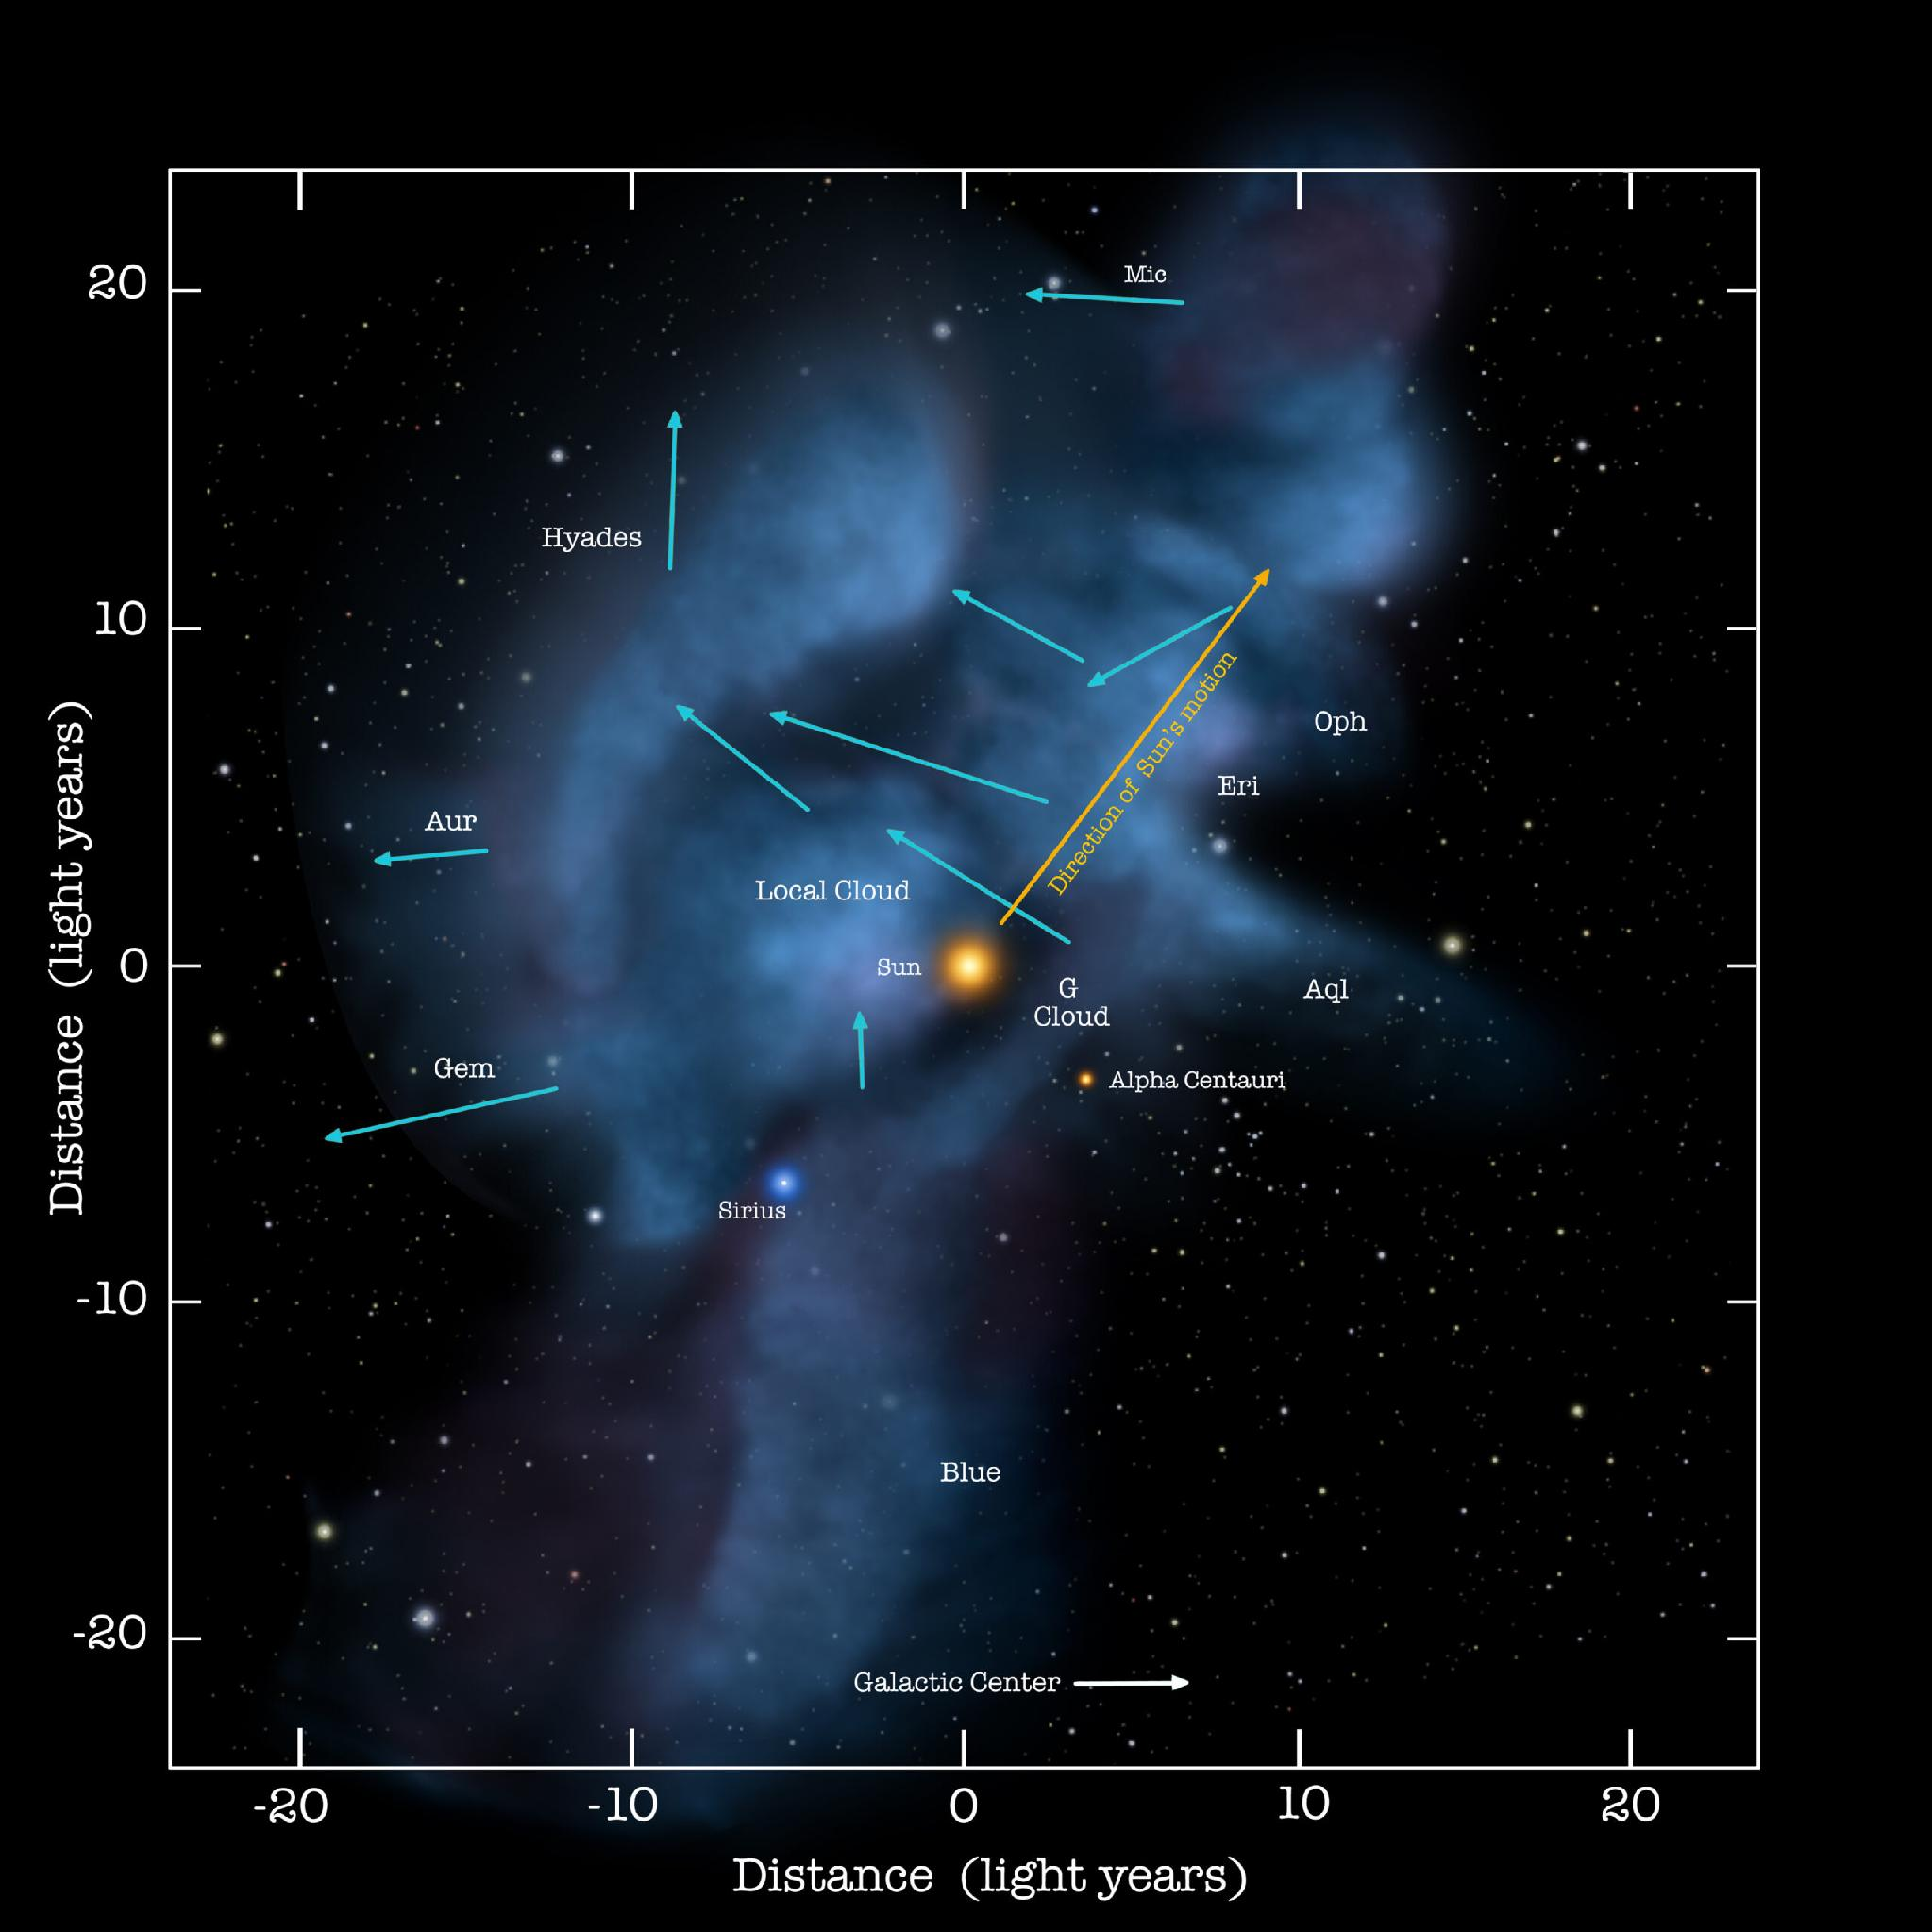
Local Interstellar Cloud (LIC)
Expected diameter of 300 light years
The existence of these sparsely dense gaseous regions can be attributed to 10–20 million old supernovae.

Slide 16
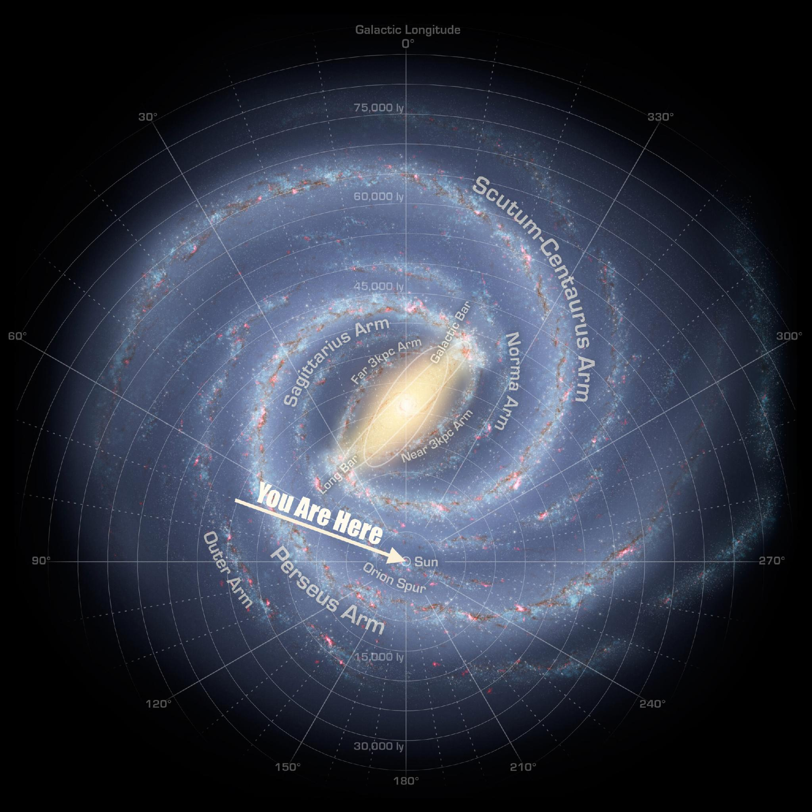
Orion–Cygnus Arm: 3,500 light-years across and 10,000 light-years in length
It is estimated the galaxy contains between 100 and 400 billion stars, spanning 100,000 light-years across

Slide 17
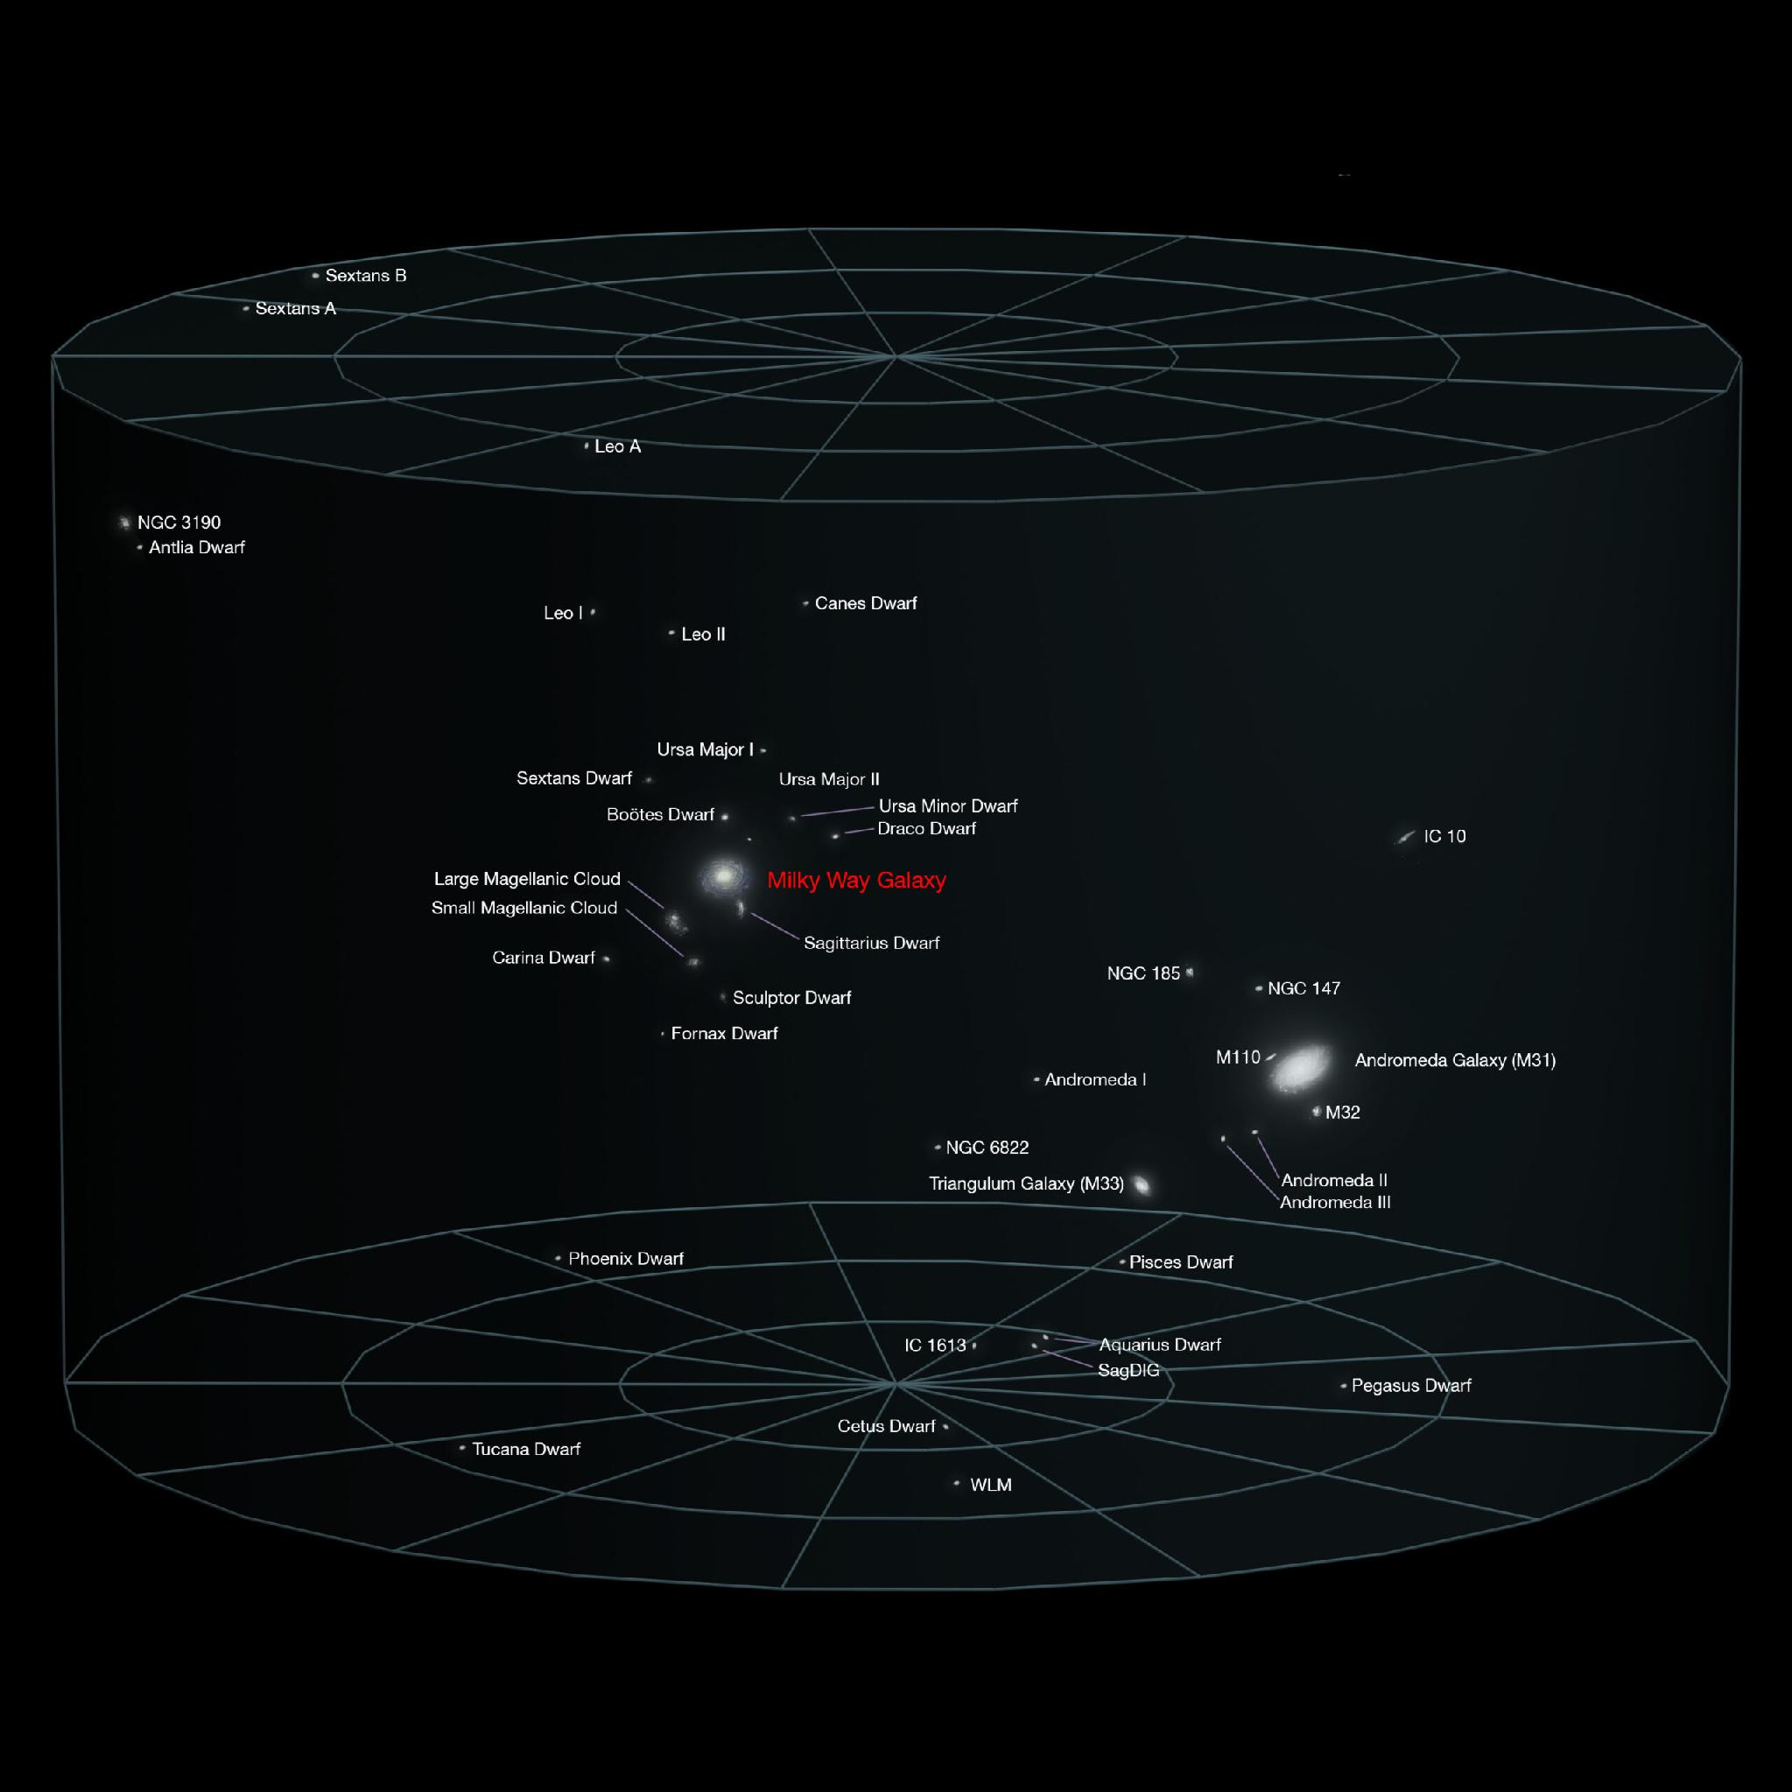
Milky Way is just one of an estimated 30–50 galaxies located in the Local Galactic Group. It spans approximately 10 million light years in diameter

Slide 18
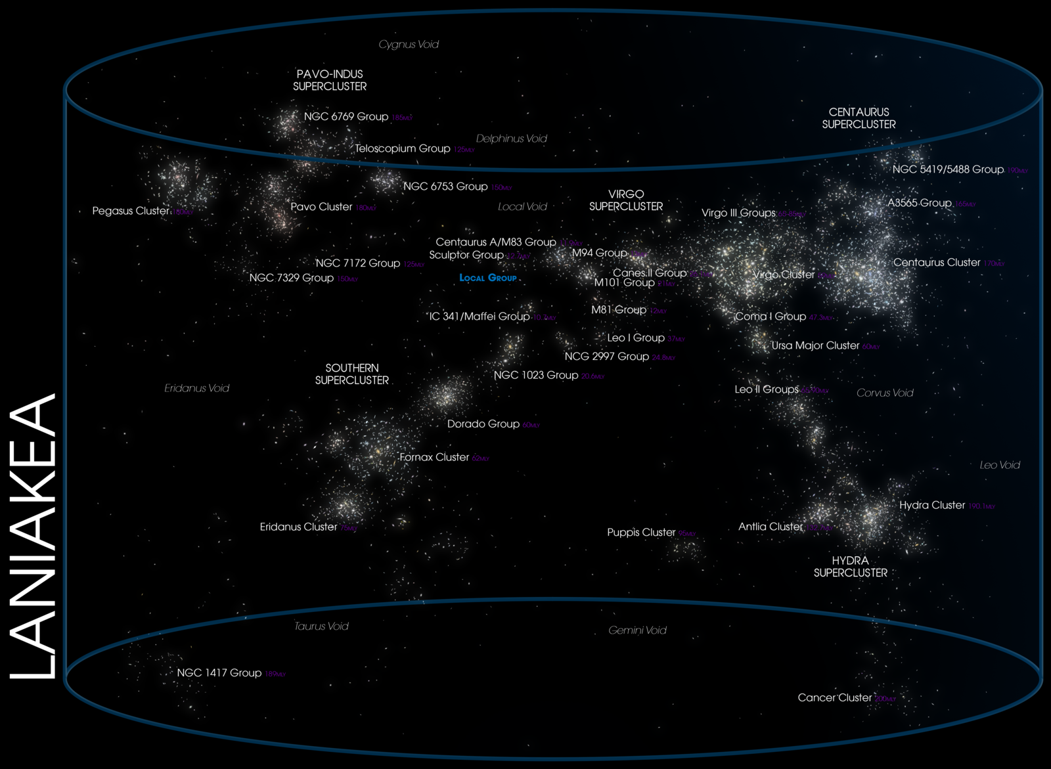
This Super cluster is 520 million light-years wide, composed of about 300–500 smaller clusters, amounting to 100,000 galaxies

Slide 19
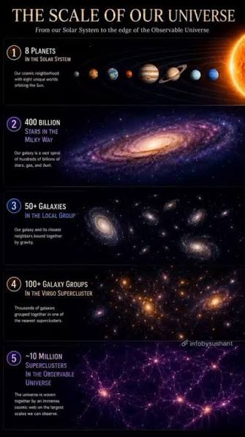
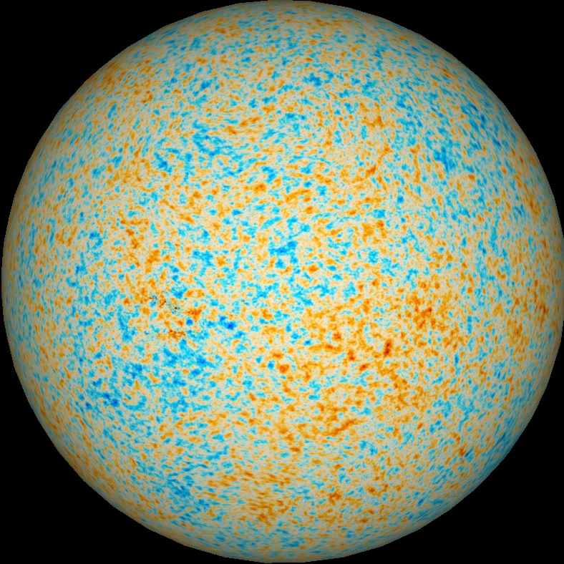
Observable Universe

Slide 20
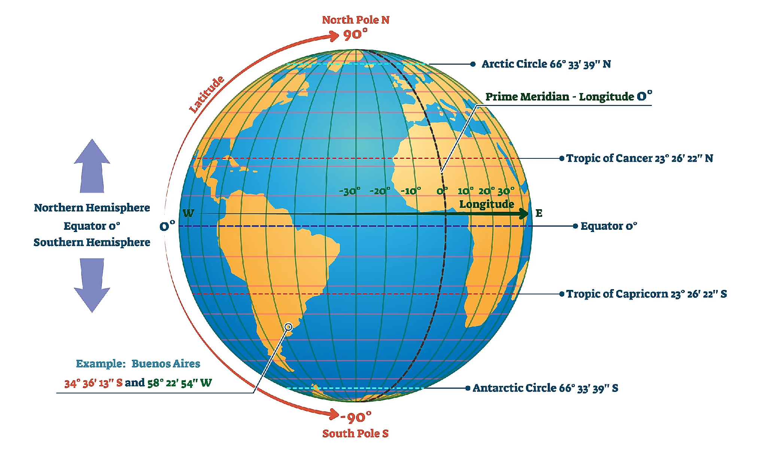

Slide 21
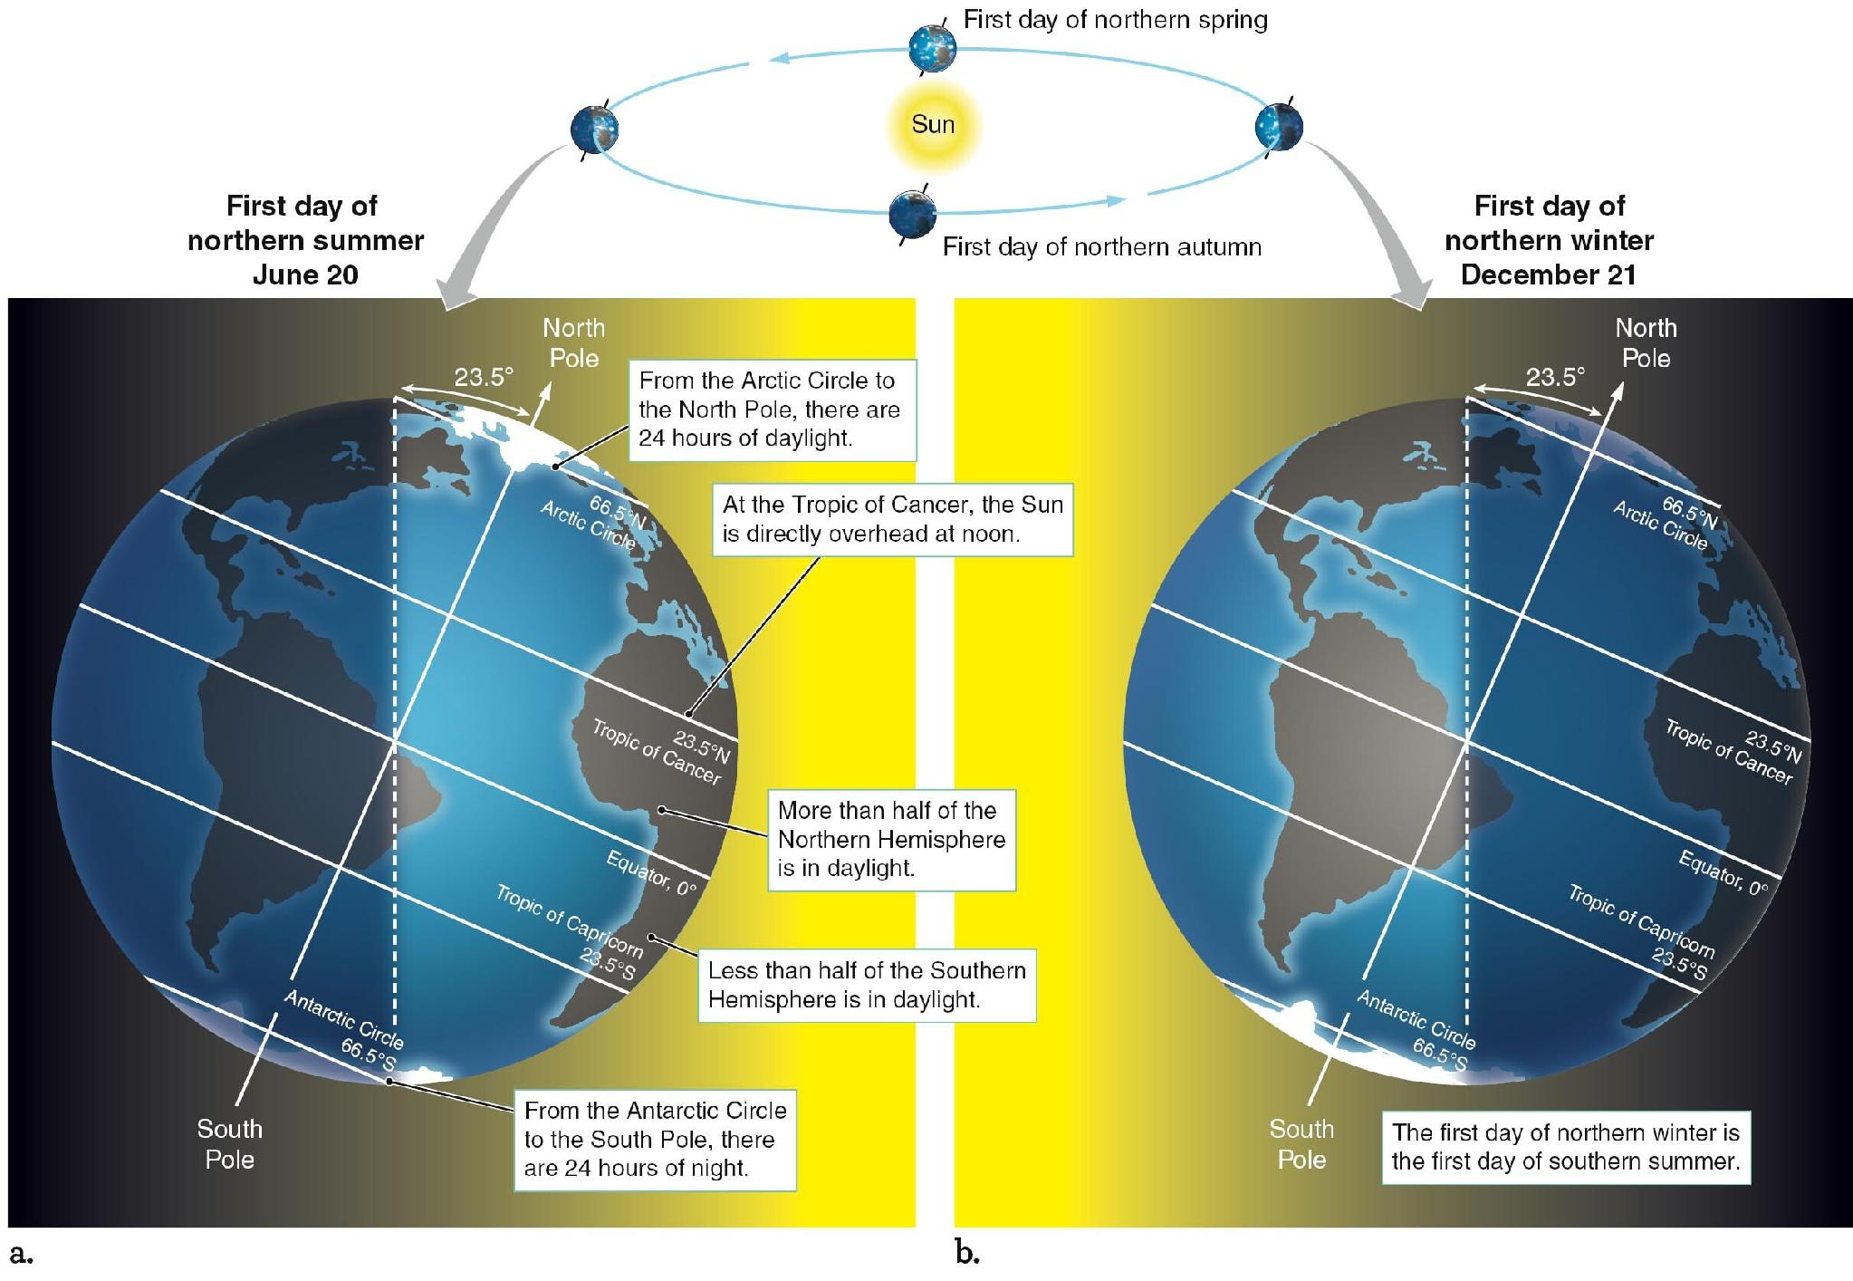

Slide 22
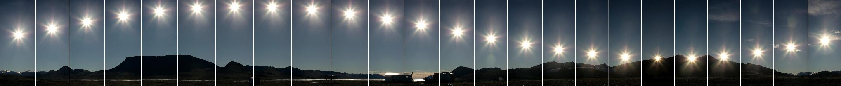
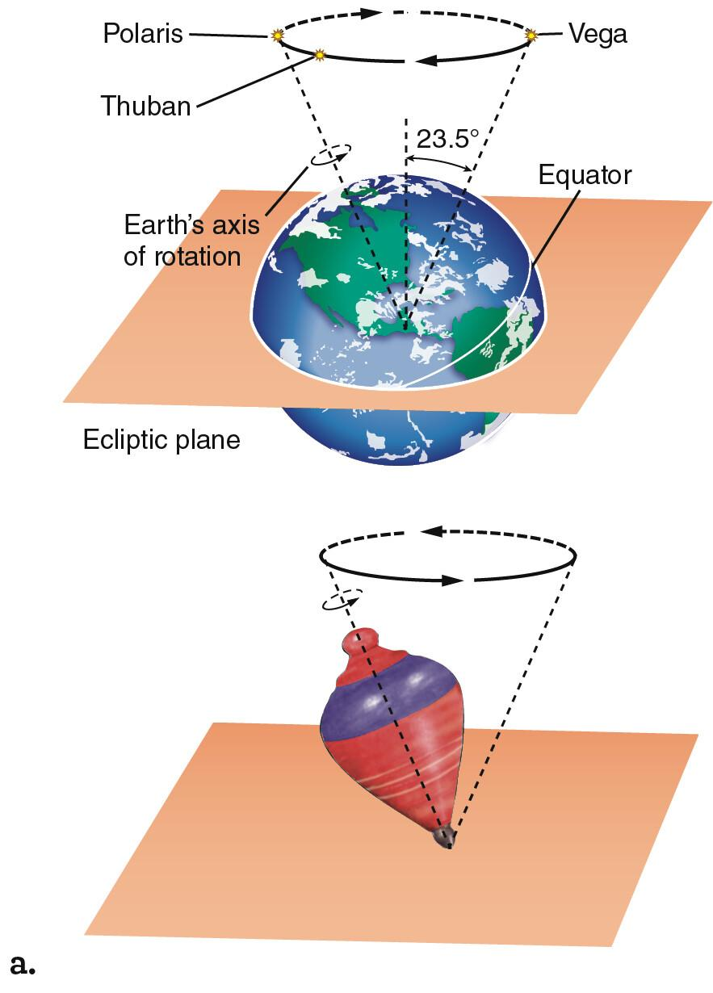
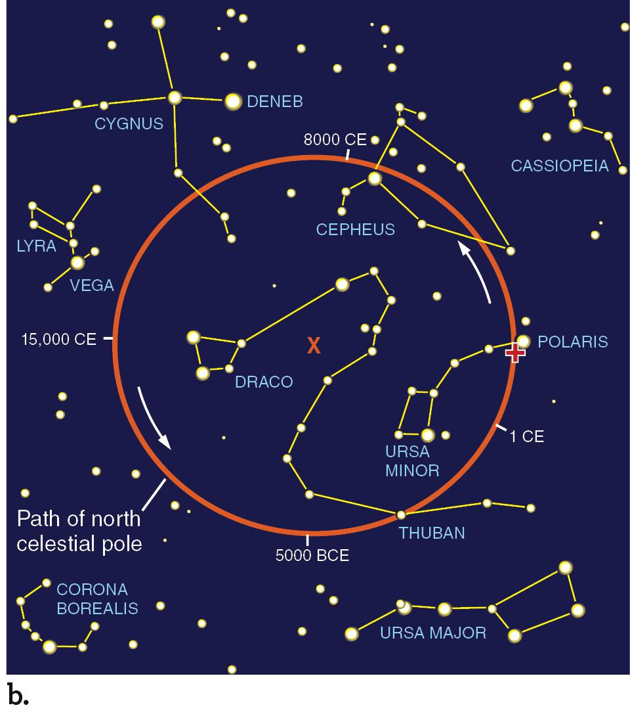
26,000-year wobble

Slide 23
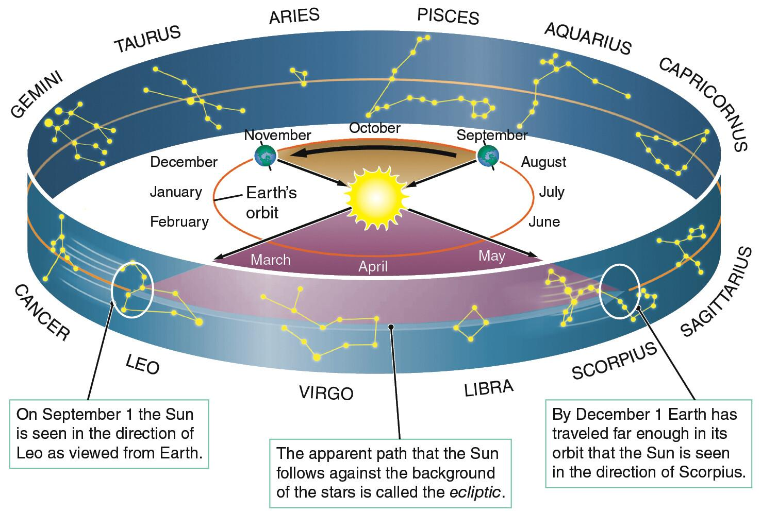

Slide 24
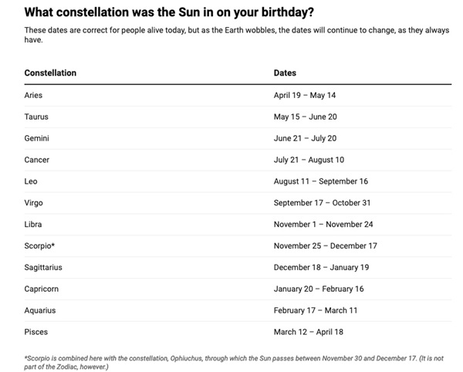
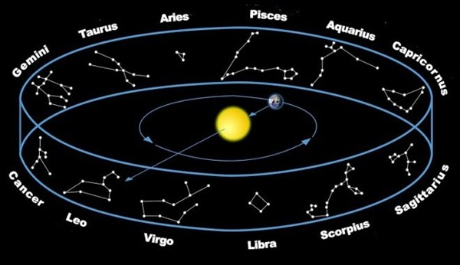

Slide 25
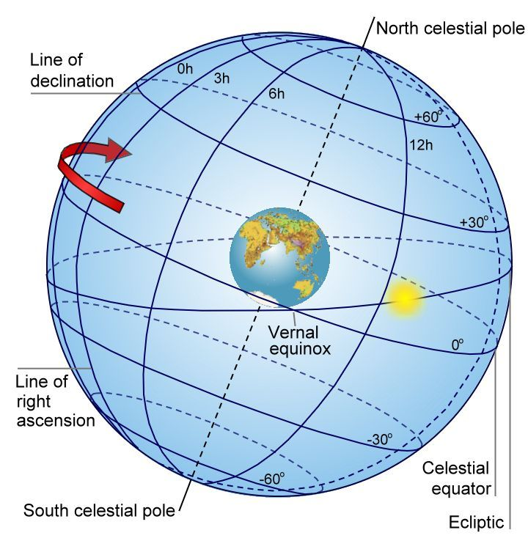
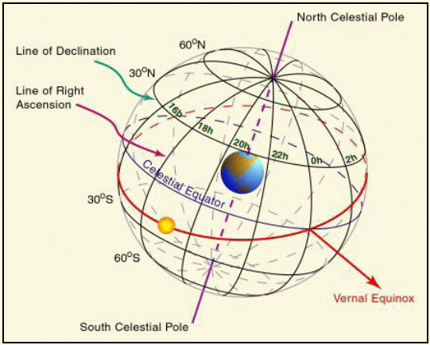

Slide 26
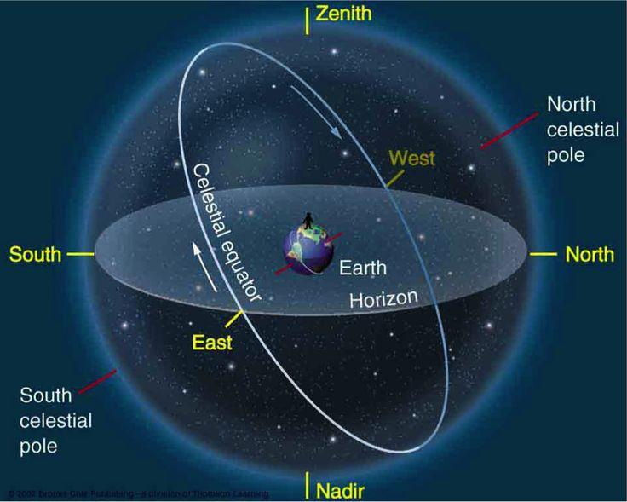

Slide 27
