Slide 1
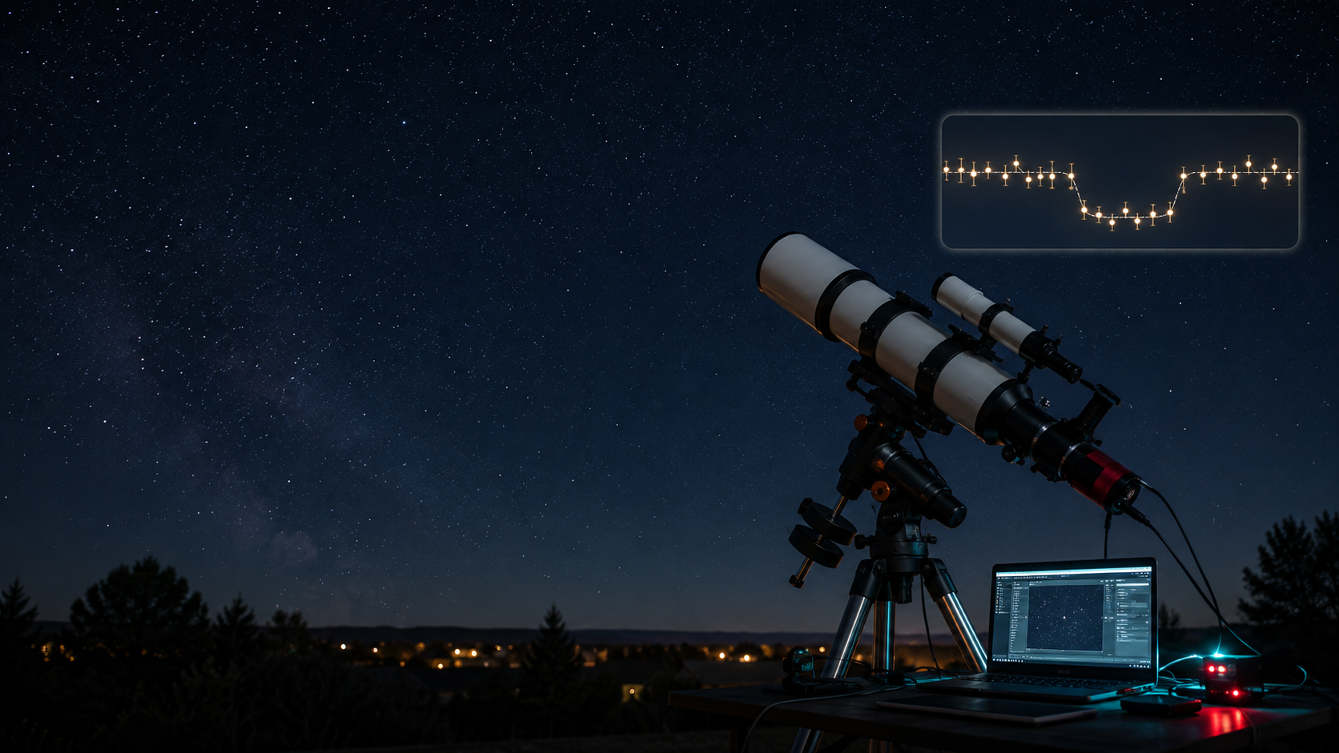
Catching a Shadow: Detecting a Known Exoplanet Transit with Backyard Photometry
Science fair project plan, September 2026 to March 2027
Shlok Jain
Keya Atre
Anushka Prasad
Team goal: measure a known planet crossing in front of its star
Notes:
Generated educational visual created with the built-in image generation tool. NASA Exoplanet Watch and NASA Exoplanet Archive informed the observing workflow.

Slide 2
Project agenda
How the team moves from astronomy basics to a fair-ready light curve
Learn the transit method and the equipment
Practice calibration and differential photometry
Observe one or more predicted transits
Analyze the light curve and compare it with predictions
Build the science fair board and presentation
Exoplanet transit photometry
undefined

Slide 3
Research question
A focused question keeps the project measurable
Can amateur telescope photometry detect the dimming caused by a known exoplanet transit?
Hypothesis: the target star will dim during the predicted transit window
Measured result: relative brightness of the target star over time
Success criterion: a light curve dip near the expected time and depth
Exoplanet transit photometry
undefined

Slide 4
Observation method
The team records a time series before, during and after one predicted transit
What students collect
Raw images every 30 to 90 seconds
Calibration frames: darks, flats and bias if used
A log of focus, exposure, weather and timing
Comparison stars in the same field of view
Exoplanet transit photometry
undefined
Notes:
NASA Exoplanet Watch recommends observing from about one hour before transit, through the full transit, and about one hour after transit.

Slide 5
Expected light curve
The main evidence is a small brightness dip at the predicted time
The dip may be less than 1% for some targets
Comparison stars remove clouds and transparency changes
A clean result includes error bars or scatter discussion
Exoplanet transit photometry
undefined
Notes:
Chart uses illustrative values to show the expected shape. Students should replace it with their measured data.

Slide 6
Project calendar
March success depends on easy practice targets before the first real transit
Month | Student learning | Project milestone
Sep | Transit method, light curves, telescope setup | Roles assigned and practice data template ready
Oct | Focus, guiding, calibration frames, comparison stars | Steady-star practice light curve
Nov | Target planning with transit prediction tools | First full transit attempt
Dec | Noise sources, timing checks, troubleshooting | Quality review and revised observing plan
Jan | Repeat observations and final dataset choice | One strong light curve selected
Feb | Graphs, uncertainty and judge questions | Board draft and oral practice
Mar | Final polish | Fair presentation ready
Exoplanet transit photometry
undefined
Notes:
Schedule assumes a March 2027 science fair and U.S. school-year pacing.

Slide 7
Analysis workflow
Raw images become a light curve through calibration and comparison
Calibrate images to reduce sensor and optical artifacts
Input | Output
Raw image series | Calibrated image series
Target star counts | Instrumental brightness
Comparison star counts | Relative brightness
Observation timestamps | Light curve
Measure the target star and several comparison stars
Calculate relative brightness for each image
Plot brightness against time
Compare observed timing, depth and duration with a prediction
Exoplanet transit photometry
undefined
Notes:
Possible software choices include NASA Exoplanet Watch EXOTIC and AstroImageJ. Keep software choice consistent once final analysis starts.

Slide 8
Risks and backup plan
The team should treat failed observing nights as part of the method
Risk | Mitigation
Clouds or poor seeing | Plan several transit nights and use archival data if needed
Saturated stars | Shorten exposure and test the sensor linear range
Field drift | Use guiding and keep the same comparison stars visible
Weak transit signal | Choose a bright star with a deep, well-timed transit
Timing errors | Sync the computer clock before observing
Backup data can support learning, but label it clearly
The observing notebook should include problems and fixes
Exoplanet transit photometry
undefined
Notes:
NASA Exoplanet Watch offers sample and archival datasets, plus EXOTIC for reduction.

Slide 9
Science fair deliverables
The final board should show what students measured and how they checked it
Research question, hypothesis and variables
Equipment diagram or setup photo
Observation log and target selection notes
Final light curve with labeled transit window
Comparison with predicted transit time and depth
Conclusion with uncertainty and next steps
Exoplanet transit photometry
undefined
Notes:
Use this slide as a checklist in February and early March.

Slide 10
Starter resources
Use these tools for planning, learning and backup data
Resource | Use
NASA Exoplanet Watch | Observer manual, EXOTIC software and community guidance
NASA Exoplanet Archive Transit Service | Transit predictions for a location and date
AAVSO CCD/CMOS photometry guide | Photometry practices and calibration concepts
AstroImageJ or EXOTIC | Light curve extraction and model fitting
Notes for mentors: pick targets by brightness, transit depth, altitude, Moon separation and full-event visibility.
Exoplanet transit photometry
undefined
Notes:
Sources: NASA Exoplanet Watch, NASA Exoplanet Archive Transit and Ephemeris Service, and AAVSO observing manuals.

Slide 11
