Slide 1
ABSTRACT
Businesses and research.
Data is tremendous in volume and highly unstructured in nature
In this study, analysis of big data has been carried out in order to find out the trends and patterns in consumption of the different services (Call, SMS, Internet Data) provided by the Telecom service providers.
Based on the Outcomes, suggest the best suited prescriptions to Telecom Industry.

Slide 2
INTRODUCTION
Businesses and researchers alike take great interests in furthering the use of Predictive Analytics in enhancing Business Intelligence and forecasting ability across a wide range of applications.
Requires new techniques and frameworks to analyzing large data sets to acquire useful information.
Big data can be analyzed using analytics method by exploiting the potential of Hadoop/Map-Reduce tool. The benefit of implementing this technique would be making business orientated decisions in a respective domain of data.

Slide 3
Problem statement
Analysis of Big data using machine learning techniques to detect current patterns and trends and predict future trends: A case study on Telecom service providers.

Slide 4
objectives
To Preprocess the highly unstructured data (Big data) using distributed framework.
To Optimize the time required for processing the data using different technique.
To Perform the time series analysis.
To suggest the prescription based on the outcomes obtained during analysis.
To recommend the best suited plans to Telecom Industry.

Slide 5
Data collection

Slide 6
In this study, the open big data that is published at the site: https://dandelion.eu/datamine/open-big-data/ under Open Data Commons Open Database License (ODbL) license has been used.
The dataset is the results of a computation over the Call Detail Records (CDRs) generated by the Telecoms Italian Republic cellular network over the city of Milan(Milano).
The data is collected over period of two months i.e NOV and DEC 2013.
Combinly the data comprises of 44 Lacks records which is for obvious not possible to analyse using any of the traditional data mining algorithms..

Slide 7
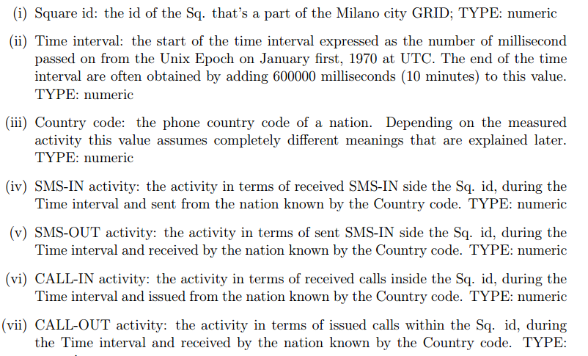
Data collection
The data contains 8 parameters like :

Slide 9
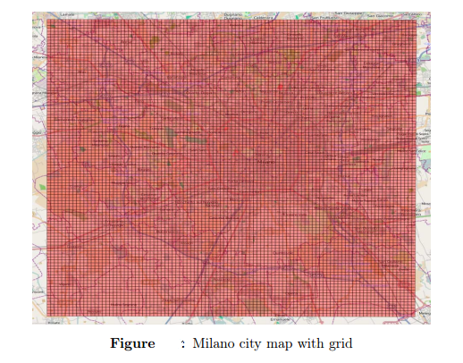
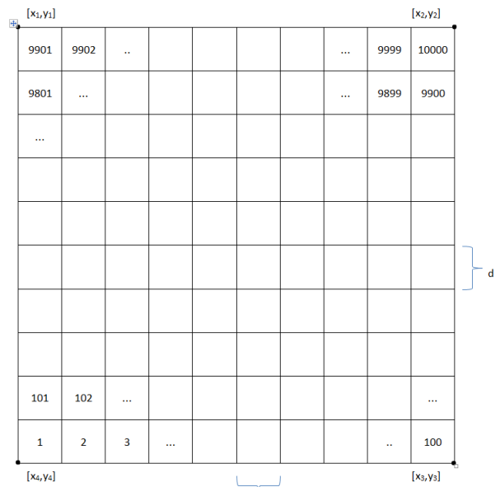
Data collection
The Milano city is divided into grid of 100 by 100 small squares, Where d=235 meter.

Slide 10
Sample Data
V1 | Time Interval | V3 | V4 | V5 | V6 | V7 | V8
1 | 1383260400000 | 0 | 0.081362 | 0.15657 | 0.09657 | 0.0524748485
1 | 1383260400000 | 39 | 0.141864 |  | 0.160937 | 0.0522748485 | 11.028366
1 | 1383261000000 | 0 | 0.136587 | 0.17023 |  | 0.0531748485 | 11.028366
1 | 1383261000000 | 33 | 0.18657 |  | 0.026137 | 0.0536748485
2 | 1383262800000 | 0 | 0.027300 | 0.18657 |  | 0.0541748485 | 11.028366
.
3 | 1383261600000 | 39 | 0.330641 | 0.170952 | 0.134176 | 0.0546009298 | 10.892770
3 | 1383262200000 | 0 | 0.026137 | 0.18917 |  | 0.0523748485 | 11.028366
3 | 1383262200000 | 39 | 0.681434 | 0.220815 | 0.027300 | 0.0534378891 | 8.62242
3 | 1383262800000 | 0 | 0.027300 | 0.19657 |  | 0.0524748485
.
.
.
10000 | 1383260400000 | 0 | 0.081362 | 0.20657 |  | 0.0528748485 | 11.028366
10000 | 1383260400000 | 39 | 0.141864 |  | 0.160937 | 0.0522748485 | 11.028366

Slide 11
Data Processing

Slide 12
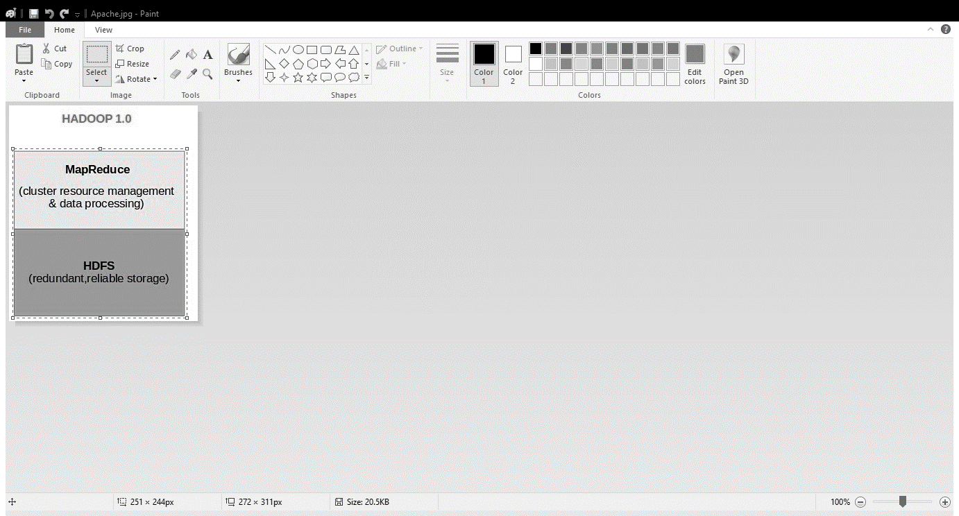
Apache Hadoop
Apache Hadoop is a software framework that supports data-intensive distributed applications.
Apache Hadoop is best known for
Computational framework (MapReduce)
Distributed file system (HDFS)
It is a scalable framework for processing data and storing on a cluster of commodity hardware system.

Slide 13
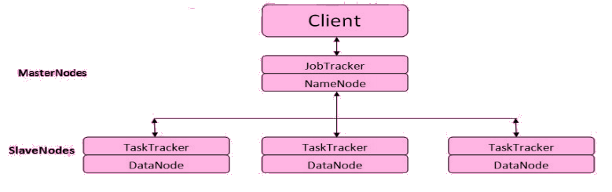
Apache Hadoop cluster architecture

Slide 14
MapReduce Architecture
The processing pillar in the Hadoop ecosystem.
The framework allows the specification of an operation to be applied to a huge data set, divide the problem and data, and run it in parallel.
The key functions
Map – The function takes key/value pairs as input and generates an intermediate set of key/value pairs
Reduce – The function which merges all the intermediate values associated with the same intermediate key

Slide 15
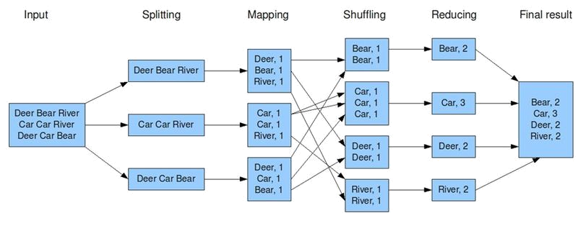
MapReduce Architecture

Slide 16
Apache pig
Apache Pig is an abstraction over MapReduce.
It is a tool/platform which is used to analyze larger sets of data representing them as data flows.
Pig Latin is used to write the scripts for analysing the data using Apache Pig.
Apache Pig has a component known as Pig Engine that accepts the Pig Latin scripts as input and converts those scripts into MapReduce jobs.
It has been observed that Apache Pig reduces the development time by almost 16 times.

Slide 17
Pre-Processing

Slide 18
Data in raw form is not suitable for the analysis, and especially not for the prescriptive data mining. The data must be pre-processed/prepared and transformed to get the best mineable form.
Data preparation is very crucial part as different data mining techniques behaves differently depending on the pre-processing and transformational methods.
The problem with our data is Missing Values: values that needs to be taken care before proceeding for further processing.

Slide 19
Missing value imputation
Data contains some missing or empty values that may create trouble while further processing the data.
The commonly used methods for value imputation are:
Single value Imputation
Complete Case Analysis
Available Case Analysis
Etc.
Here we are going to use “Single Value Imputation” method to deal with the missing data.

Slide 20
PRE Processed Data
V1 | Time Interval | V3 | V4 | V5 | V6 | V7 | V8
1 | 1383260400000 | 0 | 0.081362 | 0.15657 | 0.09657 | 0.0524748485 | 8.78458
1 | 1383260400000 | 39 | 0.141864 | 0.18053 | 0.160937 | 0.0522748485 | 10.45786
1 | 1383261000000 | 0 | 0.136587 | 0.17023 | 0.081344 | 0.0531748485 | 11.028366
1 | 1383261000000 | 33 | 0.18657 | 0.19898 | 0.026137 | 0.0536748485 | 9.45687
2 | 1383262800000 | 0 | 0.027300 | 0.18657 | 0.091344 | 0.0541748485 | 11.028366
.
3 | 1383261600000 | 39 | 0.330641 | 0.170952 | 0.134176 | 0.0546009298 | 10.892770
3 | 1383262200000 | 0 | 0.026137 | 0.18917 | 0.101344 | 0.0523748485 | 11.028366
3 | 1383262200000 | 39 | 0.681434 | 0.220815 | 0.027300 | 0.0534378891 | 8.62242
3 | 1383262800000 | 0 | 0.027300 | 0.19657 | 0.101344 | 0.0524748485 | 8.59841
.
.
.
10000 | 1383260400000 | 0 | 0.081362 | 0.20657 | 0.121344 | 0.0528748485 | 12.046548
10000 | 1383260400000 | 39 | 0.141864 | 0.20100 | 0.160937 | 0.0522748485 | 9.028366

Slide 21
Prescriptive analysis

Slide 22

Prescriptive analytics is the area of business analytics (BA) dedicated to finding the best course of action for a given situation.
Prescriptive analytics seeks to determine the best solution or outcome among various choices, given the known parameters.

Slide 23
The prescriptive analytics has been performed on the data for the following purposes:
Region-wise Analysis.
Monthly/Day-wise analysis.
Hourly analysis.

Slide 24
Region wise analysis

Slide 25
K-Means Algorithm
k-means is one of the simplest unsupervised learning algorithms that solve the well known clustering problem.
The procedure follows a simple and easy way to classify a given data set through a certain number of clusters (assume k clusters) fixed apriori.
In our work, the whole data is divided into 3 clusters with
High – 35 to 100
Medium – 10 to 35
Low – 0 to 10

Slide 26
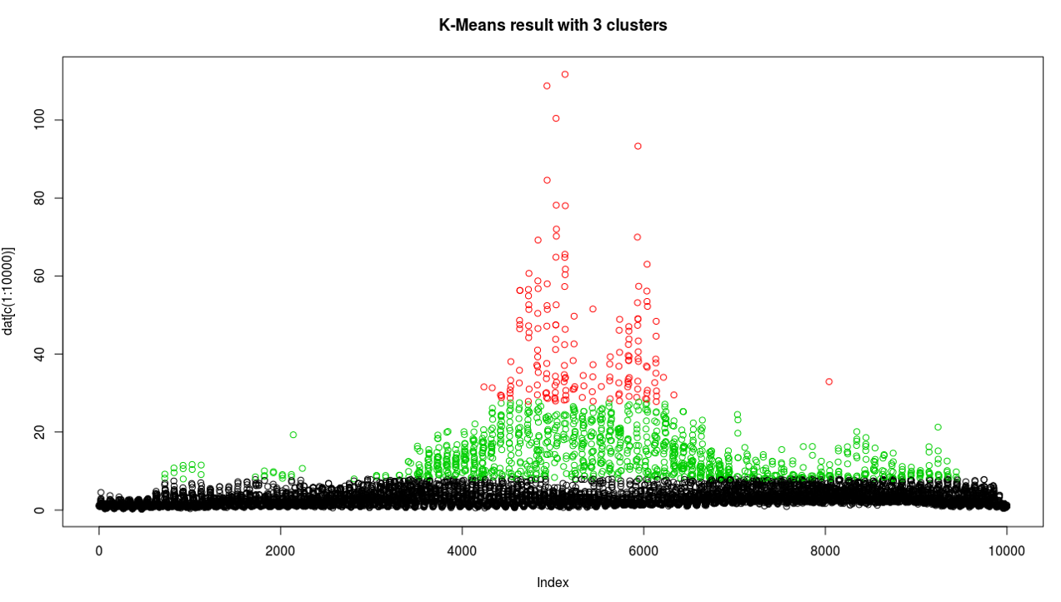
Analysis of Call_In data

Slide 27
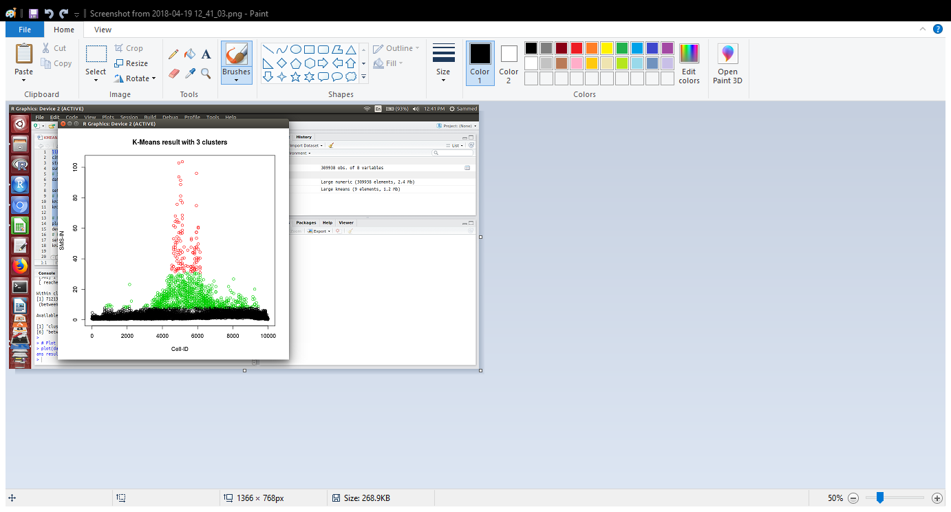
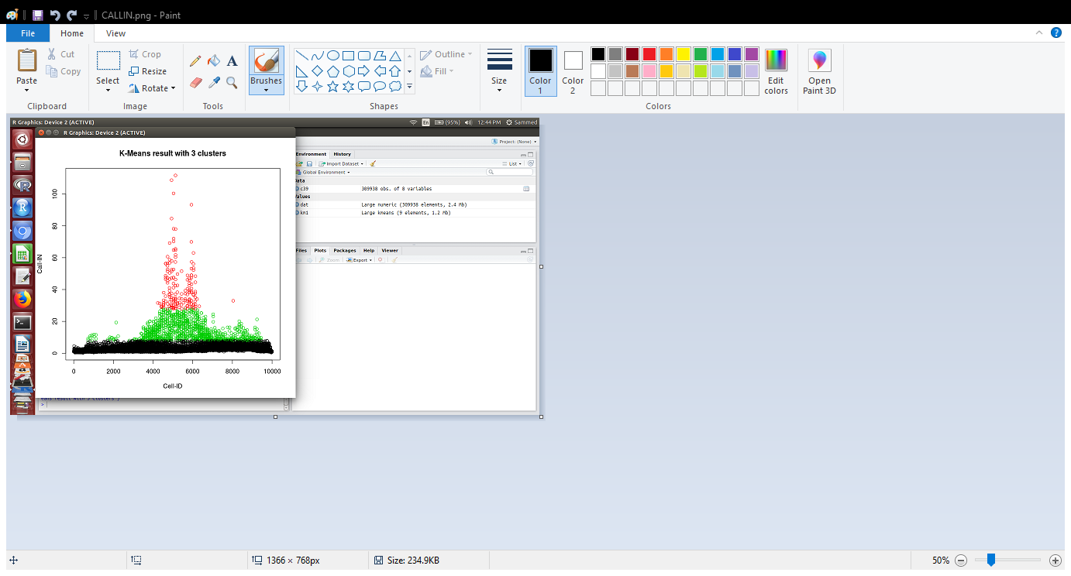
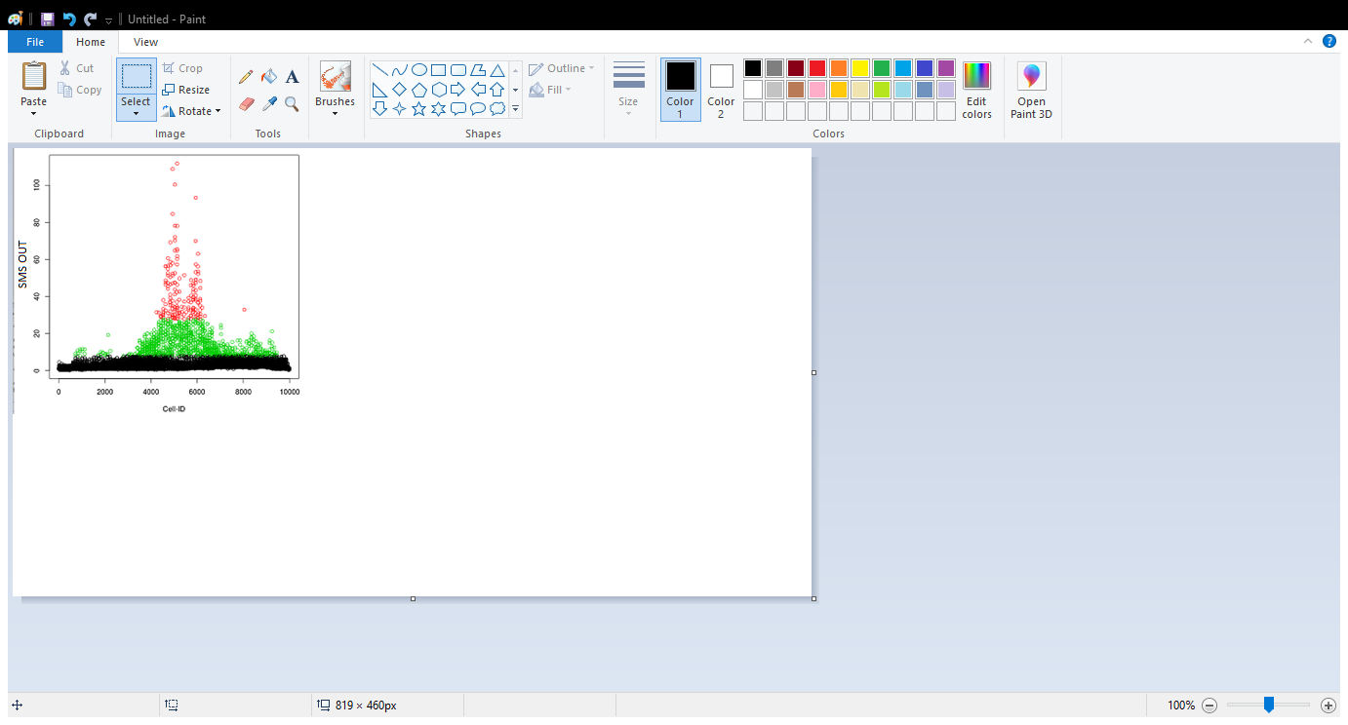
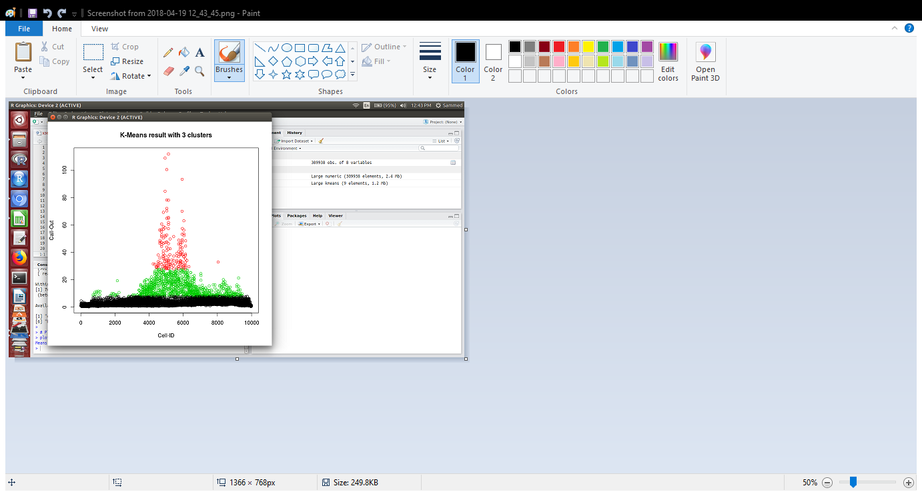
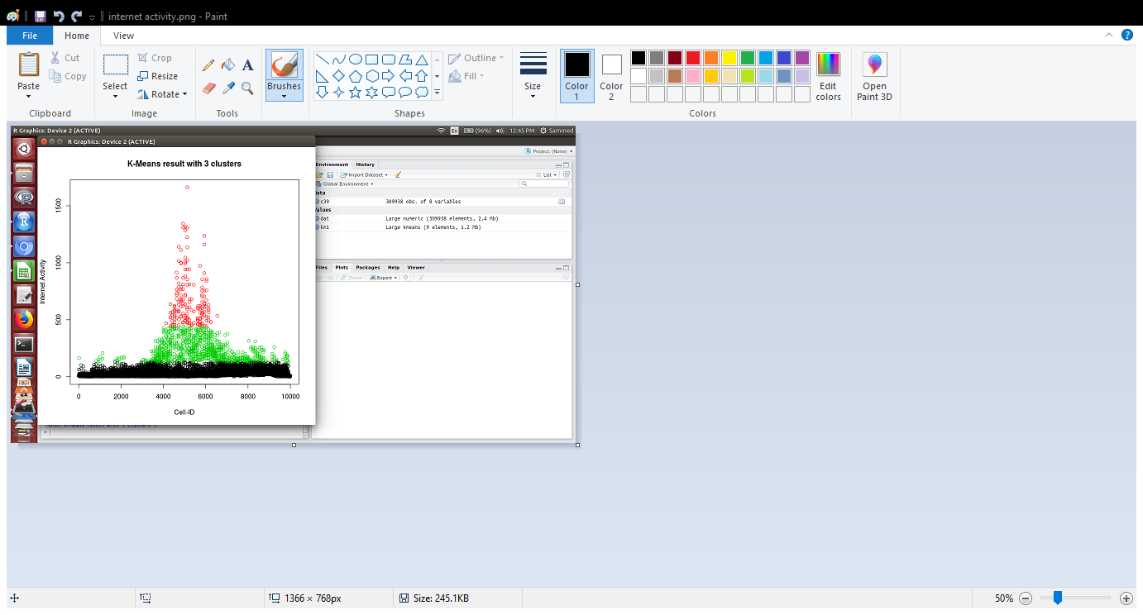

Slide 28
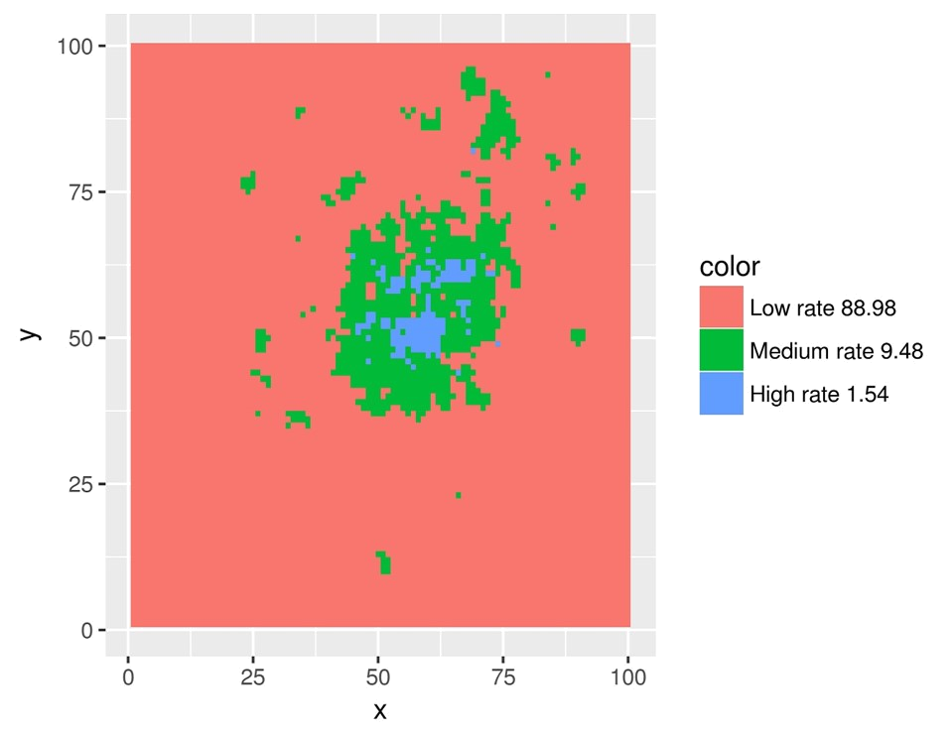
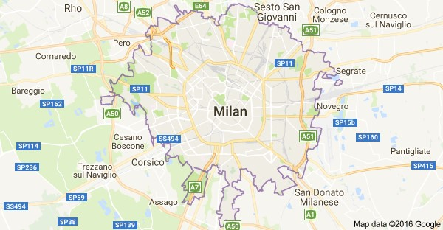
GRID PLOT

Slide 29
ouTCOMES
It has been observed that,
Middle of city has highest consumption of services.
Around the city has medium consumption of services
Outskirts have least consumption of services

Slide 30
Prescription
The Telecoms Operators, to neutralise the traffic at centre of the city, can
Increase the bandwidth of stations within that part of the city.
To transfer/use the unused bandwidth of the existing stations.
To install lesser bandwidth stations at outskirts.

Slide 31
Monthly/Day Wise Analysis

Slide 32
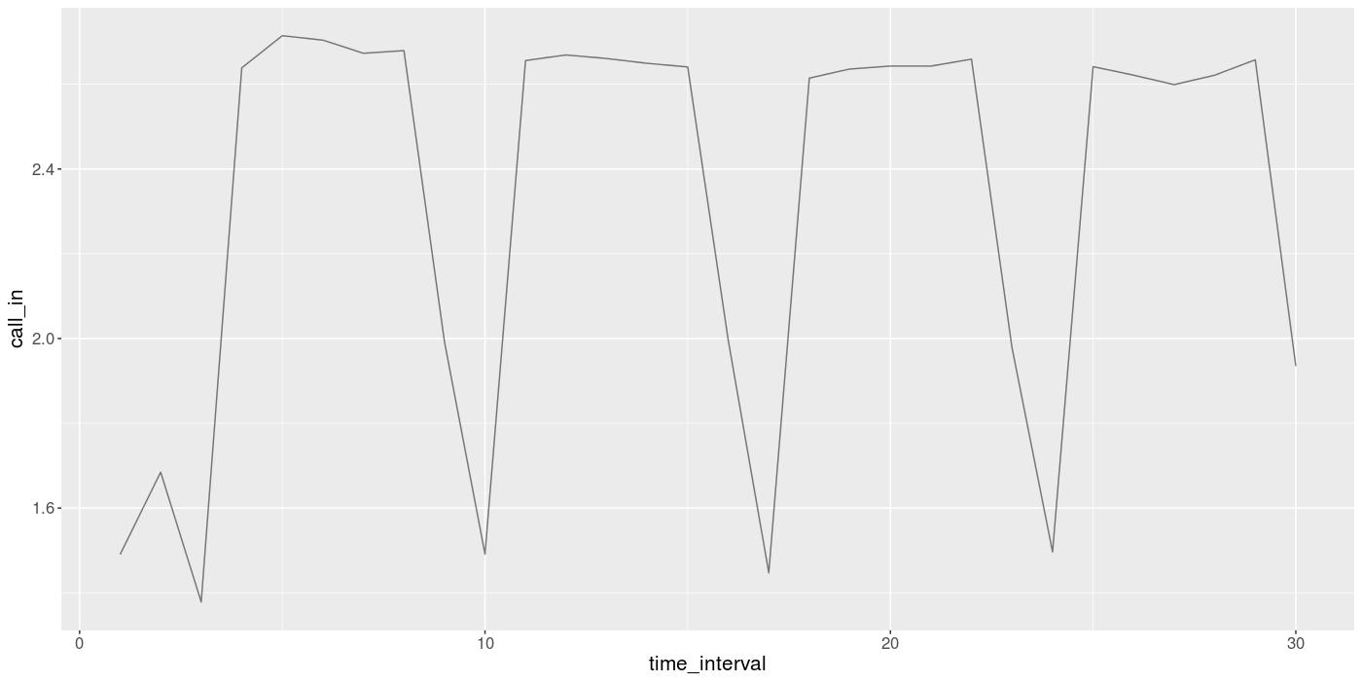
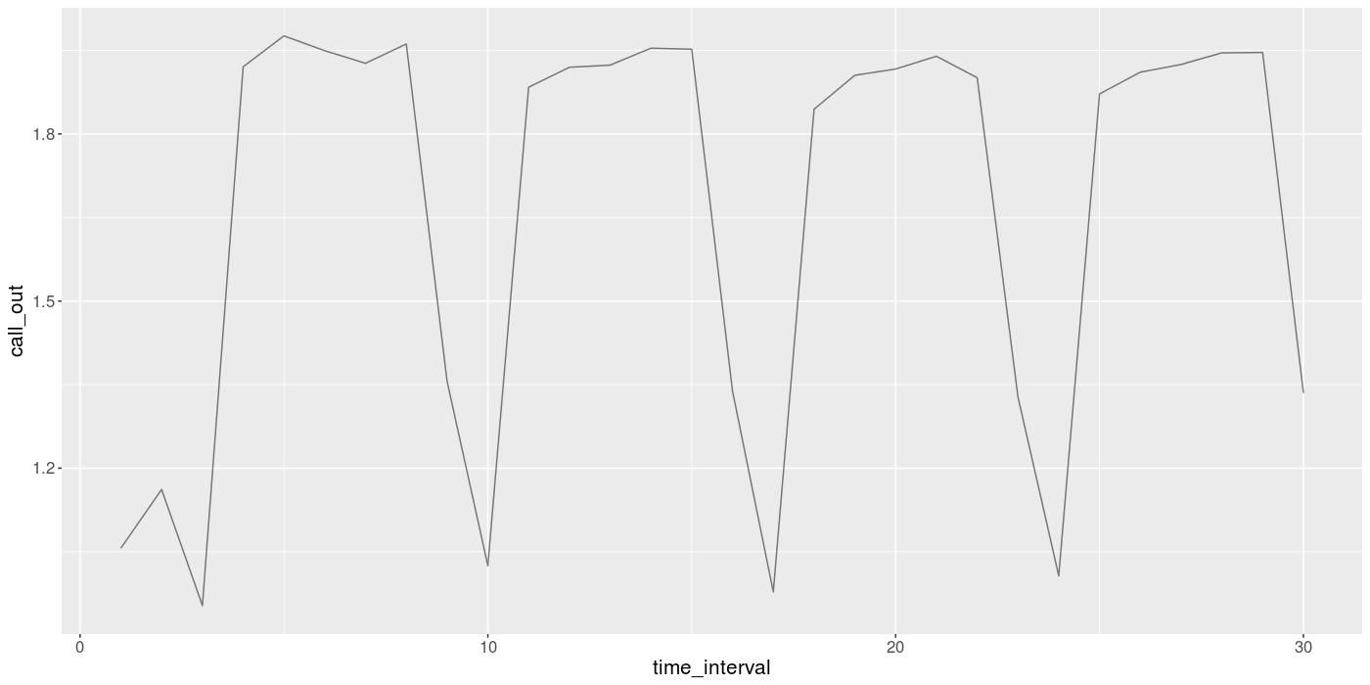
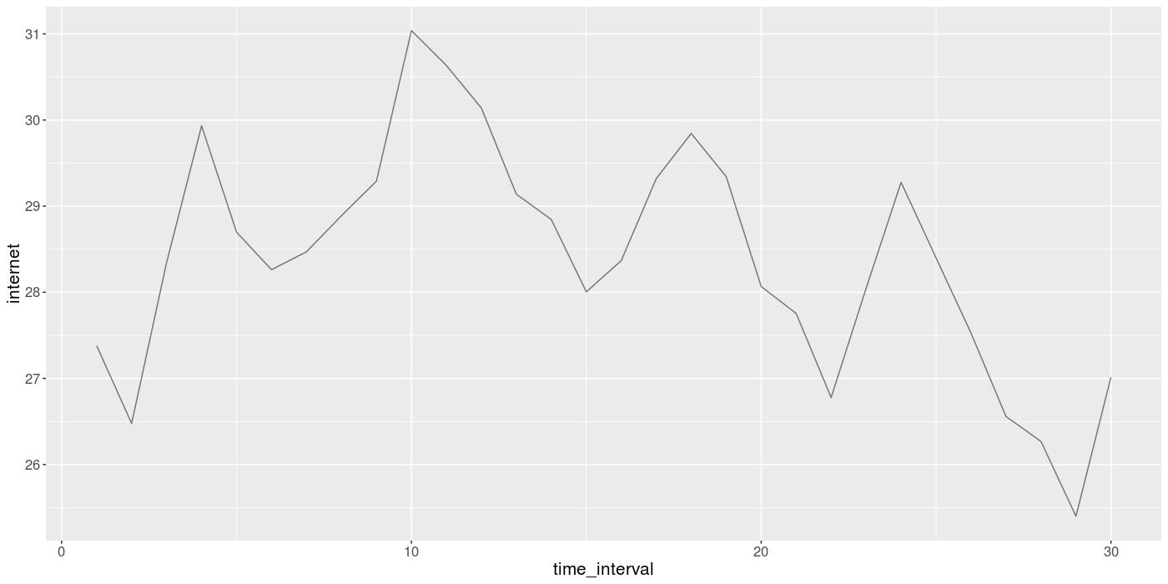
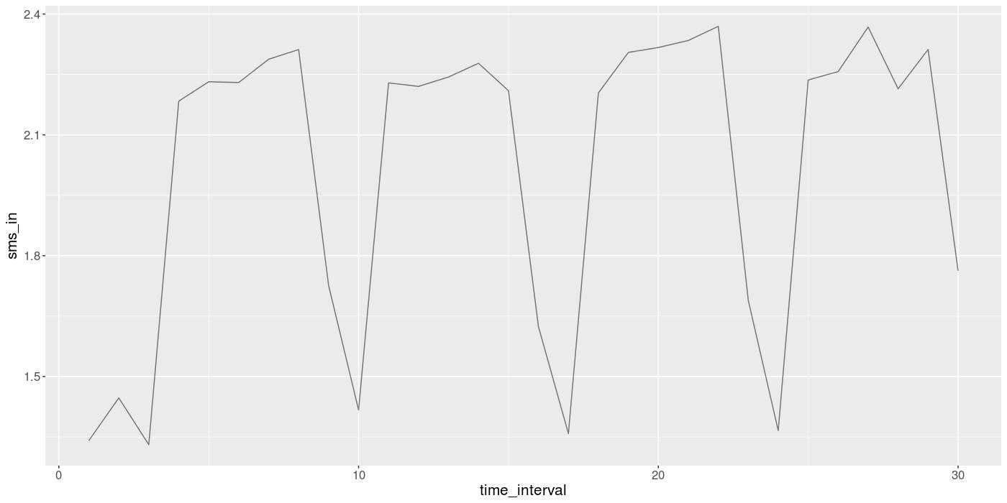
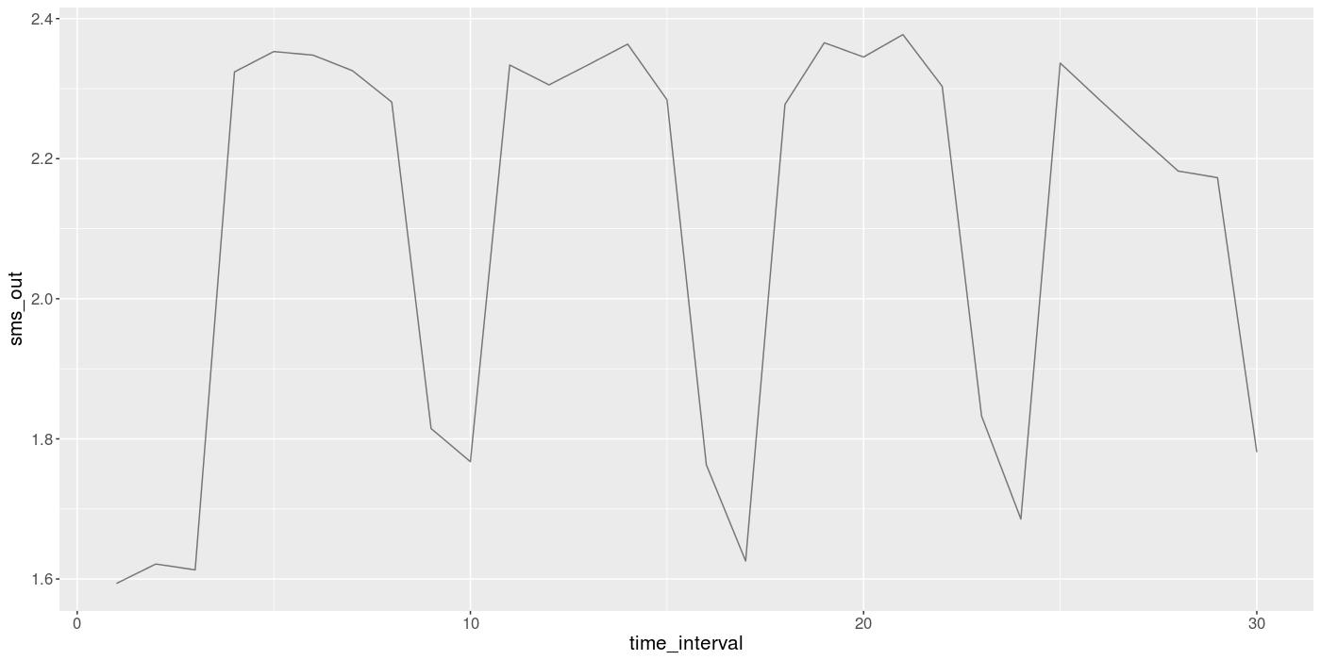
Analysis of November Data

Slide 33
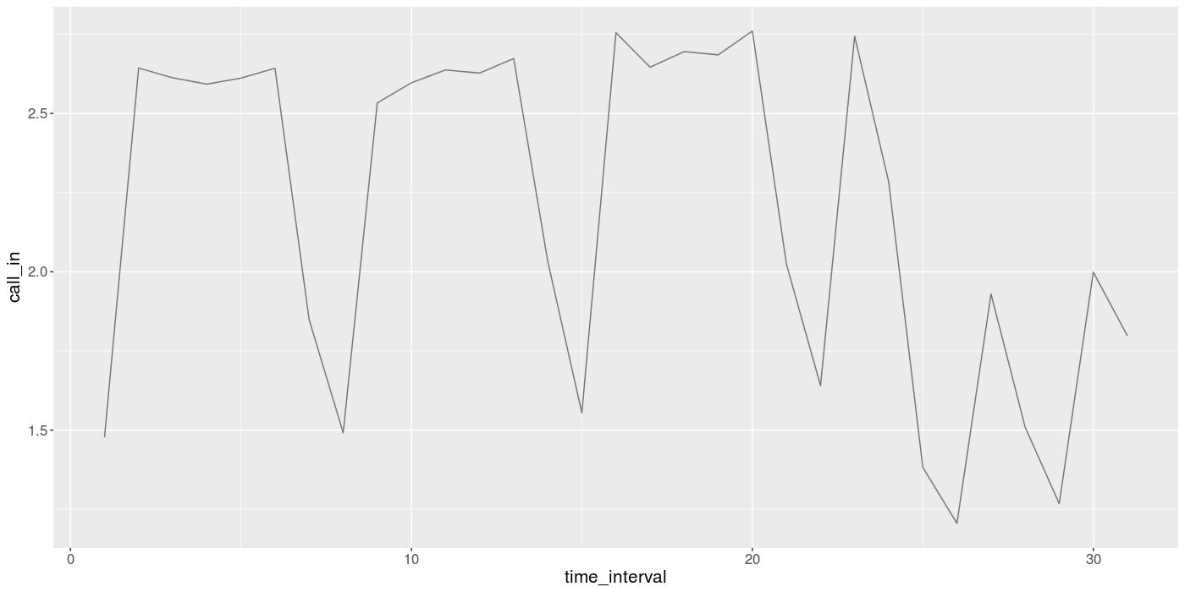
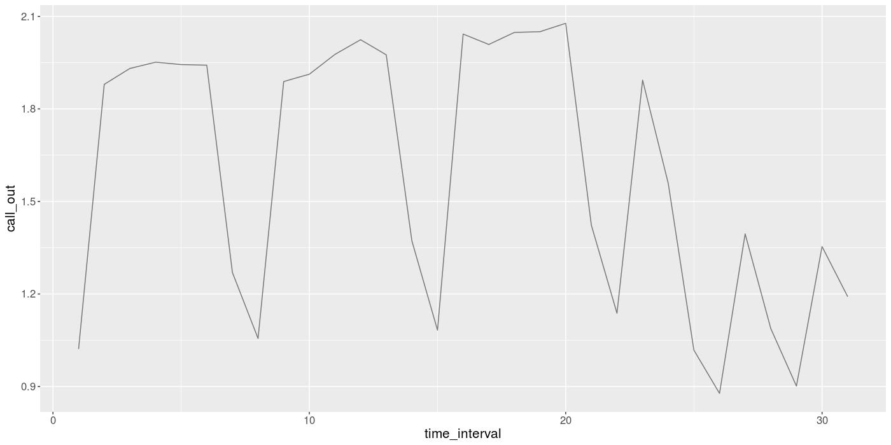
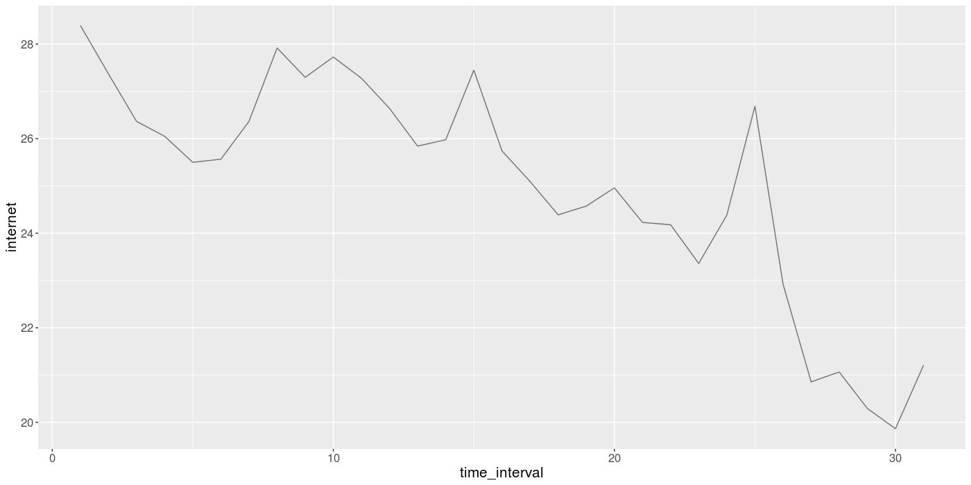
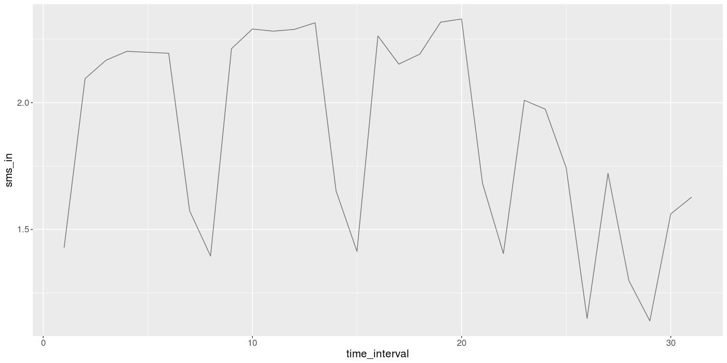
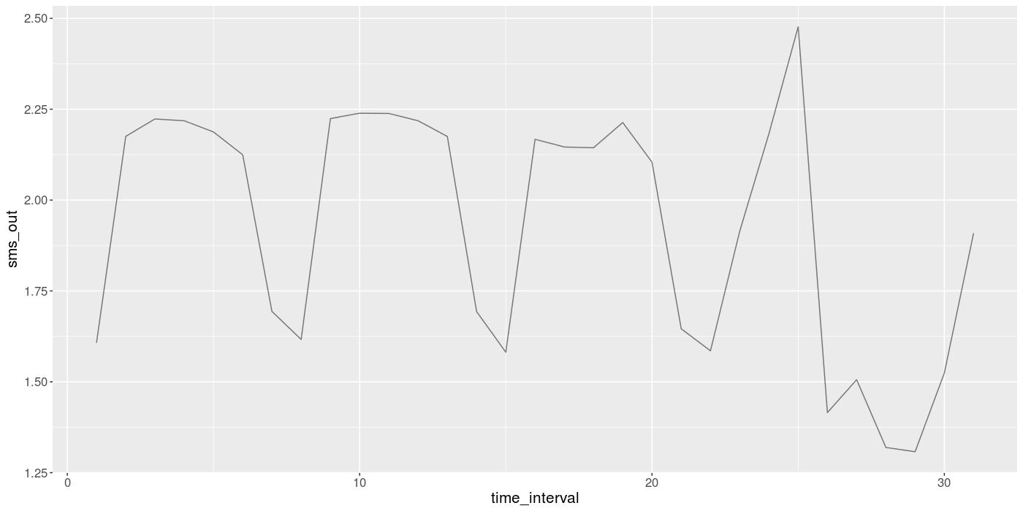
Analysis of December Data

Slide 34
ouTCOMES
It is been observed that,
On Sundays (3, 10, 17, 24 November ) & (8, 15, 22, 29 December) the consumption of services is very less.
24 December onwards till 28, the consumption of all services decreases except for SMS-Out and Internet.
Extreme peak for SMS-Out and slight increase of Internet Usage from 24 to 26 December.

Slide 35
Prescription
Telecom Operator can offer,
Maintenance work can be carried out on Sundays.
Weekend Offer (Saturday & Sunday) for Calls and SMS (call or SMS pack).
25 December - Special SMS pack or Increase cost per message or Blackout 25 December from usual SMS packs.
3 days (24, 25, 26 December) internet pack can be offered.

Slide 36
Hourly Analysis

Slide 37
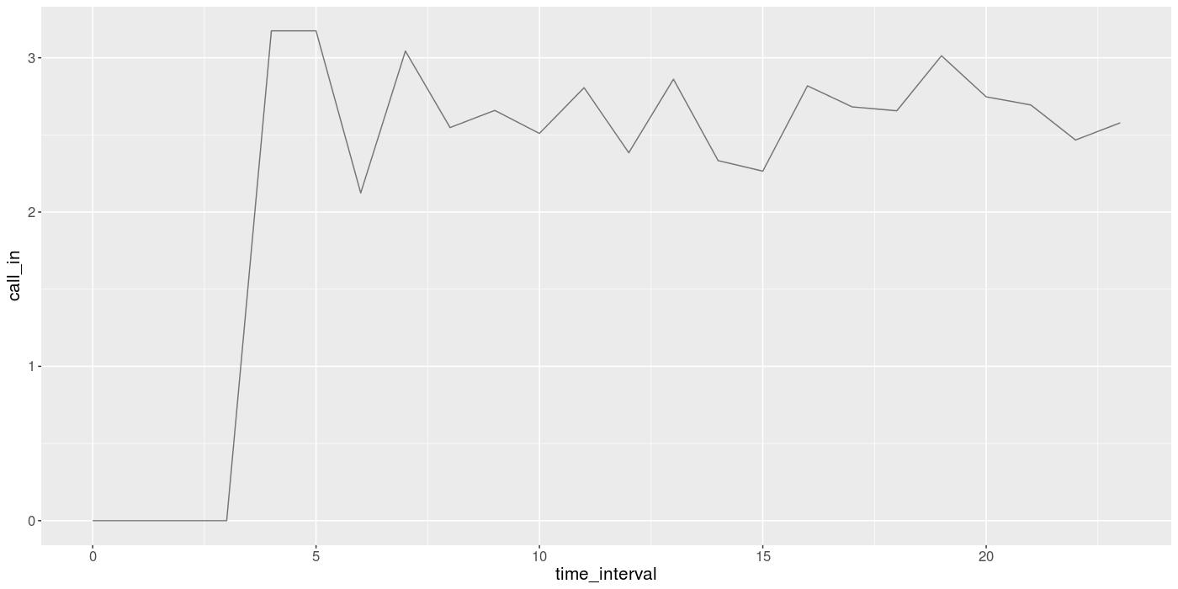
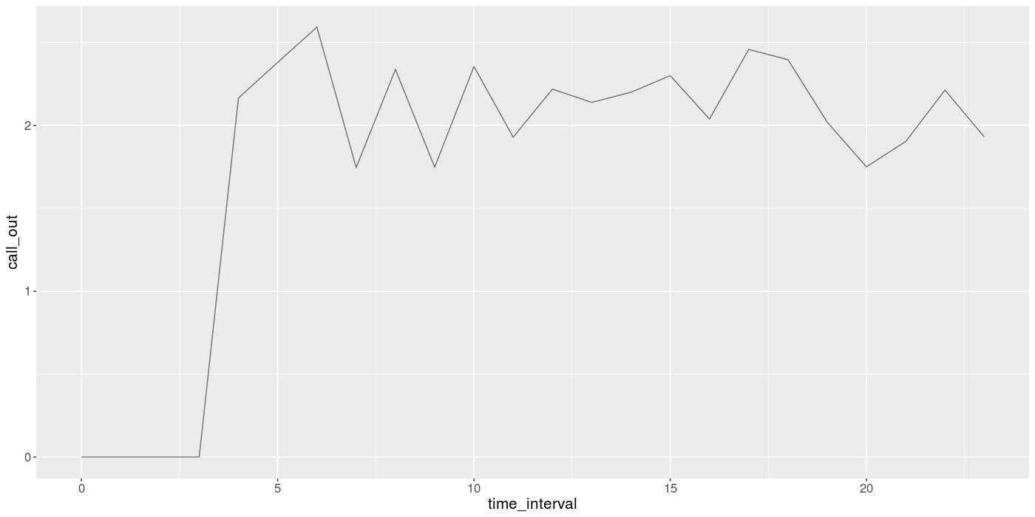
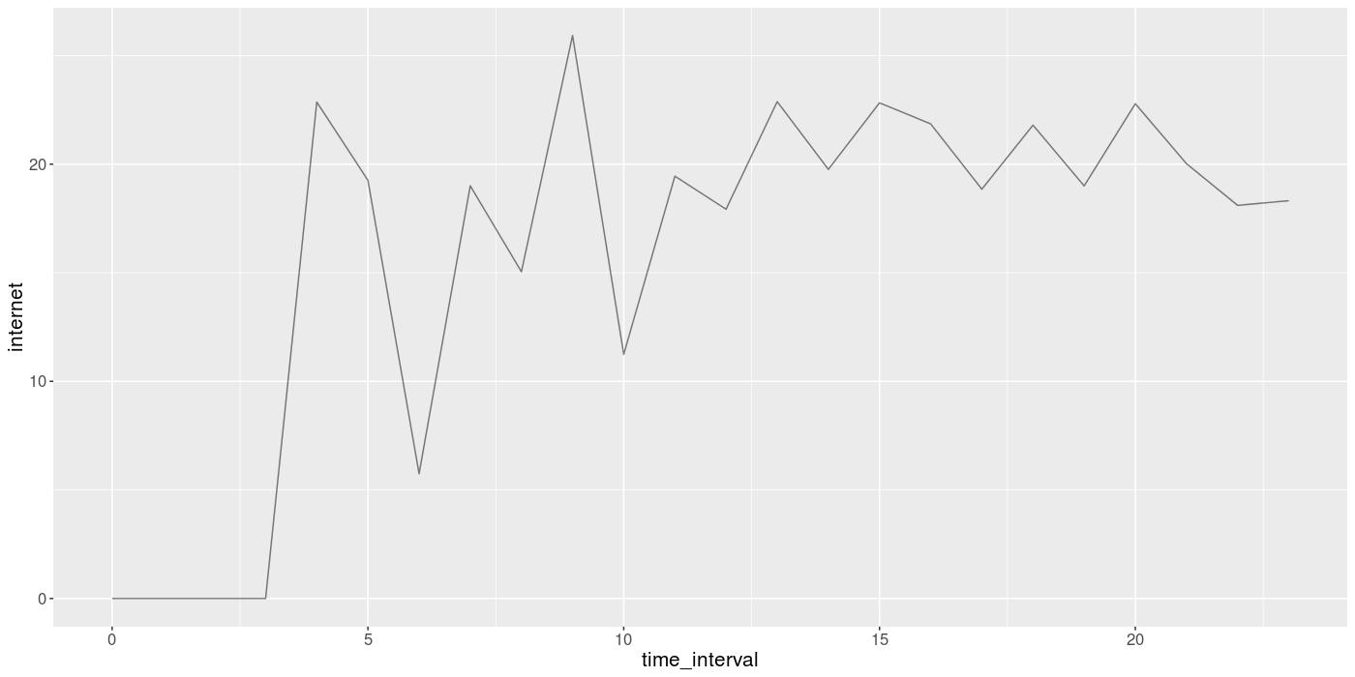
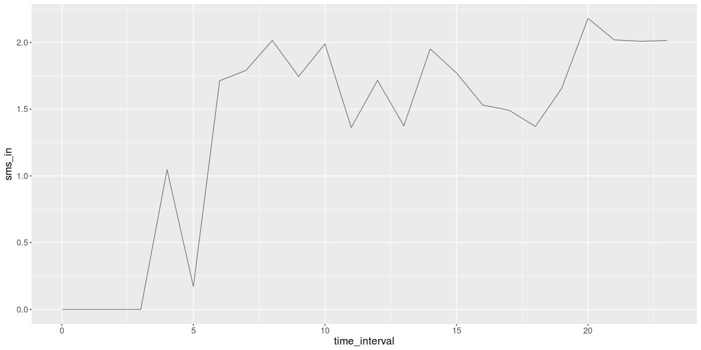
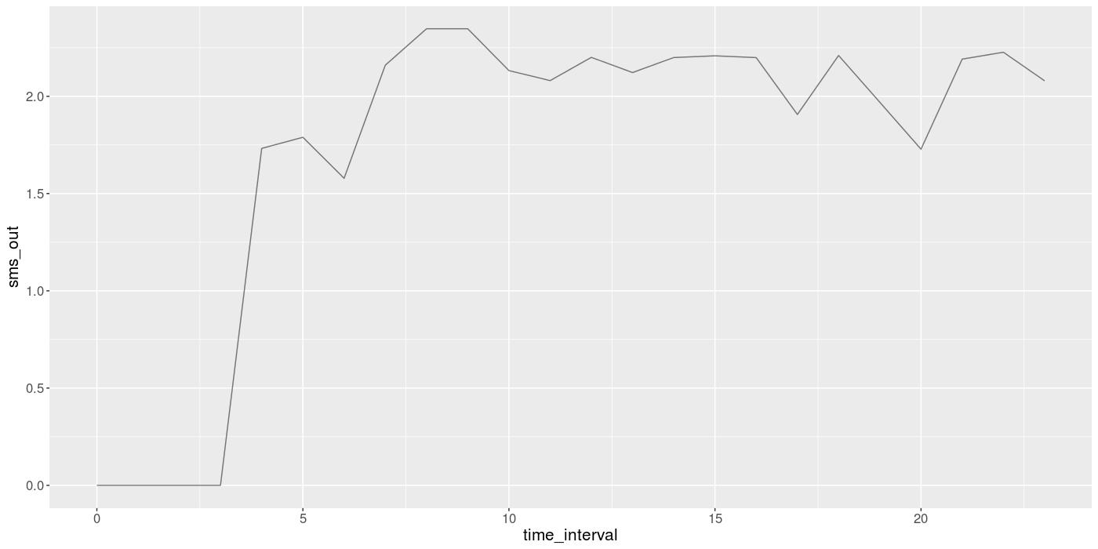
Hourly Analysis for November

Slide 38
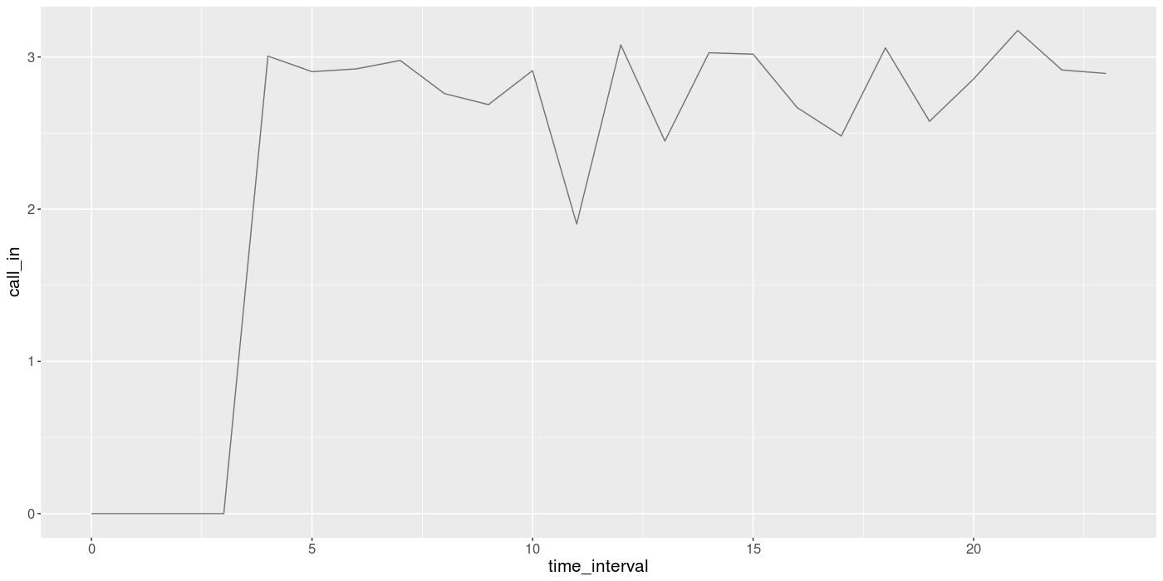
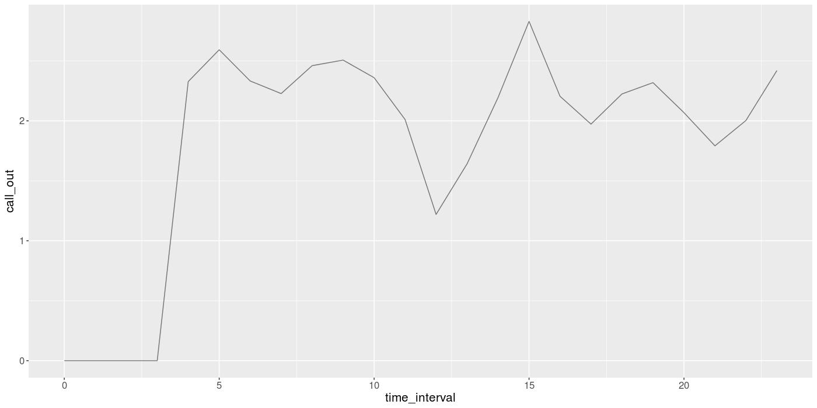
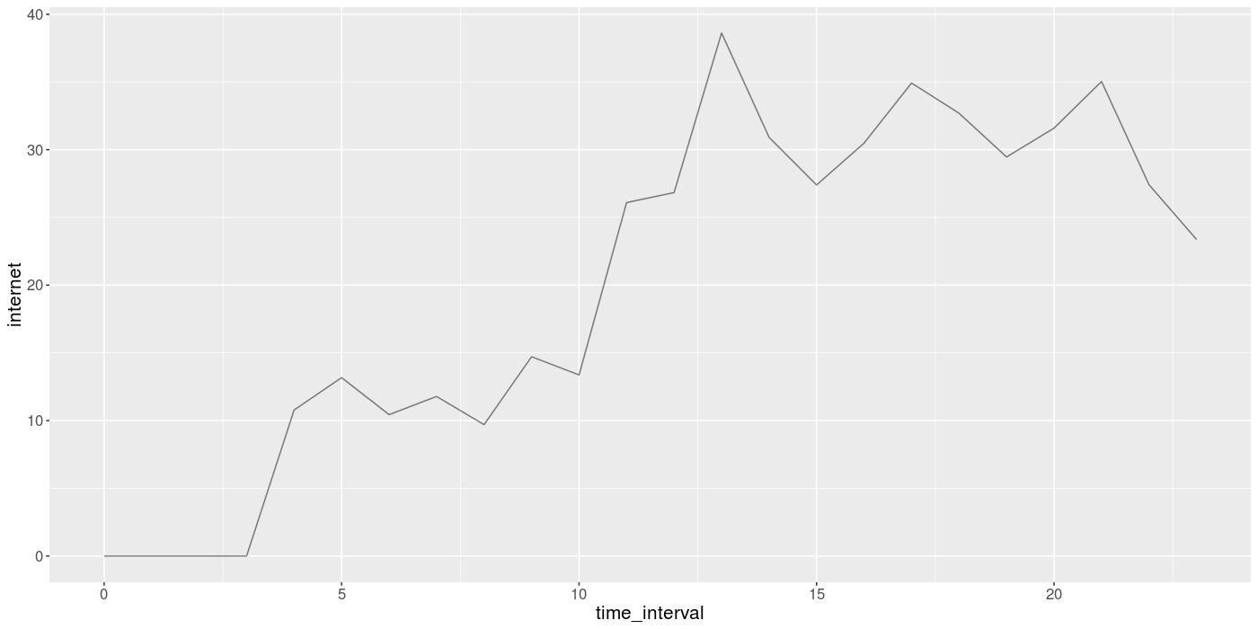
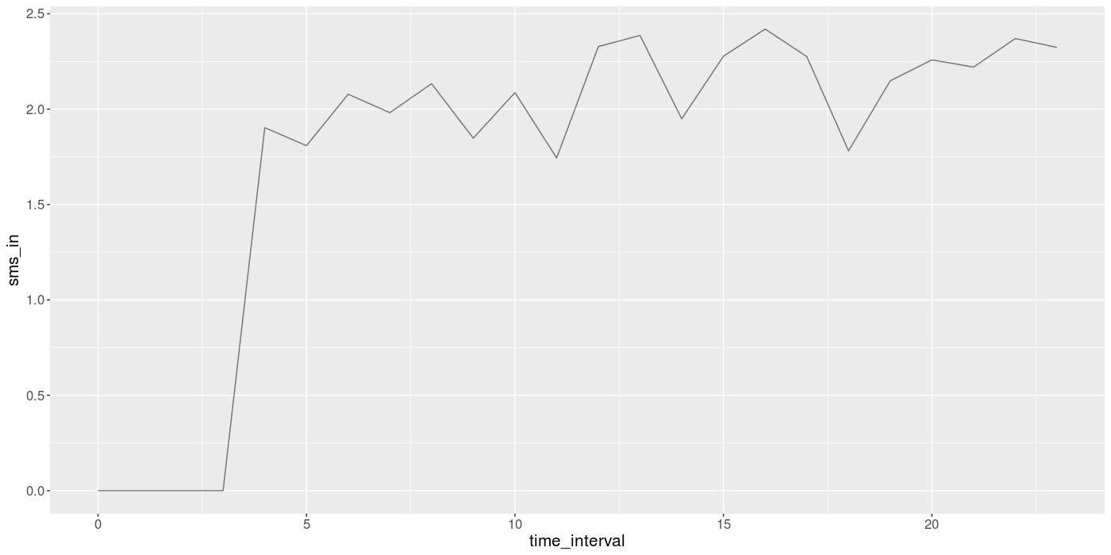
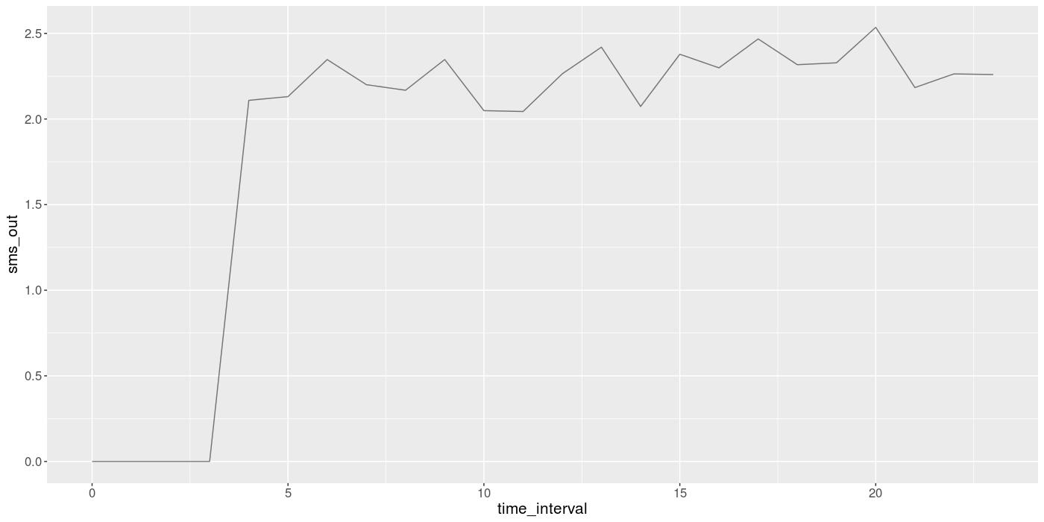
Hourly Analysis for December

Slide 39
ouTCOMES
It has been observed that,
Negligible usage between 0 to 4 .
Call_in:
High activity between 4 to 5.
Normal activity between 7 to 19.
Internet:
Negligible usage between 0 to 4 AM.
Good usage between 9 to 10.
Normal usage between 4 to 11.

Slide 40
Prescription
Telecom Operator can offer,
Maintenance work can be carried out between 0 to 4 AM.
Happy hours (Offers) during 0 to 4 AM.
Free Night calling (0 to 4 AM).
Unlimited Internet during night.
Increase rate/charges for Outcoming calls from other countries during 4 to 5 AM.

Slide 41
Thank you !

