Slide 1
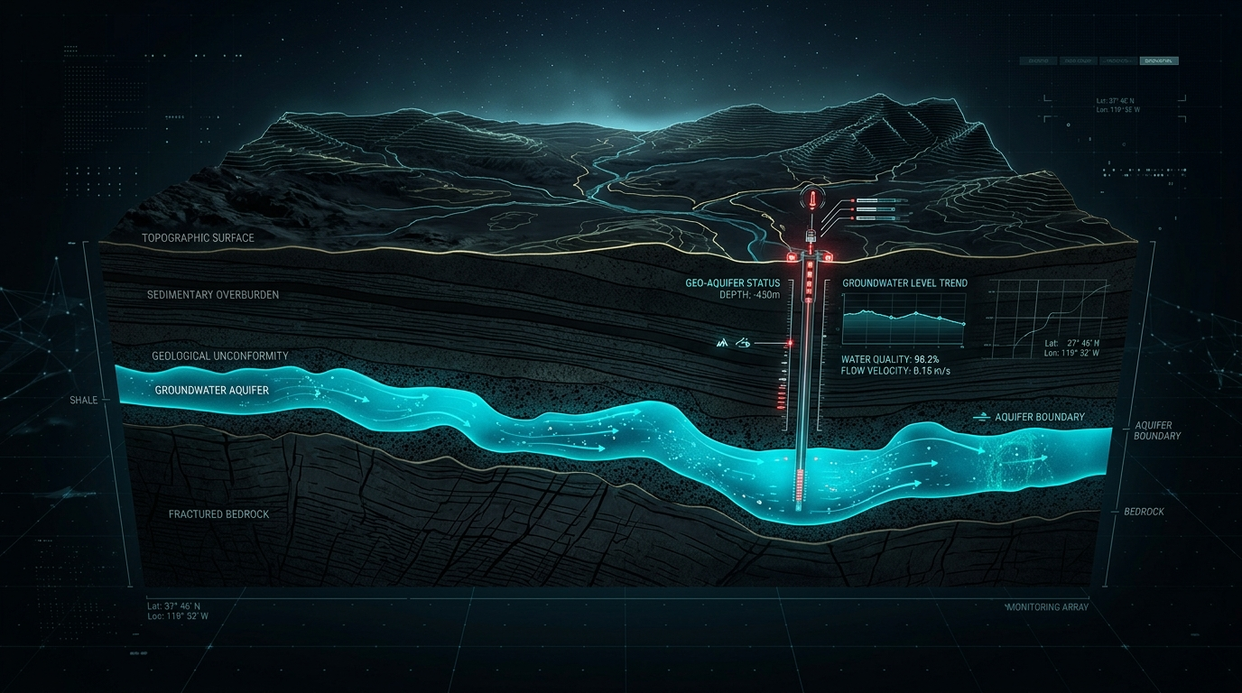
GROUNDWATER INTELLIGENCE PLATFORM
A Data-Driven System for Groundwater Monitoring, Spatial Mapping & Predictive Decision Support
Core Narrative Architecture: SENSE → INTEGRATE → MAP → ANALYZE → PREDICT → DECIDE
Powered by Hardware Telemetry, GIS, Remote Sensing & AI/ML

Slide 2
02 // GROUNDWATER INTELLIGENCE PLATFORM
GROUNDWATER IS INVISIBLE — ITS IMPACT ISN'T.
Critical global challenges facing groundwater monitoring and management
01 / AQUIFER DEPLETION
02 / WATER QUALITY RISK
03 / BLIND DECISION MAKING
Unseen Reserve Over-extraction
• Rapid decline in water table levels across agricultural & urban zones. • Severe lag in traditional manual well measurements. • Subsidence & irreversible storage capacity destruction.
Silent Contamination & Salinization
• Rising Electrical Conductivity (EC) & Turbidity levels. • pH spikes endangering drinking water & crop yield. • Lack of continuous continuous temporal contamination tracking.
Reactive Management Failure
• Policy interventions arrive after wells run dry. • Inability to model future stress under climate variability. • Absence of centralized spatial intelligence.

Slide 3
03 // GROUNDWATER INTELLIGENCE PLATFORM
THE DATA EXISTS. THE CONNECTION DOESN'T.
Groundwater data is trapped in isolated, incompatible silos
SILO 01
SILO 02
SILO 03
SILO 04
SILO 05
Physical Sensors
Local well depth & water metrics [ Isolated ]
Satellite / Remote
Soil moisture & GRACE gravity data [ Isolated ]
Rainfall Data
Meteorological precipitation logs [ Isolated ]
Soil & Terrain
Infiltration & geological GIS layers [ Isolated ]
Historical Logs
Legacy paper records & state reports [ Isolated ]
THE CONSEQUENCE
Without unification, decision-makers get partial views, delayed warnings, and fragmented policy actions.

Slide 4
04 // GROUNDWATER INTELLIGENCE PLATFORM
ONE PLATFORM. MULTIPLE DATA SOURCES. ONE GROUNDWATER VIEW.
Fusing physical telemetry with spatial environmental intelligence
UNIFIED PLATFORM ARCHITECTURE
THE CORE VALUE NARRATIVE
• Ground-Truth Telemetry:
Real-time observations from physical IoT nodes (Raspberry Pi 3B+ & ESP32).
• Remote Sensing Integration:
Broad spatial coverage extending context beyond physical sensor sites.
• GIS Layer Fusion:
Topography, slope, land cover, and soil characteristics mapped seamlessly.
• Centralized Data Engine:
Single source of truth feeding spatial analytics and predictive intelligence.
1. SENSE → Real-time physical sensor data collection
2. INTEGRATE → Pipeline unification of multi-source datasets
3. MAP → GIS spatial potential & risk visualization
4. ANALYZE → Time-series depletion & quality trend evaluation
5. PREDICT → AI/ML predictive forecasting
6. DECIDE → Government decision-support dashboard

Slide 5
05 // GROUNDWATER INTELLIGENCE PLATFORM
SYSTEM ARCHITECTURE
End-to-end data pipeline from physical sensing to decision support
01 / PHYSICAL LAYER
Raspberry Pi 3B+ | ESP32 | 6 Telemetry Sensors | Custom PCB | Physical Model
02 / GATEWAY & API LAYER
Data Acquisition Gateway | Hardware Data API | Validation & Cleaning
03 / DATA BASE & INTEGRATION
Central Database | GIS Spatial Layer Index | Remote Sensing Ingestion
04 / ANALYTICS & MAP ENGINE
Spatial Potential Mapping | Recharge Calculation | Quality Risk Indexing
05 / PREDICTIVE INTELLIGENCE
AI/ML Prediction Engine | Trend Analytics | Stress Forecasting
06 / DECISION PLATFORM
Web Frontend | GIS Dashboard | Government Decision Support & Reports

Slide 6
06 // GROUNDWATER INTELLIGENCE PLATFORM
FIELD DATA NODE
Physical prototype data-acquisition and edge gateway architecture
HARDWARE CORE COMPONENTS
EDGE GATEWAY ROLE IN SYSTEM
• Raspberry Pi 3B+:
Central edge gateway, local buffering & API communication
• ESP32 Microcontroller:
Low-latency ADC reading & sensor sampling controller
• Custom PCB & Wiring:
Noise reduction, regulated power delivery & connector bus
• Pump + Tubing:
Controlled fluid circulation for dynamic sensor testing
• Physical Groundwater Model:
Simulated aquifer column for continuous physical validation
Physical Gateway vs Platform Positioning:
✓ Data Ground-Truth
Provides real-world empirical validation for spatial models.
✓ Edge Data Acquisition
Continuous, autonomous sampling of water depth & quality parameters.
✓ Non-Exclusive Role
The hardware node is an essential data source, but the software intelligence platform is the primary project engine.

Slide 7
07 // GROUNDWATER INTELLIGENCE PLATFORM
SENSOR INSTRUMENTATION & TELEMETRY
Key physical parameters collected by the edge sensor payload
GROUNDWATER LEVEL
PH SENSOR
ELECTRICAL CONDUCTIVITY (EC)
Ultrasonic / Pressure depth sensor
Tracks real-time water table height & drawdown
Electrochemical electrode
Monitors acidity/alkalinity for water safety
Conductivity probe
Detects total dissolved solids & salinization
TURBIDITY SENSOR
TEMPERATURE SENSOR
SOIL-MOISTURE SENSOR
Optical scattering probe
Measures suspended solids & sedimentation
Digital thermal probe
Measures water/ambient thermal variations
Capacitive moisture probe
Evaluates surface infiltration readiness

Slide 8
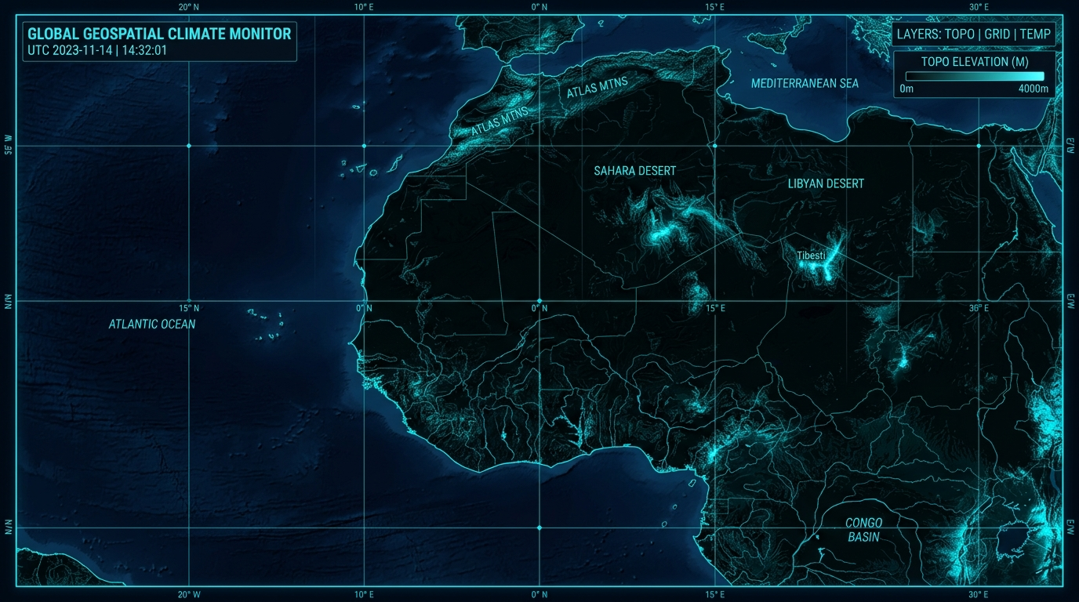
08 // GROUNDWATER INTELLIGENCE PLATFORM
GIS INTERACTIVE MAP
Spatial intelligence layer providing multi-resolution geographic visualization
SPATIAL MAPPING CAPABILITIES
• Multi-Layer Geospatial Overlay:
Integrate sensor nodes, administrative boundaries, terrain contours, and watershed basins.
• Interactive Coordinate Querying:
Clickable spatial nodes displaying live telemetry, depth history, and risk scores.
• Raster & Vector Processing:
Smooth rendering of satellite rasters alongside point sensor locations.
• Dynamic Heatmap Rendering:
Interpolate spatial data across unmonitored zones to estimate groundwater potential.

Slide 9
09 // GROUNDWATER INTELLIGENCE PLATFORM
REMOTE SENSING & ENVIRONMENTAL FUSION
Expanding coverage beyond point-sensor locations
01 / SATELLITE IMAGERY
02 / ENVIRONMENTAL DATASETS
03 / MACRO SPATIAL SCALE
Multi-spectral optical & radar observation for vegetation index (NDVI) & surface moisture.
Key Benefit:
Fills spatial gaps between physical monitoring wells without requiring thousands of physical sensors.
Integration of precipitation, temperature, evapotranspiration, and humidity logs.
Key Benefit:
Fills spatial gaps between physical monitoring wells without requiring thousands of physical sensors.
Connecting localized well sensors to regional aquifer-scale dynamics.
Key Benefit:
Fills spatial gaps between physical monitoring wells without requiring thousands of physical sensors.

Slide 10
10 // GROUNDWATER INTELLIGENCE PLATFORM
GROUNDWATER POTENTIAL MAPPING
Multi-criteria spatial assessment for groundwater availability
MULTI-LAYER OVERLAY MATRIX
Groundwater Potential Assessment Framework (Illustrative Model)
Inputs: Rainfall + Soil Type + Topography/Slope + Land Cover + Drainage Density + Sensor Ground Truth
• Topography & Slope:
Flatter terrain promotes water ponding and infiltration over rapid runoff.
• Soil Permeability:
Sandy & porous soils enable higher percolation rates than dense clay.
• Drainage Density:
Lower stream density indicates higher subsurface absorption capacity.
• Land Cover & NDVI:
Dense vegetation enhances root-zone soil porosity and reduces direct evaporation.

Slide 11
11 // GROUNDWATER INTELLIGENCE PLATFORM
RECHARGE-POTENTIAL MAPPING
Identifying optimal zones for artificial & natural groundwater recharge
INFILTRATION & RECHARGE FACTORS
DECISION SUPPORT APPLICATIONS
Spatial Recharge Factors:
• Precipitation Intensity & Duration
• Soil Hydraulic Conductivity
• Geological Lithology & Subsurface Permeability
• Surface Slope & Runoff Velocity
• Soil Moisture Saturation Levels
Actionable Interventions:
✓ Check Dam Site Selection:
Identify high-percolation zones for check dams.
✓ Recharge Shaft Placement:
Locate optimal sites for rainwater injection shafts.
✓ Rainwater Harvesting Strategy:
Guide municipal rainwater collection mandates.
✓ Conservation Zoning:
Designate protected high-recharge watershed basins.

Slide 12
12 // GROUNDWATER INTELLIGENCE PLATFORM
WATER-QUALITY RISK MAPPING
Transforming point sensor measurements into spatial risk maps
PH SPATIAL INDEX
EC RISK INDEX
TURBIDITY RISK INDEX
Acidity & Alkalinity
Maps agricultural runoff, chemical leaching & industrial contamination zones.
Electrical Conductivity
Tracks salinization, mineral concentration & coastal saltwater intrusion.
Suspended Sediment
Identifies wellhead structural damage, sediment ingress & filtration failure.
INTEGRATED WATER-QUALITY RISK SCORE
Spatial interpolation combines pH, EC, and Turbidity into a unified Risk Index (Safe / Moderate / Critical Zone) to alert authorities prior to public water supply contamination.

Slide 13
13 // GROUNDWATER INTELLIGENCE PLATFORM
HISTORICAL TREND ANALYSIS
Time-series visualization of water table depth and environmental factors
TEMPORAL PATTERN EVALUATION
Key Analytical Dimensions:
• Seasonal Water-Table Fluctuations:
Comparing monsoon recharge peaks against summer drawdown troughs.
• Multi-Year Depletion Trajectories:
Identifying long-term negative baseline drift across consecutive years.
• Rainfall-Recharge Lag Analysis:
Quantifying the precise response time between rainfall events and water table rise.
• Anomalous Event Detection:
Flagging sudden unseasonal drops caused by illegal over-pumping or sensor fault.

Slide 14
14 // GROUNDWATER INTELLIGENCE PLATFORM
GROUNDWATER DEPLETION & STRESS ZONES
Identifying critical zones approaching threshold depletion
STRESS CLASSIFICATION MATRIX
EARLY WARNING METRICS
■ Safe Zone:
Stable water table, positive annual recharge balance.
■ Semi-Critical Zone:
Minor drawdown trend, extraction equals natural recharge.
■ Critical Stress Zone:
Severe persistent drawdown, extraction exceeds recharge by >20%.
■ Over-Exploited Zone:
Irreversible storage decline, risk of well failure & land subsidence.
⚠ Rate of Drawdown (m/year):
Accelerating annual depletion rate.
⚠ Recharge Deficit Score:
Percentage of unreplenished extracted volume.
⚠ Water Quality Degradation Rate:
Simultaneous rise in EC/salinity alongside depth drop.
⚠ Proximity to Critical Infrastructure:
Threat level to municipal supply wells.

Slide 15
15 // GROUNDWATER INTELLIGENCE PLATFORM
AI / ML PREDICTION ENGINE
Predictive Intelligence Layer for groundwater forecasting (Algorithm Agnostic)
PREDICTIVE INTELLIGENCE ARCHITECTURE
Modular AI/ML engine designed to evaluate temporal patterns and environmental features. Model selection (e.g., ensemble, neural, or time-series regression) will be finalized based on dataset resolution and validation performance.
FEATURE PIPELINE INPUTS
PREDICTIVE OUTPUTS
→ Historical Water Level Time Series
→ Precipitation & Evapotranspiration Rates
→ Soil Moisture & Satellite NDVI Rasters
→ Geological Lithology & Infiltration Rates
→ Live Edge Sensor Telemetry Feeds
★ 30 / 60 / 90-Day Water Level Forecasts
★ Depletion Risk Probability Distribution
★ Recharge Deficit Predictions
★ Water Quality Risk Trend Horizon
★ Uncertainty Bounds & Confidence Intervals

Slide 16
16 // GROUNDWATER INTELLIGENCE PLATFORM
FUTURE GROUNDWATER-STRESS PREDICTION
Scenario-based forecasting for climate variability and extraction demand
BASELINE SCENARIO
MONSOON DEFICIT SCENARIO
HIGH EXTRACTION DEMAND
Normal Rainfall & Current Extraction
Projects baseline water table behavior under standard seasonal precipitation.
Below-Average Rainfall (-30%)
Forecasts severe drawdown speed during drought years to prepare buffer storage.
Agricultural/Urban Expansion (+25%)
Simulates aquifer stress under accelerated pumping schedules.

Slide 17
17 // GROUNDWATER INTELLIGENCE PLATFORM
DECISION-SUPPORT DASHBOARD
Turning complex spatial data and predictions into government policy action
01 / GROUNDWATER STATUS OVERVIEW
02 / RECHARGE PRIORITY MAP
Regional water table health, active well count, live telemetry feeds.
Geospatial highlighting of top-priority zones for check dams & artificial recharge.
03 / CONTAMINATION RISK ALERTS
04 / DEPLETION TREND FORECASTING
Automated warnings for regions exceeding safe pH, EC, or turbidity thresholds.
Interactive slider to visualize projected groundwater stress over 1–5 years.

Slide 18
18 // GROUNDWATER INTELLIGENCE PLATFORM
COMPLETE DIGITAL PLATFORM MODULES
Unified web application architecture for multi-stakeholder workflows
MODULE 01
Overview Dashboard
MODULE 02
Interactive GIS Map
MODULE 03
Live Sensor Telemetry
MODULE 04
Groundwater Potential
MODULE 05
Water Quality Index
MODULE 06
Recharge Mapping
MODULE 07
Historical Trends
MODULE 08
AI Stress Predictions
MODULE 09
Government Reports

Slide 19
19 // GROUNDWATER INTELLIGENCE PLATFORM
TECHNOLOGY & AI STACK
End-to-end technology stack powering hardware, analytics, and visual narrative
HARDWARE LAYER:
Raspberry Pi 3B+, ESP32, 6 Physical Sensors, Custom PCB
BACKEND & DATABASE:
Python Server, Relational/Spatial Database, REST Hardware API
GIS & REMOTE SENSING:
Geospatial Engine, Raster Processing, Vector Layer Indexing
AI / ML ENGINE:
Predictive Intelligence Layer, Feature Pipeline, Time-Series Modeling
NVIDIA AI STACK:
NVIDIA Nemotron-3-Ultra-550B-A55B (Reasoning) | FLUX.1-dev (Visuals)

Slide 20
20 // GROUNDWATER INTELLIGENCE PLATFORM
FUTURE SCOPE & ROADMAP
From physical prototype to regional groundwater intelligence
Phase 1: Prototype Node
Single physical IoT node & core web dashboard validation.
Phase 2: Field Sensor Net
Deploy multi-node sensor array across target watershed.
Phase 3: Multi-Location
Scale edge hardware gateways across diverse hydrogeological zones.
Phase 4: Remote Sensing Fusion
Automate high-resolution satellite raster ingestion.
Phase 5: AI Prediction
Train & validate predictive models on multi-year temporal dataset.
Phase 6: Regional Intelligence
Full government decision-support deployment for basin management.
CLOSING STATEMENT
"FROM DATA TO GROUNDWATER INTELLIGENCE."

