Slide 1
Security Log Threat Timeline Report Wireframe
Frontend & Visualization Plan - Oriah Molton-Bowman

Slide 2
Report Layout
Executive Summary
Key Findings
Threat Timeline
Indicators / Evidence
Recommendations
Raw Event Details
AI Summary Output Review

Slide 3
Executive Summary
The uploaded log indicates a likely multi-stage attack against WIN-SERVER-01 involving suspicious PowerShell activity, blocked outbound traffic, failed logins, and a critical ransomware alert.

Slide 4
Threat Timeline
Indicators / Evidence
Time (UTC) | Severity | Event Type | Host | User | Description | Evidence
2026-06-09 13:00:00 | 🔴 High | Process Start | WIN-SERVER-01 | alice | PowerShell launched with an unusual encoded command. | CommandLine contains encoded command
2026-06-09 13:05:00 | 🔴 High | Firewall Block | WIN-SERVER-01 | unknown | Outbound connection to a suspicious IP was blocked. | Destination IP 203.0.113.10 blocked
2026-06-09 13:11:00 | 🟠 Medium | Login Failure | WIN-SERVER-01 | bob | Multiple failed login attempts detected. | Three failed attempts from the same account
2026-06-09 13:20:00 | 🔴 Critical | Malware Alert | WIN-SERVER-01 | alice | Endpoint Detection and Response (EDR) reported possible ransomware behavior. | Process attempted rapid file encryption

Slide 5
Recommdation
Isolate WIN-SERVER-01
Investigate PowerShell execution
Review accounts
Perform malware forensics
Verify backups

Slide 6
Key Finds
Isolate WIN-SERVER-01
Investigate PowerShell execution
Review accounts
Perform malware forensics
Verify backups

Slide 7
Indicators / Evidence

Slide 8
Raw Event Details
13:00 | High | process_start | WIN-SERVER-01 | alice | Encoded command
13:05 | High | firewall_block | WIN-SERVER-01 | unknown | IP 203.0.113.10
13:11 | Medium | login_failure | WIN-SERVER-01 | bob | Three failed attempts
13:20 | Critical | malware_alert | WIN-SERVER-01 | alice | Rapid file encryption

Slide 9
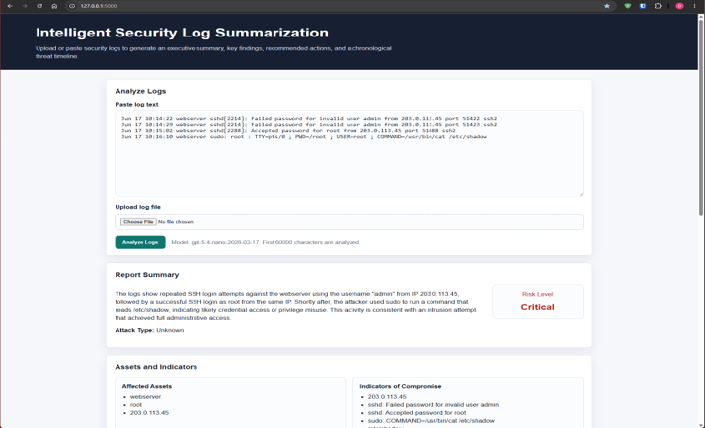
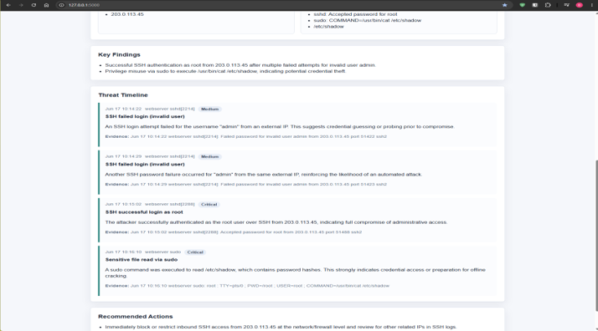
AI Summary Output Review

