Slide 1
Intelligent Security Log Summarization and Threat Timeline Generation
CSC 482 Capstone Project 2 | Project Team 2
GitHub: https://github.com/Dredman72/security-log-threat-timeline
Derrick Redman
Zion Moore
Oriah Molton-Bowman
Team Lead + AI/LLM Specialist
Backend & Log Processing Lead
Frontend & Visualization Lead

Slide 2
CSC 482 Capstone Project 2 - Team 2
Presentation Plan
15 minute presentation + 8 minute demo + 5 minute Q&A
15 Minute Presentation
8 Minute Demo
5 Minute Q&A
Problem and project goal
Architecture and workflow
Team contributions
Testing, lessons learned, future work
Open Flask app
Paste or upload security logs
Review generated report
Download JSON and HTML report
Explain design choices
Discuss limitations
Answer deployment and testing questions

Slide 3
CSC 482 Capstone Project 2 - Team 2
Problem and Motivation
Security analysts often review large volumes of Windows, firewall, authentication, Sysmon, and EDR logs.
Important events can be buried in repeated failures, noisy network activity, and raw technical details.
Manual review makes it difficult to quickly explain what happened, when it happened, and why it matters.
Our prototype helps convert raw log evidence into a readable security report and chronological threat timeline.
Target User
Blue team analyst
SOC student or beginner analyst
Incident response reviewer
Instructor reviewing log analysis output

Slide 4
CSC 482 Capstone Project 2 - Team 2
Project Goal and Scope
Primary Goal
Scope
Build a local Flask application that accepts uploaded or pasted security logs, uses OpenAI to summarize likely threats, and generates a chronological timeline with evidence.
No model training required
Prototype runs locally
Deployable on Windows Server 2025 and Ubuntu 24.04 LTS
Focus on structured output, timeline generation, and report clarity

Slide 5
CSC 482 Capstone Project 2 - Team 2
System Workflow
1. Input
2. Parse
3. Analyze
4. Render
Paste logs or upload .txt, .log, .csv, .json, or .xml files
Normalize events into fields such as timestamp, source, user, IP, event type, severity, and evidence
OpenAI returns structured JSON with summary, risk, attack type, timeline, and actions
Flask displays the report, parsed event preview, timeline, and download options
End-to-end result: raw evidence becomes a report-ready incident narrative.

Slide 6
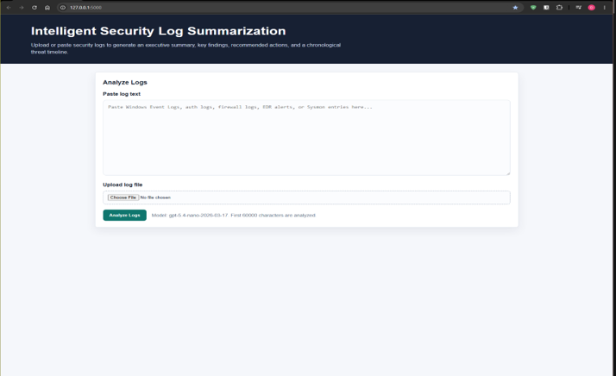
CSC 482 Capstone Project 2 - Team 2
Current Prototype Features
Flask web interface for log input and upload.
OpenAI-powered structured security summary.
Risk level, risk rationale, attack type, assets, indicators, findings, and recommended actions.
Threat timeline with timestamp, source, severity, details, and evidence.
Parsed event preview and downloadable JSON/HTML report output.

Slide 7
CSC 482 Capstone Project 2 - Team 2
Derrick: LLM Prompt and Structured Output
Structured JSON Report Fields
Quality Rules
executive_summary and generated_at
risk_level and risk_rationale
attack_type
affected_assets and indicators_of_compromise
key_findings
timeline with evidence
recommended_actions
Return only valid JSON
Do not invent unsupported events
Cite evidence from logs
Use concise language
Handle imperfect output with fallback behavior

Slide 8
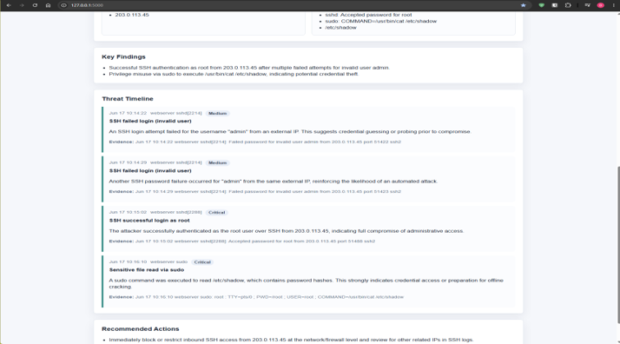
CSC 482 Capstone Project 2 - Team 2
Threat Timeline Generation
Timeline events must include timestamp, source, event, severity, details, and evidence.
Repeated similar events should be grouped when useful.
Event titles should stay short and readable.
High-impact events such as successful logins, privilege escalation, sensitive file access, and firewall blocks are prioritized.

Slide 9
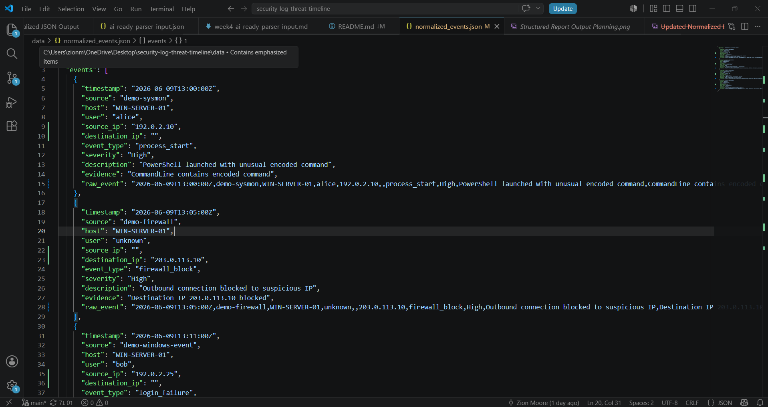
CSC 482 Capstone Project 2 - Team 2
Zion: Backend Parser and Data Handoff
Backend Responsibilities
Canonical event schema
Sample log parser testing
Normalized JSON output
Parser-to-LLM input format
Upload-to-report pipeline notes

Slide 10
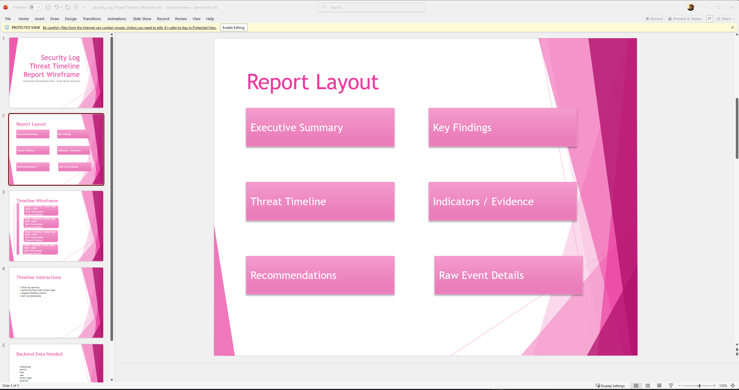
CSC 482 Capstone Project 2 - Team 2
Oriah: Frontend and Visualization
Frontend Responsibilities
Report wireframe
HTML report layout
Timeline visualization plan
Report data field documentation
Readable report sections for demo review

Slide 11
CSC 482 Capstone Project 2 - Team 2
Testing and Validation
Sample Scenarios
Validation Checks
Result
SSH brute-force/root access
Firewall block only
Suspicious PowerShell
EDR malware alert
Mixed authentication, firewall, and EDR activity
Required parser fields
Prompt output structure
Timeline evidence
Fallback behavior
Downloadable JSON and HTML output
Prototype runs locally
Reports are readable
Timeline supports incident review
Outputs support documentation and screenshots

Slide 12
CSC 482 Capstone Project 2 - Team 2
Milestones Achieved
Week 1
Lab setup, requirements, OpenAI API plan
Week 2
Initial prototypes, JSON output structure, parser schema, wireframe
Week 3
Parser validation checklist and early parser testing
Week 4
OpenAI integration, structured summaries, fallback handling
Week 5
Threat timeline rules, event grouping, evidence requirements
Week 6
End-to-end report generation, reset, JSON/HTML downloads
Week 7
Integration testing, prompt consistency, multi-scenario logs
Week 8
Final report, final presentation, final demo preparation

Slide 13
CSC 482 Capstone Project 2 - Team 2
Team Contributions
Derrick Redman
Zion Moore
Oriah Molton-Bowman
Team leadership
LLM prompt and JSON schema
Risk rationale and timeline rules
Report download/reset workflow
Testing documentation
Backend parser schema
Sample logs
Normalized event output
Parser-to-report workflow
Integration checks
Report wireframe
Timeline layout planning
HTML report generator
Frontend report fields
Visualization support

Slide 14
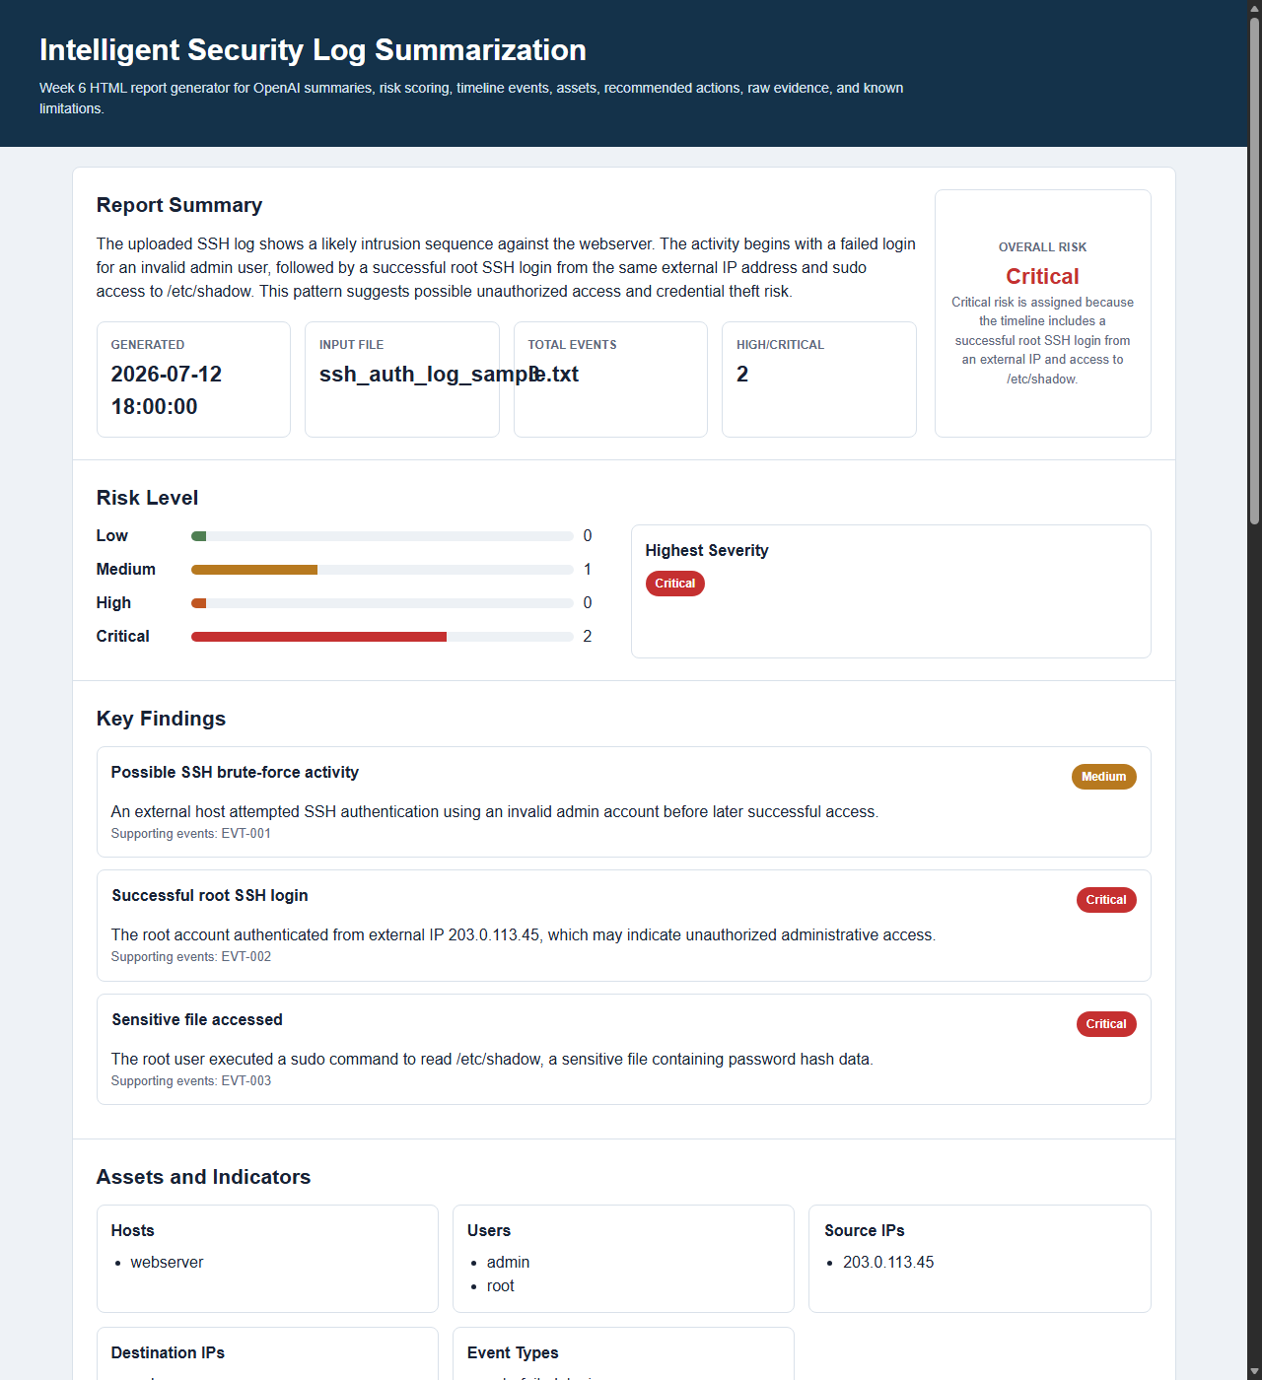
CSC 482 Capstone Project 2 - Team 2
Demo Plan
1. Open the local Flask application.
2. Paste or upload a sample security log file.
3. Click Analyze Logs.
4. Review the executive summary, risk level, attack type, and risk rationale.
5. Walk through assets, indicators, key findings, timeline, and evidence.
6. Show parsed event preview.
7. Download JSON and HTML report outputs.
8. Use Reset to prepare for another scan.

Slide 15
CSC 482 Capstone Project 2 - Team 2
Lessons Learned and Future Work
Lessons Learned
Future Work
Structured JSON makes the frontend and backend easier to connect.
Timeline evidence is critical for trust.
Parser fields must be consistent across sample log types.
Downloadable reports make testing and submission easier.
Add broader SIEM and cloud log support.
Improve source IP and destination IP extraction.
Add user authentication and deployment hardening.
Add threat intelligence enrichment and stronger validation.
Q&A

