Slide 1

IBM Capstone Project: Presenting Data Visualization via IBM Cognos Analytics
June 7, 2025
Presented by: Andreen B. Gonzaga

Slide 2



OUTLINE
Executive Summary
Introduction
Methodology
Results
Visualization – Charts
Dashboard
Discussion
Findings & Implications
Conclusion
Appendix

Slide 3

EXECUTIVE SUMMARY
This data visualization was easily made through the help of the functions and tools that can be found in IBM Cognos Analytics.
Top software / tools is analyzed.
Top Programming Language - current year: HTML/CSS; JavaScript; TypeScript, next years: C#;Dart
Top Databases Language – PostgreSQL(both)
Top Platform – current year: Amazon Web Services, next years:Microsoft Azure
Top Webframe – current year: Spring boot, next years:ASP.NET CORE
Most of the respondents came from mid 20s wherein they will be contributing a large set of knowledge when it comes to development of AI tools, data science in the next future
Conclusion relevant to the findings

Slide 4

INTRODUCTION
The purpose of this presentation is to show the top programming languages, databases, platform, and webframe in the current year up to the next year.
Target Audience:
Data Scientist- to easily find the relevant data they needed in determining the top language, databases, platform, webframe.
Manager – to easily visualize the data for whatever purpose it may serve.
Clients – to easily understand the relevance of the message of this visualizations.
This presentation will help you to analyze the relevant software that is relevant in the next few years.

Slide 5

METHODOLOGY
The dataset to be used is provided by IBM via Coursera
The data manipulation and data visualization method will be done using IBM Cognos Analytics
Key Wrangling Steps:
Data Wrangling and Data preprocessing via Python
Data report via IBM Cognos Analytics

Slide 6
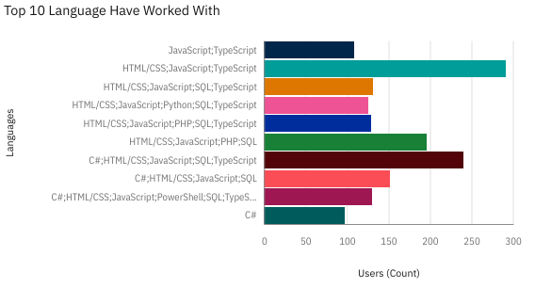
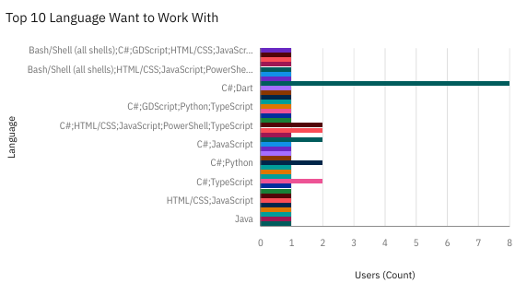
PROGRAMMING LANGUAGE TRENDS
Current Year
Next Year
<Bar chart of top 10 programming languages for the current year goes here.>

Slide 7
PROGRAMMING LANGUAGE TRENDS - FINDINGS & IMPLICATIONS
Findings
HTML/CSS; JavaScript; TypeScript gets the top spot in the top language that the respondent have worked with.
C#; Dart gets the top spot in the top language that the respondents want to work with in the next years.
Typescript often appeared in top spots in the language have worked with
Implications
Most of the users have worked with the top language
Most of the respondents want to work with C#; Dart in the next few years because they might think that it is more advanced or most useful.
Typescript is the most preferred language that most of the companies are currently using

Slide 8
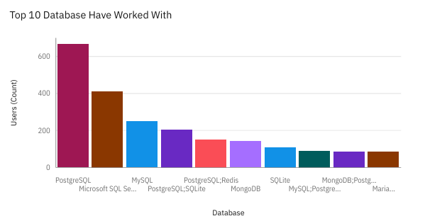
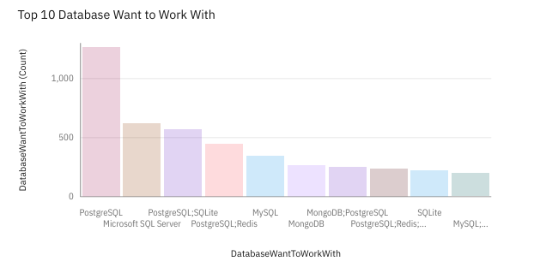
DATABASE TRENDS
Current Year
Next Year

Slide 9
DATABASE TRENDS - FINDINGS & IMPLICATIONS
Findings
PostgreSQL gets both the top spots in the language they have worked with and they want to work with.
SQL and alike gets most of the top spots.
PostgreSQL skyrocketed more than twice its current number from the current year to next few years.
Implications
PostgreSQL still the most trusted, most functionable databases to work with from the current year and to the next few years.
Most of the top databases retains its current ranking.
There is huge increase in the numbers of users who wants to work with SQL and alike databases.

Slide 10

DASHBOARD
https://github.com/DreenGonzaga/README.md/blob/fa3a1fce63ec7e01f0ef66c7ed6e4fd63bbeb535/Task%20A%20Dashboard.pdf

Slide 11
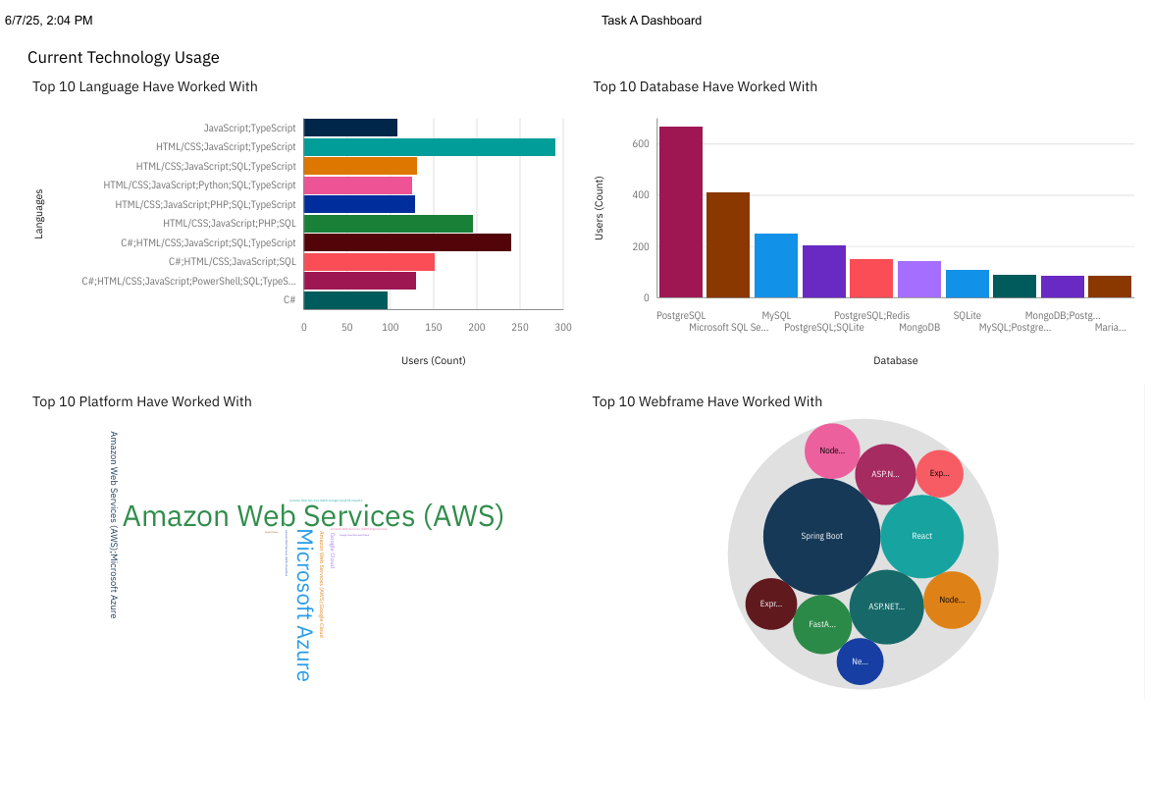
DASHBOARD TAB 1

Slide 12
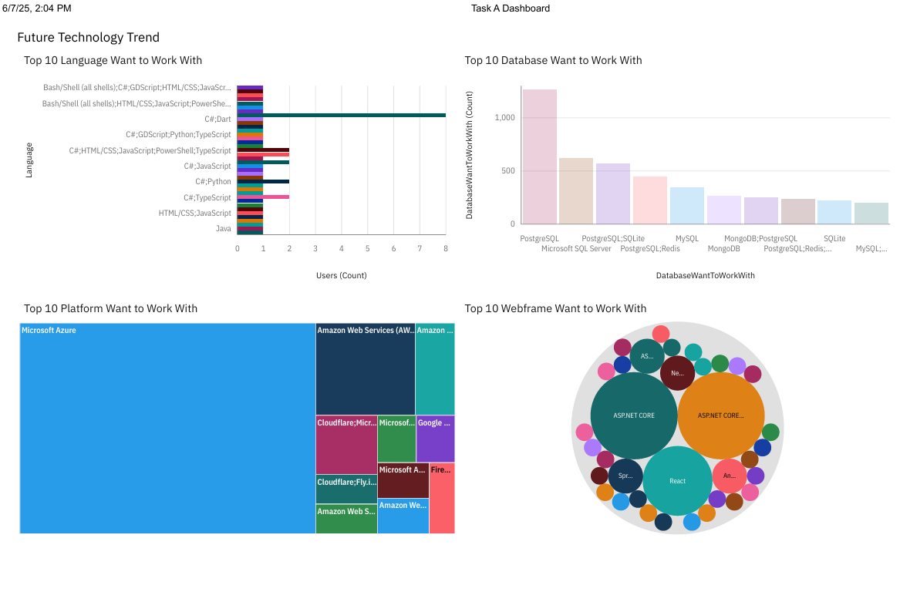
DASHBOARD TAB 2

Slide 13
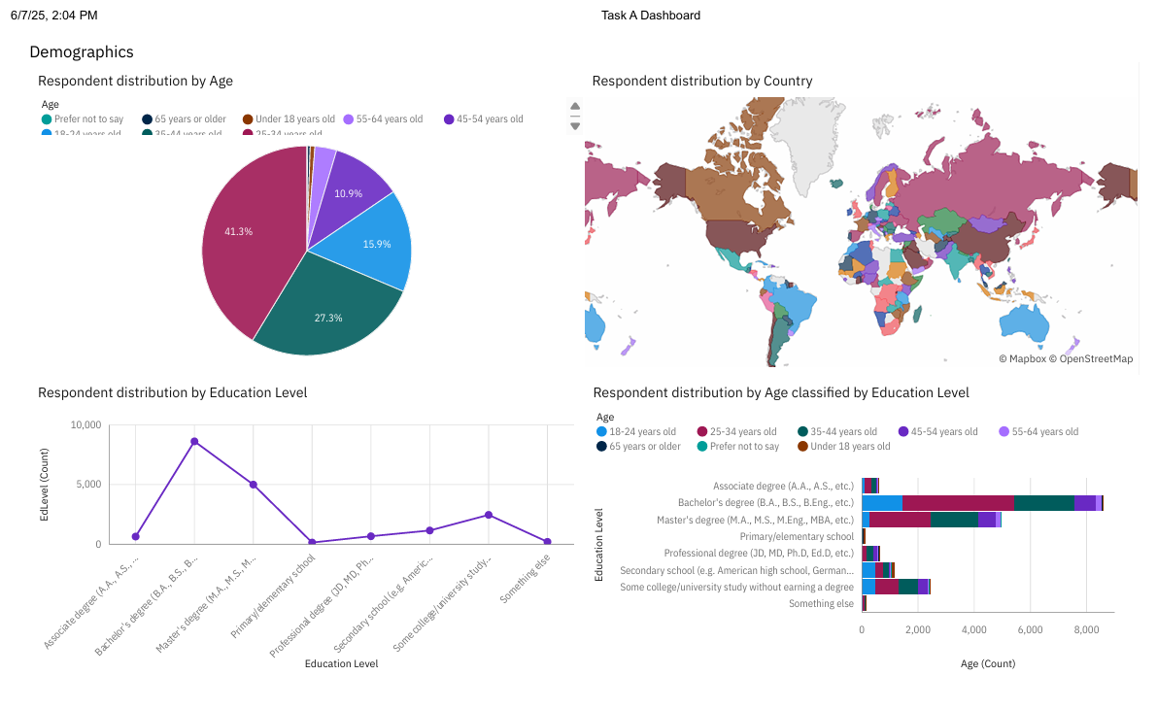
DASHBOARD TAB 3

Slide 14
DISCUSSION
In this data visualization, we found out the most preferrred programming languages, databases, platform, and webframe the respondents to work with and wants to work with in the next few years. It is also fully analyzed the demographic background of all the respondents to be able to determine its correlation.

Slide 15
OVERALL FINDINGS & IMPLICATIONS
Findings
Most of the respondents has bachelor degree and has master degree.
The top programming language, databases, platform, and webframe has slight differences from the current year and next few years.
Respondents came from different countries.
Implications
Most of the respondents are still navigating their early career path from their mid 20s and early 30s by learning competitive software to work with.
Most of the programming language, databases, platform, webframe the current year is still competitive to work with in the few years.
Data Science and Information Technology is still expanding and growing and proved that world is fast-paced when it comes to developing computers

Slide 16

CONCLUSION
Most of the top programming language, databases, platform, webframe that the respondents are currently using are still competitive, relevant and condsidered as high-demand skills/tools to have.
As mentioned, data science software is still high in demand since most of the countries are still expanding their knowledge in the programming languages, databases, that can contribute to data analysis, data wrangling, and data visualization.
Most of the respondents came from mid 20s wherein they will be contributing a large set of knowledge when it comes to development of AI tools, data science in the next future

Slide 17
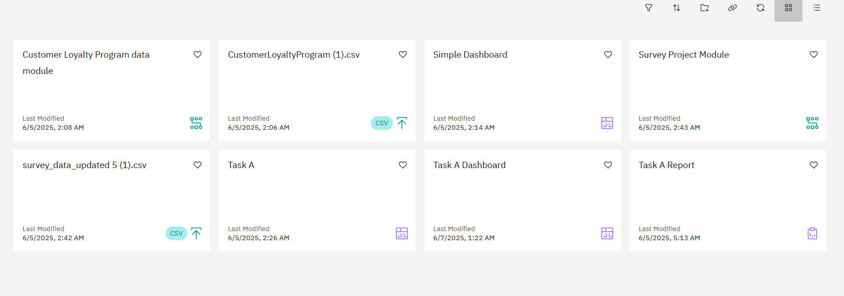

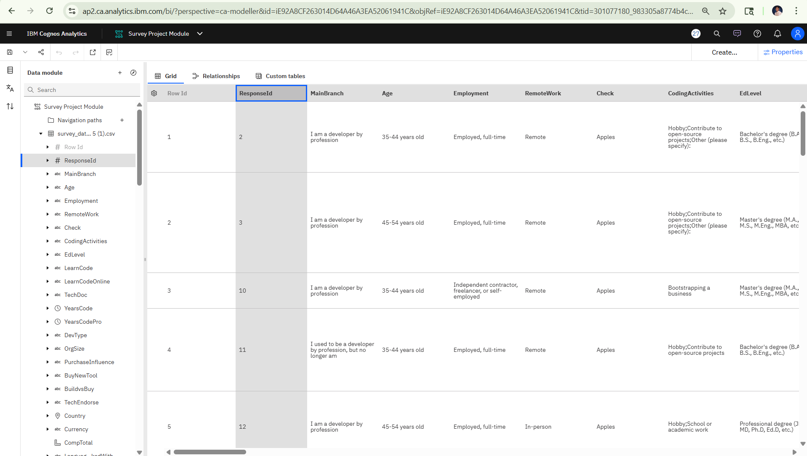
APPENDIX

