Slide 1

CTRL + THINK
An Interactive Visual Novel Game Exploring AI Dependency Among College Students
Amarela, Caldeo and Añez
BSIT, Animation and Motion Graphics · AMG 4A
College of Computer Studies
Laguna State Polytechnic University
Los Baños Campus
October 20, 2026
Capstone Defense · Adviser: Jonalyn Joy Labayne

Slide 2

CHAPTER 1 - INTRODUCTION
Problem
ChatGPT and Google Gemini are free, and students use them to brainstorm, summarize, write and solve problems
Over-reliance leads to cognitive offloading: critical thinking, creativity and analysis are not fully developed
Gap Identified
Most school responses limit or detect AI use
Few tools help students see how harmful over-reliance can be, especially Filipino college students
Proposed Solution
Ctrl + Think, an interactive visual novel built with Ren’Py for PC and Android
Students feel the consequences of AI dependency in a safe, simulated story before it affects real grades

Slide 3
PROJECT OBJECTIVE
General Objective
To develop an interactive visual novel that highlights AI dependency among college students.
Specific Objectives
Develop: Create a visual novel that shows the process and impact of relying on AI through story branches, character interactions, player decisions and 2D graphics.
Reflect: Assess whether the game supports self-reflection and responsible AI use, balancing AI assistance with the student’s own thinking.
Evaluate: Assess usability and learning efficacy using the Technology Acceptance Model (TAM).
Aligned with SDG 4 (Quality Education) and SDG 9 (Industry, Innovation and Infrastructure).

Slide 4
CHAPTER 2 - CONCEPTUAL FRAMEWORK
Perceived Usefulness
Does it help me reflect?
External variables
System: story, characters, graphics, mini games
User: profile, AI use, dependency
Attitude Toward Using
Feeling about the game
Behavioral Intention
Play again, recommend, accept
Perceived Ease of Use
Is it free of effort?
Enjoyment and Engagement
Added for a game
Adapted from Davis (1989) and Davis et al. (1992). The Technology Acceptance Model is extended with enjoyment and engagement because Ctrl + Think is a game.

Slide 5
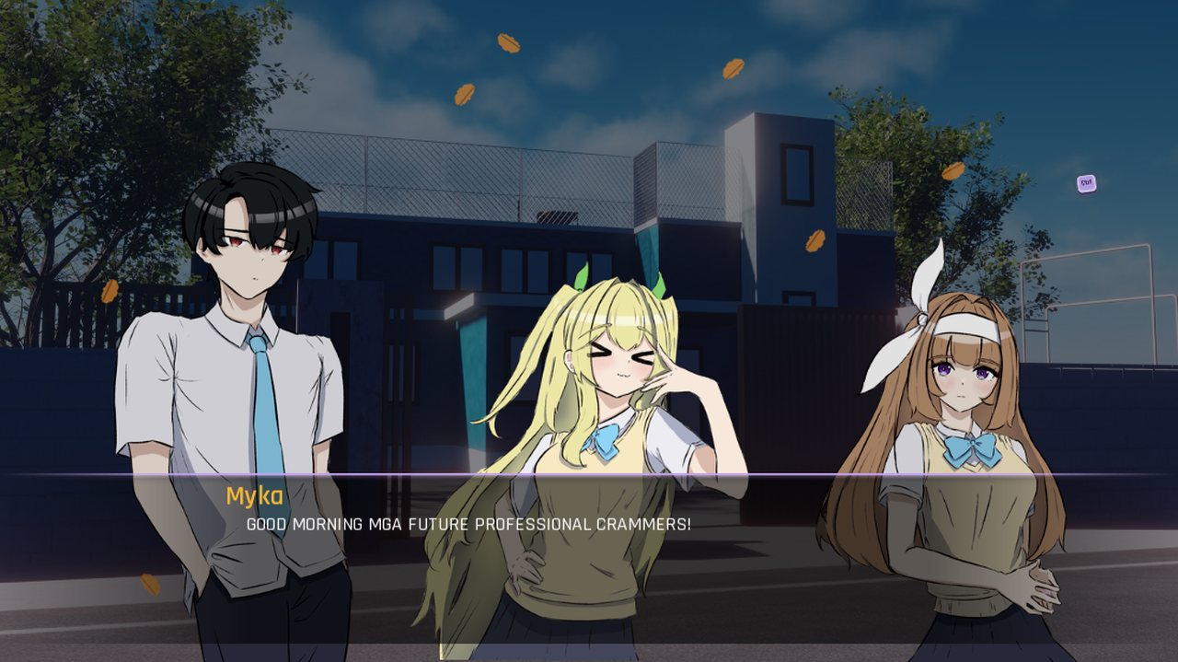
THE GAME: CTRL + THINK
What it is
A 2D Ren’Py visual novel. The player is a college student who keeps deciding whether to rely on AI or on personal effort.
6 chapters plus a Free Day
3 routes and endings
10+ mini games
2 platforms: PC and Android
Story dialogue is in Taglish.
Chapter 1, Morning Chaos (screenshot from the game)
Chapters
1 Morning Chaos · 2 The Blank Page · 3 Process Over Answers · 4 Whose Work Is It? · 5 The Final Challenge · 6 What We Carry

Slide 6
ROUTES AND ENDINGS
 | Route A · Balanced | Route B · Moderate | Route C · High dependence
Hidden score | 0–33 | 34–66 | 67–100
Behavior | Thinks first and uses AI only as support | Mixes own effort with frequent AI shortcuts | Lets AI do most of the thinking
Outcome | Strong grades and real understanding | Passes, but with shaky confidence | Fast results, weak understanding
Message | AI is a tool, not a replacement | Leaning on AI can slowly replace your own skills | Over-reliance costs learning and originality
A hidden dependency score rises with every AI shortcut and decides the ending. The player never sees the number while playing.

Slide 7
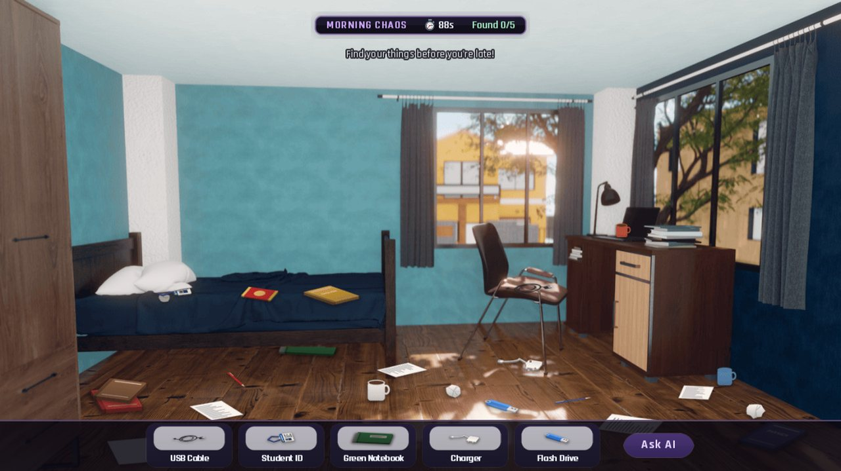
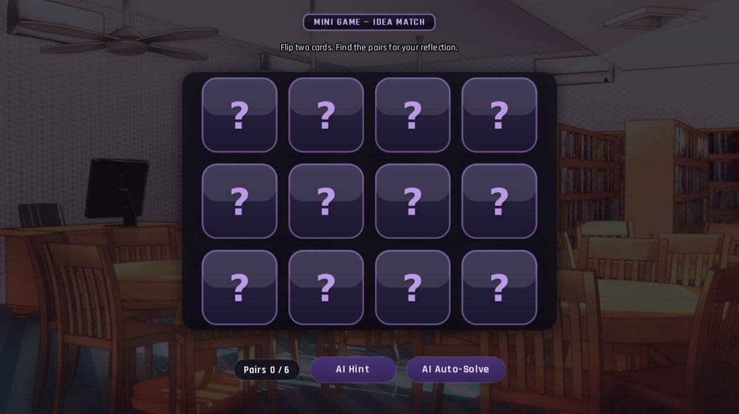
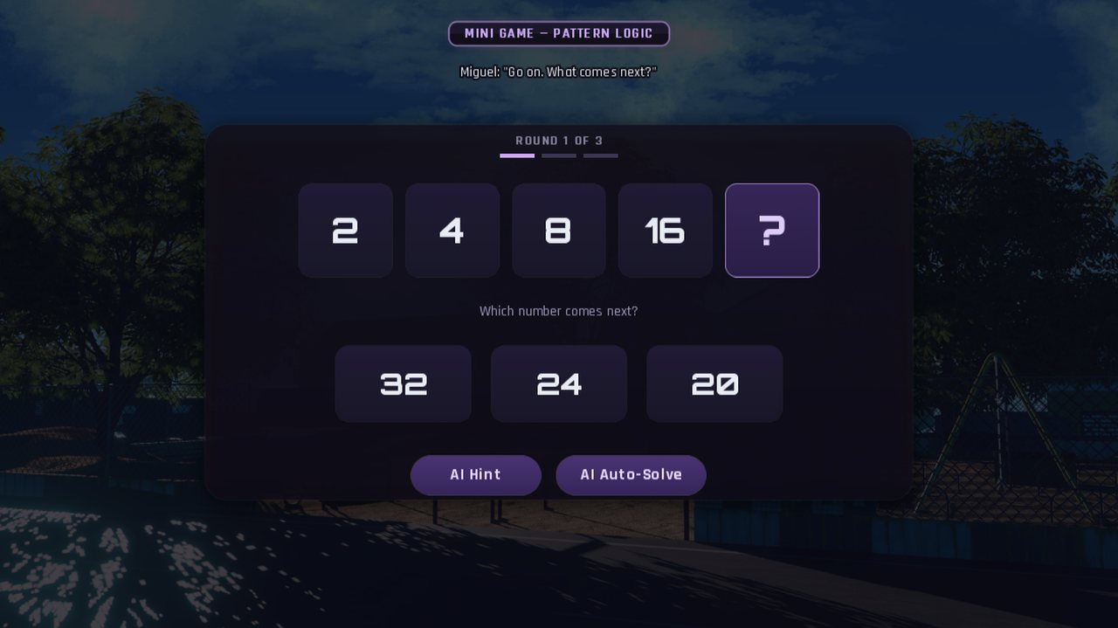
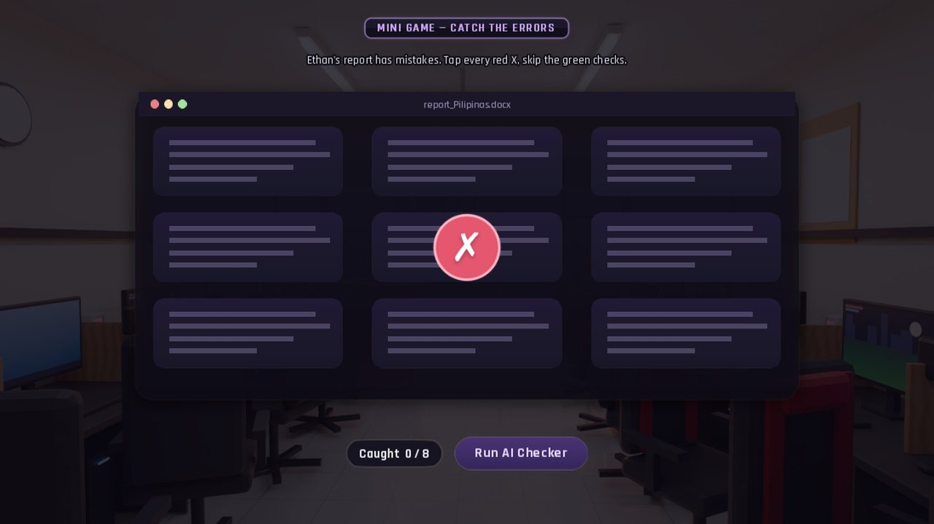
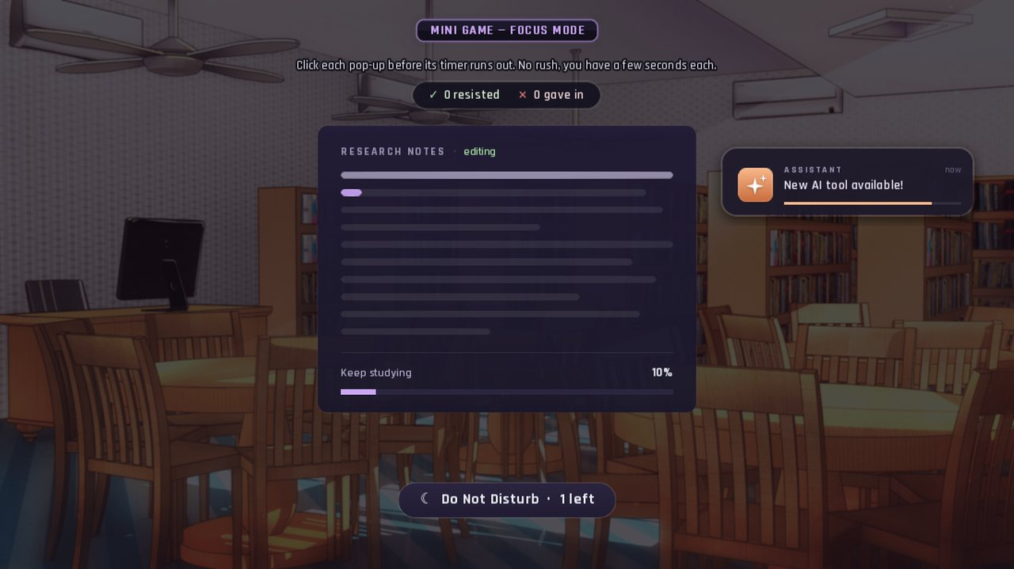
MINI GAMES WITH AN AI SHORTCUT
Morning Chaos
Idea Match
Pattern Logic
Every game offers a shortcut
AI Hint, Auto-Solve, Run AI Checker or Ask AI. It is easy to take, and it raises the hidden dependency score.
Catch the Errors
Focus Mode

Slide 8
CHAPTER 3 - RESEARCH METHOD
48
college student respondents
39
rated statements in 5 parts
5
point Likert scale
Design
Descriptive, quantitative survey answered through Google Forms after respondents played the game; data privacy consent included
Analysis
Frequency and percentage for the profile, weighted mean and standard deviation per statement, Cronbach’s alpha for reliability
Interpretation scale
4.21–5.00 Strongly Agree · 3.41–4.20 Agree · 2.61–3.40 Neutral · 1.81–2.60 Disagree · 1.00–1.80 Strongly Disagree

Slide 9
LEVEL OF AI USAGE AND DEPENDENCY
3.12
Neutral (moderate)
SD = 0.85
Respondents neither agreed nor disagreed that they rely heavily on AI. They strongly agreed that critical thinking matters (4.27) and agreed that they verify AI information (3.58).
Every item except the last had SD above 1.00, so dependency varied widely. The last two items describe responsible use, so read the composite with that in mind.

Slide 10
SYSTEM CHARACTERISTICS OF THE GAME
4.07
Agree
Highest-rated part, SD = 0.57
Three items reached Strongly Agree. The lowest item, believable character actions, was still Agree (3.69).
4.38
Character designs suit their roles
4.35
Mini games relevant to the story
4.31
Mini game difficulty appropriate

Slide 11
TECHNOLOGY ACCEPTANCE MODEL RESULTS
3.73
Overall mean: Agree
High acceptance
Easy to use and enjoyable, but usefulness scored lowest. Recognizing the importance of independent thinking was the lowest single item (3.25, Neutral).
Reliability: Cronbach’s alpha of all 39 statements = 0.873 (Good). Enjoyment (0.637), Usefulness (0.556) and Attitude (0.434) were lower because they have only 3–4 items, so read them with caution.

Slide 12
OVERALL LEARNING AND FEEDBACK
3.63
Agree
SD = 0.69
Keep in mind: these are self-reported perceptions after one play. They show what students felt, not a measured change in behavior.

Slide 13
CONCLUSION AND RECOMMENDATION
Conclusion
Ctrl + Think shows the process and effects of AI dependency through branching routes, characters and decisions
Respondents agreed it supports self-reflection (3.63) and has high acceptance (3.73), with Good reliability (0.873)
It is an acceptable, usable educational game and a starting point for balanced, responsible AI use in learning
Recommendation
Students: play it and verify AI answers before using them
Teachers and schools: use it in discussions on academic integrity and responsible AI
Developers: make the story more gripping, stress independent thinking, add routes and endings
Future researchers: larger sample, pretest and posttest, and revise the low-reliability parts

Slide 14
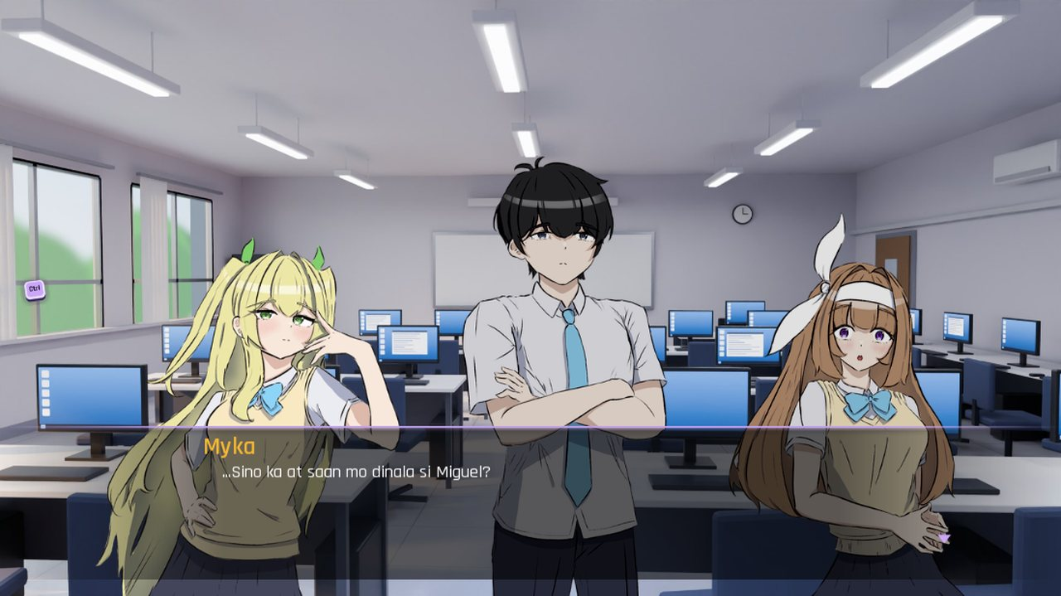

Thank you!
Questions?
John Lorence B. Amarela
Andrei H. Caldeo
Christian B. Añez
Adviser: Jonalyn Joy Labayne

