Slide 1
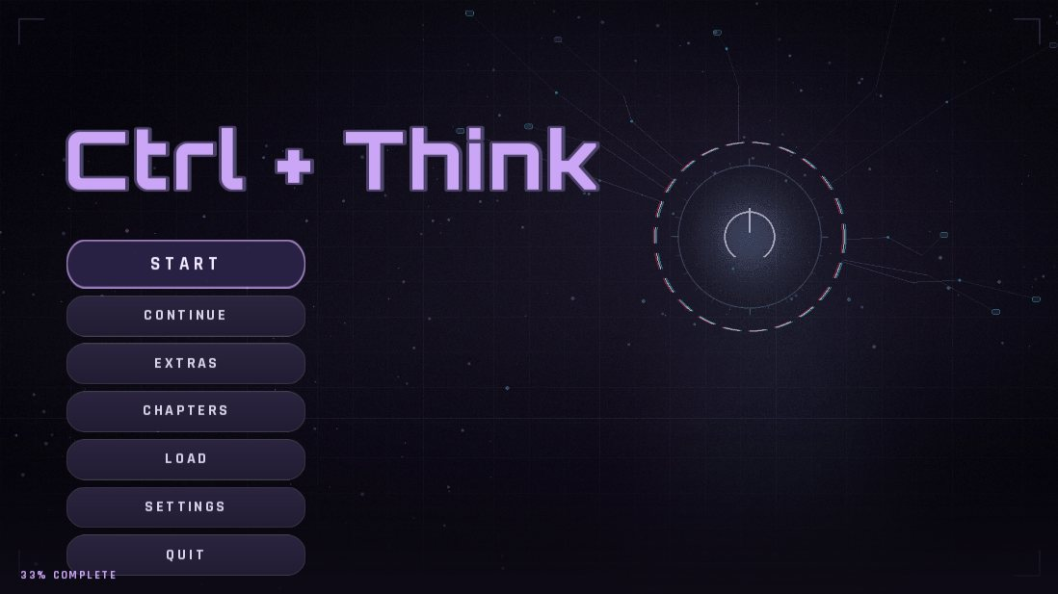
CTRL +
THINK
A CAPSTONE PROJECT
An Interactive Visual Novel Game Exploring AI Dependency Among College Students
John Lorence B. Amarela · Christian B. Añez · Andrei H. Caldeo
Adviser: Jonalyn Joy Labayne
Laguna State Polytechnic University, Los Baños Campus · BSIT, Animation and Motion Graphics
Notes:
Good day, panelists. We are presenting CTRL + THINK, an interactive visual novel that helps college students notice and reflect on their dependence on AI. The screenshot is the real main menu of the finished game.

Slide 2



Project context
THE PROBLEM
AI is everywhere
The hidden cost
The missing piece
ChatGPT and Google Gemini are free to everyone. Students use them to brainstorm, summarize sources, write essays and solve problem sets, which saves time and effort.
Over-reliance leads to cognitive offloading. Critical thinking, creativity and analysis are not fully developed when AI does the complex thinking for the student.
Most school responses limit or detect AI use. Few tools help students see how harmful over-reliance can be, and few target Filipino college students.
Ctrl + Think lets students feel the consequences of AI dependency in a safe, simulated story, before it affects their real grades.
Ctrl + Think · Capstone defense
02
Notes:
Students already use AI for school. The risk is not AI itself but letting it replace thinking. Schools mostly restrict or detect AI, which does not teach awareness. Our game fills that gap for Filipino college students.

Slide 3
Objectives
THE PROBLEM
General objective: develop an interactive visual novel that highlights AI dependency among college students.
1
2
3
Develop
Reflect
Evaluate
Create a visual novel that shows the process and impact of relying on AI through story branches, character interactions, player decisions and 2D graphics.
Assess whether the game supports self-reflection and responsible AI use, balancing AI assistance with a student’s own thinking.
Assess usability and learning efficacy with the Technology Acceptance Model (TAM): usefulness, ease of use, enjoyment, attitude and intention.
Aligned with
SDG 4 · Quality Education
SDG 9 · Industry, Innovation and Infrastructure
Ctrl + Think · Capstone defense
03
Notes:
One general objective and three specific ones: build the game, check that it supports reflection, and check that students accept it. The project also supports SDG 4 on quality education and SDG 9 on responsible innovation.

Slide 4

Technology Acceptance Model
THE FRAMEWORK
Perceived Usefulness
Does it help me reflect?
External variables
Attitude Toward Using
Behavioral Intention
System: story, characters, graphics, mini games
Perceived Ease of Use
Is it free of effort?
Feeling about the game
Play again, recommend, accept
User: profile, AI use, level of dependency
Enjoyment and Engagement
Added for a game
Adapted from Davis (1989) and Davis et al. (1992). Because Ctrl + Think is a game, the model is extended with enjoyment and engagement. The same model guides the survey and the results.
Ctrl + Think · Capstone defense
04
Notes:
TAM explains how people accept new technology. External variables shape perceived usefulness and ease of use. We added enjoyment and engagement because this is a game. All of these lead to attitude and then to intention to use the game as a learning tool.

Slide 5
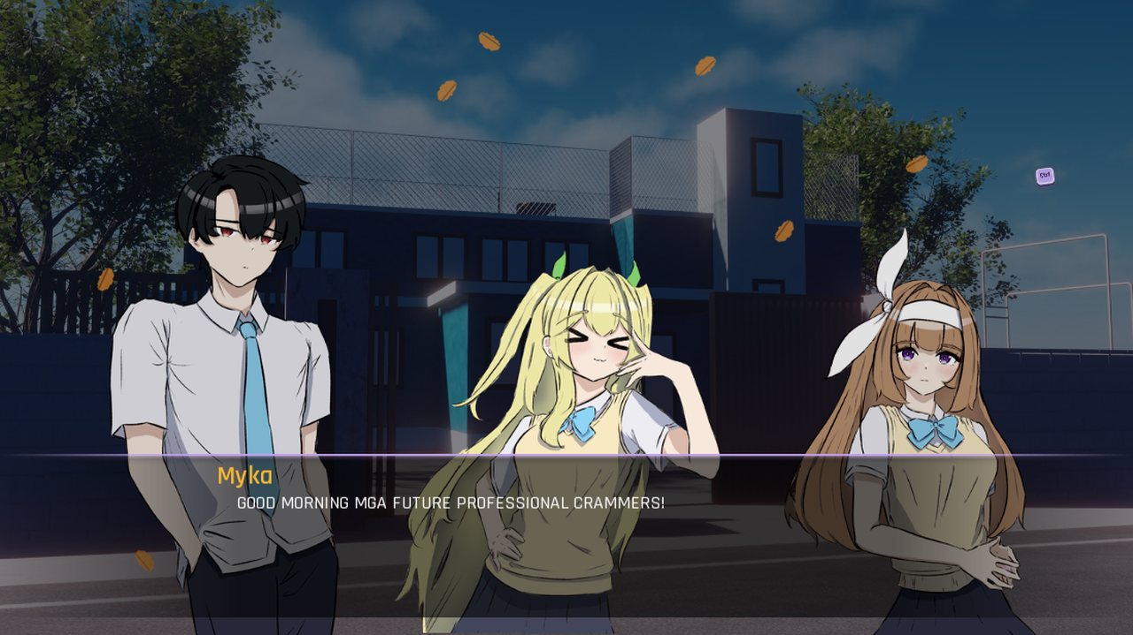
Ctrl + Think at a glance
THE GAME
A 2D Ren’Py visual novel where the player is a college student who decides, again and again, whether to rely on AI or on personal effort.
6
3
Chapters plus a Free Day
Routes and endings
10+
2
Mini games
Platforms: PC and Android
Screenshot from the game: Chapter 1, Morning Chaos
Dialogue is in Taglish, so it sounds like real student conversation.
Ctrl + Think · Capstone defense
05
Notes:
This is the finished game. The player chooses between relying on AI and doing the work themselves. The game never lectures; it shows consequences.

Slide 6
Three routes, three endings
THE GAME
ROUTE A · SCORE 0–33
ROUTE B · SCORE 34–66
ROUTE C · SCORE 67–100
Balanced
Moderate
High dependence
Behavior: Thinks first, uses AI only as support.
Behavior: Mixes own effort with frequent AI shortcuts.
Behavior: Lets AI do most of the thinking.
Outcome: Strong grades and real understanding.
Outcome: Passes, but with shaky confidence.
Outcome: Fast results, but weak understanding.
Message: AI is a tool, not a replacement.
Message: Leaning on AI can slowly replace your own skills.
Message: Over-reliance costs learning and originality.
A hidden dependency score rises with every AI shortcut and decides the ending. The player never sees the number while playing.
Ctrl + Think · Capstone defense
06
Notes:
Routes follow Table 6 of the paper. The score is hidden on purpose so players choose naturally instead of chasing a number. Story changes never alter the scoring.

Slide 7
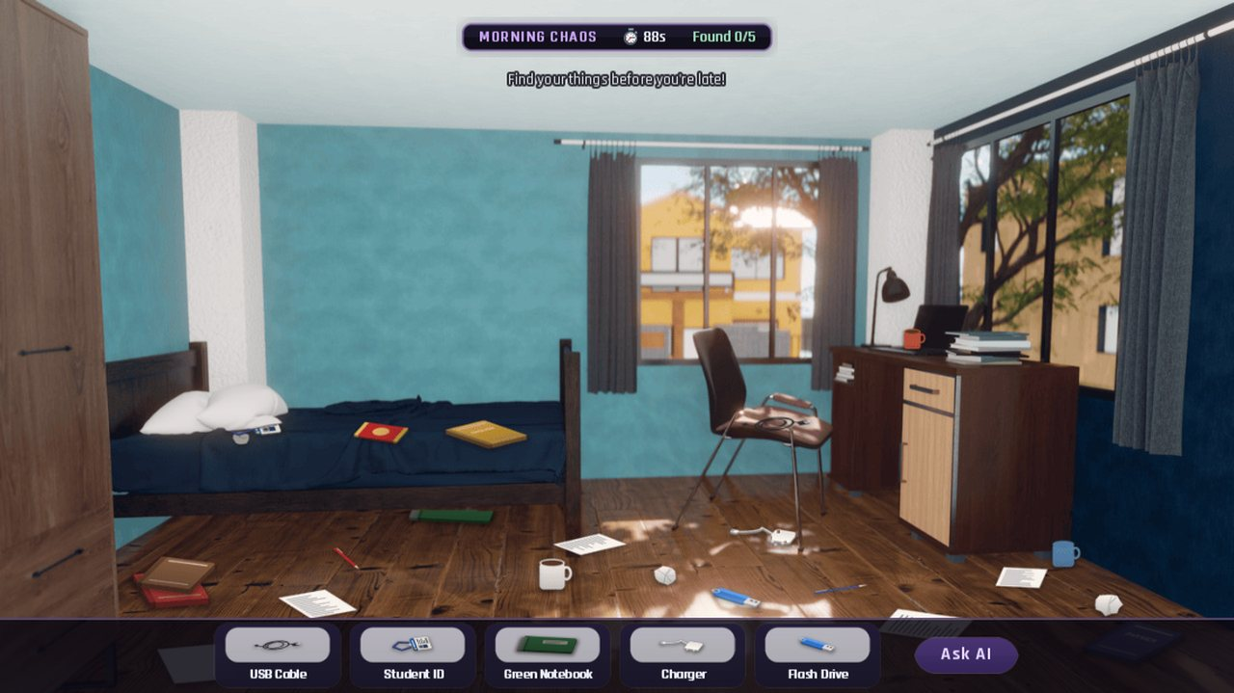
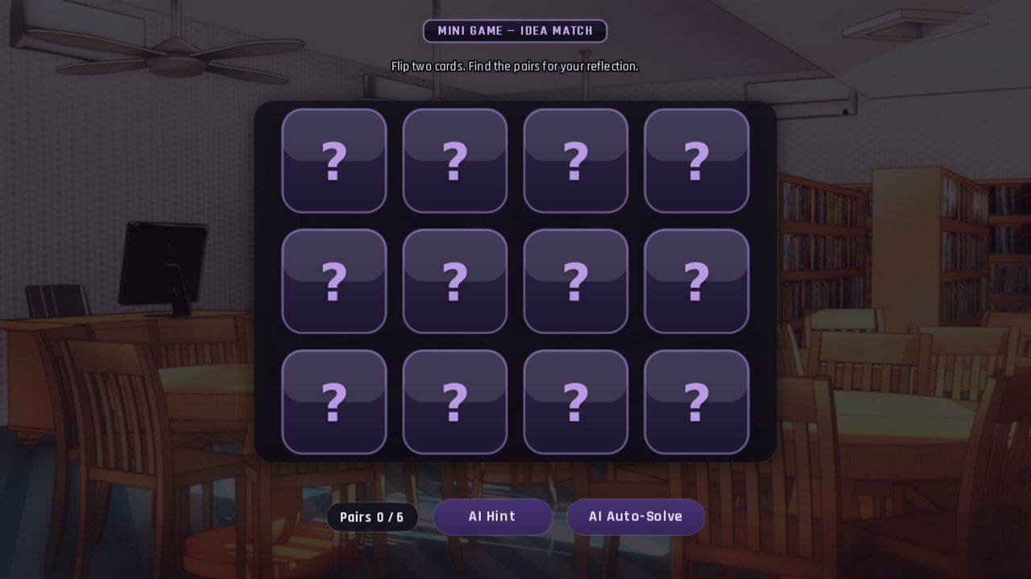
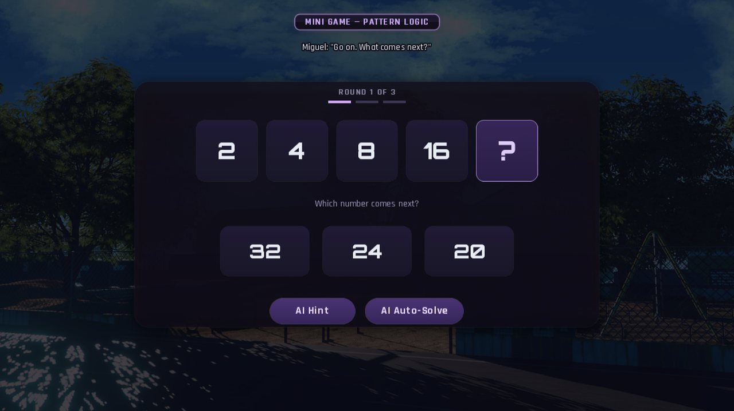
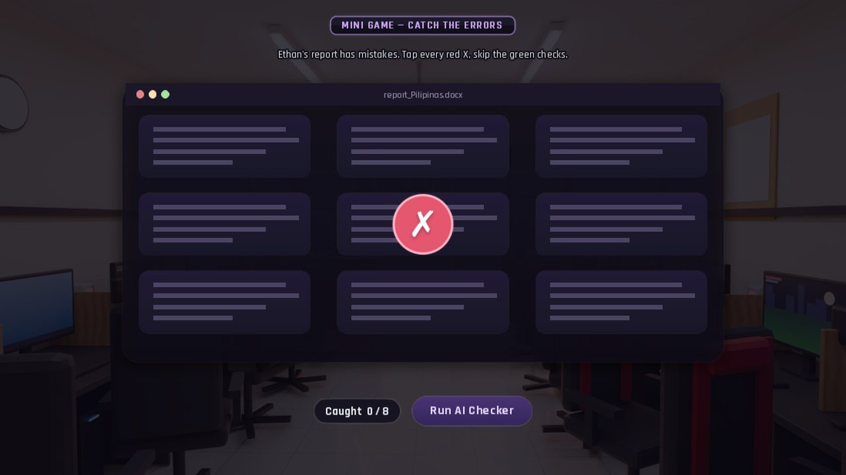
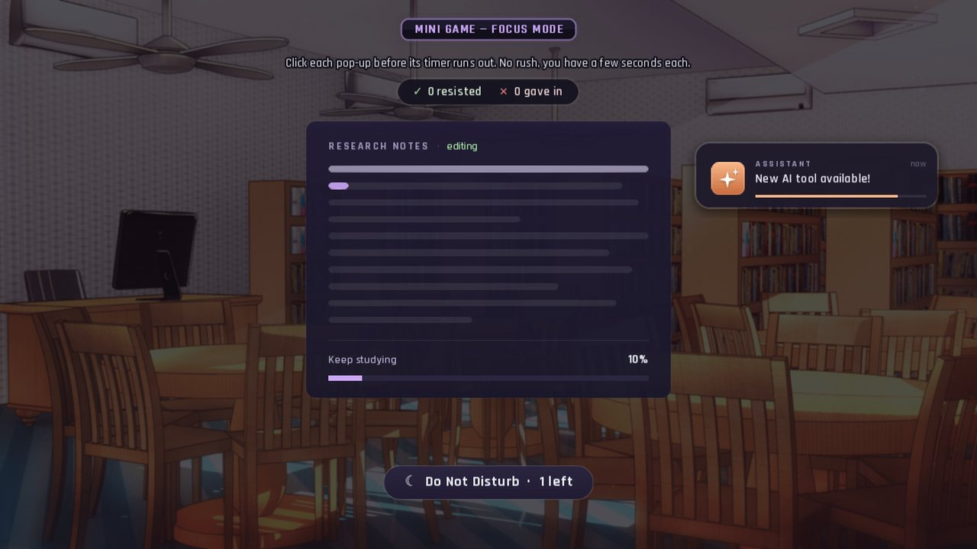
Mini games with an AI shortcut
THE GAME
Morning Chaos
Idea Match
Pattern Logic
Every game offers a shortcut
AI Hint, Auto-Solve, Run AI Checker or Ask AI. Taking it is easy, and it raises the hidden dependency score.
Catch the Errors
Focus Mode
Ctrl + Think · Capstone defense
07
Notes:
These are five of the mini games in the build. Each one trains a skill such as logic, fact-checking or focus, and each one tempts the player with an AI shortcut.

Slide 8
Method
THE STUDY
48
39
5
College student respondents
Rated statements in 5 parts
Point Likert scale
Design
Analysis
Descriptive, quantitative survey after respondents played the game. Answered through Google Forms, with data privacy consent.
Frequency and percentage for the profile, weighted mean and standard deviation for each statement, and Cronbach’s alpha for reliability.
Reading the scale: 4.21–5.00 Strongly Agree · 3.41–4.20 Agree · 2.61–3.40 Neutral
Ctrl + Think · Capstone defense
08
Notes:
All figures in the following slides come from Chapter 4 of the paper. The questionnaire has five parts: respondent profile and AI use, system characteristics, TAM constructs, and overall learning and feedback.

Slide 9
Level of AI usage and dependency
THE RESULTS
COMPOSITE MEAN
Rely on AI for academic tasks
2.94
3.12
Hard to finish tasks without AI
2.77
Accept answers without checking
2.50
Use answers I do not understand
2.94
Neutral · moderate
Depend on AI instead of trying
2.81
SD = 0.85. Respondents neither agreed nor disagreed that they rely heavily on AI.
Verify AI information
3.58
Own critical thinking matters
4.27
Every item except the last had SD above 1.00, so dependency varied a lot between students. The last two items are about responsible use, so the composite should be read with that in mind.
Ctrl + Think · Capstone defense
09
Notes:
Bars show the mean on a 5-point scale. Green marks the items rated Agree or higher: students strongly agree that critical thinking still matters even when AI is available (4.27), and agree that they verify AI information (3.58). Accepting AI answers without checking was the only item rated Disagree (2.50).

Slide 10
How players rated the game itself
THE RESULTS
SYSTEM CHARACTERISTICS
Mini games
4.33
4.07
Characters
4.03
Graphics and backgrounds
4.02
Agree
Story and situations
3.92
SD = 0.57. The highest-rated part of the whole questionnaire.
4.38
4.35
4.31
Character designs suited their roles
Mini games were relevant to the story
Mini game difficulty was appropriate
The lowest item was “Characters’ actions were believable” at 3.69, still Agree.
Ctrl + Think · Capstone defense
10
Notes:
Three items reached Strongly Agree, all about the character designs and the mini games. Group means: mini games 4.33, characters 4.03, graphics 4.02, story 3.92.

Slide 11
Technology Acceptance Model constructs
THE RESULTS
OVERALL MEAN
Perceived Ease of Use
4.11
3.73
Enjoyment and Engagement
3.82
Attitude Toward Using
3.76
Behavioral Intention
3.49
Agree
Perceived Usefulness
3.44
All five constructs were interpreted as Agree, which means a high level of acceptance.
Easy to use and fun, but weaker on usefulness. Lowest item: the value of independent thinking (3.25, Neutral).
Ctrl + Think · Capstone defense
11
Notes:
Ease of use is highest because controls and navigation were clear. Usefulness is lowest, so the game can still improve at showing why independent thinking matters. Highest BI item: appropriate educational tool for AI dependency awareness (3.88). Willingness to play again (3.29) and overall satisfaction (3.40) were Neutral.

Slide 12
Did the game help players reflect?
THE RESULTS
LEARNING AND FEEDBACK
Think critically about AI use
3.73
3.63
Understanding my own work matters
3.69
Can help other students reflect
3.67
Agree
Achieved its educational purpose
3.63
SD = 0.69. Supports the second objective.
Aware of risks of AI dependency
3.44
Keep in mind: these are self-reported perceptions after one play. They show what students felt, not a measured change in behavior.
Ctrl + Think · Capstone defense
12
Notes:
No statement reached Strongly Agree. The highest was thinking critically about how they use AI tools at 3.73.

Slide 13
Conclusion
WRAP UP
1
2
3
Game developed
Supports reflection
Highly accepted
Ctrl + Think shows AI dependency through branching routes, characters, decisions and 2D art.
Learning and feedback scored 3.63 (Agree). Results are self-reported, not measured behavior change.
All five TAM constructs were Agree, with an overall mean of 3.73 and Good reliability (0.873).
Ctrl + Think is an acceptable and usable educational game for reflecting on AI dependency, and a starting point for promoting balanced and responsible AI use in learning.
Ctrl + Think · Capstone defense
13
Notes:
Each conclusion matches one objective: develop the game, check its learning value, and evaluate acceptance with TAM.

Slide 14
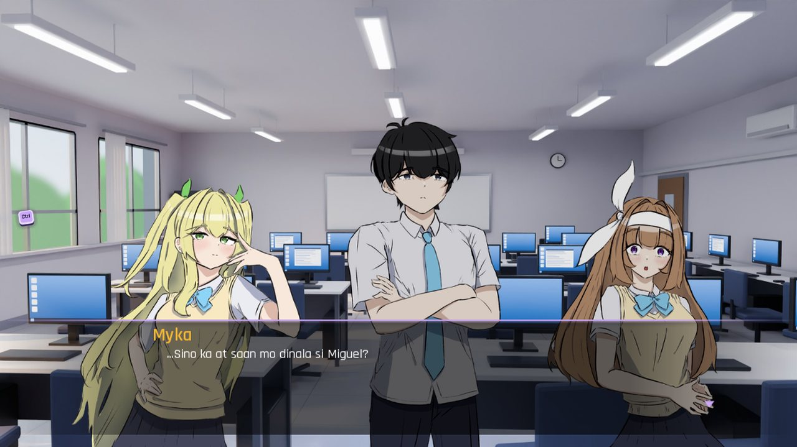
Thank you
CTRL + THINK
Questions?
John Lorence B. Amarela
Andrei H. Caldeo
Christian B. Añez
Adviser: Jonalyn Joy Labayne · Laguna State Polytechnic University, Los Baños Campus
Ctrl + Think · Capstone defense
14
Notes:
Invite questions about the game, the survey results or the development process.

