Slide 1
Code Pipeline Diagrams

Slide 2
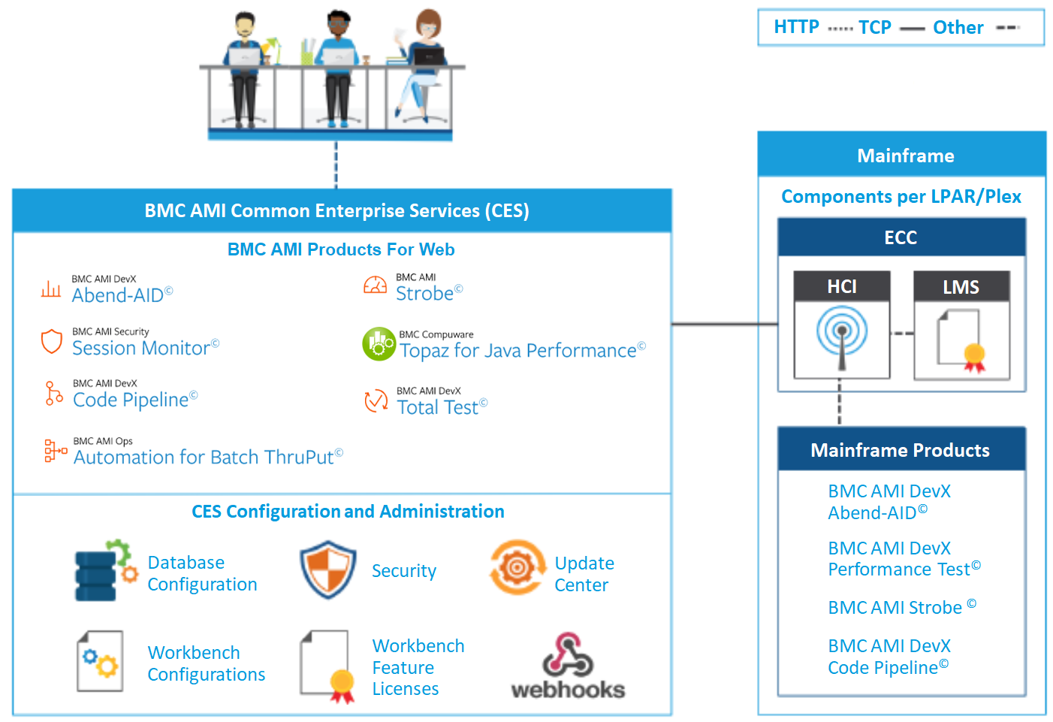
Product Architecture – Overview
CES (Common Enterprise Services)
Web Application Server for Code Pipeline (CP) Functions
Approvals
Deployments
Endpoint for CP REST API
Administration of CP Webhooks
Uses HCI connection
HCI (Host Communication Interface)
Communication between client and Mainframe application (CP)
Client – HCI: TCP
HCI – application: propriatory
ECC (Enterprise Common Components)
Common Services for BMC AMI DevX Tools
HCI (s. above)
LMS (License Management System)

Slide 3


VSCode – CP native
Any Code Pipeline Action in VSCode e.g. Search, Add, Checkout, Edit, Save, Generate, Promote will be converted into a REST call
The REST call will be served by the Werkbench Server (Local port 8089)
Workbench Server will be installed automatically with DevX Explorer
It runs as a Javaw task locally on the developer‘s PC
Workbench Server will communicate with HCI via port 16196
For Edit/Browse and Save HCI will pass the request to the Code Pipeline CT Task. The CT Task will handle download/upload of sources via port 16194
Search/Add/Checkout/ Generate/Promote
Edit/Save
HCI
16196
Edit/Save
Search/Add/Checkout/ Generate/Promote
Edit/Save
CP CT Task
8089
16194
Workbench Server
Edit/Save

Slide 4
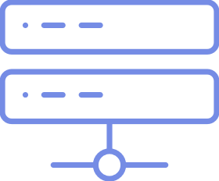
VSCode – Git with CP
Code Pipeline Action in VSCode Load, Generate, Build will use the Workbench CLI(*)
Workbench CLI needs to be installed separately onto the developer‘s PC
Workbench CLI will use
HCI for upload via port 16196
CES REST API for Generate/Build via port 48226
CES will trigger Generate/Build in Code Pipeline using HCI via port 16196
Generate/ Build
CES
16196
Generate/ Build
Load
HCI
48226
Load
Generate
Build
16196
CP CM Task
Load
Generate
Build
(*) The Git/CP integration will move away from CLI and will use the Workbench Server in the future
Load: Upload modified source to CP dev level lib and import into CP
Generate: Load, followed by Generate of the loaded task
Build: Load, followed by Generate of the loaded task and all dependent tasks
Workbench CLI

Slide 5
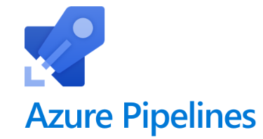
Azure DevOps with CP
In an Azure DevOps Pipeline the usual steps are
Synchronize all changes to CP
Generate/Build all changes
Other actions like deploy
Synchronize makes use of the Workbench CLI
Workbench CLI needs to be installed on the execution agent
Synchronize will load all changes to CP using HCI port 16196
All other CP actions use the REST API via CES and port 48226
CES uses HCI port 16196
Generate/ Build
CES
16196
Generate/ Build
Load
Agent
HCI
48226
Load
Generate
Build
Generate
Build
Promote
...
16196
CP CM Task
Script
Synchronize
Load
Workbench CLI

