Slide 1

Explaining Headline A/B Test Outcomes with Sparse
Autoencoder Features
Drejc Pesjak

Slide 2
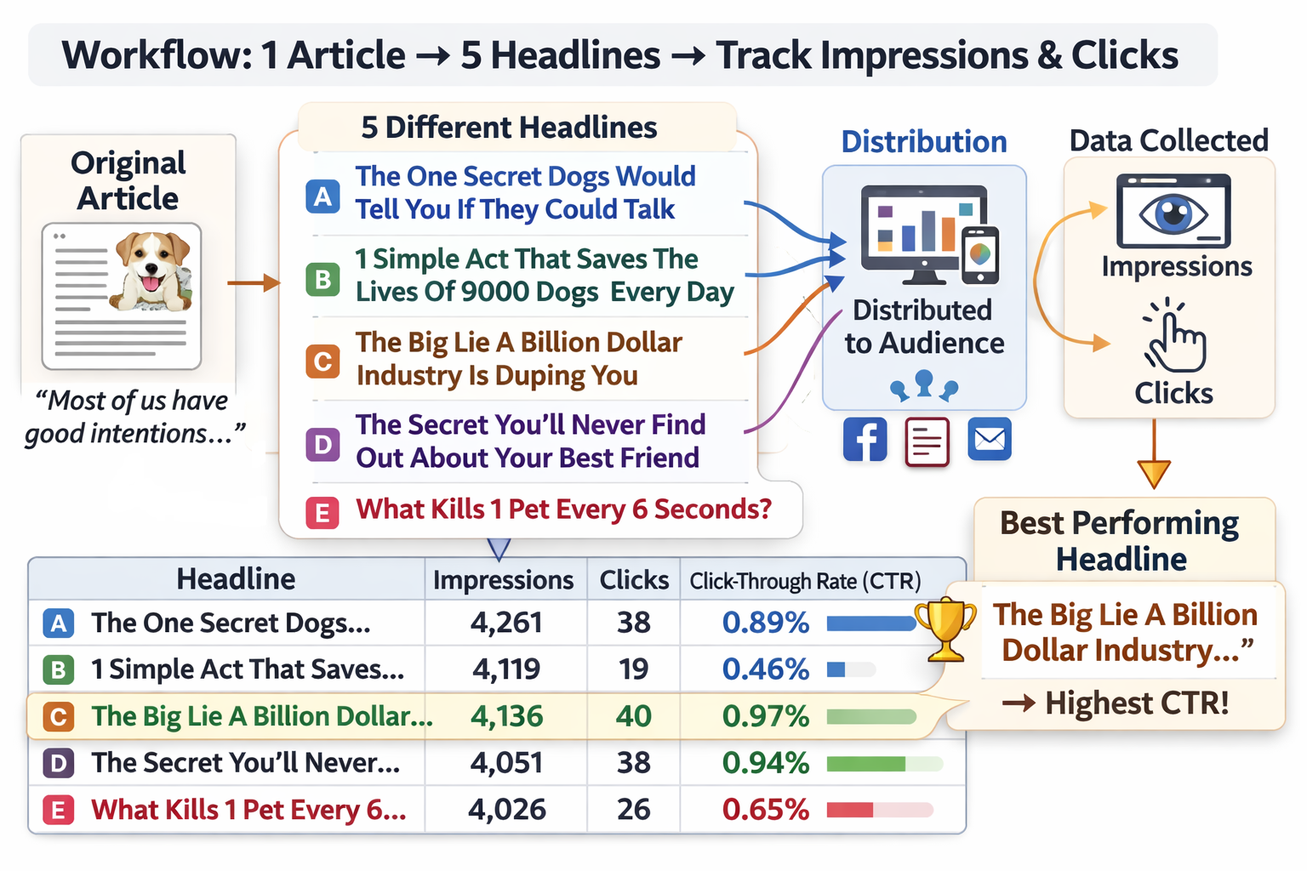
Upworthy research archive
57k headlines
13k A/B tests
(average: 4.38)

Slide 3
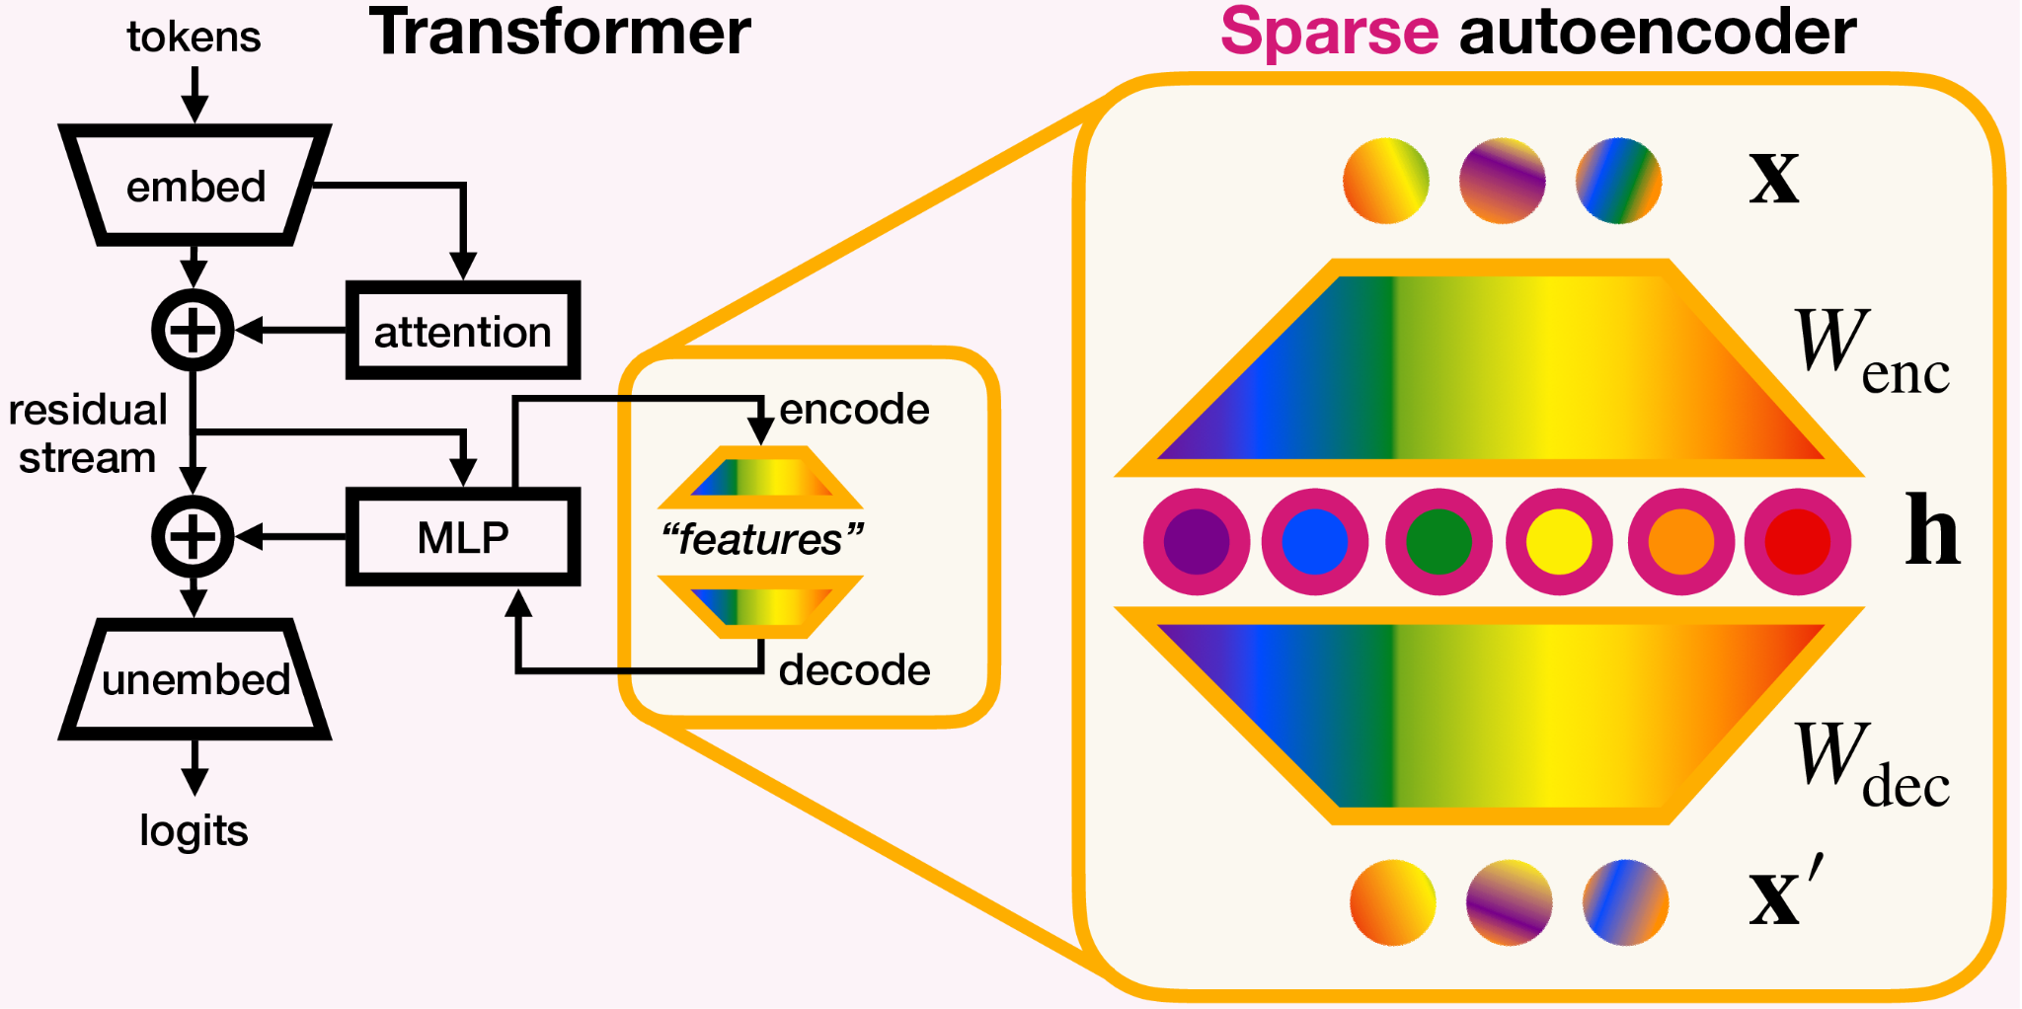
Interpretable contextual embeddings
Gemma 3 - 22nd layer , GemmaScope 2, 16k features , Neuronpedia AutoInterp

Slide 4
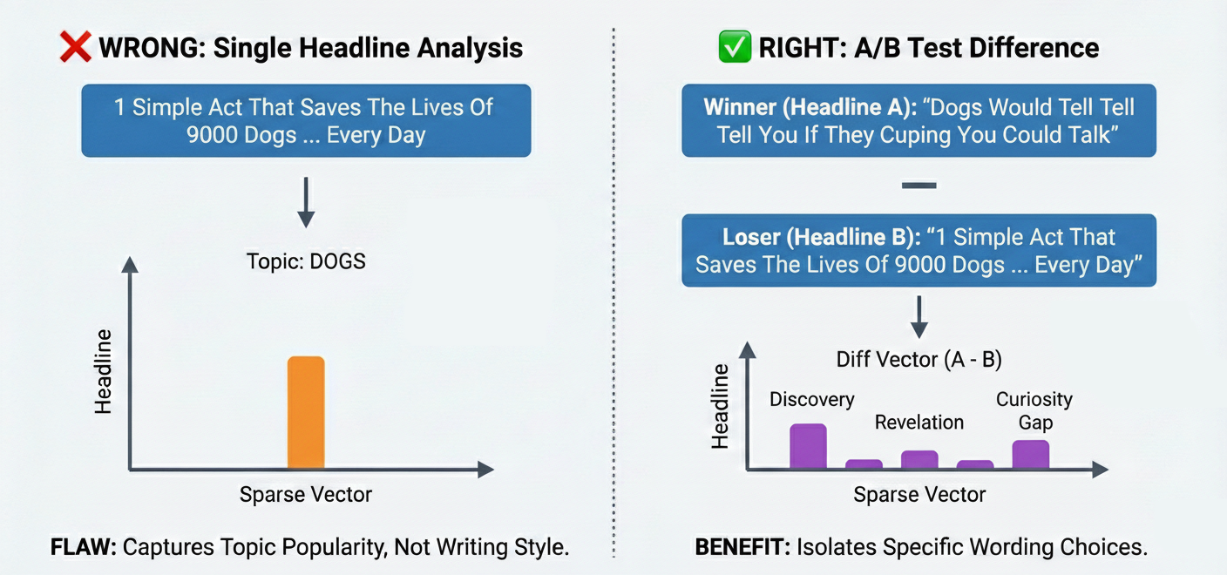
Dataset construction

Slide 5
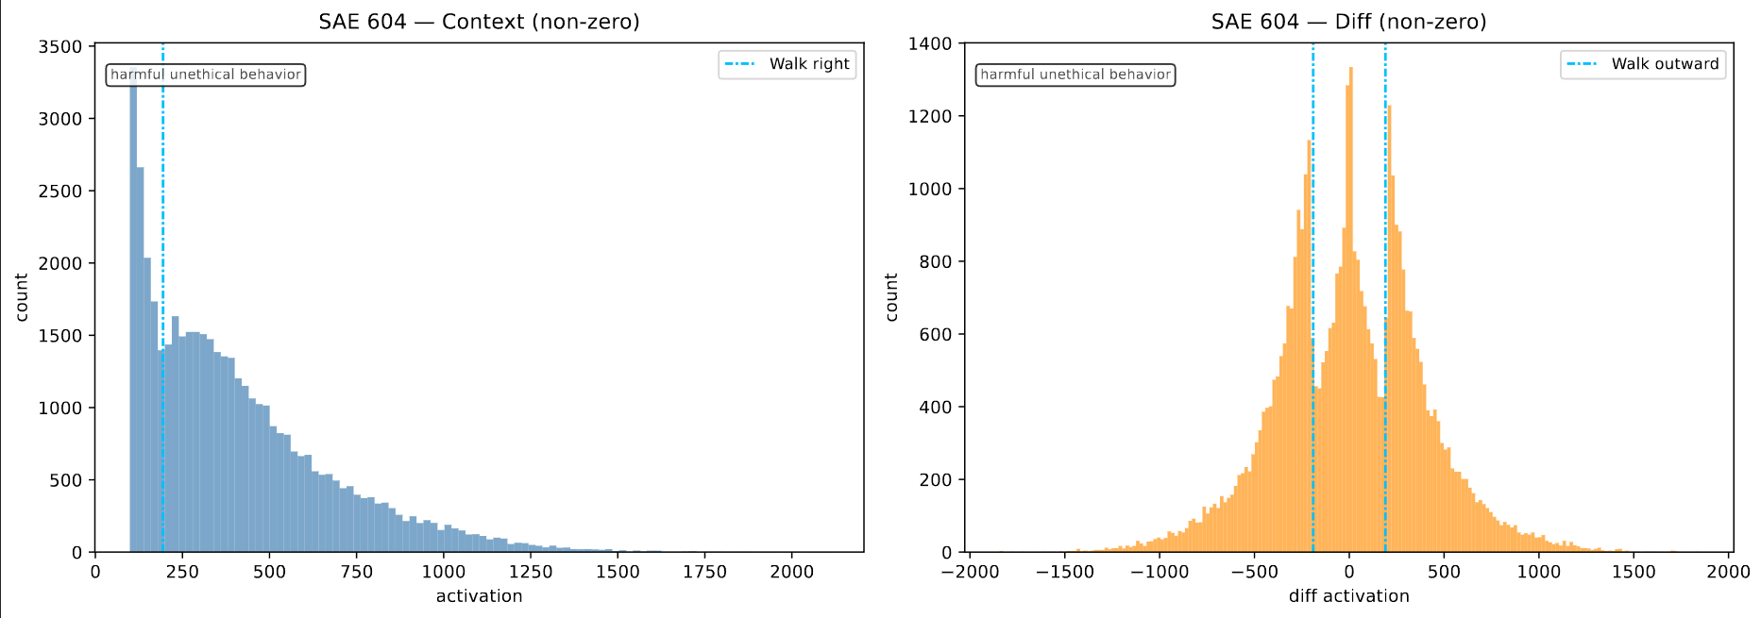
Dataset construction

Slide 6
Interpretable machine learning
Logistic regression
Decision tree
XGBoost
Decision rules

Slide 7
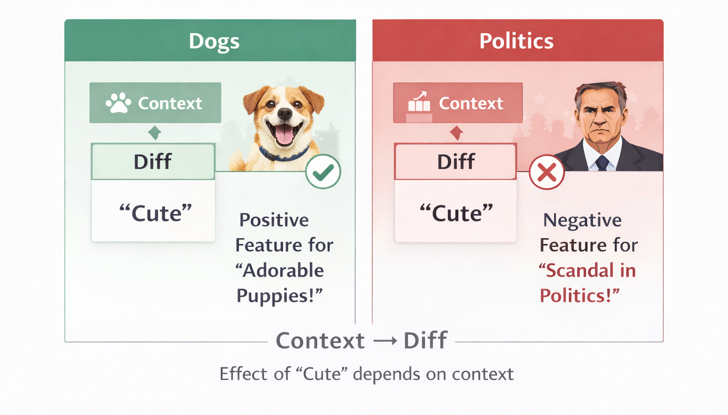
Hierarchy hypothesis

Slide 8
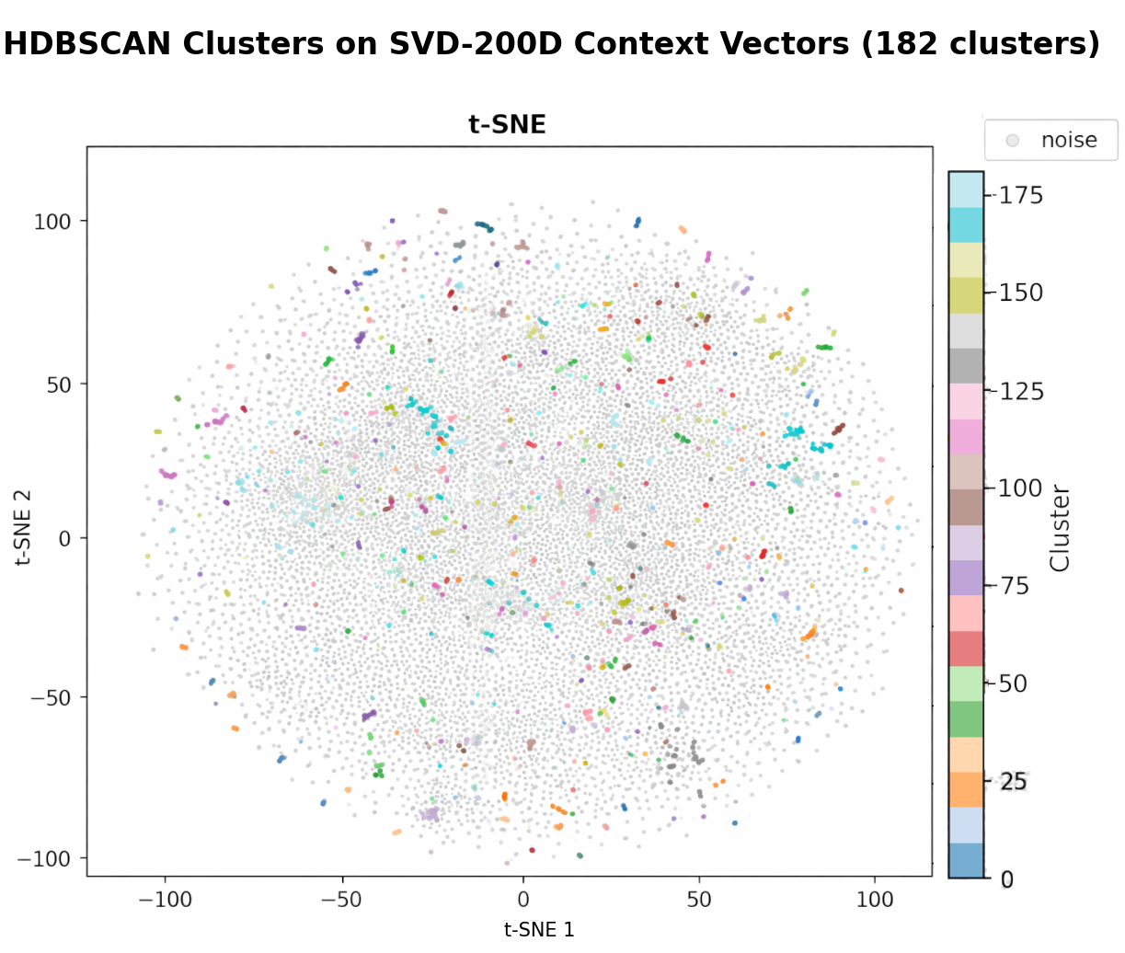
Hierarchical hypothesis

Slide 9
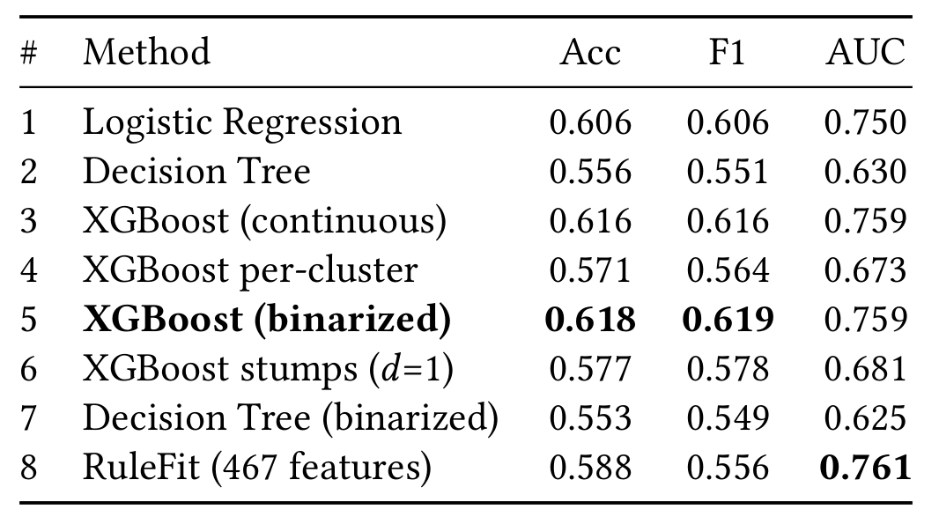
Results

Slide 10
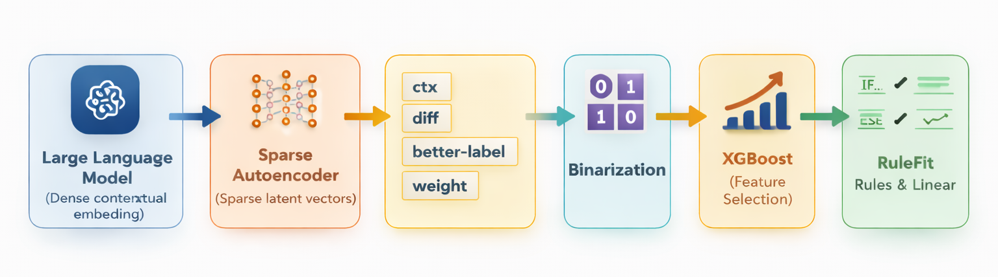
Final pipeline

Slide 11
Results
Δf2220 ‘this’ +0.1378
Δf11052 How to write clickbait titles +0.1078
Δf1730 remarkable and amazing qualities +0.1130
Δf433 problem, issue +0.1020
Δf9410 subtitles -0.1153
Δf1531 discovery and revelation +0.1168
Δf2223 past actions or events +0.1093
Δf1847 shocking or horrifying scenarios +0.1008
Δf604 harmful unethical behavior +0.0793
Δf1170 quizzes and puzzles +0.0916
Δf2203 stereotypes about gender roles +0.0934
Δf11979 sexual and explicit themes +0.1482
Δf5439 offensive content +0.0907
Δf70 -0.0742
Δf2161 female names and women +0.1025
clickbait titles > 0.5 +0.07
unexpected things > 0.5 +0.06
intense negative emotions ≤ -0.5 -0.05
recognizing or noticing ≤ -0.5 -0.14
joke, humor > -0.5 AND
‘thing’ ≤ 0.5 AND
ctx: asking questions > 0.5 +0.03
regulation, risk > 0.5 AND
past events > -0.5 -0.04

Slide 12
Results
Δf2220 “this”
A: I Thought I Had This PSA Figured Out. Turns Out I Was Wrong. Big Time.
B: I Called Grandma After I Saw The Ending. You Probably Will, Too.
A: I Thought I Had This PSA Figured Out. Turns Out I Was Wrong. Big Time.
B: An Eye-Opening Look Inside His Christmas Day Sheds Light On An Issue Too Many Of Us Ignore
A: You Probably Didn’t Learn This Sex History In School — But Holy Hot Peppers! Maybe You Should’ve.
B: The History Of Sex Is Interesting And Awkward — And You Should’ve Learned It.
Δf11052 “How to write clickbait titles”
A: The Secret About Work Life In 20 Other Countries That Will Surprise You
B: In Japan, They Have A Word For Working Yourself To Death
A: The Secret About Work Life In 20 Other Countries That Will Surprise You
B: The Next Time You Hear Someone Say That Americans Are Lazy, Show Them This
A: When Everything Was Going Wrong For These Teens, A Kind Intervention Saved The Day
B: A Kid’s Feelings Are Always Important, Especially When They’re Not Heard
Δf1730 “remarkable and amazing qualities”
A: Paul Walker's Unfinished Masterpiece Revealed. It's Not A Movie, It's Just Astonishingly Terrific.
B: How Come Paparazzis Never Manage To Catch Celebs Engaged In This Type Of Behavior?
A: Photos Of An Astonishingly Beautiful Place That's Losing So Much Of What Makes It Beautiful
B: Photos Of Fading Beauty And The Story Of What's Taking It Away
A: Photos Of Astonishingly Beautiful People Who Are Losing So Much Of What Makes Them Beautiful
B: Photos Of Fading Beauty And The Story Of What's Taking It Away

Slide 13
Results
Δf433 “problem, issue”
A: There’s One Huge Problem In Google And Facebook’s Back Yard
B: You’ll Be Shocked At What Exists In One Of The Richest Areas In The World
A: There’s One Huge Problem In Google And Facebook’s Backyard
B: You’ll Be Shocked At What Exists In One Of The Richest Areas In The World
A: Wonder Woman, Spider-Man, Captain America. All These Heroes Are Awesome. There's Just One Problem.
B: Most Of Us Are Able To Find Comic Book Heroes That Look Like Us. How About The People Who Don't?
Δf9410 “subtitles”
A: Where Have You Gone, FDR? A Nation Turns Its Broke-Ass Eyes To You.
B: The Stock Market Is Up, And I'd Prefer Not To Cheer...
A: When The Price Is Wrong…So Wrong: America’s Hospitals Get Wealthy This Way.
B: One Minute Of How Bad Our Healthcare System Really Is
A: Get Used To Me: Black. Confident. Cocky.
B: These Kids Were Asked To Act Like A Famous Idol, And They Knocked It Out Of The Park
Δf1531 “discovery and revelation”
A: On our first date, he deeply insulted me. I didn't realize until years later.
B: I'm a black guy who dates outside of my race. Here's a heart-dropping letdown moment I experienced.
A: A creepy parody commercial for a pet company that made me so angry until I realized it was fake.
B: A couple gave their son a cute little puppy. So why am I sorta creeped out?
A: I Thought This Ad Was Trying To Sell Me Jewelry, And Then I Realized It Had A Powerful Message
B: Marriage Gets A Shiny Reboot In This Fantastic Ad From India

Slide 14
Conclusion / Limitations
long pipeline - accumulating error
correlation vs causation
crude clustering

Slide 15
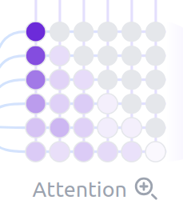
Thank
you
for
your

