Slide 1
The Reentrancy Attack

Slide 2
Outline
The reentrancy attack
Launch the attack
Countermeasures

Slide 3
reentrancy attack

Slide 4
The DAO Attack (on Ethereum Blockchain)
DAO: Decentralized Autonomous Organizations
Application of Blockchain technologies
The DAO (for venture capital funding)
A smart contract (a program running on the blockchain)
Had 3.6 million ethers (worth $70 million)
It has a vulnerability
May 2016: attackers stole $50 million
The severe damage caused Ethereum to take a rare action
Hard fork of the Ethereum blockchain: Ethereum Classic

Slide 5
How The DAO Attack Works (Reentrancy)
Attacker’s Smart Contract
attack()
{
Deposit 1 Ether to the victim contract
Invoke victim’s withdraw()
}
fallback()
{
Require victim’s balance >= 1 Ether
Invoke victim’s withdraw()
}
Victim’s Smart Contract
withdraw()
{
Require caller’s balance >= 1 Ether
Send 1 Ether to caller
Deduct caller’s balance by 1 Ether
}

Slide 6
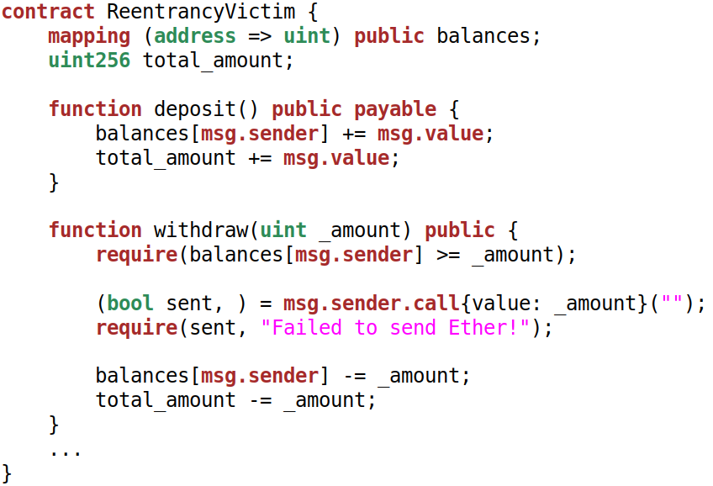
The Vulnerable Contract

Slide 7
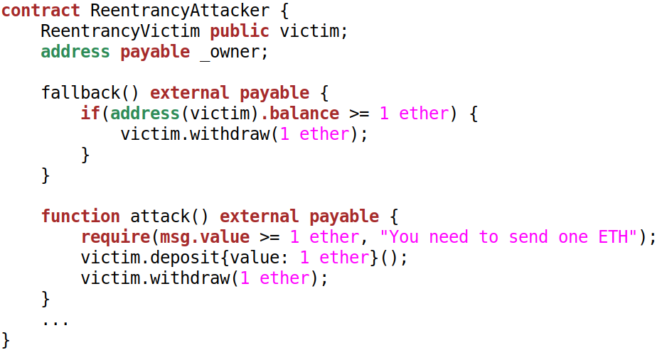
The Attack Contract

Slide 8
launch the attack

Slide 9
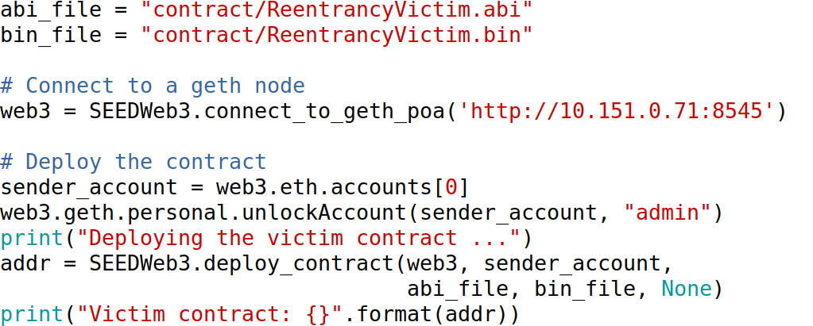
Deploy the Victim Contract

Slide 10
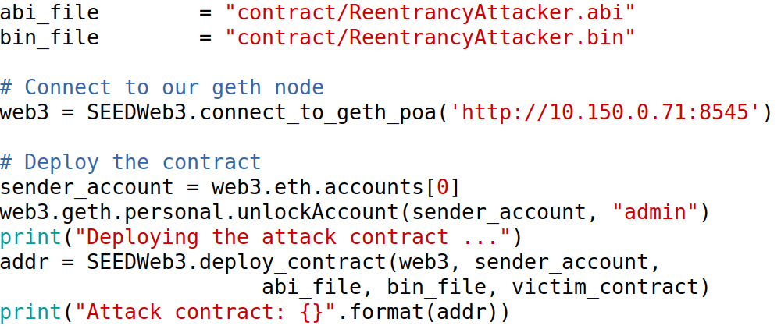
Deploy the Attack Contract

Slide 11
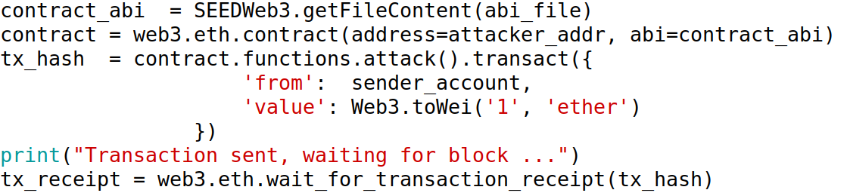
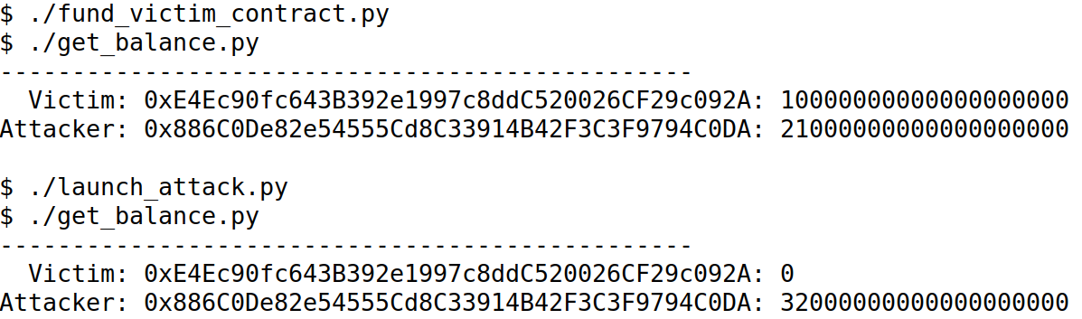
Launch the Attack

Slide 12
Notes
Using Solidity 0.8.10: the attack failed
Countermeasures are implemented by Solidity
Haven’t figured out the exact countermeasures
Using Solidity 0.6.8: successful
We can download the older version (binary) from https://github.com/ethereum/solidity/releases

Slide 13
Reference
A Historical Collection of Reentrancy Attacks
https://github.com/pcaversaccio/reentrancy-attacks
Language feature: disallow state-changing effects after an external call by default #12996
https://github.com/ethereum/solidity/issues/12996

Slide 14
countermeasure

Slide 15
Limit the gas allowed
Use send or transfer: forwards 2300 gas stipend, so its damage is limited. [1]
Notes:
Reference:
[1] https://docs.soliditylang.org/en/latest/security-considerations.html#use-the-checks-effects-interactions-pattern

Slide 16
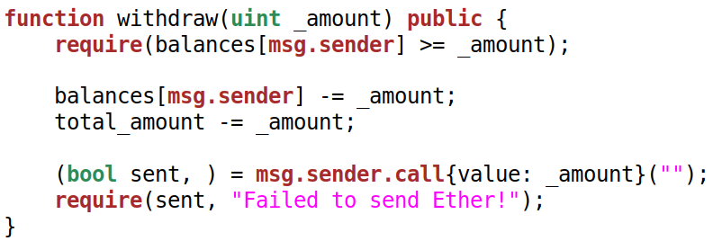
Use the Checks-Effects-Interactions pattern
Most functions will first perform some checks
Effects to the state variables of the current contract should be made before the interaction with other contracts
Notes:
Reference:
[1] https://docs.soliditylang.org/en/latest/security-considerations.html#use-the-checks-effects-interactions-pattern
Because transactions are atomic, putting the effects before the interaction is fine. If the interaction fails, all the actions involved will be rolled back and the effects will be restored.
In our conventional programming, this is not the case. That is why developers are used to update the effects after the interaction.

