Slide 1



TEMPLATE_ID:cover
Progetto HCI
[PROJECT TITLE]
[SUBTITLE GOES HERE]
[YEAR/DATE]
[AUTHORS]

Slide 2



TEMPLATE_ID:section_divider_neutral
[SECTION NAME]

Slide 3


TEMPLATE_ID:section_divider_deliveroo
[SECTION NAME]

Slide 4



TEMPLATE_ID:section_divider_glovo
[SECTION NAME]

Slide 5
TEMPLATE_ID:graph_full_neutral
[GRAPH TITLE]
[INSIGHT_TEXT]

Slide 6

TEMPLATE_ID:graph_full_deliveroo
[GRAPH TITLE]
[INSIGHT_TEXT]

Slide 7
TEMPLATE_ID:graph_full_glovo
[GRAPH TITLE]
[INSIGHT_TEXT]

Slide 8

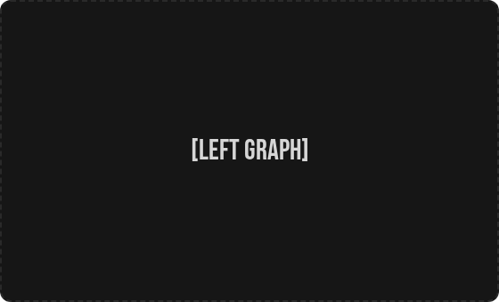

TEMPLATE_ID:comparison_neutral
[COMPARISON TITLE]
[SUMMARY_TEXT]

Slide 9
TEMPLATE_ID:table_large_neutral
[TABLE_TITLE]
Metric | Deliveroo (Avg) | Glovo (Avg) | p-value | Significance
Task Success Rate | 92% | 85% | 0.042 | Significant
Time on Task (s) | 45.2 | 58.1 | 0.001 | High
SUS Score | 78.5 | 72.1 | 0.125 | Not Significant
Error Rate | 0.5 | 1.2 | 0.033 | Significant
[TABLE_FOOTNOTE]

Slide 10
TEMPLATE_ID:table_large_deliveroo
[TABLE_TITLE]
Metric | Deliveroo (Avg) | Glovo (Avg) | p-value | Significance
Task Success Rate | 92% | 85% | 0.042 | Significant
Time on Task (s) | 45.2 | 58.1 | 0.001 | High
SUS Score | 78.5 | 72.1 | 0.125 | Not Significant
Error Rate | 0.5 | 1.2 | 0.033 | Significant
[TABLE_FOOTNOTE]

Slide 11
TEMPLATE_ID:table_large_glovo
[TABLE_TITLE]
Metric | Deliveroo (Avg) | Glovo (Avg) | p-value | Significance
Task Success Rate | 92% | 85% | 0.042 | Significant
Time on Task (s) | 45.2 | 58.1 | 0.001 | High
SUS Score | 78.5 | 72.1 | 0.125 | Not Significant
Error Rate | 0.5 | 1.2 | 0.033 | Significant
[TABLE_FOOTNOTE]

Slide 12

TEMPLATE_ID:findings_neutral
[SUMMARY_TEXT]
KEY FINDINGS & INSIGHTS
[FINDING_1]
[FINDING_2]
[FINDING_3]
[FINDING_4]

Slide 13
TEMPLATE_ID:findings_deliveroo
[SUMMARY_TEXT]
KEY FINDINGS & INSIGHTS
[FINDING_1]
[FINDING_2]
[FINDING_3]
[FINDING_4]

Slide 14
TEMPLATE_ID:findings_glovo
[SUMMARY_TEXT]
KEY FINDINGS & INSIGHTS
[FINDING_1]
[FINDING_2]
[FINDING_3]
[FINDING_4]

Slide 15
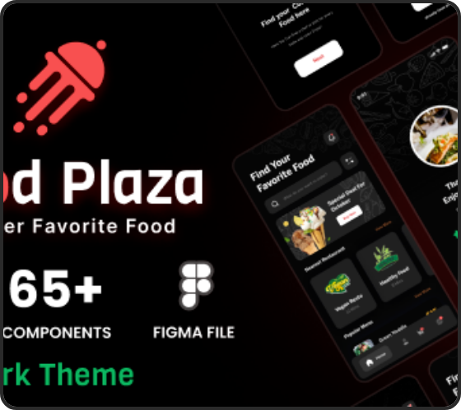

TEMPLATE_ID:task_results_neutral
[TASK_TITLE]
TASK DESCRIPTION
[TASK_DESCRIPTION]
TASK RESULTS
SUCCESS RATE
AVG TIME
[SUCCESS_RATE]
[AVG_TIME]

Slide 16
TEMPLATE_ID:task_results_deliveroo
[TASK_TITLE]
TASK DESCRIPTION
[TASK_DESCRIPTION]
TASK RESULTS
SUCCESS RATE
AVG TIME
[SUCCESS_RATE]
[AVG_TIME]

Slide 17
TEMPLATE_ID:task_results_glovo
[TASK_TITLE]
TASK DESCRIPTION
[TASK_DESCRIPTION]
TASK RESULTS
SUCCESS RATE
AVG TIME
[SUCCESS_RATE]
[AVG_TIME]

Slide 18


TEMPLATE_ID:ueq_question_neutral
[QUESTION_TITLE]
[MEAN_VALUE]
[STD_VALUE]
[MIN_VALUE]
[MAX_VALUE]
MEAN
STD DEV
MIN
MAX

Slide 19
TEMPLATE_ID:ueq_question_deliveroo
[QUESTION_TITLE]
[MEAN_VALUE]
[STD_VALUE]
[MIN_VALUE]
[MAX_VALUE]
MEAN
STD DEV
MIN
MAX

Slide 20
TEMPLATE_ID:ueq_question_glovo
[QUESTION_TITLE]
[MEAN_VALUE]
[STD_VALUE]
[MIN_VALUE]
[MAX_VALUE]
MEAN
STD DEV
MIN
MAX

Slide 21




TEMPLATE_ID:final_verdict
FINAL VERDICT & CONCLUSIONS
DELIVEROO
GLOVO
[STRENGTH 1]
[STRENGTH 1]
[STRENGTH 2]
[STRENGTH 2]
[WEAKNESS]
[WEAKNESS]

Slide 22

TEMPLATE_ID:sources
IMAGE SOURCES
https://s3.envato.com/files/390502005/01_Preview.__large_preview.png
Source: themeforest.net

Slide 23
TEMPLATE_ID:text_only_neutral
[TEXT_TITLE]
[TEXT_BODY]

Slide 24
TEMPLATE_ID:text_only_deliveroo
[TEXT_TITLE]
[TEXT_BODY]

Slide 25
TEMPLATE_ID:text_only_glovo
[TEXT_TITLE]
[TEXT_BODY]

