Slide 1
OPERATING SYSTEM
LESSON 2

Slide 2
INTRODUCTION TO OPERATING SYSTEM
Computer Hardware’s complexity
Operating Systems (OS) hide this complexity from users
OS manages all hardware devices and provide user programs with a simpler interface to the hardware.

Slide 3
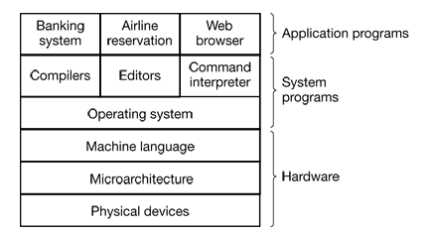
Layers of A Comptuter Systems

Slide 4
System Programs
System programs consist of operating system and the rest of the system software.
Command interpreter, compilers, database managament systems, editors are called SHELL.
The operating system is the system software that runs in kernel mode or supervisor mode.
Compilers and editors are the system software that run in user mode.

Slide 5
What Does Operating System Do?
Operating systems perform two basically unrelated functions:
Extending the machine
Managing resources

Slide 6
Extending Machine
Generally programmer does not want to get too deeply involved with the programming of disks or other hardware devices.
Instead, the programmer wants is a simple, high-level abstraction to deal with. A typical abstraction of a disk would be that it contains a collection of named files.
OS hides the details of the hardware from the programmer and presents a nice, simple view of named files that can be read and written.
OS also conceals a lot of unpleasant business concerning interrupts, timers, memory management, and other low-level features.

Slide 7
Managing Resources
Computers consist of processors, memories, timers, disks, mouses, network interfaces, printers, and a wide variety of other devices.
The job of the operating system is to provide an orderly and controlled allocation of the processors, memories, and I/O devices among the various programs competing for them.

Slide 8
Managing Resources
Printer Example:Imagine what would happen if three programs running on some computers all tried to print their output simultaneously on the same printer. The first few lines of printout might be from program 1, the next few from program 2, then some from program 3, and so forth. The result would be chaos. The operating system can bring order to the potential chaos by buffering all the output destined for the printer on the disk. When one program is finished, the operating system can then copy its output from the disk file where it has been stored to the printer.

Slide 9
Managing Resources
Managing and protecting memory in a multi-user system
OS keeps track of who is using which resource, to grant resource requests and to prevent conflicting requests from different programs and users.
Resource management includes multiplexing (sharing) resources in two ways: in time and in space.
CPU usage as the way of time multiplexing
Main memory or disk usage as the way of space multiplexing

Slide 10
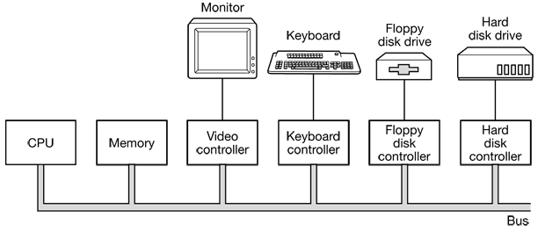
COMPUTER HARWARE REVIEW
An operating system is intimately (closely) tied to the hardware of the computer it runs on. It makes easy the usage of the computer’s instruction set and manages its resources.
OS must know a great deal about the hardware

Slide 11
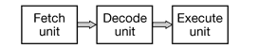
1.Processors
The “brain” of the computer is the CPU. It fetches instructions from memory and executes them.
To improve performance, many modern CPUs have facilities for executing more than one instruction at the same time. For example, a CPU might have separate fetch, decode, and execute units, so that while it was executing instruction n, it could also be decoding instruction n + 1 and fetching instruction n + 2. Such an organization is called a pipeline.

Slide 12
Accesing memory takes too much time. Thus CPU has registers which are very fast memory units in CPU. Instruction sets have instructions to load data from memory to register or store data from register to memory.
Most computers have several special registers that are visible to the programmer:
Program Counter,
Stack pointer,
PSW (Program Status Word)
….

Slide 13
Program Counter contains the memory address of the next instruction to be fetched.
Stack pointer points to the top of the current stack in memory. The stack contains one frame for each procedure that has been entered but not yet exited.
PSW (Program Status Word) register contains the condition code bits, the CPU priority, the mode (user or kernel), and various other control bits. User programs may normally read the entire PSW but typically may write only some of its fields.

Slide 14
Most CPUs have two modes, kernel mode and user mode. Usually a bit in the PSW controls the mode. When running in kernel mode, the CPU can execute every instruction in its instruction set and use every feature of the hardware. The operating system runs in kernel mode and access to the complete hardware.
In contrast, user programs run in user mode, which permits only a subset of the instructions to be executed and a subset of the features to be accessed. Generally, all instructions involving I/O and memory protection are disallowed in user mode.
To obtain services from the operating system, a user program must make a system call, which traps into the kernel and invokes the operating system. The TRAP instruction switches from user mode to kernel mode and starts the operating system.

Slide 15
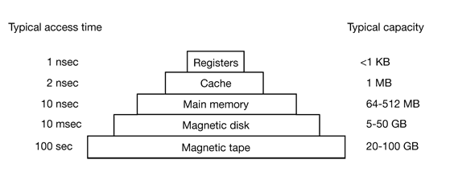
2.Memory
The memory system is constructed as a hierarchy of layers.

Slide 16
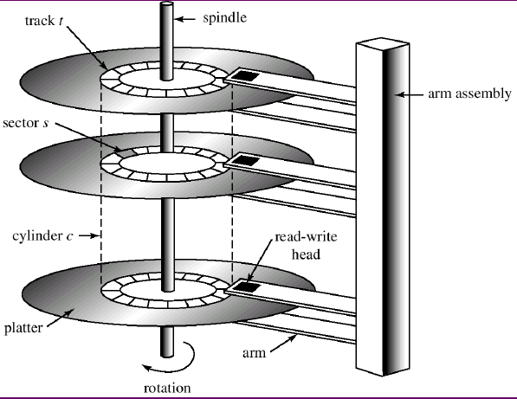
Disk structure
Metal platters
Cylinders
Tracks
Sectors

Slide 17
Maın memory
If one program is blocked waiting for a disk read to complete, another program can use the CPU, giving a better CPU utilization. However, with two or more programs in main memory at once, two problems must be solved:
How to protect the programs from one another and the kernel from them all.
How to handle reallocation.

Slide 18
Phisical and virtual adresses
When a program is compiled and linked, the compiler and linker do not know where the program will be loaded in physical memory.
They usually assume it will start at address 0, and just put the first instruction there.
Suppose that the first instruction fetches a word from memory address 10,000. Now suppose that the entire program and data are loaded starting at address 50,000. When the first instruction executes, it will fail because it will reference the word at 10,000, instead of the word at 60,000.
MMU (Memory Management Unit) converts virtual adresses to phisical adresses.

Slide 19
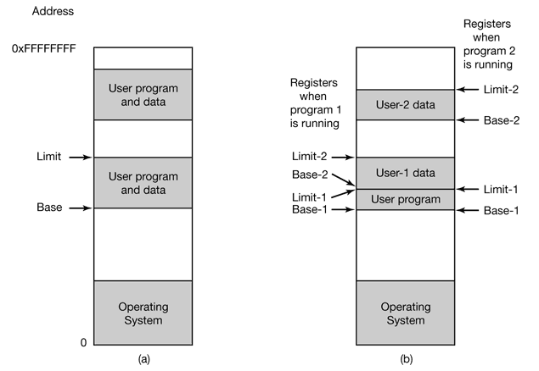
Main memory equipped with two special registers, the base register and the limit register.

Slide 20
3. I/O Devices
I/O Devices are also resource that the operating system must manage.
I/O devices generally consist of two parts: a controller and the device itself. The controller is a chip or a set of chips on a plug-in board that physically controls the device. It accepts commands from the operating system, for example, to read data from the device, and carries them out.

Slide 21
Device Drivers
Different software is needed to control each controller because each type of controller is different. The software that talks to a controller, giving it commands and accepting responses, is called a device driver. Each controller manufacturer has to supply a driver for each operating system it supports. Thus a scanner may come with drivers for Windows XP, Windows 7, and UNIX, for example.

Slide 22
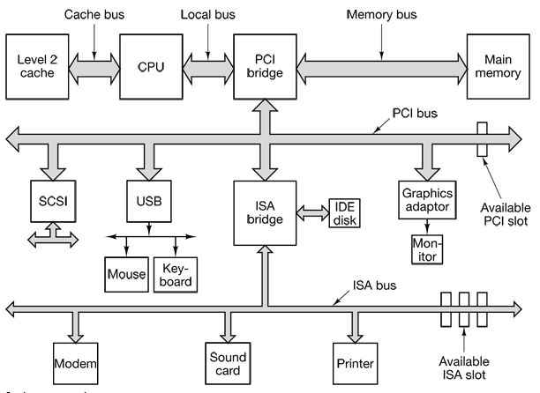
BUSES

Slide 23
QUESTIONS ???

