Slide 1
OPERATING SYSTEM
LESSON 3

Slide 2
OPERATING SYSTEM CONCEPTS
All operating systems have certain basic concepts such as process, memory, and files.
A general OS do following jobs in a computer system:
Process Management
Scheduling
Inter-process Communication
Memory Management
I/O Management
File Management
Security
Networking

Slide 3
Process
A process is basically a program in execution.
Each process has an address space in the memory which the process can read and write.
The address space contains the executable program, the program’s data, and its stack.
Also each process has some set of registers’ value, including the program counter, stack pointer, and other hardware registers, and all the other information needed to run the program.

Slide 4
Periodically, the operating system decides to stop running one process and start running another because of the different reasons (timesharing, I/O process).
When a process is suspended temporarily, it must later be restarted in exactly the same state it had when it was stopped.
This means that all information about the process must be explicitly saved somewhere during the suspension.
In many operating systems, all the information about each process is stored in an operating system table called the process table, which is an array (or linked list) of structures.

Slide 5
Memory Management
The executing programs are held in memory in computers.
In a very simple operating system, only one program at a time is in memory. To run a second program, the first one has to be removed and the second one placed in memory.
More sophisticated operating systems allow multiple programs to be in memory at the same time.
Today, many computers addresses are 32 or 64 bits, giving an address space of 2³² or 2⁶⁴ bytes, respectively.
Virtual memory exists, in which the operating system keeps part of the address space in main memory and part on disk and shuttles pieces back and forth between them as needed.

Slide 6
Input/Output
All computers have physical devices for acquiring input and producing output.
Many kinds of input and output devices exist, including keyboards, monitors, printers, and so on. It is up to the operating system to manage these devices.
Every operating system has an I/O subsystem for managing its I/O devices.

Slide 7
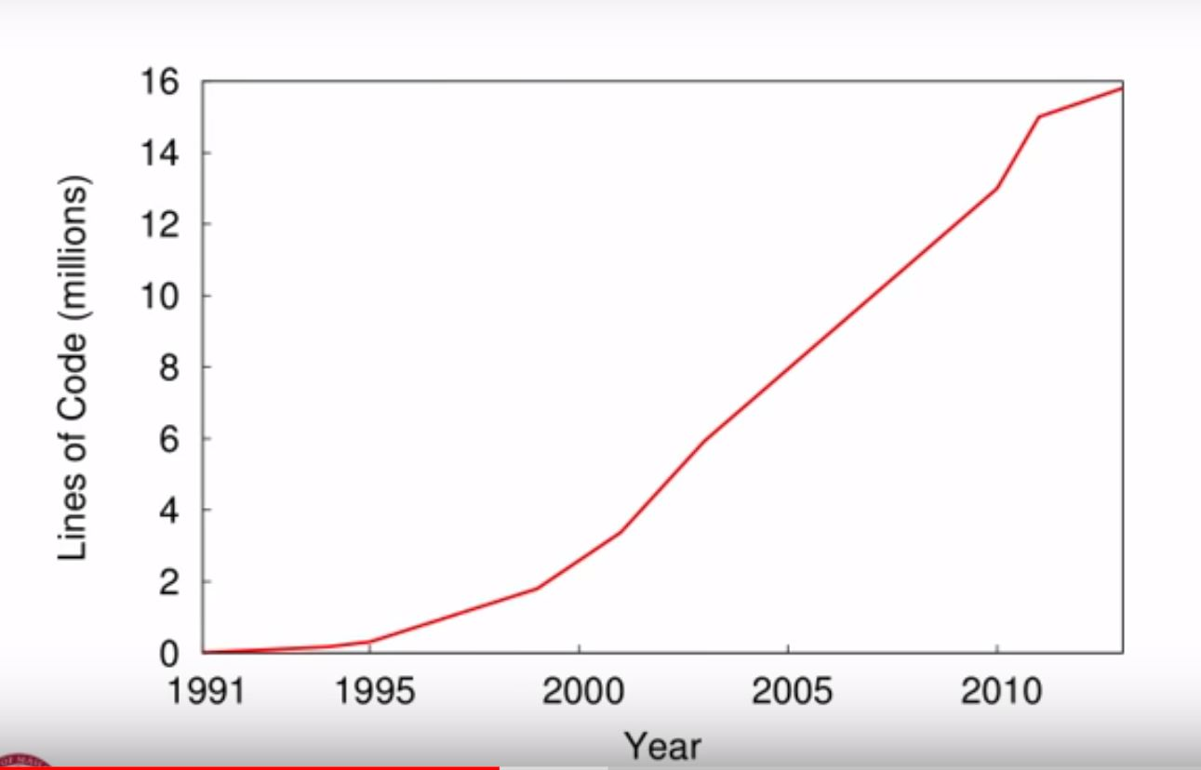

Slide 8
Files
A major function of the operating system is to hide the details of the disks and other I/O devices and present the programmer with a nice, clean abstract model of device-independent files.
System calls are obviously needed to create files, remove files, read files, and write files.
Most operating systems have the concept of a directory as a way of grouping files together.

Slide 9
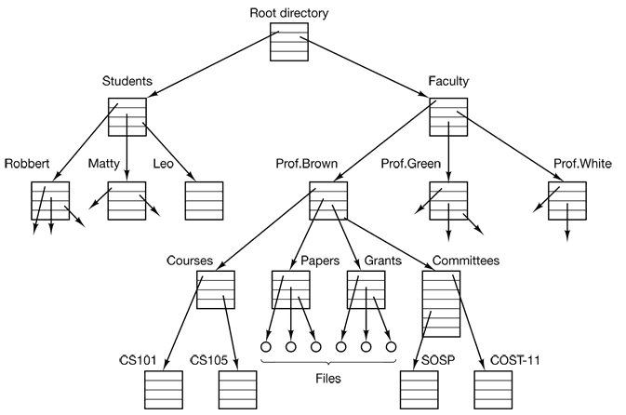
File hierarchies are organized as trees.

Slide 10
Every file within the directory hierarchy can be specified by giving its path name from the root directory.
The path for directory CS101 is /Faculty/Prof.Brown/Courses/CS101 (Unix)
\Faculty\Prof.Brown\Courses\CS101 (MS_DOS)
Before a file is read or written, it must be opened by checking the permissions. If the access is permitted, the system returns a small integer called a file descriptor to use in subsequent operations. If the access is prohibited, an error code is returned.

Slide 11
Securıty
Computers contain large amounts of information that users often want to keep confidential. This information may include electronic mail, business plans, tax returns, and much more.
As a simple example, just to get an idea of how security can work, consider UNIX. Files in UNIX are protected by assigning each one a 9-bit binary protection code. The protection code consists of three 3-bit fields, one for the owner, one for other members of the owner’s group (users are divided into groups by the system administrator), and one for everyone else. Each field has a bit for read access, a bit for write access, and a bit for execute access. These 3 bits are known as the rwx bits.
For example, the protection code rwx r-x - -x means that the owner can read, write, or execute the file, other group members can read or execute (but not write) the file, and everyone else can execute (but not read or write) the file. For a directory, x indicates search permission. A dash means that the corresponding permission is absent.

Slide 12
SYSTEM CALLS
OS provides the set of system calls that is an interface between the operating system and the user programs.
The system calls vary from operating system to operating system.
System calls are highly machine dependent and often must be expressed in assembly code. So an OS provides a procedure library to make system calls from C programs and often from other languages as well.

Slide 13
If a process is running in user mode and needs a system service, such as reading data from a file, it has to execute a trap or system call instruction to transfer control to the operating system.
The operating system then figures out what the calling process wants by inspecting the parameters. Then it implements the system call and returns control to the instruction following the system call.
In a sense, making a system call is like making a special kind of procedure call, only system calls enter the kernel and procedure calls do not.

Slide 14
Let us take a quick look at the read system call. It has three parameters: the first one specifying the file, the second one pointing to the buffer, and the third one giving the number of bytes to read. Like nearly all system calls, it is invoked from C programs by calling a library procedure with the same name as the system call: read. A call from a C program might look like this:
count = read(fd, buffer, nbytes);
The system call returns the number of bytes actually read in count.
If the system call cannot be carried out, either due to an invalid parameter or a disk error, count is set to -1, and the error number is put in a global variable, errno. Programs should always check the results of a system call to see if an error occurred.

Slide 15
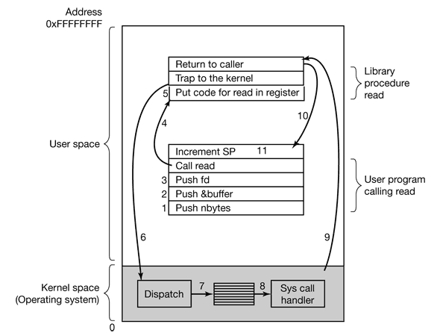
System calls are performed in a series of steps.

Slide 16
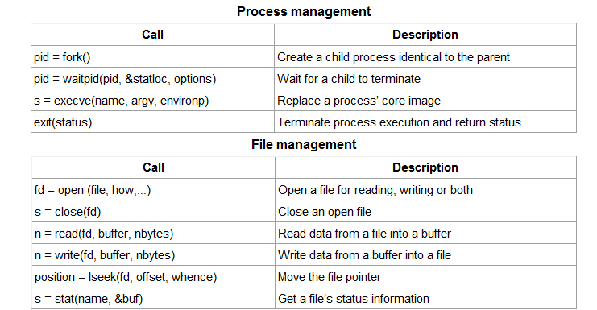
Some of the most heavily used POSIX system calls and library procedures that make those system calls.

Slide 17
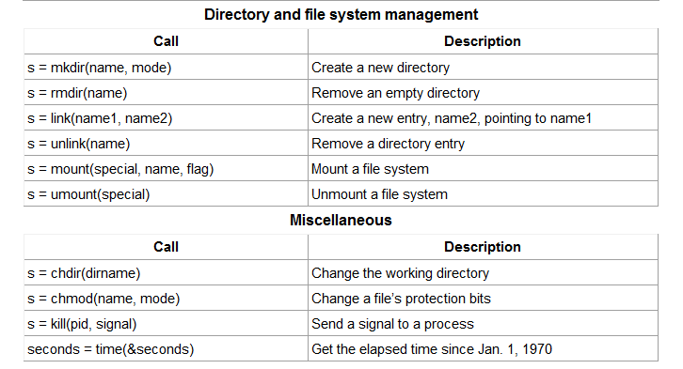

Slide 18
The Windows Win32 API
So far we have focused primarily on UNIX.
Windows and UNIX differ in a fundamental way in their respective programming models.
A UNIX program consists of code making system calls to have certain services performed.
In contrast, a Windows program is normally event driven. The main program waits for some event to happen, then calls a procedure to handle it. Typical events are keys being struck, the mouse being moved, a mouse button being pushed, or a floppy disk inserted. Handlers are then called to process the event, update the screen and update the internal program state.

Slide 19
In UNIX, there is almost a 1-to-1 relationship between the system calls and the library procedures used to invoke that system calls. In other words, for each system call, there is roughly one library procedure that is called to invoke it, as indicated in above slides. Furthermore, POSIX has only about 100 procedure calls.
Of course, Windows also have system calls. But in Windows, the situation is radically different. The library calls and the actual system calls are highly decoupled (seperated).
Microsoft has defined a set of procedures, called the Win32 API (Application Program Interface) that programmers are expected to use to get operating system services.

Slide 20
This interface is (partially) supported on all versions of Windows since Windows 95. By decoupling the interface from the actual system calls, Microsoft retains the ability to change the actual system calls in time (even from release to release) without invalidating existing programs.
In Windows, it is impossible to see what is a system call and what is simply a user-space library call.

Slide 21
Win32 API has a huge number of calls for managing windows, geometric figures, text, fonts, scrollbars, dialog boxes, menus, and other features of the GUI.
Win32 API calls correspond to the functionality of the UNIX calls listed in next figure.

Slide 22
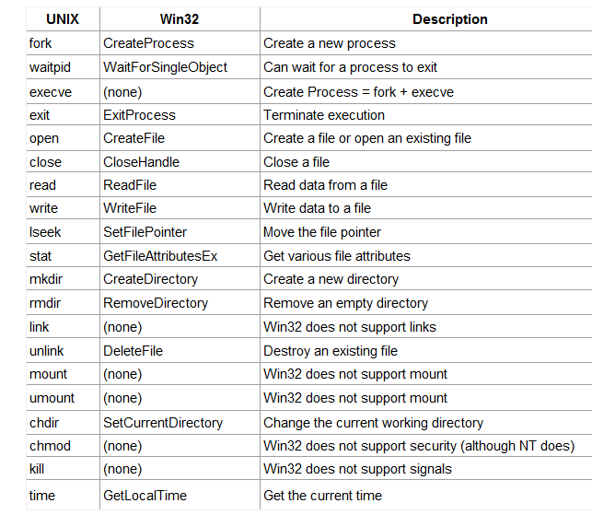

Slide 23
OUESTIONS ???

