Slide 1

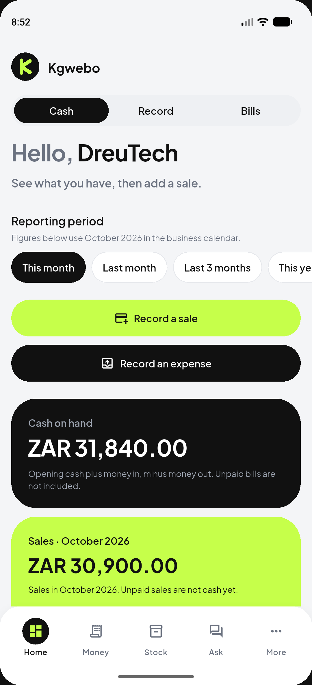
Kgwebo
Helping small businesses
understand their money.
A Flutter stall-finance app that records cash-basis activity, shows what cash is actually available, and turns those records into the next useful step.
2026 FNB App of the Year · Youth entrepreneurship & small-business growth
JUDGE DEMO ACCOUNT
Email: dreu.davids1@gmail.com
Password: password
Stall: DreuTech · illustrative records
Demo & Apk Link: https://drive.google.com/drive/folders/1wElrUXpOcWKaumeP9yL9Q3arMl5naetR?usp=drive_link
GitHub: https://github.com/DreuDavids/Kgwebo
Notes:
Open on the product, not awards. Credentials are required for judges. DreuTech is an illustrative stall in ZAR. Do not claim traction.

Slide 2
THE PROBLEM
The till is busy. The picture of the money is not.
These are practical problems for informal traders and small service owners across Southern Africa.
Records live in notebooks
and chat threads
Cash on hand is a guess
Upcoming bills arrive as surprises
Numbers rarely become a decision
Sales, expenses and stock are captured inconsistently, if at all.
Money in the till is mixed with personal cash, unpaid sales and unpaid bills.
Rent, software and supplier payments are not visible before they fall due.
A tracker that only lists transactions does not say what to do next.
Kgwebo · FNB App of the Year 2026 · Judge demo: dreu.davids1@gmail.com
2
Notes:
Stay human. No invented statistics. Botswana-first product; screenshots later show a ZA/ZAR illustrative stall.

Slide 3
THE SOLUTION
One place to record, understand, anticipate and act.
Kgwebo is a working Android app. It already records sales and expenses, keeps a stock catalogue, forecasts outgoing bills, and answers questions from recorded figures.
Record
Paid and unpaid sales, expenses, refunds, owner cash moves.
Understand
Recorded cash is separated from sales. Opening cash is not revenue.
Anticipate
7 / 14 / 30-day outlook subtracts unpaid bills.
Act
Deterministic recommendations plus Ask Ai.
Kgwebo · FNB App of the Year 2026 · Judge demo: dreu.davids1@gmail.com
3
Notes:
State clearly what works: live auth, dashboard, money, stock, bills, Ask, reports. Demo stall is DreuTech in ZAR.

Slide 4
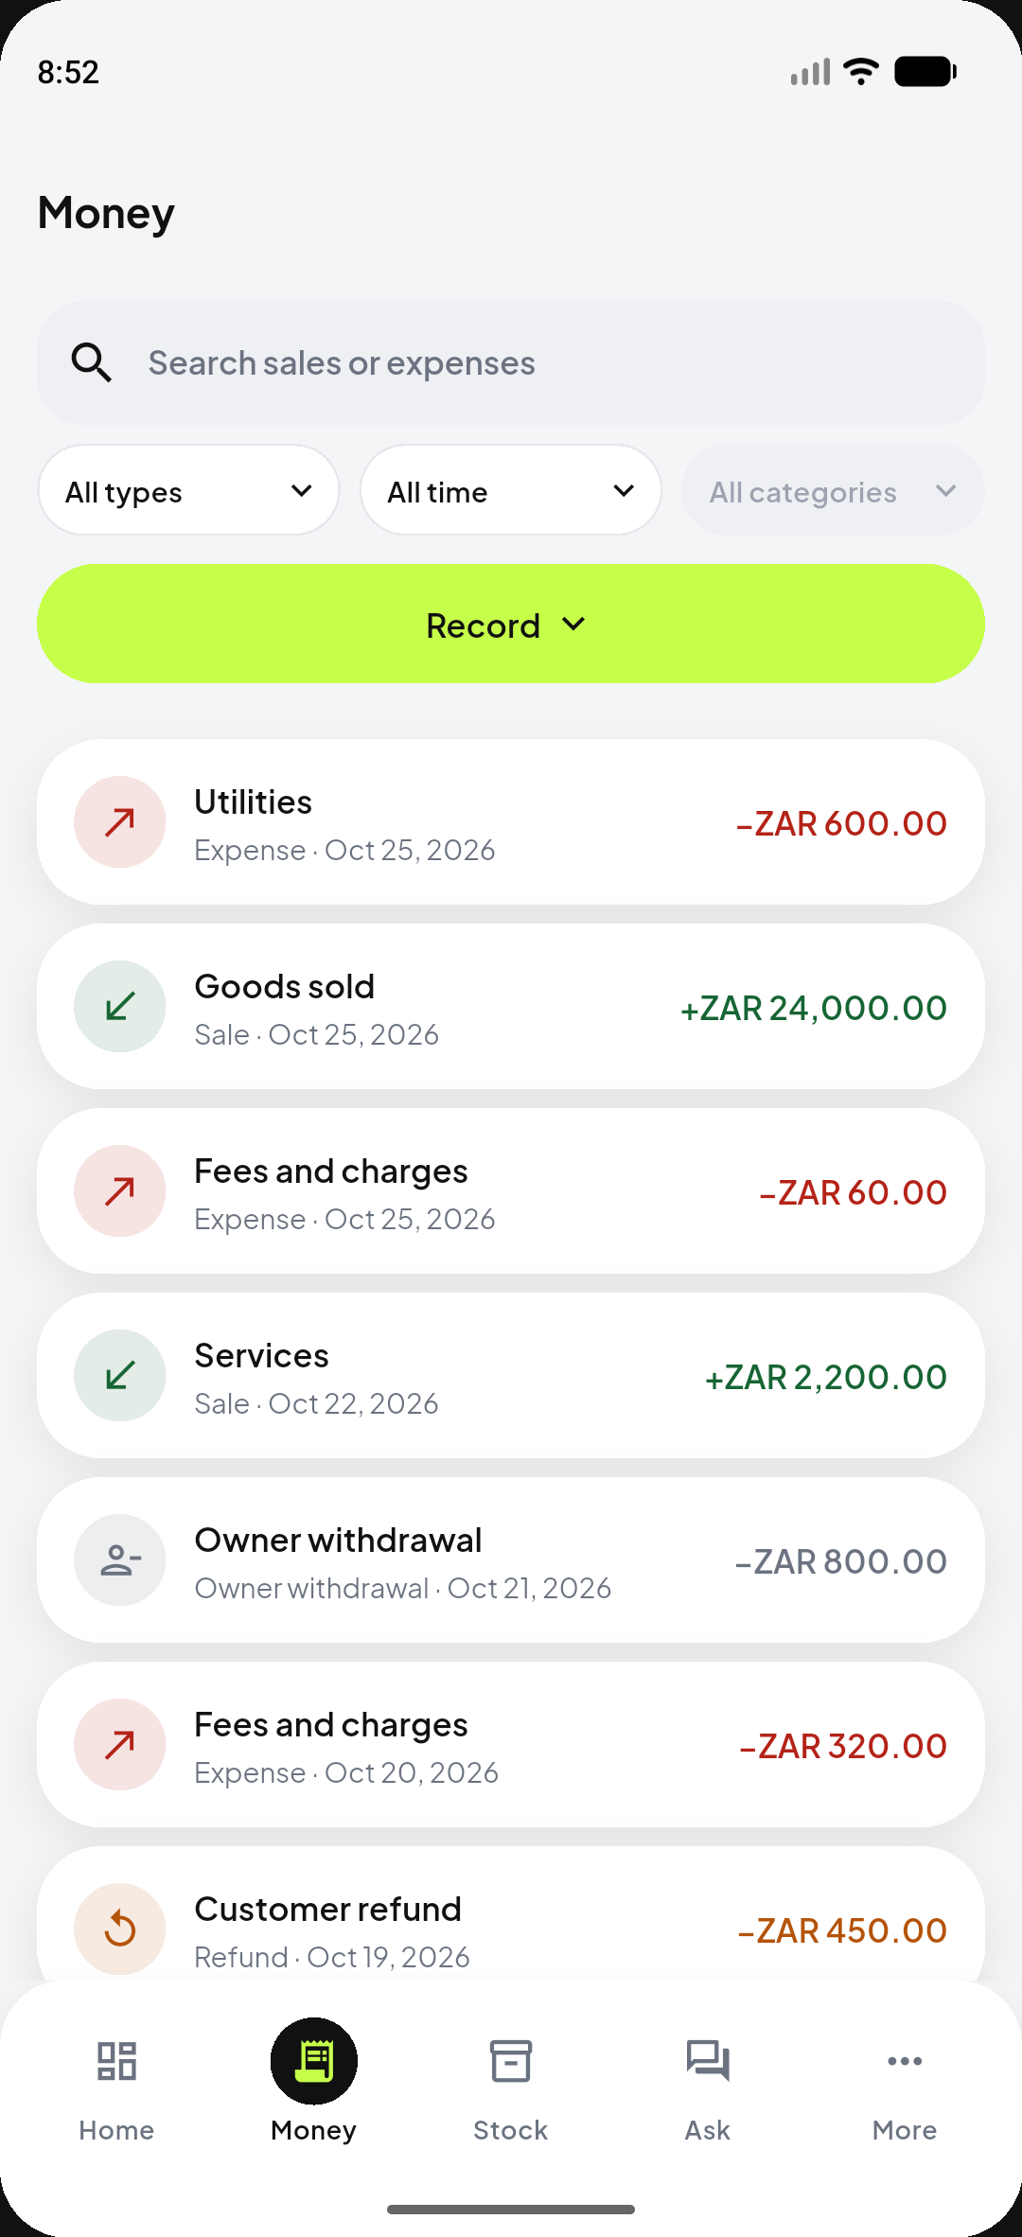
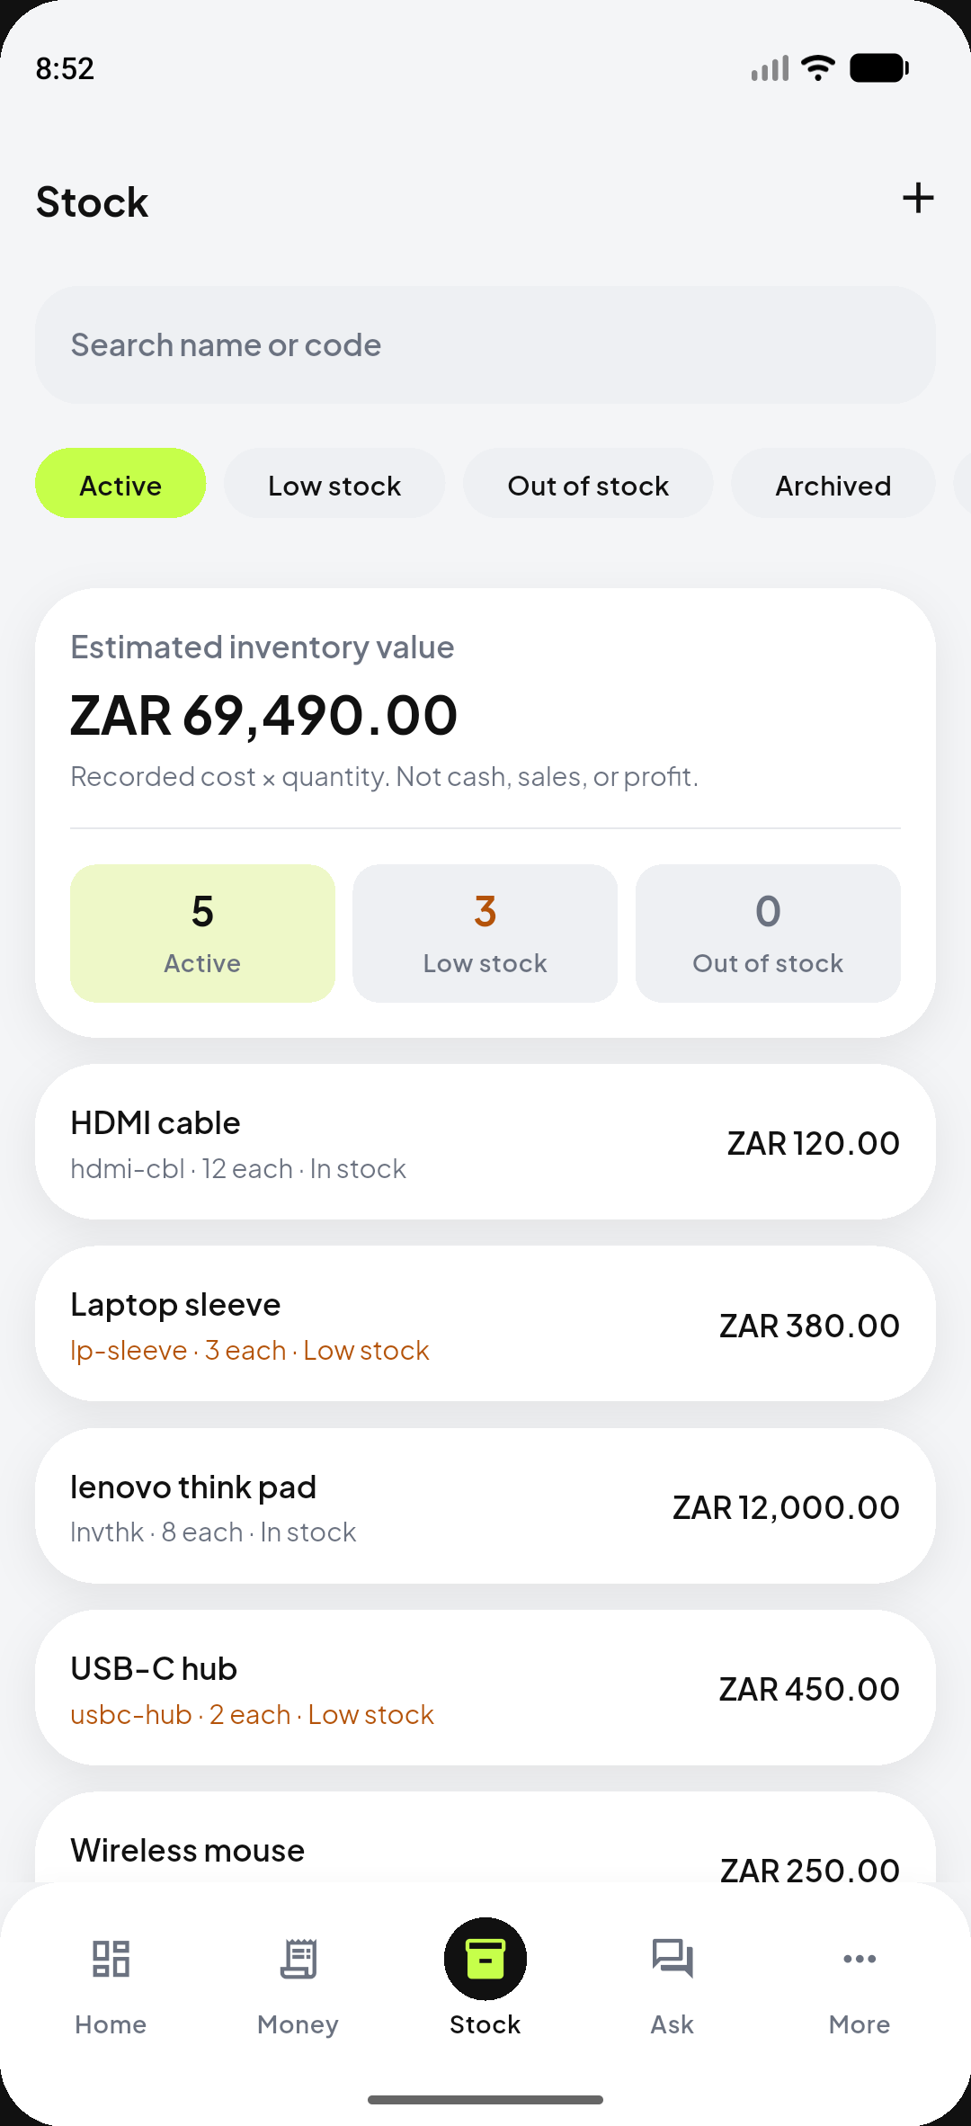
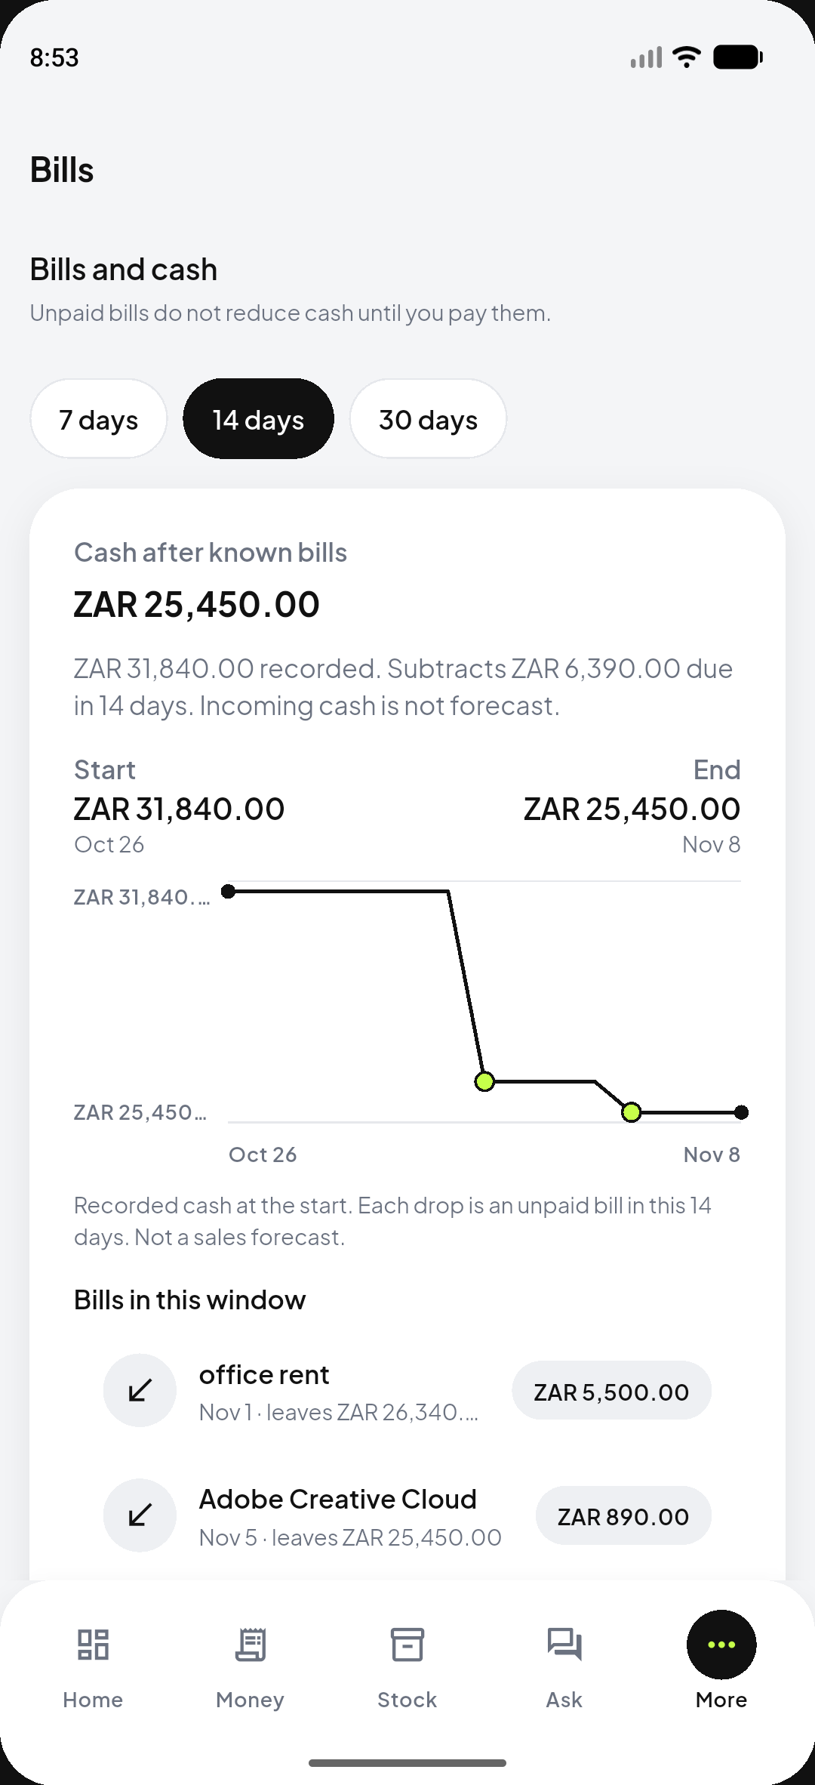
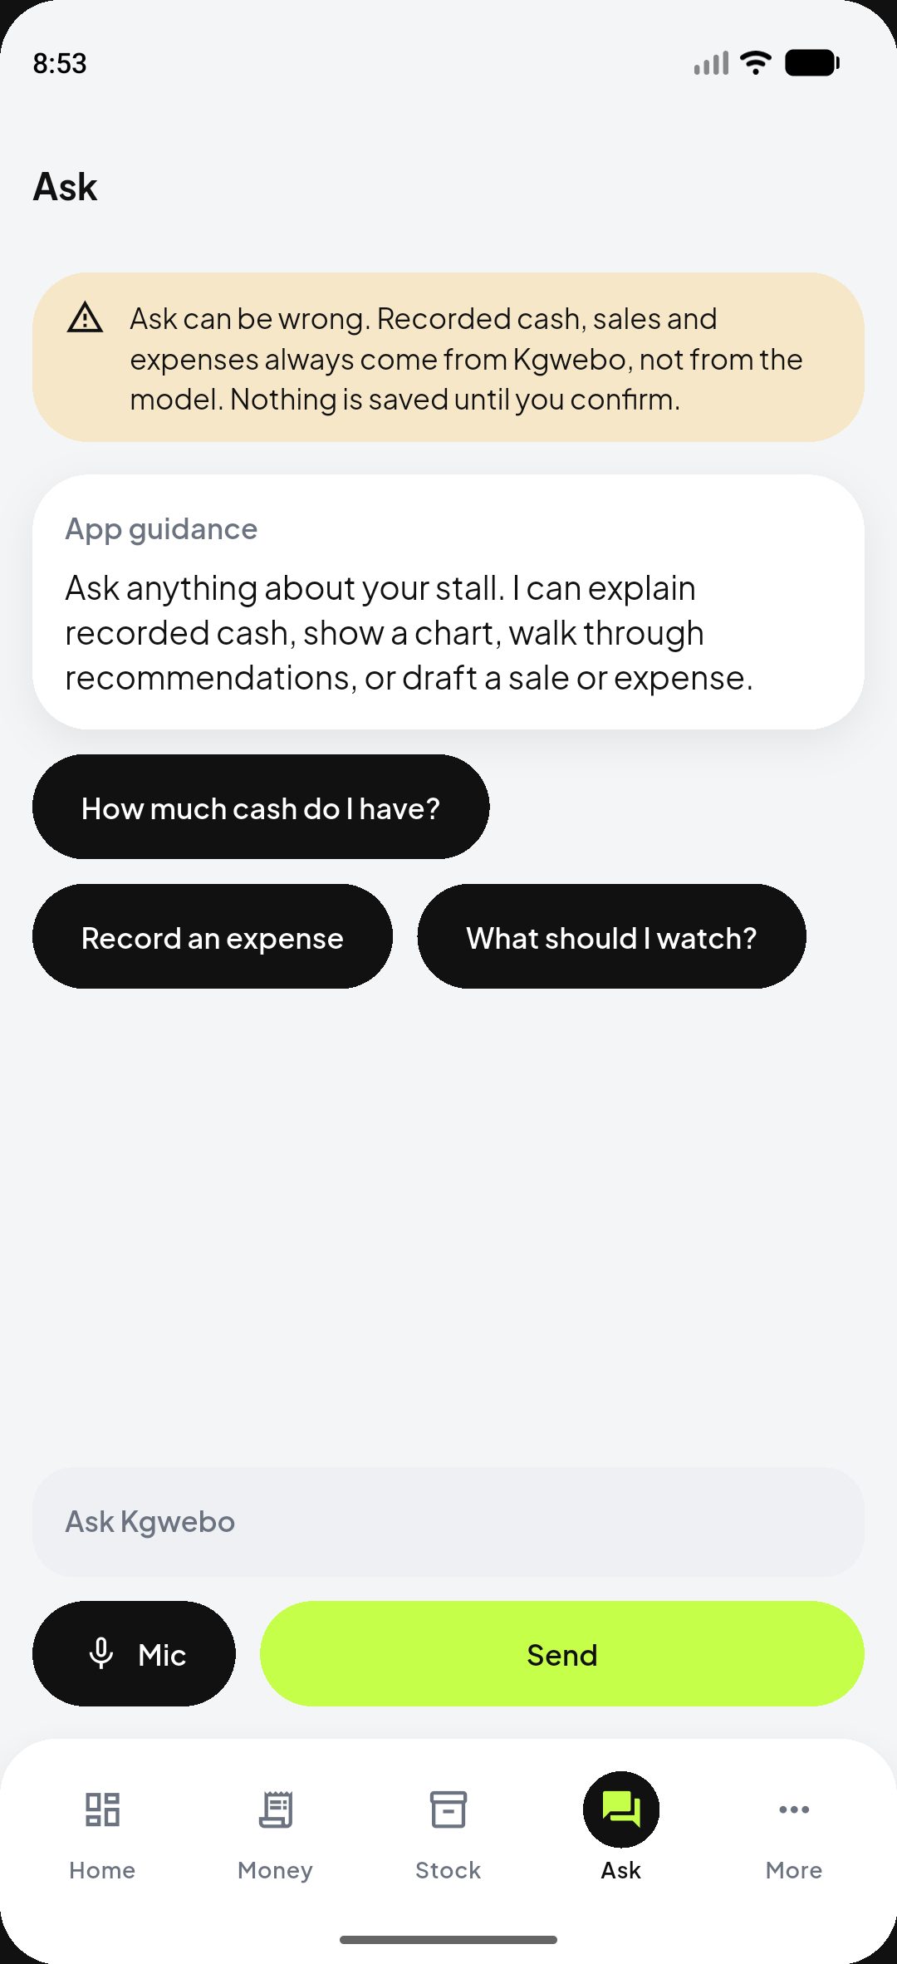
HOW IT WORKS
Four screens. Four jobs.
Money
Stock
Bills
Ask Ai
Sales, expenses, refunds and owner movements in one ledger.
Catalogue, cost, quantity. Inventory value.
Unpaid commitments sit in the forecast, not in recorded cash.
Talk or type. Figures come from Kgwebo. Nothing saves until confirm.
Kgwebo · FNB App of the Year 2026 · Judge demo: dreu.davids1@gmail.com
4
Notes:
Offline: only amount-only creates and new unpaid bills queue. Pending is not cash. Product sales need a network. Ask can fall back to on-device heuristics if the cloud call fails.

Slide 5
USER STORY · ILLUSTRATIVE DREUTECH
The till looks full.
Rent is due in six days.
Monday 26 October. Dreu runs DreuTech — cables, laptops, and the odd website job. A supplier WhatsApps: ten USB-C hubs, R 4000 cash, today. The till shows R 31,840. Instinct says yes.
What the till does not say: office rent of R 5,500 lands on 1 November. Adobe Creative Cloud of R 890 lands on 5 November. Three products are already low. A client just paid R 450 for a website fix that is not in the book yet.
Recorded cash
Bills in 14 days
R 31,840
R 6,390
Supplier offer
Cash after bills
R 4,000
R 25,450
The question is not “is there money in the till?” It is “can Dreu restock and still pay rent on 1st November?”.
Kgwebo · FNB App of the Year 2026 · Judge demo: dreu.davids1@gmail.com
5
Notes:
Tell the WhatsApp restock offer first. Point at the bills drop: R 31,840 → R 25,450. Label DreuTech illustrative. Do not claim Dreu is a real customer.

Slide 6
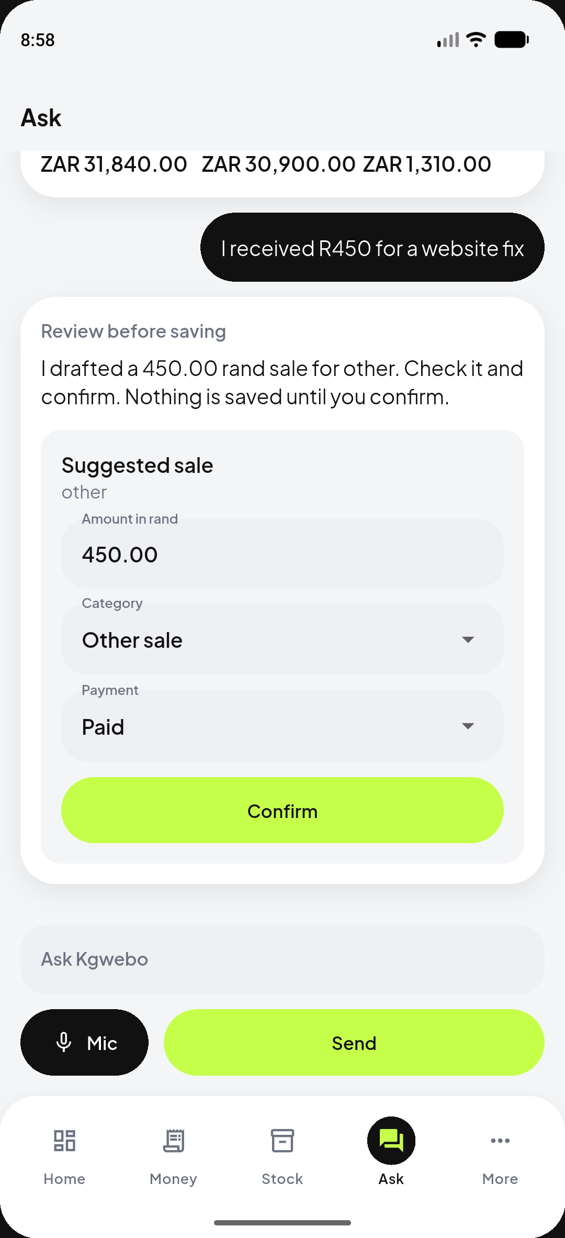
USER STORY · SAME MORNING
Dreu opened Kgwebo and answered it.
1
See the cash
2
Subtract the bills
3
Check the shelf
4
Ask Ai, then record
Home shows R 31,840 recorded cash. Unpaid bills are excluded. This is not free-to-spend money.
14-day Bills path: rent 1 Nov, Adobe 5 Nov. After known bills: R 25,450. Incoming cash is not invented.
USB-C hub is genuinely low (2 left). Stock on the shelf is R 69,490 — labelled as not cash.
Ask answers cash from records. “I received R 450 for a website fix” becomes a draft. Confirm still waiting.
Decision: R 4,000 restock still fits inside R 25,450 after rent and Adobe. Dreu can say yes with eyes open. The R 450 sale is not in cash until Confirm.
Kgwebo · FNB App of the Year 2026 · Judge demo: dreu.davids1@gmail.com
6
Notes:
Walk the four screens as one morning. End on the decision: restock is affordable after bills. Ask’s Confirm is still unsaved — say that out loud.

Slide 7
A CLOSER LOOK
The product, as it runs.
Home · recorded cash first
Money · the actual ledger
Bills · cash after known commitments
Ask Ai · draft, then confirm
Kgwebo · FNB App of the Year 2026 · Judge demo: dreu.davids1@gmail.com
7
Notes:
Let the screenshots do the talking. Point at cash vs sales, the forecast drop, and Ask’s Confirm button.

Slide 8
INTELLIGENCE
Trustworthy figures first. Then a copilot that cannot quietly change them.
Cash is not sales
The till is not free cash
Recorded cash = opening cash + paid in − paid out. Dreu’s R 24,000 laptop sale is cash only because it is marked paid.
R 31,840 is recorded cash. R 6,390 of bills still sit outside it until they are paid.
Bills wait their turn
Recommendations are rules
Unpaid rent does not reduce cash today. The 14-day outlook subtracts it.
Six evidence-backed rules. Low stock uses catalogue quantities. Copy says estimate, not advice.
Ask Ai is grounded
Stock value is not cash
Ask Ai reads FinancialEngine. Money talk is overwritten with recorded figures. Nothing saves until Confirm.
R 69,490 on the shelf is cost × quantity. Spending it would be spending goods Dreu still needs to sell.
Kgwebo · FNB App of the Year 2026 · Judge demo: dreu.davids1@gmail.com
8
Notes:
Tie numbers back to Dreu’s morning. Do not imply a silent LLM posting. Cloud Ask uses kgwebo-copilot (LiteLLM). If the key is missing, Ask still answers from recorded totals.

Slide 9
ARCHITECTURE
Built so the phone cannot lie about money.
PRESENTATION
Flutter UI
GoRouter
Riverpod
Android screens. Widgets render values. They never add cash.
Auth guards and onboarding redirects.
One graph of state. Home, Bills, Reports and Ask Ai subscribe to the same summary.
↓
MONEY CORE
FinancialEngine
CashForecast
RecommendationRules
CopilotOrchestrator (Ask Ai)
Pure Dart. Integer minor units.
7 / 14 / 30-day path. Subtracts unpaid bills.
Six deterministic rules. Empty stalls stay quiet.
Classifies intent, grounds replies, never writes the ledger.
↓
ON THE PHONE
Drift cache
Sync outbox
Owner-keyed confirmed rows only. Stale cache is labelled, never invented.
Amount-only creates and new bills. Pending is not cash, sales, or a forecast input.
↓
SUPABASE
Auth
Postgres + FORCE RLS
Inventory RPCs
kgwebo-Ai
Email/password. JWT on every call. Publishable key only in the APK.
Ownership frozen on write. A second account cannot read DreuTech.
record_product_sale is atomic. Clients cannot insert stock rows.
Edge Function. Rate-limited. LiteLLM JSON. No SQL from the model.
One engine feeds Home, Bills, Reports, the PDF and Ask Ai. Isolation lives in Postgres (FORCE RLS, frozen owner_id, SECURITY DEFINER RPCs) — not in the client. There are no bank feeds, payment processors, or silent auto-posts in this build.
Kgwebo · FNB App of the Year 2026 · Judge demo: dreu.davids1@gmail.com
9
Notes:
Walk the stack top to bottom. Emphasise: widgets do not calculate; pending is not cash; RLS not client honour; Ask cannot write SQL. Do not draw bank feeds.

Slide 10
ARCHITECTURE · TWO PATHS
The model is a parser. The ledger is the source of truth.
When Dreu records a sale
When Dreu asks a question
1
Form validators accept integer minor units. Binary float never holds money.
1
CopilotOrchestrator(Ask Ai) classifies intent from the utterance.
2
Repository tries Supabase first. Auth JWT. Idempotency key on every create.
2
A snapshot is read from FinancialEngine — the same R 31,840 Home already shows.
3
Amount-only sale or new bill, network fails → durable outbox. Status: pending. FinancialEngine ignores it.
3
JWT call to kgwebo-copilot. Rate-limited Edge Function. LiteLLM returns JSON only.
4
Product sale stays online. record_product_sale writes the transaction, line and stock movement in one RPC. Retry cannot double-count.
4
groundCopilotTurn overwrites any invented cash, sales or advice with recorded figures.
5
Confirmed row upserts Drift. Home, Bills, Reports, PDF and Ask Ai all recompute from FinancialEngine.
5
A draft is shown. Confirm runs CopilotLedgerCommit through the same repository as a typed sale. Cloud down? On-device heuristics, still grounded, still confirm-before-save.
Kgwebo · FNB App of the Year 2026 · Judge demo: dreu.davids1@gmail.com
10
Notes:
Left path: honest offline. Right path: LLM cannot mutate the ledger. Say ‘confirm-before-save’ twice. Do not claim Ask is always online.

Slide 11
IMPACT AND SUSTAINABILITY
Better habits. Clearer cash. Room to grow.
Daily recording
A stall that captures the R 450 website fix the same morning can see cash move instead of reconstructing the week from chat threads.
Cash that is actually available
Dreu’s restock decision uses R 25,450 after known bills, not the R 31,840 sitting in the till. Money already spoken for stays visible.
Stock discipline
Low-stock notices use saved catalogue quantities. Inventory value is labelled as not cash, so a full shelf does not look like a full till.
A path that stays cheap to run
One Flutter app, one Supabase project, one money engine. Operating cost stays a small backend, not a stack of bank feeds and extra models.
Kgwebo · FNB App of the Year 2026 · Judge demo: dreu.davids1@gmail.com
11
Notes:
No testimonials, no user counts, no revenue projections. Tie impact back to Dreu’s morning. Potential outcomes only.

Slide 12
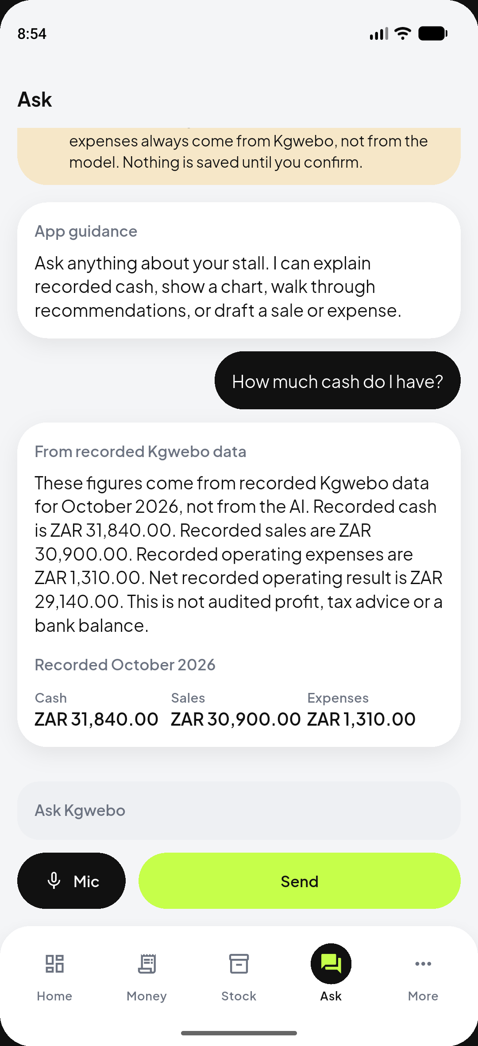
Kgwebo
Every business deserves a clearer picture of its money.
Record what happened. See the cash that is actually free. Act before rent lands.
JUDGE DEMO ACCOUNT
Email: dreu.davids1@gmail.com
Password: password
Stall: DreuTech · illustrative records
Demo & Apk Link: https://drive.google.com/drive/folders/1wElrUXpOcWKaumeP9yL9Q3arMl5naetR?usp=drive_link
GitHub: https://github.com/DreuDavids/Kgwebo
Notes:
End on the line. Point judges at the credentials. Offer to open Ask live if time remains.

