Slide 1
City Event Tracker v1.0
Know what’s going on in any city.
Notes:
Alex:
The name of the app is City Event Tracker v1.0
The Tag Line: Know what’s going on in any city.

Slide 2
Elevator pitch
Notes:
Alex
Pitch:
We’ve all been in cities looking for something to do. Our second concern is if the weather will be ideal for trying to visit the event. This app allows you to see events in your local area and weather forecasts in a single window.

Slide 3
Concept
Description
City Event Tracker is a web application designed to help users explore local events and the current weather in a city. By combining data from Google Places and Open Weather API, users can easily discover what's happening around them and plan their activities accordingly. The user-friendly interface, built with HTML, CSS, Tailwind, and JavaScript, ensures a smooth and engaging experience.
Motivation for development?
People want to know what events are occuring in a given city and will the weather be nice to go to the event.
User story
As a user.
I want to search for a city in a search bar.
I want to view the upcoming events and the 7-day weather forcast for the searched city.
Notes:
Alex
Description of the web app:
City Event Tracker is a web application designed to help users explore local events and the current weather in a city. By combining data from Google Places and Open Weather API, users can easily discover what's happening around them and plan their activities accordingly. The user-friendly interface, built with HTML, CSS, Tailwind, and JavaScript, ensures a smooth and engaging experience.
Motivation for development of the web app:
People want to know what events are occuring in a given city and will the weather be nice to go to the event.
User Story:
As a user, I want to search for a city in a search bar,
I want to view the upcoming events and the 7-day weather forecast for that city.

Slide 4
Process
The technologies used in creating City Event Tracker include:
JavaScript
Tailwind (CSS Framework)
CSS
HTML
Breakdown of tasks and roles
Drew Andersen – JavaScript Design
Jacob Robinson – HTML and CSS Framework Design
Alex Brown – API Research, GitHub Repro Management
Notes:
Jacob
The technologies used in creating City Event Tracker include:
JavaScript
CSS Framework Tailwind
CSS
HTML
Breakdown of tasks and roles
Drew Andersen – JavaScript Design
Jacob Robinson – HTML and CSS Framework Design
Alex Brown – API Research and GitHub Repro Management

Slide 5
Successes
Successes
Building API Query to collect results for searched cities.
Allowing users to provide a city to search and allowing users to revisit searched cities.
Notes:
Jacob
Successes to mention
Building API Query to collect results for searched cities.
Allowing users to provide a city to search and allowing users to revisit searched cities.

Slide 6
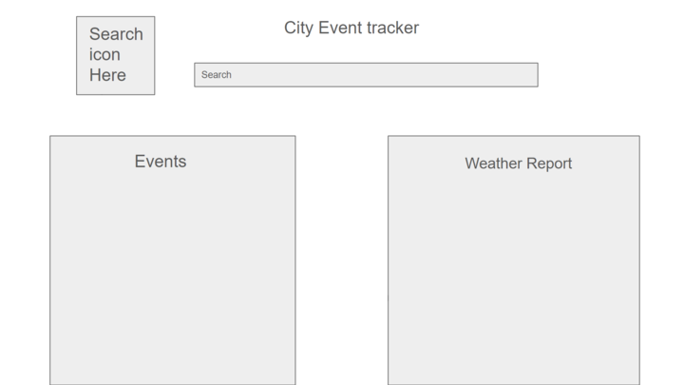
Wireframing
Notes:
Jacob
Here is a wireframe we used for our initial concept for the web application.

Slide 7
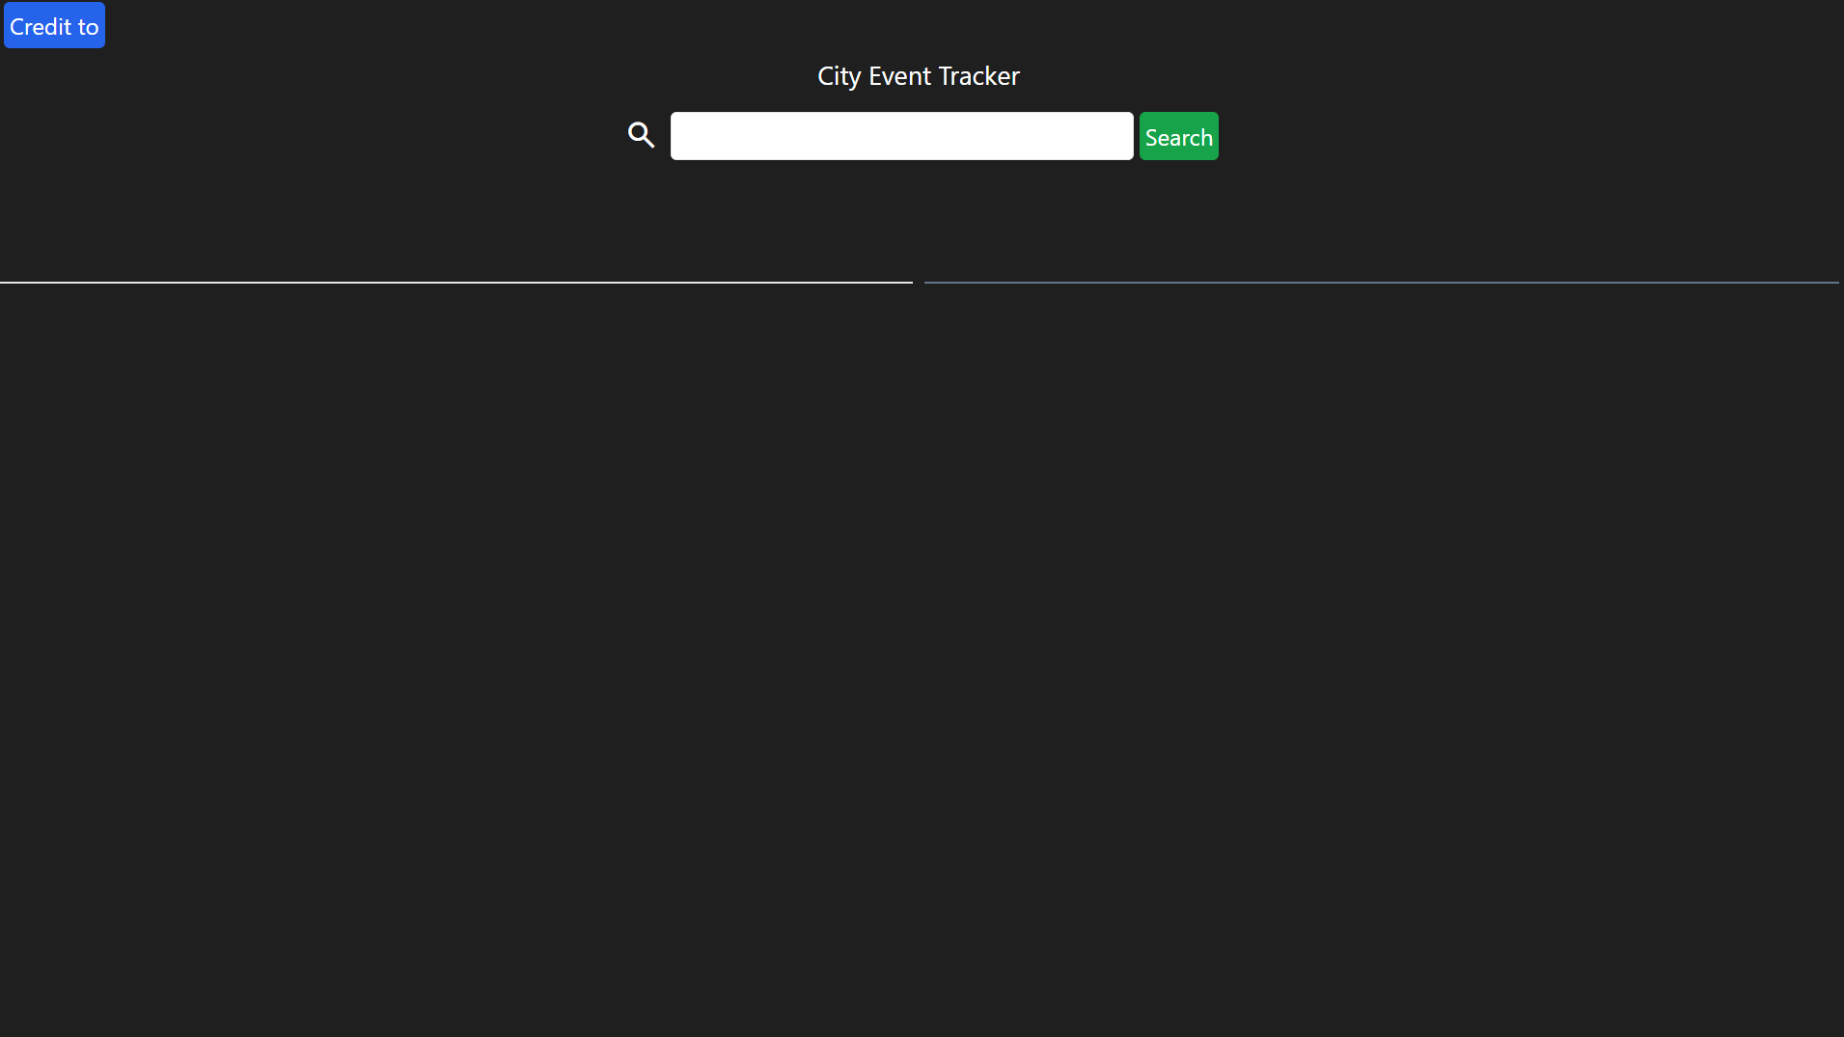
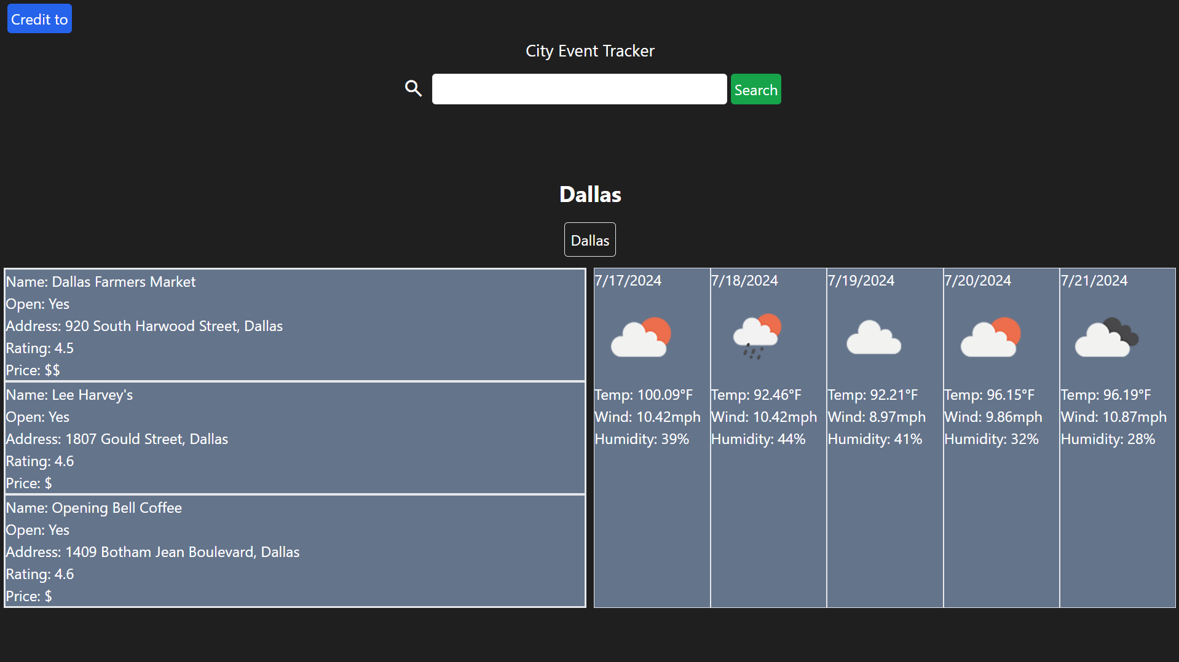
Screenshots showing design
Notes:
Jacob
These images show the design of the web applicaiton and expected results.
Drew will now demo the City Event Tracker.

Slide 8
Demo
Notes:
Drew
demo the web application.
Demo the modal as well.
Recommend using Atlanta, Dallas, Jacksonville or a known city.

Slide 9
Directions for Future Development
Add photos and links for the events returned through searching.
Provide details for indoor and outdoor seating.
Provide more events than restaurants.
Expand search radius to receive more results.
Notes:
Alex
We discussed features we would like to see in our second deployment.
Add Photos and links for events returned through searching.
Provide details for indoor and outdoor seating at events.
Provide more events than restaurants to give users more options for events.
Expand radius search radius to receive more resuls

Slide 10
Links
Deployed - https://djdevjams.github.io/city_eventtracker/
GitHub repo - https://github.com/DJDEVJAMS
Notes:
Here are direct links to the Repro and Web application.

Slide 11
Thank You
Notes:
Thank you for your attention.

