Slide 1
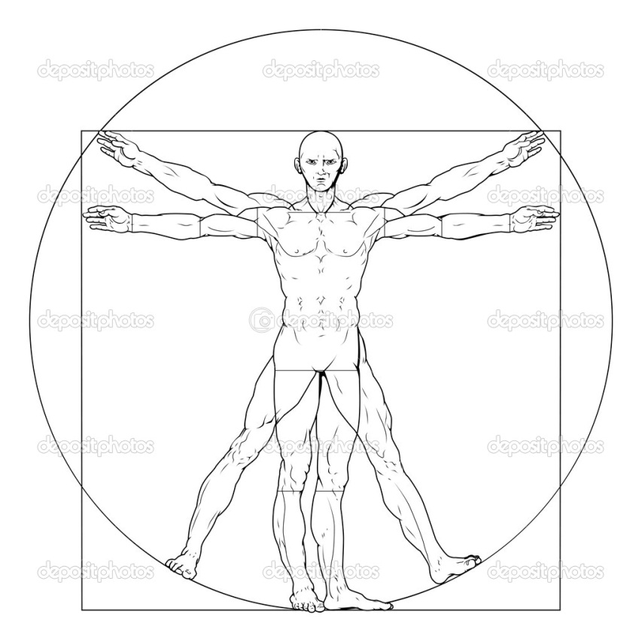
Hyperloop Passenger Vehicle
41” x 53” capsule
capsule
88” tube inner diameter
rotor
dimensions are to scale
36” wide air bearing pad
1mm air bearing gap (not to scale)

Slide 2
Hyperloop Passenger Vehicle Compression System Model
FlowEnd
endA
Nozzle
nozzle
FlowEnd
endB
FlowStart
tube
Splitter
tubeBypass
Inlet
inlet
Compressor
compA
Duct
intercoolA
Splitter
splitter
Compressor
compB
Duct
toAir
Bearings
FlowEnd
endC
HeatX
intercoolB
Duct
toSteam
Tank
FlowEnd
endD
FlowStart
steam
Shaft
shaftA
Shaft
shaftB

Slide 3
Hyperloop Passenger Vehicle Compression System Model
FlowEnd
endA
Nozzle
nozzle
FlowEnd
endB
FlowStart
tube
Splitter
tubeBypass
Inlet
inlet
Compressor
compA
Duct
intercoolA
Splitter
splitter
Compressor
compB
Duct
intercoolB
Duct
toAir
Bearings
FlowEnd
endC
water to steam
steam to
even hotter
steam
steam tank
Shaft
shaftA
Shaft
shaftB

