Slide 1

Tutor Matching Algorithm Proposal
By: Andrew O’Drain
Presented to:
John Politis, Director of Learning Labs at CCP
and
Community College of Philadelphia I.T. Department

Slide 2
EXECUTIVE SUMMARY
PROPOSAL
CCP should implement a tutor matching algorithm
BENEFITS
Increased student satisfaction with online tutoring
Decreased opportunity cost for both student and tutor
Improved over-all GPA
Increased sense of well-being
Time saved for student, tutor, and administration

Slide 3
THE PROBLEM
Tutor service uses only availability and qualifications to match
Service does not match based on personal learning styles or interests
Students may feel nothing was achieved during tutoring session
Tutors may feel like they haven’t been the best resource for the student
Wasted time and additional stress is created

Slide 4
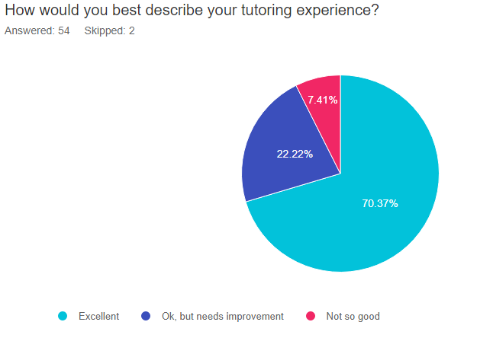
30% of students polled agree that their tutoring service needs improvement

Slide 5
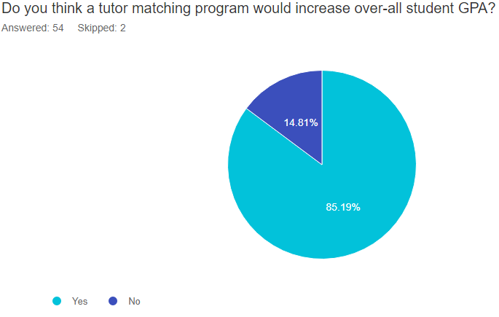
85% of students polled agree use of an algorithm would increase GPA

Slide 6
COMMON CONCERNS OF STUDENTS POLLED
“They need to explain better.”
“It felt like they didn’t know how to help me”
“How they communicated and needed to show more work.”
“Some tutors didn’t explain thoroughly or were unsure of topics”
“More dedication needed”
“I feel as though it wasn’t as focused as It needed it to be. It wasn’t specific enough, and I didn’t leave feeling like I was better prepared.”

Slide 7
PROPOSAL: CREATE A STABLE-MATCH ALGORITHM FOR USE AT CCP
CCP I.T. will customize the algorithm and develop surveys for students and tutors
The student and tutor surveys will assess them along four dimensions:
Availability
Personal interests e.g.,, music, art
Preferred learning styles e.g.,, abstract, visual
Strengths/weaknesses in subject topics

Slide 8
FINAL MATCHING
1. Student logs on to wconline
2. Student opts in or opts out
3. Student fills out a brief 6 question survey
4. Student receives email with suggested matches a day later
5. Student has the option to contact tutors

Slide 9
function stableMatching {
initialize all t € T and s € S to free
while ∃ free tutor t who still has a student to be matched with {
s = first student on t’s list to whom t has not been matched
if s is free
(t, s) become matched
else some match (t’, s) already exist
if s prefers t to t’
t’ becomes unmatched
(t, s) become unmatched
else
(t’, s) remain unmatched
}}
ALGORITHM CORE
LOGIC

Slide 10
Jan 3 - Jan 5
Jan 6 - Jan 7
Jan 10 - Jan 12
- Meetings held to discuss project
- Development of custom matching algorithm
- Development of Custom Surveys
Jan 13 - Jan 14
- Send surveys to every tutor
Jan 18+
- Ongoing assessment and quality control
Jan 17 - Jan 18
- Fully integrate project
IMPLEMENTATION PLAN

Slide 11
CONCLUSION
Students want improvement in their tutoring services
CCP should implement the stable match algorithm
There will be no upfront costs
Can be done quickly

Slide 12
REFERENCES
Access wire, (2020, July 29) Gooroo. How Gooroo’s Student-Tutor Matching Algorithm Will Change the Future of E-Learning.
https://www.accesswire.com/599449/How-Gooroos-Student-Tutor-Matching- Algorithm-Will-Change-the-Future-of-E-Learning
Assistant Professor, Politis J. Community College of Philadelphia, September 20, 2021.
https://www.ccp.edu/college-catalog/college-faculty-staff/full-time-faculty-visiting-lecturers-instructional-aides
Nextgen Tutoring. About Us. Retrieved, 2021 September 19.
https://nexgentutoring.com/Home/aboutus
Drexel. Student and Family Life. Retrieved, 2021 September 19.
https://drexel.edu/studentlife/student_family_resources/class/tutoring/
Temple Student Success Center. STEM Tutoring. Retrieved, 2021 September 19.
https://studentsuccess.temple.edu/programs/stem/tutoring
Wikipedia Contributors. (2021, August 6). Gale-Shapely algorithm. Retrieved
Oct 15, 2021, from
https://en.wikipedia.org/wiki/Gale%E2%80%93Shapley_algorithm

