Slide 1

PINK CAB or YELLOW CAB ?
ANALYSIS BY: ANDREW O’DRAIN
DATE: 08-21-2023

Slide 2

GENERAL ASSUMPTIONS
BOTH YELLOW & PINK CAB ARE TRADITIONAL CAB COMPANIES
THEY DO NOT HAVE THEIR ROOTS IN CONDUCTING ONLINE BUSINESS OR ONLINE TRANSACTIONS
BOTH COMPANIES DIRECT COMPETITIOR IS THE RIDESHARE INDUSTRY i.e. UBER, LYFT
YELLOW CAB IS A DIRECT COMPETITOR OF PINK CAB
PINK CAB IS NEW TO THE MARKET OR IS WELL ESTABLISHED
WE CAN ASSUME EITHER, AND THE DATA FOLLOWS
YELLOW CAB IS AN ESTABLISHED COMPANY WITH A LONG HISTORY
THE BRAND NAME AND ITS DATA SUGGESTS THIS, BUT NO WAY TO VERIFY

Slide 3
EXECUTIVE SUMMARY
AN AD-HOC ANALYSIS OF PINK & YELLOW CAB YIELDED INTERESTING & USEFUL INSIGHTS
KEY FINDINGS:
YELLOW CAB’S PROFIT MARGINS ARE GREATER IN MAGNITUDE AND MORE HOMOGENEOUS THAN PINK CAB’S
OVER THE LAST THREE YEARS, YELLOW CAB LEAD IN CUSTOMER RECIDIVISM
PRICING & A MORE ESTABLISHED CUSTOMER BASE ARE THE LARGEST CONTRIBUTORS TO YELLOW CAB’S HIGHER PROFIT SHARE
YELLOW CAB MIGHT BE ABLE TO CHARGE HIGHER PRICES DUE TO BRANDING FACTORS
PROFITS FOR BOTH PINK & YELLOW CAB COMPANIES FOLLOW A PREDICTABLE SEASONAL CYCLE
PROFITS FOR BOTH COMPANIES HIT ALL-TIME LOWS IN JANUARY OF 2018
THE PROFIT TREND FOR BOTH COMPANIES IS NEGATIVE AND QUADRATIC IN NATURE
MORE RESEARCH OVER A LONGER TIMEFRAME THAT INCLUDES RIDESHARE DATA FOR COMPARISON
WOULD BE BENEFICIAL
THESE INSIGHTS WILL AID ‘XYZ’ IN MAKING A FINAL DECISION ON WHICH COMPANY TO ACQUIRE
DATA THAT WAS UTILIZED?
CAB COMPANY
CITY
CUSTOMER
TRANSACTION

Slide 4
EXECUTIVE SUMMARY
RECOMMENDATIONS
ANALYZE DATA OF BOTH COMPANIES INCLUDING FIXED & VARIABLE COSTS OVER A MUCH LONGER TIMEFRAME
CONFIRM NEGATIVE PROFIT TRENDS
IF PROFIT TRENDS ARE NON-NEGATIVE
ACQUIRE YELLOW CAB
FOCUS ON LOWERING FIXED AND VARIABLE COSTS
MAXIMIZING PROFITS
REMAINING COMPETITIVE WITH RIDESHARE INDUSTY & OTHER TRADITIONAL COMPANIES
IF PROFIT TRENDS ARE NEGATIVE
REVIEW FIXED AND VARIABLE COSTS OF BOTH COMPANIES
IDENTIFY INTERVENTIONS & SIMULATE NEW FORECASTS THAT INCLUDE RIDESHARE DATA
IF DECLINE IN PROFITS IS A RESULT OF THE RIDESHARE INDUSTRY
BE CAUTIOUS ABOUT PURCHASING YELLOW CAB OR A TRADITIONAL CAB COMPANY
UNLESS A WELL-ESTABLISHED RESTRUCTURING PLAN IS IN PLACE

Slide 5
GENERAL APPROACH
DATA MINING
DEFINE THE PROBLEM
DATA COLLECTION
DATA PREPARATION & PREPROCESSING
EXPLORATORY DATA ANALYSIS (EDA)
FEATURE ENGINEERING
MODEL SELECTION
MODEL BUILDING
MODEL EVALUATION
MODEL INTERPRETATION

Slide 6
DATA CLEANSING & FEATURE ENGINEERING
DATA PREPARATION & PREPROCESSING
DATA CLEANING
COLUMN HEADS RENAMED
DUPLICATES & MISSING VALUES ASSESSED & REMOVED
CHARACTER DATA CONVERTED TO LOWERCASE
PUNCTUATION REMOVED
FEATURE DATATYPES ASSESED & LABELED
TRANSFORMATIONS
DATE : REFORMATTED
KILOMETERS : TRANSFORMED TO STANDARD NORTH AMERICAN MILES
OUTLIERS : STANDARDIZED AND EVALUATED
FEATURE ENGINEERING
QUARTER : EXTRACTED FROM DATE INDEX, LABELS CREATED FOR EACH ROW
DAY_OF_WEEK : EXTRACTED FROM DATE INDEX & LABELS CREATED FOR EACH ROW
STATE : SEPARTED FROM THE CITY FEATURE
PROFIT : CREATED BY SUBTRACTING ‘COST’ FROM ‘PRICE’
PROFIT_MARGIN: CREATED FROM DIVIDING ‘PROFIT’ INTO ‘PRICE’
AGE_CATEGORY: EXTRACTED FROM ‘AGE’ , LABELS WERE CREATED FOR EACH ROW

Slide 7
SUMMARY: PROFITS, REVENUES, & COSTS OVER A THREE-YEAR PERIOD

Slide 8
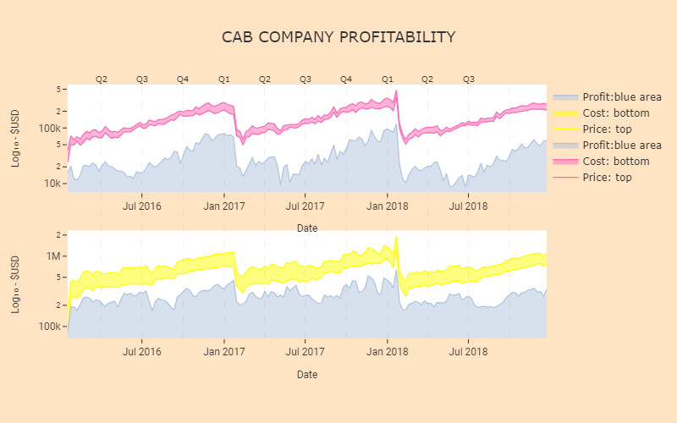
PINK CAB’S PROFITS ARE LESS IN MAGNITUDE THAN YELLOWS DURING THE ‘OFF-SEASONS’
YELLOW’S PROFITS ARE HIGHER DURING ‘OFF-SEASONS WHEN PINK’S ARE LOWER

Slide 9
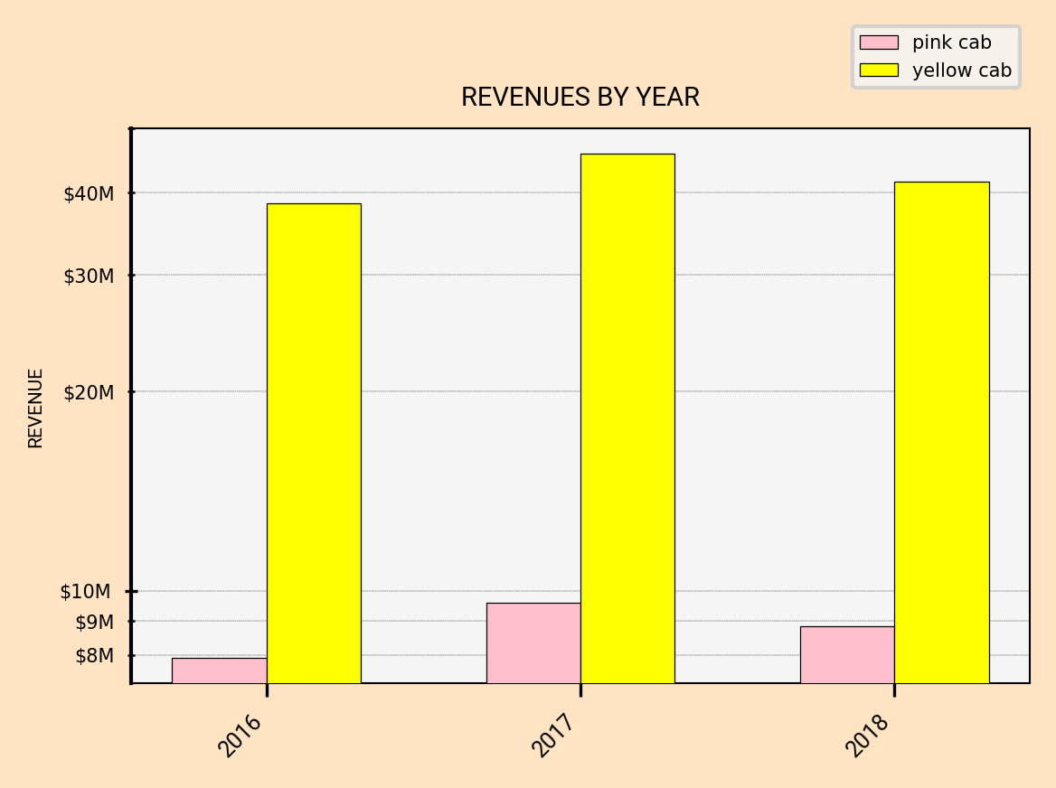
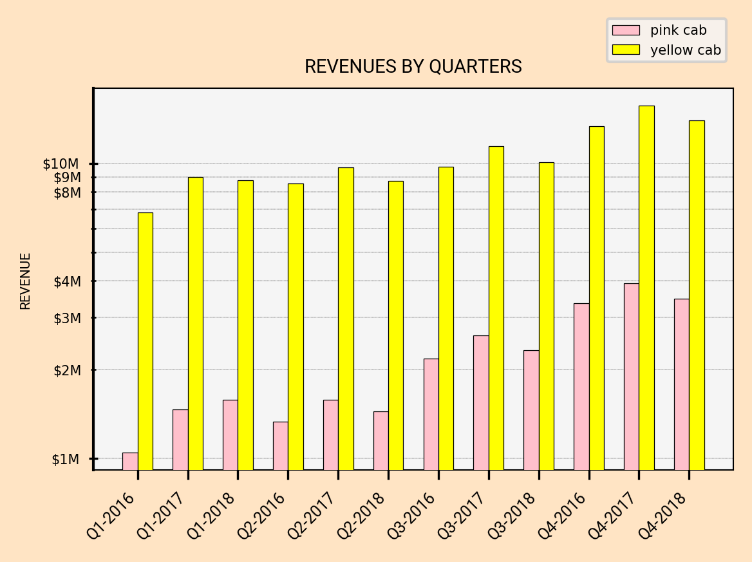
YELLOW CAB GENERATED 480% MORE REVENUE THAN PINK CAB OVER THE LAST THREE YEARS
WE CAN INFER FROM THESE NUMBERS THAT YELLOW CAB HAS MUCH HIGHER CASH FLOW

Slide 10
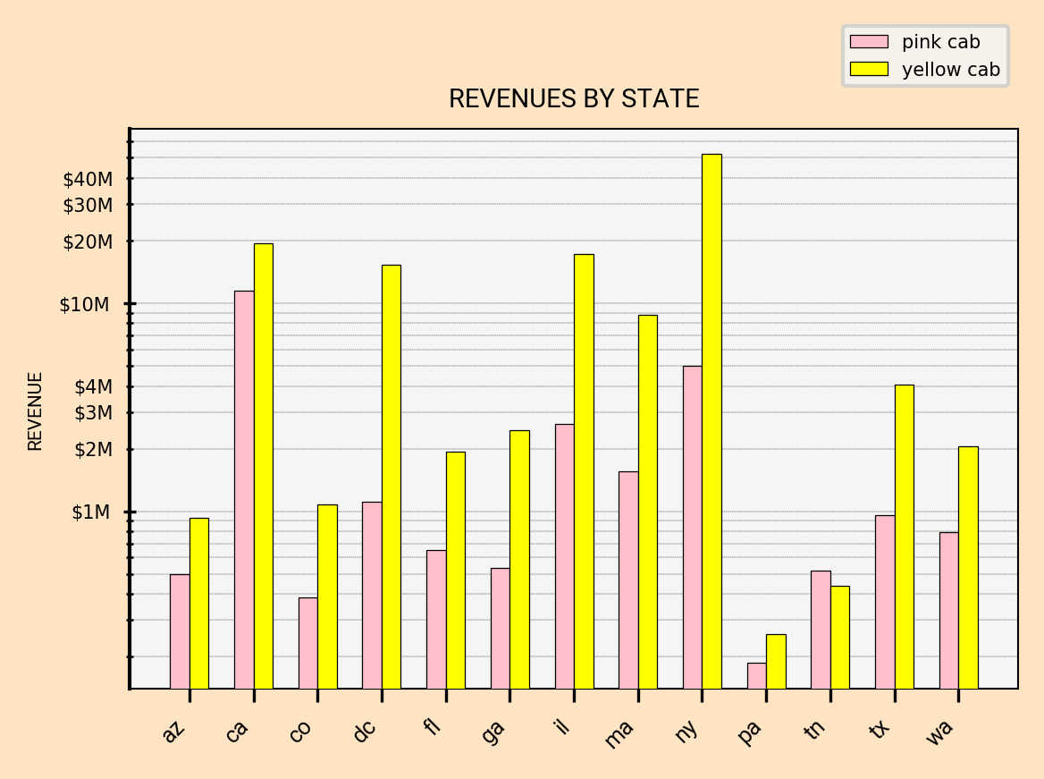
YELLOW CAB DOMINATED REVENUES IN ALL STATES EXCEPT IN TENNESSEE OVER THE PAST THREE YEARS

Slide 11
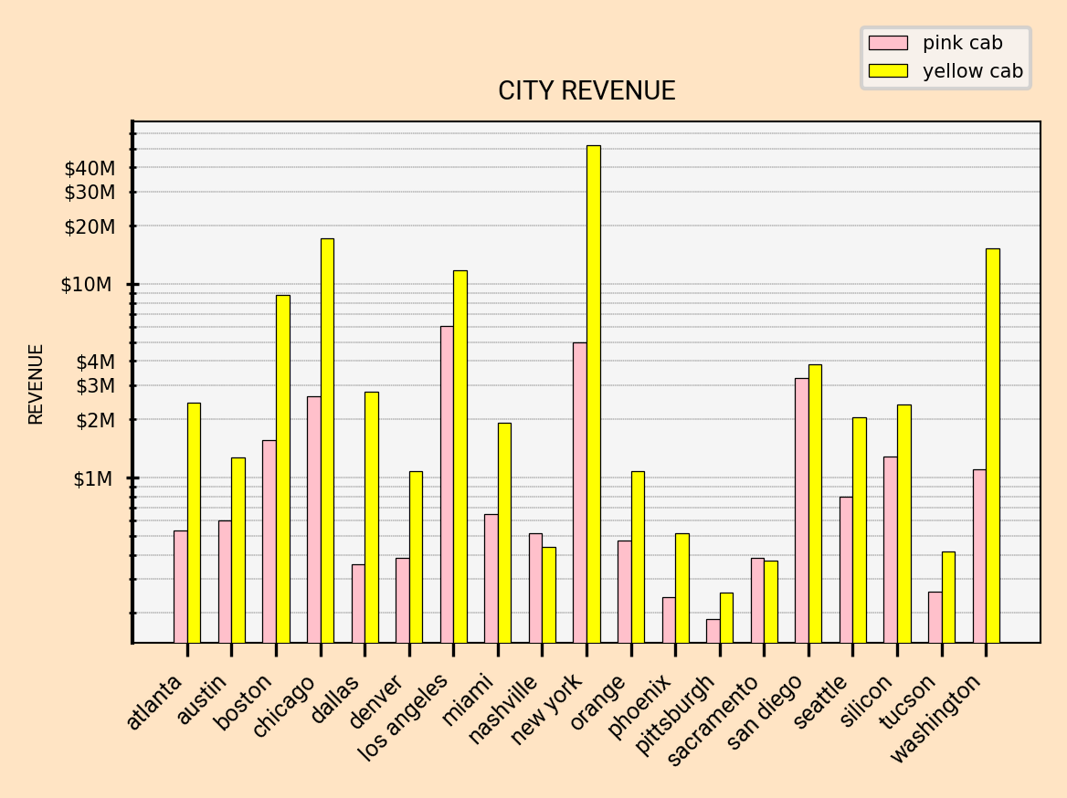
YELLOW CAB DOMINATES REVENUES IN ALL CITIES EXCEPT SACREMENTO & NASHVILLE

Slide 12
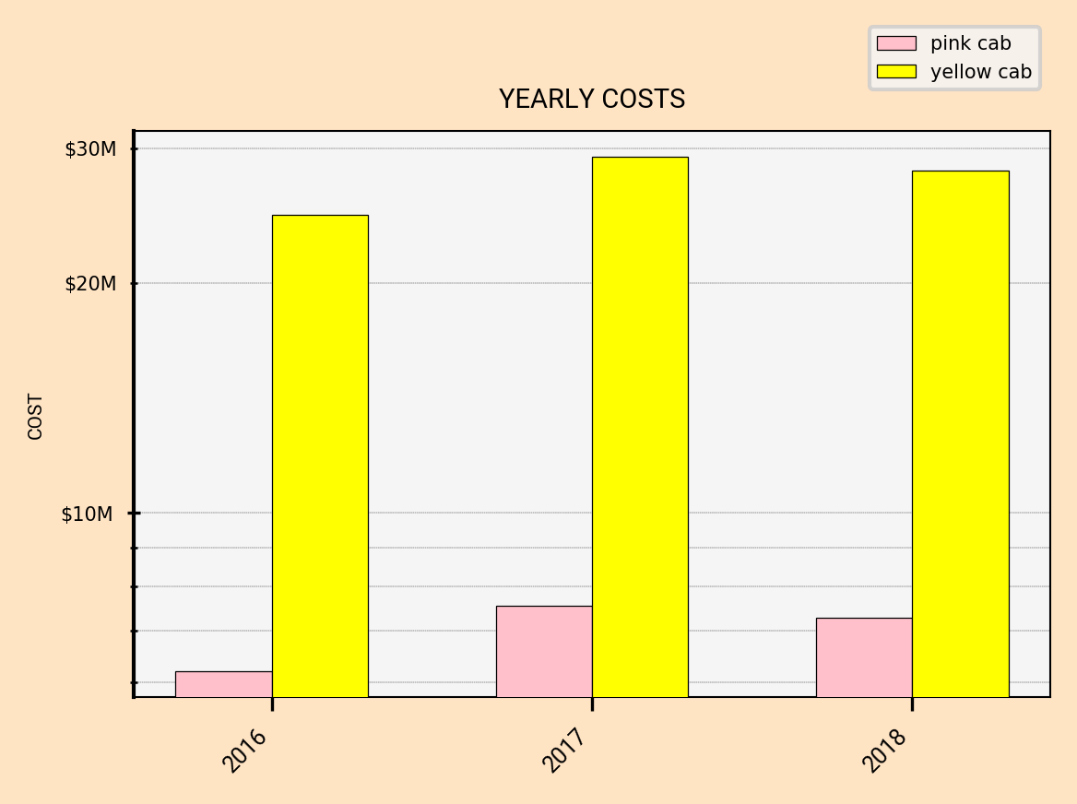
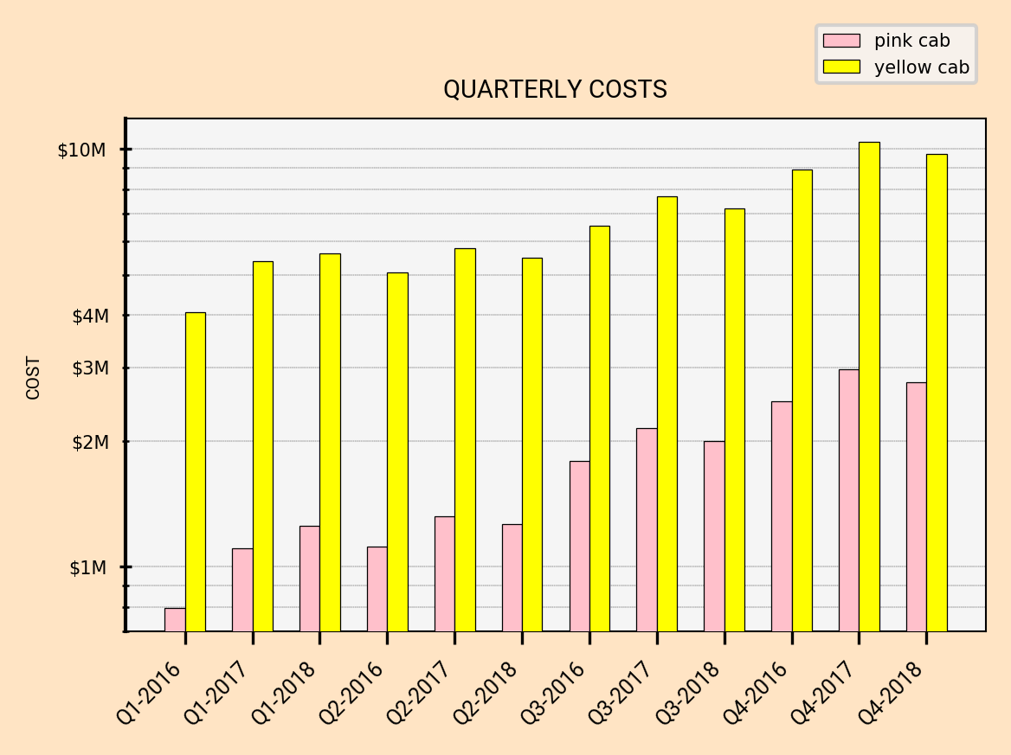
YELLOW CAB HAD 489% MORE COSTS THAN PINK CAB FROM 2016 UNTIL THE END OF 2018

Slide 13
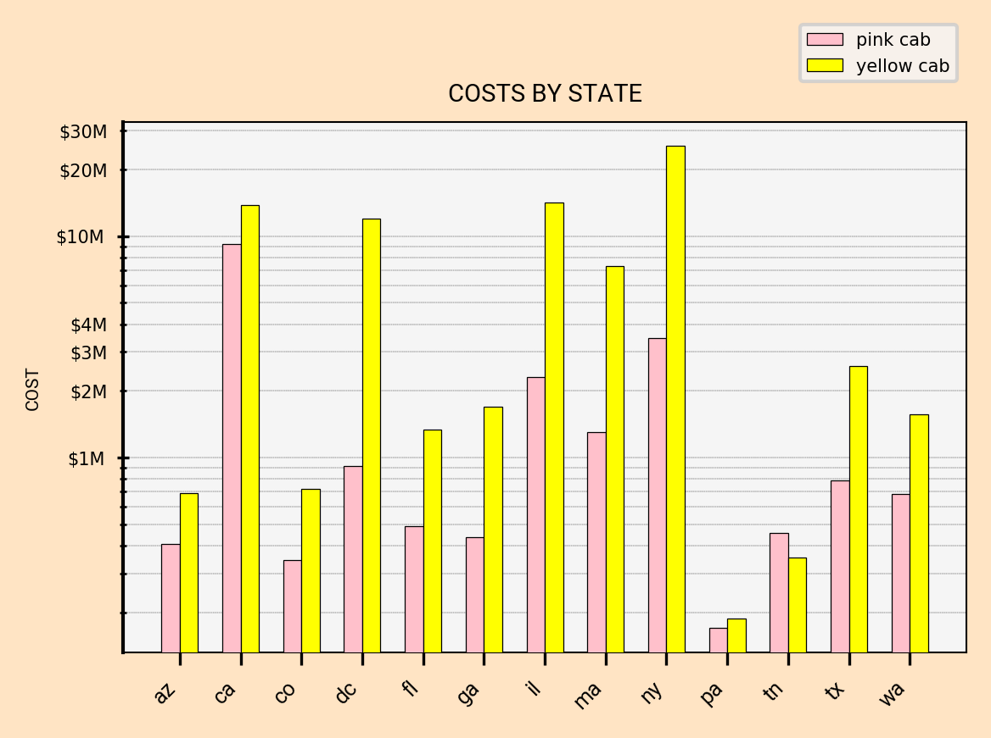
YELLOW CAB HAS HIGHER COSTS IN ALL STATES BUT TENESSEE

Slide 14
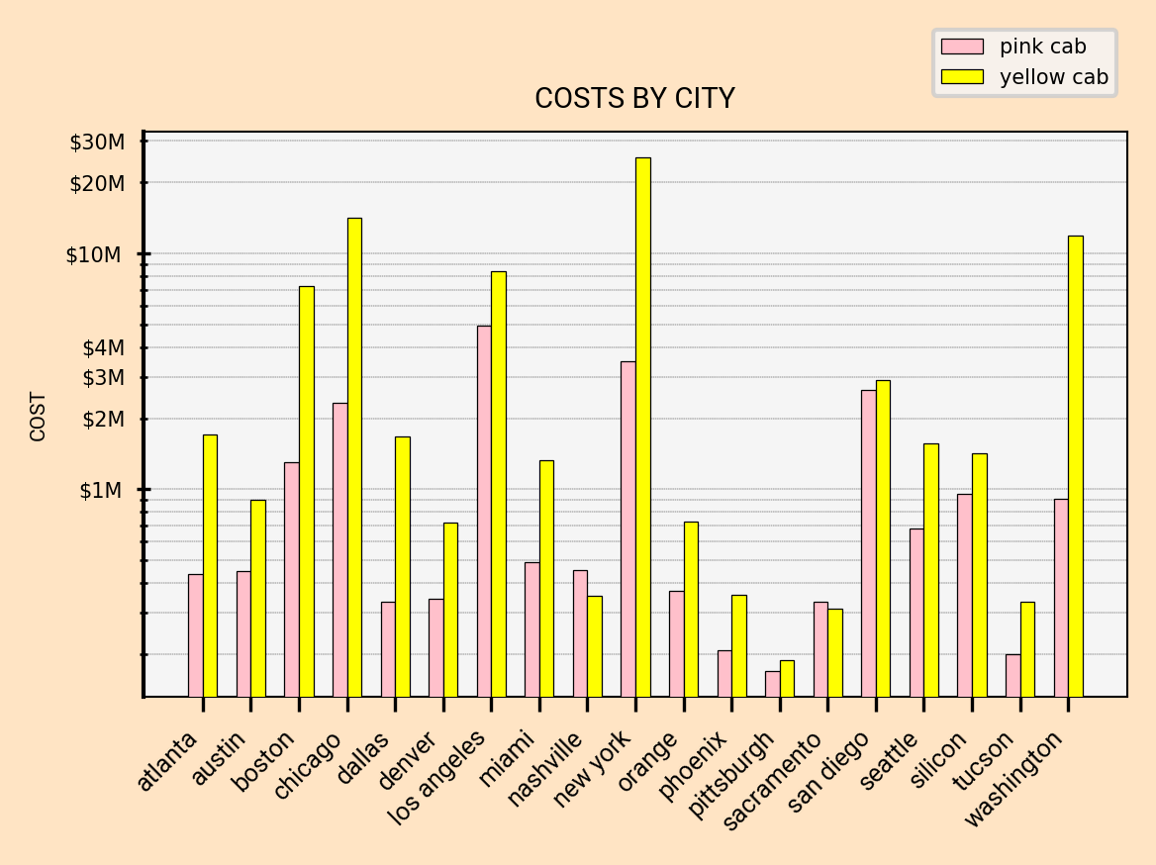
OUT OF EVERY DOLLAR OF REVENUE YELLOW CAB SPENDS .65c TO COVER COSTS WHILE PINK CAB SPENDS .80c
YELLOW CAB MANAGES THEIR COSTS BETTER THAN PINK CAB

Slide 15
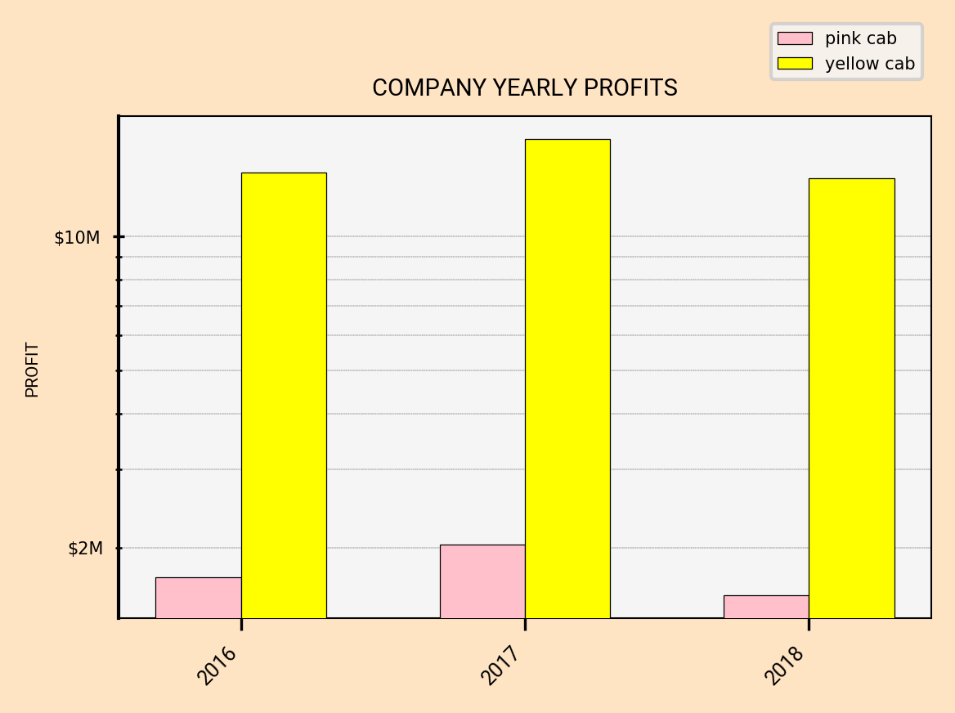
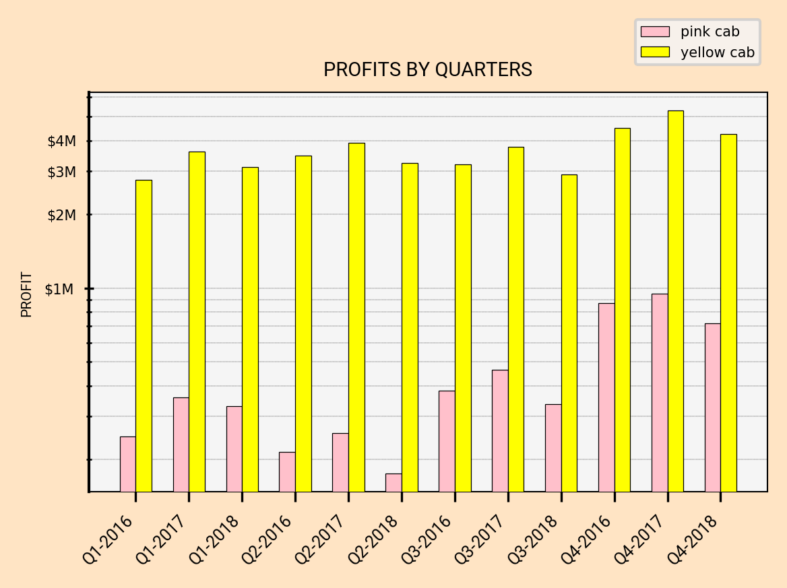
YELLOW CAB KEEPS .35c OUT OF EVERY DOLLAR GENERATED WHILE PINK CAB KEEPS .20c
YELLOW CAB IS OVERALL MORE PROFITABLE THAN PINK CAB

Slide 16
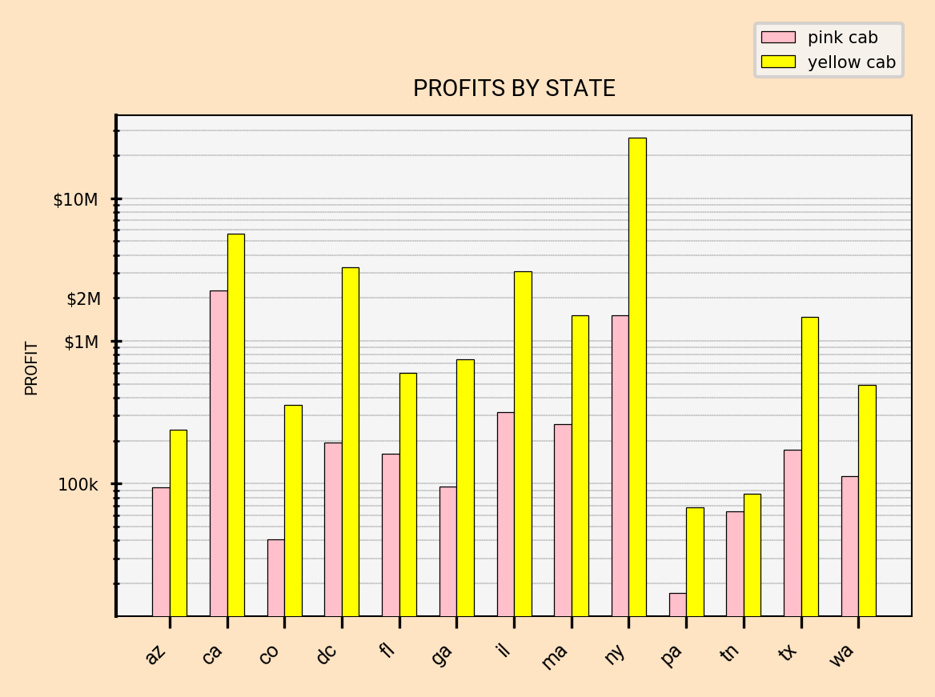
YELLOW CAB DOMINATES PROFITS IN ALL STATES

Slide 17
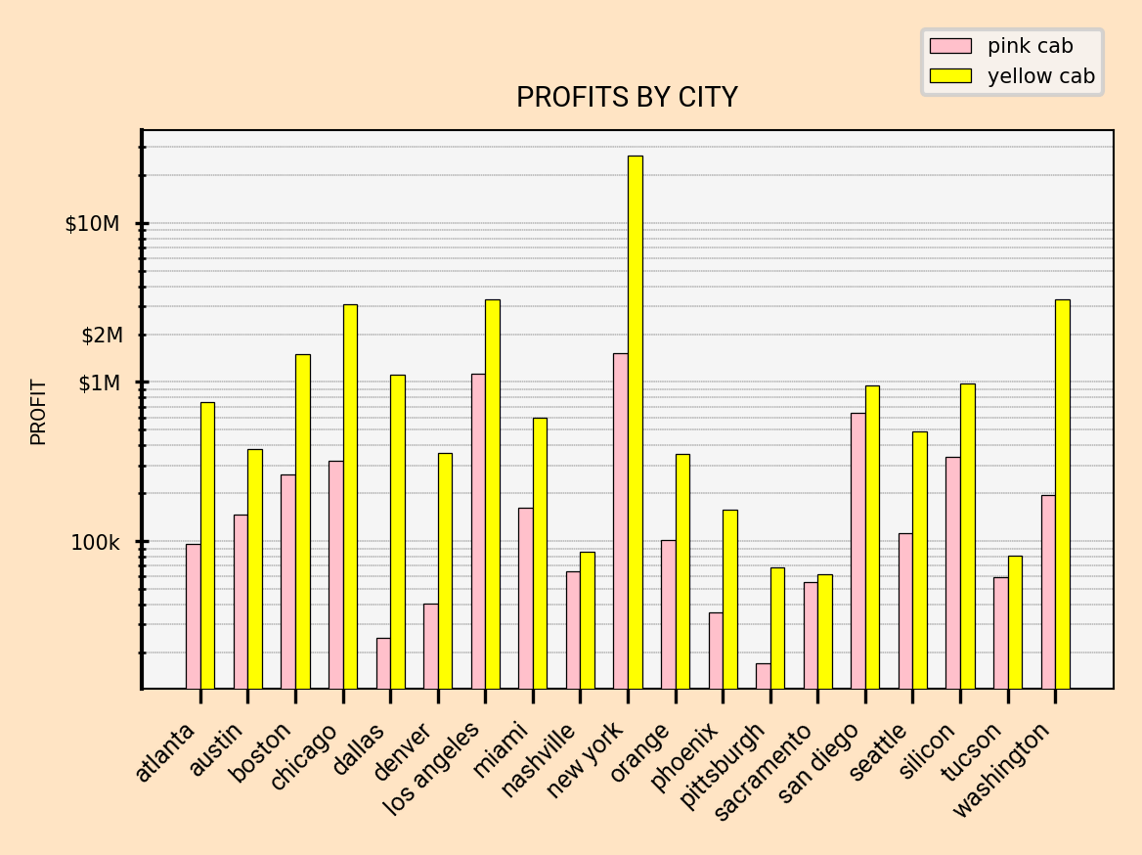
YELLOW CAB DOMINATES PROFITS IN ALL CITIES

Slide 18
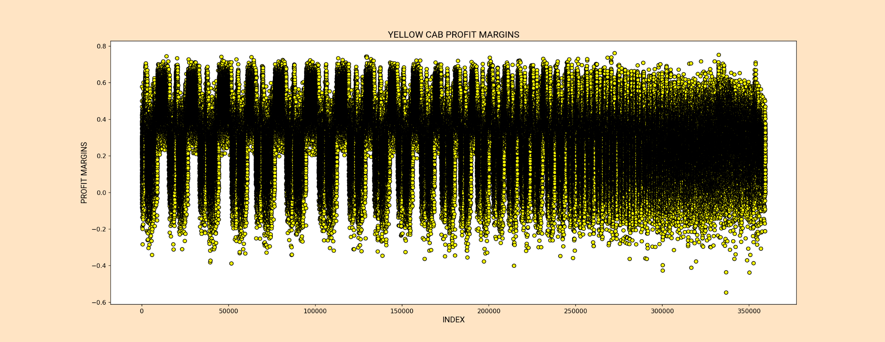
YELLOW CAB’S INDIVIDUAL PROFIT MARGINS ARE TIGHTLY CLUSTERED
IMPLYING AN EFFICIENT OPERATION

Slide 19
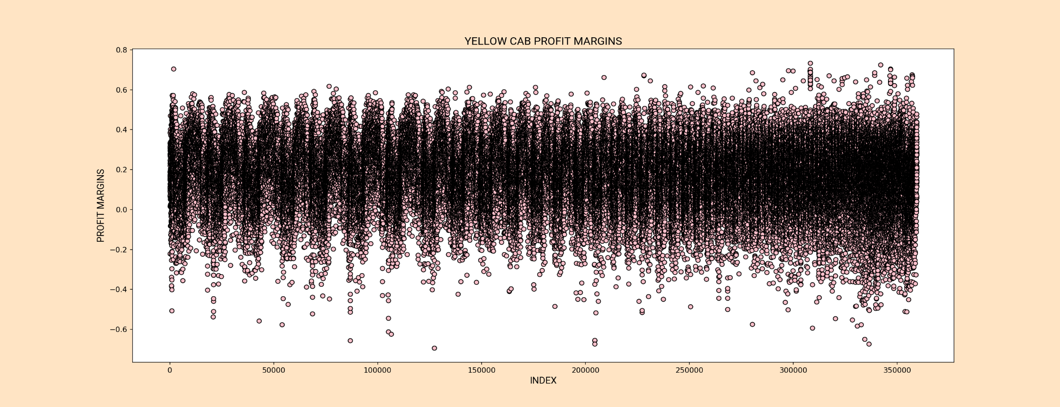
PINK CAB’S INDIVIDUAL PROFIT MARGINS ARE LESS TIGHTLY CLUSTERED
IMPLYING A LESS EFFICIENT OPERATION
NOTE: LOOSE SCATTER IS NOT STRICTLY DUE TO SAMPLE SIZE

Slide 20
RIDERSHIP & RECIDIVISM

Slide 21
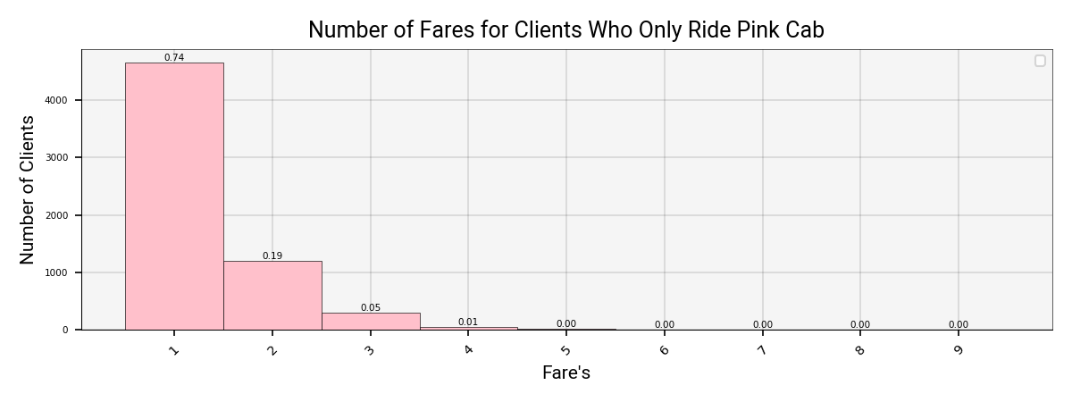
75% OF CLIENTS WHO ONLY RIDE WITH PINK CAB WHERE ONE TIME CUSTOMERS OVER A THREE-YEAR PERIOD
THIS IMPLIES A LESS ESTABLISHED CUSTOMER-BASE THAN YELLOW CAB

Slide 22
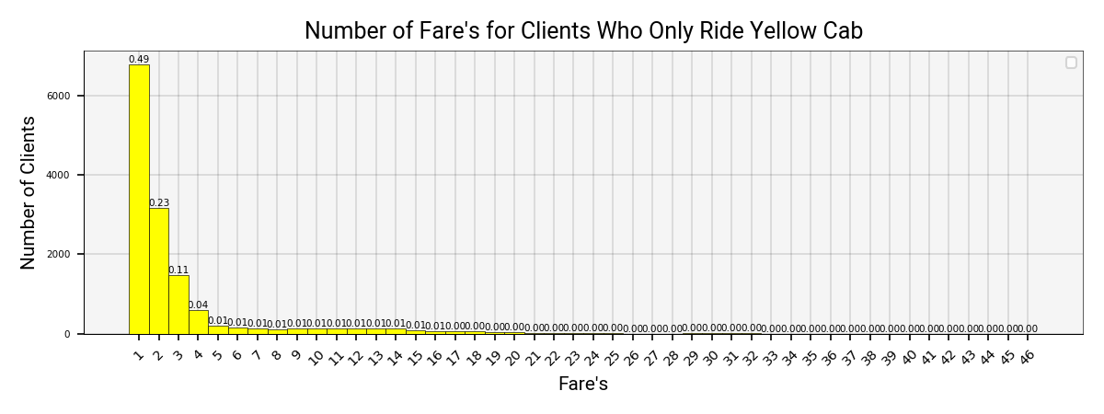
49% OF CLIENTS WHO ONLY RIDE WITH YELLOW CAB WHERE ONE TIME CUSTOMERS OVER A THREE-YEAR PERIOD
THIS IMPLIES A MORE ESTABLISHED CUSTOMER-BASE THAN PINK CAB

Slide 23
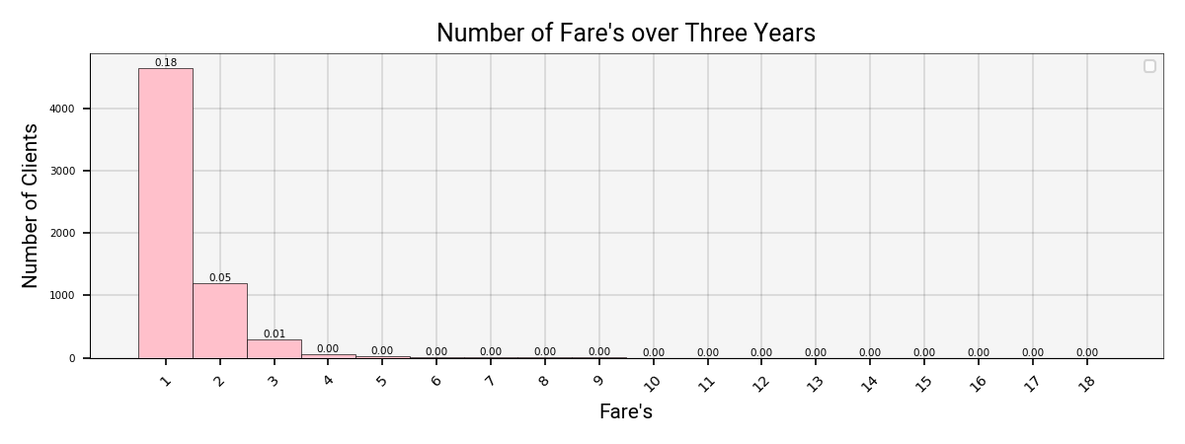
18% OF CLIENTS WHO RIDE WITH PINK CAB & YELLOW CAB WHERE ONE TIME CUSTOMERS WITH PINK CAB OVER A THREE-YEAR PERIOD

Slide 24
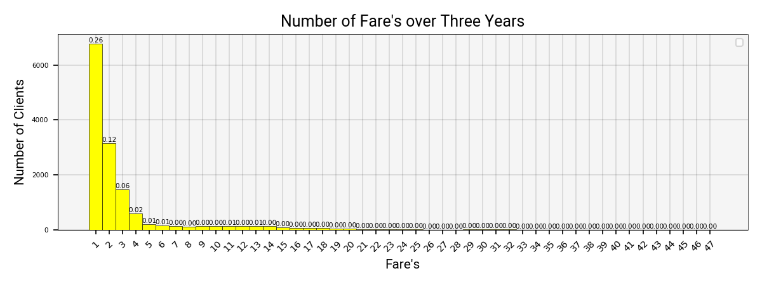
26% OF CLIENTS WHO RIDE WITH PINK CAB & YELLOW CAB WHERE ONE TIME CUSTOMERS WITH YELLOW CAB OVER A THREE-YEAR PERIOD
THIS COULD BE EVIDENCE OF PREFERENCE FOR PINK CAB AMONG THE DUAL RIDERSHIP

Slide 25
DEMOGRAPHICS

Slide 26
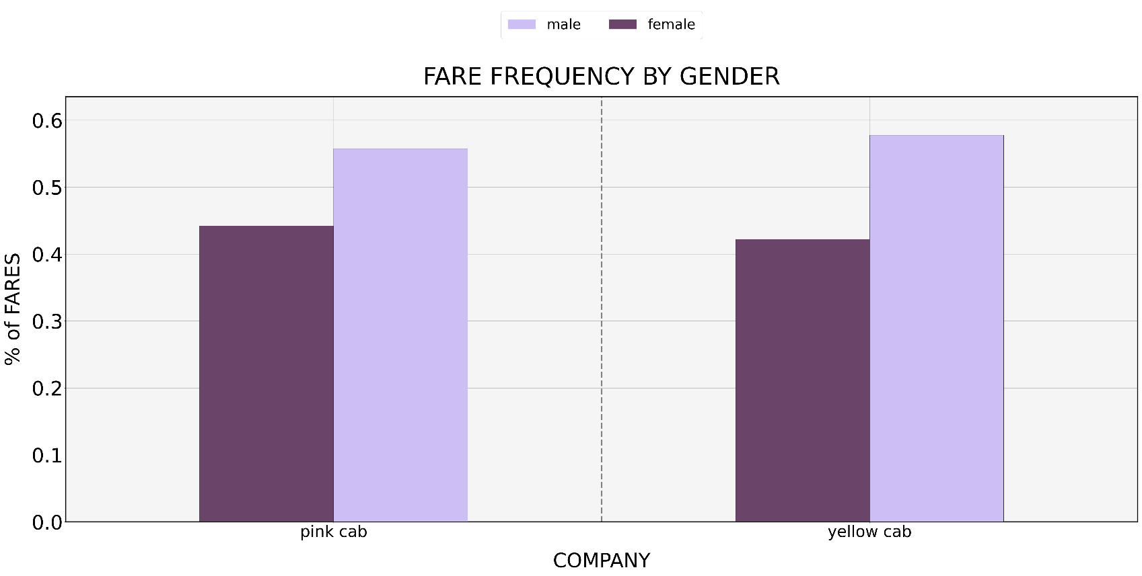
APPROX. 44% OF RIDERS WITH PINK CAB ARE FEMALE & 56% ARE FEMALE
APPROX. 42% OF RIDERS WITH YELLOW CAB ARE FEMALE & 58% ARE MALE

Slide 27
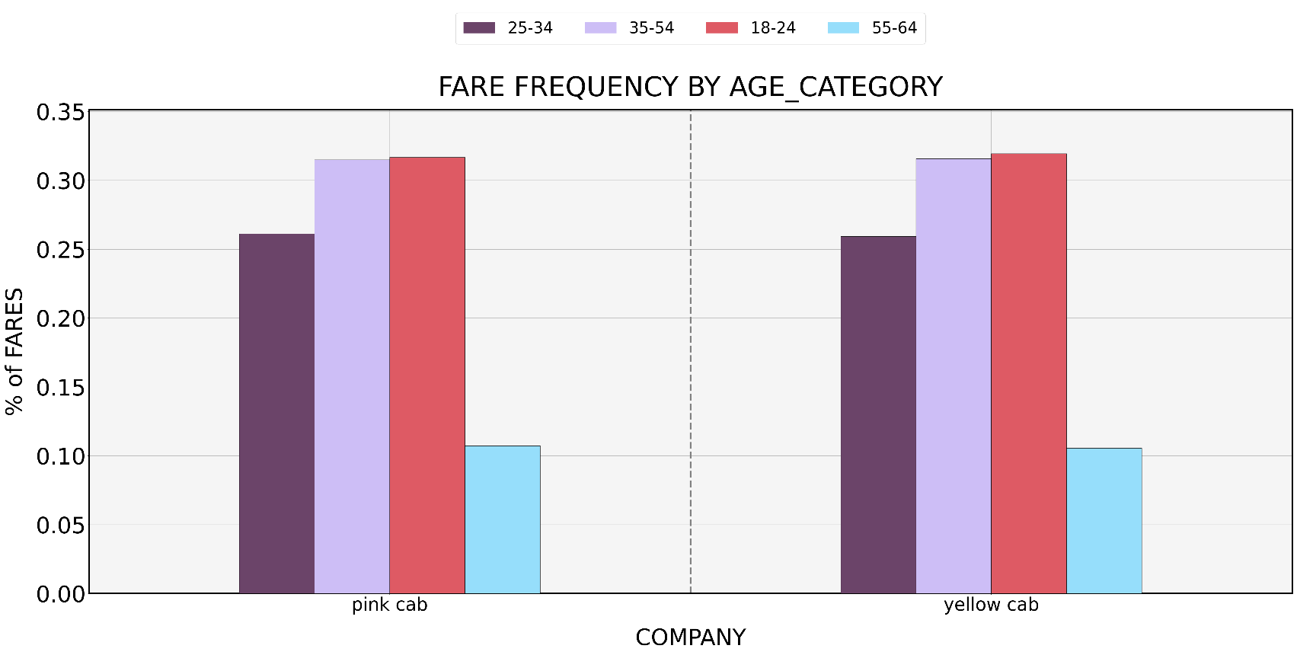
RIDERSHIP IS NEARLY IDENTICAL BETWEEN YELLOW AND PINK CAB
SUGGESTING NO SIGNIFICANT EFFECT OF AGE ON BRAND PREFFERENCE

Slide 28
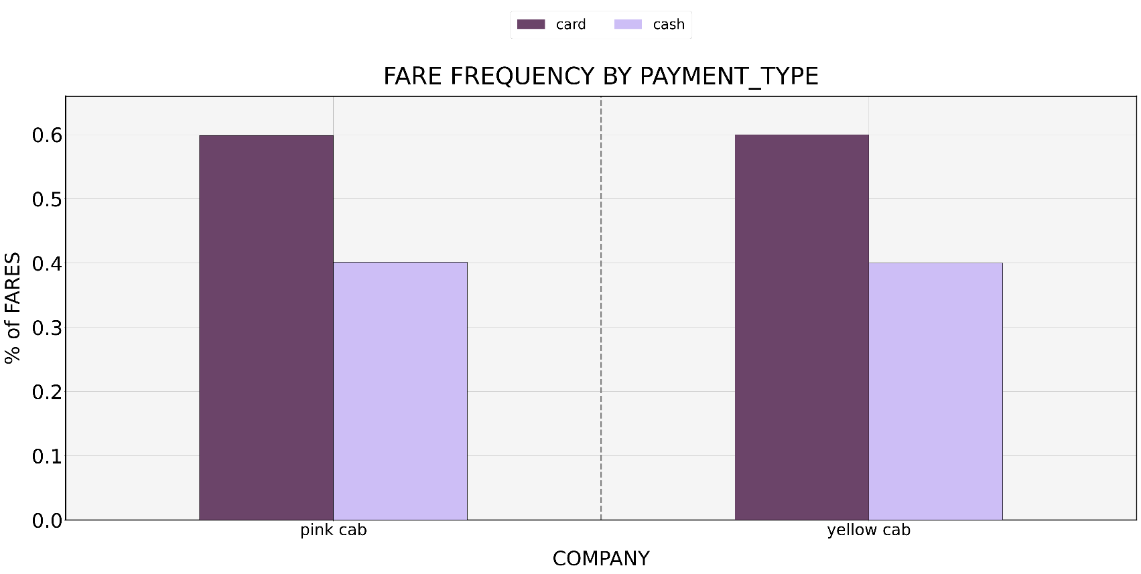
FOR PINK CAB 60% OF FARE’S USED A CARD & 40% USED CASH
YELLOW CABS PROPORTIONS ARE IDENTICAL, SUGGESTING CAB COMPANY HAS NO EFFECT ON PAYMENT TYPE

Slide 29
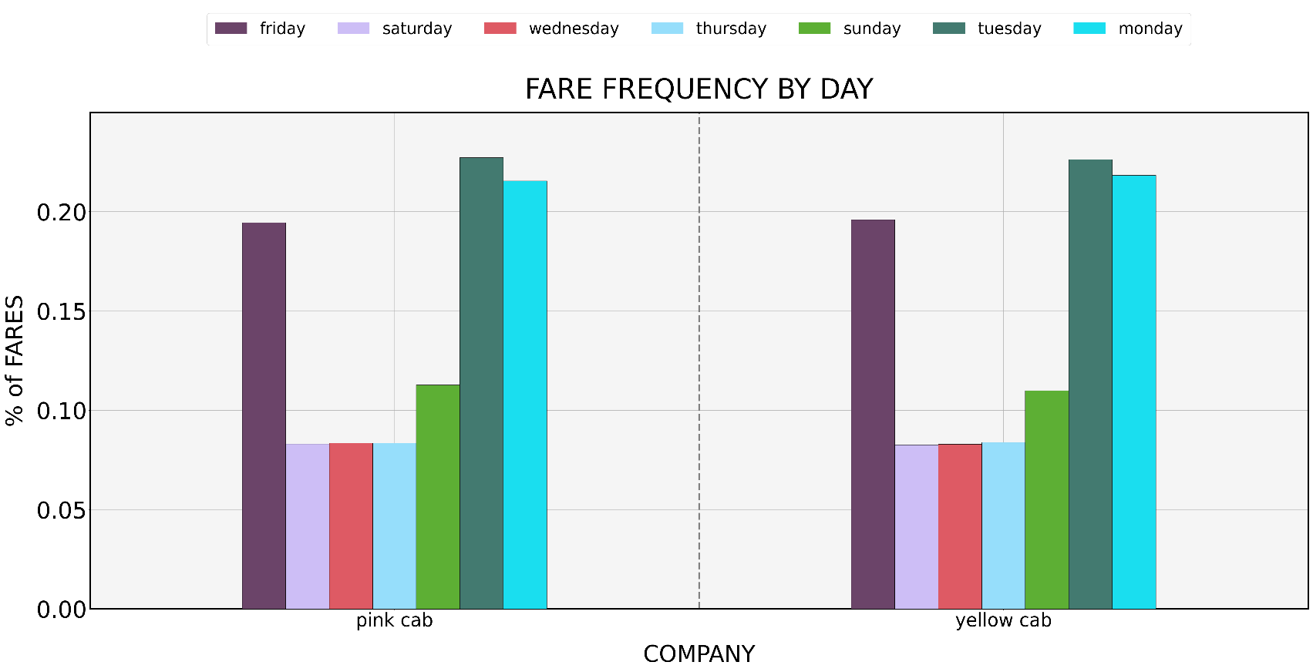
FOR PINK CAB 60% OF FARE’S USED A CARD & 40% USED CASH
YELLOW CABS PROPORTIONS ARE NEARLY IDENTICAL TO PINK CAB’S, SUGGESTING NO EFFECT FROM COMPANY ON DAY OF WEEK TO RIDE

Slide 30
TWO YEAR PROFIT FORECAST

Slide 31
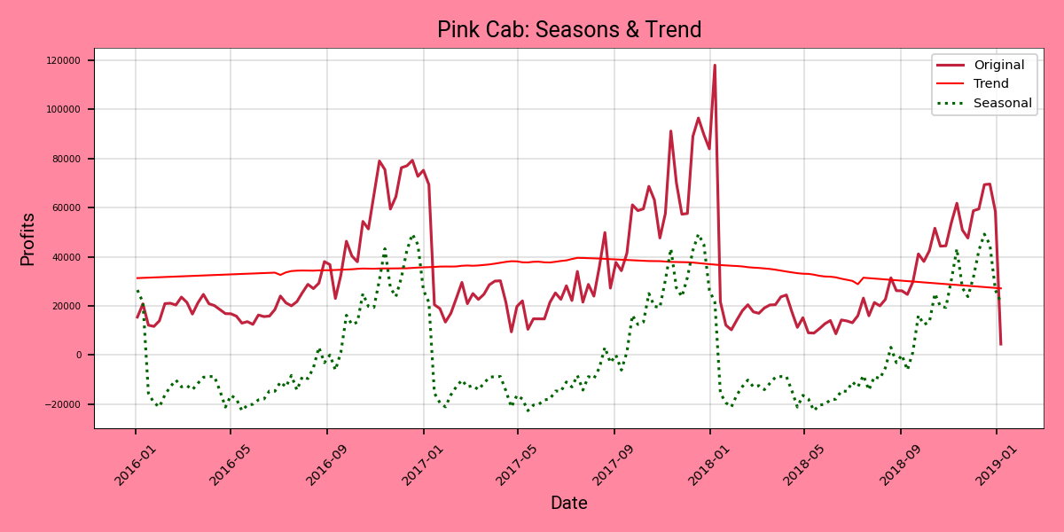
PINK CABS PROFIT TREND IS HIGHLY SEASONAL. THE SEASONAL DECOMPOSITION CAPTURED THE TREND AND SEASONS PERFECTLY

Slide 32
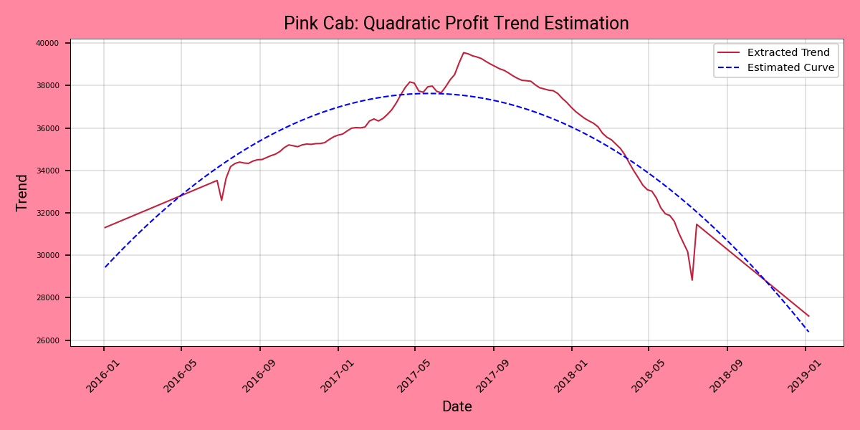

THE TREND IS QUADRATIC IN NATURE: ${−1.57X}^{2}+226.68X+29430.32$

Slide 33
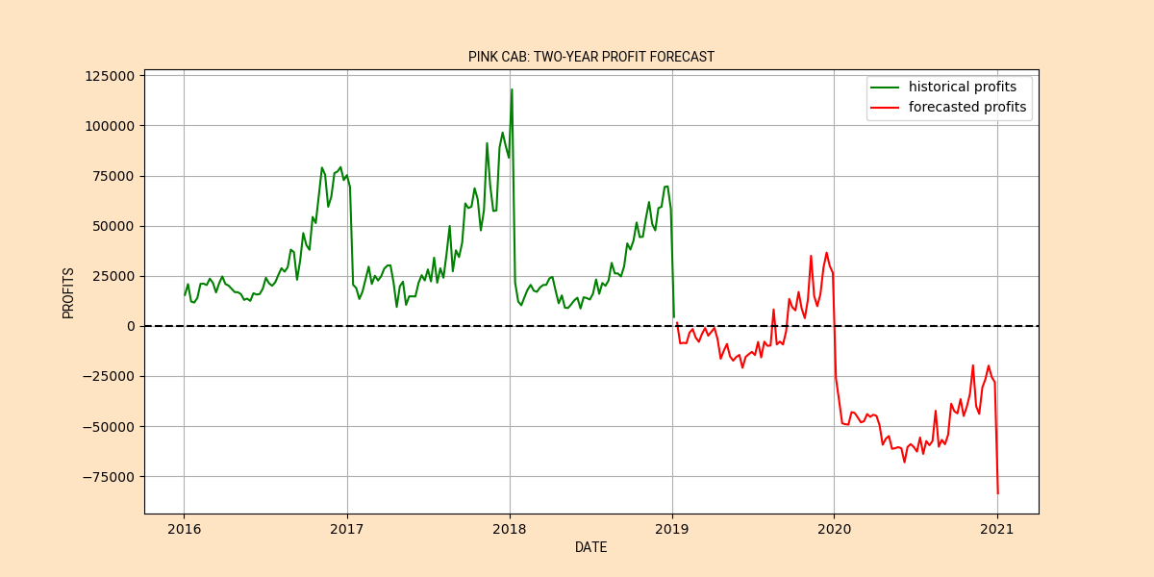
STARTING THIS YEAR (2019), PINK CAB IS FORECASTED TO BECOME UNPROFITABLE IF THE TREND CONTINUES

Slide 34
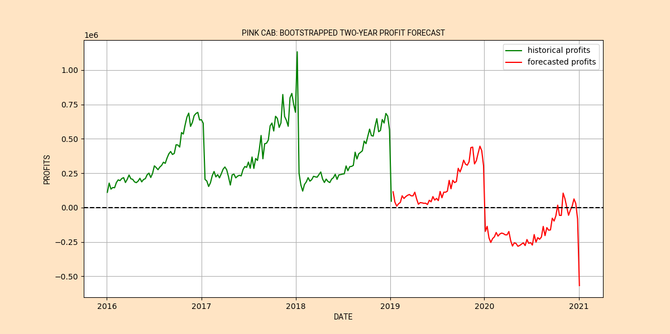
PINK CAB: 84,711 FARES AT AN AVG. PRICE OF $22.17/mile
YELLOW CAB: 274,681 FARES AT AN AVG. PRICE OF 32.68/mile
EVEN IF PINK CAB HAD AS MANY FARES AS YELLOW CAB & RAISED THEIR PRICES TO MATCH YELLOWS, THEY WOULD STILL BECOME UNPROFITABLE IN A YEAR, ACCORDING TO THE SIMULATION

Slide 35
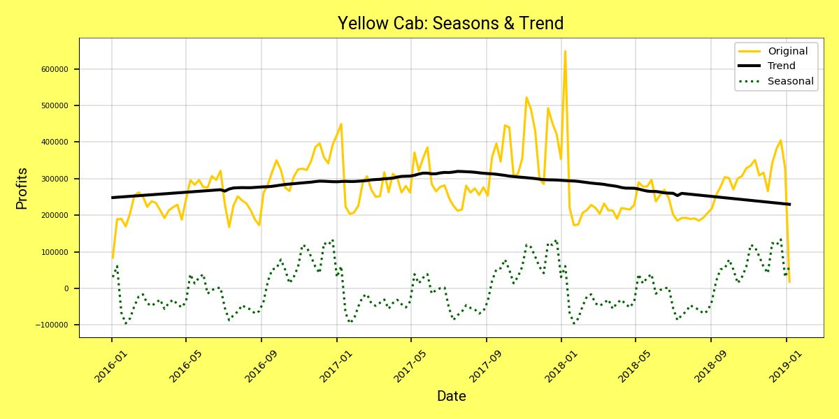
YELLOW CABS SEASON IS LESS PRONOUNCED THAN PINKS

Slide 36
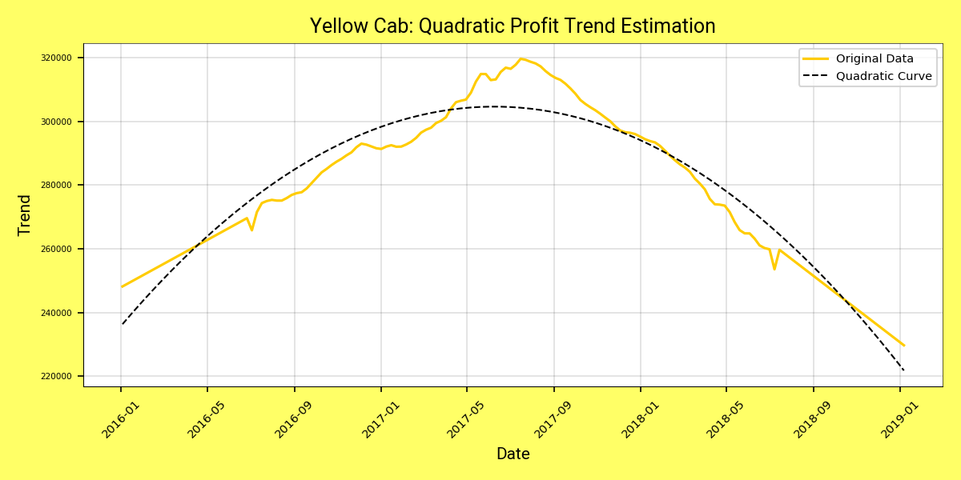

TREND:${−1.23X}^{2}+1830.47X+23631.11$
THE SQUARED TERM IS LESS THAN PINK CAB’S, IMPLYING A LESS STEEP DERIVATIVE
THIS MEANS PINK CAB WILL BECOME UNPROFITABLE MUCH FASTER THAN YELLOW CAB AS SHOWN IN THE NEXT SLIDE

Slide 37
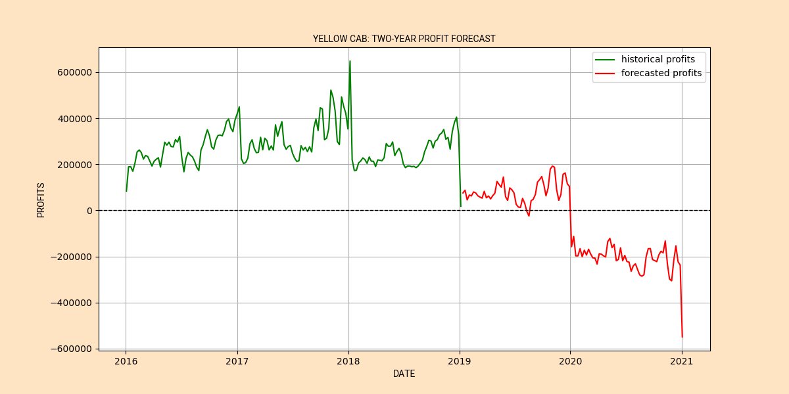
BY 2020 YELLOW CAB WILL BECOME UNPROFITABLE CETERES PARIBUS

Slide 38
FUTURE CONSIDERATIONS
A MORE DETAILED ANALYSIS SHOULD BE PERFORMED TO VERIFY INITIAL INSIGHTS
IDEALLY FUTURE ANALYSIS SHOULD PARTIALLY FOCUS ON PROVIDING CONFIDENCE INTERVALS

Slide 39
THANK YOU!
ANY QUESTIONS?

