Slide 1


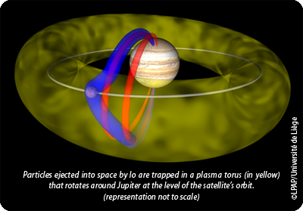
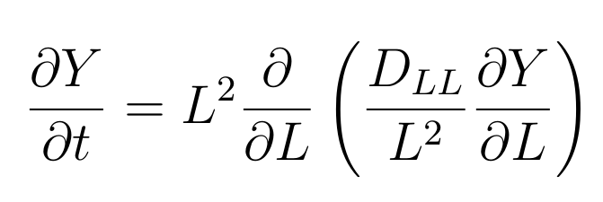
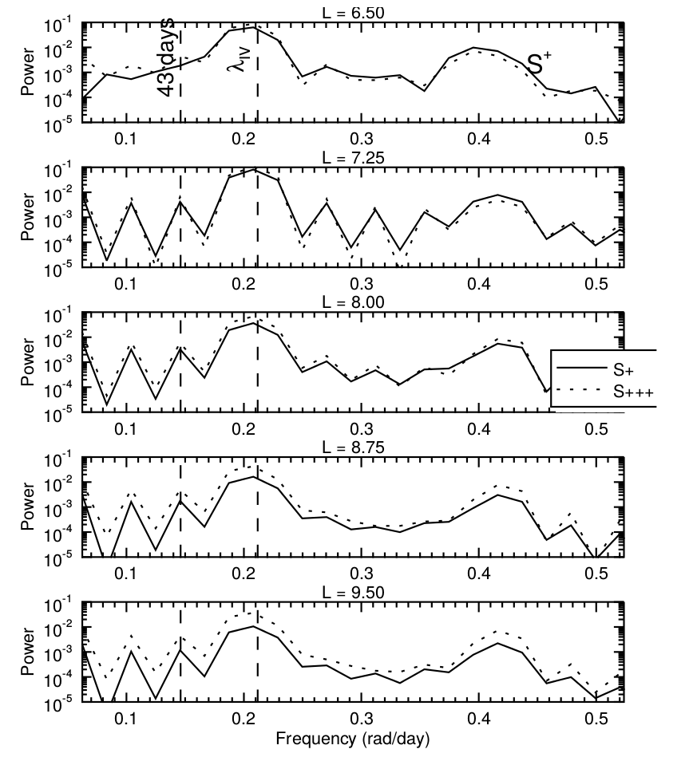
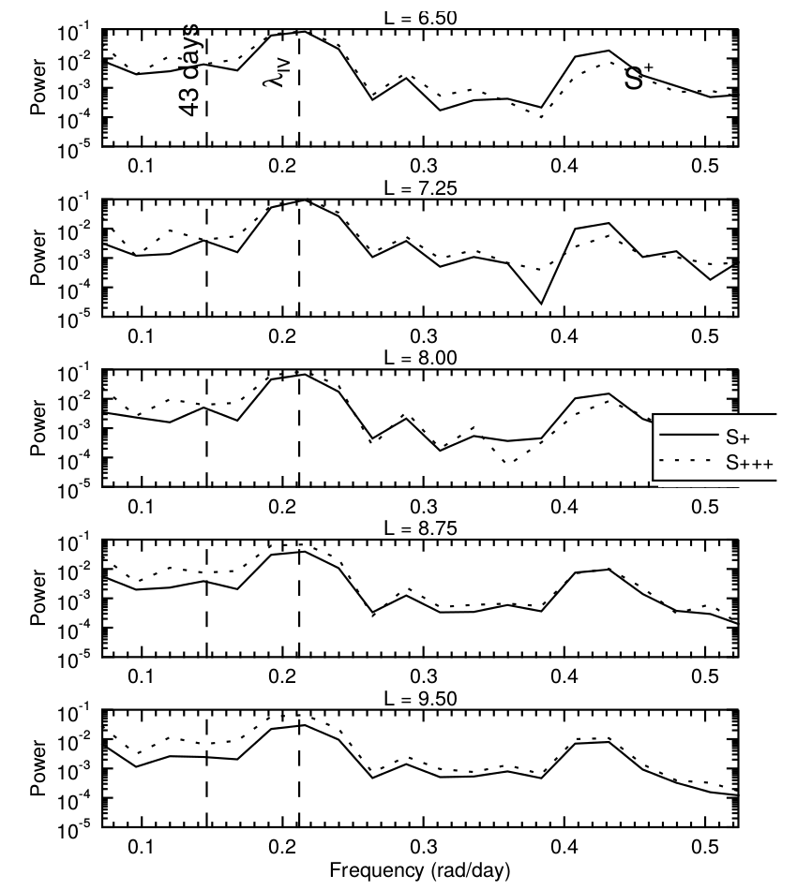
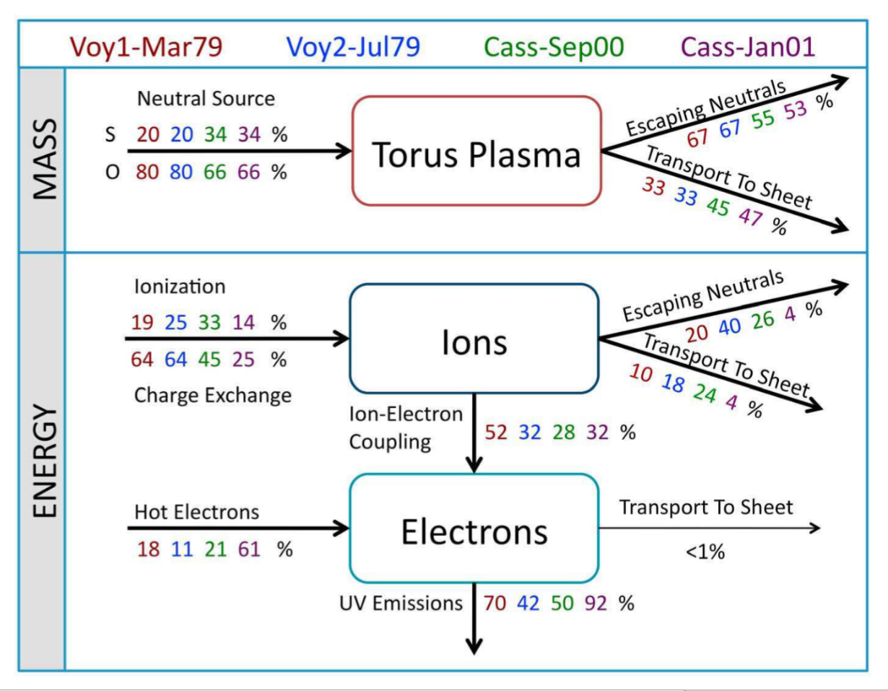
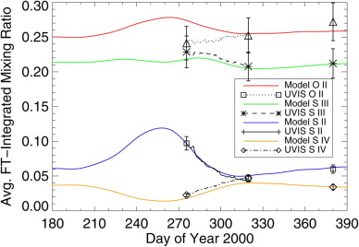
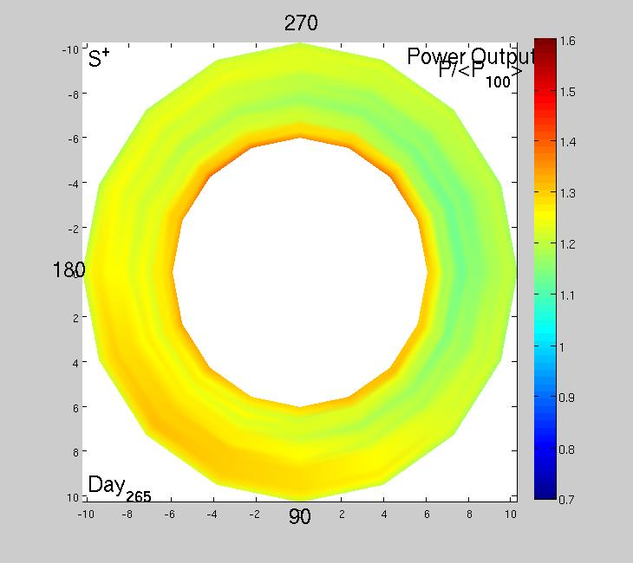
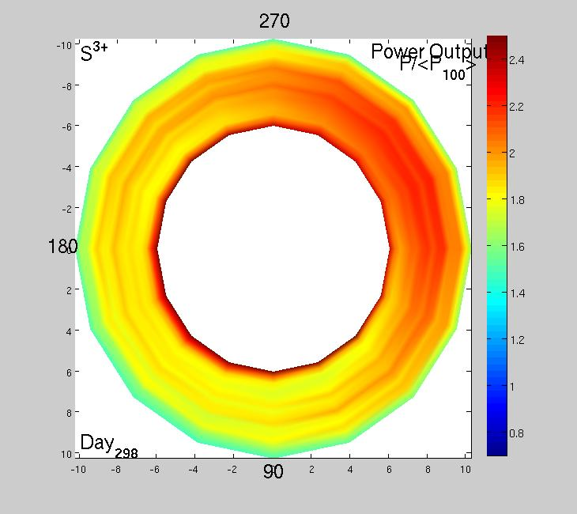
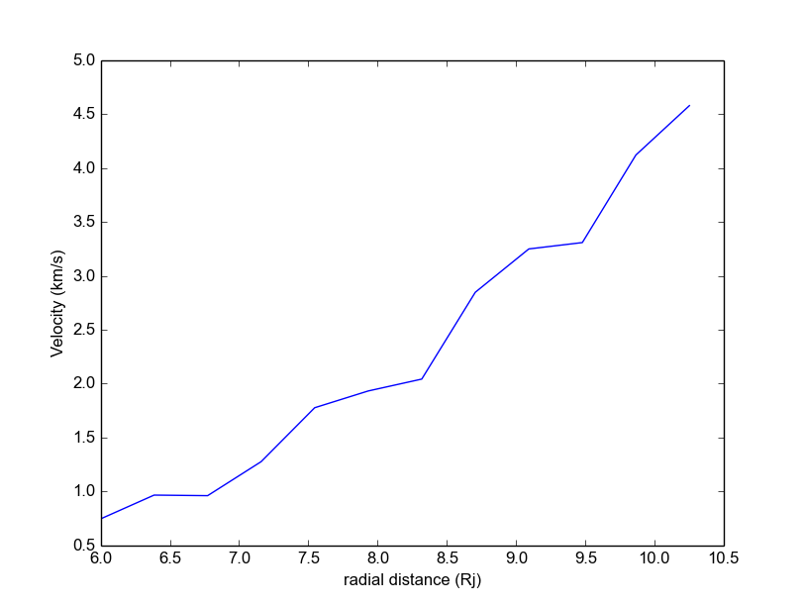
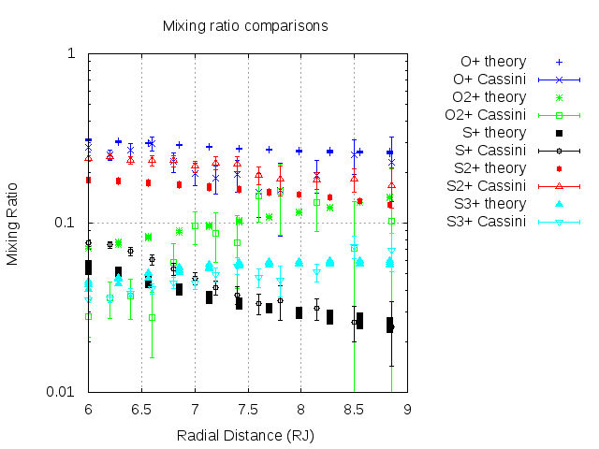
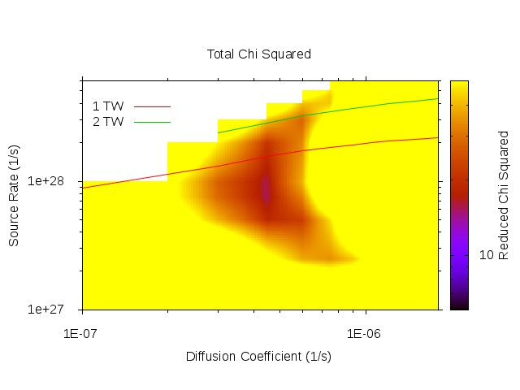
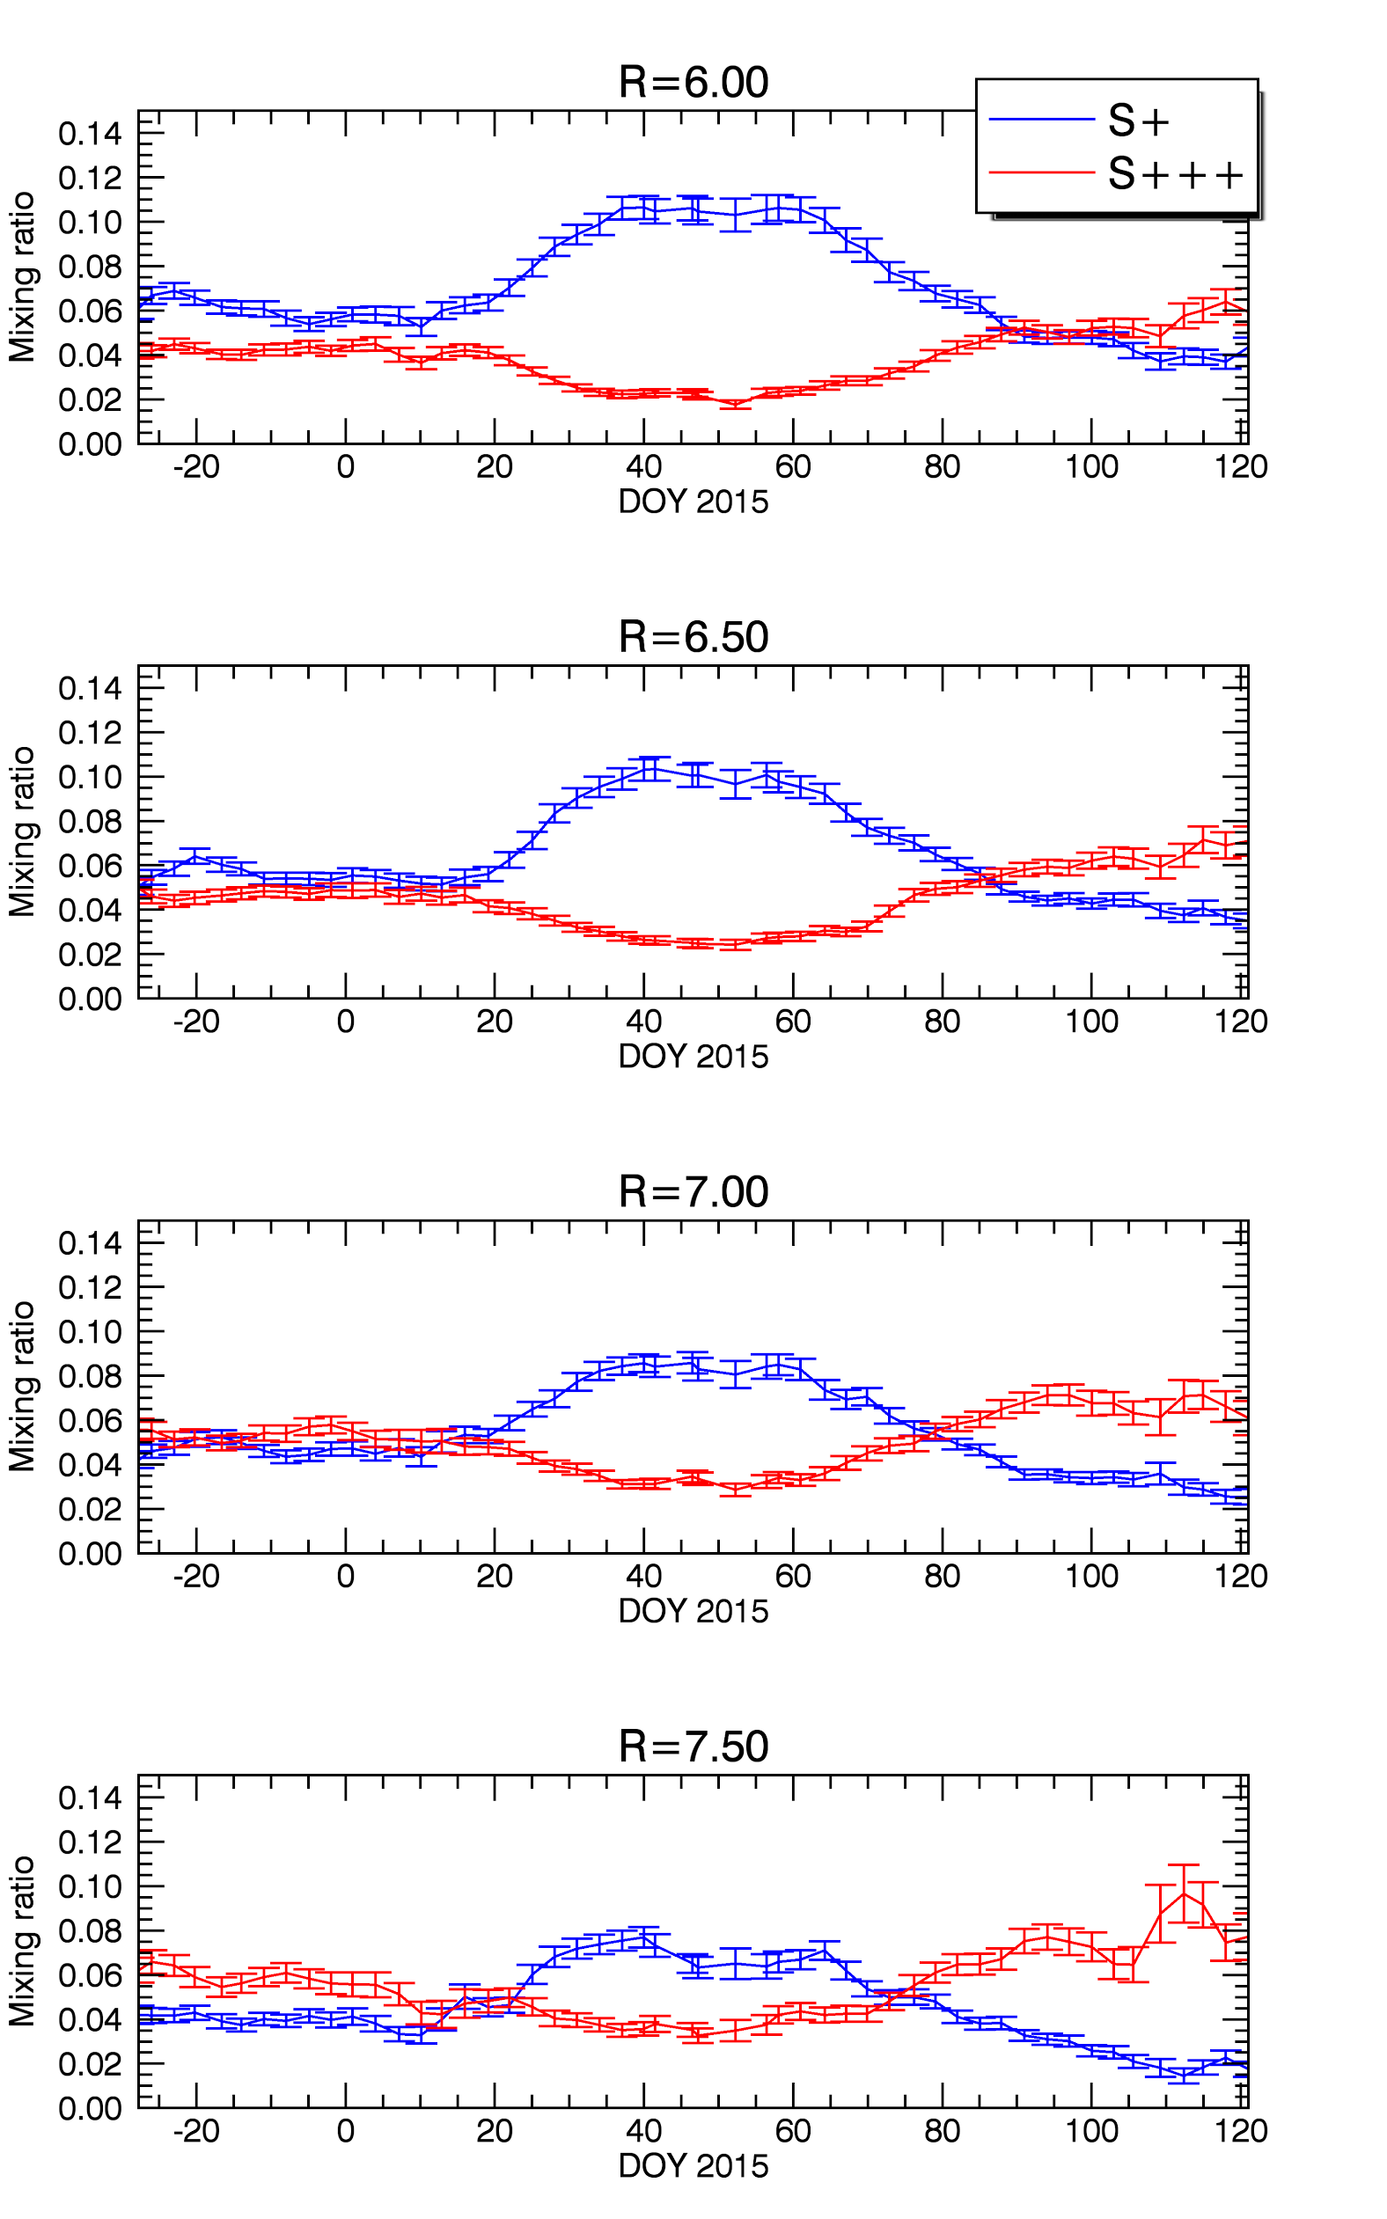
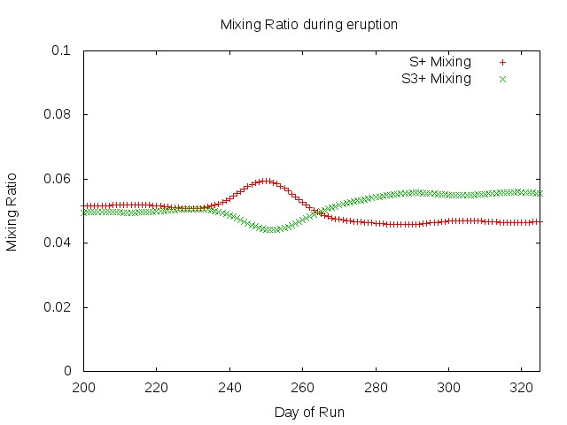
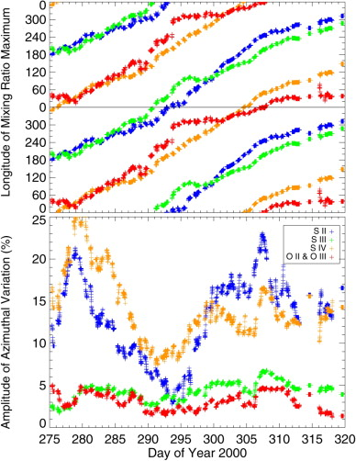
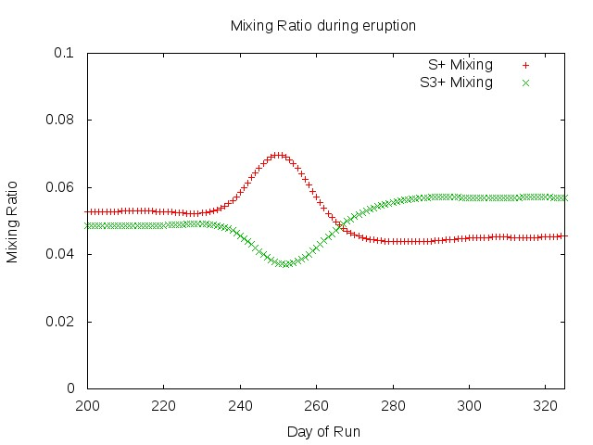
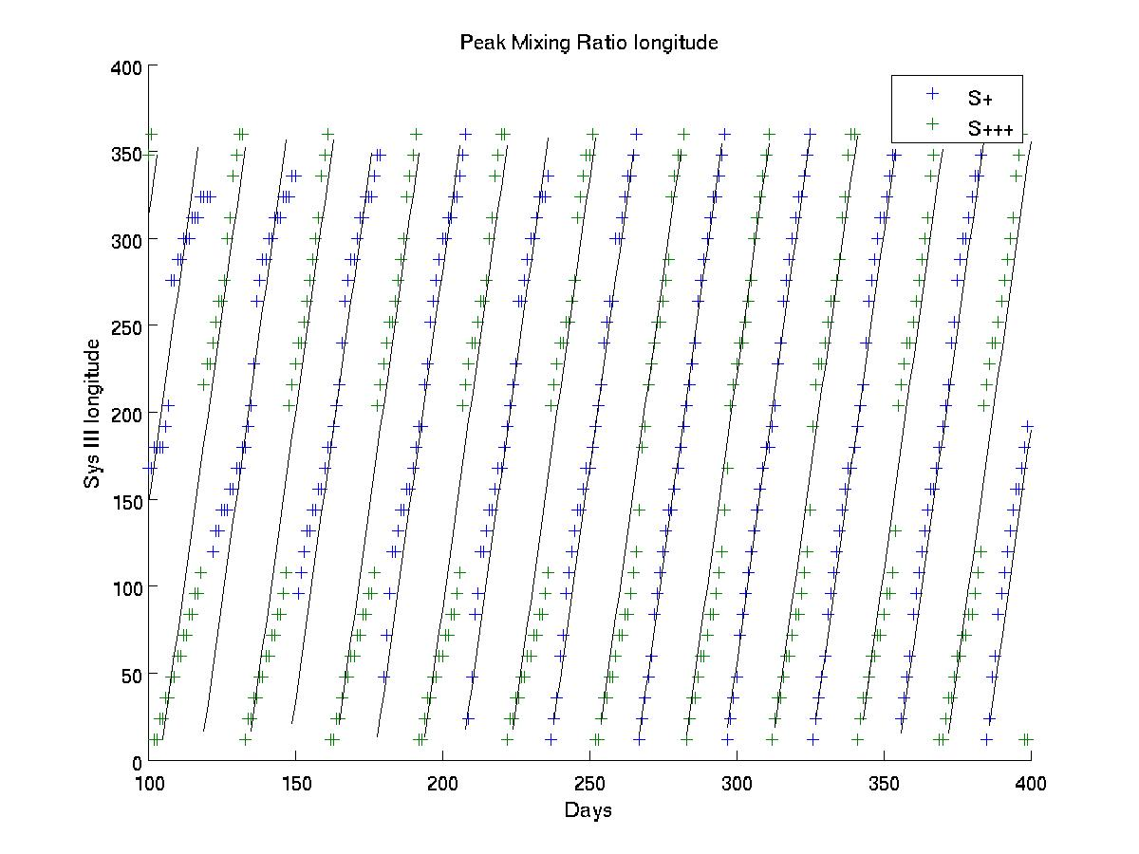
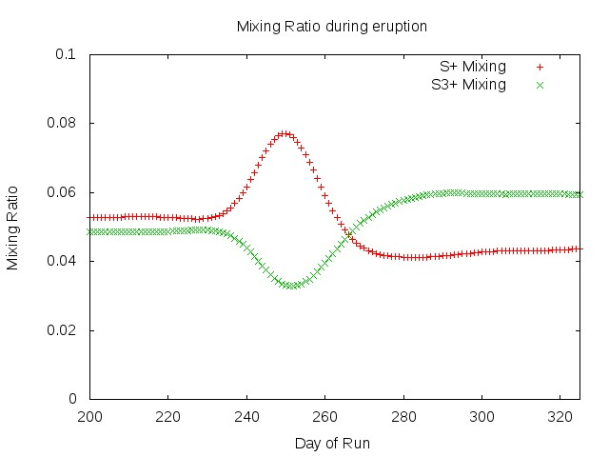
Modeling Jupiter's subcorotation-driven System IV period
D. A. Coffin¹ and P. A. Delamere¹
1. Geophysical Institute, University of Alaska Fairbanks
Abstract
The response of the Io plasma torus to superthermal electron modulation and volcanic eruptions is studied using a two-dimensional physical chemistry model (Copper et al., 2016). The model includes radial and azimuthal transport, latitudinally-averaged physical chemistry, and prescribed System III superthermal electron modulation following Steffl et al., [2008]. Volcanic eruptions are modelled as a temporal Gaussian enhancement (e.g., 2x) of the neutral source rate and hot electron fraction (e.g., <1%). However, we adopt an alternative approach for the Steffl et al., [2008] System IV electron modulation. Coupling hot electrons to radial transport, the modulation is determined by the radial flux tube content gradient. Radially-dependent subcorotation is prescribed, consistent with observations [Brown, 1994; Thomas et al., 2001]. We find that the model produces a radially-independent periodicity that is consistent with System IV, which may be directly coupled to subcorotation. We also find that post-eruption, the ionic composition of the torus changes and UV emission rate decreases but in a distinctly different manner for the inner (< 8.5 Rj) and outer (> 8.5 Rj) torus. The pre-eruption-normalized power radiated (ΔPUV) in the inner torus retreats inward while in the outer torus the enhancement transports outward through the boundary. We infer that the recovery is chemically-dominated in the inner torus, and transport-dominated in the outer torus.
Recreating System IV
There are multiple potential explanations for the System IV period. We investigated coupling of the hot electron fraction to three different radial dependences:
Flux tube content - NL²
Flux tube content gradient – d (NL ²) /dL as suggested by Hess, 2011
Mass loading – Pontius and Hill, 1982
Flux tube content gradient – d (NL ²) /dL
150 day bins: pre-eruption (left) and post-eruption (right)
43 days marks typical transport timescale (Bagenal, 2011)
Shift of System IV beat period from 30.2 days to 28.9 days
Motivation
Two-Dimensional Model
How does the plasma torus respond to an influx of superthermal ions and electrons from a volcanic event on Io?
What physical parameters determine power output?
What physical process is causing the torus to modulate at System IV?
Diffusive radial transport of any conserved Y (Delamere, 2003)
Azimuthal transport has radial dependence
Latitudinally averaged (Delamere, 2005)
Each grid point analyzed on independent processor
MPI code for processor communication (Copper, 2015)
Boundary conditions: inner – 6 Rj, outer – 11 Rj (Note Europa at 9 Rj)
In contrast, weighting the hot electron distribution by flux tube content generates a System IV-like modulation, but is not responsive to eruptions.
Using mass loading results in an inconclusive FFT.
Plasma Torus Mass and Energy Flow
Modeling torus response to an eruption
Plots show radial transport, plasma comoving with Io
Modeled eruption peaking on day 249 of 400 day run
UV power emission normalized to first 100 days
S+, S+++ completely out of phase per Steffl
S+++ has stronger relative gain (~2.5 baseline vs. ~1.4 baseline) and a much longer decay period (~60 days versus ~20 days)
Radial wave structure is apparent
Delamere and Bagenal, 2011 show the hot electrons can provide a majority of energy input despite the influx density being an order of magnitude less than the neutral influx
Superthermal electrons (tens to hundreds of eVs) effect chemistry on short time scales (hours to days).
Radial profile of subcorotation and mixing
Power output
Flux off Io held at 1 ton/s save for Gaussian increase to simulate eruption
Total run of 450 days (~16 System IV periods)
Neutral influx peaks at 1.2 times baseline, fwhm of 25 days
Electron influx simulates chemistry lag of 30 days and peaks at 0.2 times baseline, fwhm of 45 days
Hot electron (40 eV) fraction of 0.2% total electron population
O to S ratio of 1.7
Plasma subcorotation of 2 km/s (per Brown, 1994)
Radial power laws: -12 on Sn, 5 on feh, 5.5 on Teh
Steffl (2008) plots simulated UV emissions from ionic species against Cassini observations using a 2.4x neutral source increase and a 12% hot electron increase. The figure shows the perfectly out of phase relationship between S+ and S+++ ions in the torus.
Per Thomas [2004] the torus produces 1-2 TW of power. Performing a chi-squared fit against Cassini values, our model predicts a typical non-eruptive output at the low end of this range.
The System IV beat period corresponds to the subcorotation velocity with respect to System III at 6.3 Rj, within the chemically dominated portion of the torus.
Our model produces mixing ratios that follow the same power laws as Cassini data, and save for singly ionized oxygen, fall within the range of error
References
Hisaki collaboration
Hisaki is a JAXA (Japanese Aeronautical Exploration Agency) satellite in low-Earth orbit
Multiple viewing bands; ultraviolet observations relevant to poster authors
Remote observing of Io torus emissions
Captured March 2015 eruption
Our model can replicate observed emissions – revealing internal torus parameters based on external observations
Below left is Tomoki, 2016 showing Hisaki measurements of the torus mixing ratio during an eruption
Below right is our simulation of the torus response for different amplitudes of the neutral influx, with the hot electron amplitude fixed at 5% of baseline
Brown, 1994
Copper, 2016
Delamere and Bagenal, 2003
Hess, 2011
Pontius and Hill, 1982
Steffl, 2008
Thomas, 2001
Conclusions
Further Research
Hisaki observations
Neutral amp = 0.5 x base
Giving the hot electron fraction a dependence on radial flux tube gradient reproduces System IV subcorotation with the ~28 day beat period observed by Cassini (Steffl, 2008)
This supports the Hess et al. view that empty flux tube transport drives System IV modulation
Uniform period coupled to 6.3 Rj velocity – chemically dominated torus broadcasts energy balance to global scale
Power, density drops at 9 Rj suggest a bifurcation of dispersion processes
Comparison to Cassini hot electron modulation
Neutral amp = 1
Steffl (2006) shows multiple ionic species in System III coordinates. The clear periodicity is System IV. The cause of this periodicity is the focus of this investigation.
The lower picture is from the run described above. The apparent jumps are due to the radial waveform, as the peak mixing ratio switches crest.
Neutral amp = 1.5
Origin of superthermal electrons – Alfvénic acceleration in 3D model
Conditions at Europa's orbit in support of planned missions
Torus conditions in support of Juno mission
Comparison and analysis of Hisaki data
Origin of superthermal electrons – Alfvénic acceleration in 3D model
Conditions at Europa's orbit in support of planned missio
Torus conditions in support of Juno mission
Comparison and analysis of Hisaki data

