Slide 1

Analytic Report for Frito Lay
Analysis of Existing Employee Data for Talent Management
Andrew Larsen

Slide 2
EDA - Data Structure
Dataset: CaseStudy2-data.csv
No NA values
9 factor variables, 27 integer variables
Unbalanced classification variable
140 yes vs. 730 no
Test train split: 80%
Accuracy vs. Sensitivity vs. Specificity

Slide 3
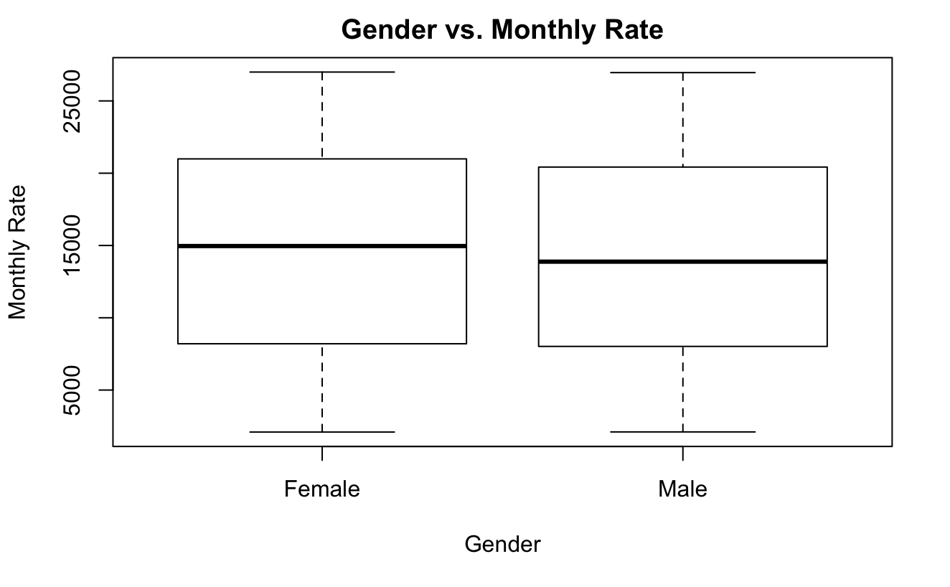
EDA – Miscellaneous
Relationships studied:
Gender vs. Monthly Rate
Education vs. Monthly Rate
Gender vs. Years with Current Manager
Work Life Balance vs. Monthly Rate
Marital Status and Gender vs. Job Satisfaction
No factors were significantly different

Slide 4
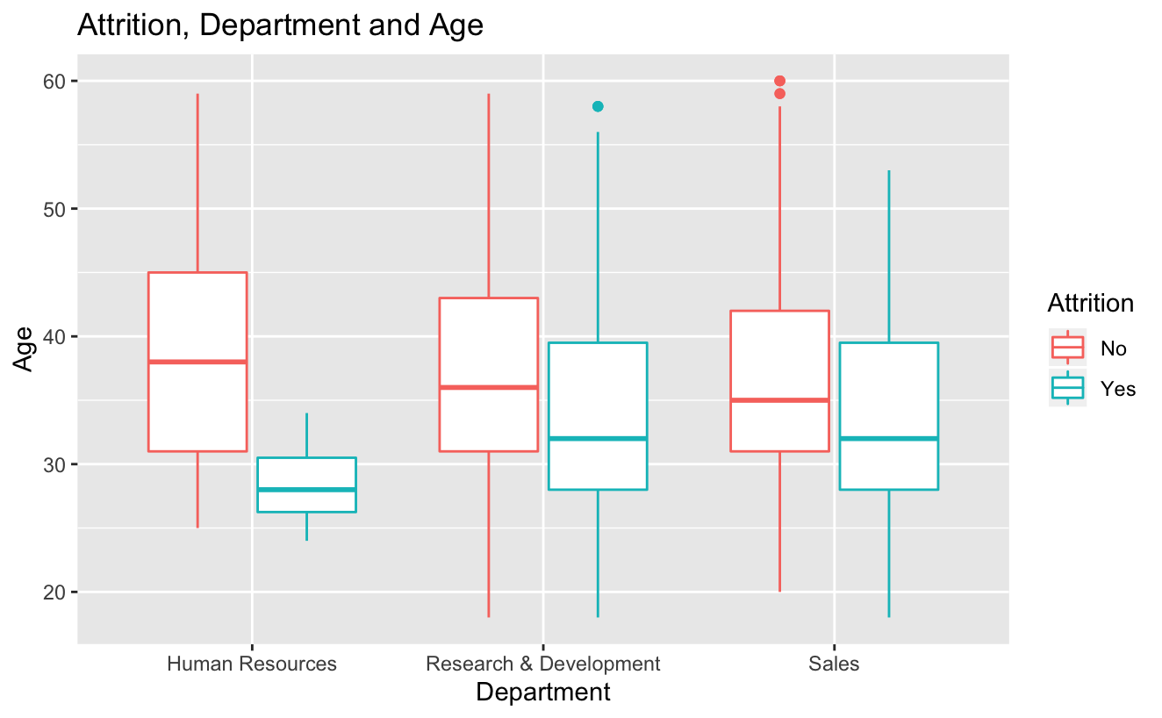
EDA - Interactions
Interactions investigated for attrition
Department and Age
Job Role and Age
Marital Status and Age
Business Travel and Monthly Income
Education Field and Monthly Income
All 5 of these interactions were put into the initial logistic regression model

Slide 5
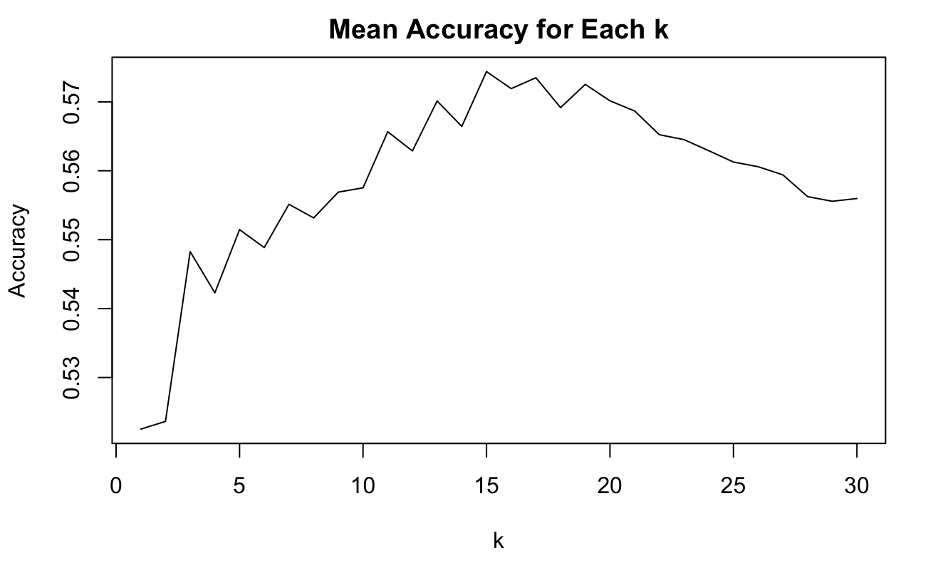
Attrition Prediction – k-NN
All numeric variables
50 iterations each of 30 k’s
K = 15 maximizes accuracy
Maximum average accuracy: 57.4%
Maximum average sensitivity: 57.5%
Maximum average specificity: 59.7%
Accuracy is too low to consider this model

Slide 6
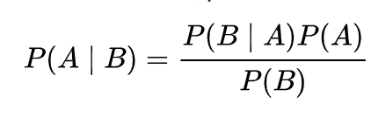
Attrition Prediction – Naïve Bayes
All categorical variables
50 iterations
Average accuracy: 69.2%
Average sensitivity: 69.3%
Average specificity: 67.7%
Significantly better than our initial k-NN model

Slide 7
Attrition Prediction - LDA
All categorical and numeric variables
50 iterations
Average accuracy: 66.4%
Average sensitivity: 68.1%
Average specificity: 66.3%
Better than k-NN but worse than Naïve Bayes
The categorical variables are important in predicting attrition

Slide 8
Attrition Prediction – Logistic Regression
All categorical and numeric variables, plus interactions
50 iterations, anything greater than 43% is classified as yes
Average accuracy: 68.5%
Average sensitivity: 72.7%
Average specificity: 68.3%
Highest average sensitivity, 0.7% less accuracy than Naïve Bayes
Our best model for predicting attrition
Model used to predict attrition in the CaseStudy2CompSet No Attrition.csv file
Most important factors in determining attrition
If someone works overtime
Job Satisfaction
Job Role
Manager and Manufacturing Director less likely to leave
Sales Representative more likely to leave

Slide 9
Salary Prediction – Linear Regression
100 iterations
Variables used:
Determined by a combination of backwards selection and EDA
Age
PercentSalaryHike
JobLevel
TotalWorkingYears
YearsAtCompany
Average Root Mean Squared Error: $1,050

Slide 10
Conclusion
Logistic Regression used to predict attrition
Average accuracy: 68.5%
Average sensitivity: 72.7%
Average specificity: 68.3%
Linear Regression used to predict salary
Root Mean Squared Error: $1,050
Salary, Years with Current Manager, Job Satisfaction not affected by gender
Most important factors for turnover
If someone works overtime
Job Satisfaction
Job Role

