Slide 1

RIMS Restaurant Inventory Management System Module One: Order and Menu Items
Drew Parsons
drewmparsons@gmail.com

Slide 2
Background
Tools and Technologies
User Stories
Website workflow
Database Schema
Challenges

Slide 3
Background
About the application
who its for and what it does

Slide 4
About RIMS
RIMS is a Restaurant Inventory Management System.
RIMS is a web-based application that will allow users to manage their restaurant menu items, product inventory, and outgoing orders.
RIMS will allow customers to order menu items from the current menu set by the restaurant administrator
RIMS Module one: consists of Menu Creation, Order Creation, and User Login and Registration
Overview of application
And current module

Slide 5
Target Audience
RIMS is built for restaurant owners and managers.
RIMS will be useful for restaurants as well as for their customers.
Restaurants can be single entities, but scalable from small to large sized operations
The users want to keep better track of their inventory
The users want to easily link and track their orders, menus, and inventory stocks
The users want to increase their online presence, and add value for their customer
The users want a simple way to create and present an online menu

Slide 6
Tools and Technologies

Slide 7
Programming Environment:
Heidi SQL
Visual Studio
Eclipse IDE
Design
Lucid
Adobe
Balsamiq
Additional Tools
Bootstrap
Font Awesome

Slide 8
User Stories
Features of the software from the users perspective

Slide 9
Functional Requirements
Have
Users will have the ability to create accounts and log in with secure authentication
View
Users can view the current menu
Access
User can access the menu item page from the login home screen
Create
User can create new menu items by adding items from the inventory
Edit/delete
User can edit/delete menu items from the menu item page
Access
User can access the orders page from the home page
Enter/edit
User can enter/edit orders from the order page
View
User can view their order details from the order summary page
Create
User can create an order that will be stored in the database

Slide 10
Non-Functional Requirements
Compatibility:
RIMS will be web based and available on any systems with internet access
RIMS will be accessible to all major web browsers(Chrome, FIreFox, Edge,etc)
Usability:
RIMS will incorporate material design elements
RIMS will include necessary accessibility options
Universal fonts will be used
Robust design
All images, buttons, items on site are clearly defined and described
Pages will be simple in design, and perform one main task
Documentation will be thorough and easily accessible
Performance
Simple, scalable design will allow for fast loading of web pages
Database operations will be tuned for reliability and speed
Security
User credentials will be stored securely on the database
Passwords will be encrypted
Notes:
Navigation, Buttons, common color theme

Slide 11
Work Flow
Current workflow for RIMS website

Slide 12
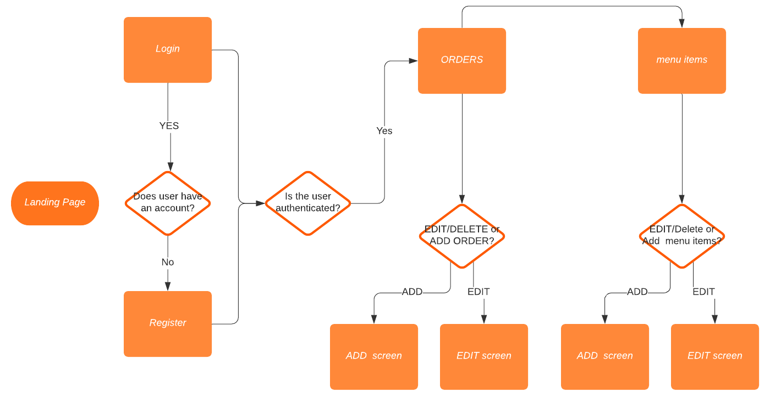

Slide 13
Database ERD
Current entity relationship diagram

Slide 14
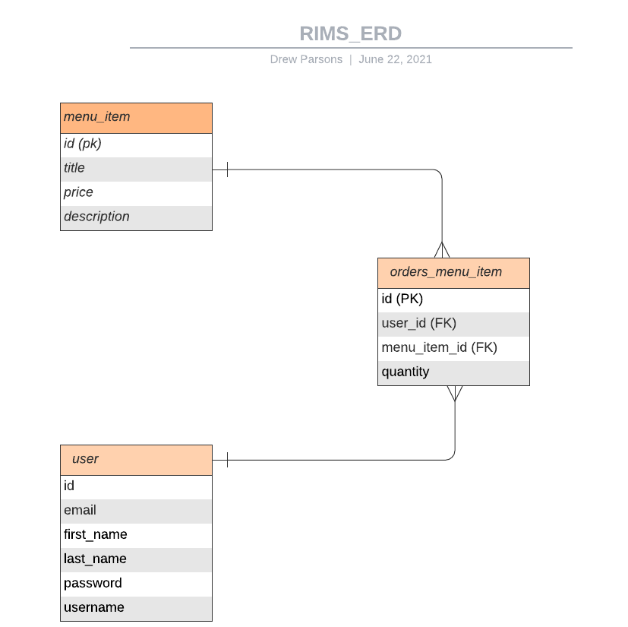
DB diagram for Order and Menu Items Module

Slide 15
Challenges

Slide 16
Scope of Project: Original scope was much too large
Solution: Break project down to smaller modules
Modular programming allows for faster build time
Refactoring is easier
Testing is simpler, more efficient
Website did not scale well on mobile
Solution: add responsive design elements
Bootstrap classes
CSS@media rules
Security Features: tough to implement
Solution: find help from students, teachers, online programs
Simplify login to one role
add additional roles as programming skills increase

