Slide 1
Unit Testing in MS Test

Slide 2
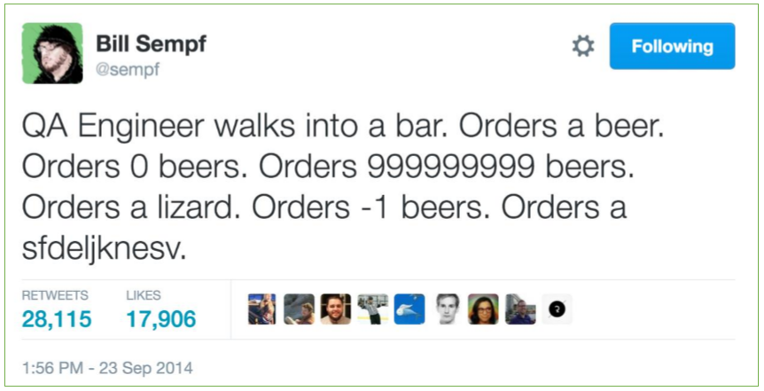
What is a Unit Test?
A unit test should focus on a single aspect of the system under test to validate that it works as intended

Slide 3
What is a Unit Test?
In computer programming, unit testing is a software testing method by which individual units of source code, sets of one or more computer program modules together with associated control data, usage procedures, and operating procedures, are tested to determine whether they are fit for use
https://en.wikipedia.org/wiki/Unit_testing
Notes:
In computer programming, unit testing is a software testing method by which individual units of source code, sets of one or more computer program modules together with associated control data, usage procedures, and operating procedures, are tested to determine whether they are fit for use
A unit test should be fast, reproducible, and (hopefully) automated… If your tests produce different results with each run or are slow to execute, you won’t run them.
If your tests are slow, it’s probably because they are…

Slide 4
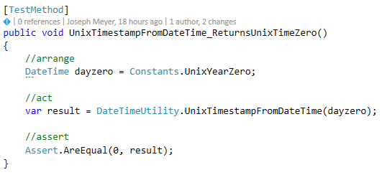
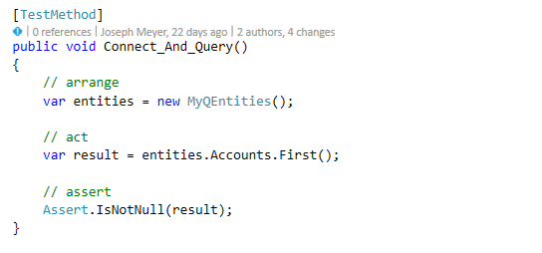
What is a Unit Test?
Individual software modules combined and tested as a group are not unit tests
Notes:
Integration tests! Integration tests combine modules and test them as a group. Tests that run against APIs, services and (especially) data bases are integration tests

Slide 5
What is a Unit Test?
Other close relatives to Unit Test
Acceptance test
Characterization test
Regression test
UI Test

Slide 6
Why Unit Test

Slide 7
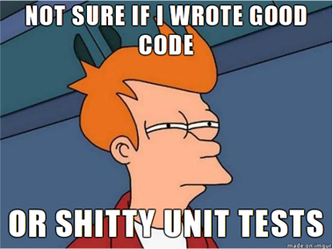
Principles of Unit Testing
Unit Testing
Test Driven Development
Tests are written after the code
Functionality drives tests
Tests are written before the code
Test drive functionality

Slide 8
Principles of Unit Testing: Naming Methods
Action_Input_ExpectedResult
UnitOfWork_Scenario_ExpectedResult
SystemUnderTest_WhatIsBeingTested_ExpectedResult

Slide 9
Principles of Unit Testing: Arrange, Act, Assert
Arrange
Act
Assert
Notes:
Demo Phoneword example here?

Slide 10
Principles of Unit Testing: Red/Green/Refactor

Slide 11
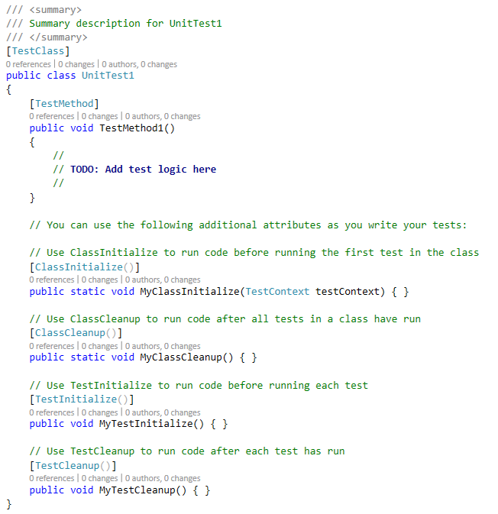
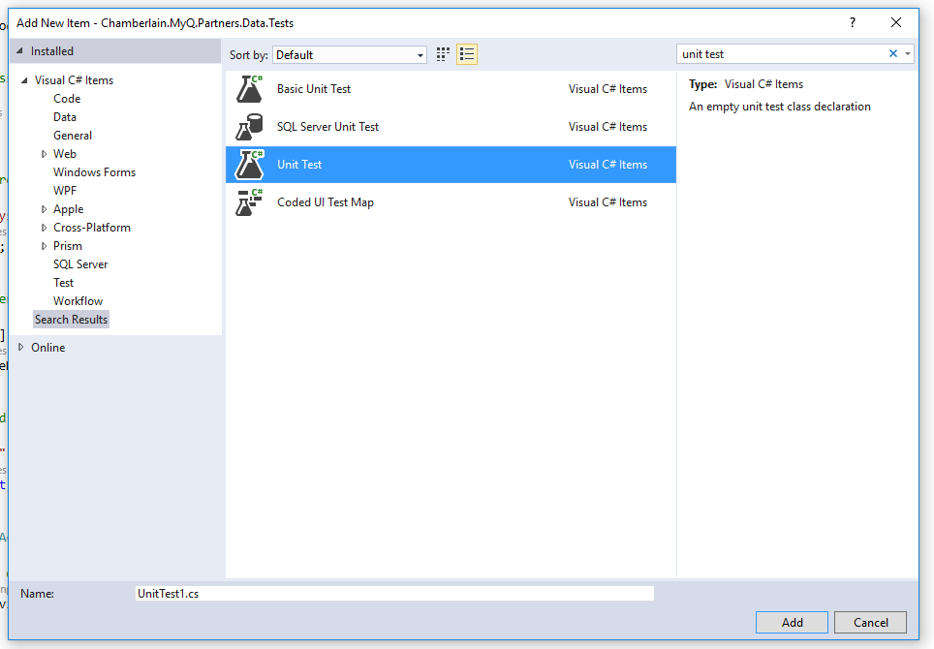
Principles of Unit Testing: Test Attributes
[TestClass]
[TestMethod]
[ClassInitialize]
[ClassCleanup]
[TestInitialize]
[TestCleanup]

Slide 12
Unit Test Structures

Slide 13
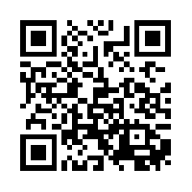
Sample Code
https://github.com/DrewNull/BFF-UnitTestingInMSTest

