Slide 1
Unit Testing in MS Test
Notes:
Drew:
I’ve been at Rightpoint a long time but haven't seen much unit testing done
As both a consultant and CMS developer, it’s easy to let unit testing slip through the cracks.
I’m a newb to unit testing but I understand the benefits and want to force myself to write better code
For me, the biggest question was, “How do I get started?”
And, more importantly, “How do I know or decide what to test?”
The truth is that, especially with modern tools, it is very easy to get started.
And it’s important to understand that even a little bit of unit testing is better than nothing.
The goal of this BFF is to provide an introduction to unit testing concepts and tools, and encourage you to use it

Slide 2
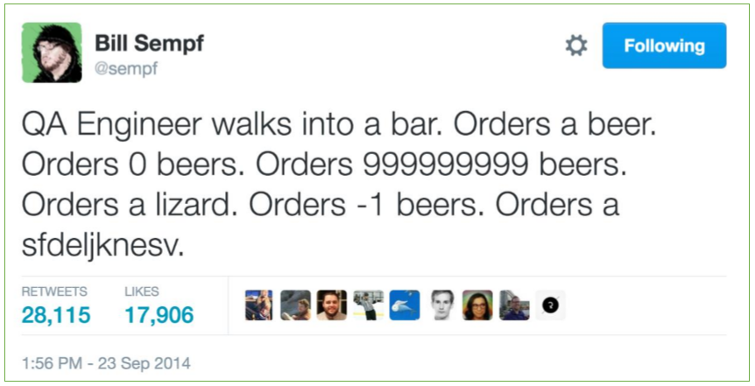
What is a Unit Test?
A unit test should focus on a single aspect of the system under test to validate that it works as intended

Slide 3
What is a Unit Test?
In computer programming, unit testing is a software testing method by which individual units of source code, sets of one or more computer program modules together with associated control data, usage procedures, and operating procedures, are tested to determine whether they are fit for use
https://en.wikipedia.org/wiki/Unit_testing
Notes:
In computer programming, unit testing is a software testing method by which individual units of source code, sets of one or more computer program modules together with associated control data, usage procedures, and operating procedures, are tested to determine whether they are fit for use
A unit test should be fast, reproducible, and (hopefully) automated… If your tests produce different results with each run or are slow to execute, you won’t run them.
If your tests are slow, it’s probably because they are…

Slide 4
A good unit test should…
...be automated and repeatable
…be easy to implement
…remain for future use
…be able to be ran by anyone
…run at the push of a button
…run quickly

Slide 5
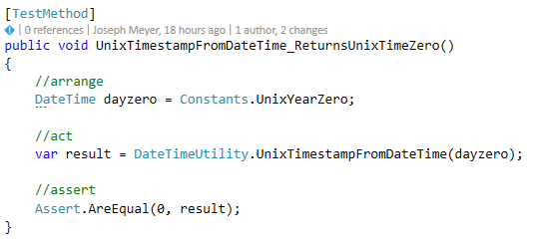
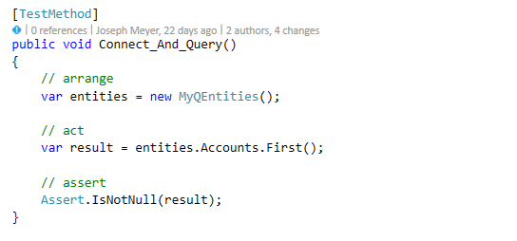
What is a Unit Test?
Individual software modules combined and tested as a group are not unit tests
Notes:
Integration tests! Integration tests combine modules and test them as a group. Tests that run against APIs, services and (especially) data bases are integration tests
NO. NO. NO.
Other types of tests:
Acceptance test
Characterization test
Regression test
UI Test

Slide 6
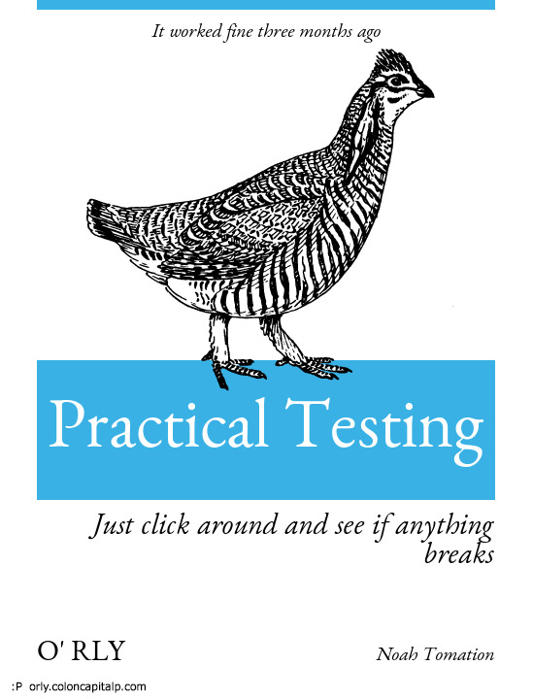
Why Unit Test?
Manual testing sucks
Time consuming and prone to human error
Maintainability
Avoids breaking changes; describes behavior
Encourages good patterns
Testable code usually means better code
“Code Coverage”
It’s easy to get started
Notes:
Manual testing sucks – This goes for automated testing in general. Manual testing is time-consuming and prone to human error. And you miss out on the benefit of running all your tests every time you run a single test.
Maintainability –
It helps to avoid making breaking changes committed by future developers (which could be you)
It helps to describe the behavior of the unit under test. For example, a factory method that accepts dependencies to the object that it constructs. If the arguments are invalid, does it return an empty instance? Null? Throw an exception? A unit test will tell you.
Encourages good patterns – Testable code and clean dependency graphs go hand-in-hand. You have to be more deliberate, think about your code more, not be lazy, consistently treat your dependencies as first class citizens.
“Code Coverage” – In addition to meeting legit project requirements, it makes clients happy to see evidence of testing taking place.
It’s easy to get started – Setting up tests in Visual Studio is easy. We’ll give an example later

Slide 7
Why unit test?
How much does a bug cost in Development?
How much does a bug cost in QA?
How Much does a bug cost in Production?
Development
QA
Production
$
$$
$$$
Notes:
Finding an issue in dev is cheap
Fixing an issue in dev is cheap
(Optional) Shouldn’t SOWs have testing built into dev time, rather than a separate line item?

Slide 8
What Should I Unit Test?
Yes
No
Control flow code
conditionals
loops
anything that makes a decision
External dependencies
unit testing != integration testing
Code without logic
data transfer (DTOs)
default getters and setters

Slide 9
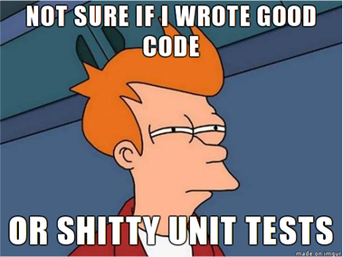
Principles of Unit Testing
Unit Testing
Tests are written after the code
Functionality drives tests
Test Driven Development
Tests are written before the code
Test drive functionality

Slide 10
Principles of Unit Testing: Naming Methods
Action_Input_ExpectedResult
UnitOfWork_Scenario_ExpectedResult
SystemUnderTest_WhatIsBeingTested_ExpectedResult
TestDrewNullMethod

Slide 11
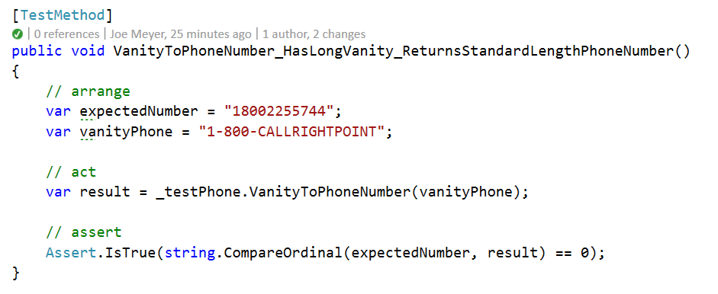
Principles of Unit Testing: Arrange, Act, Assert
Arrange your variables
Act on the object under test
Assert that the outcome meets expectations
Notes:
Demo Phoneword example here?

Slide 12
Principles of Unit Testing: Red/Green/Refactor
Test
Code
Refactor
..Your code fails again, and the cycle starts anew
Write as short a test as possible so that your code fails… this is “red”
Start
Then, write as little code as possible so that your test passes… this is “green”
Then, write more test so that…

Slide 13
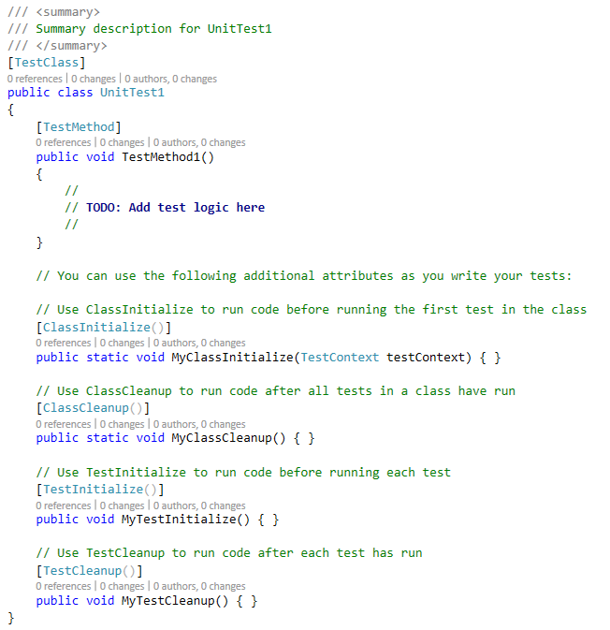
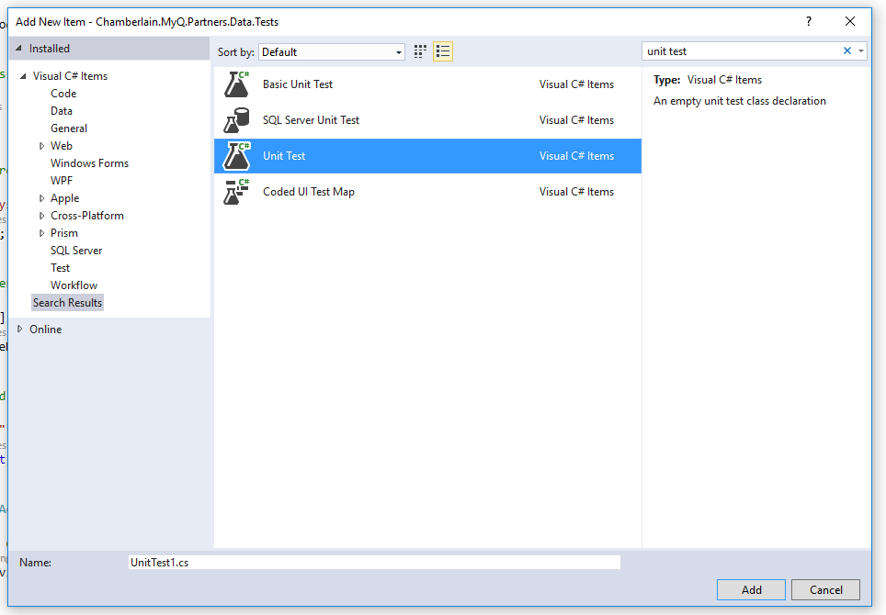
Principles of Unit Testing: Test Attributes
[TestClass]
[TestMethod]
[ClassInitialize]
[ClassCleanup]
[TestInitialize]
[TestCleanup]

Slide 14
Unit Testing Example

Slide 15
Unit Test Structures
Fakes
Stubs
Mocks
Fixtures

Slide 16
Unit Test Structures: Stubs
“A stub is a controllable replacement for an existing dependency in the system. By using a stub, you can test your code without dealing with the dependency directly.”
Stubs break dependencies.
You do not assert against stubs.
Roy Osherove, The Art of Unit Testing, Second Edition: with Examples in C#

Slide 17
Unit Test Structures: Mocks
“A mock object is a fake object in the system that decides whether the unit test has passed or failed. It does so by verifying whether the object under test called the fake object as expected.”
Mocks test interactions.
You do assert against mocks.
Roy Osherove, The Art of Unit Testing, Second Edition: with Examples in C#

Slide 18
TDD Example

Slide 19
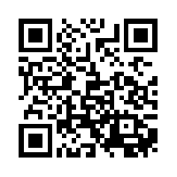
Sample Code
https://github.com/DrewNull/BFF-UnitTestingInMSTest

