Slide 1
Upgrading to CMS 12 and Commerce 14
And avoiding pitfalls while doing it
by Drew Null
dnull@rightpoint.com

Slide 2

Upgrading to CMS 12 and Commerce 14
And avoiding pitfalls while doing it
by Drew Null
dnull@rightpoint.com

Slide 3
Why present on upgrading from CMS 11?
There are many great resources for learning CMS12 and Commerce14:
The official developer documentation has been updated: https://world.optimizely.com
The official user guide has been updated: https://webhelp.optimizely.com
Mark Price and Scott Reed host a masterclass on .NET5: https://www.optimizely.com/support/education/product/migrating-to-optimizely-cms-12-and-commerce-14
…and so on.
But there aren’t many resources for upgrading from CMS 11 / Commerce 13

Slide 4
(one exception)
Upgrading Optimizely CMS 11 to 12 and Commerce 13 to 14
https://world.optimizely.com/blogs/drew-null/dates/2022/5/upgrading-optimizely-cms-11-to-12-and-commerce-13-to-14

Slide 5
Prerequisites
Phase 0
Stuff to do before you begin

Slide 6
Read the official documentation
Upgrading to Content Cloud (CMS 12)
https://docs.developers.optimizely.com/content-cloud/v11.0.0-content-cloud/docs/upgrading-to-content-cloud-cms-12
Breaking changes in Content Cloud (CMS 12)
https://docs.developers.optimizely.com/content-cloud/v11.0.0-content-cloud/docs/breaking-changes-in-content-cloud-cms-12
System requirements for Optimizely
https://docs.developers.optimizely.com/content-cloud/v12.0.0-content-cloud/docs/system-requirements-for-optimizely

Slide 7
Be on .NET Framework 4.7.2 or higher
CMS11 only requires .NET Framework 4.6.1, but Microsoft recommends being on 4.7.2 or higher when using Upgrade-Assistant
https://docs.developers.optimizely.com/content-cloud/v11.0.0-content-cloud/docs/system-requirements-for-optimizely
https://docs.microsoft.com/en-us/dotnet/core/porting/premigration-needed-changes

Slide 8
Update to the latest version of CMS11 (Commerce13) before upgrading
The official documentation doesn’t explicitly say to do this…
but I can’t think of any reason not to.

Slide 9
Check the status of add-on packages
Official CMS/Commerce add-on platform compatibility:
https://docs.developers.optimizely.com/integrations/v1.1.0-apps-and-integrations/docs/add-ons-platform-compatibility
Official big list of package migration status:
https://world.optimizely.com/resources/net5/add-ons

Slide 10
Check the status of add-on packages
Give yourself time to check the status of your favorite third party add-ons.
Having no workaround for unsupported add-ons could derail your whole upgrade project. Know what you’re getting into.
Note: Some old, .NET Framework add-ons will still work, just with a warning.
Example: Authorize.Net.
There is no .NET Core+ package, but it still compiles and runs.

Slide 11
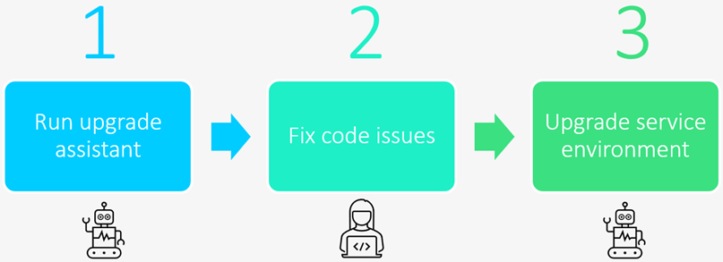

Slide 12
Upgrade-Assistant
Phase 1
How to use Microsoft’s CLI tool for upgrading to .NET 5+

Slide 13
Delete Commerce Manager
As of Commerce 14, Commerce Manager is no more.
👏
Remove the Commerce Manager project before getting started with Upgrade-Assistant.
Note that some of Commerce Manager’s functionality hasn’t been ported over to the CMS yet and can only be done with APIs:
Importing and exporting catalogs
Adding countries and regions
Adding currencies
Working with business objects
Working with catalog and order meta classes and fields

Slide 14
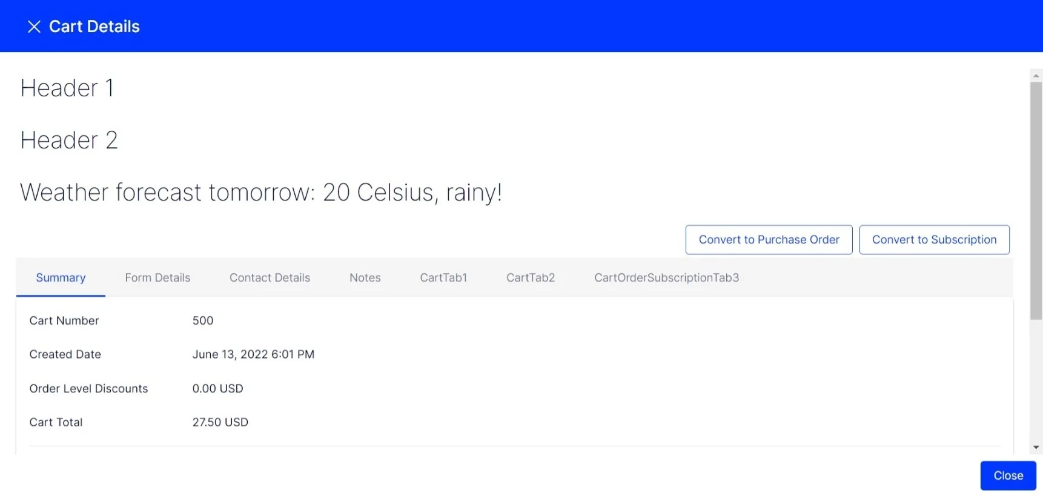
Delete Commerce Manager
The new Customer Service back-
office is extensible as of Commerce
14.4.0 🥳
More info:
How to extend Customer Service UI in Commerce 14
https://world.optimizely.com/blogs/thanh-duc-nguyen/dates/2022/6/sample/

Slide 15
Delete node_modules
As a first step, Upgrade-Assistant copies all files in your solution/project folder into a Backup directory.
This can be disabled, but to play it safe:
If you have /node_modules/ in the project folder you are upgrading, then delete it before running UA.
(don’t forget to stop any local watch)

Slide 16
Use Opti’s Upgrade-Assistant-Extensions
Optimizely provides Upgrade-Assistant extensions with some Opti-specific capabilities:
String Replacement
Remove Default Argument for the TemplateDescriptor Attribute
Base Class Mapping
Replace IFindUIConfiguration with FindOptions
Remove PropertyData ParseToObject method overrides
Remove obsolete using statements like Mediachase.BusinessFoundation
Type Mapping like EPiServer.Web.Routing to EPiServer.Core.Routing
Additionally, NuGet packages can be specified and templates for Program.cs and Startup.cs as they are required by .NET 5.0 can be added as well.
Read how it works (there are a couple gotchas): https://github.com/episerver/upgrade-assistant-extensions
Learn how to configure UAE: https://github.com/episerver/upgrade-assistant-extensions/releases

Slide 17
Use Opti’s Upgrade-Assistant-Extensions
Ugrade-Assistant-Extensions will do some nice things for you out of the box (i.e., replace BlockController with BlockComponent*), but do consider spending some time customizing the config for string/type/class replacements.
*It does not, e.g., change PageController Index methods into IndexAsync methods, though.
How to get it ready:
Download the latest release (Epi.Source.Updater.X.Y.Z.zip): https://github.com/episerver/upgrade-assistant-extensions/releases
Unzip it to your local file system. E.g., C:\Temp\Epi.Source.Updater\
Make your preferred configuration changes

Slide 18
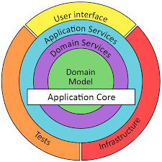
Make a plan-of-attack before running Upgrade-Assistant
Upgrade-Assistant can run against a Solution file (.SLN) or Project file (.CSPROJ).
If you run it against the Solution, it will execute against the child Projects in sequence according to the project dependency tree.
Example:
MySolution.Domain.csproj
MySolution.Application.csproj
MySolution.Web.csproj
(done)

Slide 19
Consider doing one CSPROJ at a time
Upgrade-Assistant will track progress and start where it left off if you cancel it at any time. But…
Do figure out the dependency sequence first and then run UA manually against each Project. This will allow you to resolve code issues in isolation on a per-Project basis without getting confused about where you are with UA.
MySolution.Domain.csproj
Run Upgrade-Assistant
Fix code issues
Commit to source control
MySolution.Application.csproj
Run Upgrade-Assistant
Fix code issues
Commit to source control
MySolution.Web.csproj
Run Upgrade-Assistant
Fix code issues
Commit to source control

Slide 20
Think about what flags to use
Basic syntax if your terminal is at the solution root:
upgrade-assistant upgrade MySolution.Web/MySolution.Web.csproj --flags-go-here
--extension “c:\temp\epi.source.updater” --target-tfm-support LTS
Enables Opti’s Upgrade-Assistant-Extensions
--ignore-unsupported-features
This is required for upgrading the web application CSPROJ.
--skip-backup
Without this, UA will copy all solution files into /Backup/ first (RE: delete node_modules). But don’t you have source control?
--non-interactive
Officially: Microsoft’s documentation says that Upgrade-Assistant is meant to be interactive and to think twice about using this flag.
Unofficially: If you don’t use this flag, you will be sitting at your keyboard, pressing Enter repeatedly, for hours.

Slide 21
Install and update Upgrade-Assistant
Open a terminal from anywhere:
dotnet tool install -g upgrade-assistant
dotnet tool update -g upgrade-assistant
https://docs.developers.optimizely.com/content-cloud/v12.0.0-content-cloud/docs/upgrade-assistant

Slide 22
Run Upgrade-Assistant
From a terminal in your solution root (recommended):
set DefaultTargetFrameworks__LTS=net5.0
(this is required by Upgrade-Assistant-Extensions)
upgrade-assistant upgrade MySolution.Web/MySolution.Web.csproj --ignore-unsupported-features --skip-backup --non-interactive --extension "c:\temp\epi.source.updater" --target-tfm-support LTS

Slide 23
Wait…

Slide 24
Review the code changes
+ Properties/launchSettings.json
Local server/IIS Express settings. Note that .NET5+ runs on HTTPS by default!
+ appsettings.Development.json
+ appsettings.json
Where your Web.config appSettings and connectionStrings went.
- packages.config
Packages are now referenced in the CSPROJ files.
+ Program.cs
+ Startup.old.cs
Program.cs and Startup.cs will need to be ported over. Look at Foundation for inspiration:
https://github.com/episerver/Foundation/tree/main/src/Foundation

Slide 25
Commit the broken code
Do this so that if the code fixes go sideways, you can easily go back to the state immediately after running the Upgrade-Assistant
Consider checking in .upgrade-assistant.
This is where UA tracks what steps it has already done.
Commit frequently from this point on.

Slide 26
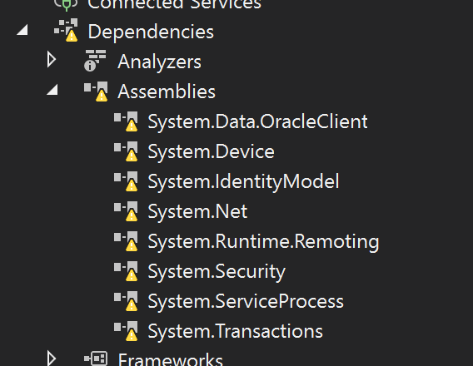
Delete leftover assembly dependencies
Some .NET Framework System assemblies will not have corresponding packages and get orphaned in the Dependencies > Assemblies node.
Unless any of these were explicitly added by your implementation, you should be free to delete them.

Slide 27
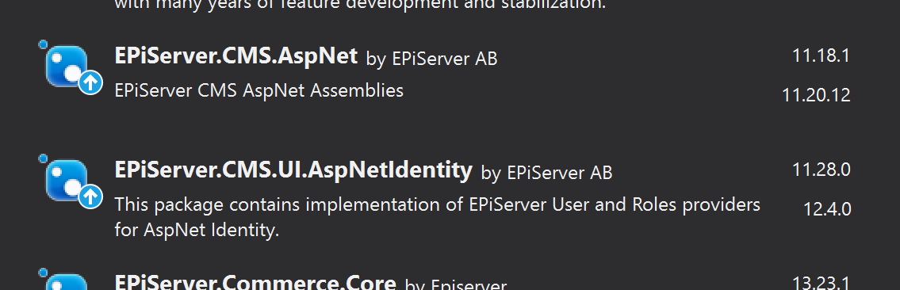
Uninstall obsolete NuGet packages
Some EPiServer packages will need to be replaced entirely (i.e., removed and replaced with something else):
https://docs.developers.optimizely.com/content-cloud/v12.0.0-content-cloud/docs/breaking-changes-in-content-cloud-cms-12
Uninstall:
EPiServer.CMS.AspNet
EPiServer.Framework.AspNet
EPiServer.ServiceLocation.StructureMap
EPiServer.Logging.Log4Net
NuGet Package Manager can help. Example:
The most recent version of EPiServer.CMS.AspNet is 11.X, so you know this one must be replaced.
But the most recent version of EPiServer.CMS.UI.AspNetIdentity is 12+, so you know this can be updated.

Slide 28
Manually resolve package errors
NU1177: Version conflict detected for Xyz. Install/reference Xyz.1.2.3 directly to project MySolution.Web to resolve this issue.
https://docs.microsoft.com/en-us/nuget/reference/errors-and-warnings/nu1107
Address this by:
Open your new CSPROJ file (just double-click the project in Solution
Find where all the <PackageReference /> elements are.
Manually add the PackageReference it is complaining about: <PackageReference Include="Xyz" Version="1.2.3" />
Keep track of which packages you add manually. Once you're finished, if they are redundant then you can remove them.

Slide 29
Update NuGet packages
EPiServer.CMS.AspNet should be replaced with the following:
EPiServer.CMS.AspNetCore
EPiServer.CMS.AspNetCore.Templating
EPiServer.CMS.AspNetCore.Routing
EPiServer.CMS.AspNetCore.Mvc
EPiServer.CMS.AspNetCore.HtmlHelpers
EPiServer.Framework.AspNet should be replaced with EPiServer.Framework.AspNetCore.

Slide 30
Address known breaking changes
Go through the official breaking changes documentation:
https://docs.developers.optimizely.com/content-cloud/v11.0.0-content-cloud/docs/breaking-changes-in-content-cloud-cms-12
It’s dense but worth it.

Slide 31
Code Fixes
Phase 2
Code issues that are commonly encountered

Slide 32
Replace HttpContextHelper with IHttpContextAccessor
Upgrade-Assistant gives you the HttpContextHelper static helper class and replaces all instances of HttpContext.Current with it. But we want to use DI, right?
.NET Core introduced IHttpContextAccessor, which you can inject.
// .NET Framework
string myCookie = HttpContext.Current.Request.Cookies[CookieNames.PostalCode]?.Value;
// .NET Core
string myCookie = _httpContextAccessor.HttpContext?.Request.Cookies["MyCookie"];

Slide 33
Give yourself time to replace HttpRequest
// .NET Framework
string userIp = httpRequest.ServerVariables["HTTP_X_FORWARDED_FOR"]
?? httpRequest.UserHostAddress;
string userAgent = httpRequest.UserAgent;
string host = httpRequest.Url.Host;
string url = httpRequest.Url.ToString();
string anonymousId = httpRequest.AnonymousID;
// .NET Core
string userIP = httpRequest.HttpContext.GetServerVariable("HTTP_X_FORWARDED_FOR")
?? request.HttpContext.Connection.RemoteIpAddress?.ToString();
string userAgent = httpRequest.Headers["User-Agent"];
string host = httpRequest.Host.ToString();
string url = httpRequest.GetDisplayUrl(); // or GetEncodedUrl()
// There is no AnonymousID. Roll your own!

Slide 34
We need to talk about HttpClient.
Managing the lifecycle of HttpClient in .NET Framework was always a pain. Even though HttpClient implements IDisposable, putting it in a Using statement can lead to SNAT port exhaustion (i.e., when your web server runs out of outgoing connections) and bring your entire application to its knees.
Much has been written on this:
You're using HttpClient wrong and it is destabilizing your software
You're (probably still) using HttpClient wrong and it is destabilizing your software
Singleton HttpClient? Beware of this serious behaviour and how to fix it
Issues with the original HttpClient class available in .NET (Microsoft)
In practice, you probably either new up an HttpClient on-demand or roll your own HttpClient lifecycle management (beware of DNS refreshes).

Slide 35
Use IHttpClientFactory
Microsoft: Use IHttpClientFactory to implement resilient HTTP requests
TLDR: Register the HttpClient(s) as application middleware and then rely on IHttpClientFactory to get it for us.
Example: Say we depend on a custom API that requires a client certificate…

Slide 36
Use IHttpClientFactory
Example: Say we depend on a custom API that requires a client certificate…
// .NET Framework
public static HttpClient GetHttpClientForCustomApi()
{
var certificate = LoadX509Certificate2ForCustomApi(); // from file, blob, etc.
var requestHandler = new WebRequestHandler();
requestHandler.ClientCertificates.Add(certificate);
var httpClient = new HttpClient(requestHandler);
return httpClient;
}
(this code doesn't attempt to manage the request handler's lifecycle, but illustrates the point)

Slide 37
Use IHttpClientFactory
// .NET Core
// Register a named HttpClient as middleware in Startup.cs:
public static void AddHttpClientForCustomApi(this IServiceCollection services)
{
var certificate = LoadX509Certificate2ForCustomApi();
var handler = new HttpClientHandler();
handler.ClientCertificates.Add(certificate);
services.AddHttpClient("CustomAPI", httpClient => { })
.ConfigurePrimaryHttpMessageHandler(() => handler);
}
// Then you can get the custom API HttpClient by name:
public static HttpClient GetHttpClientForCustomApi(IHttpClientFactory factory) =>
factory.CreateClient("CustomAPI");

Slide 38
Replace HostingEnvironment with IWebHostEnvironment
Example: Loading a file from the file system…
// .NET Framework
string myFilePath =
HostingEnvironment.MapPath("~/App_Data/MyFile.zip");
// .NET Core
string myFilePath =
Path.Combine(_webHostEnvironment.WebRootPath, "App_Data/MyFile.zip");

Slide 39
Replace Output Caching
[OutputCache] and [ContentOutputCache] are gone.
https://docs.developers.optimizely.com/content-cloud/v12.0.0-content-cloud/docs/caching#output-caching
It is recommended to replace these with the server-side Response Caching Middleware new in ASP.NET Core ([ResponseCache] should feel familiar):
https://docs.microsoft.com/en-us/aspnet/core/performance/caching/middleware
Note that this is different than plain vanilla “Response Caching”
You must handle caching for authenticated users yourself
Be careful about the sequence in which you call app.UseResponseCaching()
Consider using the <cache> or <distributed-cache> tag helpers:
https://docs.microsoft.com/en-us/aspnet/core/mvc/views/tag-helpers/built-in/distributed-cache-tag-helper

Slide 40
Replace RouteTable with UseEndpoints
RouteTable is from System.Web and no longer exists. Use attribute routing if you can. But if you can’t…
// .NET Framework
RouteTable.Routes.MapRoute(
"RobotsTxtRoute", "robots.txt",
new { controller = "RobotsTxt", action = "Index" });
// .NET Core
app.UseEndpoints(endpoints =>
{
endpoints.MapControllerRoute(
"RobotsTxtRoute", "robots.txt",
new { controller = "RobotsTxt", action = "Index" });
});

Slide 41
Refactor async controller methods
PageControllers and ContentControllers can now be “async all the way”.
BlockComponents (f.k.a. BlockControllers), not so much.
// .NET Framework
public ActionResult Index(HomePage currentPage)
public ActionResult Index(StandardProduct currentContent)
// .NET Core
public async Task<ActionResult> IndexAsync(HomePage currentPage)
public async Task<ActionResult> IndexAsync(StandardProduct currentContent)

Slide 42
Delete SessionStateBehavior.Disabled
In .NET Framework, MVC controllers would—by default—handle multiple incoming requests within a single session synchronously.
That is, if a user’s browser issues 3 requests at the same time, ASP.NET would execute them one at a time.
We could get around this by using the SessionState attribute on our controllers:
[SessionState(SessionStateBehavior.Disabled)]
public class MyController : Controller
In .NET Core, this asynchronous behavior is the default. So, the SessionState attribute is no longer needed.

Slide 43
Take care when replacing Newtonsoft.Json with System.Text.Json
.NET Core introduced a performant JSON toolkit with System.Text.Json. It isn’t as feature rich as Newtonsoft, but it is the default (and preferred) JSON de/serializer in ASP.NET Core.
Test any serialization that is migrated from Newtonsoft to STJ.
Examples:
API controller requests and response models
Anything that is indexed or projected with Opti Search & Nav
External API client requests and responses

Slide 44
Don’t get confused by authorization action filters
Use case: Triggering custom behavior when an authentication check either succeeds or fails.
Do implement both ActionFilterAttribute and IAuthorizationFilter:
public class AuthenticationRequiredAttribute : ActionFilterAttribute, IAuthorizationFilter
But the OnAuthorization signature changed slightly:
// .NET Framework
public void OnAuthorization(AuthorizationContext filterContext)
// .NET Core
public void OnAuthorization(AuthorizationFilterContext filterContext)

Slide 45
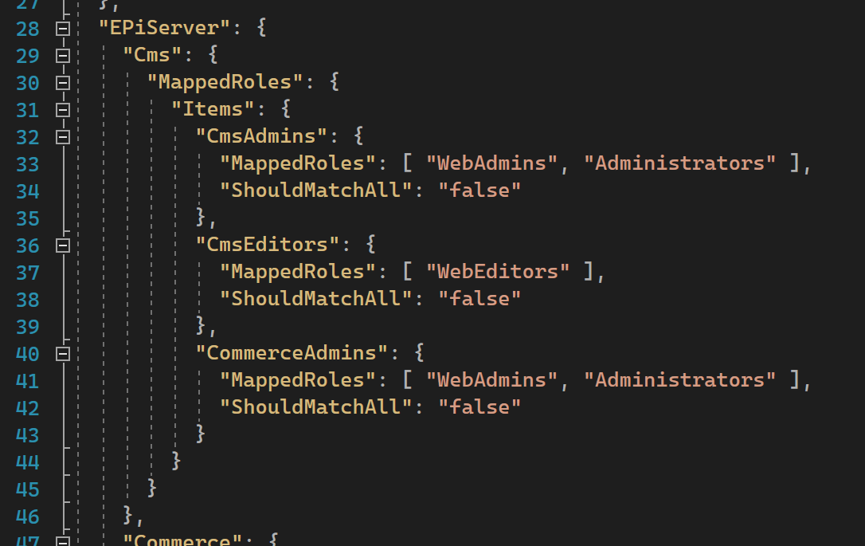
Check virtual roles in appsettings.json
If you cannot add a new user to the WebAdmin or Administrators group in CMS Admin, check your appsettings.json for virtual role definitions…

Slide 46
Remove VisitorGroupHelper
// CMS 11 public IEnumerable<string> GetVisitorGroupIds() { var helper = new VisitorGroupHelper(_visitorGroupRoleRepository); foreach (var visitorGroup in _visitorGroupRepository.List()) { if (visitorGroup != null && helper.IsPrincipalInGroup(PrincipalInfo.CurrentPrincipal, visitorGroup.Name)) yield return visitorGroup.Id.ToString(); } }
// CMS 12 public IEnumerable<string> GetVisitorGroupIds() { foreach (var visitorGroup in _visitorGroupRepository.List()?.ToList()) { _visitorGroupRoleRepository.TryGetRole(visitorGroup.Name, out var visitorGroupRole); if (visitorGroupRole != null && visitorGroupRole.IsMatch(PrincipalInfo.CurrentPrincipal, _httpContextAccessor.HttpContext)) yield return visitorGroup.Id.ToString(); } }

Slide 47
CMS 12 on DXP
Phase 3
Upgrading the service environment

Slide 48
Things to consider
If your solution is large or has many dependencies, expect to measure the upgrade duration in sprints.
An effective branch management strategy is critical. Consider maintaining the old .NET Framework branch in parallel with the .NET 5+ branch. Build
Think about what can be done to the solution ahead of time. For example, consider refactoring existing code to use .NET Core and Standard dependencies instead of .NET Framework ones (where applicable).

Slide 49
Optimizely Support is there for you
We’re on our own for upgrading our solutions, but Optimizely Support has a playbook for coaching you through the infrastructure upgrade process.
Opti will create new Linux-based environments that will be stood up in parallel with your existing DXP environments.
The PaaS Portal has a new tool that allows you to copy databases and blobs over from the old environments to the new environments.
Additional Development Environment (ADE) instances are not currently supported by the PaaS Portal at the time of this writing (July 2022).
https://docs.developers.optimizely.com/content-cloud/v11.0.0-content-cloud/docs/upgrading-to-content-cloud-cms-12

Slide 50
Thank You
https://github.com/DrewNull/optimizely-cms12-upgrade

