Slide 1
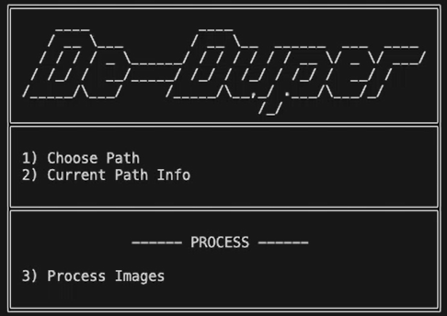
Industry Project Week
Python Photo DeDuplicator Utility
Presented & Created By:
Ozzy, Sony,
Imran, Andrew
& Sebastian

Slide 2

PROJECT MANAGEMENT METHODOLOGY
Agile or Waterfall – Advantages and disadvantages of the two methodologies.

Slide 3

Waterfall Methodology
Advantages:
Clear and well-defined stages: Requirements, design, implementation, testing, and deployment are separate phases, making it easier to manage and track progress.
Suitable for well-understood projects: If the project requirements are clear and unlikely to change, the Waterfall model can be effective.
Detailed documentation: Each phase produces extensive documentation, which can be useful for future reference and maintenance.
Disadvantages:
Inflexible to change: Any changes in requirements or scope can be costly and disruptive, as it requires revisiting previous stages.
Delayed feedback: Testing and user feedback occur late in the project life cycle, making it difficult to address issues early on.
Limited client involvement: The client is usually involved only at the beginning and end of the project, which can lead to misalignment of expectations.

Slide 4

Agile Methodology
Advantages:
Flexibility and adaptability: Agile methodologies embrace change and allow for requirements to evolve throughout the project life cycle.
Early and continuous delivery: Working software is delivered in short iterations, allowing for early feedback and course corrections.
Client involvement: Clients are actively involved throughout the project, ensuring better alignment with their needs and expectations.
Improved collaboration: Cross-functional teams work closely together, fostering better communication and knowledge sharing.
Disadvantages:
Increased client involvement: Clients need to be available and engaged throughout the project, which may not always be possible.
Lack of comprehensive documentation: Agile methodologies prioritize working software over extensive documentation, which can be a challenge for maintenance and knowledge transfer.
Potential for scope creep: The flexibility of Agile can lead to scope creep if not managed properly, resulting in project delays and increased costs.

Slide 5

Chosen Methodology Agile
For the "Photo DeDuplicator" project, considering the need for flexibility to handle multiple image formats and the potential for evolving requirements, the Agile methodology would be a suitable choice. Agile's iterative approach allows for incremental development, testing, and feedback, which is beneficial for a project involving image processing and duplication detection across various formats.
Additionally, the Agile methodology encourages client involvement, which can be advantageous in ensuring that the Photo DeDuplicator meets the users' needs and expectations. The ability to adapt to changes and incorporate feedback throughout the development process can lead to a more robust and user-friendly final product.

Slide 6

Architect/Project Manager
Designs the overall system architecture and technology stack
Collaborates with the Software Developer/UX Designer on architectural decisions
Defines the software patterns, principles, and best practices
Manages project timelines, milestones, and stakeholder expectations

Slide 7

Scrum Master/Tester
Leads and facilitates the Agile/Scrum process
Conducts daily stand-ups, sprint planning, and retrospectives
Designs and executes test plans and test cases
Performs manual and automated testing using Python scripts and frameworks
Utilizes SQL and SSMS Studio for database testing and data validation

Slide 8

Software Developer/UX Designer
Responsible for developing the core image processing and duplication detection logic using Python
Designs and implements the user interface using HTML, CSS, and Vanilla JavaScript
Ensures a responsive and user-friendly design
Integrates the backend and frontend components

Slide 9
Responsibilities for each job role throughout the stages of development
Stages of development | Architect/Project Manager | Scrum Master/Tester | Software Developer/UX Designer
Planning and Requirement Gathering | 1.Gather and analyze requirements 2.Plan project roadmap and releases 3.Prioritize features and tasks | 1. Facilitate planning sessions 2. Identify user stories and acceptance criteria 3. Groom and prioritize the product backlog | 1. Understand and clarify requirements 2. Break down requirements into tasks 3. Estimate task complexity and effort
Design and Architecture | 1. Define system architecture 2. Design system components 3. Select technologies | 1. Review testability of designs 2. Collaborate on test scenarios 3. Ensure test coverage | 1. Design user interfaces and experiences 2. Collaborate with architects on technical designs 3. Prototype UI/UX concepts
Development and Implementation | 1. Review architectural decisions 2. Coordinate cross-team efforts 3. Manage project risks | 1. Develop test plans and scripts 2. Collaborate with developers on testing 3. Participate in code reviews | 1. Implement application features 2. Write clean, maintainable code 3. Integrate with other components
Testing and Quality Assurance | 1. Oversee testing strategies 2. Monitor project progress 3. Ensure quality standards | 1. Execute manual and automated tests 2. Log and track defects 3. Report test results and metrics | 1. Perform unit and integration testing 2. Fix defects and issues identified 3. Collaborate with testers on debugging
Deployment and Maintenance | 1. Plan deployment and maintenance strategies 2. Coordinate release and maintenance activities 3. Manage stakeholder expectations | 1. Conduct post-deployment testing 2. Perform regression testing 3. Monitor system performance and stability | 1. Optimize application performance 2. Maintain and enhance existing features 3. Provide technical support and documentation
Notes:
Architect/Project Manager:
Defined overall system structure and components
Chose technologies (Python, SQL Server, image processing libraries)
Coordinated development efforts and managed project timeline
Ensured quality standards were met throughout development
Scrum Master/Tester:
Facilitated planning and prioritization of features
Developed test plans for image comparison functionality
Executed manual tests on user interface, compatibility on different platforms (windows/MAC) and image processing
Tracked and reported bugs and issues
Software Developer/UX Designer:
Implemented core image processing and comparison algorithms
Designed and built user interface for image management
Integrated database connectivity for storing results
Created reporting features (HTML, CSV exports)
Optimized performance of image comparison functions

Slide 10

MoSCoW
Must Haves
Pick up on duplicates
Be able to manage different files extensions
Be able to show the originals and the duplicates files
Give an option to delete or keep the duplicates
Should Have
Be able to export a list of the originals and duplicate files into a CSV file as a report
In the list shown back to the user have the resolution shown for each file
Could Have
Front end UI
To be able to see the pictures
Be able to recall the deleted files
Color recognition
Will not have this time
Facial recognition
AI quality recognition
Sorting system based on the objects identified in the picture

Slide 11
Software Tools and skills available
Software tools
Skills
Python
Visual studio code
SSMS Studio
Figma
Canva
PowerPoint
Libraries: SSIM, PIL, PYODBC, scikit-image
HTML
CSS
Python
Databases
SQL

Slide 12
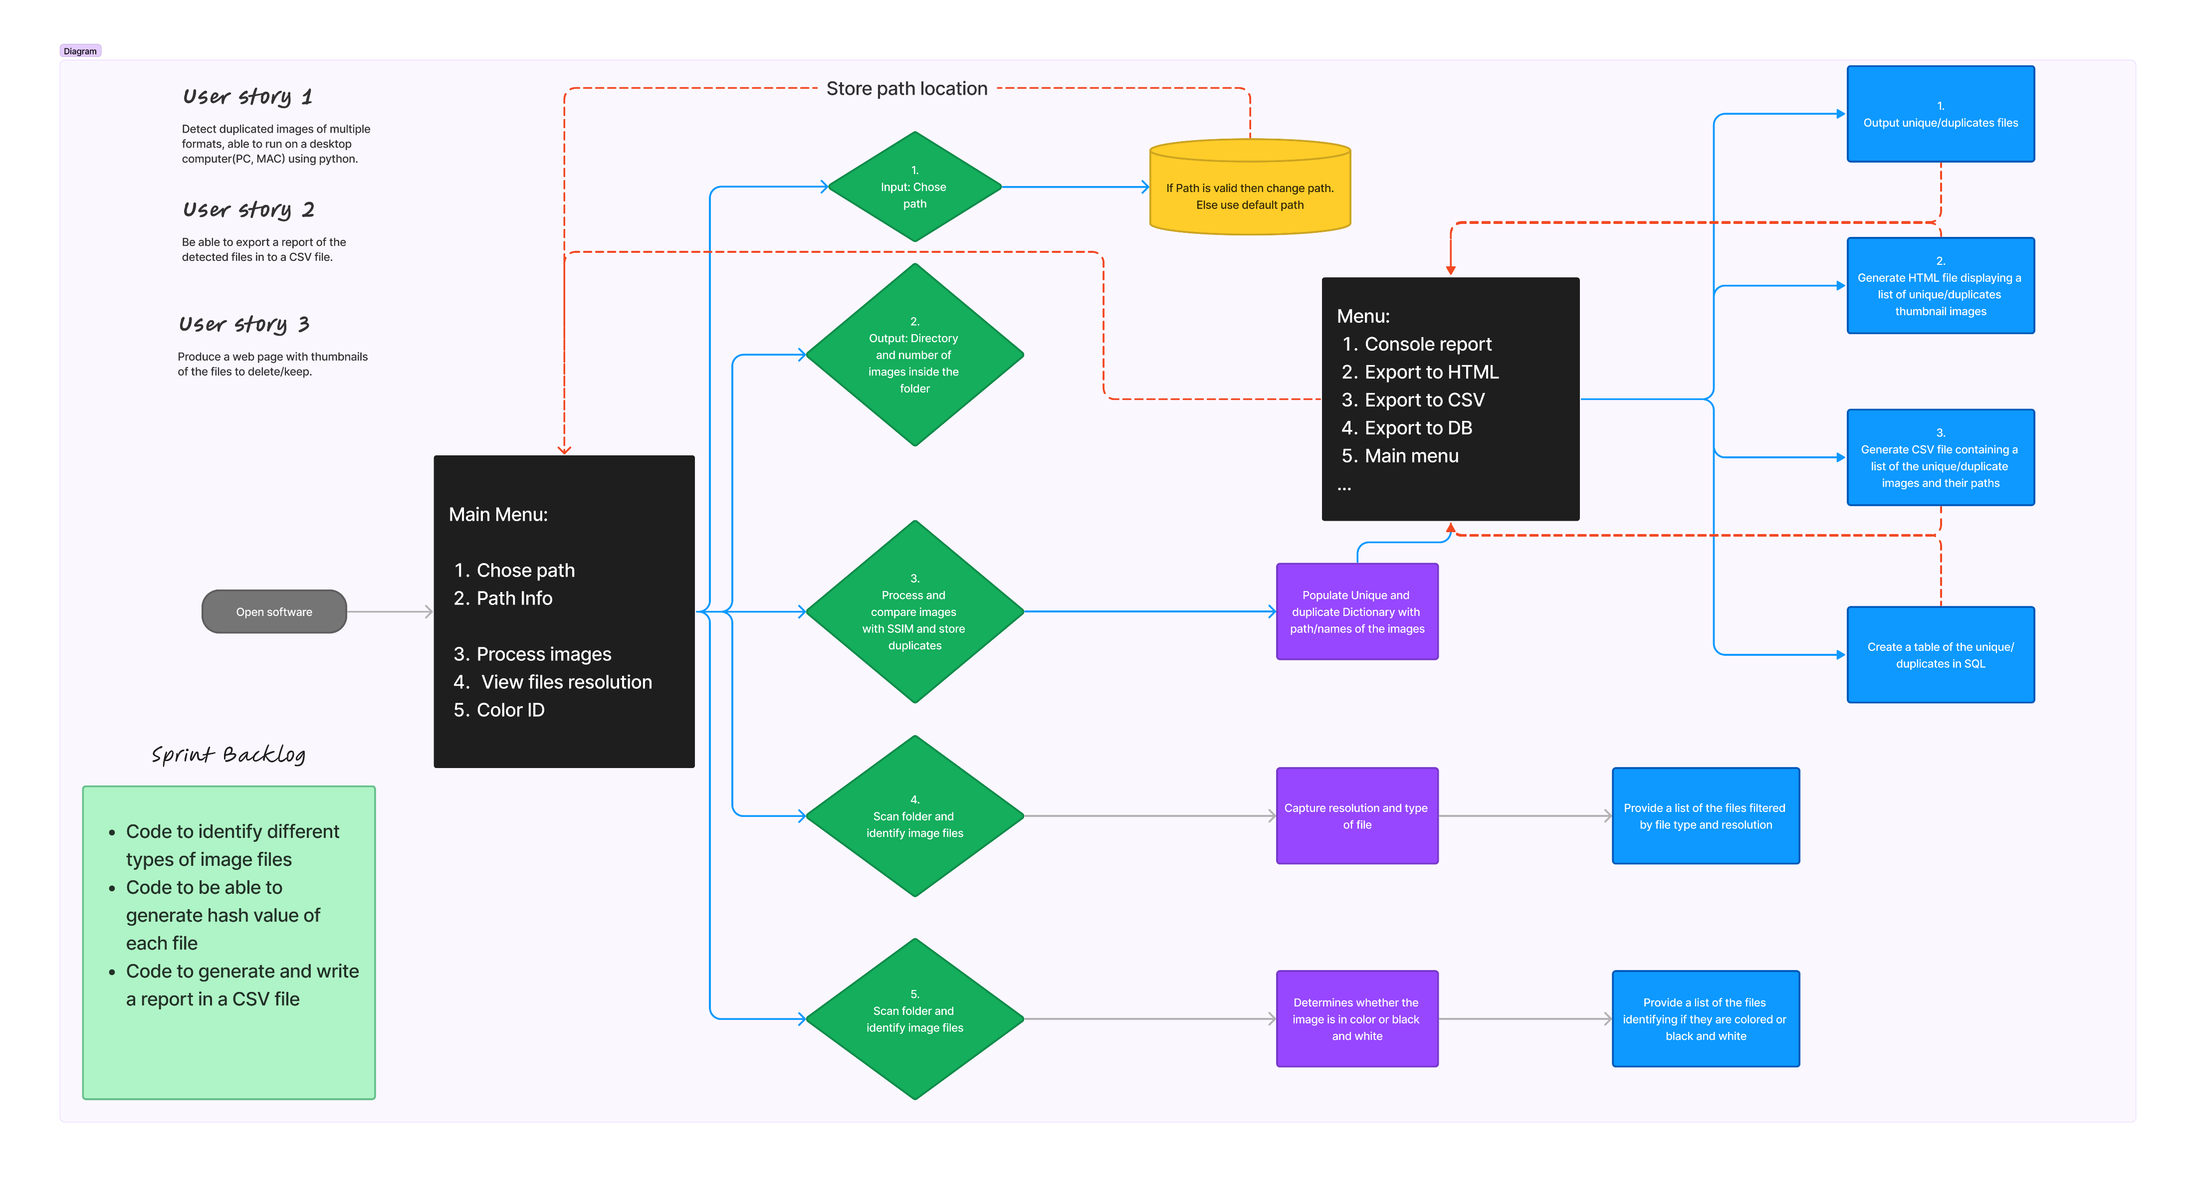

Slide 13
Thought process for testing
Possible tests
Possible tests without time limitations
Test SQL Image Insertion
Test SSIM Comparison Function
Test Sorting Function
Test HTML Report Generation
Test CSV Dump Function
Performance and Scalability Test: test the performance of the script with a large dataset, to ensure it handles large volumes efficiently
Comprehensive SSIM Accuracy Test: compare images with varying degrees of similarity to ensure the SSIM threshold accurately detects duplicates

Slide 14
Test table
Test Case ID | Test Case Description | Input | Expected Output | Pass/Fail
TC001: Verify that images are correctly inserted into the SQL database. | Test SQL Image Insertion | List of image paths: ["path1.jpg", "path2.jpg"] | Images are inserted into test_table in the database | Pass
TC002: Check that the SSIM comparison function works correctly for known images. | Test SSIM Comparison Function | Folder with two identical images: ["test_image1.jpg", "test_image2.jpg"] | The second image is detected as a duplicate of the first | Pass
TC003: Ensure that images are correctly classified as unique or duplicates. | Test Sorting Function | Dictionary of images with one duplicate: unique={"path1.jpg": "", "path2.jpg": ""} | Duplicate image is removed from unique dictionary | Pass
TC004: Verify that the HTML report generation function creates a file and includes expected content. | Test HTML Report Generation | Dictionaries: unique={"path1.jpg": ""}, duplicates={"path2.jpg": "dummy_data"} | HTML report is generated and includes "Unique Images" and "Duplicate Images" | Pass
TC005: Check that the CSV dump function creates a file and includes expected content. | Test CSV Dump Function | Dictionaries: unique={"hash1": "path1.jpg"}, duplicates={"hash2": "path2.jpg"} | CSV file is generated and includes "Unique Images" and "Duplicate Images" | Pass

Slide 15
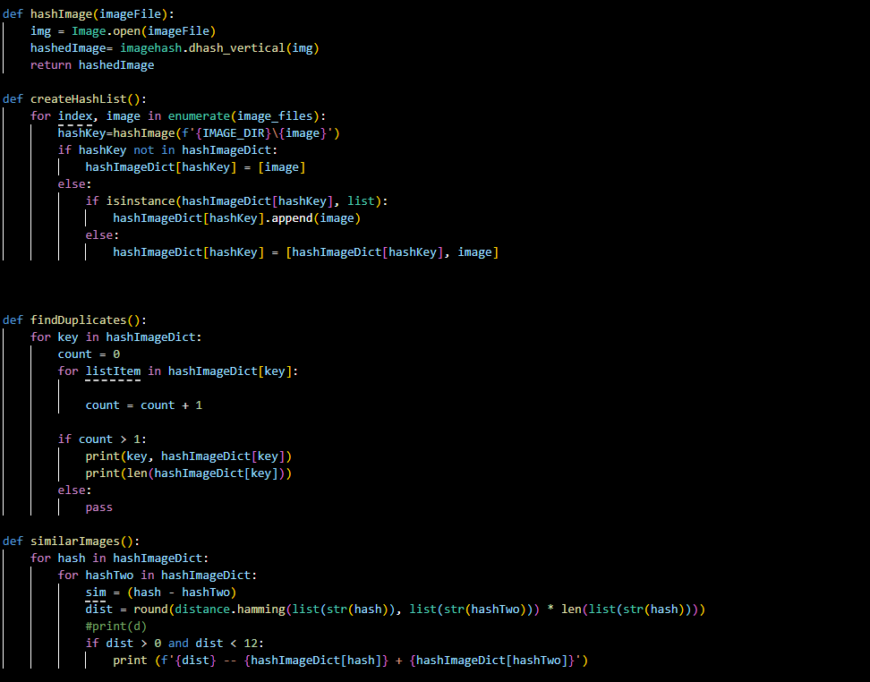
Hash Code

Slide 16
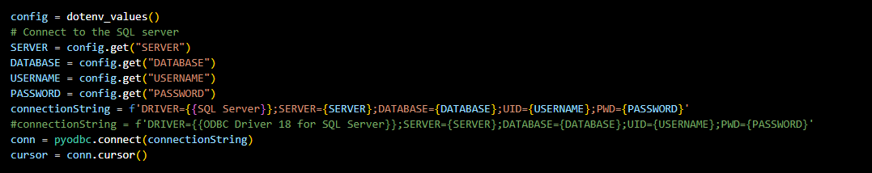
Security
‘.env’ file to hide credentials
modularisation

Slide 17

Hello! And Welcome to the De-Duper Demo Video!
Unfortunately, the video is too large to add to the PowerPoint and then upload to EQUAL. Here is the link to the fully functioning product, on MAC:
https://1drv.ms/v/s!AuLkJ7I610fdlKdvY9QTgFUdPwqZ-w?e=49PESW
We hope you enjoy watching it as much as we enjoyed creating it!

Slide 18
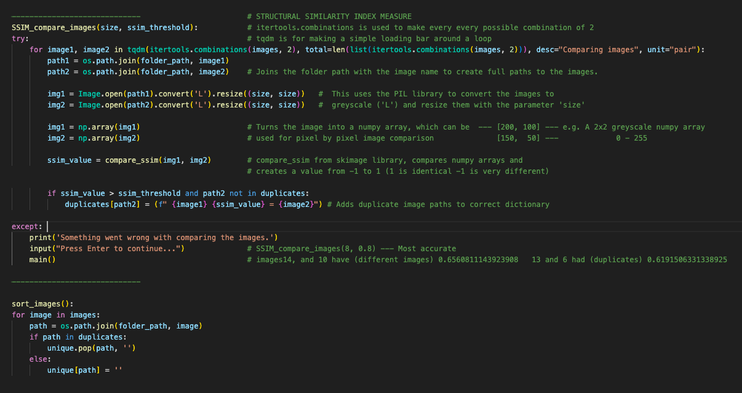
SSIM (Structural Similarity Index)

Slide 19
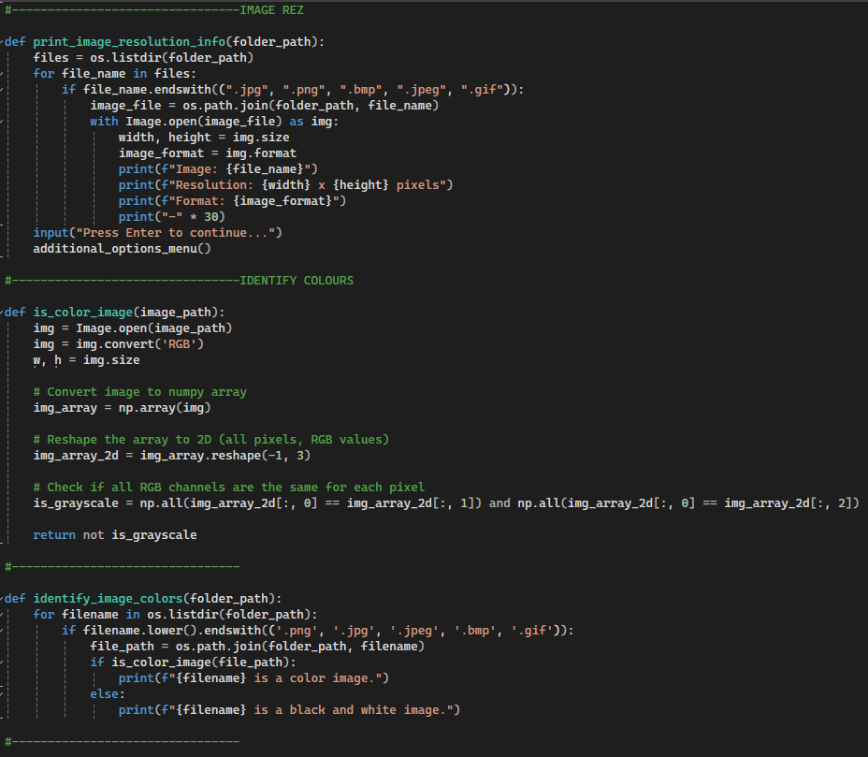
Additional Options….
Print Image Resolution
Color and B&W Detection

Slide 20
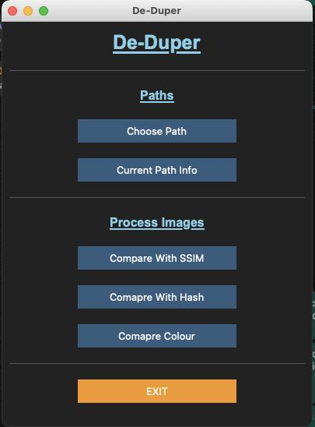
Prototype
GUI Interface

Slide 21
That concludes our Presentation!
We hope you are satisfied with your product

