Slide 1
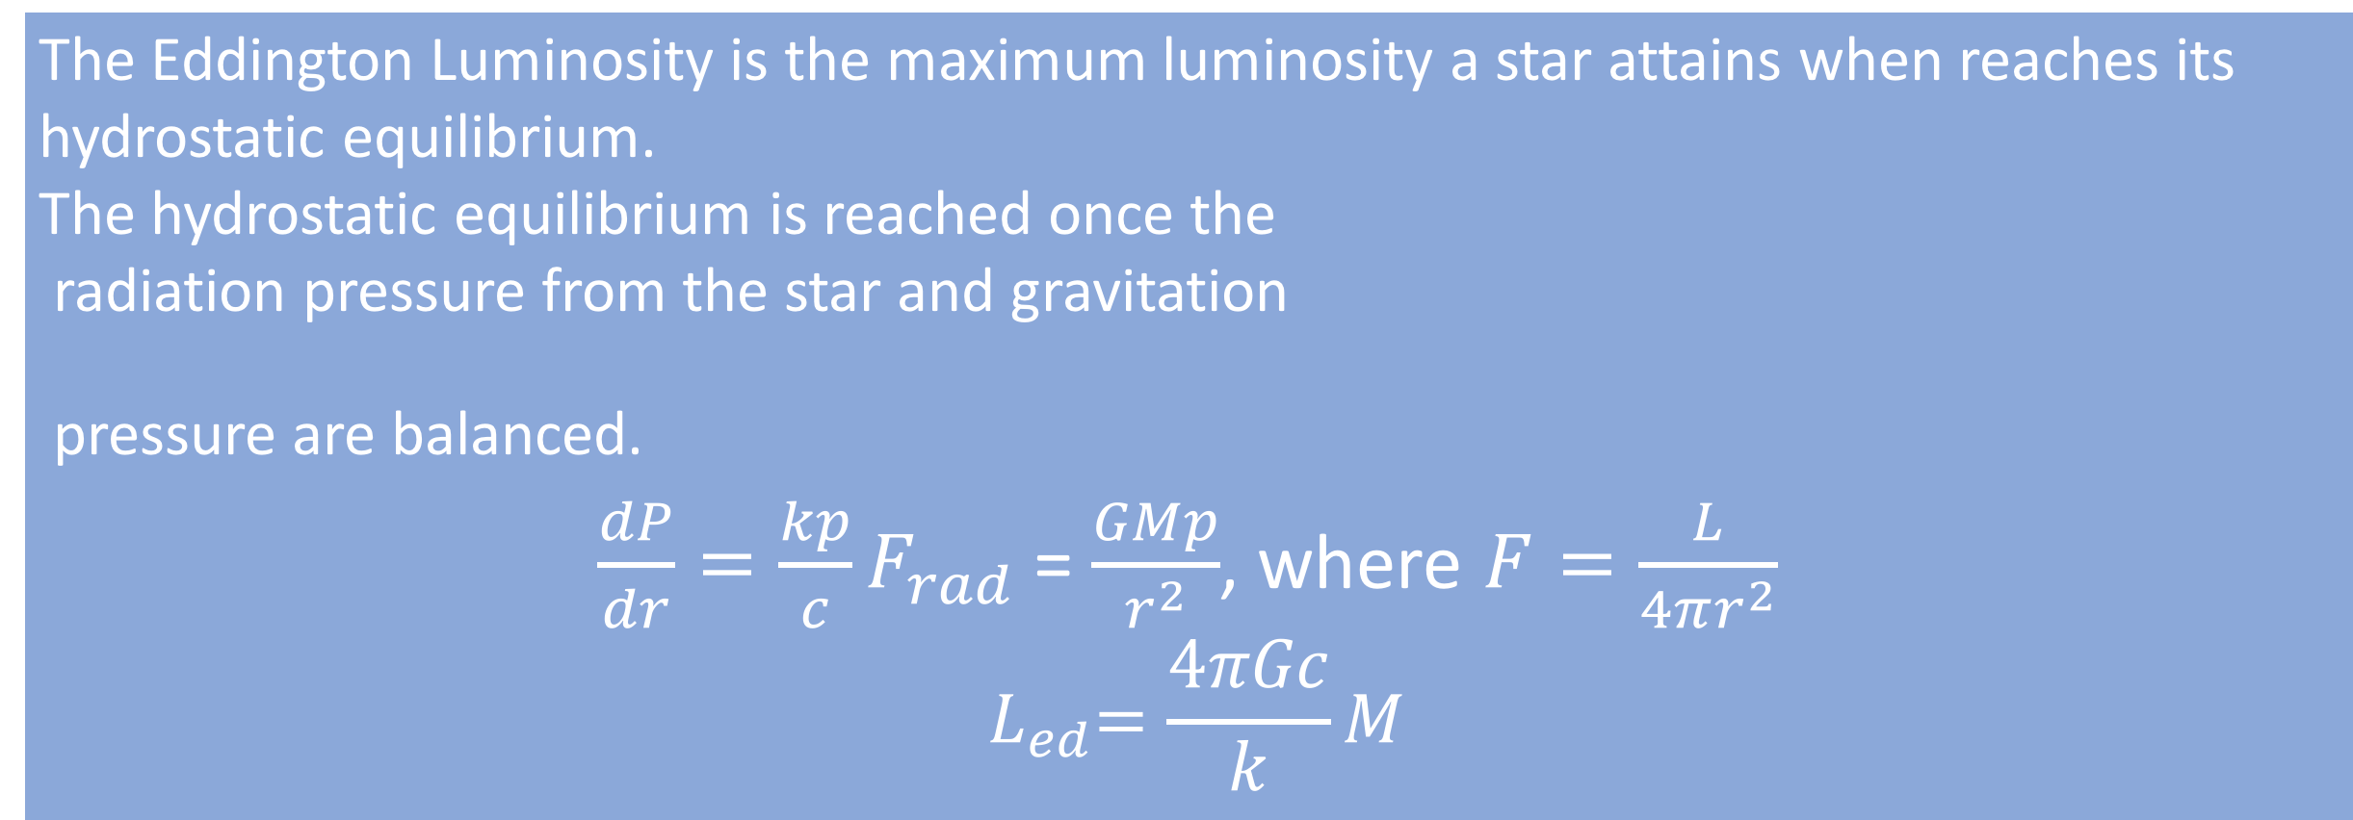
A systematic search for absorption features in the X-ray spectra of ultraluminous X-ray sources
Andrew Sosanya (Caltech)
M. Brightman, F.A Harrison
Introduction
Ultraluminous X-ray sources (ULXs) are variable, non-nuclear bright X-ray sources in nearby galaxies not associated with the central supermassive black hole. These ULXs are brighter than black hole systems in our galaxy‑they have super-Eddington luminosities the accretion limit of a 10 M⊙ black hole. The Eddington luminosity limit of a star is the maximum luminosity a star can achieve due to the hydrostatic equilibrium between the force of radiation acting outward and the gravitational force acting inward. This constraint on radiation from the star limits its accretion flow. These ULXs break the Eddington theory because there are extreme accretion rates onto a compact stellar remnant, or an intermediate mass black hole. It was previously thought that only black hole accretion could power ULXs, but recent research has shown that neutron stars may also provide the power mechanism . Using the data from the XMM-Newton and Chandra X-ray observatories, we conducted a systematic search to find absorption features in the X-Ray spectra of ULXs.
Eddington Luminosity
The Eddington Luminosity is the maximum luminosity a star attains when reaches its hydrostatic equilibrium.
The hydrostatic equilibrium is reached once the
radiation pressure from the star and gravitation
pressure are balanced.
$\frac{dP}{dr}=\frac{kp}{c}F_{rad}$ = $\frac{GMp}{r^{2}}$, where $F=\frac{L}{4πr^{2}}$
$${ L}_{ed}=\frac{4πGc}{k}M$$
Methods
Systematic Search
We cross-referenced the Serendipitous XMM-Survey, a catalogue of ULXs, to find ULXs with at least 10,000 intensity counts. These sources were further filtered by fitting models to pre-reduced spectra. This led to four strong ULX candidates: Holmberg II X-1, IC-342, NGC 1313, and M32.
Spectral Analysis
We reduced data taken from the XMM archive and Chandra source catalogue. Astronomical Imaging software DS9 was used to determine centroid coordinates on EPIC & Chandra detectors. When reducing XMM data, we conducted trials using the Chi-Squared test to determine the parameters—filter rate, detector radius, and event grade pattern
When considering spectra collected by XMM, we initially analyzed the EPIC-pn detector data, and later used the EPIC-mos data to supplement. We used XSPEC v12.9.1p to perform our spectral analysis and fitted the cutoff power law in conjunction with the Tuebingen-Boulder ISM Gaussian absorption model to identify absorption lines within spectra

