Slide 1
Intermediate php Techniques
Lecture 9

Slide 2
Objectives
Namespaces
Composer
Unit Testing

Slide 3
Namespaces
Added in version 5.3 of PHP is support for Namespaces.
Namespaces provide a solution to a common OOP problem: as you begin utilizing more and more classes, including those defined by other developers and in third-party libraries, conflicts can occur if multiple classes have the same name.
Namespaces prevent these conflicts by letting you organize your code into groups. This has the effect of allowing you to safely use descriptive names without concern for conflicts.

Slide 4
Namespaces
An apt analogy (which the PHP manual also uses) is to compare namespaces to creating a directory structure on your computer.
You cannot place two files named functions.php within the same folder.
However, you can place one in the MyUtilities/ folder and another in the YourUtilities/ folder, thereby making both versions of functions.php available.

Slide 5
Namespace Limitations
There are, of course, limits as to what you can place in a namespace, specifically:
Classes
Interfaces
Functions
Constants
You couldn’t, for example, create a namespace just to hold some variables.

Slide 6
Namespaces
To define a namespace, create a new file that will store the namespaced code.
Within that file, you create a namespace by using the namespace keyword, followed by the identifier:
Note that this should be the first line of PHP code in a file, and that the file cannot even have any HTML before that PHP code. You can have PHP comments before that line, however.
<?php namespace MyUtilities;

Slide 7
Namespaces
Any code that follows that line will automatically be placed within that namespace:
Namespaces can have sub-namespaces, just as you’d have levels of directories on your computer. To do that, indicate a sub-namespace using the backslash:
<?php namespace MyUtilities; class NewClass { }
namespace MyUtilities\UserManagement; class Login { }

Slide 8
Namespaces
Once you’ve defined a namespace, you can reference it by using the backslashes again.
First, though, you’d need to include the file that defines the namespace then use backslashes to indicate a namespace is being used:
A common convention (and PSR-4 standard) is that you organize the files themselves using the same structure as the namespace.
<?php require('MyUtilities/NewClass.php'); $obj = new \MyUtilities\NewClass();

Slide 9
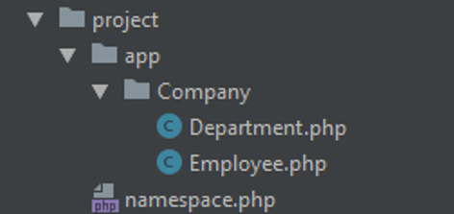
Namespace Example
As an example, all of your reusable code would go into the app namespace.
Then, all of the classes and code related to creating company-based objects would go in the Company sub-namespace.
Note: namespace.php exists in the project/ directory. Not project/app

Slide 10
Namespace Example
All code related to creating a company is placed in the same namespace (app\Company).
This includes all classes, interfaces and functions.
This greatly organizes your code structure and prevents name collisions in your code.
<?php namespace App\Company; class Department { private $_name; private $_employees; public function __construct($name) { $this->_name = $name; $this->_employees = array(); } public function addEmployee(Employee $e) { $this->_employees[] = $e; echo "<p>{$e->getName()} has been added to the {$this->_name} department.</p>"; } } // End of Department class.
<?php namespace App\Company; class Employee { private $_name; function __construct($name) { $this->_name = $name; } public function getName() { return $this->_name; } } // End of Employee class.
Department.php
Employee.php

Slide 11

Namespace Example 1
<?php require_once('app/Company/Department.php'); require_once('app/Company/Employee.php'); // Create a department: $hr = new \App\Company\Department('Accounting'); // Create employees: $e1 = new \App\Company\Employee('Holden Caulfield'); $e2 = new \App\Company\Employee('Jane Gallagher'); // Add the employees to the department: $hr->addEmployee($e1); $hr->addEmployee($e2); // Delete the objects: unset($hr, $e1, $e2);
To use the classes in the namespace, include the required files.
Creating objects of a specific type simply needs to be prepended with the namespace.
namespace1.php

Slide 12
Namespace Example 2
<?php require_once('app/Company/Department.php'); require_once('app/Company/Employee.php'); use App\Company\Department; use App\Company\Employee; // Create a department: $hr = new Department('Accounting'); // Create employees: $e1 = new Employee('Holden Caulfield'); $e2 = new Employee('Jane Gallagher'); // Add the employees to the department: $hr->addEmployee($e1); $hr->addEmployee($e2); // Delete the objects: unset($hr, $e1, $e2);
Additionally, PHP allows you to more quickly reference a namespace by bringing it into current scope via the use keyword.
Having done that, you can create an object by just referencing classes.
namespace2.php

Slide 13
Namespace Example 3
<?php require_once('app/Company/Department.php'); require_once('app/Company/Employee.php'); use App\Company\Department as Dept; use App\Company\Employee as Emp; // Create a department: $hr = new Dept('Accounting'); // Create employees: $e1 = new Emp('Holden Caulfield'); $e2 = new Emp('Jane Gallagher'); // Add the employees to the department: $hr->addEmployee($e1); $hr->addEmployee($e2); // Delete the objects: unset($hr, $e1, $e2);
Sometimes, there still may exist class name collisions when using the use keyword.
PHP allows you to resolve this problem by aliasing the class in scope by adding the as keyword followed by a unique name at the end of the use statement.
namespace3.php

Slide 14
Composer
Modern PHP applications tend to be comprised of a large number of files.
Laravel contains just over 7 thousand files
The reason for the size is usually due to the number of third party libraries and packages.
These third party libraries and packages allow you to incorporate features quickly into your project without having to reinvent the wheel.
There are several advantages and a few disadvantages to using third party packages
Generally higher quality.
Lowered maintenance.
Larger application size

Slide 15

Composer
Composer is a package manager for PHP originally released in 2011.
Since then, it has quickly become the most popular PHP package manager available.
Composer allows you to manage dependencies for an application.
Composer works closely with the Packagist repository, which contains many of the third party libraries and packages (think GitHub to Git) and also provides autoload capabilities.

Slide 16
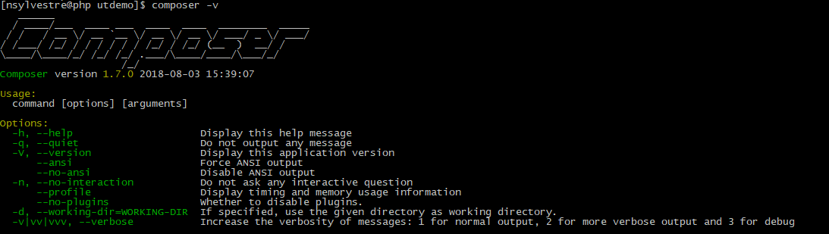
Composer
To verify that you have composer installed, simply open up the command line and type the following:
composer -v

Slide 17
Composer
To install an existing library using Composer, type the following in the root directory for your application:
composer require "vendor/package:version"
Note: replace vendor/package and version with the corresponding library and the desired version.
Ex. composer require "phpunit/phpunit:^9.0"
Note: this method is fine for one or two packages but what if you want to include several more? This method is a bit cumbersome.

Slide 18
Composer Versioning
You can specify versions of packages you wish to include in various ways within Composer.
Exact Version Constraint
You can specify the exact version of a package. This will tell Composer to install this version and this version only.
Example: 1.0.2
Version Range
By using comparison operators you can specify ranges of valid versions. Valid operators are >, >=, <, <=, !=.
You can define multiple ranges. Ranges separated by a space or comma will be treated as a logical AND. A double pipe (||) will be treated as a logical OR. AND has higher precedence than OR.
Examples:
>=1.0
>=1.0 <2.0
Hyphenated Version Range
Inclusive set of versions. Partial versions on the right include are completed with a wildcard. For example, 1.0 - 2.0 is equivalent to >=1.0.0 <2.1 as the 2.0 becomes 2.0.*

Slide 19
Composer Versioning
Wildcard Version Range
You can specify a pattern with a * wildcard. 1.0.* is the equivalent of >=1.0 <1.1
Next Significant Release Operators
Tilde Version Range
The ~ operator is best explained by example: ~1.2 is equivalent to >=1.2 <2.0.0, while ~1.2.3 is equivalent to >=1.2.3 <1.3.0
Caret Version Range
The ^ operator behaves very similarly, but it sticks closer to semantic versioning, and will always allow non-breaking updates. For example, ^1.2.3 is equivalent to >=1.2.3 <2.0.0 as none of the releases until 2.0 should break backwards compatibility.

Slide 20
Composer
The more common way to use Composer is to create a composer.json file in the root of the project directory which contains all required dependencies.
Once complete, composer can be instructed to install them using the composer install command.
If changes are made to the json file, you may simply invoke composer update instead.
{ "name": "nsylvestre/utdemo", "description": "Some New Project", "minimum-stability": "stable", "license": "MIT", "authors": [ { "name": "Nicholas Sylvestre", "email": "nsylvestre@stclaircollege.ca" } ], "require": {}, "require-dev": { "phpunit/phpunit": "^9.0" } }

Slide 21
Composer
Note: The difference between require and require-dev is that require will be included in both production & development environments where as require-dev will only be installed in a development environment.
For a complete list of directives for the composer.json file, visit the following URL:
https://getcomposer.org/doc/04-schema.md
We will see a more complete example when we discuss phpunit in the next section.
{ "name": "nsylvestre/utdemo", "description": "Some New Project", "minimum-stability": "stable", "license": "MIT", "authors": [ { "name": "Nicholas Sylvestre", "email": "nsylvestre@stclaircollege.ca" } ], "require": {}, "require-dev": { "phpunit/phpunit": "^9.0" } }

Slide 22
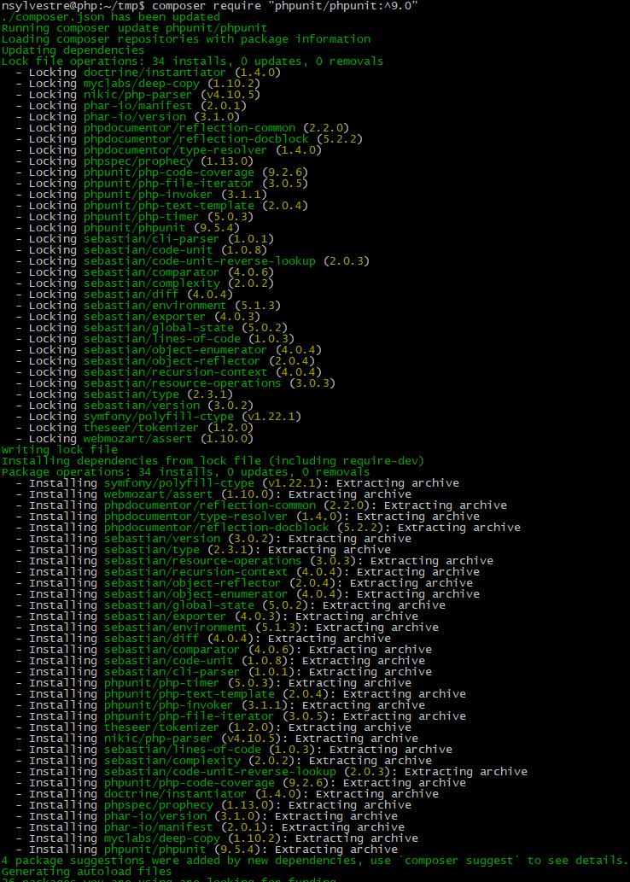
Composer
Upon execution, two files and a directory are created: composer.json, composer.lock, and vendor.
The vendor directory is where Composer will place all installed packages.

Slide 23
Composer
Another benefit of using Composer is its built-in autoloading capabilities.
When composer installs or updates the project packages, it also generates an autoloader with all required bootstrap scripts for each package.
To include the autoloader in your package, you simply need to require the autoload.php file located in the vendor/ directory:
require_once('/vendor/autoload.php');
The result is that all of the pulled in packages become available to our application.

Slide 24
Composer
Additionally, you may define your own project’s class files in the autoloader using PSR-4 standards within the composer.json ’s autoload directive.
In the following example, all classes within the app/ and tests/ directory of the current project will be registered with composer’s autoloader.
Note: to maintain the PSR-4 standard, classes should be namespaced as discussed in the prior lesson.
{ "name": "nsylvestre/utdemo", "description": "Some New Project", "minimum-stability": "stable", "license": "MIT", "authors": [ { "name": "Nicholas Sylvestre", "email": "nsylvestre@stclaircollege.ca" } ], "require": {}, "require-dev": { "phpunit/phpunit": "^9.0" }, "autoload": { "psr-4": { "App\\": "app/", "Tests\\": "tests/" } } }

Slide 25
Unit Testing
Unit testing is a relative newcomer to programming, but it is an approach that many developers have embraced. The premise of unit testing is that you define tests to confirm that particular bits of code work as needed.
Here are a few of the benefits of unit testing:
Tests will minimize bugs (this is the most obvious benefit).
Tests can help you improve your design.
Tests can assist in creating documentation for your code.
You are less likely to break code and introduce errors as you make changes down the line.

Slide 26
Unit Testing
Learning how to implement unit testing involves syntax and theory.
As for unit testing theory, unit tests should:
Be easy to write, read, and execute.
Be as atomic as possible (i.e., specific and small).
Check that code works as intended.
Not be used to validate user input.
Not be used to handle problems that could possibly arise during the live execution of a site.

Slide 27
Unit Testing
To put these ideas in context, remember that error and exception handling in your code should watch for bad things that could possibly happen.
This might be poor user input or an inability to open a file.
Unit testing, as a comparison, should test for what absolutely should happen and what absolutely shouldn’t.
As the scope of the application increases, and as you add and modify the code, you continue to write tests for the new code, while still checking all of the original code against the existing tests, too.
By doing this, you ensure that the introduction of new and modified code doesn’t break something that was previously working.

Slide 28
Unit Testing
In the last project, you were provided “unit tests” to run against your code, however, the best way to implement unit testing is to use one of the many frameworks available for this purpose.
The de facto standard is PHPUnit

Slide 29
Test-Driven Development
The primary objective for the last project was focused on writing unit tests to validate existing code.
Another approach is called test-driven development (TDD). It takes the opposite stance: you define your tests and then write code that passes those tests. This way, the tests set the expectations for the functionality and not the other way around.
Although this approach may be counterintuitive, there’s a lot to be said for it. Besides the unit-testing benefits already outlined, TDD also means:
You won’t end up writing tests to match the code (which, therefore, defeats the purpose of testing).
You have targets to shoot for, in terms of features needed and what isn’t required.
You know when the code is done, because all the tests pass.
You’re less likely to experience “coder’s block,” because you’ll have a running list of what to code next.

Slide 30
Test-Driven Development
“I have to admit, that I didn't know what TDD really was until recently. I thought that it is some nonsense, because it sounds really impractical and unrealistic to first write all the tests for some feature (without the ability to try it or even compile it), and then try to implement something that satisfies it.
But that is not TDD, and it had to be shown to me in a "for dummies" way for me to realize how wrong I was.
TDD actually is the constant fast switching between extending the tests and making them pass continuously. So as you write tests, you write code to satisfy them basically at the same time. This allows you to instantly test what you write, and mainly use tests as specification of what the code should actually do, which guides the thought process to make you think about where you are headed to, and to write code that is more structured and testable from the very beginning.
So after the "AHA" moment of realizing what TDD really is, I started to be instant fan. I'm now putting a lot of effort to try to follow the TDD methodology as much as possible, and to force it on others in the team as well. It feels slower, to write tests even for simple pieces of logic that just bound to be right, but the test proved me wrong several times already, and prevented annoying low-level debugging sessions in the near future.”
-- https://factorio.com/blog/post/fff-366

Slide 31
Unit Testing
PHPUnit comes prepackaged in some development environments such as XAMPP.
Alternatively, it can be installed globally on your system (local or server) or on a per project basis using composer.
To add PHPUnit to an existing project, you may simply issue the following command from the command line:
composer require "phpunit/phpunit:^9.0"

Slide 32
Unit Testing
Alternatively, you may add the PHPUnit package to a new project by including it in a composer.json file then issuing the composer install command from the command line
{ "require-dev": { "phpunit/phpunit": "^9.0" } }
composer.json

Slide 33
Unit Testing
Unit tests are defined using assertions.
An assertion is a programming concept that simply says: confirm that this is or is not the case.
In theory, you could define your own assertion functions, but one of the benefits of a unit-testing framework such as PHPUnit is the number of assertion functions it defines for you.
As of PHPUnit v9, there exists over 50 different assert functions.

Slide 34
Unit Testing
A small subset of the assert functions available in PHPUnit:
You can find the complete list on phpunit’s website:
https://phpunit.readthedocs.io/en/9.5/assertions.html
assertContains()
assertCount()
assertEquals()
assertFalse()
assertFileExists()
assertGreaterThanOrEqual()
assertRegularExpression()
assertSame()
assertInstanceOf()
assertNull()
assertEmpty()
assertIsArray()
assertIsBool()
assertIsString()
assertIsInt()
assertIsObject()

Slide 35
Unit Testing
Tests in PHPUnit get grouped together in a suite of test cases.
Normally, one suite of test cases would be created for each class you’ve defined.
Understand that unit testing is not specific to object-oriented programming but is more commonly used with OOP than with procedural programming, particularly when frameworks are involved.

Slide 36
Unit Testing
With PHPUnit installed, you create a test suite by extending the TestCase class:
Conventionally, you’ll name the new class a combination of the name of the class being tested, followed by the word Test.
<?php use PHPUnit\Framework\TestCase; class SomeClassTest extends TestCase { }

Slide 37
Unit Testing
Within this class, create one new public method for each test. Each method’s name should start with test:
There won’t be a one-to-one correlation between the number of test methods defined and the number of methods in the class being tested.
This is because class methods may be complex and do multiple things, whereas unit tests are intended to be small and specific.
<?php use PHPUnit\Framework\TestCase; class SomeClassTest extends TestCase { public function testSomeMethod() { } }

Slide 38
Unit Testing
The last thing to know before getting into an example is that you must invoke all the assertion methods via $this:
Using the $this object is necessary because when PHPUnit goes to run the tests, it will create an object of the class type.
Through that object, the tests will be run, and the assertion functions will be accessible via $this.
<?php use PHPUnit\Framework\TestCase; class SomeClassTest extends TestCase { public function testSomeMethod() { $this->assertTrue(true); } }

Slide 39
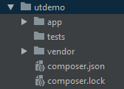
Unit Testing
{ "name": "nsylvestre/utdemo", "description": "Some New Project", "minimum-stability": "stable", "license": "MIT", "authors": [ { "name": "Nicholas Sylvestre", "email": "nsylvestre@stclaircollege.ca" } ], "require": {}, "require-dev": { "phpunit/phpunit": "^9.0" }, "autoload": { "psr-4": { "App\\": "app/", "Tests\\": "tests/" } } }
Let’s examine how we might use Unit testing in a new example project called utdemo.
First, setup a new composer.json file with the required PHPUnit framework.
All project files will reside in the app/ directory, and unit tests will be placed in the tests/ directory.
Install the required packages using the following command: composer install

Slide 40
Unit Testing
Once the project files are installed, switch into the tests/ directory and create a new file called RectangleTest.php
This will define test suite for a Rectangle class we will build
Set the namespace, and import the PHPUnit TestCase class as well as the Rectangle class and ensure that the RectangleTest extends TestCase
It’s time to create our first test.
Create a new public function called test__construct()
The purpose of this test is to verify the instantiation of a rectangle object using the __construct method.
<?php namespace Tests; use App\Classes\Rectangle; use PHPUnit\Framework\TestCase; class RectangleTest extends TestCase {
public function test__construct() { $rect = new Rectangle(2, 4); $this->assertInstanceOf(Rectangle::class, $rect); }
}

Slide 41
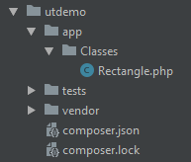
Unit Testing
Now that we have our first test, we’ll create the Rectangle class and add the method to ensure it passes the test (TDD).
Create a new class file in app\Classes\Rectangle.php
<?php namespace App\Classes; class Rectangle { private $length; private $width; public function __construct($length, $width) { $this->length = $length; $this->width = $width; } }

Slide 42
Unit Testing
To run the test, drop to the terminal, switch into the test directory and run the following command:
../vendor/phpunit/phpunit/phpunit --bootstrap ../vendor/autoload.php RectangleTest.php
The test should successfully pass.
Note: the autoloader is required to load the Rectangle class into memory before the tests are run.
[tests]$ ../vendor/phpunit/phpunit/phpunit --bootstrap ../vendor/autoload.php RectangleTest.php
PHPUnit 9.5.21 by Sebastian Bergmann and contributors.
. 1 / 1 (100%)
Time: 00:00.003, Memory: 4.00MB
OK (1 test, 1 assertion)

Slide 43
Unit Testing
Let’s continue to add tests to the RectangleTest suite.
Here, we’ve defined two new tests for a method called calcArea(), which, returns the area for the given object.
<?php namespace Tests; use App\Classes\Rectangle; use PHPUnit\Framework\TestCase; class RectangleTest extends TestCase { public function test__construct() { $rect = new Rectangle(2, 4); $this->assertInstanceOf(Rectangle::class, $rect); } public function testCalcArea() { $rect = new Rectangle(4, 8); $result = $rect->calcArea(); $this->assertEquals(32, $result); } public function testCalcArea2() { $rect = new Rectangle(2, 4); $result = $rect->calcArea(); $this->assertNotEquals(16, $result); } }

Slide 44
Unit Testing
Add the calcArea() method to the Rectangle class and re-run the tests to ensure they pass.
<?php namespace App\Classes; class Rectangle { private $length; private $width; public function __construct($length, $width) { $this->length = $length; $this->width = $width; } public function calcArea() { return $this->length * $this->width; } }
[tests]$ ../vendor/phpunit/phpunit/phpunit --bootstrap ../vendor/autoload.php RectangleTest.php
PHPUnit 9.5.21 by Sebastian Bergmann and contributors.
... 3 / 3 (100%)
Time: 00:00.004, Memory: 4.00MB
OK (3 tests, 3 assertions)

Slide 45
Unit Testing
One of the hardest aspects of unit testing is accurately replicating how the code will be used in the real world.
For example, almost always, something will have to happen before an assertion can be made, even something as simple as the creation of an object in order to test its methods.
You can see an example of this in the RectangleTest suite.
Those things you need in order to perform a test are called “fixtures” in unit-testing parlance.

Slide 46
Unit Testing
In theory, you could create your fixtures in the testing method, as in the testCalcArea() example.
But if multiple tests all require the same fixture, there’s a better alternative: define a setUp() method.
The setUp() method will automatically be called before each test is run.
There is also a corresponding tearDown() method that will be called after each test is run.
Note: each of these methods will be called before and after each individual test, not at the beginning and end of the entire test suite.

Slide 47
Unit Testing
Adding the setUp() and tearDown() methods to the class allows us to define a single instantiation call and any cleanup before and after each test is run.
class RectangleTest extends TestCase { private $rect; public function setUp() : void { $this->rect = new Rectangle(4, 8); } public function tearDown() : void { $this->rect = null; } public function test__construct() { $this->assertInstanceOf(Rectangle::class, $this->rect); } public function testCalcArea() { $result = $this->rect->calcArea(); $this->assertEquals(32, $result); } public function testCalcArea2() { $result = $this->rect->calcArea(); $this->assertNotEquals(16, $result); } }
[tests]$ ../vendor/phpunit/phpunit/phpunit --bootstrap ./vendor/autoload.php RectangleTest.php
PHPUnit 9.5.21 by Sebastian Bergmann and contributors.
... 3 / 3 (100%)
Time: 00:00.004, Memory: 4.00MB
OK (3 tests, 3 assertions)

Slide 48
Unit Testing
To streamline the process a bit more, PHPUnit allows you to create a configuration file which supports quite a robust list of options.
Create a phpunit.xml file in the root directory of project utdemo/ with the following:
<?xml version="1.0" encoding="UTF-8"?> <phpunit xmlns:xsi="http://www.w3.org/2001/XMLSchema-instance" bootstrap="./vendor/autoload.php" colors="true" convertErrorsToExceptions="true" convertNoticesToExceptions="true" convertWarningsToExceptions="true" stopOnFailure="false" xsi:noNamespaceSchemaLocation="https://schema.phpunit.de/9.3/phpunit.xsd"> <coverage/> <testsuites> <testsuite name="Unit"> <directory suffix="Test.php">./tests/</directory> </testsuite> </testsuites> <php/> </phpunit>

Slide 49
Unit Testing
The bootstrap option allows you to run a file before the tests are executed, in this case, to load the required class files.
Converting errors to exceptions allows you to use $this->expectException(<ExceptionType>); within your tests.
The testsuites section defined the location of the tests and which tests to run, in this case, run all tests in the tests/ directory with a suffix of Test.php
Additional PHP can be defined in the <PHP></PHP> section; useful when defining constants such as ones needed to create a DB connection.
A complete list of available options can be found at the following link:
https://phpunit.readthedocs.io/en/9.5/configuration.html

Slide 50
Unit Testing
To run your tests, you now simply need to use the following command:
./vendor/phpunit/phpunit/phpunit
[utdemo]$ ./vendor/phpunit/phpunit/phpunit
PHPUnit 9.5.21 by Sebastian Bergmann and contributors.
... 3 / 3 (100%)
Time: 00:00.004, Memory: 4.00MB
OK (3 tests, 3 assertions)

Slide 51
Unit Testing
You can create a “shortcut” (symbolic link) to the phpunit program by issuing the following command in the project’s root directory:
[utdemo]$ ln -s ./vendor/phpunit/phpunit/phpunit phpunit
[utdemo]$ ./phpunit
PHPUnit 9.5.21 by Sebastian Bergmann and contributors.
... 3 / 3 (100%)
Time: 00:00.004, Memory: 4.00MB
OK (3 tests, 3 assertions)

Slide 52
Unit Testing
One final note regarding Unit Testing. Because of the nature of OOP, objects often interact with other objects to do work. While creating unit tests, a problem may arise in which one class requires the use of another but the dependent class is unavailable or has not yet been created.
Consider the following example:
To create a test for this class’s authenticate method, you require a User object.
What can you do if the User class has not yet been created?
<?php namespace App\Classes; class Auth { public $user; public function authenticate(User $user) { $this->user = $user; return $this->user; } }

Slide 53
Unit Testing
Fortunately, PHPUnit has the ability to create mock objects to overcome this pitfall.
A mock object allows you to generate a temporary object of a specified class type for use in unit tests.
After generating a mock, you can then test the behaviour of type-hinted methods.
Note the full namespace App\Classes\User
<?php namespace Tests; use App\Classes\Auth; use PHPUnit\Framework\TestCase; class AuthTest extends TestCase { protected $mock; public function setUp() : void { $this->mock = $this->getMockBuilder('App\Classes\User') ->disableOriginalConstructor() ->disableOriginalClone() ->disableArgumentCloning() ->getMock(); } public function testAuthenticate() { $auth = new Auth(); $user = $auth->authenticate($this->mock); $this->assertInstanceOf('App\Classes\User', $user); } }

Slide 54
The end of Lecture 09

