Slide 1

BOTTOM OF THE BARREL BANK
Aged to Top Shelf.
2026 Annual Shareholder Presentation
Team B1 · Fiscal Years 2029–2030 · Graduate School of Banking at Colorado
$41.36 share price · A credit rating · $6.7M 2030 net income
Notes:
Opening (CEO, 1 min): Two years ago this bank earned its name. Tonight we hand shareholders an A-rated bank, a growing dividend, and record earnings. This is how we aged it to top shelf.

Slide 2
IDENTITY · VISION, MISSION & CORE VALUES
Who We Are
VISION
To build a bank like a great bourbon: crafted with purpose, strengthened over time, and built to endure.
MISSION
Slow-aged investment, distilled from trust, poured back into the community.
CORE VALUES
Integrity
Stewardship
Excellence
Relationships
We report the hard numbers as plainly as the good ones.
Shareholder capital is borrowed trust — we spend it carefully.
Priced right, funded right, reserved right — every quarter.
Depositors and borrowers chose us; we earn that choice daily.
Notes:
CEO (40 sec): Vision and mission set the pace — slow, deliberate, durable. The four core values — Integrity, Stewardship, Excellence, Relationships — show up in this deck as honest scorecards, careful capital, disciplined pricing, and a funding base built on customers rather than borrowings.

Slide 3
15 MINUTES · 5 MINUTES Q&A · EVERY MEMBER PRESENTS
Agenda & Presenters
1
The Bank We Inherited
[CEO — name]
2 min
2
Strategy — Growth, Balance Sheet, Products
[KS — Lending & Credit]
4 min
3
Operating Results, FY29 & FY30
[CU — Treasury & CFO]
4 min
4
Goals & Regulatory Compliance
[AY — Credit Administration]
3 min
5
KPIs & the Road Ahead
[JS — Deposits & Strategy]
2 min
Notes:
CEO (20 sec): One line per person. Swap bracketed names before presenting.

Slide 4
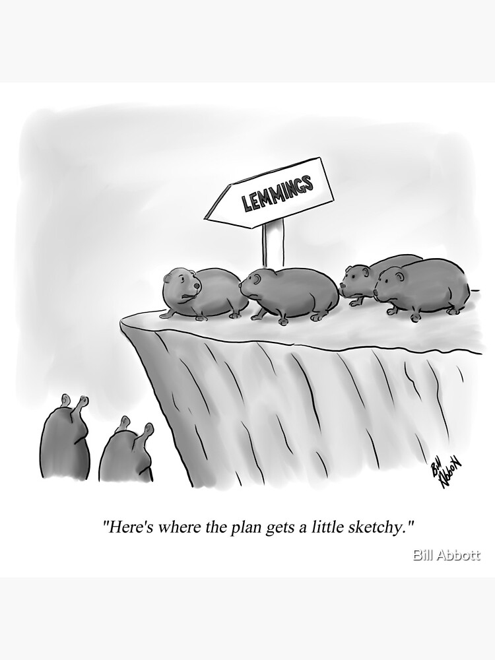
JANUARY 2029 · SECTION 1
The Bank We Inherited
−$0.5M
187%
quarterly operating loss, worsening
fed funds purchased vs equity — the limit is 100%
8.64%
C
risk capital vs a 10% rule due in 8 quarters
credit rating — wholesale funding nearly shut
Prior management’s strategy, illustrated.
A dividend the earnings couldn’t cover, an under-funded loss reserve, and a plan that was mostly momentum.
Notes:
CEO (2 min): Set the scene honestly — the name was earned. Four numbers tell it: losing money, funding on overnight borrowings far past the regulatory line, capital short of a hard new requirement, and a C rating. First team decision: stop following the lemmings.

Slide 5
SHARE PRICE, QUARTER BY QUARTER
Our Two-Year Journey
$22.97
the low — Q2/29. We told you the plan; we kept to it.
$47.41
the peak — Q3/30, our record quarter
$41.36
year-end 2030 — above where we started, with a dividend again
Notes:
KS (30 sec): The dip was the investment; everything after Q2/29 is the return on it. From here, the how.

Slide 6
SECTION 2 · STRATEGY
The Recipe — Three Phases
1 · THE MASH
2 · THE BARREL
3 · THE POUR
H1 2029 — Stabilize
H2 2029 — Reprice & Reserve
FY 2030 — Harvest
Converted emergency borrowings into core deposits
Raised $12M of common equity early
Suspended the dividend — painful, honest
Repriced the loan book +100 to +300bp
Exited money-losing consumer products
Pre-funded credit; finished the capital plan
Variable funding rode rates down into margin
Restarted the dividend: $0.25 → $0.50
De-risked construction as the cycle aged
Sequence was the strategy: stabilize before you reprice, reprice before you harvest.
Notes:
KS (90 sec): One phase per column, one breath each. The through-line: you cannot reprice loans while your funding is on fire, and you cannot harvest a margin you never repriced.

Slide 7
HOW WE GREW, HOW WE FUNDED IT
Growth & Balance Sheet Strategy
Growth: organic first, M&A-ready next
These two years we grew by winning customers — pricing, fees, service. Assets $740M → $818M. That discipline built the balance sheet an acquirer needs.
Capital raised early and cheap
$18M common + $5M subordinated notes, raised before prices fell further. Philosophy: hold a buffer above every requirement.
Funding model: core first
Core deposits fund ~99% of the book; wholesale borrowings retired to near zero. Deposits $551M → $658M.
$M · capital = equity + subordinated notes
Notes:
KS (60 sec): Growth strategy per the framework — organic, deposit-funded, capital raised ahead of need. The chart: bigger on every line that matters, and the growth is funded by customers, not borrowings.

Slide 8
WHAT WE OFFER — AND WHAT WE STOPPED OFFERING
Products & Capabilities
WHERE WE LEAD
CAPABILITIES BUILT
PRUNED FROM THE SHELF
Commercial & construction lending — priced for risk, reviewed every cycle
Full deposit suite — top-of-market rates, low fees, ~99% core funding
Business banking relationships — deposits follow our borrowers
Mortgage banking & servicing — originate, sell, service for fee income
Treasury: interest-rate swaps (+$2.1M in 2030), disciplined securities ladder
CECL-grade credit administration and full loan review
Credit card & installment lending — earned less than our cost of funds
Below-market fixed CDs that customers rightly ignored
Premises we didn't need — sold, leaned out occupancy
Notes:
KS (45 sec): Differentiation was subtraction as much as addition — we stopped doing what lost money and doubled down where we had an edge. Hand off to CU for the results.

Slide 9
SECTION 3 · OPERATING RESULTS, QUARTER BY QUARTER
The Earnings Turn
−$2.5M
FY2029 operating result — the rebuild year
+$7.8M
FY2030 operating result — a $10.3M swing
+$3.8M
our record quarter (Q3/30) — 16.5% ROAE
Notes:
CU (90 sec): Three shrinking losses, breakeven in Q3/29, then five straight profitable quarters capped by our best ever. FY30 net income $6.7M — after resuming tax payments, a problem we're glad to have.

Slide 10
THE TWO ENGINES OF THE TURNAROUND
Margin Built, Costs Cut
Net interest margin (%)
Efficiency ratio (%) — lower is better
3.12% → 4.10% at peak — repricing that stuck
91% → 60% at best — a third less cost per dollar of revenue
Notes:
CU (60 sec): Left — margin: every loan repriced for its risk, funding costs floating down. Right — efficiency: the product pruning and volume discipline made the cost base a third lighter per revenue dollar. Both are structural.

Slide 11
FY2029 VS FY2030 ($M)
Two Years on One Page
 | FY2029 | FY2030
Net interest income | 23.9 | 29.0
Fees & other income | 8.3 | 7.2
Credit loss provision | 7.7 | 5.3
Operating expenses | 25.1 | 23.1
Operating earnings | −0.6 | +7.8
Net income | −0.0 | +6.7
Earnings per share | −$0.03 | +$3.66
Dividends per share | $0.00 | $1.40
+$10.3M
swing in annual operating earnings
9.4% ROAE
full-year 2030 return on equity
$1.40 / share
2030 dividends — restarted, then doubled
Notes:
CU (60 sec): The provision line matters: it came down because the book got safer, never because we stopped counting. Fees normalized after FY29's one-time loan-sale gains.

Slide 12
SECTION 4 · THE GOALS WE SET, GRADED HONESTLY
Goal Realization — 2029
▸
Net income $6.5M · ROAA 0.8%
Missed in the rebuild year (−$0.0M / −0.01%) — delivered in 2030: $6.7M and 0.79%
✓
Grow assets to $815M (+10%)
Exceeded: $857.6M at year-end — deposit-funded growth
▸
Raise capital to an 8% leverage ratio
Raise completed ($18M+$5M); 7.57% at year-end, crossed 8% in early 2030
The conflict we named up front: raising capital while growing is hard. We reconciled it by raising early, growing with deposits, and letting efficiency carry the earnings.
Notes:
AY (75 sec): Integrity means grading our own paper honestly. 2029: one exceeded, two amber — profitability arrived a year late because we chose to pre-fund credit and finish the capital plan first. Both amber goals fully landed in 2030.

Slide 13
THE GOALS WE SET, GRADED HONESTLY
Goal Realization — 2030
▸
Hit an ROAA of 1.2%
Peaked at 1.45% in Q3/30 — our best quarter ever; full year 0.79% as we chose to keep reserving
▸
Grow assets to $1 billion
Chose not to chase it: held ~$820M and quadrupled earnings instead — size is not stewardship
✓
Maintain an 8% leverage ratio
Exceeded: 9.05% at year-end, with risk capital at 12.2% — buffers above every requirement
The reconciliation: staying well-capitalized while lowering borrowings meant growing slower than the $1B goal — we believe shareholders got the better trade.
Notes:
AY (75 sec): 2030's grade is a stewardship story. We could have bought $180M of assets with cheap wholesale money and called the $1B goal 'achieved' — instead we kept the balance sheet clean and delivered record earnings and a doubled dividend. Own the trade-off proudly.

Slide 14
REGULATORY COMPLIANCE — TWO DINGS, BOTH CURED
The Distiller's License
Boulder Capital Accord (6% / 10% by 4Q29)
MET ON DEADLINE
10.85% risk capital in Q4/29; ended 2030 at 12.2%
Fed funds purchased ≤ 100% of equity
BREACHED, THEN CURED
Over the line Q2–Q3/29; cured Q4/29; $0 by Q3/30
ACL / CECL requirements
COMPLIANT THROUGHOUT
Never below the floor; 106% coverage of non-performers at year-end
100% loan review by Q3/29
COMPLETED
Full portfolio reviewed; findings drove early reserves
Construction concentration guidance
FLAGGED & MANAGED
Peaked 198% of capital; deliberate glide to 147%, still falling
Dividend cessation rule
FOLLOWED
Suspended when required; restarted lawfully, then doubled
Notes:
AY (75 sec): Lead with the two honest dings — the fed-funds breach during 2029's loan surge (fixed structurally, not cosmetically) and construction concentration (a guidance flag we ran deliberately while it earned, then walked down). Everything else clean. The regulators' own verdict: C to A.

Slide 15
SECTION 5 · SIX KPIS — FINANCIAL, CUSTOMER, CULTURAL
What Defines Success From Here
FINANCIAL
FINANCIAL
FINANCIAL
ROAA ≥ 1.0%
Efficiency ≤ 65%
Leverage ≥ 8% · Risk capital ≥ 11%
exiting 2030 at 0.99% run-rate
2030 average: 64%
9.05% / 12.2% today
CUSTOMER
CUSTOMER
CULTURAL
Core deposits ≥ 95% of funding
Business deposit share ≥ 30%
Meet or beat guidance
~97% today — customers, not borrowings
26% at year-end — the growth engine
credibility is compounding capital
2031 outlook — ready to lead, ready to acquire: rates rising again and we are positioned for it; ~$100M of deposit-funded lending capacity; ≈$15M of capital above requirements and a stock near book value — dry powder for growth, dividends, buybacks, or the right acquisition.
Notes:
JS (2 min): Six KPIs across financial, customer, and cultural measures — each with today's reading. Close on M&A readiness: an acquirer needs three things — excess capital (we have ~$15M above requirements), a credible currency (stock at ~1.0x book and an A rating), and an integration-ready operating model (our efficiency and credit discipline). Two years ago we'd have been the target. Today we can be the buyer — organic remains plan A, but we are prepared to move if the right bank comes available.

Slide 16
M&A EXERCISE OUTCOME — OUR RECOMMENDATION TO SHAREHOLDERS
The Next Barrel: Acquiring Bank 4
THE PROPOSED DEAL
FINPRO M&A MODEL — EVERY GATE PASSED
Offer
$49.00 / share — 100% stock
Cash EPS accretion
+$0.85 (+25%)
must be positive
Premium
24.7% over market · 108% of tangible book
Tangible book dilution
−8.4%
limit −10%
Deal value
$57.3M · ~1.39M new shares issued
Earn-back period
4.0 years
limit 5 years
Combined bank
≈ $1.50B assets — the $1B goal, achieved
Pro-forma TCE / TA
8.0%
minimum 6%
Why Bank 4
97% core deposits · fixable 86% efficiency
Buyer currency (P/TBV)
103%
must exceed 100%
Cost savings
$6.2M / yr (30% of their expense base)
Combined CAMELS profile
2-rated buyer
required
Recommendation: move forward, pending regulatory approval. What we learned: discipline is the deal. Price past a 30% premium and the same transaction fails two gates — dilution and earn-back. The model kept us honest: pay for the franchise, not the trophy.
Notes:
JS + AY (90 sec): We didn't just claim M&A readiness — we ran the full FinPro exercise on our community. Bank 4 is the strategic fit: $684M of assets, 97% core deposits, and an 86% efficiency ratio that is a fixable flaw, not a franchise flaw — our operating discipline converts it into $6.2M of annual savings. At $49 all-stock we pay a fair 24.7% premium yet only 108% of tangible book, because they trade at 0.87x. Every FinPro gate is green: +25% cash EPS accretion, 8.4% book dilution earned back in 4 years, 8% pro-forma tangible capital. And the combined bank crosses $1.5B — the growth goal we declined to buy with wholesale leverage, achieved with a franchise instead. Q&A crib: (1) Why not Bank 3? Stronger bank but B-rated funding profile and priced closer to book — less value to unlock. (2) Integration risk? Cost saves at 30% are mid-range of the 20–40% norm; credit marked at 150% of their allowance because their coverage is thin (63.5% of non-performers). (3) Management? Our team leads; their retail and consumer bench deepens ours. (4) Above 30% premium the deal fails dilution and earn-back gates — we walk.

Slide 17
Aged to Top Shelf.
+$10.3M
C → A
12.2%
$1.40
operating earnings swing
credit rating
risk capital
dividends restored
Thank you, shareholders. Questions welcome — we kept the receipts.
Notes:
Full team (30 sec + 5 min Q&A). Crib sheet: (1) Why dilute at the bottom? The penalty regime cost more than the dilution; later raises priced far better. (2) Construction risk? Priced for it, reviewed it, walked it down before the cycle forced us. (3) Is FY30 repeatable? The margin and cost base are structural; we guide conservatively on purpose. (4) Why believe the numbers? Every figure is from the regulatory reports, unadjusted.

