Slide 1
MSDS 670- Data Visualization
Week 7- Advanced Data Visualization
Andrew Lujan
John Koenig

Slide 2
Introduction
For this assignment, I wanted to perform attempt some advanced data visualizations using the Pokemon dataset found at Kaggle: https://www.kaggle.com/abcsds/pokemon
I wanted to explore Poke’mon attributes within the Poke’mon game using the plotly library and all of the features within it.
I chose to create a scatterplot for every Poke’mon in the game on their attributes Special Attack and Special Defense. I chose these attributes because of the popularity of special attacks in the game.
I also wanted to see the distribution of my favorite type of Pokemon, psychic, by their attributes.
The last plot I created was a radar chart which I believe is the best kind of chart to present the contrasts between a poke’mon and their attributes.

Slide 3
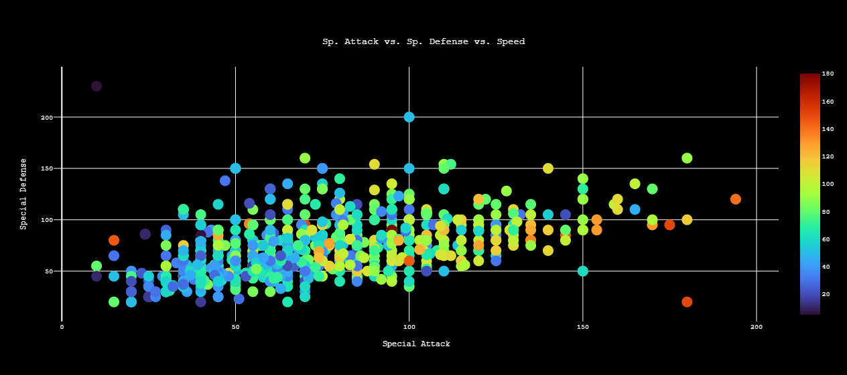
Visualization # 1 Plotly Scatterplot interactive chart link: file:///C:/Users/Andrew/Scatterplot.html
The chart measures special defense by special attack. I added on speed as an additional way to filter each Poke’mon as is a crucial attribute in the games.
At the end of the chart we can see some legendary Pokemon like Mewtwo and Deoxys with extremely high special attack and speed attributes, but low special defense attributes.
Most Poke’mon are generally slow which explains the large amounts of blue in the plot.

Slide 4
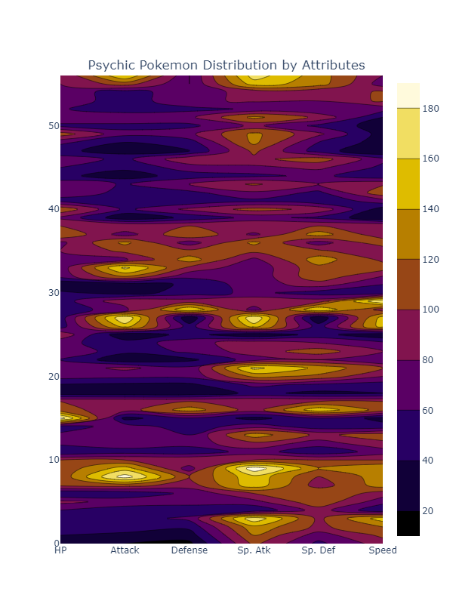
Visualization # 2 Plotly Contour Chart interactive chart link: file:///C:/Users/Andrew/Psychic-contour.html
The chart to the right takes a look at the distribution of psychic Poke’mon by their attributes.
Essentially, it tells how many psychic Poke’mon attributes fall within those categories. The colorscale is used as the mode of measure for the attributes.
With the Y-axis representing the frequency.
I expected to see a lot of Poke’mon the high attribute scores to fall within the special attack column. Which it looks is the case.

Slide 5
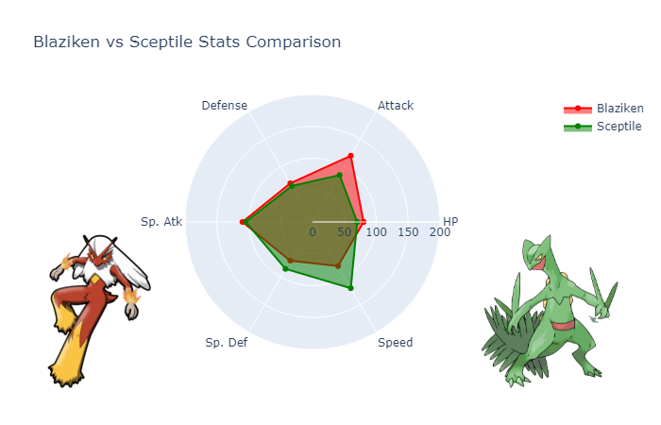
Visualization # 3 Plotly Radar Chart interactive chart: file:///C:/Users/Andrew/Blaziken_Sceptile_Comparison.html
Radar charts are fantastic for comparing the attributes of Poke’mon. These are frequently used to compare attributes of athletes.
I wanted to compare the attributes of two Poke’mon from generation 3.
Blaziken’s attribute profile is a more physical attack based Poke’mon with a decent hp attribute.
Sceptile’s attribute profile is more focused on speed and special defense.

Slide 6
Conclusion
According to the scatterplot, a lot of the Poke’mon have relatively low speeds. A lot of this can be attributed to the fact that Poke’mon grow from babies into fully evolved forms.
Additionally, lighter colors appear at the end of the scatterplot indicating there that Poke’mon with higher special attacks were more likely to have higher speed attributes.
From the contour chart we can see that the attribute profile of a psychic type Poke'mon tends to be special attack and special defense based. They excel in those attributes and frequently have that type of attribute profile.
From the radar chart, we learned that Blaziken is a more physical attacking while Sceptile focuses on being evasive and attacking first with speed attributes.

