Slide 1
HCUP Infrastructure Proposal
Ran Li
12/9/22

Slide 2
Overview
Database
Define database and evaluate databases
Database recommendations
Datawarehouse
Define data warehouse and evaluate two options
Datawarehouse recommendations
Demo of current prototype
`targets` pipeline on the backend
`dbt`-like documentation on the front-end

Slide 3
Database
Database is a collection of data
Database Management System (DBMS) is a software used to manage databases.
DBMS can be evaluated based on two criteria
Purpose: Transactional vs Analytical
Infrastructure: Sever vs Serverless

Slide 4
Database
Database is a collection of data
Database Management System (DBMS) is a software used to manage databases.
DBMS can be evaluated based on two criteria
Purpose: Transactional vs Analytical
Infrastructure: Sever vs Serverless

Slide 5
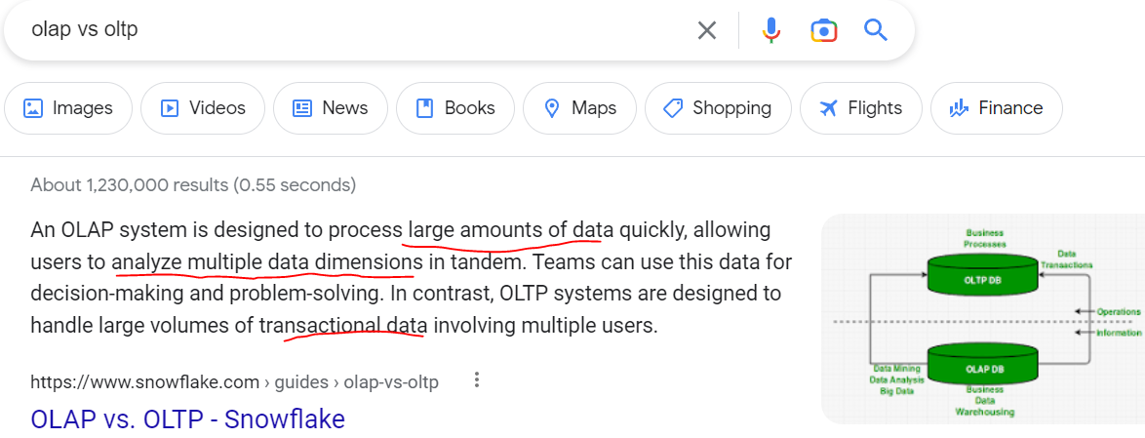
Database Purpose

Slide 6
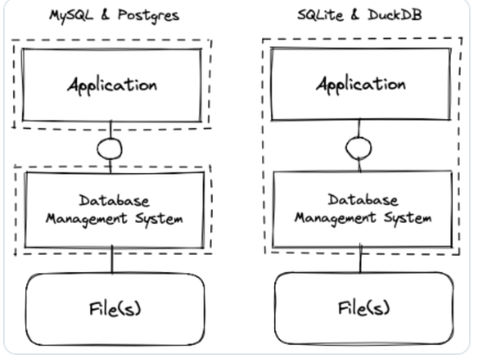
Database Archeticture
Serverless Pros
No setup
Native to whatever analytical programming you are working in (R, Python … ETC).
No cost for running DBMS server
No man-house required to administrer to server
Cons:
Not good for real-time databases
Rather new tech, so unproven hen it comes to production.
Server-based
Serverless

Slide 7
Comparison
https://db-engines.com/en/system/DuckDB%3BGoogle+BigQuery%3BPostgreSQL
Takeaway:
Big Query is analytical, sever based DBMS
PostgreSQL: is a transactional, server based DMBS
DuckDB/Arrow: analytical, server-less DBMS
Recent venture investment indicates ong term manintainblity
Light-weight
Multi-lingual
No cost

