Slide 1
Hello Quarto
A document to demo Quarto features

Slide 2
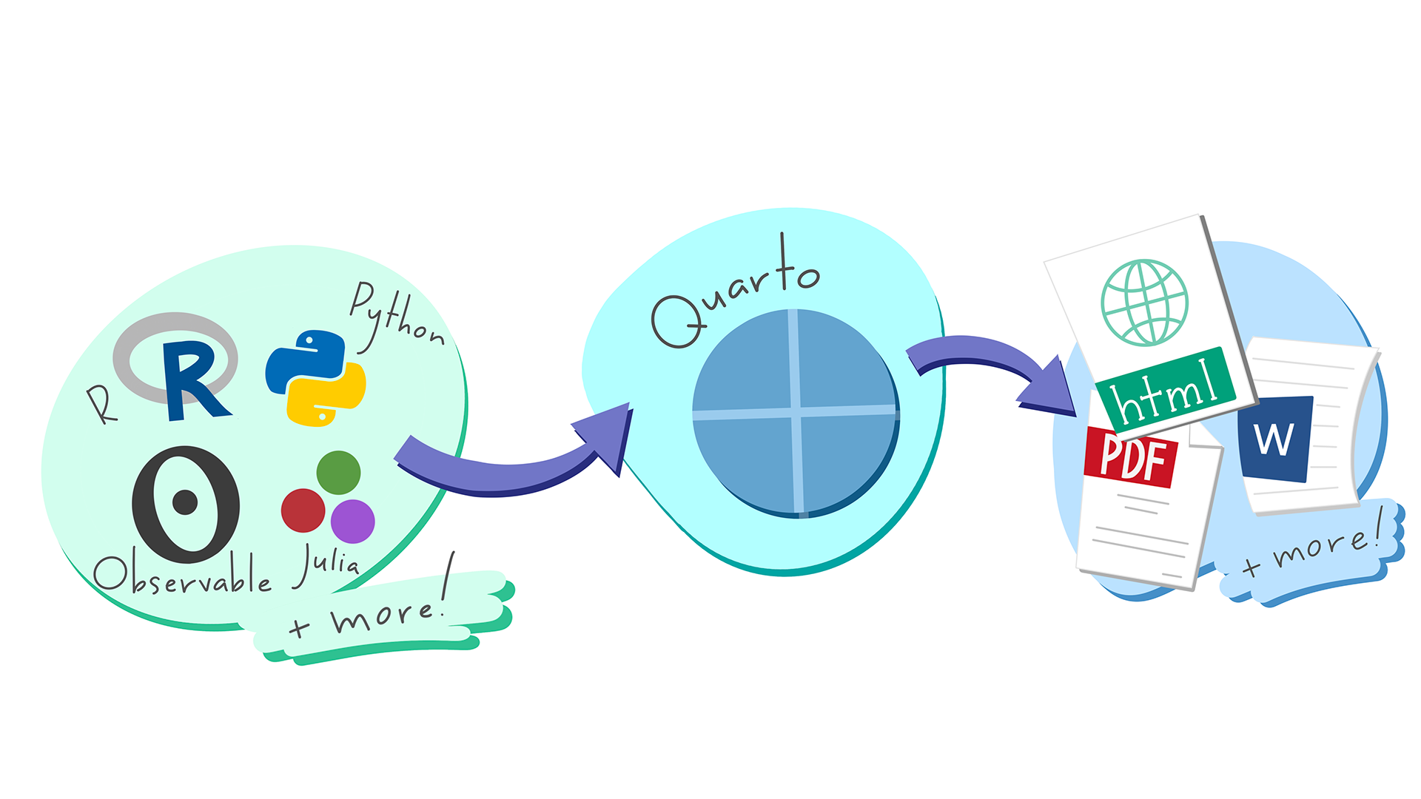
Introduction
This section is all prose. Quarto allows us to weave computation and prose into publication and web ready outputs. Visit the Quarto website to get started.
Quarto schematic

