Slide 1

Artathon 2019
Organizers:
Uri Hershberg , Data Science Research Center
Creds : Clone Reliability Decision Support
Group members:
Uri Hershberg, Alexandra Kogan
Project web interface:
artathon-creds.herokuapp.com

Slide 2
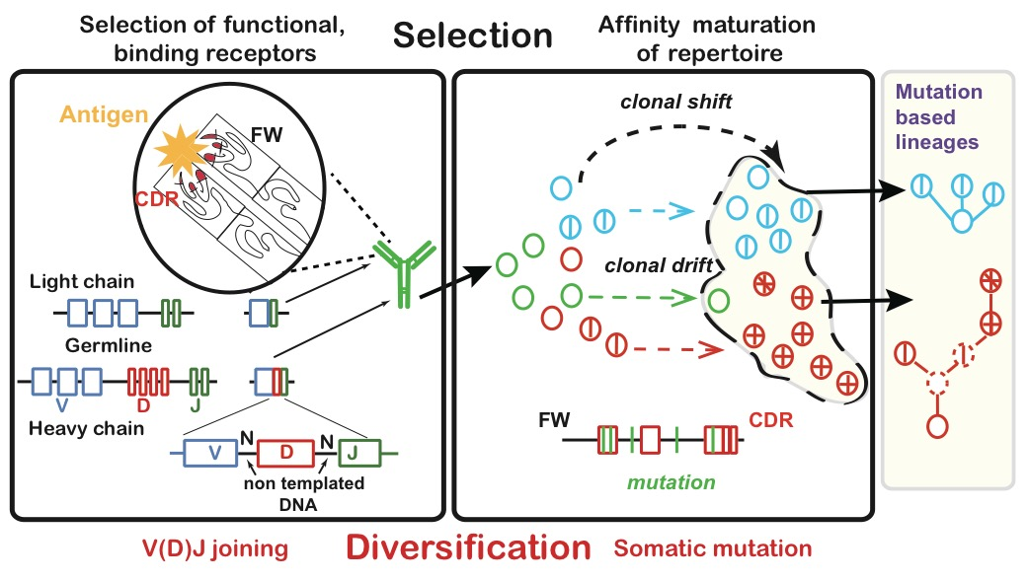
Intro

Slide 3
Assessing B-Cell lineage reliability
Reliability is important for identifying the true structure of the clone tree.
We defined a number of measures to discern the reliability of the member nodes in a B-cell lineage:
Number of mutations from parent
Number of copies / instances
Distance from terminal (leaf) node

Slide 4
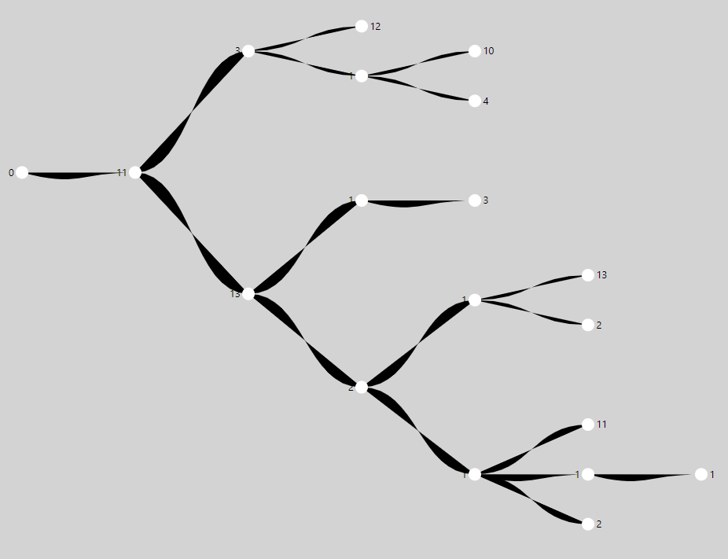
1
1
1
1
1
1

Slide 5
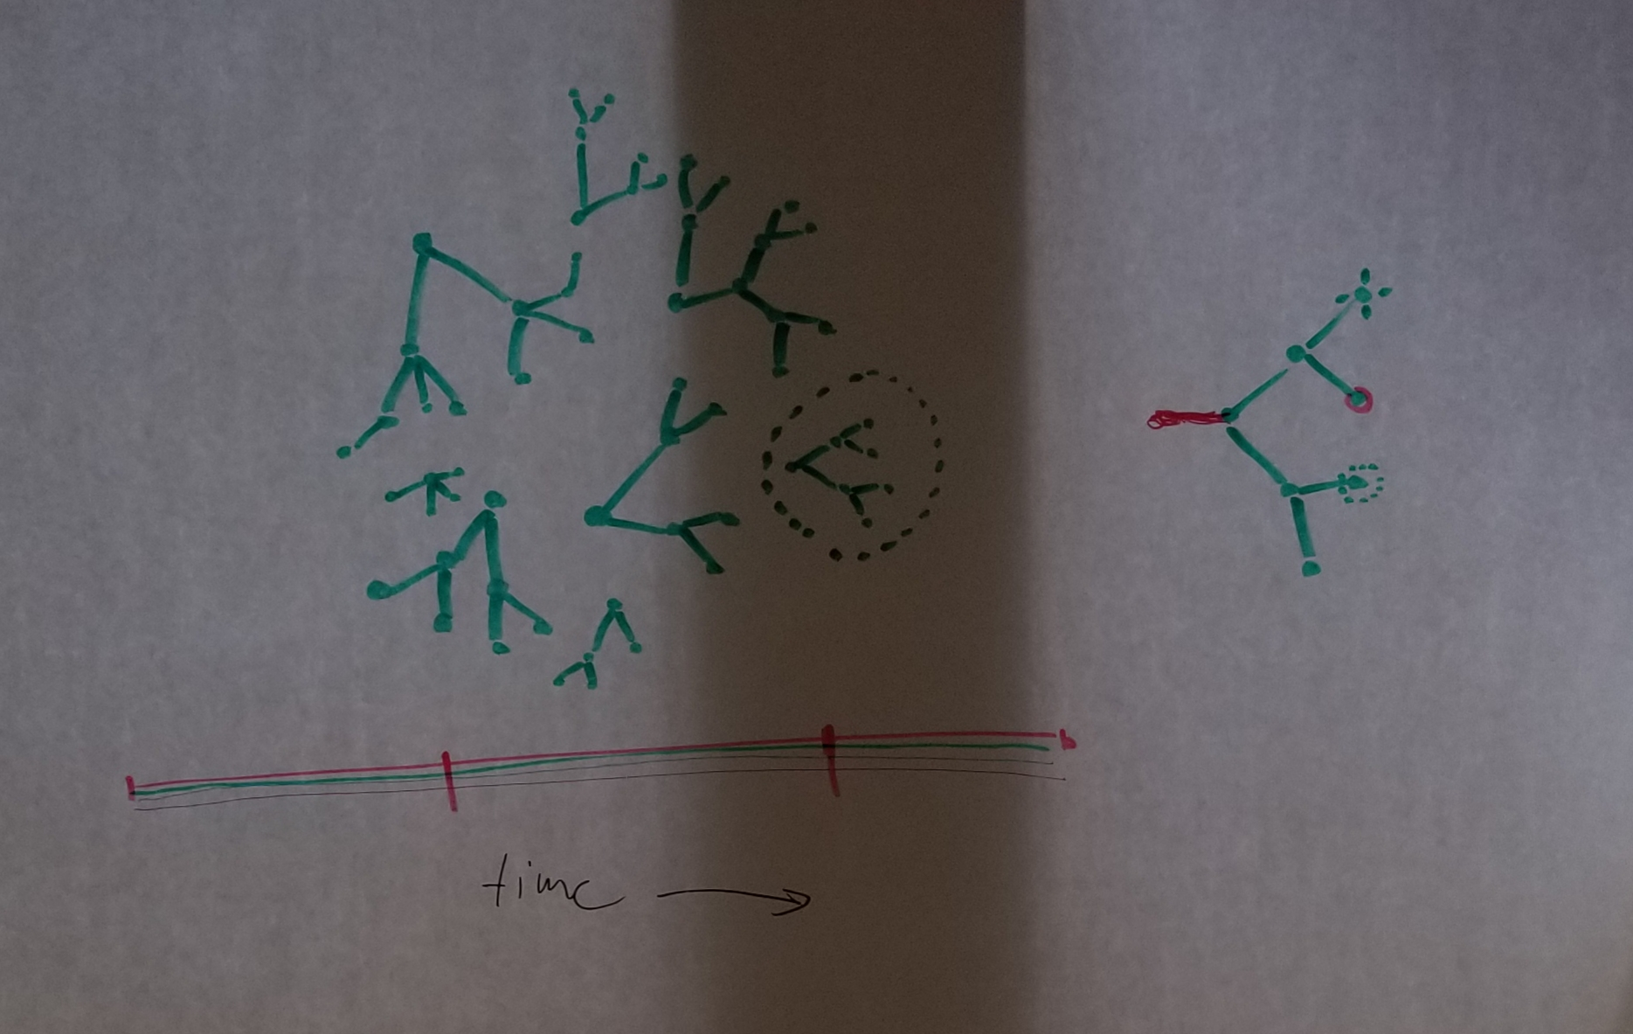
Future work
Visualization of large groups of clone trees from the perspective of different sub-divisions:
Across time
In different tissue types
Etc…

Slide 6
Thank you!

