Slide 1
FAO Global Agricultural Production and Data Quality Analysis
A Data Analytics Project Using SQL & Power BI
Prepared by; dare olopade

Slide 2
Introduction
This project analyzes FAO agricultural production data (1961–2013) to reveal production trends and evaluate data quality across countries and commodities.
Objective: Clean and standardize the raw dataset, measure data completeness, and deliver three interactive Power BI dashboards for exploratory and stakeholder reporting.
Tools & workflow: Data cleaning and modeling in SQL Server, transformations in Power Query, and reporting in Power BI.

Slide 3
Problem Statement
Agricultural data reported by different countries is often inconsistent, incomplete, or recorded using varying formats.
Missing values, zero entries, and non-standardized fields make it difficult to compare production across countries, years, or commodities.
These irregularities reduce the reliability of analysis, distort trend interpretation, and hinder evidence-based decision-making.
This project aims to clean, standardize, and transform FAO’s raw data into a reliable, comparable, and analytics-ready format for meaningful insights.

Slide 4
Project Objectives
Ensure Data Accuracy & Consistency: Clean the dataset by handling missing values, incorrect zeros, duplicates, and inconsistent entries to improve reliability.
Standardize Country & Production Metrics: Normalize country names, measurement units, and product categories so comparisons across regions and time are valid.
Build a Structured, Analysis-Ready Dataset: Transform the raw FAO data into a well-organized table that supports efficient querying, trend analysis, and modeling.

Slide 5
Project Objectives
Identify Key Agricultural Trends: Reveal year-to-year performance, leading producers, production gaps, and anomalies across different countries.
Develop an Interactive Insight Dashboard: Create a simple, visual reporting tool for stakeholders to explore agricultural performance and make informed decisions.
Support Data-Driven Agriculture Policy: Provide insights that help governments, analysts, and organizations improve planning, resource allocation, and intervention strategies.

Slide 6
Dataset Description
Dataset Source: Food and Agriculture Organization (FAO) global agricultural production data.
Dataset Structure:
  Rows: Each row represents a country’s agricultural output for a specific product and year.
  Columns include:
    Area Abbreviation - Representing abbreviation of the country’s name
    Area - Represents the Country. Item Code – Code of items produced
    Item - The agricultural product (e.g., maize, rice, sorghum)
    Element Code - Code for each element represented
    Element - (e.g., Food or Feed)
    Unit - Type of measurement used (1000 tonnes)
    Latitude and Longitude
    Year – Reporting years from Y1961 to Y2013

Slide 7
Dataset Description
Key Characteristics:
  Covers multiple countries and a wide range of crops.
  Includes several decades of historical data.
  Contains zeroes, missing values, and non-standard reporting formats.
  Requires cleaning to ensure correct analysis.
Purpose of Dataset Use:
To build a consistent, reliable view of agricultural production trends across countries and time periods.

Slide 8
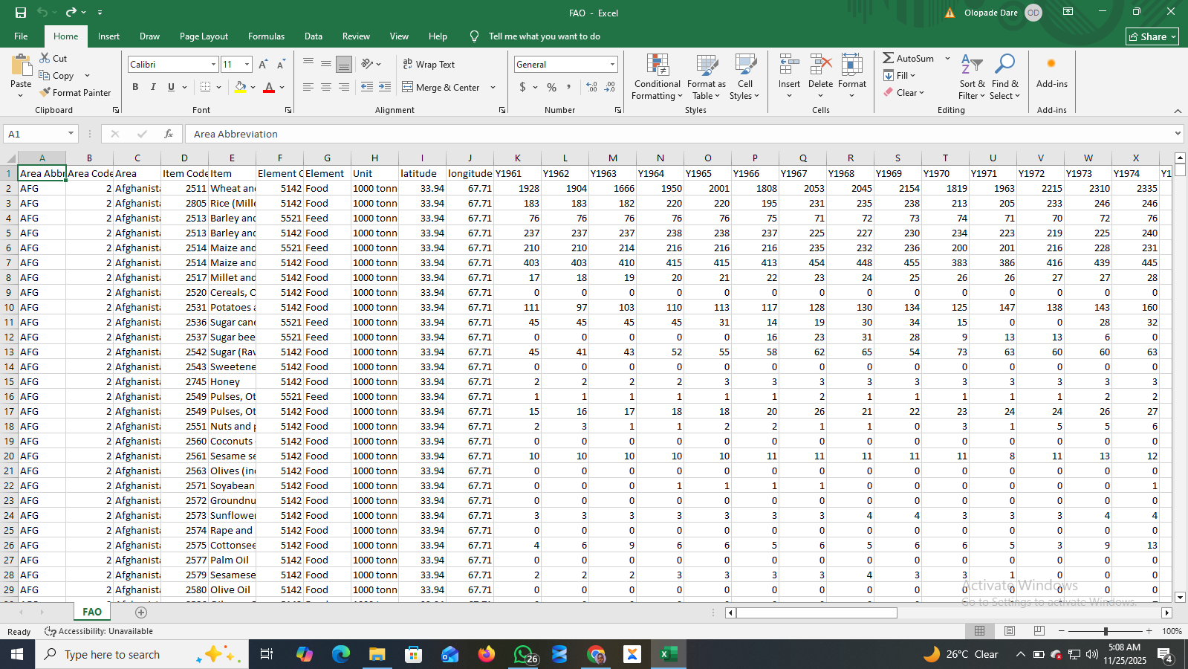
Dataset Description

Slide 9
methodology
Raw FAO agricultural data was first explored to understand structure, gaps, and inconsistencies.
Data cleaning and transformation were performed using SQL.
A long-format analytical table was created to enable time-series analysis.
Data quality indicators were engineered to track missing and zero values.
Cleaned and summarized views were connected to Power BI for modeling and visualization.

Slide 10
Data Preparation & Cleaning (SQL)
Raw dataset contained year values as columns (1961–2013).
Data was unpivoted to convert years into a single Year column and corresponding Quantity values.
Text fields were standardized (country names, item names, elements).
Empty cells were preserved as NULL values to avoid false zero assumptions.
Numeric fields were validated to ensure proper data types.

Slide 11
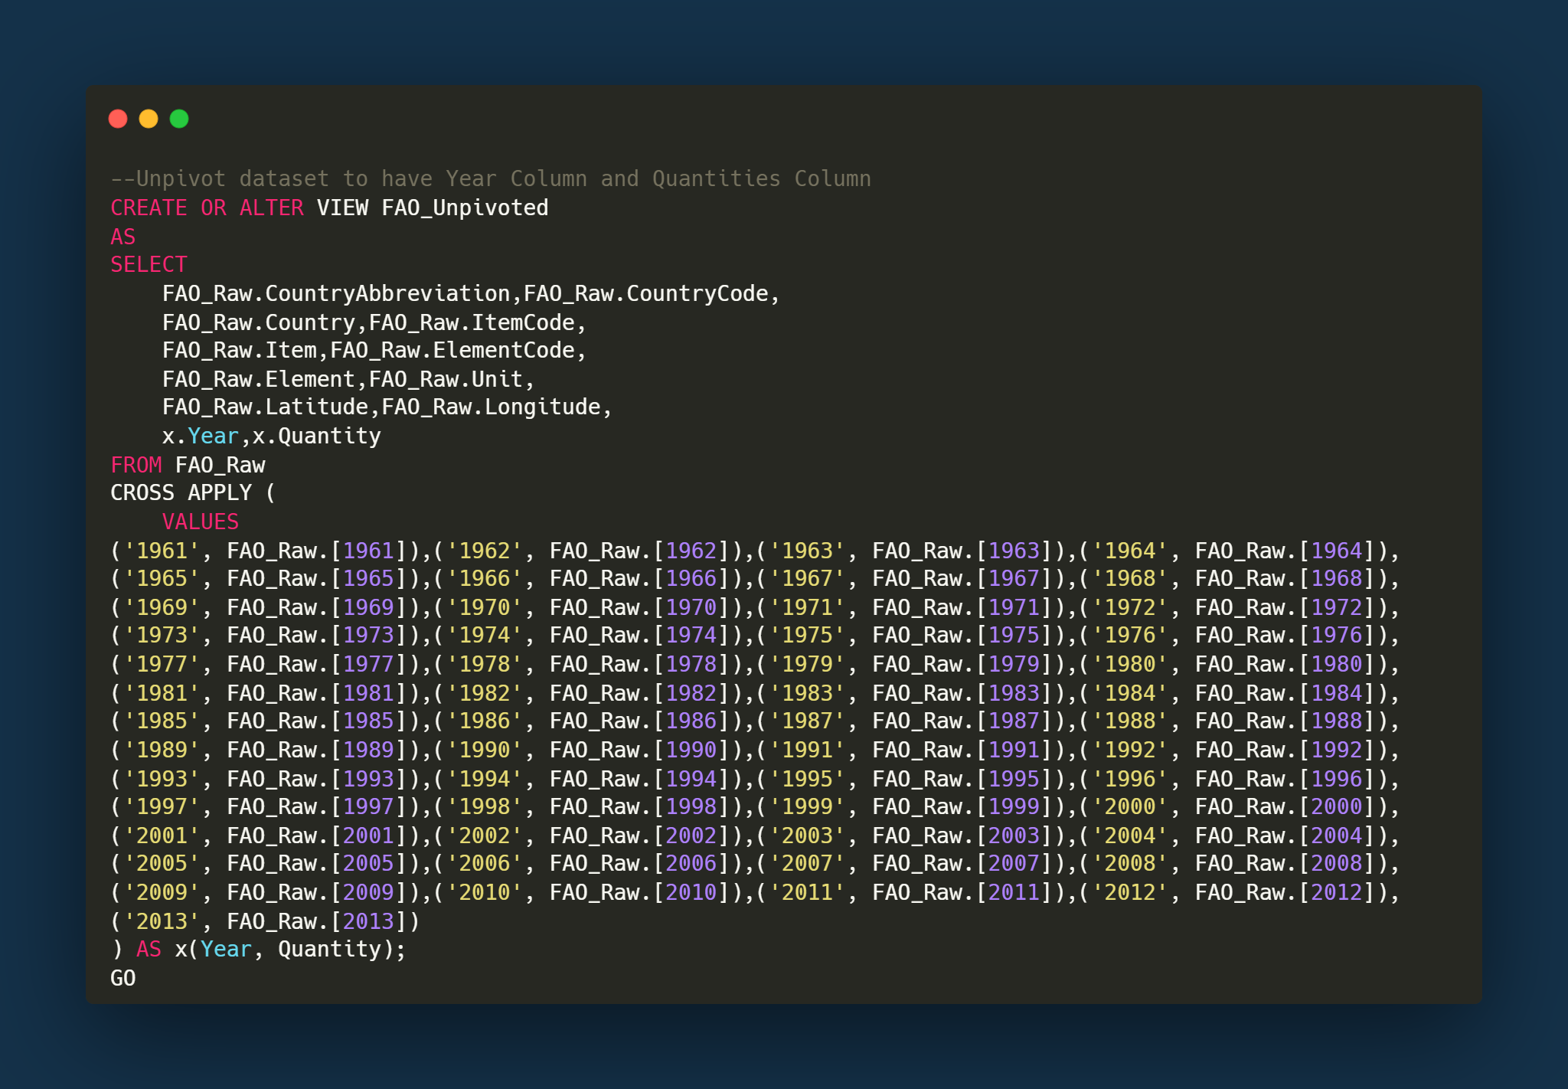
Data Preparation & Cleaning (SQL)
The dataset was transformed into a long format by unpivoting year columns into a single Year and Quantity field to support time-series analysis.

Slide 12
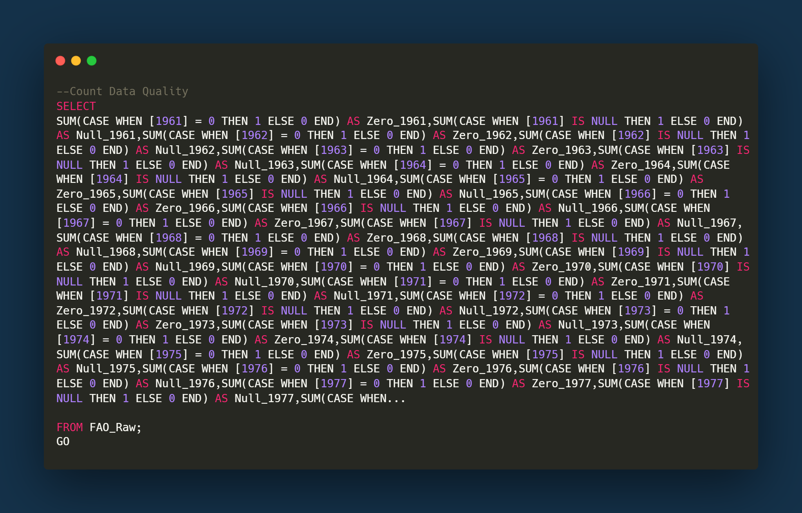
Data Preparation & Cleaning (SQL)
A data quality check was performed to quantify zero and missing values across all yearly columns in the raw FAO dataset.

Slide 13
Data Modeling
Cleaned SQL views were imported into Power BI using DirectQuery.
Summary views were used to improve performance and reduce memory load.
Logical separation of tables which were used for:
  Production summaries.
  Country-level analysis.
  Data quality analysis.
Measures were created using DAX for KPIs, trends, and comparisons.

Slide 14
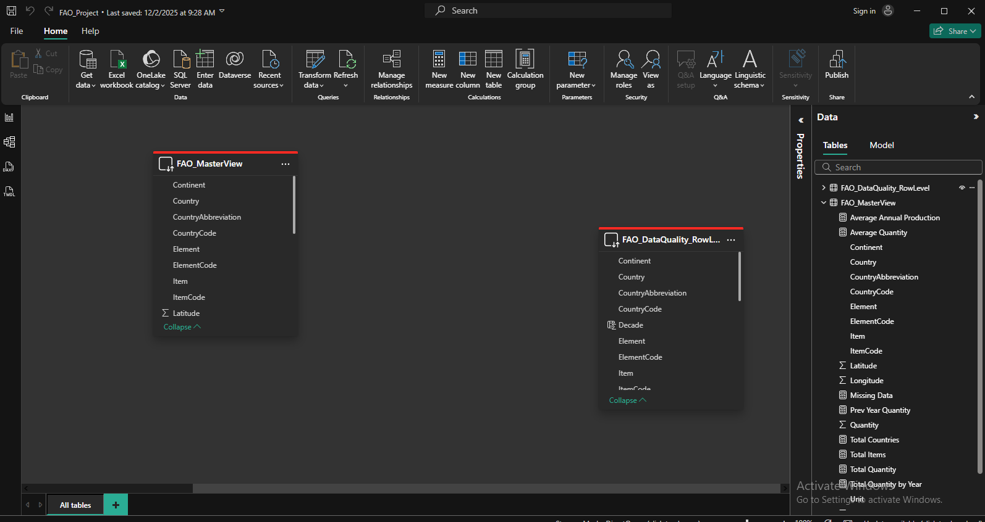
Data Modeling

Slide 15
Data Analysis & Dashboard Design
Analytical Approach
  Analysis was conducted using a long-format analytical table optimized for time-series and regional comparison.
  Data was explored across time (year & decade), geography (country & continent), and commodities (items & elements).
  Special focus was placed on data quality, distinguishing between missing values and true zero production values.

Slide 16
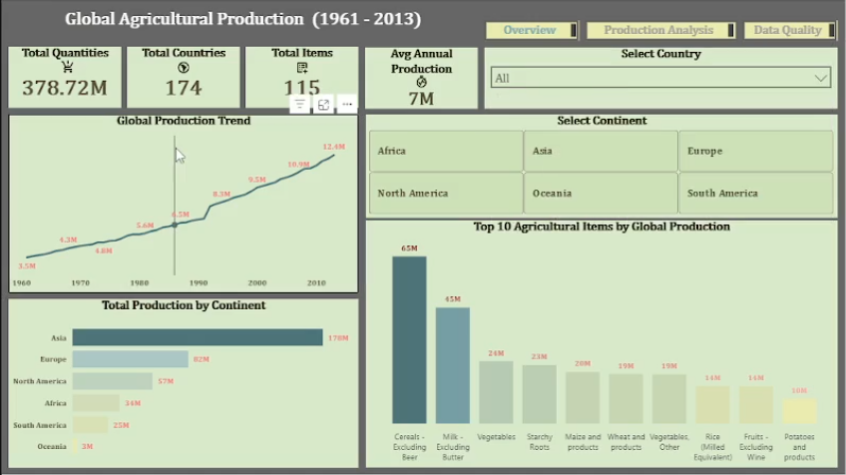
Data Analysis & Dashboard Design
The Power BI dashboard was organized into three interconnected pages:
  Overview
    Global production trends (1961–2013).
    Top agricultural items by output
    Production comparison across continents.
    High-level KPIs (total output, countries, items).

Slide 17
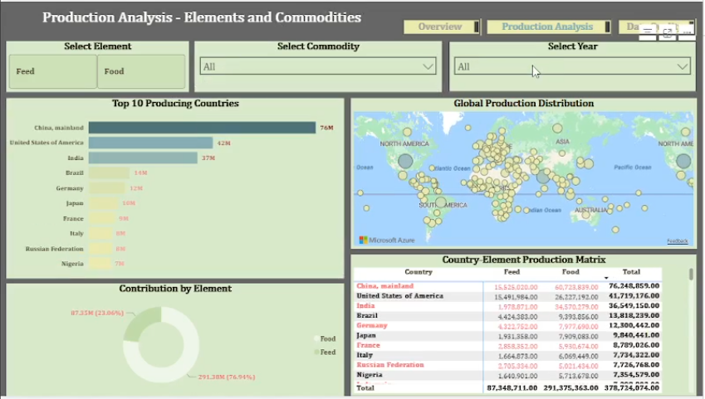
Data Analysis & Dashboard Design
Production Analysis
  Top producing countries by commodity.
  Decade-based production trends.
  Regional and commodity dominance patterns.
  Interactive filtering by year, item, and continent.

Slide 18
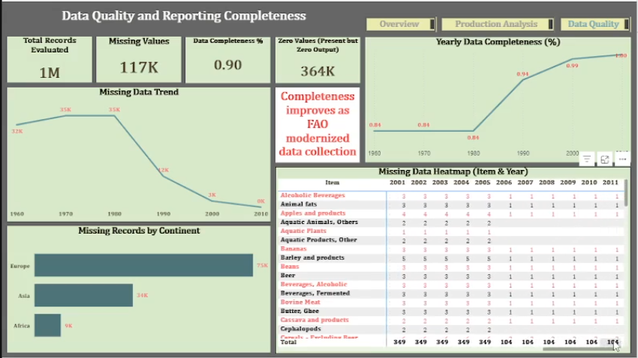
Data Analysis & Dashboard Design
Data Quality
  Missing vs zero value analysis.
  Data completeness trends over time.
  Regional patterns in data reporting.
  Validation of reporting improvement hypothesis.

Slide 19
Data Analysis & Dashboard Design
Hypothesis Testing
  Earlier years show higher levels of missing data, indicating weaker reporting systems.
  Data completeness improves steadily over time, reaching near-complete coverage in later years.
  This trend supports the hypothesis of improving global agricultural data reporting standards.

Slide 20
Key insight and findings
Global Production Trends
  Global agricultural production shows a consistent upward trend from 1961 to 2013.
  Production growth becomes more pronounced from the 1990s onward, indicating expansion in both output and reporting.
Commodity Dominance
  Staple crops such as cereals and starchy roots dominate global agricultural output.
  These commodities consistently account for the largest share of total production across decades.

Slide 21
Key insight and findings
Regional Performance
  Asia emerges as the leading contributor to global agricultural production.
  The Americas and Europe follow, while Africa shows steady but comparatively lower output.
Data Quality Patterns
  Early years (1960s–1970s) contain higher levels of missing data.
  Data completeness improves significantly in later years, reaching near-complete reporting by the 2000s.
  This supports the hypothesis that global agricultural reporting improved over time.

Slide 22
Recommendations and implications
Improve Early-Year Data Coverage
  Stakeholders should treat agricultural data from earlier years with caution due to higher levels of missing records.
  Historical trend analysis should account for data gaps when making long-term comparisons.
Strengthen Data Reporting Standards
  Continued investment in standardized agricultural data collection will ensure consistency across countries.
  Clear differentiation between true zero and missing records should be enforced in reporting systems.

Slide 23
Recommendations and implications
Use Regional Benchmarks for Policy Planning
  Regions with lower output growth can be benchmarked against high-performing regions such as Asia.
  Policymakers can leverage regional comparisons to identify opportunities for productivity improvement.
Focus on High-Impact Commodities
  Staple crops dominate global production and should remain a priority for food security planning.
  Data-driven allocation of resources towards key commodities can improve agricultural sustainability.

Slide 24
conclusion
Data quality directly affects the reliability of agricultural insights and policy decisions.
Through structured cleaning, validation, and modeling, the FAO dataset was transformed into an analysis-ready format.
The analysis revealed improving data completeness over time, alongside clear regional and commodity-level production patterns.
The final dashboard provides a clear, interactive view for exploring agricultural output trends and data quality across countries and years.

