Slide 1

POULTRY FARM PERFORMANCE DASHBOARD ANALYSIS
Flock Health, Production Performance & Feed Efficiency (Jan-Jul 2025)
Dare S. Olopade
Data Analyst
Tools Used: Excel | DAX | Power BI
Poultry Farm Performance
Dashboard

Slide 2
Business Context & Analytical Focus
Business Context
Commercial poultry operation managing multiple pens over time.
Daily operational data captured across production, feed, mortality and medication.
Management requires visibility into performance, efficiency and health risks.
Analysis supports operational decision-making, not academic reporting.
Key Business Questions
How is egg production performing across age and pens?
Where are productivity gaps and peak performance points?
How efficiently is feed being converted into eggs?
Are health interventions aligned with mortality patterns?

Slide 3
Data Overview and Modelling Approach
Data Overview
Daily farm operational records captured across multiple pens.
Core data fields include population, feed, egg production, mortality and medication.
Time span covers flock growth and early laying phases.
Data cleaned, standardized and validated for consistency.
Modeling & Analytical Approach
Pen-level data consolidated into a single fact table.
Star schema design used for scalable analysis.
Dimensions created for Date, Pen, and Medication.
Metrics calculated using consistent, population-aware logic.

Slide 4
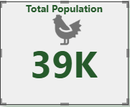
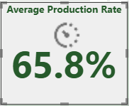
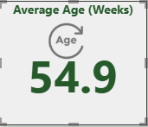
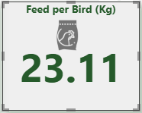
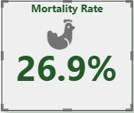
Executive Overview – Farm Performance Snapshot

Slide 5
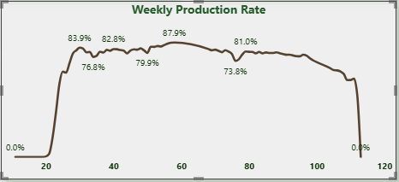
Executive Overview – Farm Performance Snapshot

Slide 6
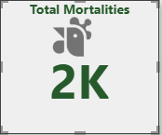
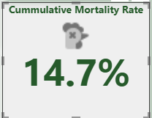
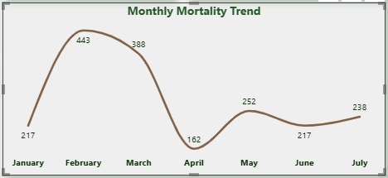
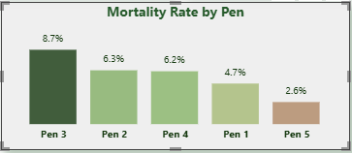
Flock Health & Mortality Insight

Slide 7
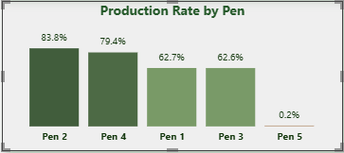
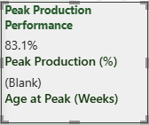
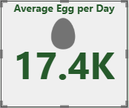
Production Performance Insight

Slide 8
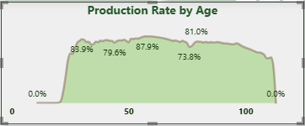
Production Performance Insight

Slide 9
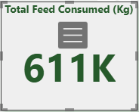
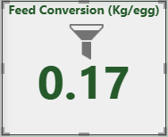
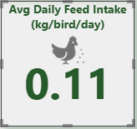
Feed & Efficiency Insight

Slide 10
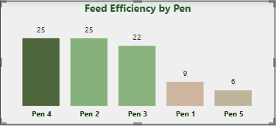
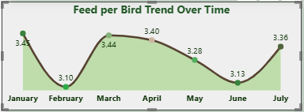
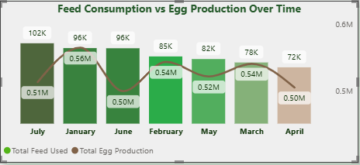
Feed & Efficiency Insight

Slide 11
Key Insights
Overall production is moderate but declining over time, with an average production rate of 65.8% and a noticeable drop in egg output after peak age.
Production performance varies significantly across pens, with some pens maintaining strong output while others show sharp underperformance.
Feed efficiency is inconsistent, as higher feed consumption does not always translate into proportionate egg production across periods.
Mortality is non-trivial and uneven across pens, with a cumulative mortality rate of 14.7%, indicating health or management gaps.
Peak production occurs within a narrow age window, after which productivity declines rapidly, impacting overall farm output.
Medication usage is concentrated in specific months and pens, suggesting reactive rather than preventive health management.

Slide 12
Recommendations
Standardize Best-Performing Pen Practices: Investigate high-performing pens and replicate their feeding, housing, and management conditions across underperforming pens.
Optimize Feed Strategies around Peak Production Age: Align feed quantity and quality with peak laying periods to maximize return on feed investment.
Introduce Early-warning Mortality Thresholds: Monitor pens approaching abnormal mortality levels and intervene earlier with preventive health measures.
Review Feed-to-egg Conversion Drivers: Identify periods where feed intake increases without corresponding egg output and adjust rations accordingly.
Shift from Reactive to Preventive Flock Health Management: Use mortality and medication patterns to design proactive vaccination and biosecurity schedules.
Optimize Flock Replacement Timing Post-peak Production: Mitigate productivity decline by optimizing flock lifecycle decisions.

Slide 13
Executive Takeaway
Farm performance is being constrained less by scale and more by execution consistency across pens.
The economic peak of the flock is short, and value erosion begins quickly once that window passes.
Feed spend is increasingly exposed to diminishing returns as birds age and output declines.
Health outcomes suggest interventions are occurring late, increasing avoidable losses.
The biggest opportunity lies in earlier decisions and standardization, not additional inputs.

Slide 14
Business Impact
Production losses are driven more by timing and inconsistency than by farm scale, limiting overall return from the flock.
Feed efficiency risk increases sharply post-peak, exposing margins if flock decisions lag performance decline.
Uneven pen performance represents unrealized value, not unavoidable biological limits.
Delayed health interventions amplify mortality and productivity loss, increasing avoidable cost.

Slide 15
THANK YOU FOR LISTENING

