Slide 1

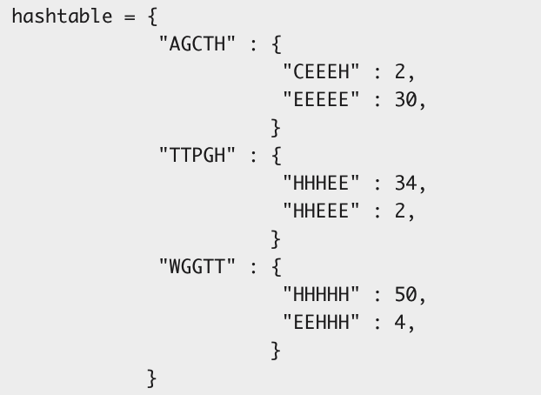
General Implementation:
Specific Implementation:

