Slide 1
DebruijnExtend
Dreycey Albin, Angela Folz

Slide 2
Algorithm Overview

Slide 3
1
ATW
CCE, 0.3
ECC, 0.2
HHH, 0.5
seq = ATWGRTG
K = 3
2
TWG
CEE, 0.9
CCH, 0.1
3
ATWGRTG
WGR
EEE, 0.9
CCE, 0.1
4
GRT
EEE, 1
5
RTG
EEE, 0.5
EEC, 0.4
CCC, 0.1
Length(sequence) - (k-1) = # layers
7 - (3-1) = 5

Slide 4
seq = ATWGRTG
K = 3
0.3
0.2
0.5
CCE
ECC
HHH
1
0.9
0.1
ATW
CCE, 0.3
ECC, 0.2
HHH, 0.5
CEE
CCH
2
TWG
CEE, 0.9
CCH, 0.1
0.1
0.9
3
CHE
EEE
WGR
CHE, 0.1
EEE, 0.9
4
GRT
EEE, 1
1
EEE
5
RTG
EEE, 0.5
EEC, 0.4
CCC, 0.1
0.5
0.4
0.1
EEE
EEC
CCC

Slide 5
seq = ATWGRTG
K = 3
0.3
0.2
0.5
CCE
ECC
HHH
stitchextend_dict
0.9
0.1
CEE
CCH
Layer 1, Layer 2

Slide 6
seq = ATWGRTG
K = 3
0.3
0.2
0.5
CCE
ECC
HHH
stitchextend_dict
0.9
0.1
CEE
CCH
CCE
ECC
CEE
CCH
Layer 1, Layer 2

Slide 7
seq = ATWGRTG
K = 3
0.3
0.2
0.5
CCE
ECC
HHH
stitchextend_dict
0.3*0.9
0.2*0.1
CCEE
0.3*0.9
CCEE
ECCH
ECCH
0.2*0.1
CCE
ECC
CEE
CCH
Edge Contraction
Layer 1, Layer 2

Slide 8
seq = ATWGRTG
K = 3
stitchextend_dict
0.3*0.9
0.2*0.1
CCEE
0.3*0.9
CCEE
ECCH
ECCH
0.2*0.1
0.1
0.9
CHE
EEE
Layer 2, Layer 3

Slide 9
seq = ATWGRTG
K = 3
stitchextend_dict
0.3*0.9
0.2*0.1
CCEE
0.3*0.9
CCEE
ECCH
ECCH
0.2*0.1
0.1
0.9
CHE
EEE
CCEE
ECCH
EEE
CHE
Layer 2, Layer 3

Slide 10
seq = ATWGRTG
K = 3
stitchextend_dict
0.3*0.9
0.2*0.1
CCEE
0.3*0.9
Del
CCEE
ECCH
ECCH
0.2*0.1
Del
0.2*0.1*0.1
0.3*0.9*0.9
ECCHE
CCEEE
ECCHE
0.2*0.1*0.1
Add
CCEEE
0.3*0.9*0.9
CCEE
ECCH
Add
EEE
CHE
Edge Contraction
Layer 2, Layer 3

Slide 11
seq = ATWGRTG
K = 3
stitchextend_dict
ECCHE
0.2*0.1*0.1
CCEEE
0.3*0.9*0.9
0.2*0.1*0.1
0.3*0.9*0.9
ECCHE
CCEEE
Layer 2, Layer 3

Slide 12
seq = ATWGRTG
K = 3
stitchextend_dict
ECCHE
0.2*0.1*0.1
CCEEE
0.3*0.9*0.9
0.2*0.1*0.1
0.3*0.9*0.9
ECCHE
CCEEE
CCEEE
1
EEE
EEE
Layer 2, Layer 3

Slide 13
seq = ATWGRTG
K = 3
stitchextend_dict
ECCHE
0.2*0.1*0.1
Del
CCEEE
0.3*0.9*0.9
Del
0.2*0.1*0.1
0.3*0.9*0.9
ECCHE
CCEEE
CCEEEE
0.3*0.9*0.9*1
Add
CCEEE
0.3*0.9*0.9*1
EEE
CCEEEE
Edge Contraction
Layer 2, Layer 3

Slide 14
seq = ATWGRTG
K = 3
stitchextend_dict
CCEEEE
0.3*0.9*0.9*1
0.3*0.9*0.9*1
CCEEEE
Layer 2, Layer 3

Slide 15
seq = ATWGRTG
K = 3
stitchextend_dict
CCEEEE
0.3*0.9*0.9*1
0.3*0.9*0.9*1
CCEEEE
0.5
0.4
0.1
EEE
EEC
CCC
Layer 2, Layer 3

Slide 16
seq = ATWGRTG
K = 3
stitchextend_dict
CCEEEE
0.3*0.9*0.9*1
Del
CCEEEEE
Add
0.3*0.9*0.9*1*0.5
Edge Contraction
CCEEEEC
Add
0.3*0.9*0.9*1*0.4
0.3*0.9*0.9*1
CCEEEE
0.3*0.9*0.9*1*0.5
0.3*0.9*0.9*1*0.4
CCEEEEE
CCEEEEC
Layer 2, Layer 3

Slide 17
seq = ATWGRTG
K = 3
stitchextend_dict
CCEEEEE
0.3*0.9*0.9*1*0.5
Entire graph is now edge contracted!
CCEEEEC
0.3*0.9*0.9*1*0.4
0.3*0.9*0.9*1*0.5
0.3*0.9*0.9*1*0.4
CCEEEEE
CCEEEEC
Layer 2, Layer 3

Slide 18
seq = ATWGRTG
K = 3
stitchextend_dict
CCEEEEE
0.3*0.9*0.9*1*0.5
Entire graph is now edge contracted!
CCEEEEC
0.3*0.9*0.9*1*0.4
0.3*0.9*0.9*1*0.5
0.3*0.9*0.9*1*0.4
CCEEEEE
CCEEEEC
Layer 2, Layer 3

Slide 19
seq = ATWGRTG
K = 3
Choose the node with the highest probability
stitchextend_dict
CCEEEEE
0.3*0.9*0.9*1*0.5
CCEEEEC
0.3*0.9*0.9*1*0.4
0.3*0.9*0.9*1*0.5
0.3*0.9*0.9*1*0.4
CCEEEEE
CCEEEEC
Layer 2, Layer 3

Slide 20
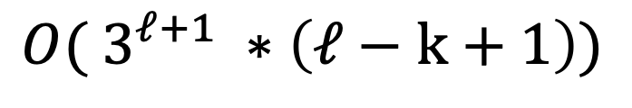
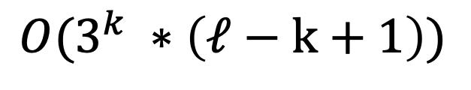
Time Complexity Evaluation
Original:
$$O( 3^{ℓ+1} ∗\left(ℓ−k+1\right))$$
Heuristic:
$$O(3^{k} ∗\left(ℓ−k+1\right))$$

Slide 21
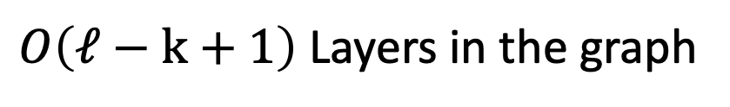
Original
HHH
+
HHE
+
…
+
HHE
HHH
+
HHE
+
…
+
HHE
HHH
+
HHE
+
…
+
HHE
*
*
*
HHH
+
HHE
+
+
HHE
$O\left(ℓ−k+1\right)$ Layers in the graph

Slide 22
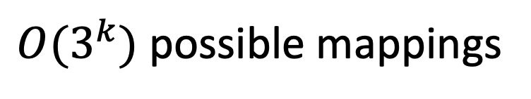
Original
HHH
+
HHE
+
…
+
HHE
$O(3^{k})$ possible mappings

Slide 23


Original
HHH
+
HHE
+
…
+
HHE
$$At most 3 out edges per node$$
E..C..C
E..C..C
E..C..C
HHH
+
HHE
+
…
+
HHE
C..CH
C..CC
C..CE
$k−1$ overlap

Slide 24
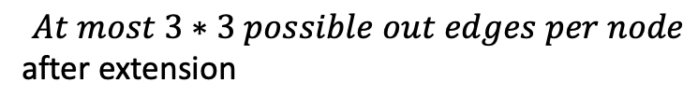
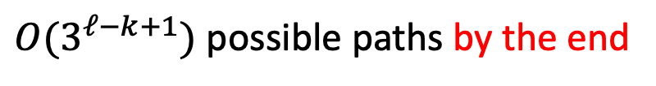
Original
HHH
+
HHE
+
…
+
HHE
$$At most 3 out edges per node$$
HHH
+
HHE
+
…
+
HHE
$$At most 3∗3 possible out edges per node$$
after extension
HHH
+
HHE
+
…
+
HHE
*
*
*
*
*
*
HHH
+
HHE
+
+
HHE
$O(3^{ℓ−k+1})$ possible paths by the end
(upper bound)

Slide 25
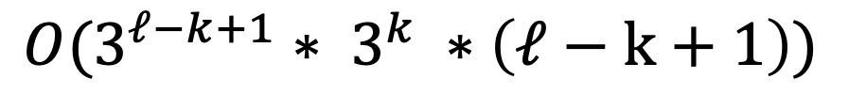

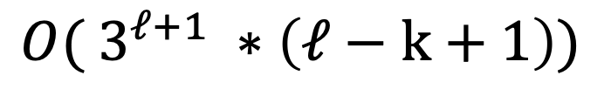
Original
HHH
+
HHE
+
…
+
HHE
HHH
+
HHE
+
…
+
HHE
$$O(3^{ℓ−k+1}∗ 3^{k} ∗\left(ℓ−k+1\right))$$
HHH
+
HHE
+
…
+
HHE
$$O( 3^{ℓ+1} ∗\left(ℓ−k+1\right))$$
*
*
*
HHH
+
HHE
+
+
HHE
$O\left(ℓ−k+1\right)$ Layers in the graph

Slide 26
Heuristic
HHH
+
HHE
+
…
+
HHE
Heuristic:
Limit the number of extended
sequences kept after each iteration
through layers. Only take the top
X probable extended sequences.
HHH
+
HHE
+
…
+
HHE
HHH
+
HHE
+
…
+
HHE
*
*
*
HHH
+
HHE
+
+
HHE

Slide 27
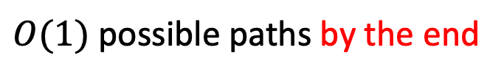
Heuristic
HHH
+
HHE
+
…
+
HHE
$$At most 3 out edges per node$$
HHH
+
HHE
+
…
+
HHE
$$At most 3∗3 possible out edges per node$$
after extension
HHH
+
HHE
+
…
+
HHE
*
*
*
*
*
*
HHH
+
HHE
+
+
HHE
$O(1)$ possible paths by the end
Since paths are limited as we
are extending

Slide 28
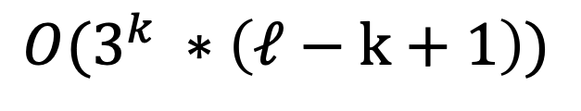
Heuristic
HHH
+
HHE
+
…
+
HHE
HHH
+
HHE
+
…
+
HHE
Heuristic:
$$O(3^{k} ∗\left(ℓ−k+1\right))$$
HHH
+
HHE
+
…
+
HHE
*
*
*
HHH
+
HHE
+
+
HHE
$O\left(ℓ−k+1\right)$ Layers in the graph

Slide 29
Poster Presentation

Slide 30
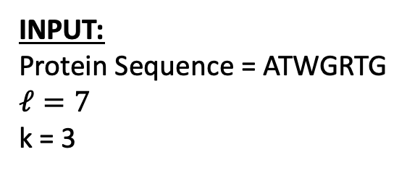

INPUT:
Protein Sequence = ATWGRTG $$ℓ=7$$
k = 3
DebruijnExtend
OUTPUT (most probable):
CCEEEEE
Prob: 0.1215
Dreycey Albin, Angela Folz
$$TC: O( 3^{ℓ+1} ∗\left(ℓ−k+1\right))$$
Example of using software (CMD line)
STEP 1 – K-mer Mapping
Look up the corresponding set of secondary structures for each k-mer using the precomputed hash table.
python DebruijnExtend.py gfp.fasta 4 gfp.ss3
CCCCCCCCCCCEEEEEEEEEEECCEEEEEEEEEEEECCCCEEEEEEEECCCCCCCCHHHHCCCCCCHHHC
-log(P)=231.1
STEP 0 – Hash Table (Training)
For each k-mer in a training database, find every possible secondary structure and its probability.
STEP 2 – Stitch-Extend
Use BFS to traverse the Debruijn graph to find the highest weighted path. This is implemented using a dynamic programming method where the subproblem is matching the contracted nodes to the nodes of the next layer.
1
2
3
4
5

