Slide 1
1
ATW
CCE, 0.3
ECC, 0.2
HHH, 0.5
2
TWG
CEE, 0.9
CCH, 0.1
3
ATWGRTG
WGR
EEE, 0.9
CCE, 0.1
4
GRT
EEE, 1
5
RTG
EEE, 0.5
EEC, 0.4
CCC, 0.1
seq = ATWGRTG
K = 3
1
ATW
CCE, 0.3
ECC, 0.2
HHH, 0.5
2
TWG
CEE, 0.9
CCH, 0.1
3
ATWGRTG
WGR
EEE, 0.9
CCE, 0.1
4
GRT
EEE, 1
5
RTG
EEE, 0.5
EEC, 0.4
CCC, 0.1
Length(sequence) - (k-1) = # layers
7 - (3-1) = 5

Slide 2
seq = ATWGRTG
K = 3
0.3
0.2
0.5
CCE
ECC
HHH
1
0.9
0.1
ATW
CCE, 0.3
ECC, 0.2
HHH, 0.5
CEE
CCH
2
TWG
CEE, 0.9
CCH, 0.1
0.1
0.9
3
CHE
EEE
WGR
CHE, 0.1
EEE, 0.9
4
GRT
EEE, 1
1
EEE
5
RTG
EEE, 0.5
EEC, 0.4
CCC, 0.1
0.5
0.4
0.1
EEE
EEC
CCC

Slide 3
seq = ATWGRTG
K = 3
0.3
0.2
0.5
CCE
ECC
HHH
stitchextend_dict
0.9
0.1
CEE
CCH
Layer 1, Layer 2

Slide 4
seq = ATWGRTG
K = 3
0.3
0.2
0.5
CCE
ECC
HHH
stitchextend_dict
0.9
0.1
CEE
CCH
CCE
ECC
CEE
CCH
Layer 1, Layer 2

Slide 5
seq = ATWGRTG
K = 3
0.3
0.2
0.5
CCE
ECC
HHH
stitchextend_dict
0.3*0.9
0.2*0.1
CCEE
0.3*0.9
CCEE
ECCH
ECCH
0.2*0.1
CCE
ECC
CEE
CCH
Edge Contraction
Layer 1, Layer 2

Slide 6
seq = ATWGRTG
K = 3
stitchextend_dict
0.3*0.9
0.2*0.1
CCEE
0.3*0.9
CCEE
ECCH
ECCH
0.2*0.1
0.1
0.9
CHE
EEE
Layer 2, Layer 3

Slide 7
seq = ATWGRTG
K = 3
stitchextend_dict
0.3*0.9
0.2*0.1
CCEE
0.3*0.9
CCEE
ECCH
ECCH
0.2*0.1
0.1
0.9
CHE
EEE
CCEE
ECCH
EEE
CHE
Layer 2, Layer 3

Slide 8
seq = ATWGRTG
K = 3
stitchextend_dict
0.3*0.9
0.2*0.1
CCEE
0.3*0.9
Del
CCEE
ECCH
ECCH
0.2*0.1
Del
0.2*0.1*0.1
0.3*0.9*0.9
ECCHE
CCEEE
ECCHE
0.2*0.1*0.1
Add
CCEEE
0.3*0.9*0.9
CCEE
ECCH
Add
EEE
CHE
Edge Contraction
Layer 2, Layer 3

Slide 9
seq = ATWGRTG
K = 3
stitchextend_dict
0.3*0.9
0.2*0.1
ECCHE
0.2*0.1*0.1
CCEE
ECCH
CCEEE
0.3*0.9*0.9
0.2*0.1*0.1
0.3*0.9*0.9
ECCHE
CCEEE
Edge Contraction
Layer 2, Layer 3

Slide 10
seq = ATWGRTG
K = 3
stitchextend_dict
ECCHE
0.2*0.1*0.1
CCEEE
0.3*0.9*0.9
0.2*0.1*0.1
0.3*0.9*0.9
ECCHE
CCEEE
0.3*0.9*0.9*1
CCEEEE
0.3*0.9*0.9*1*0.5
0.3*0.9*0.9*1*0.4
CCEEEEE
CCEEEEC
Edge Contraction
Layer 2, Layer 3
0.3*0.9*0.9*1*0.5
CCEEEEE

Slide 11
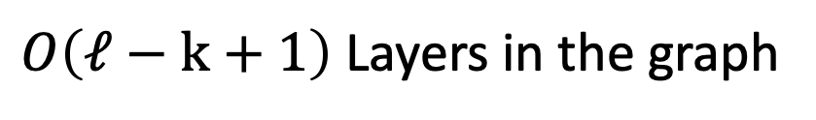
HHH
+
HHE
+
…
+
HHE
HHH
+
HHE
+
…
+
HHE
HHH
+
HHE
+
…
+
HHE
*
*
*
HHH
+
HHE
+
+
HHE
$O\left(ℓ−k+1\right)$ Layers in the graph

Slide 12
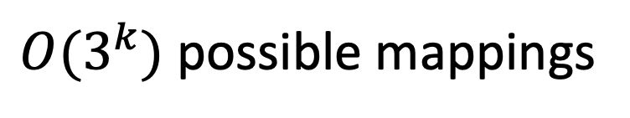
HHH
+
HHE
+
…
+
HHE
$O(3^{k})$ possible mappings

Slide 13


HHH
+
HHE
+
…
+
HHE
$$At most 3 out edges per node$$
E..C..C
E..C..C
E..C..C
HHH
+
HHE
+
…
+
HHE
C..CH
C..CC
C..CE
$k−1$ overlap

Slide 14
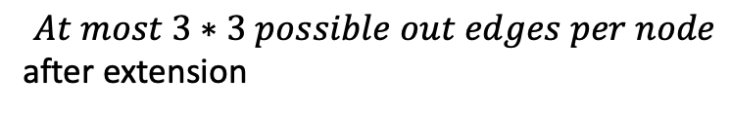
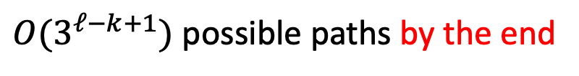
HHH
+
HHE
+
…
+
HHE
$$At most 3 out edges per node$$
HHH
+
HHE
+
…
+
HHE
$$At most 3∗3 possible out edges per node$$
after extension
HHH
+
HHE
+
…
+
HHE
*
*
*
*
*
*
HHH
+
HHE
+
+
HHE
$O(3^{ℓ−k+1})$ possible paths by the end
(upper bound)

Slide 15
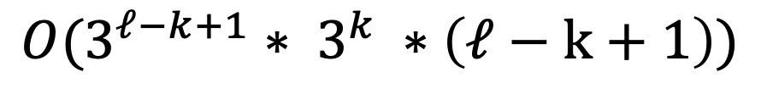

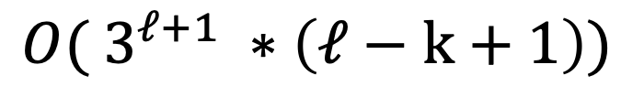
HHH
+
HHE
+
…
+
HHE
HHH
+
HHE
+
…
+
HHE
$$O(3^{ℓ−k+1}∗ 3^{k} ∗\left(ℓ−k+1\right))$$
HHH
+
HHE
+
…
+
HHE
$$O( 3^{ℓ+1} ∗\left(ℓ−k+1\right))$$
*
*
*
HHH
+
HHE
+
+
HHE
$O\left(ℓ−k+1\right)$ Layers in the graph

Slide 16
HHH
+
HHE
+
…
+
HHE
Heuristic:
Limit the number of extended
sequences kept after each iteration
through layers. Only take the top
X probable extended sequences.
HHH
+
HHE
+
…
+
HHE
HHH
+
HHE
+
…
+
HHE
*
*
*
HHH
+
HHE
+
+
HHE

Slide 17
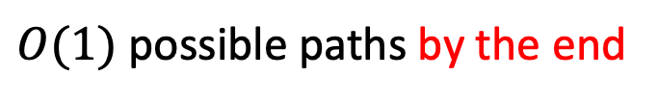
HHH
+
HHE
+
…
+
HHE
$$At most 3 out edges per node$$
HHH
+
HHE
+
…
+
HHE
$$At most 3∗3 possible out edges per node$$
after extension
HHH
+
HHE
+
…
+
HHE
*
*
*
*
*
*
HHH
+
HHE
+
+
HHE
$O(1)$ possible paths by the end
Since paths are limited as we
are extending

Slide 18
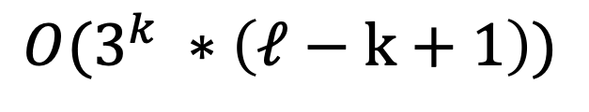
RTG
EEE, 0.5
EEC, 0.4
CCC, 0.1
ATW
CCE, 0.3
ECC, 0.2
HHH, 0.5
GRT
EEE, 1
TWG
CEE, 0.9
CCH, 0.1
WGR
CHE, 0.1
EEE, 0.9
HHH
+
HHE
+
…
+
HHE
HHH
+
HHE
+
…
+
HHE
Heuristic:
$$O(3^{k} ∗\left(ℓ−k+1\right))$$
HHH
+
HHE
+
…
+
HHE
*
*
*
HHH
+
HHE
+
+
HHE
$O\left(ℓ−k+1\right)$ Layers in the graph

Slide 19
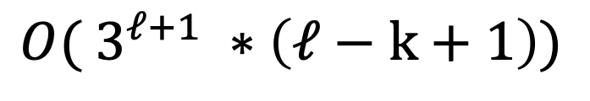
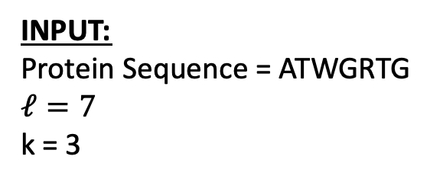
INPUT:
Protein Sequence = ATWGRTG $$ℓ=7$$
k = 3
DebruijnExtend
Output (most probable):
$$O( 3^{ℓ+1} ∗\left(ℓ−k+1\right))$$
CCEEEEE
Prob: 0.1215

Slide 20
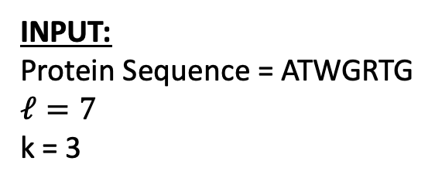

INPUT:
Protein Sequence = ATWGRTG $$ℓ=7$$
k = 3
DebruijnExtend
OUTPUT (most probable):
CCEEEEE
Prob: 0.1215
Dreycey Albin, Angela Folz
$$TC: O( 3^{ℓ+1} ∗\left(ℓ−k+1\right))$$
Example of using software (CMD line)
STEP 1 – K-mer Mapping
Look up the corresponding set of secondary structures for each k-mer using the precomputed hash table.
python DebruijnExtend.py gfp.fasta 4 gfp.ss3
CCCCCCCCCCCEEEEEEEEEEECCEEEEEEEEEEEECCCCEEEEEEEECCCCCCCCHHHHCCCCCCHHHC
-log(P)=231.1
STEP 0 – Hash Table (Training)
For each k-mer in a training database, find every possible secondary structure and its probability.
STEP 2 – Stitch-Extend
Use BFS to traverse the Debruijn graph to find the highest weighted path. This is implemented using a dynamic programming method where the subproblem is matching the contracted nodes to the nodes of the next layer.
1
2
3
4
5

