Slide 1
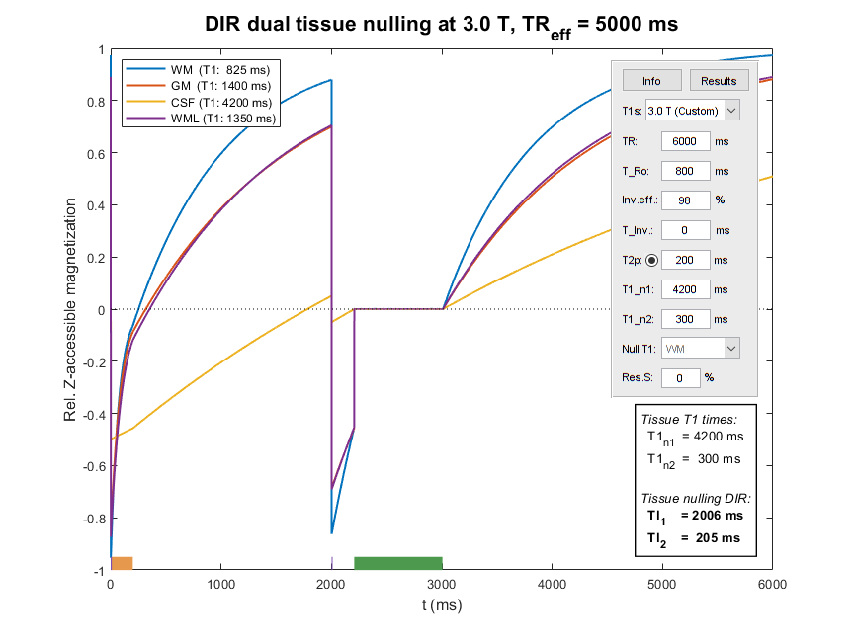
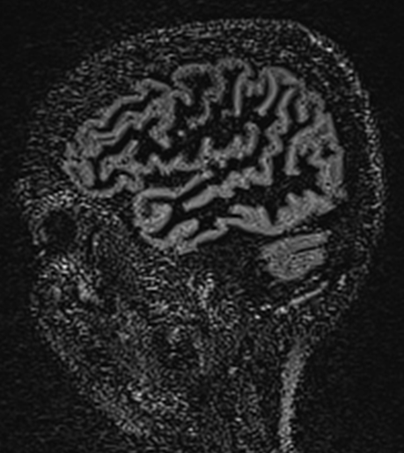
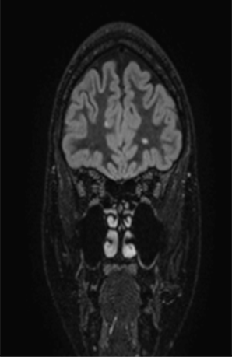

MR Inversion Recovery Simulation
and Scanning of Subjects with Focus on
White Matter Lesion Contrast Optimization
Øystein Bech Gadmar & Wibeke Nordhøy
ISMRM 2021 (MS: White Matter & Other Structures), #2807

Slide 2

Declaration of
Financial Interests or Relationships
Speaker Name: Øystein Bech Gadmar
I have no financial interests or relationships to disclose
with regard to the subject matter of this presentation.

Slide 3
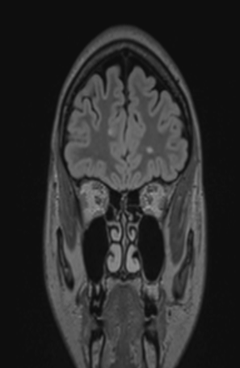
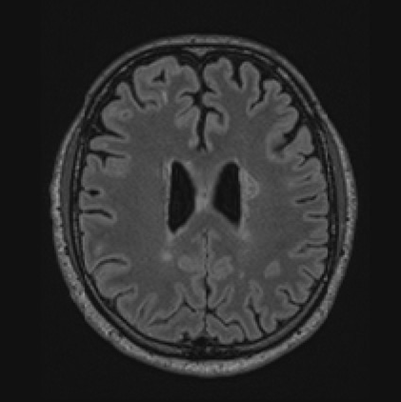
3D Fluid Attenuated Inversion Recovery
3D T2-weighted readout (SPACE/CUBE/VIEW)
T1 weighting from IR counteracts desired T2 contrast
C = S_{WML} – S_{WM} primarily. End point: CNR/t ∝ C/sqrt(TR).

Slide 4
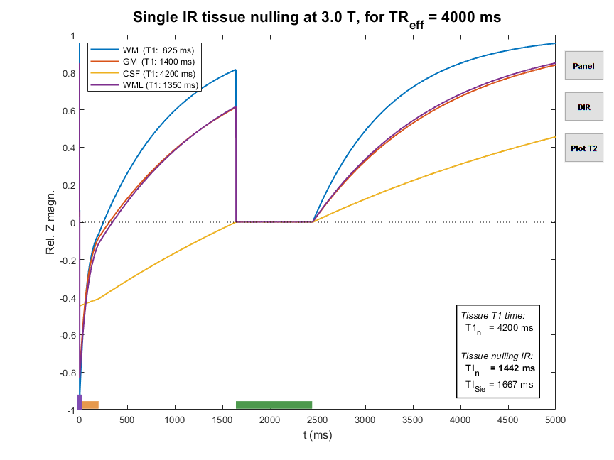
FLAIR Calculation w/ inv.eff. & T2P
M₀
M₁
M_{TI}
TI
TR_{eff} – TI
-αM₁
TR_{eff} = TR – T_{Ro} – T2P

Slide 5
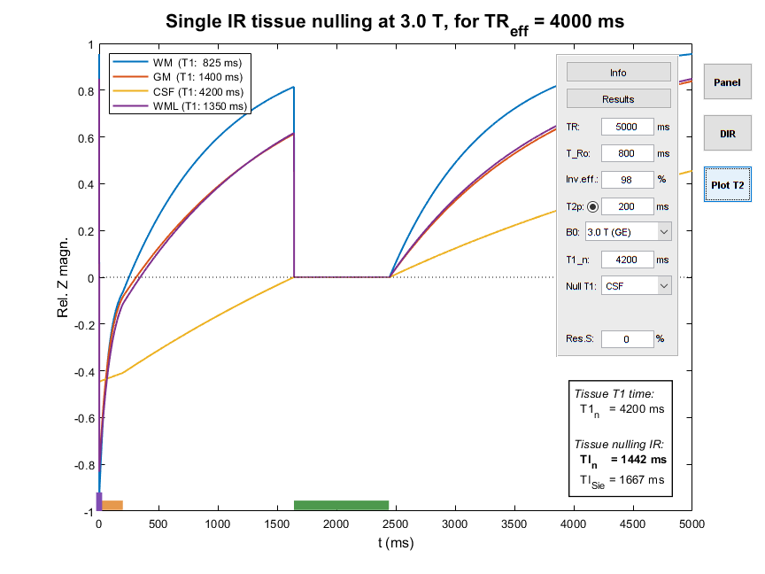
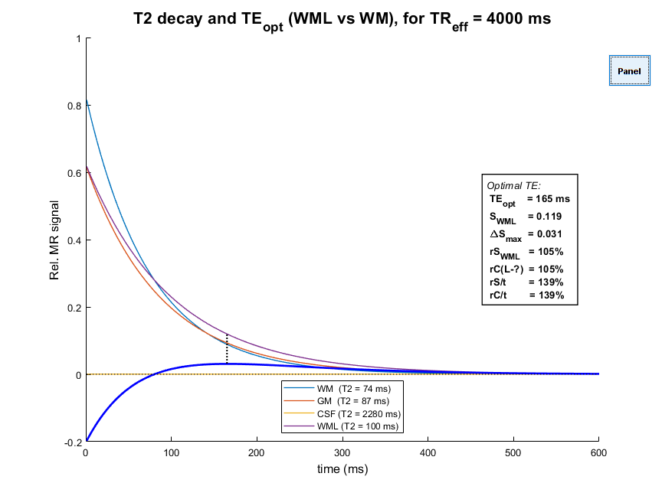
Vendor 3D FLAIR w/ T2 Prep.

Slide 6
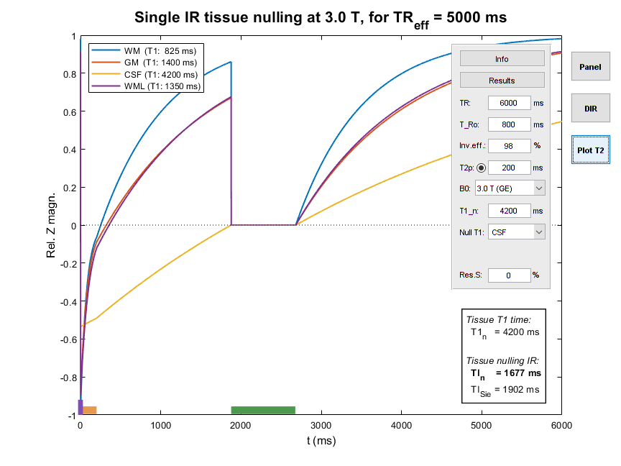
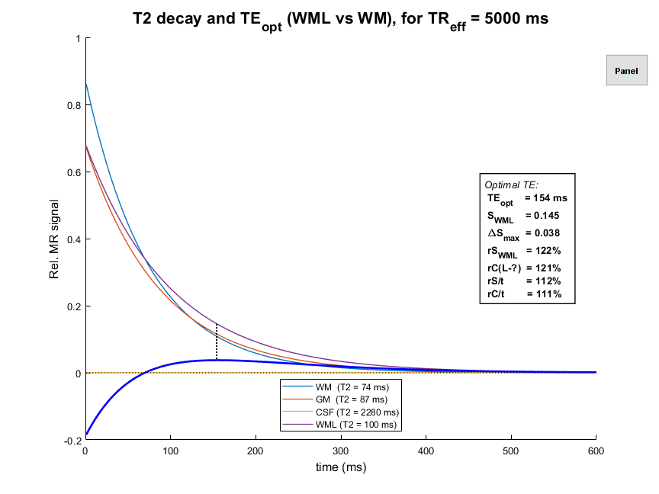
Optimized 3D FLAIR – vendor TR +1 s

Slide 7
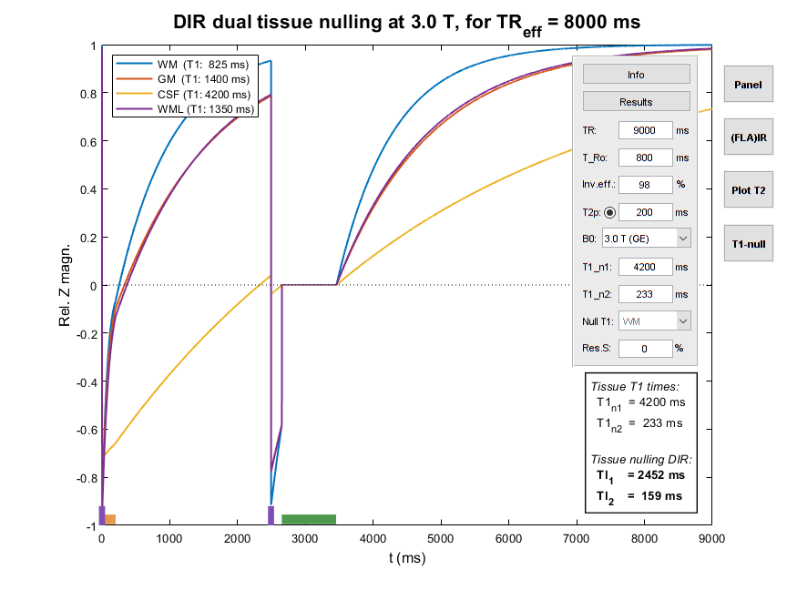
Dual IR Calculation
M₀
M₁
TI₁ – TI₂
TI₁
M₂
-αM₂
-βM₁

Slide 8
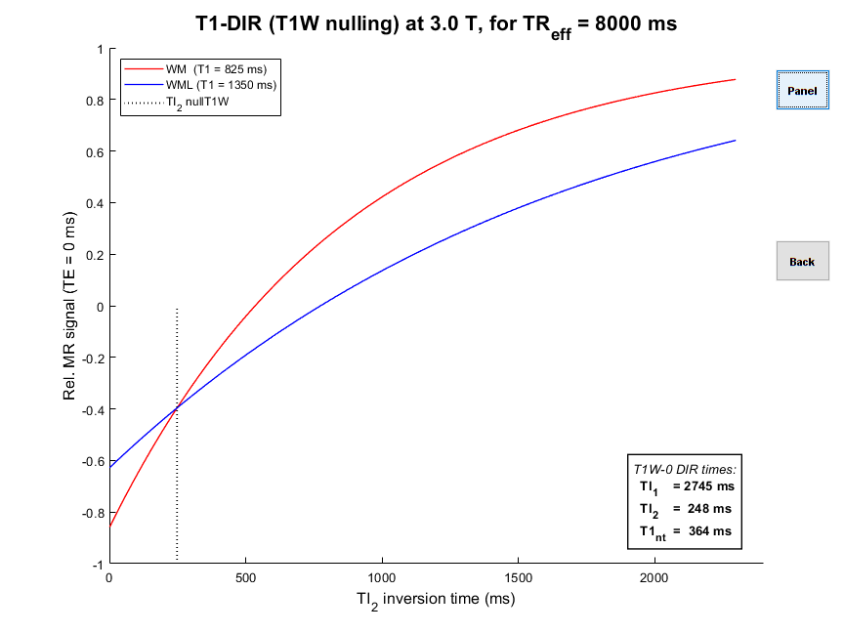
True-T2 DIR Simulation
Find the TI₁/TI₂ pair that null the difference between the DIR signals of WM and WML
Numeric solution necessary
Optimal T2 decay will be free of T1 effects
[Madhuranthakam et al, Mag Res Med 2012 67(1):81-88]

Slide 9
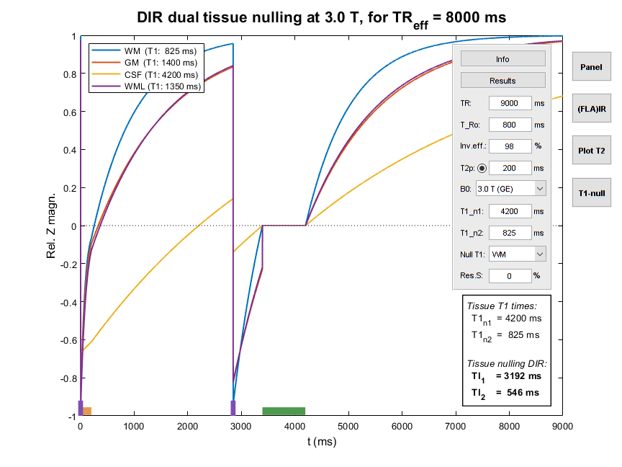
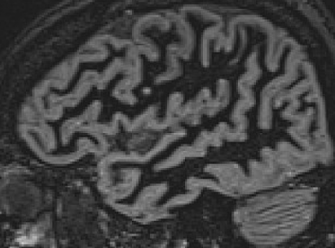
Standard DIR: Nulling SWM – at a price!
Poor SNR!
T2Prep?
(Ineffective)
(Availability?)
Longer TR
(Inefficient)
Shorter TE
(Contrast loss)
Longer readout
(Blurring/res.)
1.5 T DIR, diff. TE

Slide 10
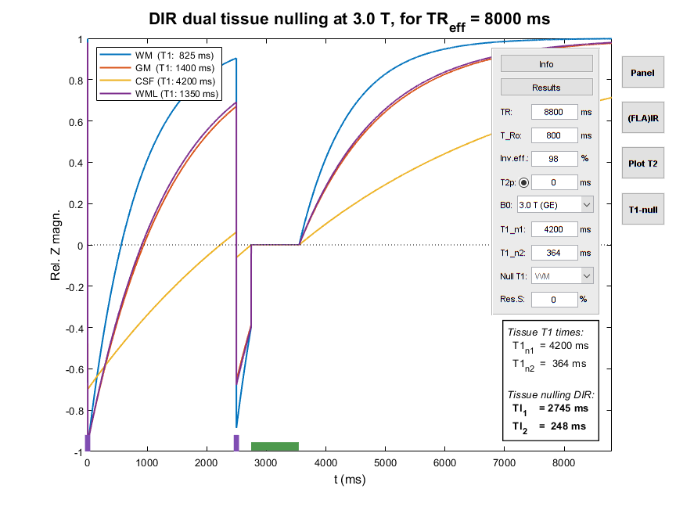
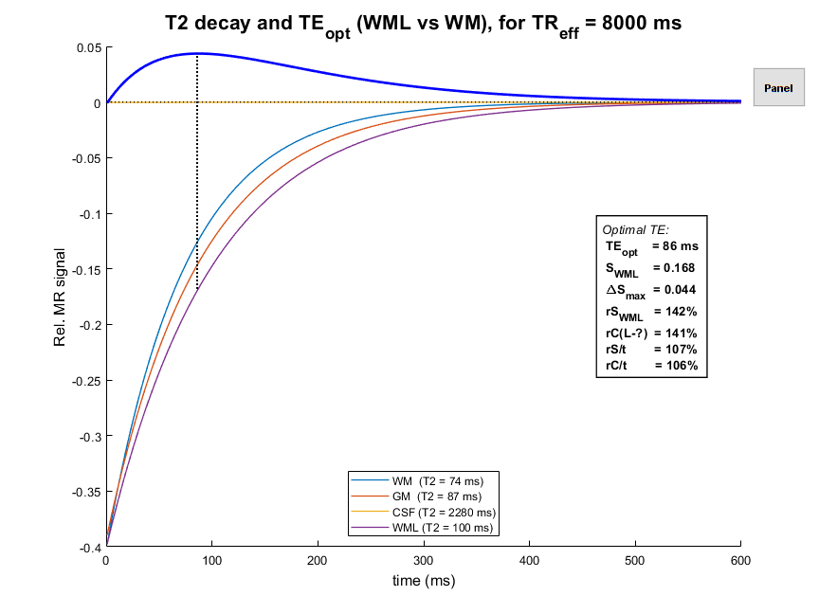
TrueT2-DIR – T1 contrast nulled
[Madhuranthakam et al, Mag Res Med 2012 67(1):81-88]

Slide 11
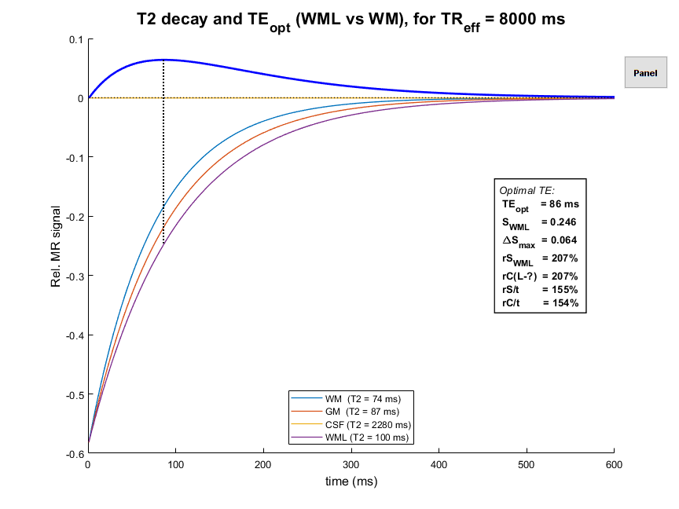
TrueT2-DIR w/ T2Prep

Slide 12
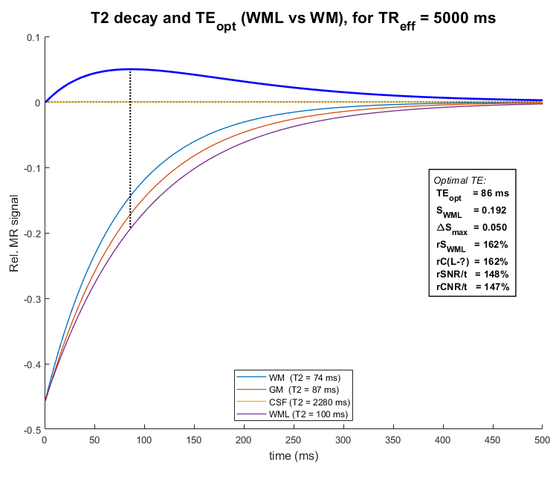
TrueT2-DIR w/ T2Prep & TR 6 s

Slide 13
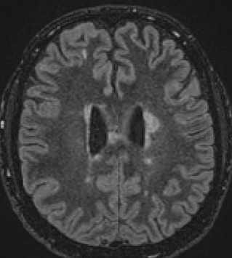


TrueT2-DIR vs FLAIR (1.5 T, 6:30 scan time)
TrueT2
FLAIR
Volunteer (age 50+)
MS patient
CNR/t at least as good as optimized FLAIR.
Better WML–GM CNR?! Preliminary analysis suggests so.
Acceleration more robust than for FLAIR.
Vendor specific DIR T2Prep availability. We hope this will be remedied!

Slide 14
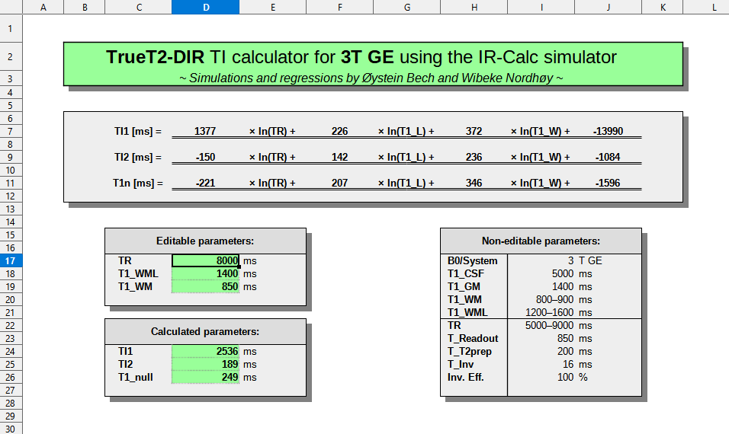
TrueT2-DIR on the scanner
Accessible spreadsheet tools, based on simulation regressions

Slide 15
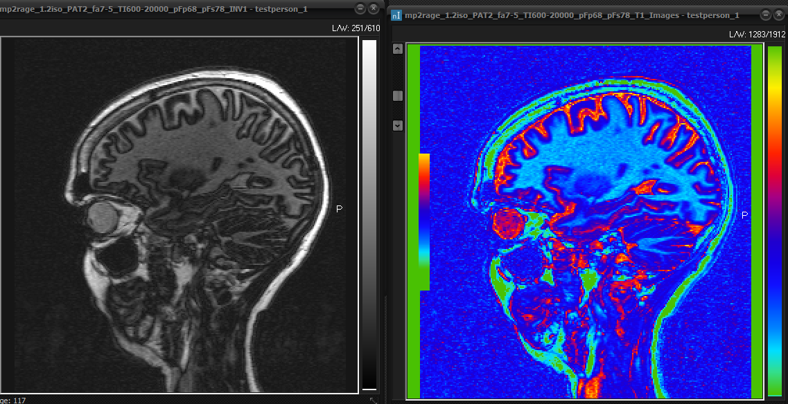
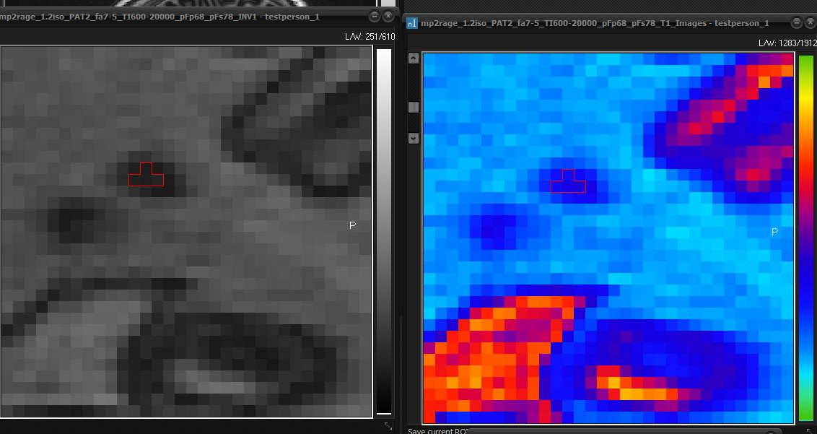
Measuring T1 for TrueT2-DIR
Measuring WM and WML T1 values w/ MP2RAGE MRI

Slide 16
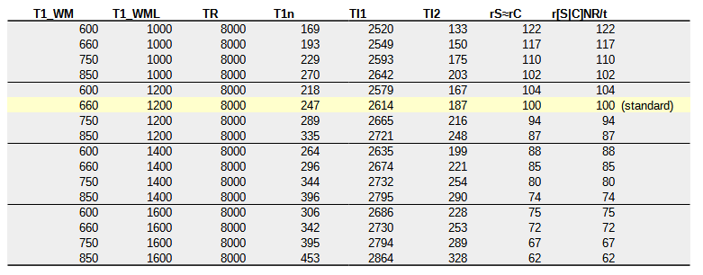
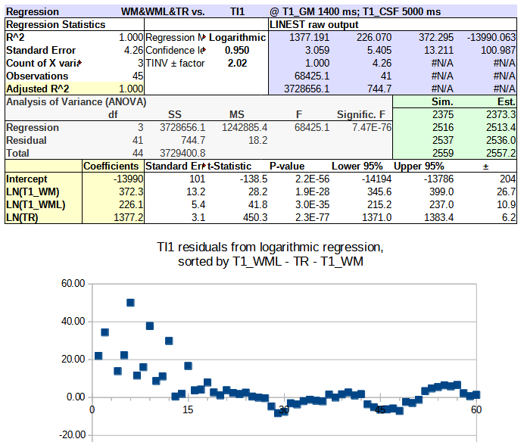
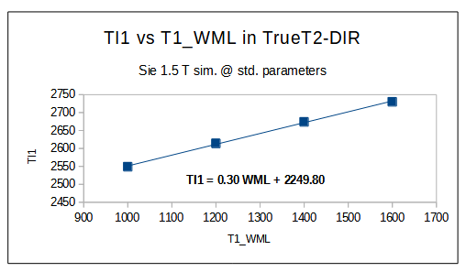
The difficulty of simplicity
Good regressions may be hard
to get right, but…
Their results are easy to use!

