Slide 1
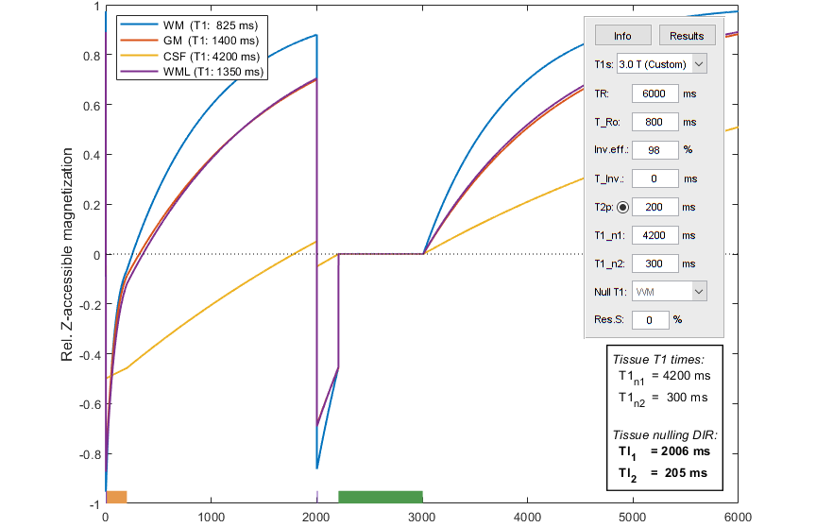
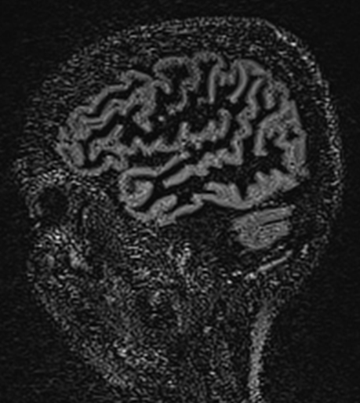
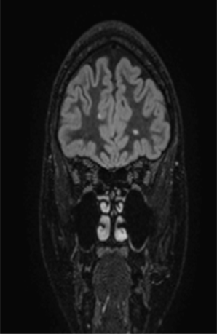

MR Inversion Recovery Calculation
Simulation and optimizing of
IR sequences using MatLab
Øystein B Gadmar & Wibeke Nordhøy

Slide 2
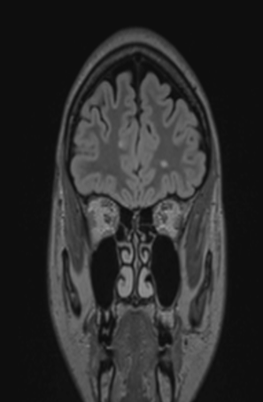
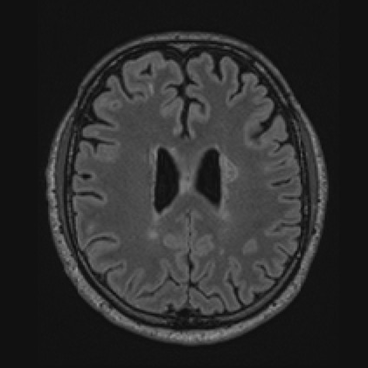
3D Fluid Attenuated Inversion Recovery
One IR pulse, then a TI delay before readout
3D T2-weighted readout (SPACE/CUBE/VIEW)
T1 weighting from IR counteracts the desired T2 contrast...

Slide 3
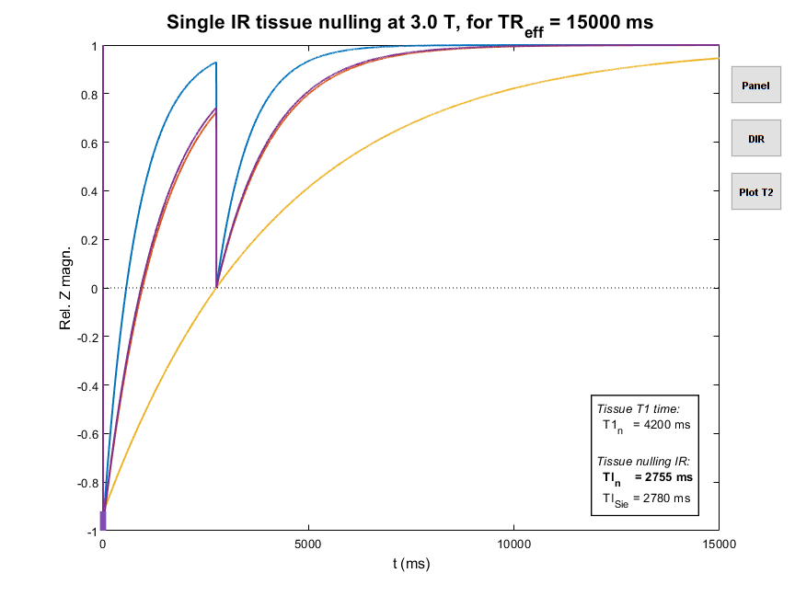
FLAIR – Fluid Attenuated Inv. Recovery
WM/GM
CSF
TI
Inv.

Slide 4

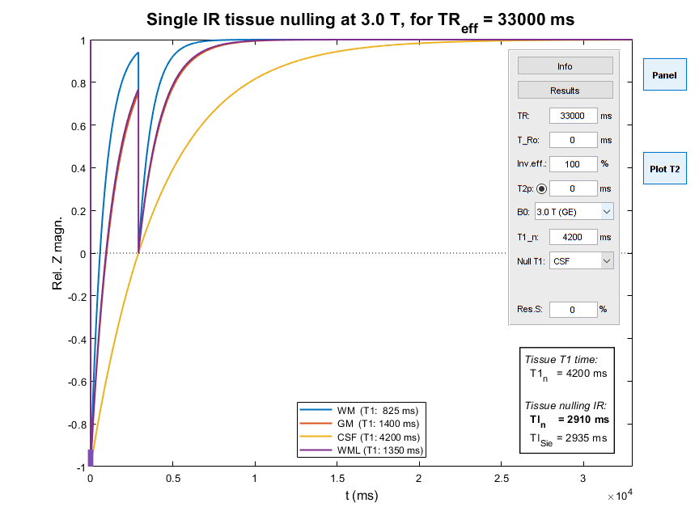
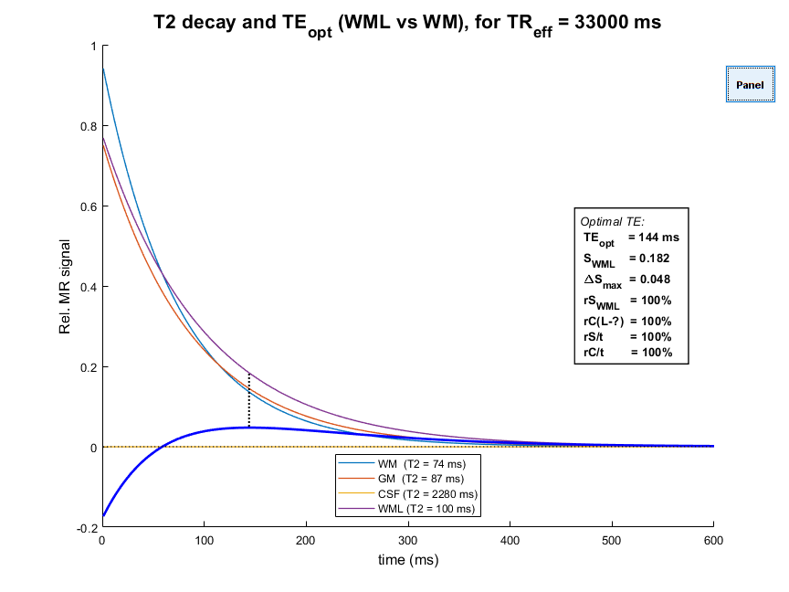
“Simple” FLAIR
4200 × ln(2) = 2911

Slide 5
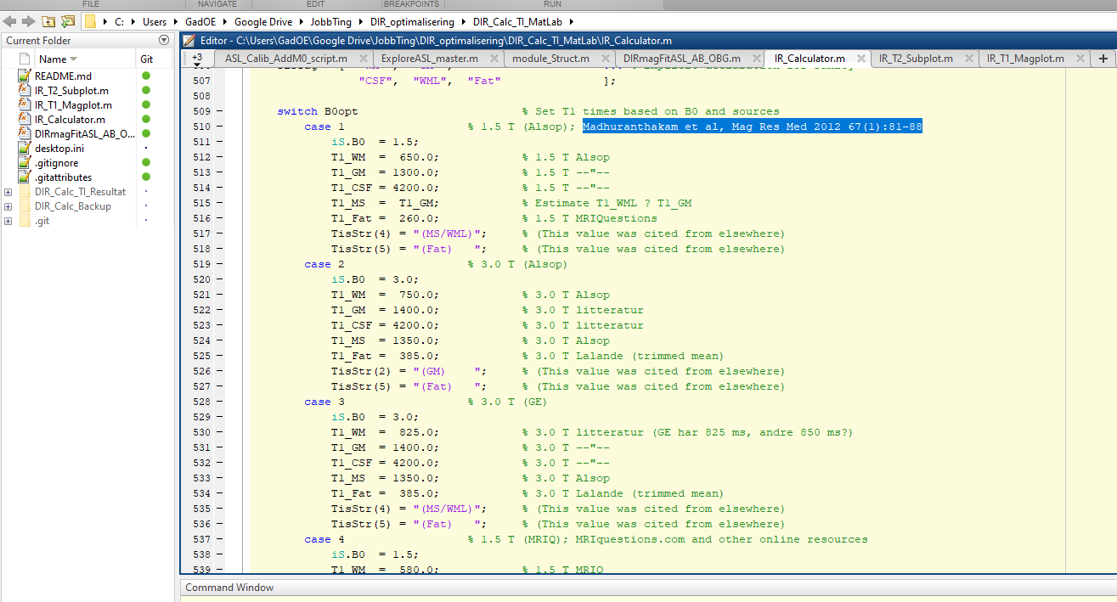
Our IR Calculator for MatLab
Git!

Slide 6
Notes On Noise
S = Signal strength at TE
C = Difference between S_{WML} and S_{WM} (usually)
N = Noise ∝ sqrt(t)
CNR = C/N ∝ t/sqrt(t) = sqrt(t)
Contrast efficiency: CNR/t ∝ C/sqrt(TR)
CNR/t – a good end point (but also look to SNR/t)

Slide 7
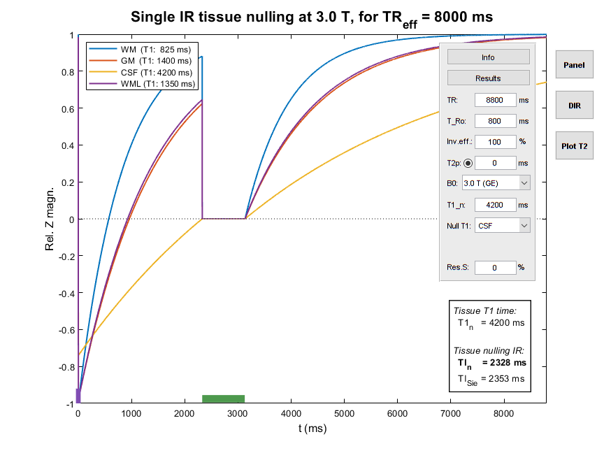
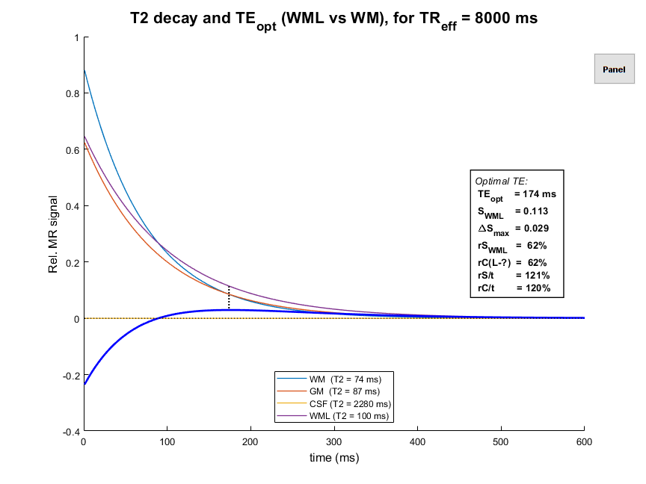
Realistic 3D FLAIR

Slide 8
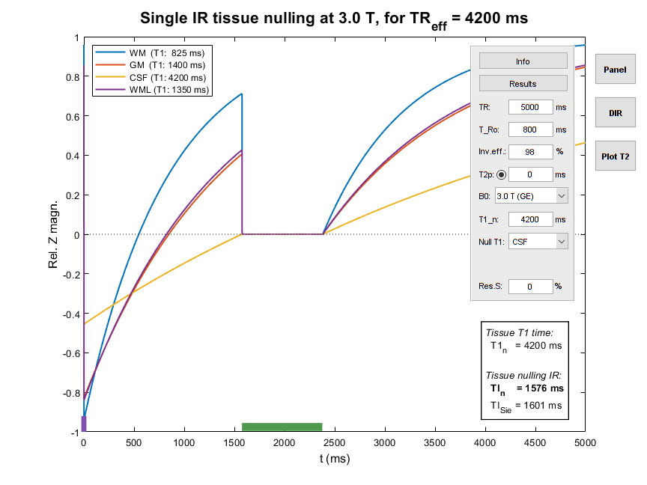
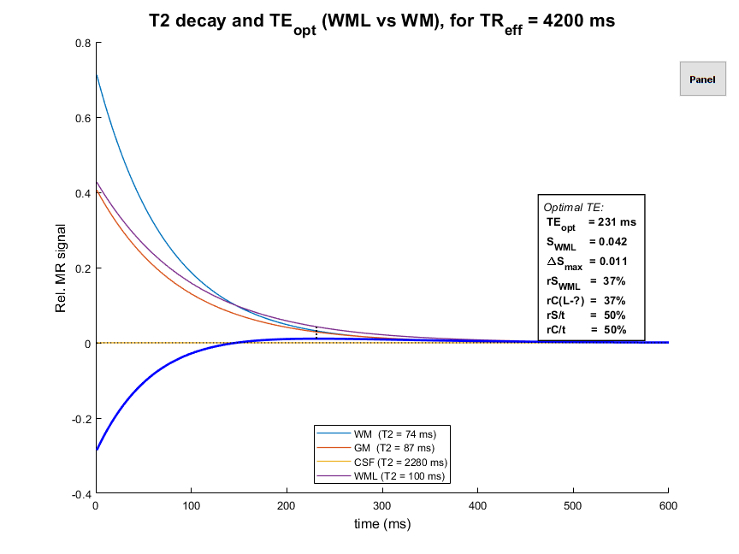
“Vendor” 3D FLAIR w/ short TR???

Slide 9
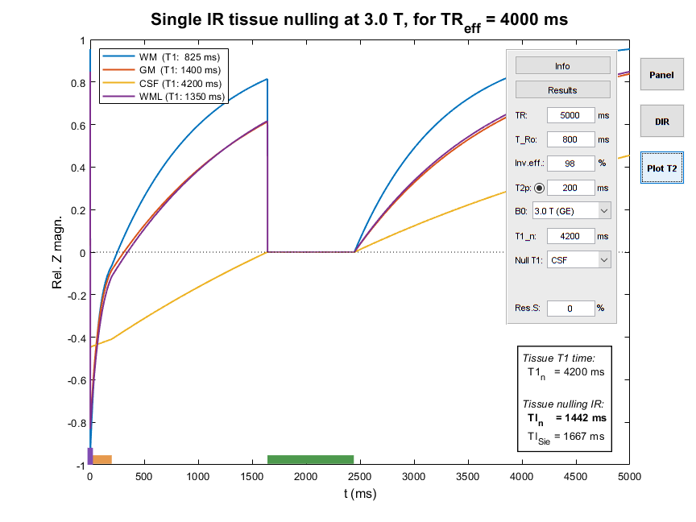
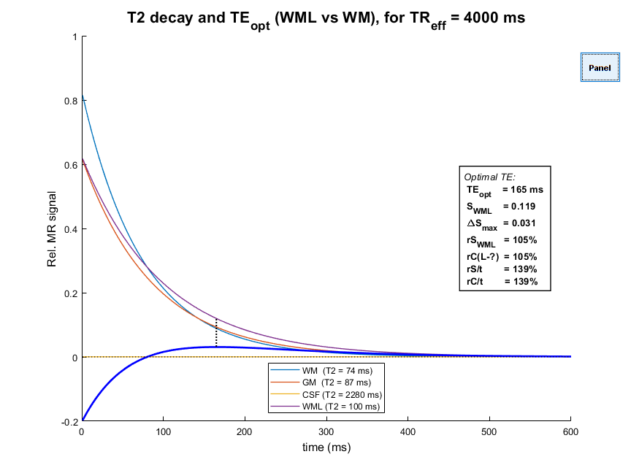
“Vendor” 3D FLAIR w/ T2 Prep.!
Std. for further
comparison

Slide 10
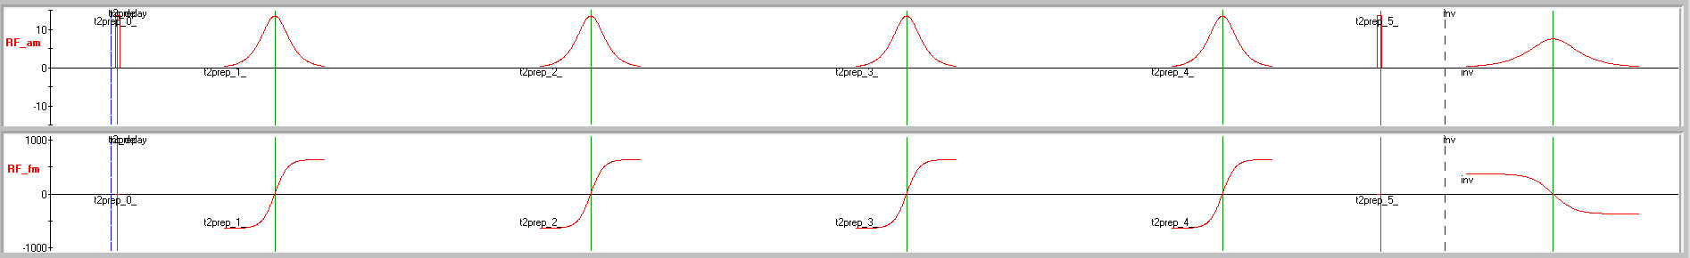
T2 prep. – How?
90°x – [ 180°y ]_{n} – -90°x to achieve spin lock
T2P and inversion are interchangeable
Pure T2 decay used for Mz preparation
CSF hardly affected (long T2), but tissues relax much

Slide 11
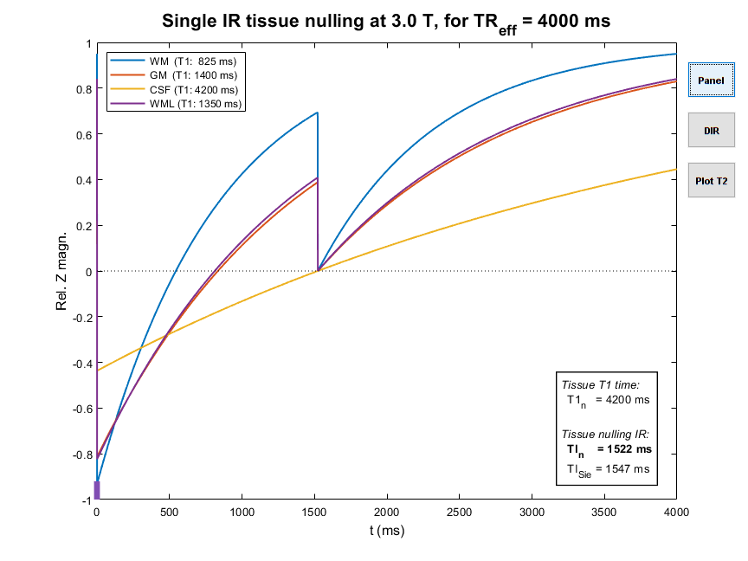

IR-Calc (0th: In Real Time)
M₀
M₁
M_{TI}
TI
TR – TI
-M₁

Slide 12
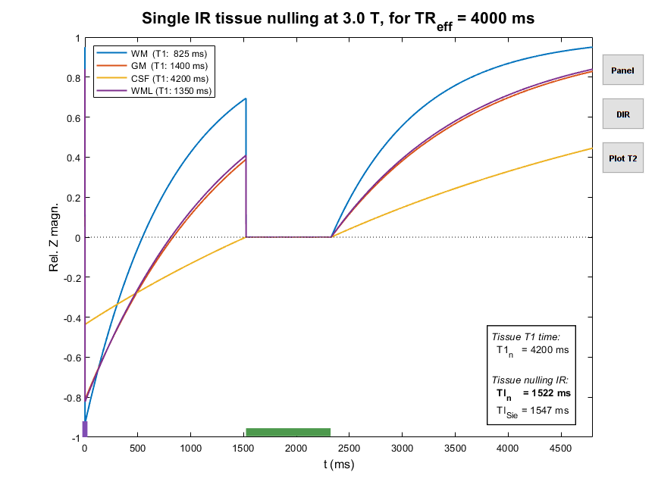
IR-Calc (1st: Effective TR)
M₀
M₁
M_{TI}
TI
TR_{eff} – TI
-M₁
TR_{eff} = TR – T_{Ro}

Slide 13


The efficiency of inversion efficiency?
~ 95% – 99%

Slide 14
IR-Calc (2nd: Inefficient Inversion)
M₀
M₁
T_{Ro}
M_{TI}
TI
TR_{eff} – TI
-αM₁

Slide 15
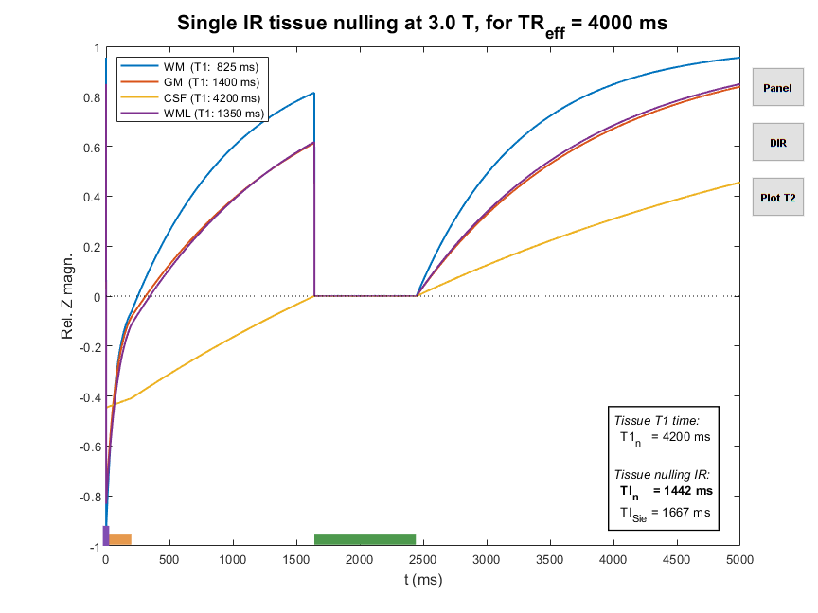
IR-Calc (3rd: Be T2 Prepared!)
M₀
T_{Ro}
!?
M₁
M_{TI}
TI
TR_{eff} – TI
-αM₁
TR_{eff} = TR – T_{Ro} – T2P

Slide 16
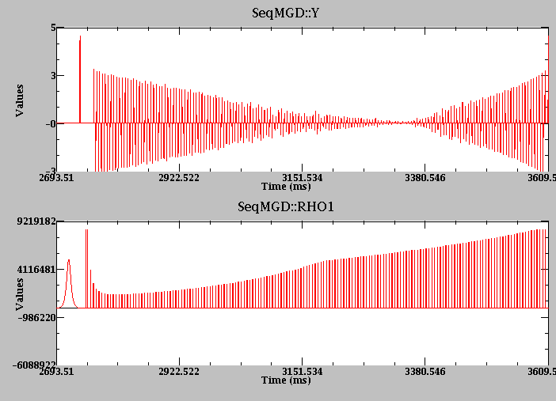
3D TSE readout – How?
Complex flip angle sweep to preserve magnetization
Complex profile ordering to avoid artefacts/blurring
TE_{eff} estimated; much shorter than zero crossing time!
Contrast mainly T2 – some T1?!
Mz probably used up over T_{Ro}?
We’re working to understand it…!

Slide 17
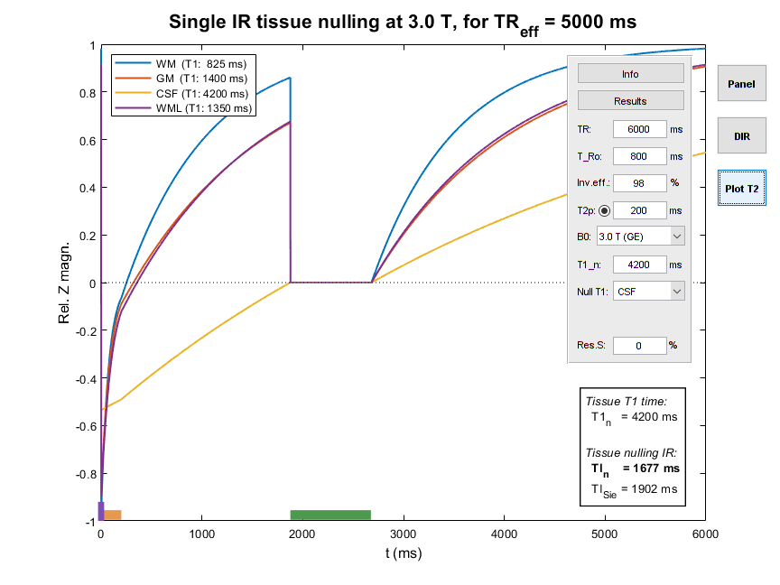
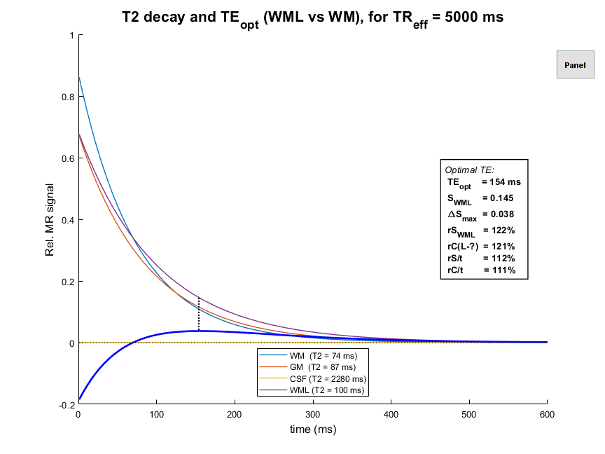
TR 6 s – “One up” on the vendor

Slide 18
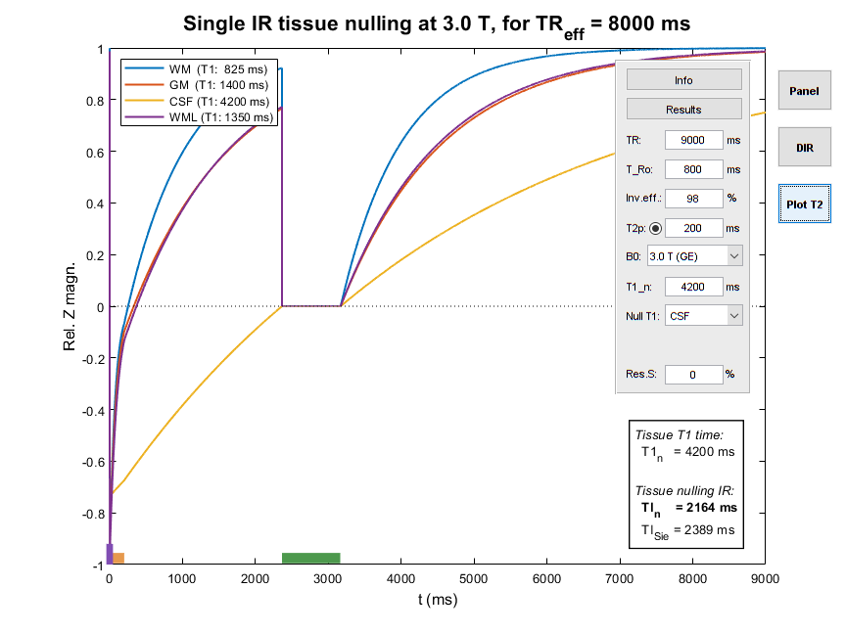
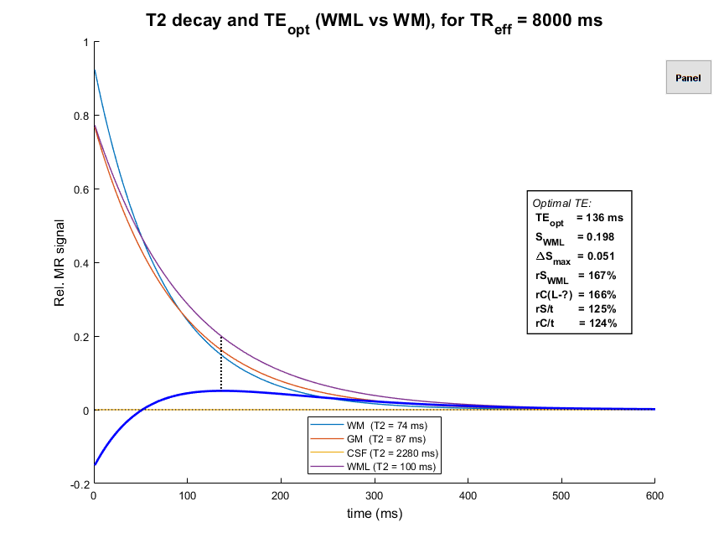
TR 9 s – FLAIR And Back Again?!
Acceleration?!

Slide 19
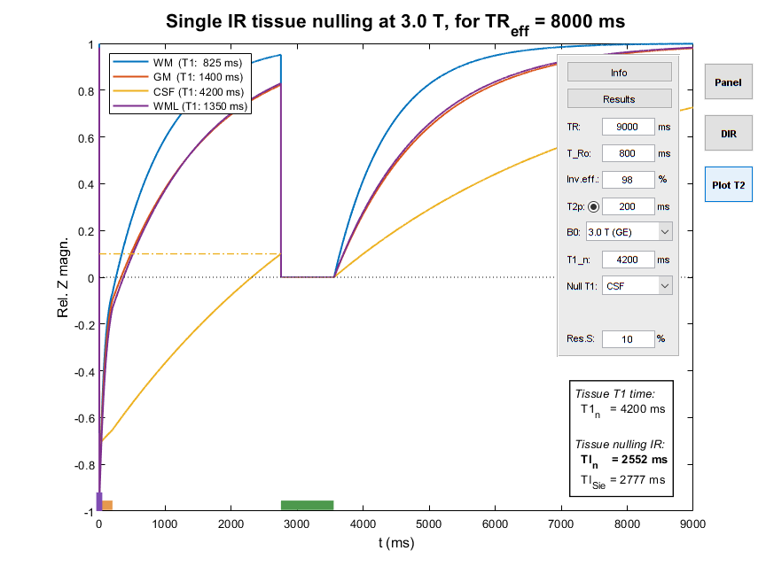
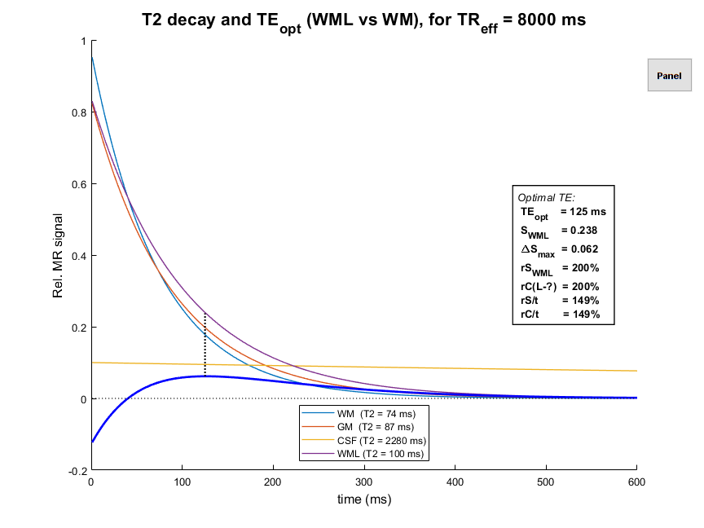
Fluid Attenuated IR … by how much?
“Images that computers like”
TE ↓ ?

Slide 20
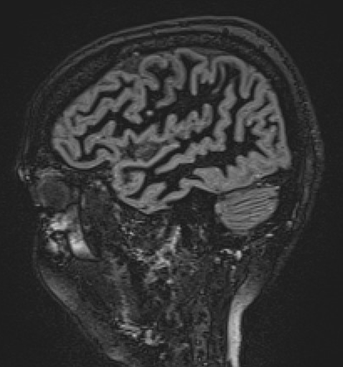
DIR-WM – A Pulse Too Far?
CNR/t bad. Better at low TE – at the cost of WML–GM CNR

Slide 21
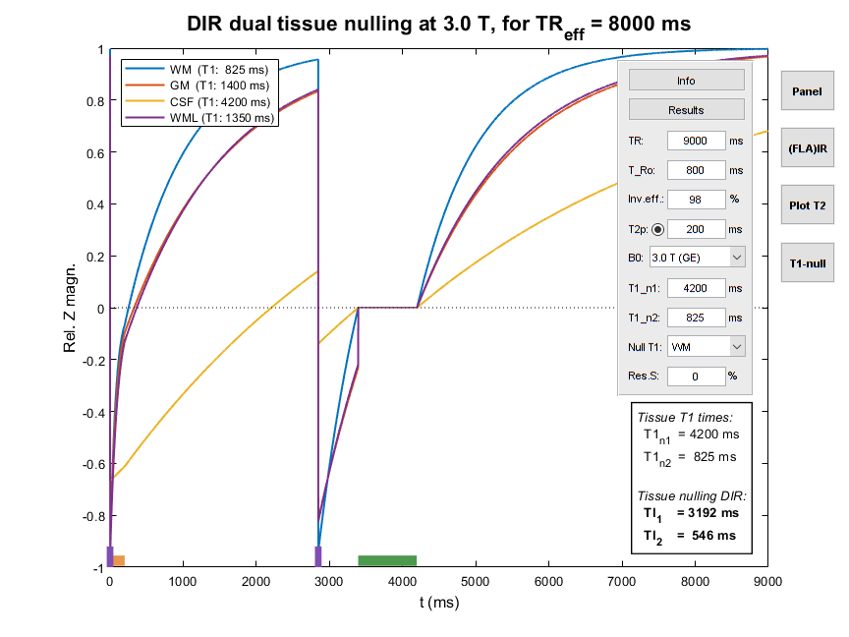
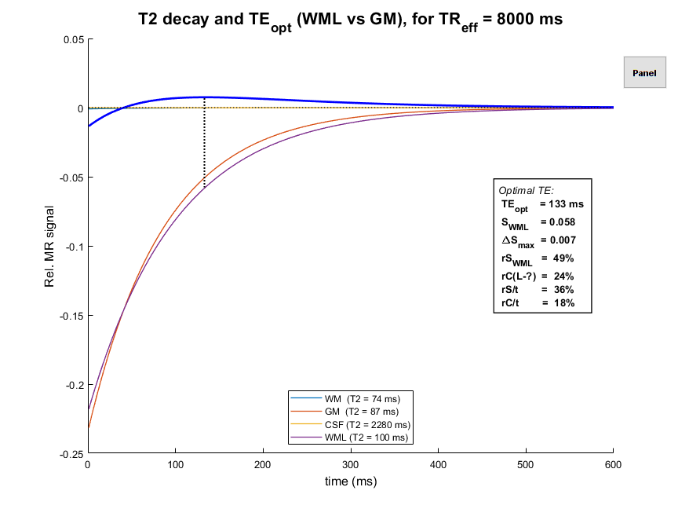
Dual IR: Two for the price of WM (and SNR)
TE ↓ !?
(& CNR)

Slide 22
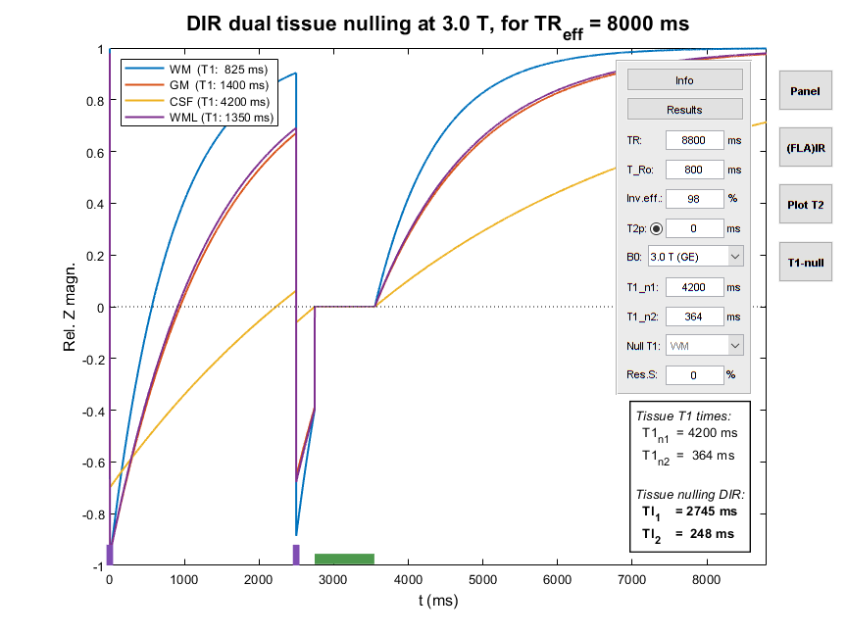
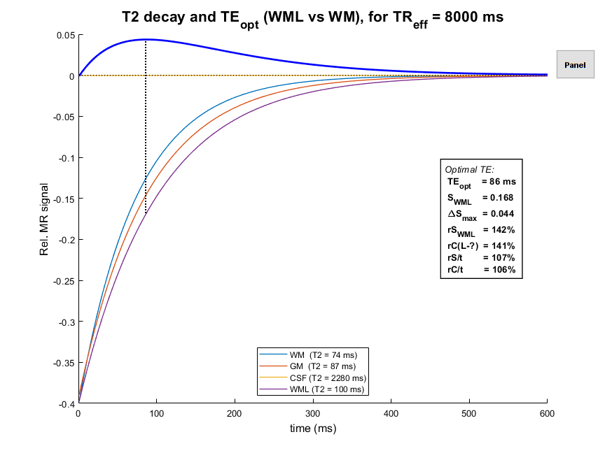

T1-nulled DIR – A New Hope

Slide 23
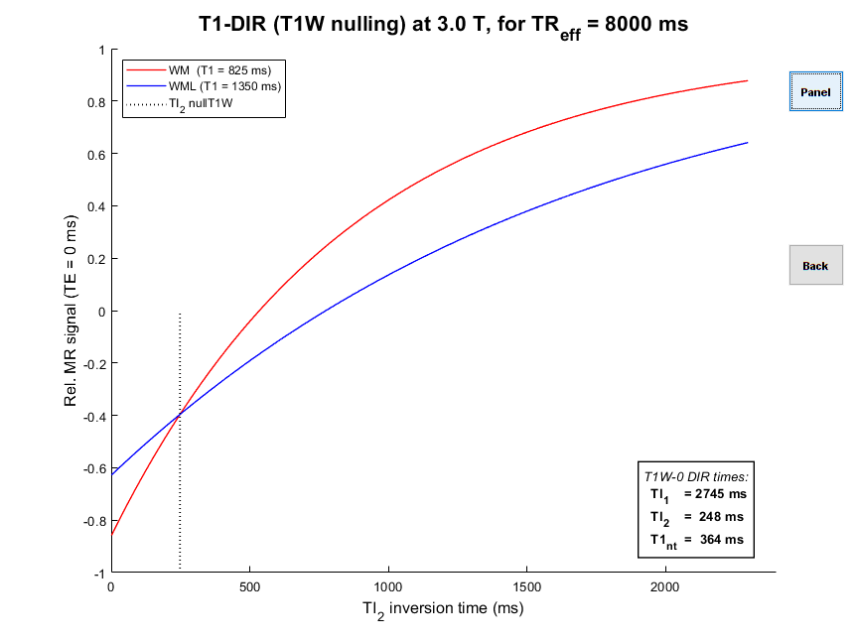
T1-nulled DIR – How?
Find the TI₁/TI₂ pair that null the difference between the DIR signal for T1 times of WM and WML
Find the T1 that is nulled at these TI₁/TI₂
WM will be brighter, but SNR/CNR better
Optimal TE will be free of T1 effects
[Madhuranthakam et al, Mag Res Med 2012 67(1):81-88]

Slide 24
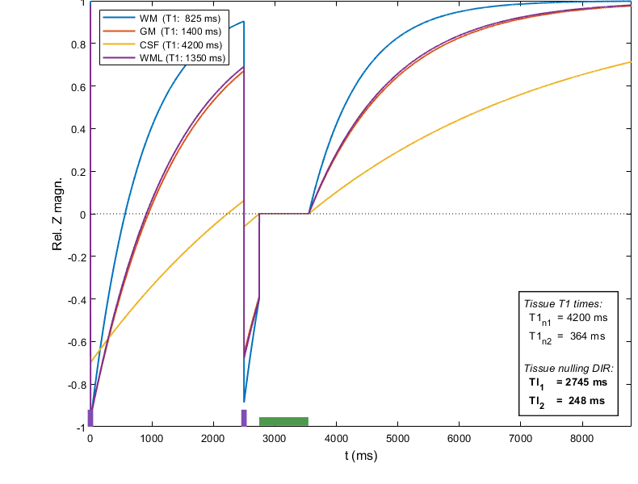
DIR-Calc (Inversion juggling)
M₀
M₁
TI₁ – TI₂
TI₁
M₂
-αM₂
-αM₁

Slide 25
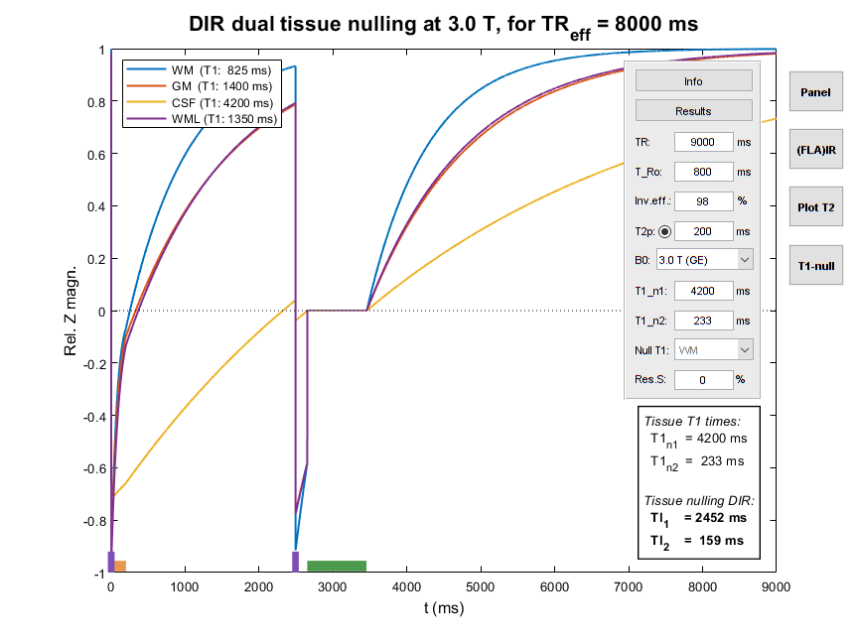
DIR-Calc (Oh My T2P... version)
M₀
M₁
TI₁ – TI₂
TI₁
M₂
-αM₂
-βM₁

Slide 26
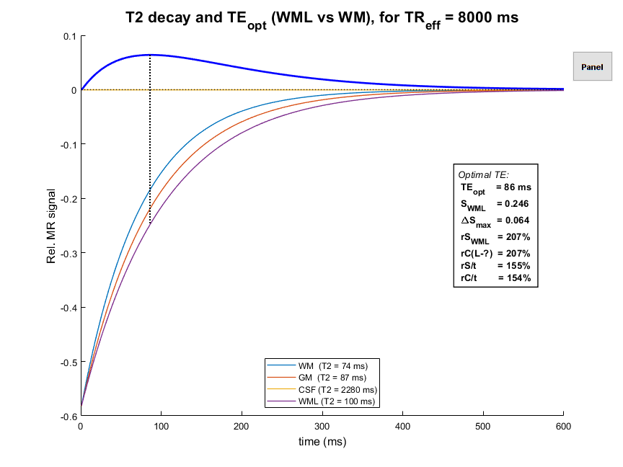
TrueT2-DIR – From Zero To Hero!

Slide 27
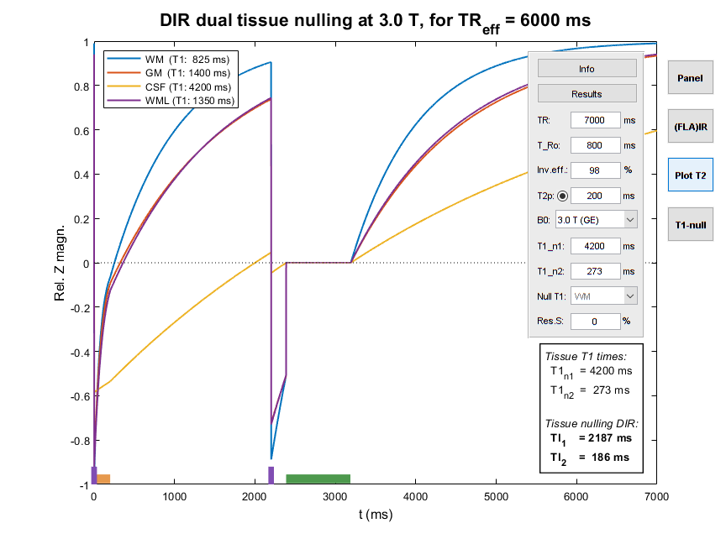
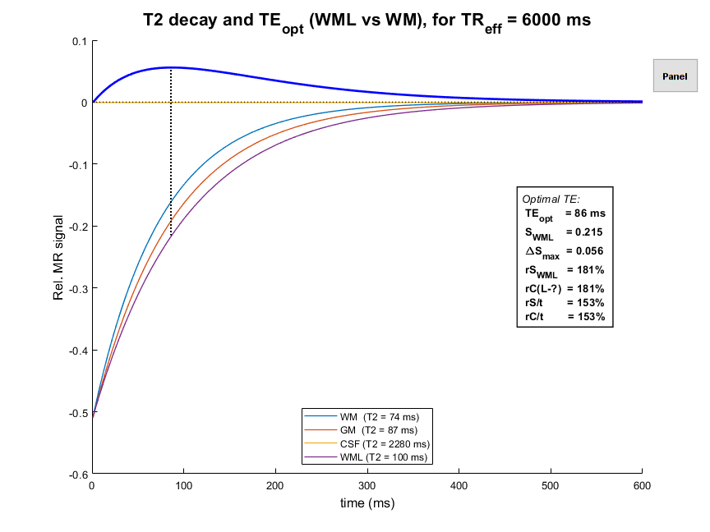
TrueT2-DIR – From Zero To Hero!

Slide 28
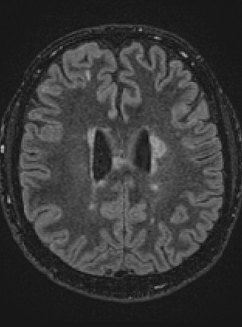
TrueT2-DIR vs FLAIR images
TrueT2
FLAIR
CNR/t at least as good as FLAIR; better WML–GM CNR?!

Slide 29

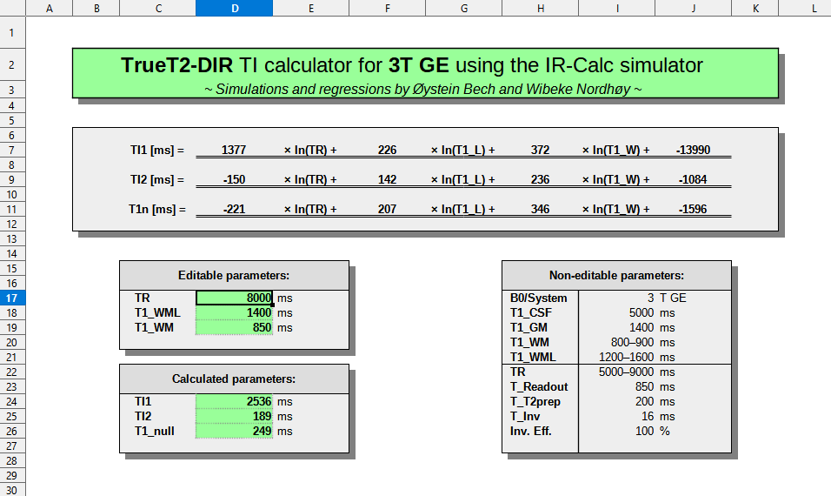
DIR 4 Dummies!
Accessible spreadsheet tools, based on simulation regressions

Slide 30

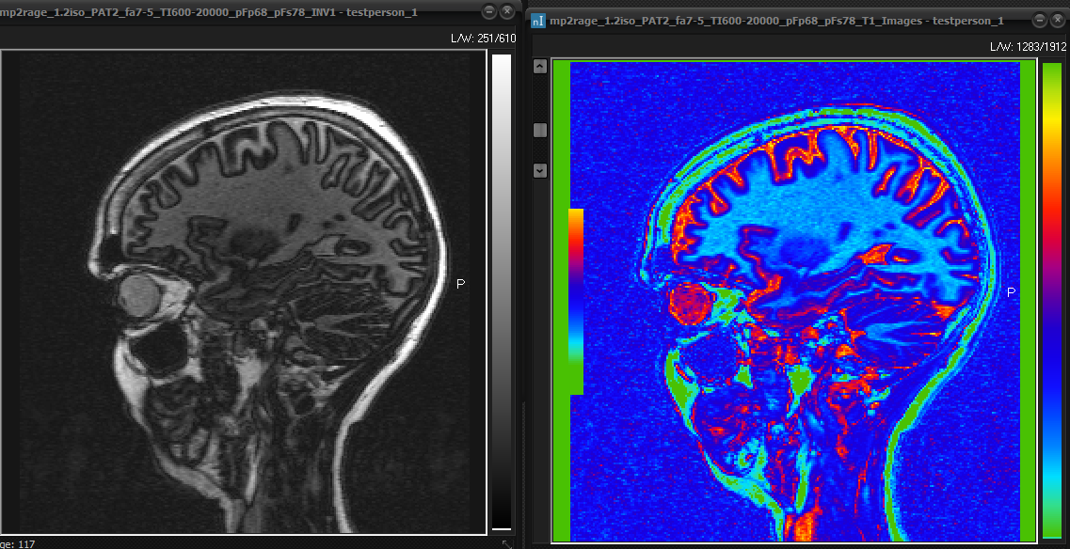
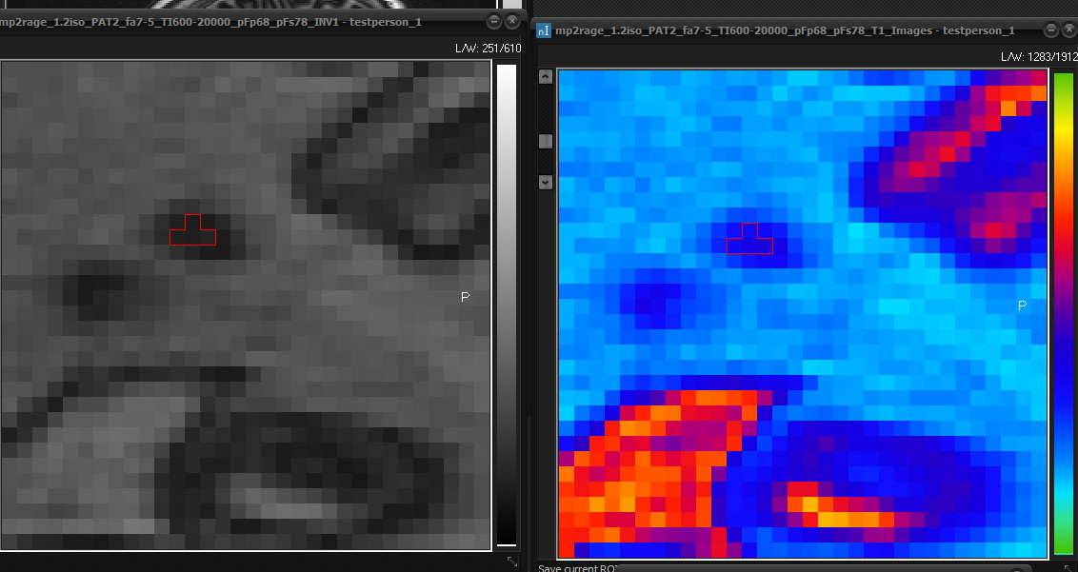
DIR 4 Dummies!?
Measuring WM and WML T1 values w/ MP2RAGE MRI

Slide 31

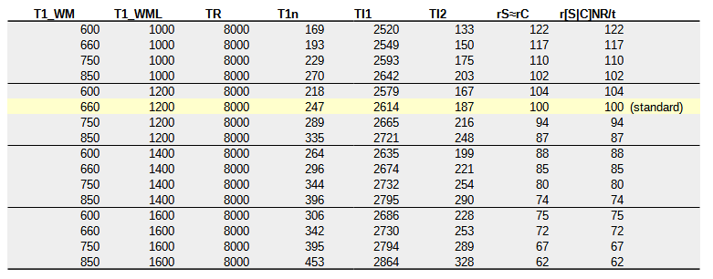
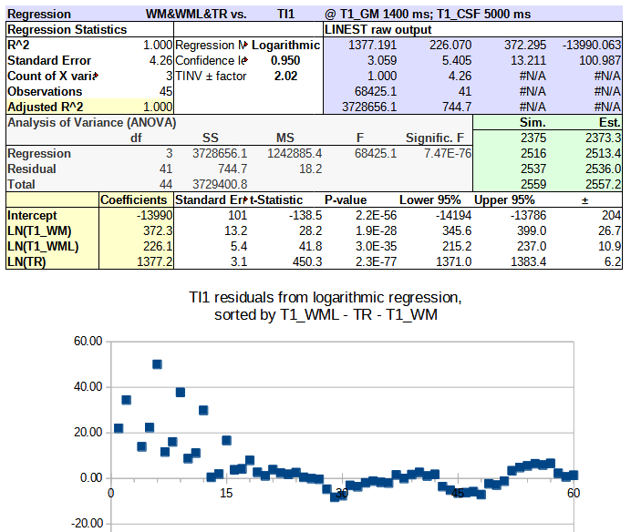
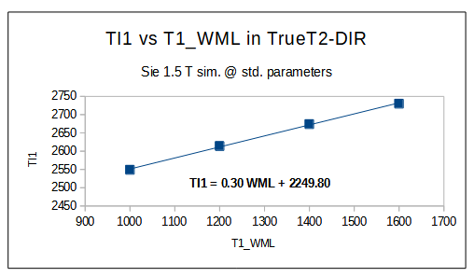
DIR 4 Dummies???
Good regressions may be hard
to get right, but…
Their results are easy to use!

