Slide 1
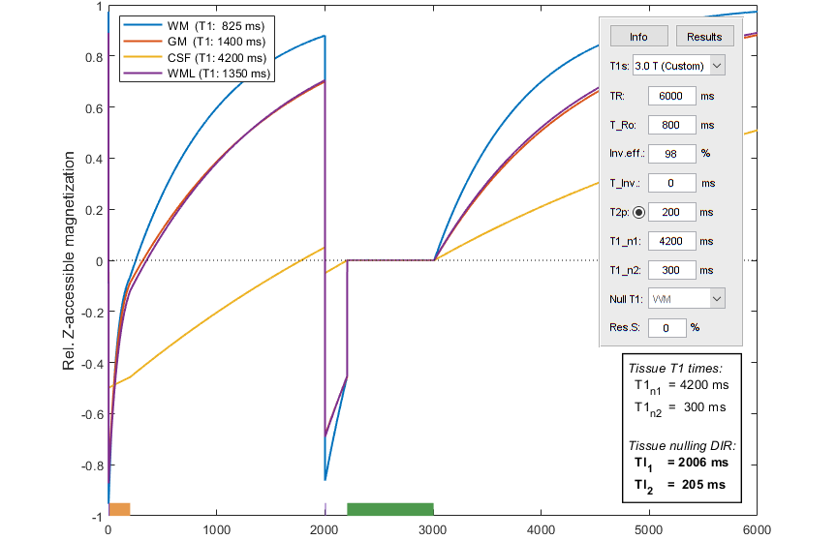
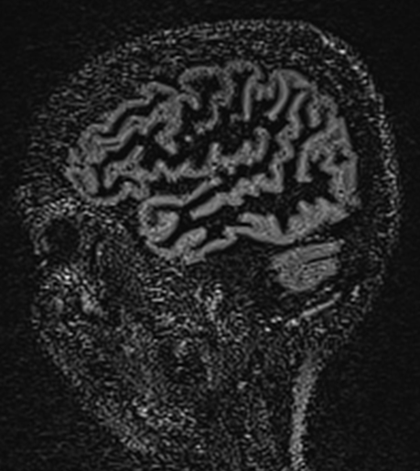
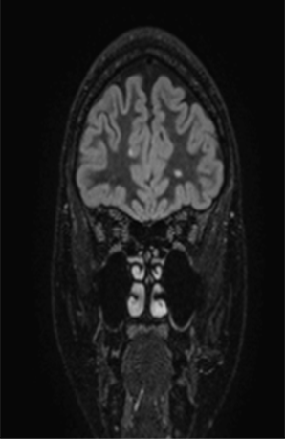

MR Inversion Recovery Calculation
Simulation and optimizing of
IR sequences using MatLab
Øystein Bech-Aase & Wibeke Nordhøy

Slide 2
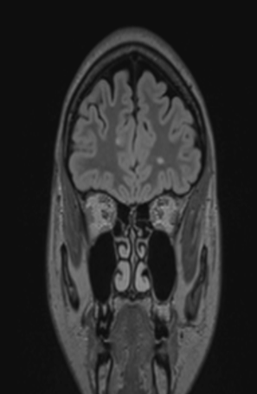
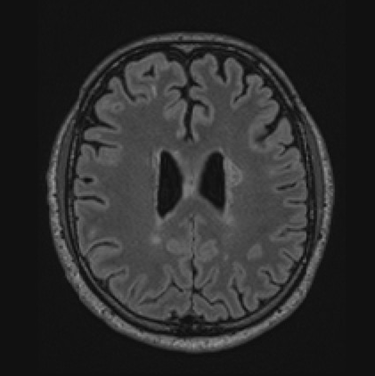
3D Fluid Attenuated Inversion Recovery
One IR pulse, then a TI delay before readout
3D T2-weighted readout (SPACE/CUBE/VIEW)
T1 weighting from IR counteracts the desired T2 contrast...

Slide 3
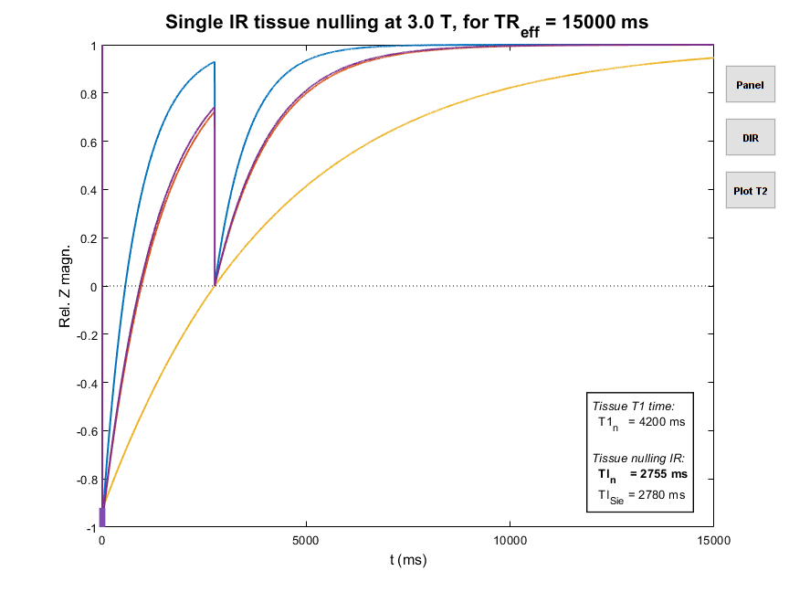
FLAIR – Fluid Attenuated Inv. Recovery
WM/GM
CSF
TI
Inv.

Slide 4
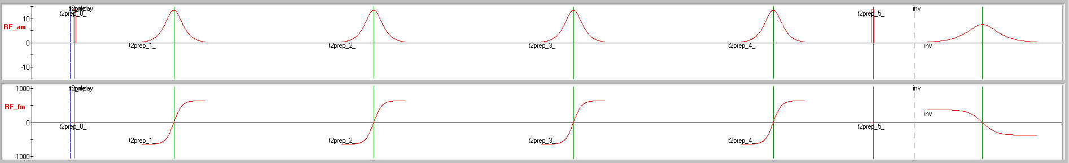
T2 prep. – How?
90°x – [ 180°y ]_{n} – -90°x to achieve spin lock
T2P and inversion are interchangeable
Pure T2 decay used for Mz preparation
CSF hardly affected (long T2), but tissues relax much

Slide 5
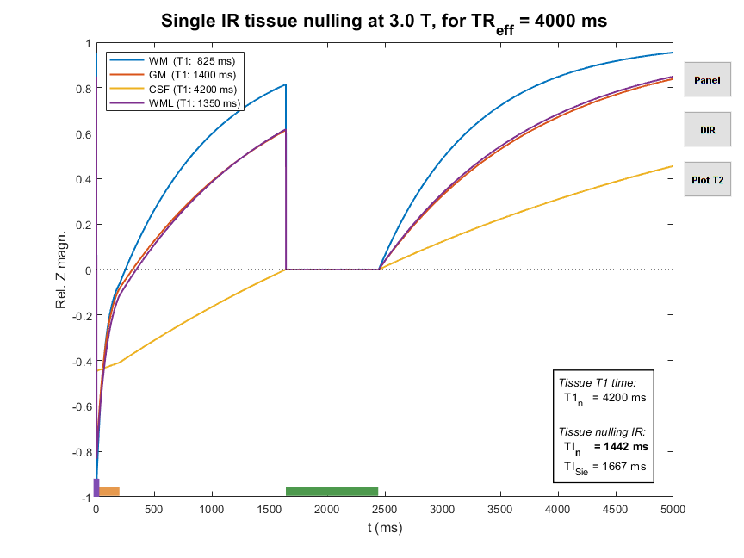
FLAIR m/ T2-prep
M₀
T_{Ro}
(?)
M₁
M_{TI}
TI
TR_{eff} – TI
-αM₁
TR_{eff} = TR – T_{Ro} – T2P

Slide 6
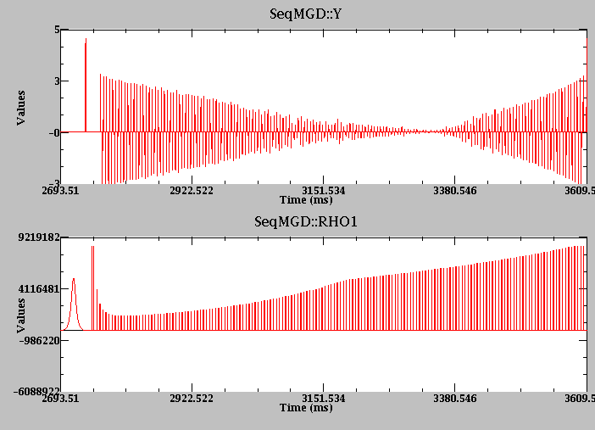
3D TSE readout – How?
Complex flip angle sweep to preserve magnetization
Complex profile ordering to avoid artefacts/blurring
TE_{eff} estimated; much shorter than zero crossing time!
Contrast mainly T2 – some T1?!
Mz probably used up over T_{Ro}?
We’re working to understand it…!

Slide 7
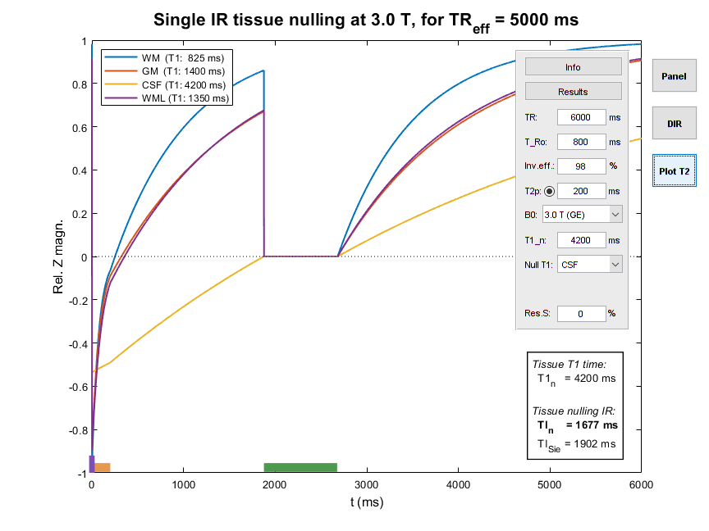
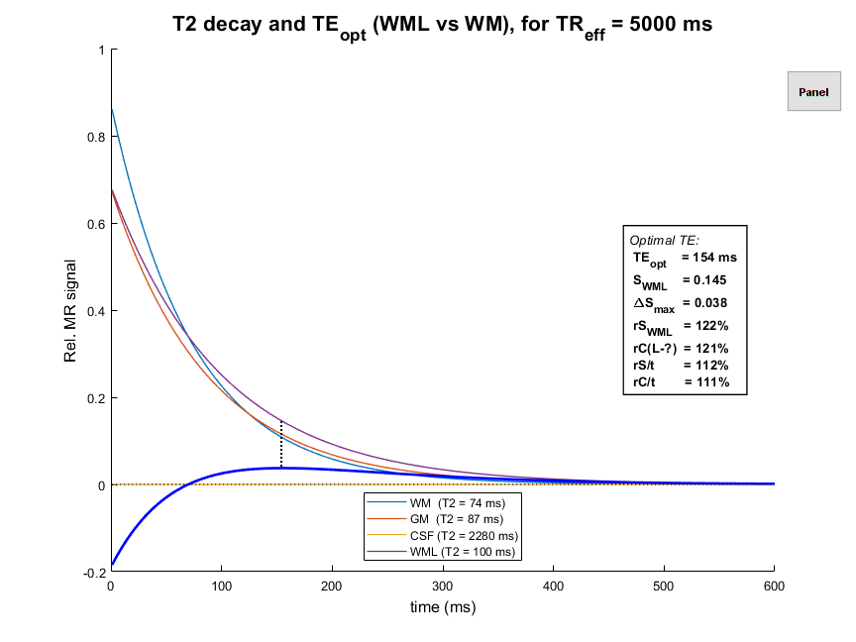
FLAIR m/ TR 6 s (vs 5 s)

Slide 8
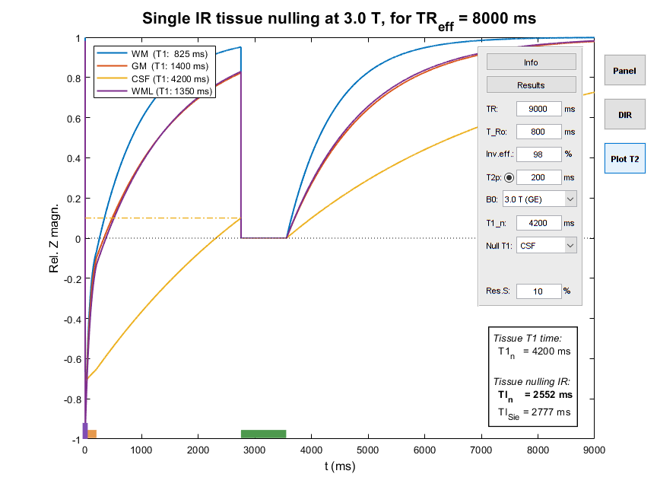
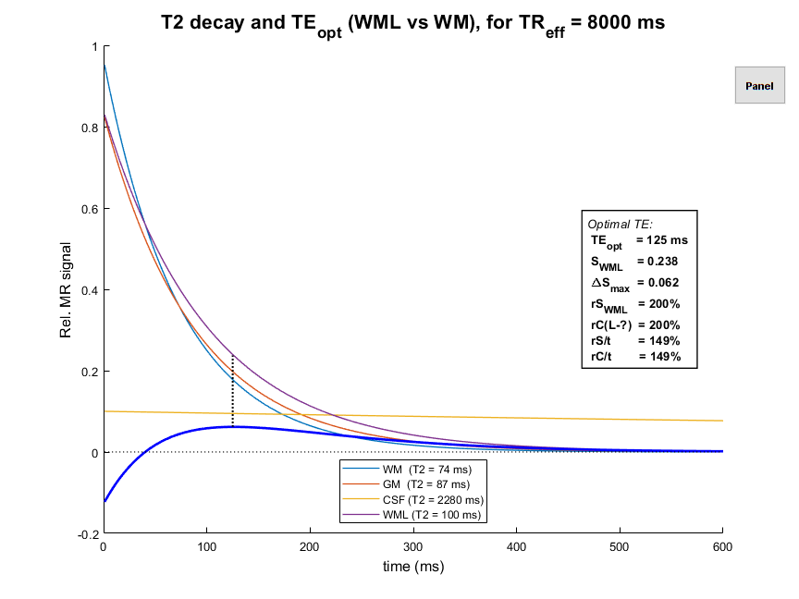
Fluid Attenuated IR … by how much?
“Images that computers like”
TE ↓ ?

Slide 9
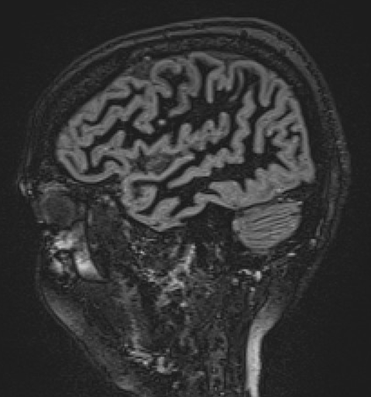
DIR-WM – A Pulse Too Far?
CNR/t bad. Better at low TE – at the cost of WML–GM CNR

Slide 10
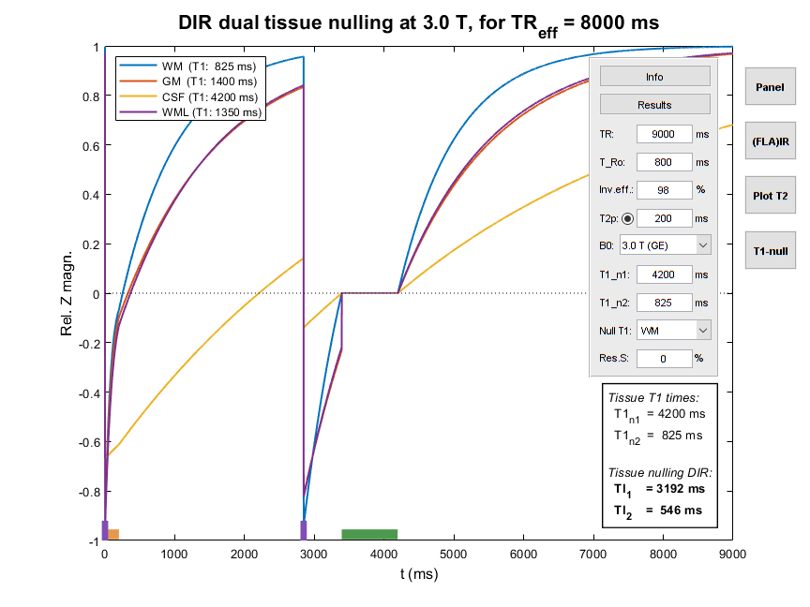
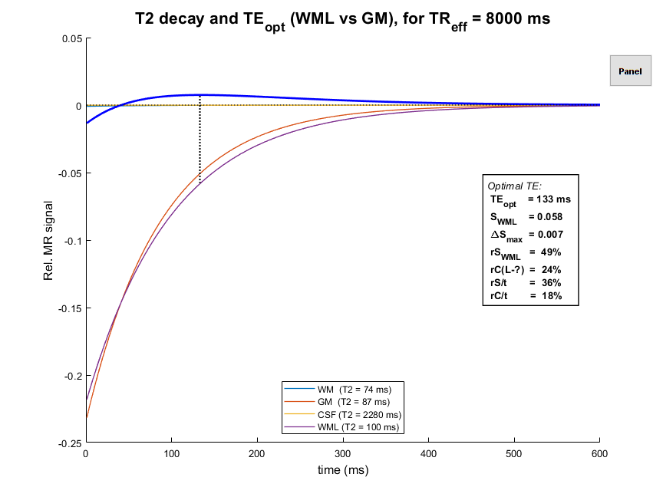
Vanlig WM-nullet DIR (lav SNR)
TE ↓ !?
(& CNR)

Slide 11
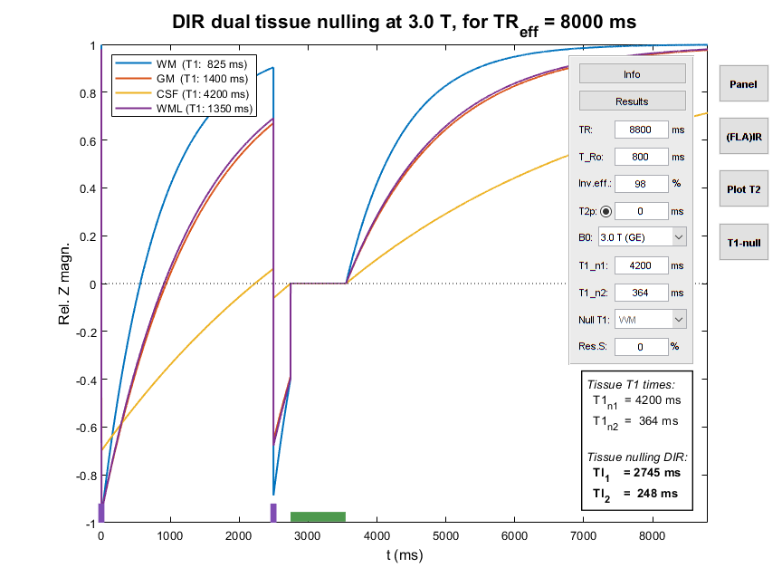
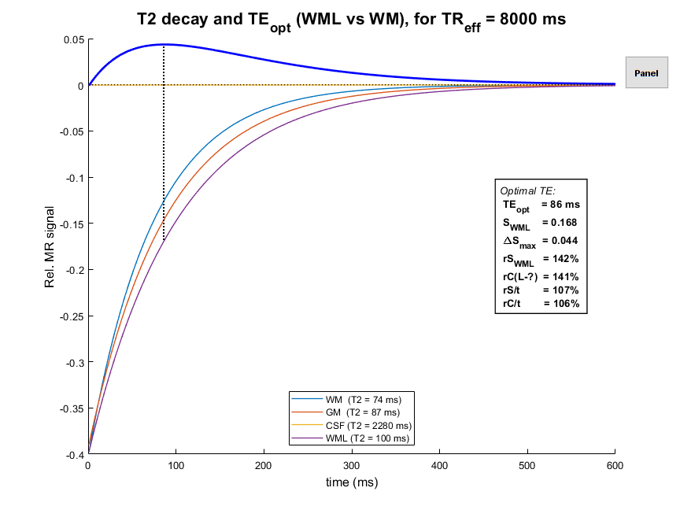
TrueT2-FLAIR (T1-nullet DIR)

Slide 12
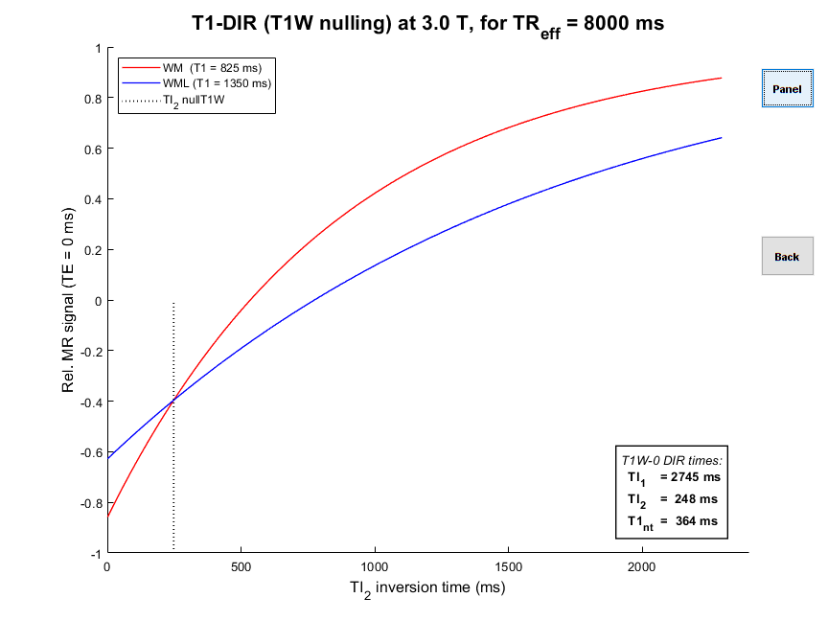
T1-nulled DIR – How?
Find the TI₁/TI₂ pair that null the difference between the DIR signal for T1 times of WM and WML
Find the T1 that is nulled at these TI₁/TI₂
WM will be brighter, but SNR/CNR better
Optimal TE will be free of T1 effects
[Madhuranthakam et al, Mag Res Med 2012 67(1):81-88]

Slide 13
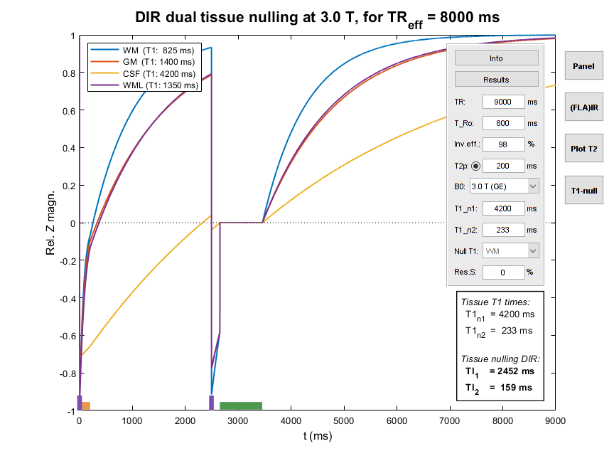
TrueT2-FLAIR m/ T2-prep
M₀
M₁
TI₁ – TI₂
TI₁
M₂
-αM₂
-βM₁

Slide 14
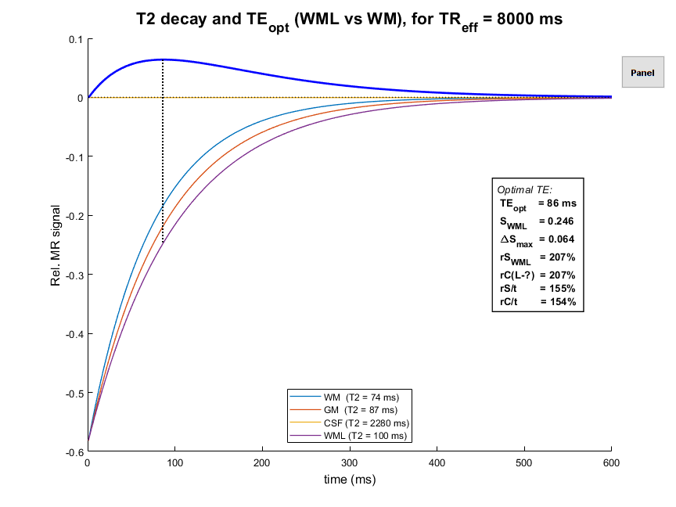
TrueT2-DIR – From Zero To Hero!

Slide 15
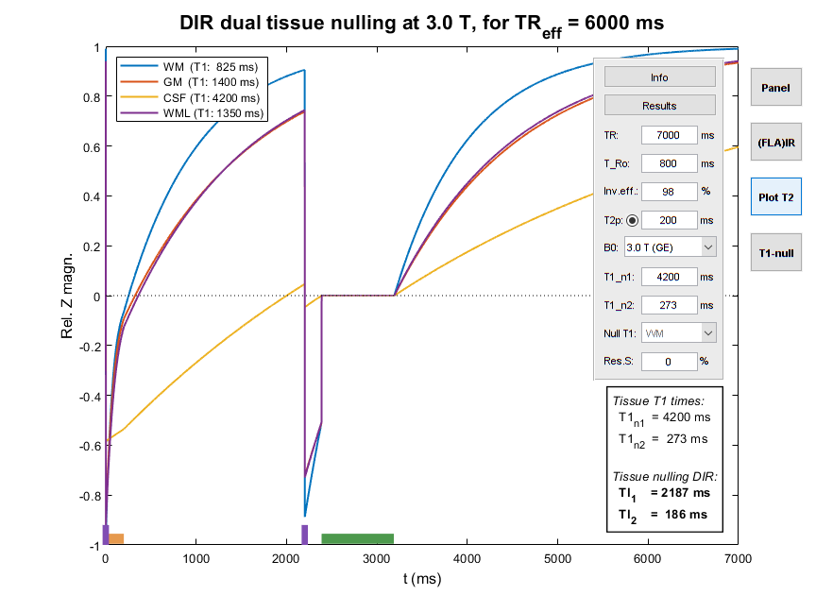
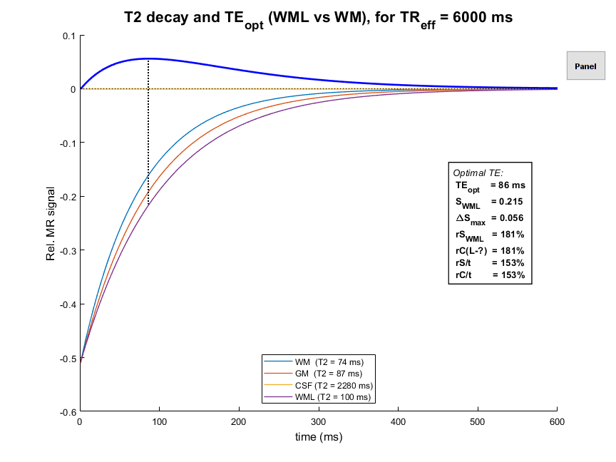
TrueT2-FLAIR m/ TR 7 s

Slide 16
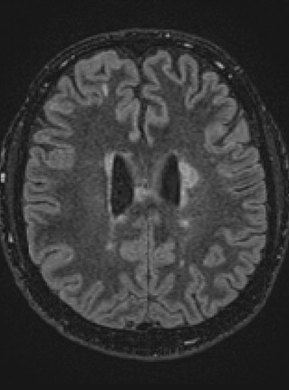
TrueT2-DIR vs FLAIR images
TrueT2
FLAIR
CNR/t at least as good as FLAIR; better WML–GM CNR?!

Slide 17
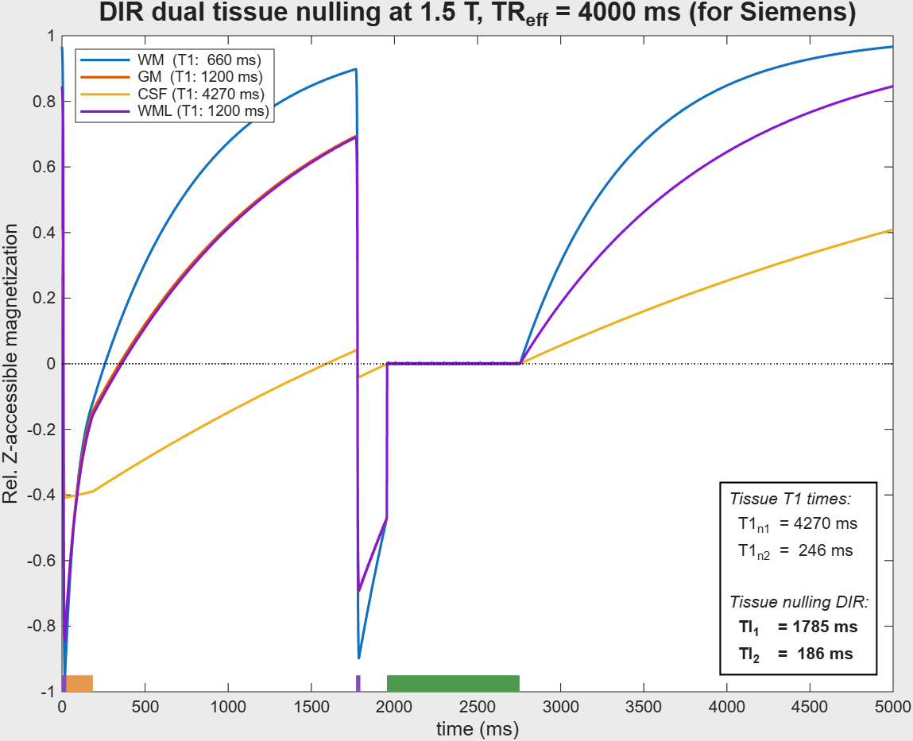
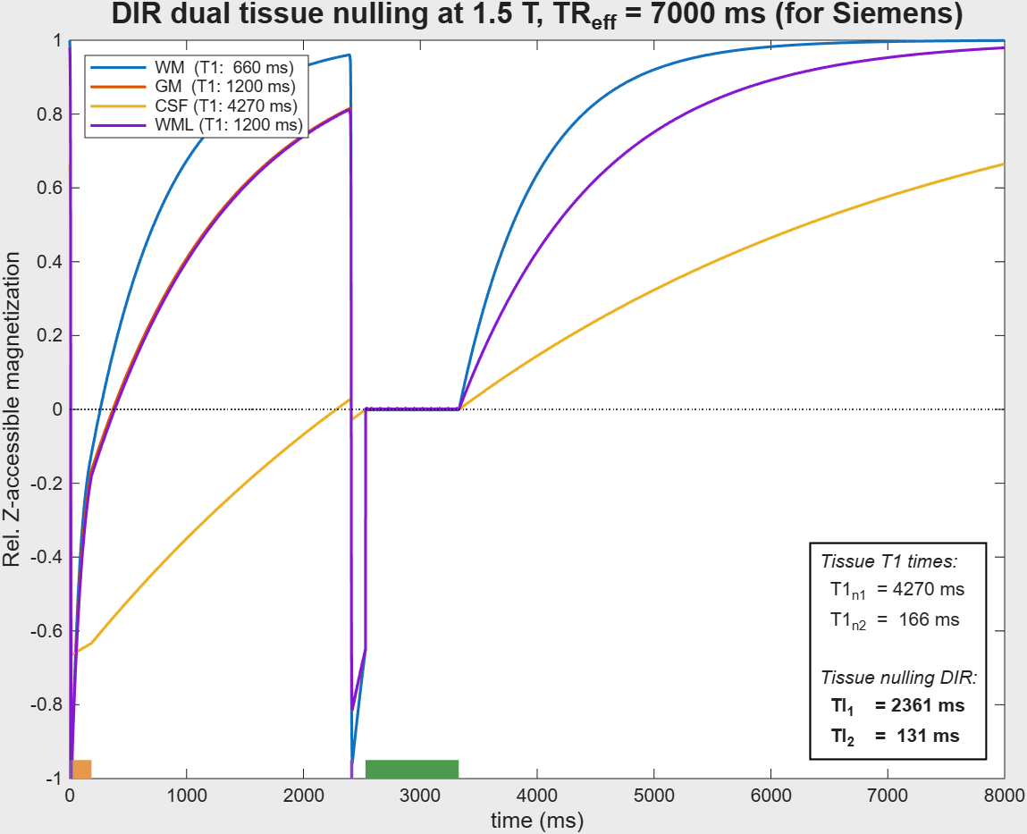
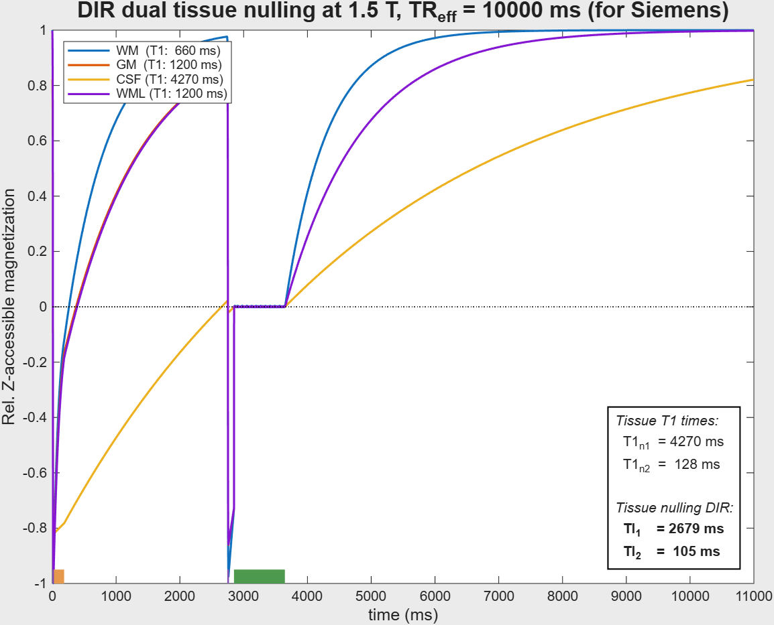
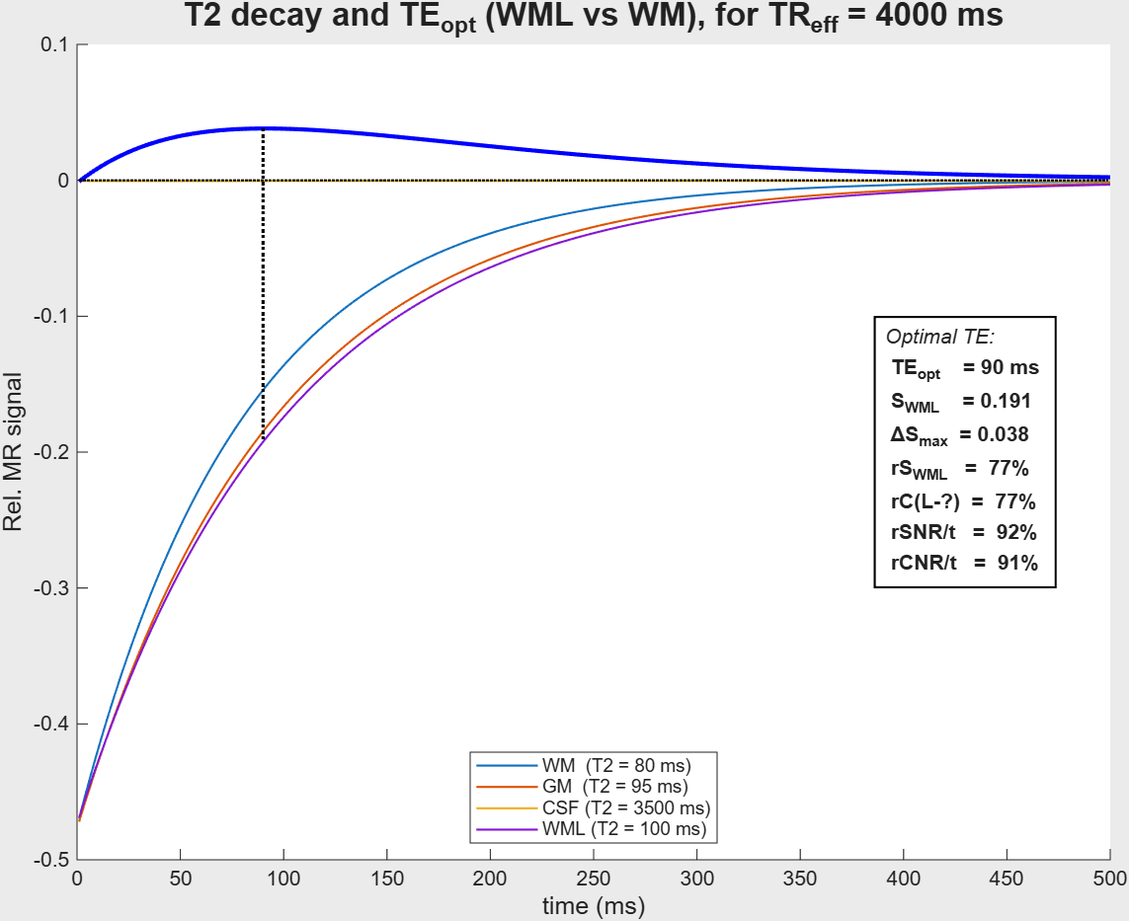
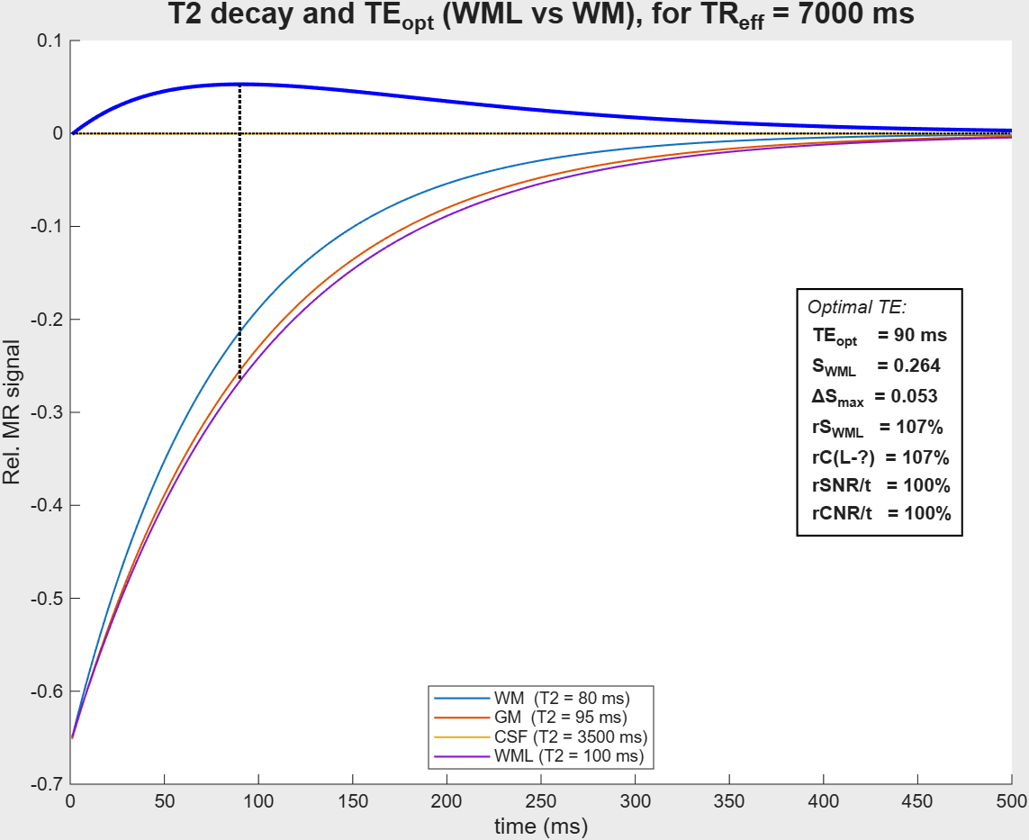

Var. TR (3–18 s)

Slide 18
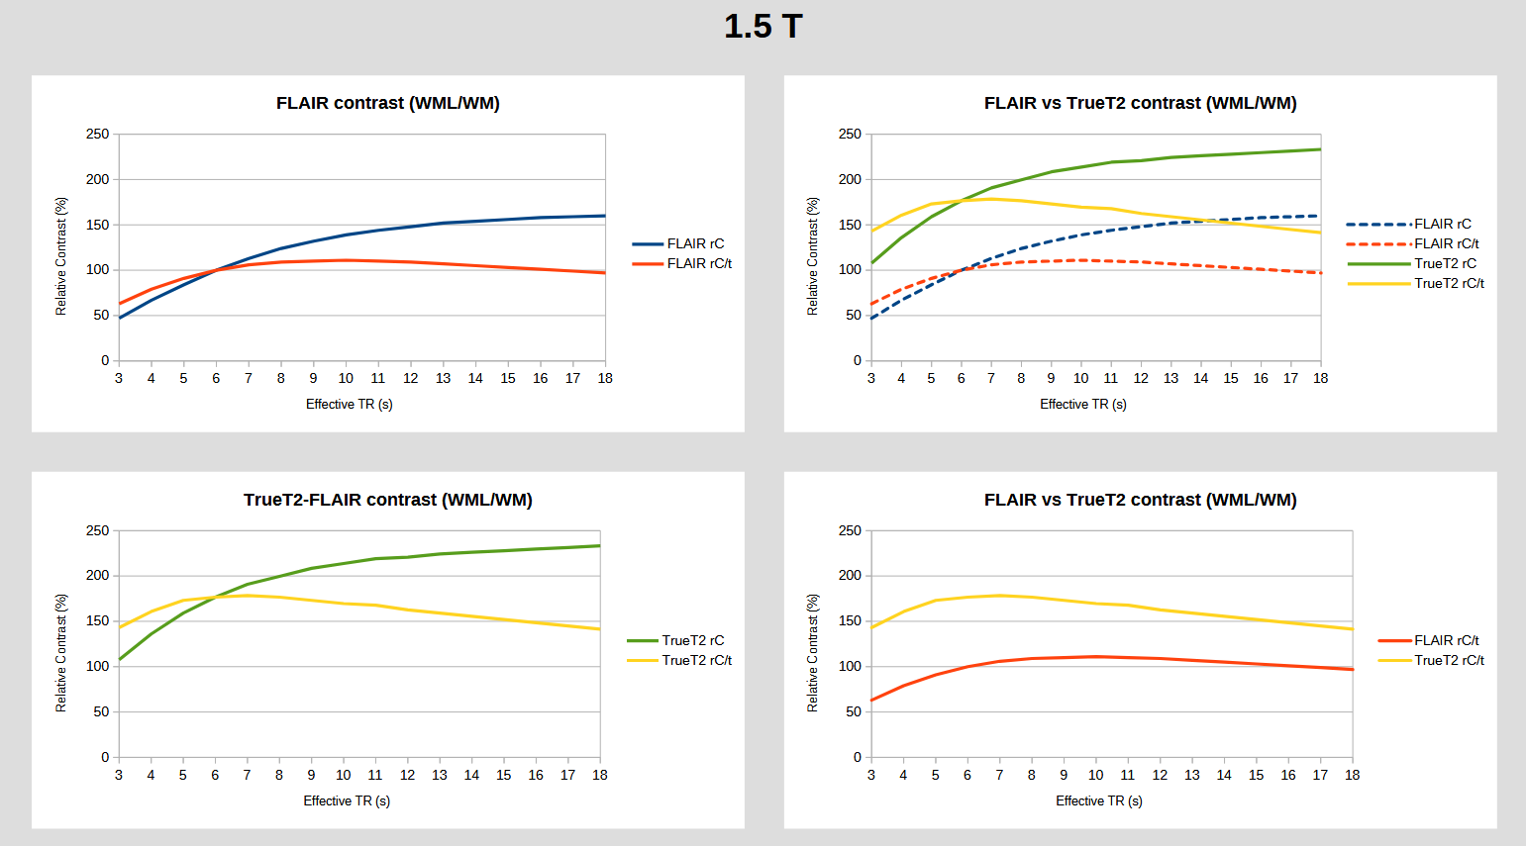

Slide 19
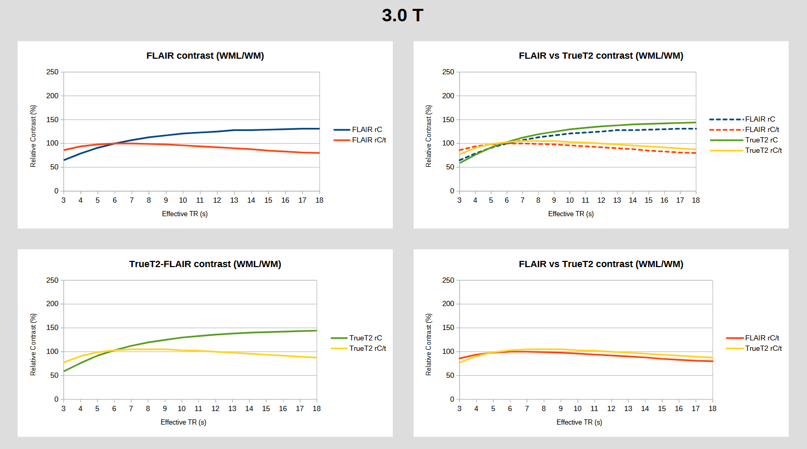

Slide 20
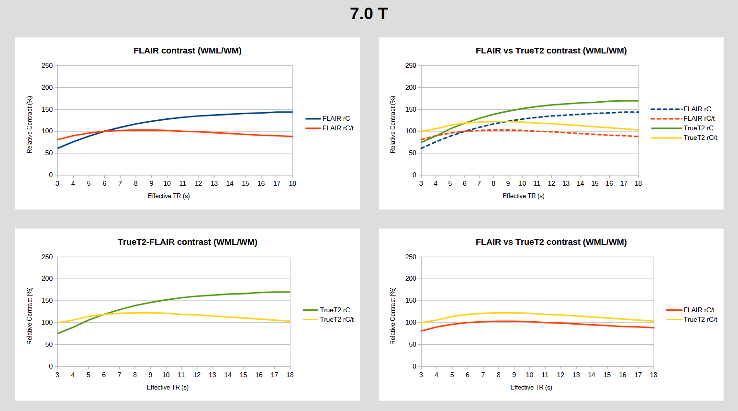

Slide 21
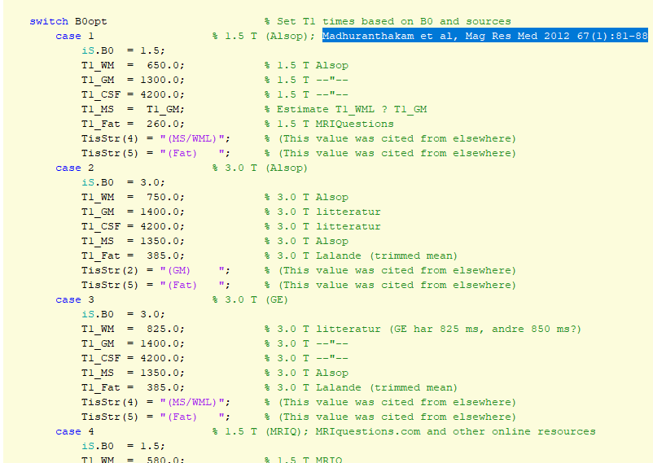
Ulike T1/T2-tider

