Slide 1
Expense Tracker
By: Andrey Owen & Logan Poe

Slide 2
Project overview
The Expense Tracker program is a desktop application designed to help you manage your personal finances by tracking expenses and savings. It provides an intuitive interface to add entries, view financial summaries, and analyze your data.

Slide 3
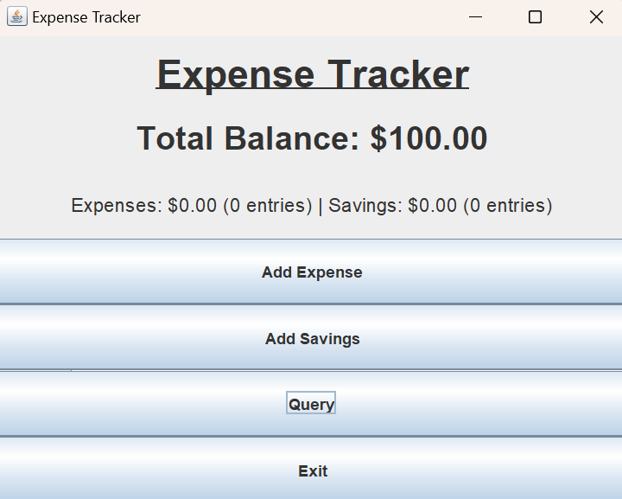
Initial Features
1. Set Starting Balance 2. Add Expenses 3. Add Savings 4. Query Entries

Slide 4
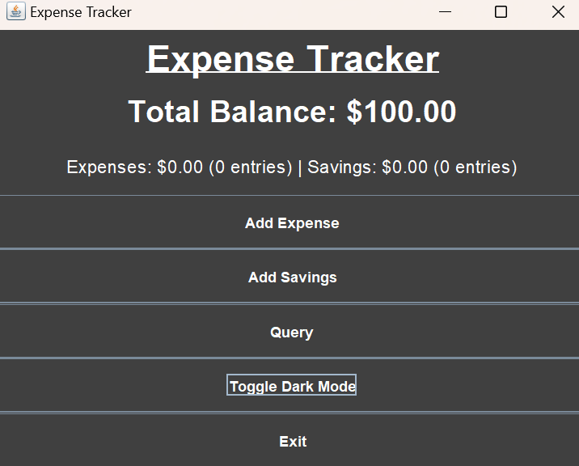
New Features
Dark Mode
Adds functionality to change the color palate of the program

Slide 5
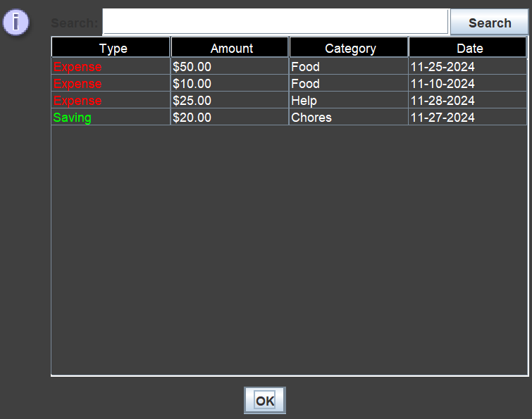
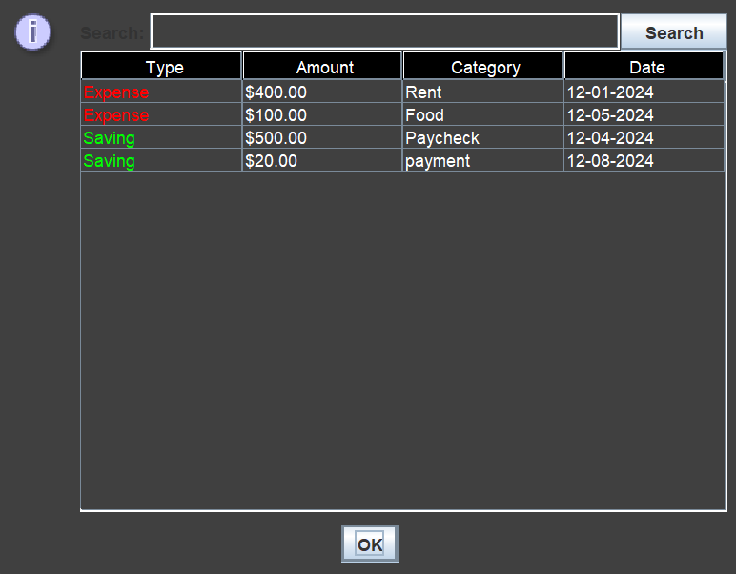
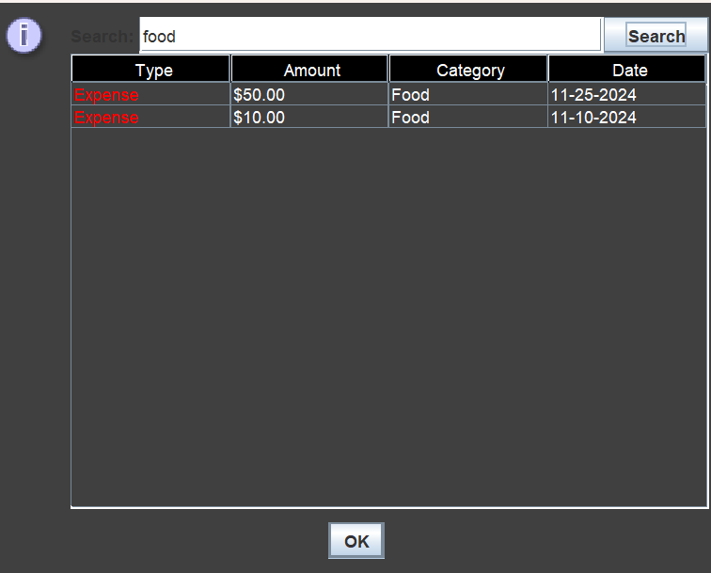
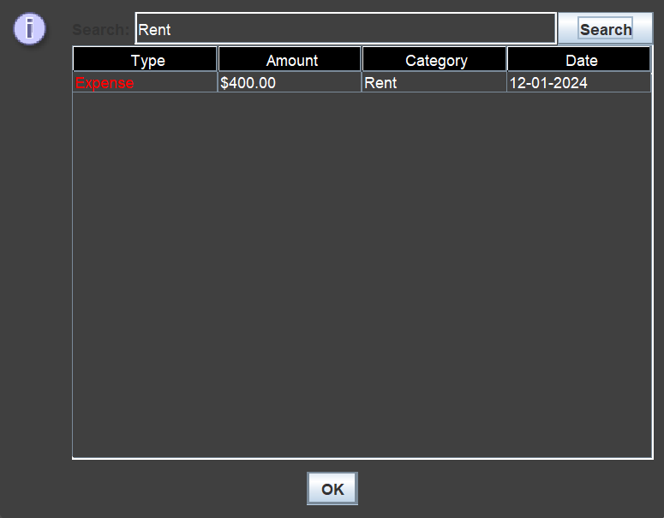
New Features
Search in Query
Adds the ability to search for certain categories

