Slide 1
Expense Tracker
By: Andrey Owen & Logan Poe

Slide 2
Project overview
The Expense Tracker program is a desktop application designed to help you manage your personal finances by tracking expenses and savings. It provides an intuitive interface to add entries, view financial summaries, and analyze your data.
The application uses SQLite internally to store data within a query/search page.
This rough prototype works similar to other finance tracking applications such as Rocket Money.

Slide 3
User Stories (Version 1)
Set Starting Balance
As a user, I want to track and analyze my spending so I can manage my budget effectively.
Add Expenses
As a user, I want to add expenses with details like date, amount, category, and tags (e.g., “groceries”) to track my spending.
Add Savings
As a user, I want to add savings to update my balance to further track my budget.
Query Entries
As a user, I want to query my expenses by date, category, or tag so that I can analyze my spending in specific areas.

Slide 4
Modules
Database Module (Persistence Layer)
Purpose: To handle all interactions with the database (e.g., SQLite) to store and retrieve expense data.
User Interface (UI) Module
Purpose: To provide a graphical user interface (GUI) for the user to interact with the application.
Business Logic Module (Core Logic)
Purpose: To manage the core logic of the application, such as calculating total balance, adding/removing expenses, and handling business rules.
Utility Module (Helper Functions)
Purpose: To provide utility functions that support the other modules in the app.

Slide 5
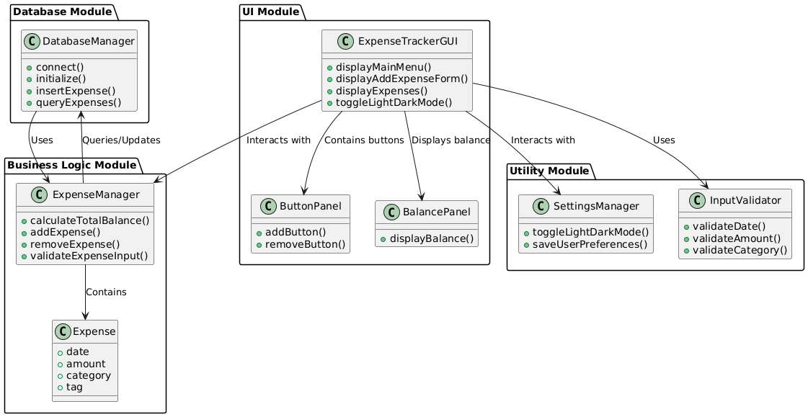
Module Relation Diagram

Slide 6
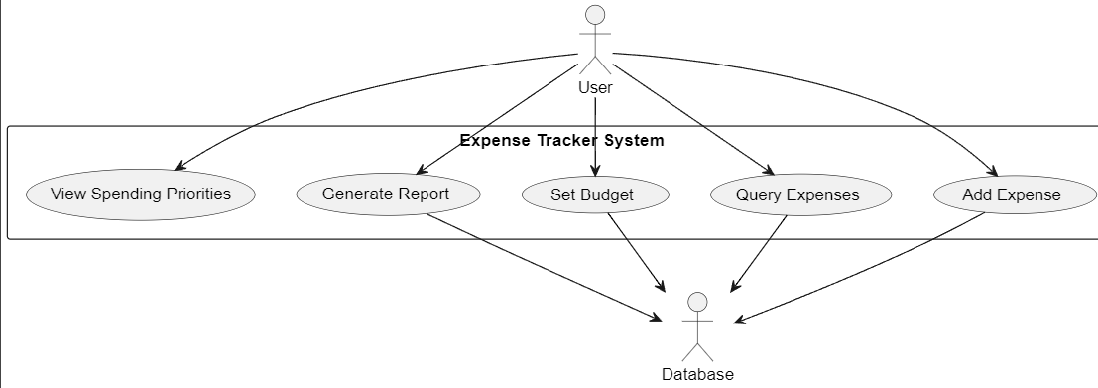
Use Case

Slide 7
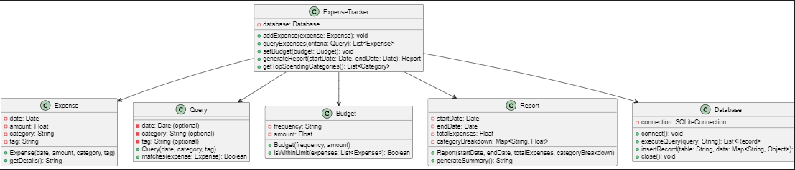
Relational UML

Slide 8
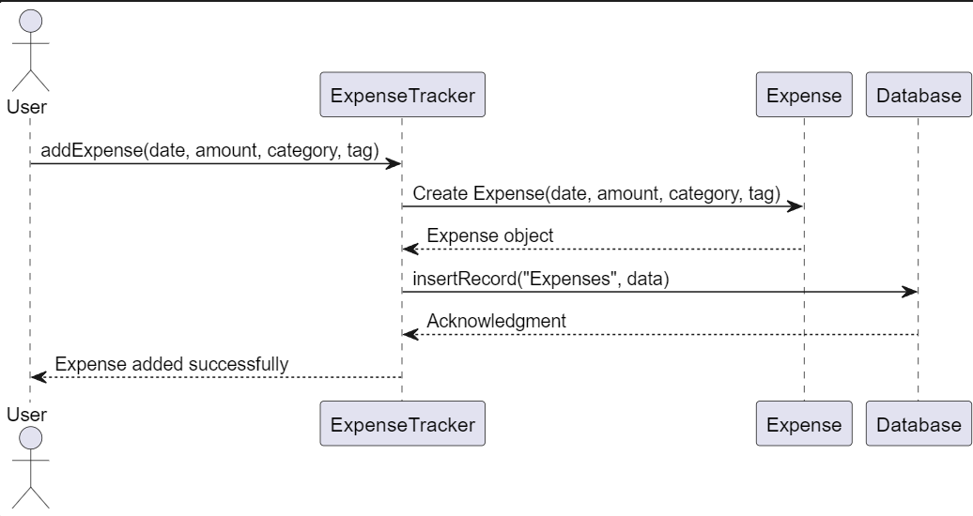
Query Sequence Diagram

Slide 9
Expense Sequence Diagram

Slide 10
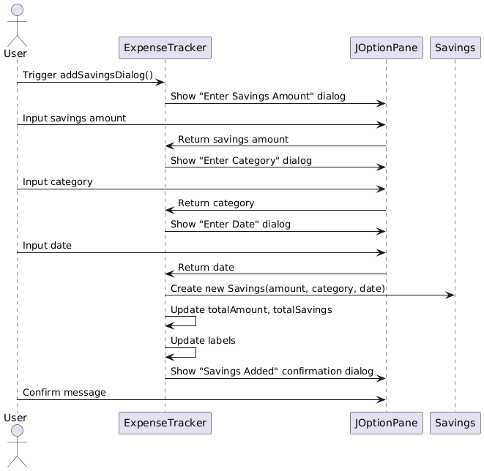
Savings Sequence Diagram

Slide 11
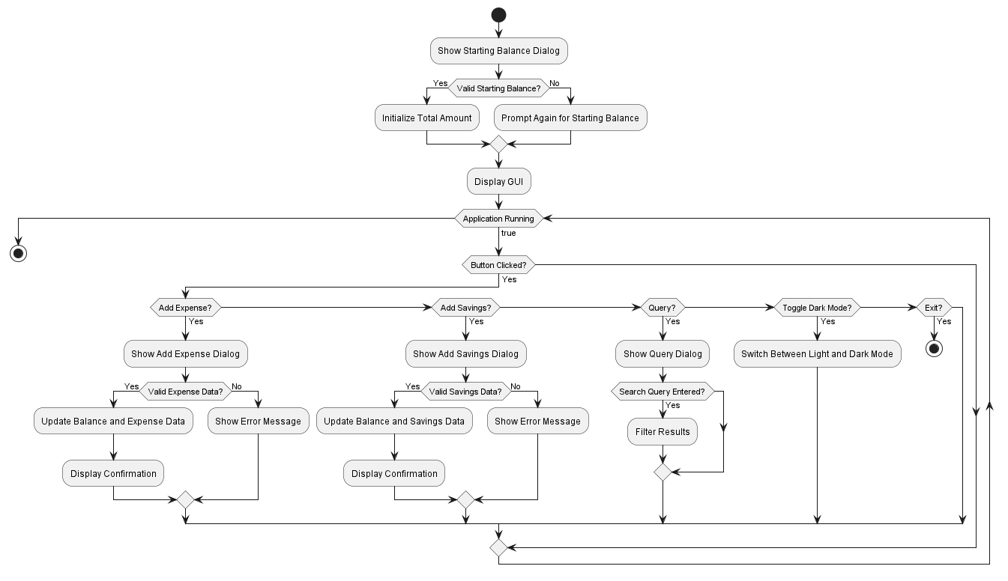
Activity Diagram

Slide 12
Code Smells
1. Duplicated Logic for UI Updates - Found 11/27/24
- Smell: There was redundant code for updating the UI in multiple places.
- Fix: Used more of a strategy pattern by encapsulating more code into certain blocks. Making flow easier to understand.
2. Large Method: `showAddExpenseDialog` and `showAddSavingsDialog` - Found 11/28/24
- Smell: Both the `showAddExpenseDialog` and `showAddSavingsDialog` methods are large, wanted to condense these to fit more in line.
- Fix: used more of a template pattern to help with overall formatting stucture.
3. Hardcoded Colors in Dark Mode Logic - Found 11/30/24
- Smell: The dark mode color scheme is hardcoded within the methods, which reduces flexibility and makes it harder to change the theme in the future.
- Fix: Used Factory pattern to reduce the repetitiveness.
4. Confusing Type Meanings and Constrained Code – Throughout Project
- Smell: The application logic for expenses and savings is tightly coupled to the UI components like `JLabel` and `JButton`.
- Fix: Moved Private methods in place to reduce tightness and constrains on code.

Slide 13
Refactoring (Version 2)
Hypothetical User Story : This is a great start; I want my users to understand their money tracking and make the app easier on the eyes when viewing it.
1. Added a Search Panel to the Query Dialog
- A new search panel was introduced in showQueryDialog(), consisting of:
- A JTextField for entering search keywords.
- A JButton labeled "Search" for triggering the search manually.
2. Added Dark Mode Theming
- A dark mode theme was implemented to make the viewing experience better for the user.
- Key Feature: Users can now toggle between a light and dark mode setting within the apps main menu.
3. Search Logic (Filtering and Highlighting) ( Green / Red Labels )
- Implemented the applySearchHighlight() method:
- Purpose: Filters the data displayed in the table based on the user's query.
- Iterates through the data rows and checks if any cell matches the query.
- Builds a filtered list of matching rows and updates the table model with the results.
- Restores the full dataset if the search field is empty.

Slide 14
Refactoring Continued
4. Updated Table Generation
- Reapplies the custom renderer for the "Type" column to maintain the color coding (red for expenses, green for savings) after filtering.
5. Tightened Loose, Overextended Code
- The applySearchHighlight() function is isolated, keeping the search logic reusable and easy to update.
- Ensures separation of concerns: the query dialog handles UI updates, while the search logic handles filtering.
6. Enhanced User Experience
- Integrated real-time feedback into the query interface.
- Ensures the design is intuitive and user-friendly.
Key Benefits of the Refactoring
Improved Functionality: Users can now search for specific entries by keyword (type, category, date, or amount).
Enhanced Performance: The search dynamically filters data without modifying the original dataset.
Reusable Components: The applySearchHighlight() shows specific user data, making it easier for the user to understand the components of the app.
User Experience: The addition of real-time search significantly improves interaction within the query dialog.

Slide 15
Design Patterns
1. Singleton Pattern
- Why: When formatting the second implementation, we've decided to use the singleton pattern to enforce capsulation. When doing this, encapsulating the ExpenseTracker class with the Singleton Pattern would ensure only one instance exists.
2. Observer Pattern
- Why: When we developed the second iteration, the Observer Pattern was applied to decouple the state from the display logic, making the code more modular.
3. Strategy Pattern
- Why: The application processes input differently for expenses and savings. We decided to use encapsulation to form these operations into separate classes to simplify extensibility.

Slide 16
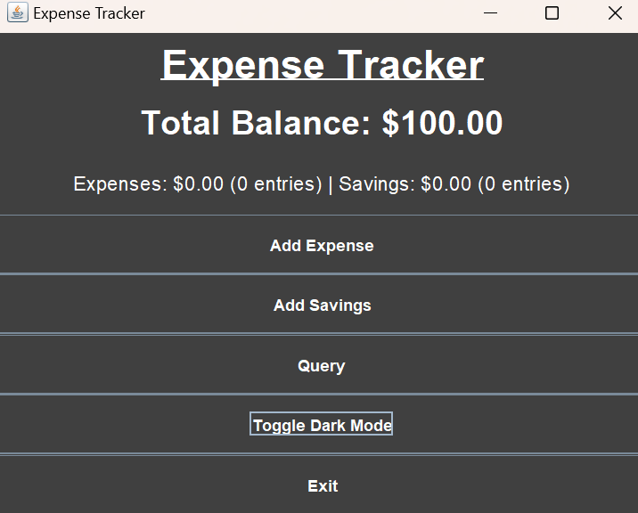
New Features
Dark Mode
"As a user, I want to change color of the program between light and dark."
Adds functionality to change the color palate of the program

Slide 17
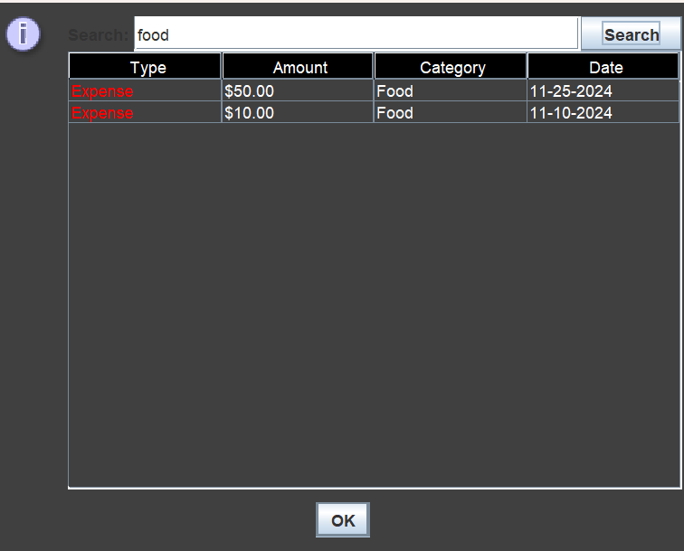
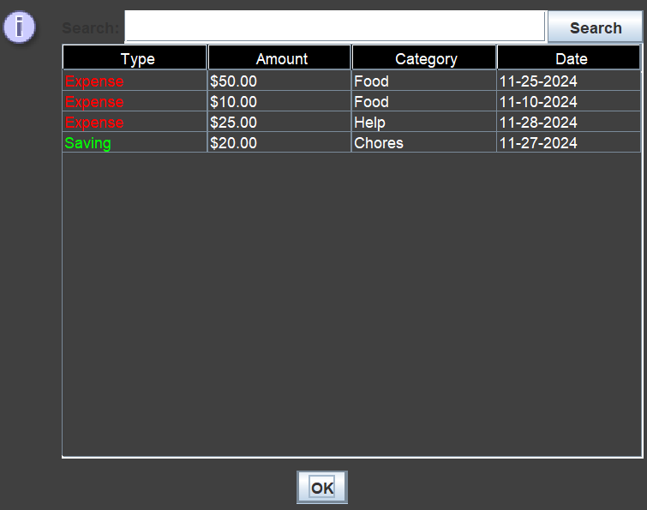
New Features
Search in Query
"As a user, I want to query my expenses by date, category, or tag so that I can analyze my spending in specific areas."
Adds the ability to search for certain categories

Slide 18

Code Demo

