Slide 1
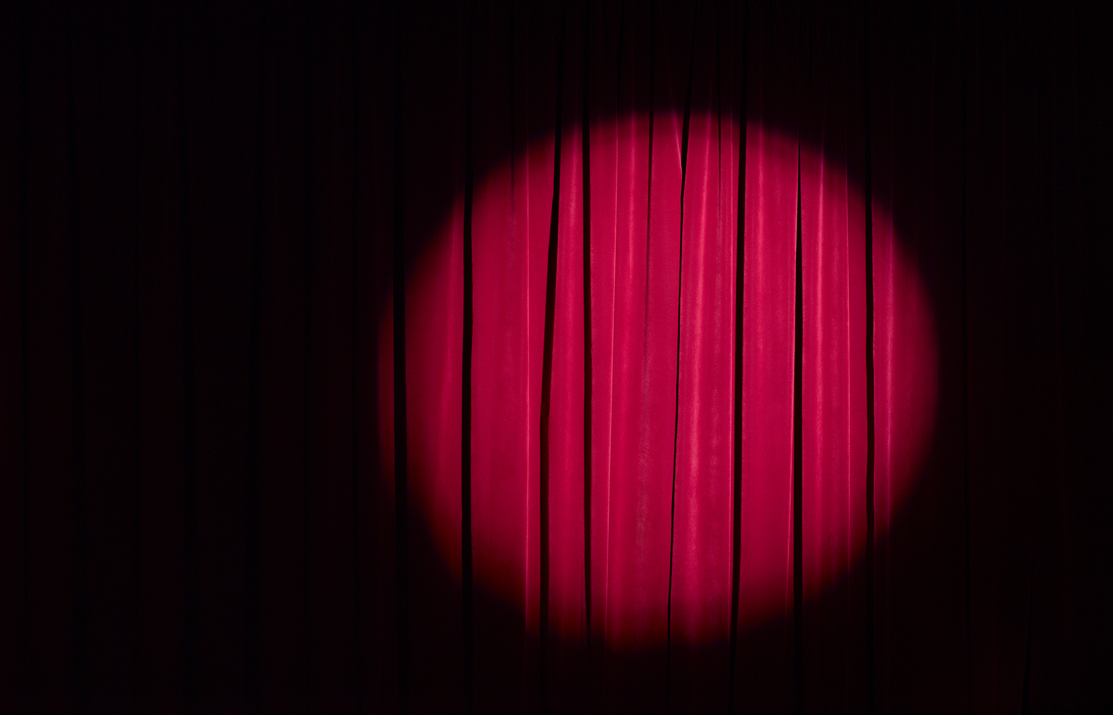
Captsone Project
Cohort 18

Slide 2
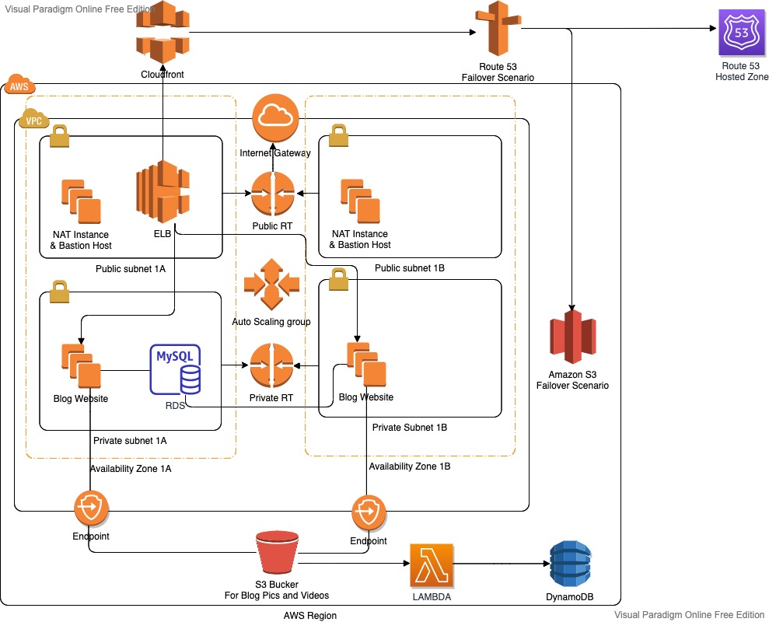



Slide 7
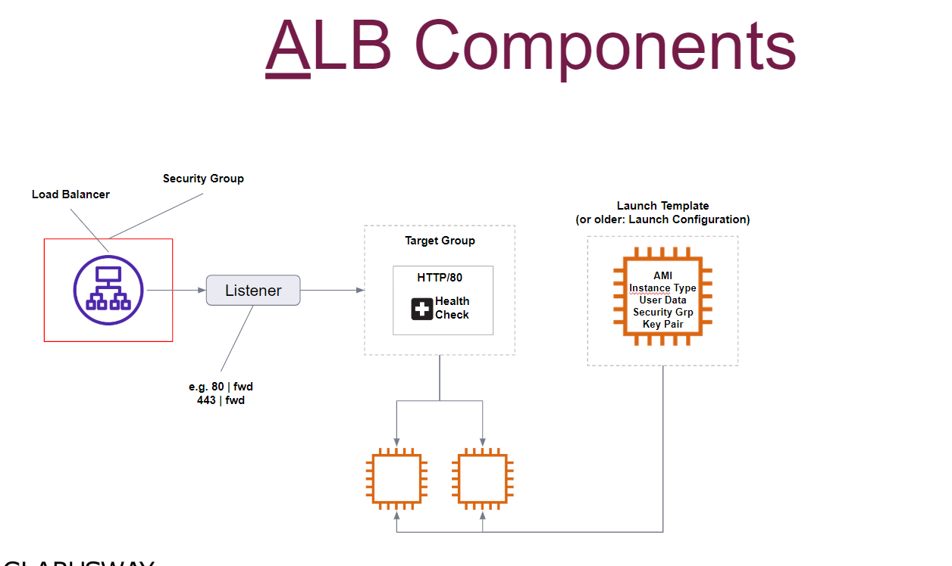

Slide 8



Break
return @ 5pm

